Slide 1
Reactive Systems V, ch 15~18
Communication Notations
何明昕 HE Mingxin, Max
Send your email to c.max@yeah.net with
a subject like: SE345-Andy: On What …
Download from c.program@yeah.net
/文件中心/网盘/SoftwareEngineering26S

Slide 2

List of Slides
238 Part V. Communication Notations
246 Chapter 15. Data Flow Diagrams
265 Chapter 16. Communication Diagrams
276 Chapter 17. Communication Semantics
287 Chapter 18. Context Modeling Guidelines
3

Slide 3
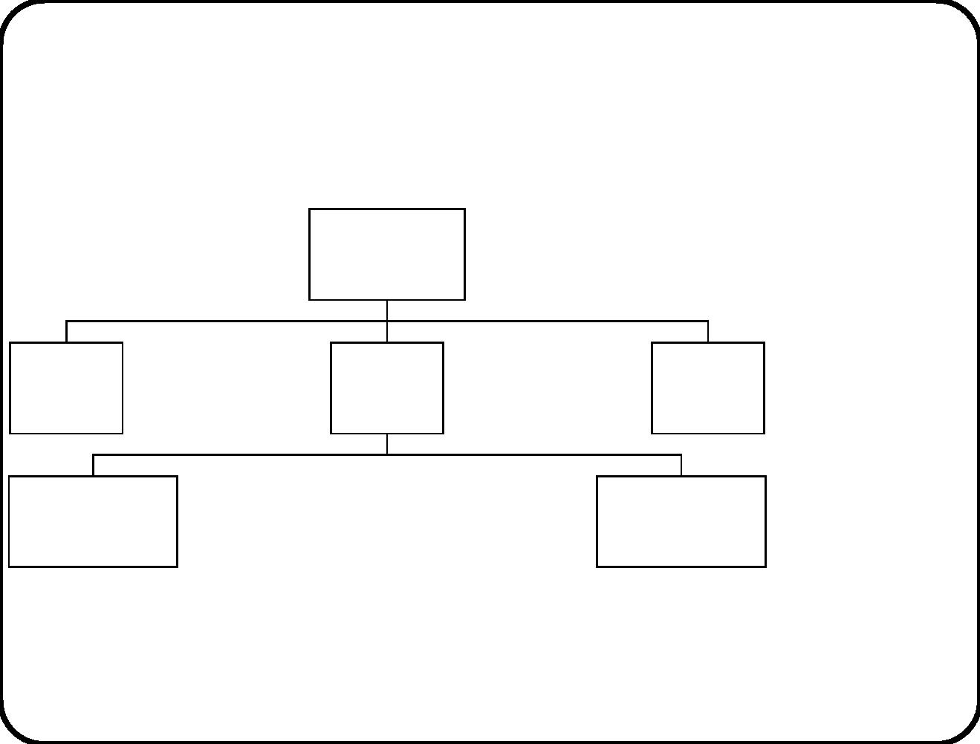
Part V. Communication Notations
Services
Composite
system
Behavior
Communication
External
entity
Services
Behavior
Communication
Services
SuD Behavior
External
entity
Services
Behavior
Communication
Communication
Services
Services
Subsystem 1 Behavior
Communication
......
Subsystem n Behavior
Communication
239

Slide 4
Uses of communication notations
Context modeling
• Communications in environment
• Communications between SuD and environment
Architecture design
• Decomposition of stimulus-response pairs into communication
between components
• Communications between components and external entities
240

Slide 5
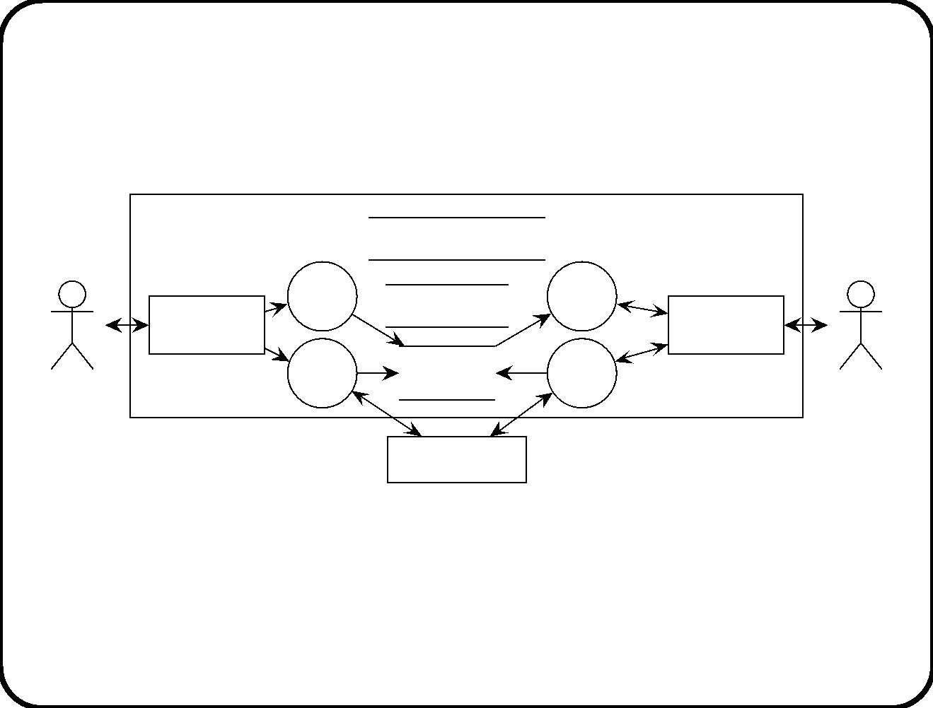
Example: Electronic Ticket System (1)
Requirements-level architecture
ETS
Rail network database
Use
Show
ticket
Conductor
interface
ticket
Bank database
Traveller
interface
Refund
ticket
Tickets and
stamps
Sell
Conductor
ticket
Traveler
Clearing house
• Independent from physical architecture
• Independent of software implementation platform
• Motivated only in terms of environment and requirements
241

Slide 6
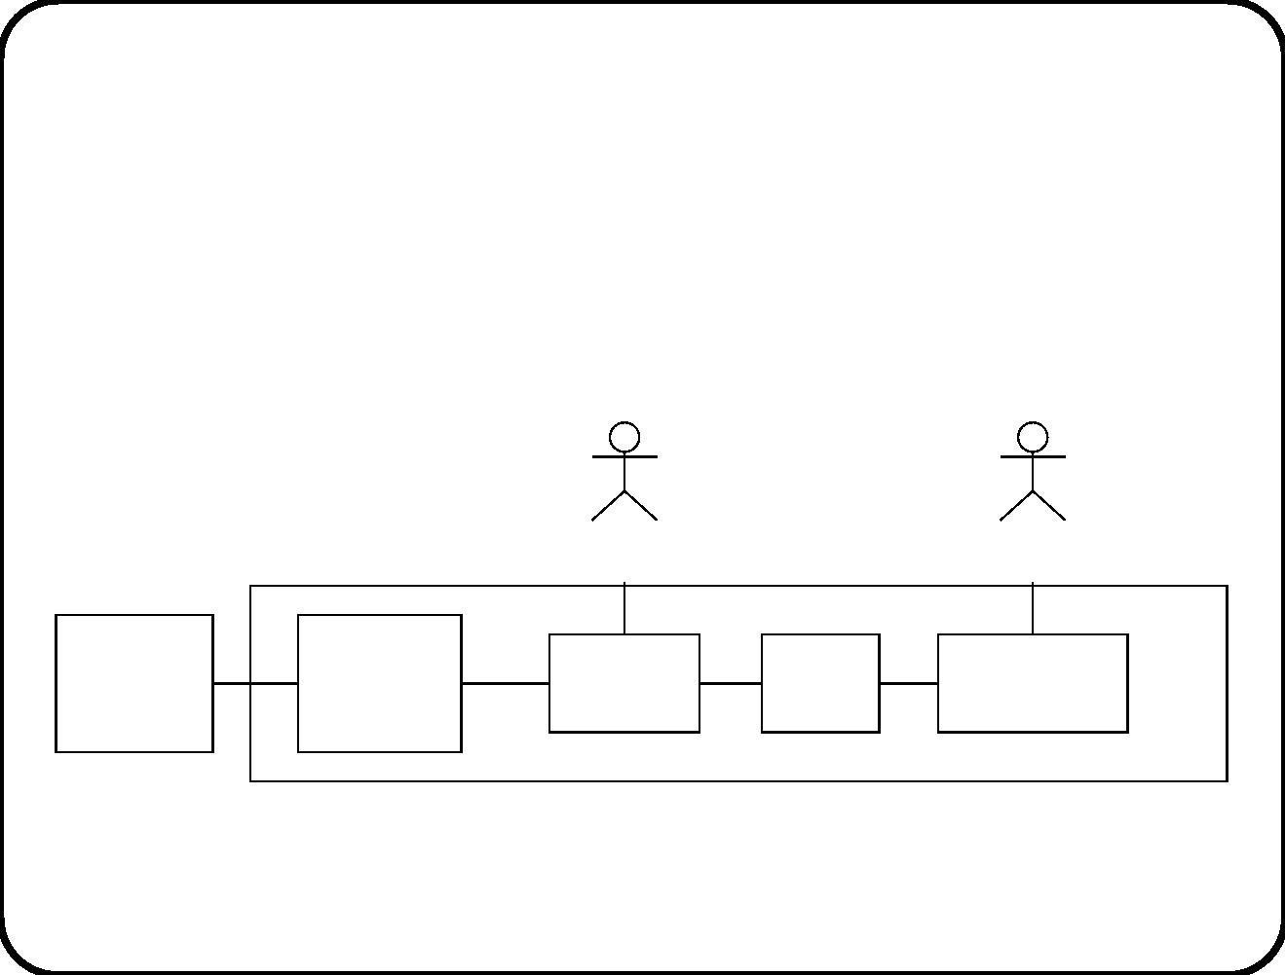
Example: Electronic Ticket System (2)
Physical network architecture
Traveler
Conductor
Clearing
house
Railway
company
computer
ETS
Traveler’s
PDA
Smart
card
Conductor’s
PDA
computer
242

Slide 7
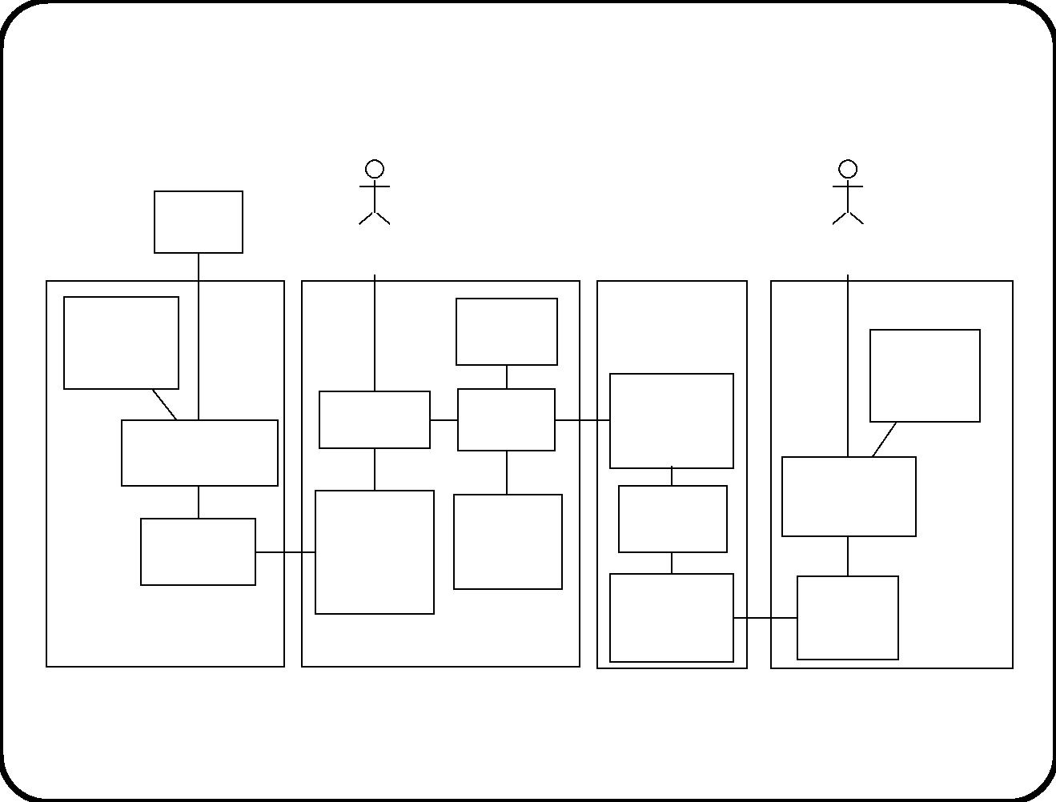
Example: Electronic Ticket System (3)
Allocation of essential components to physical components
Clearing
house
Traveler
Conductor
* Rail
Smart card
Bank
network
database
database
* Rail
Interface to
traveler’s
PDA
network
Traveler
interface
Interface
to card
database
Central selling
dialog
Conductor
Central
information
system
* Rail
Tickets
interface
PDA
network
database
database
interface
Conductor’s
PDA
interface
Interface to
conductor’s
PDA
Interface
to card
Railway company
computer
Traveler’s PDA
Components introduced to deal with internal interfaces. Replicated
components indicated by asterisk.
243

Slide 8
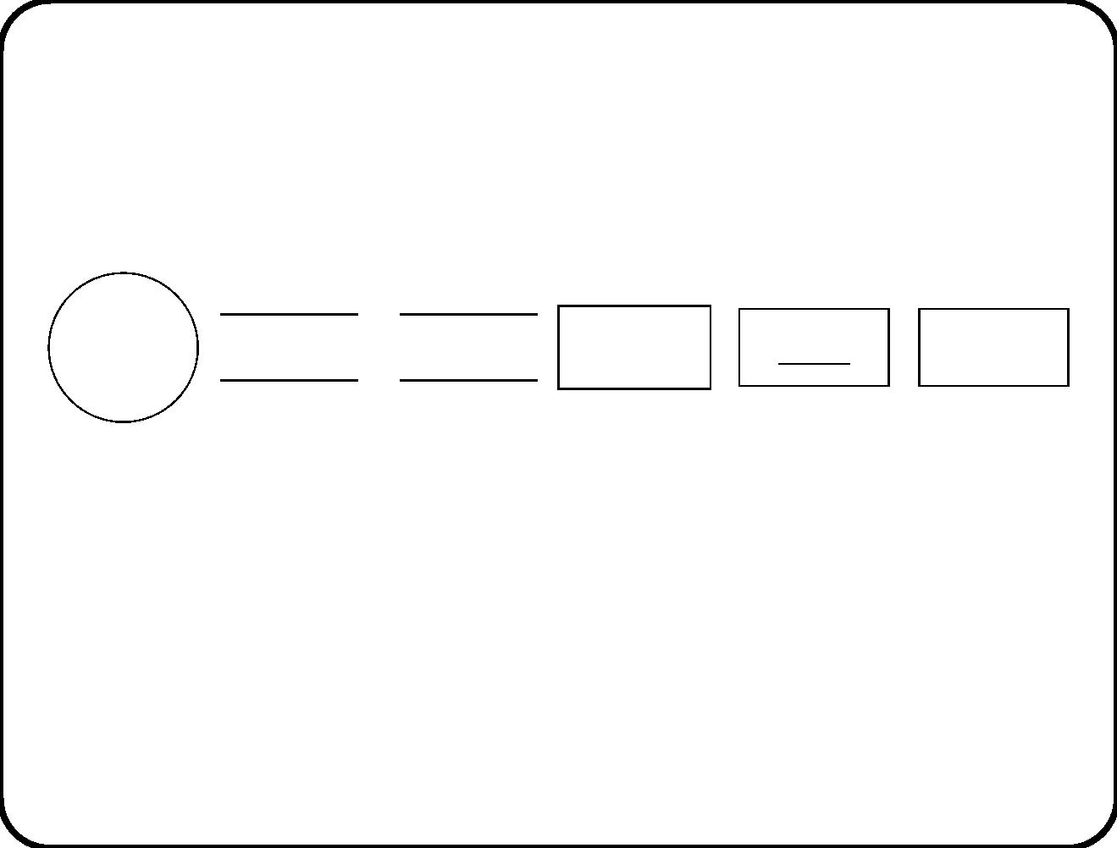
Icons used
Data
(Sub)system
>
Object
class
transfor−
mation
Variable
Database
Object
• There is a small number of icons used to represent the
communication between components in an architecture.
• Data ﬂow diagrams (DFDs): No boxes.
• Architecture diagrams: All icons.
244

Slide 9
Structure of part IV
• Data ﬂow diagrams (DFDs)
• Architecture diagrams
• Execution semantics
• Context modeling guidelines
• Architecture design guidelines
245

Slide 10
Main points
• Communication occurs in the environment and at all levels in
the system.
• Find essential system decomposition by
– Analyzing required external system communication and
– modeling desired environment communications.
• Communications can be described by DFDs or architecture
diagrams.
246

Slide 11
Chapter 15. Data Flow Diagrams
• Introduced in the 1970s to represent logical software
decomposition.
• Still widely used.
• Ontology built into the notation: Software consists of data
stores and data transformations.
(Ontology = classiﬁcation of kinds of things.)
247

Slide 12
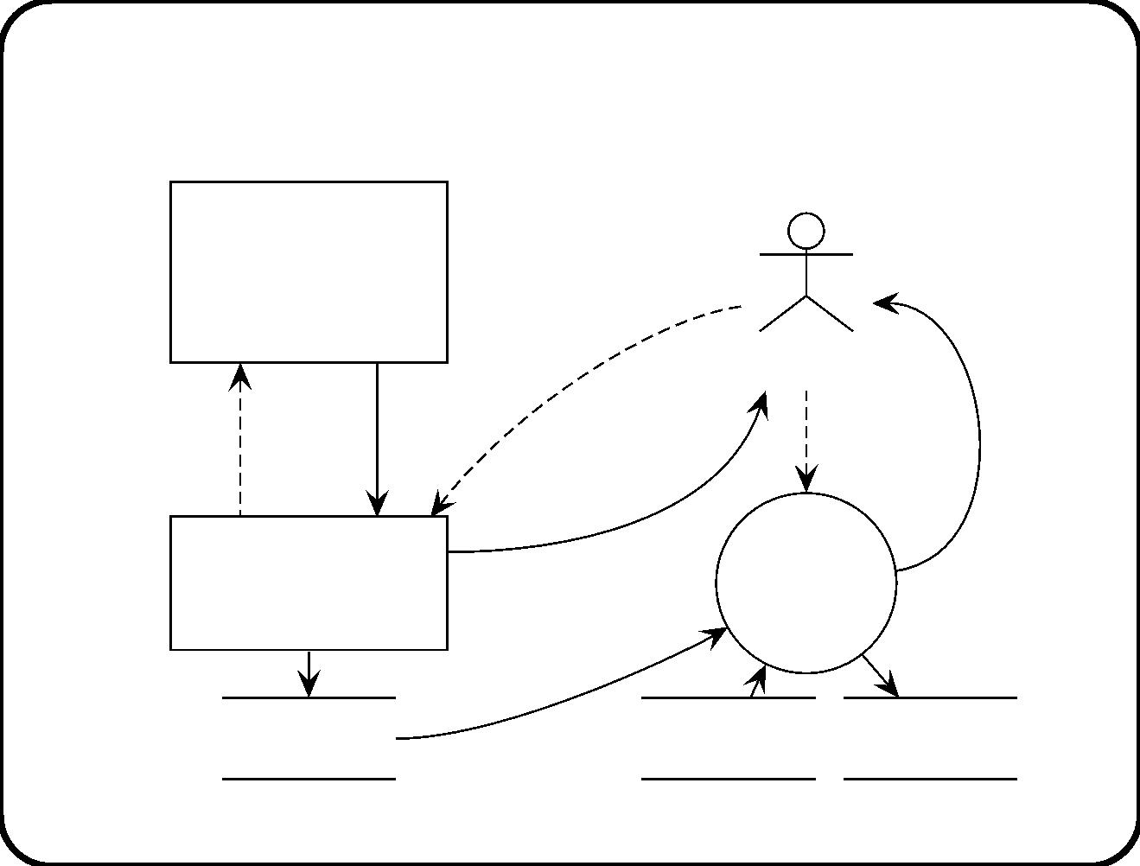
Fragment of architecture of Training Information
System
<<actor>>
download
Personnel
list of
information
joiners
system
Course coordinator
list of
send me a list
joiners
allocate
joiners
report
of joiners
<<dialog object>>
Allocate
joiners
to groups
Download list
of joiners
report
Joiners
Rooms
Participations
248

Slide 13
Typical information system architecture
• Collection of data stores holding info about subject domain.
• Collection of data transformations accessing the stores on
behalf of external entities.
Often more insightful to present functional DFD fragments
separately.
249

Slide 14
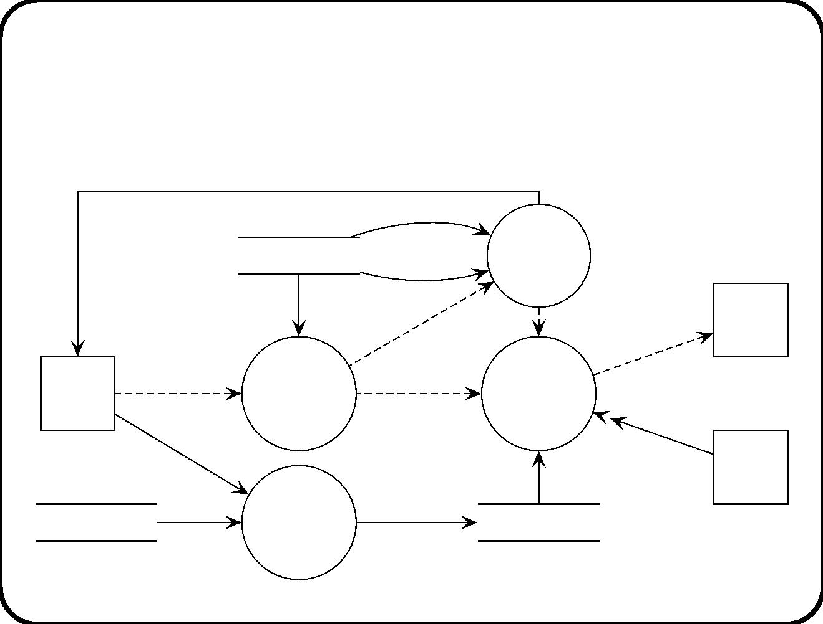
Requirements-level architecture of heating
controller
finished(b)
i
3
*
Monitor
end time(b)
(S)
Batch data
duration
start(b)
tank id
stop(i)
switch on(i),
switch off(i)
Heater(i)
1
2
Operator
console
start heating(b)
Start
start(i)
Tank
heating
batch(b)
control(i)
>
temperature(i)
batch data
Thermo−
meter(i)
4
desired temperature(i)
*
Recipes
Enter
batch
Batch data
data(b)
250

Slide 15
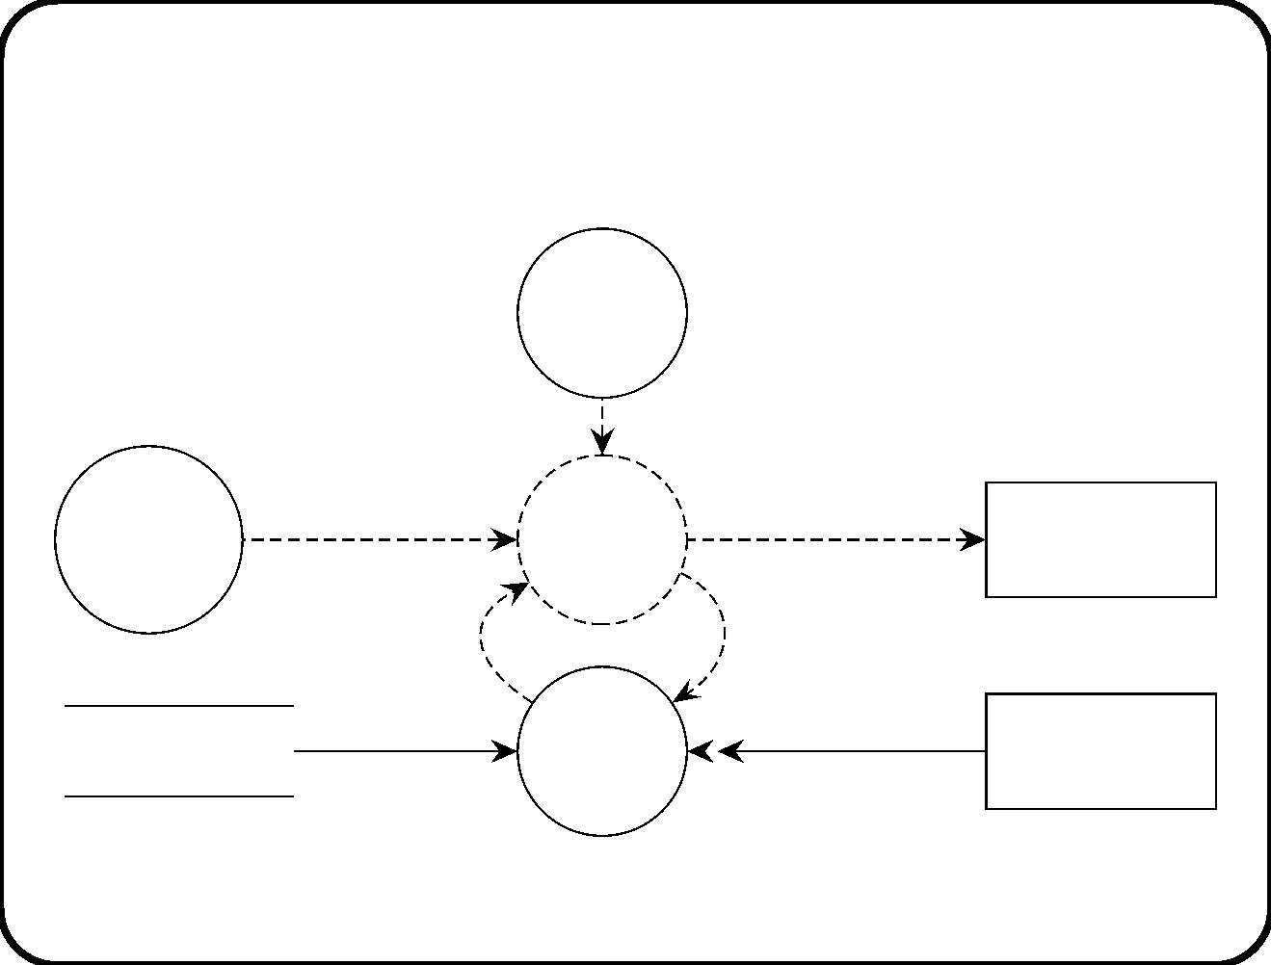
Decomposition of Tank control(i)
3
Monitor
end time(i)
(S)
stop(i)
1
2.1
switch on(i),
switch off(i)
Start
start(i)
Heater
heating
batch(b)
control(i)
Heater(i)
too hot(i),
too cold(i),
OK(i)
T(i)
2.2
temperature(i)
Batch data
Compare(i)
Thermometer(i)
251

Slide 16
Typical control system architecture
• One or more control processes.
• Collection of interface processes connecting the control
processes to external devices.
252

Slide 17
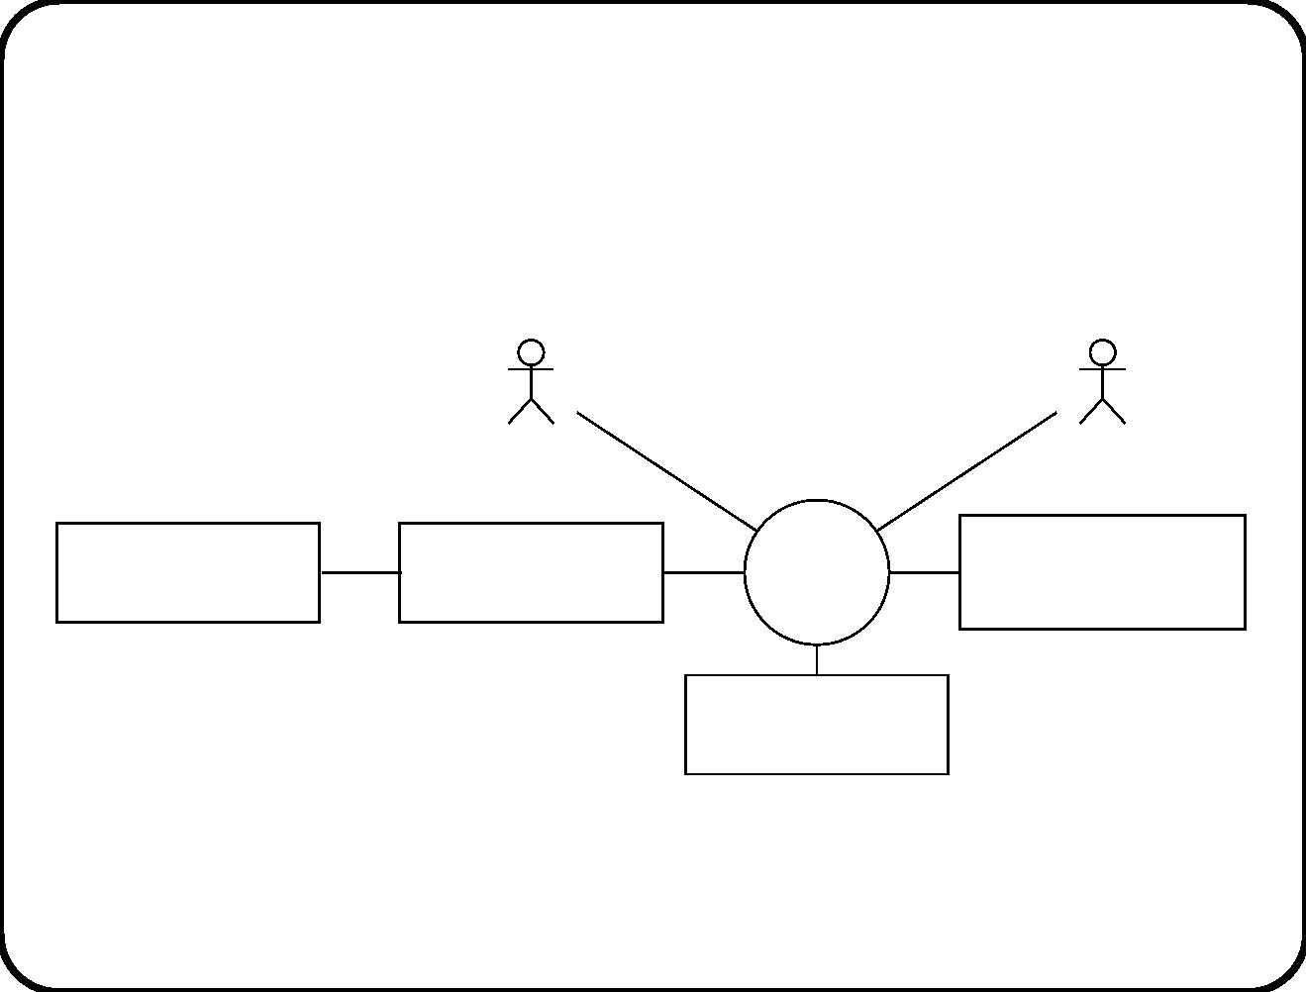
Context diagram of ETS
Traveler
Conductor
Bank
Clearing house
ETS
>
Railway company
computer
Rail network
253

Slide 18
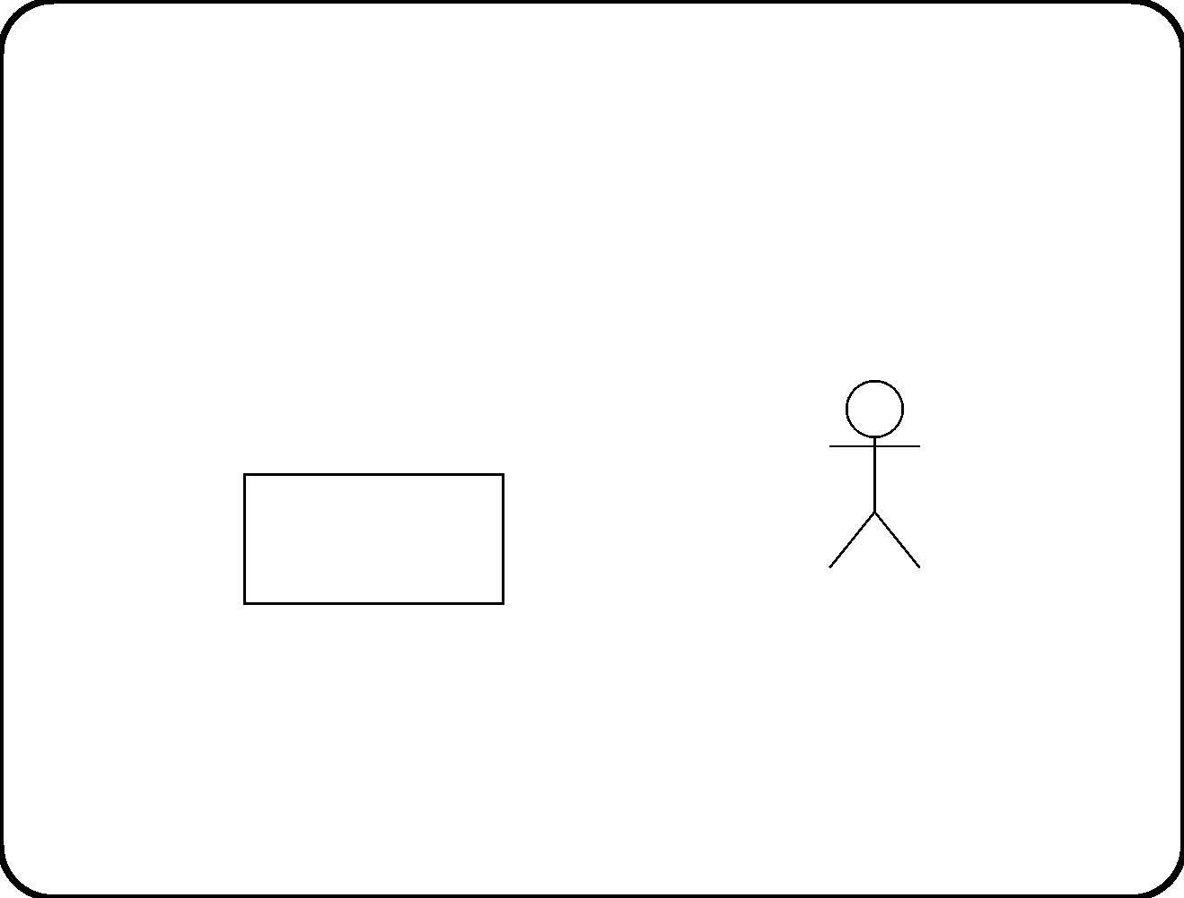
Icons for external entities
External
entity
External entity
254

Slide 19

Time-behavior of ﬂows
Value
Time−discrete flow
Time
Time−continuous flow
(continuous values)
Time−continuous flow
(discrete values)
NB. Time-discrete and time-continuous ﬂows all carry data values.
255

Slide 20
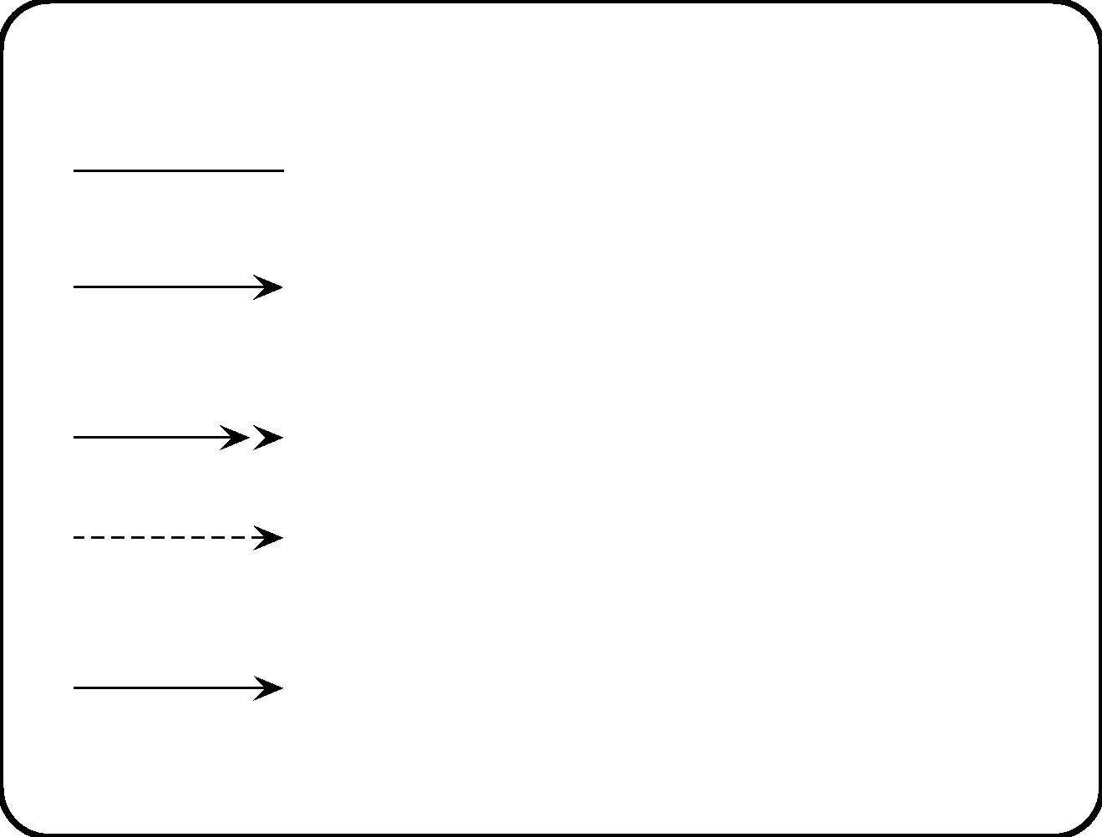
Icons for ﬂows
Communication channel
Connected entities can communicate.
d
Time-discrete data flow
Sender can share info with receiver.
Data is present at discrete instants of time.
d
e
Time-continuous data flow
Data present during periods of time
Event flow
Sender can cause receiver to do something.
Named after effect or after cause.
Compound flow
Bundles a collection of time-discrete flows.
256

Slide 21
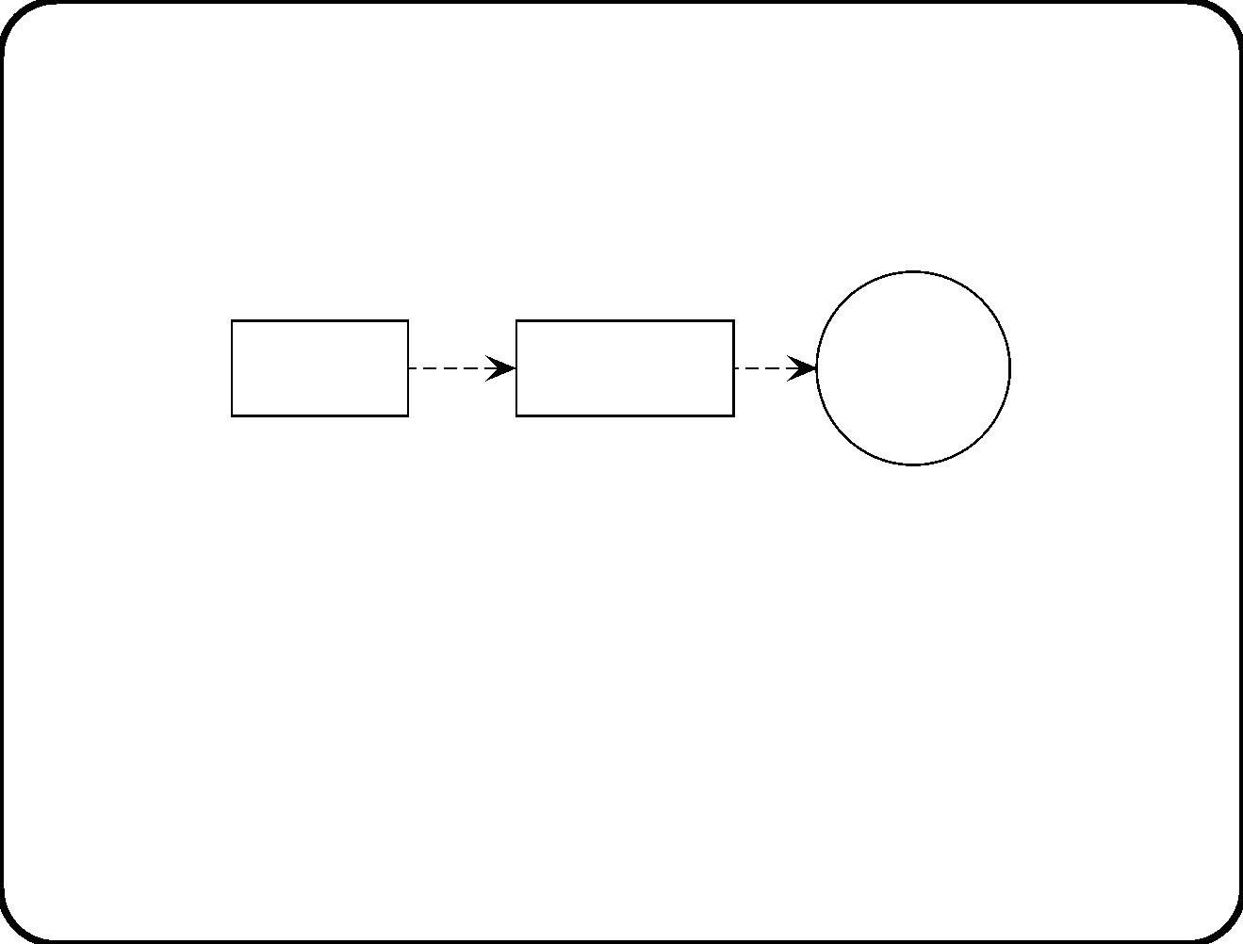
Event ﬂows
enter
off
Elevator
controller
Passenger
Entry sensor
• In our approach, event ﬂows can carry events with parameters.
• Not allowed in Yourdon approaches.
• In our approach, the diﬀerence between event ﬂows and data
ﬂows is only in the naming.
257

Slide 22
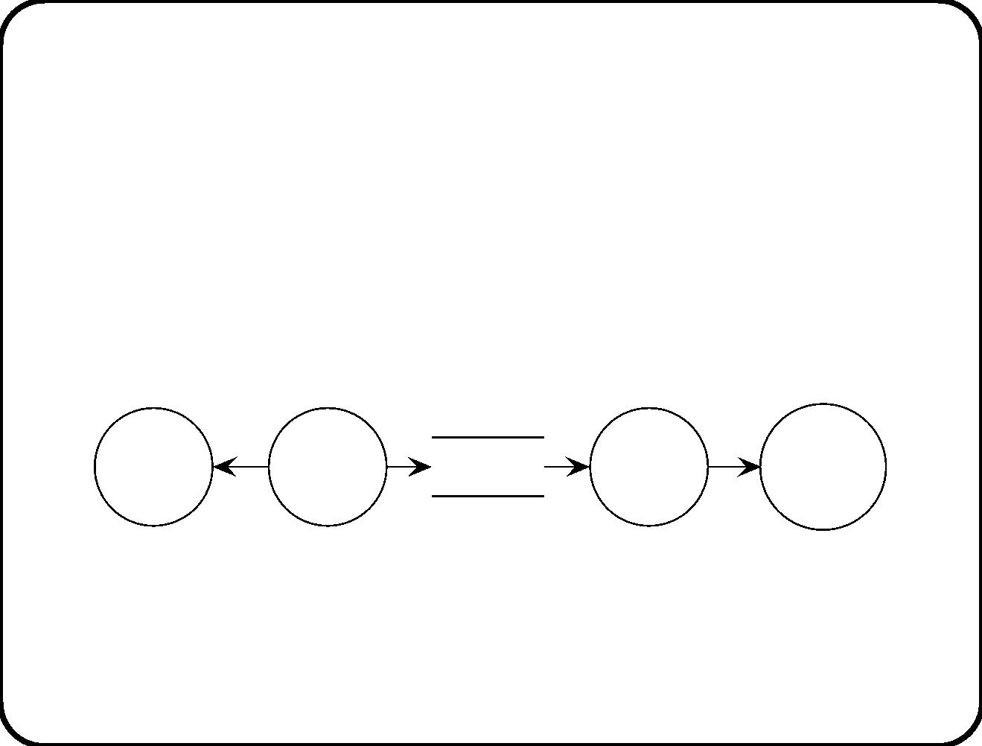
Communication semantics of ﬂow lines
A ﬂow is an instantaneous and reliable communication chan-
nel between two elements.
• Introducing delay and unreliability:
Mis-
direc-
tion
Sender
Delay
Distort-
ion
Intended
receiver
• A ﬂow is an abstraction!
• We always must choose some abstraction level.
258

Slide 23
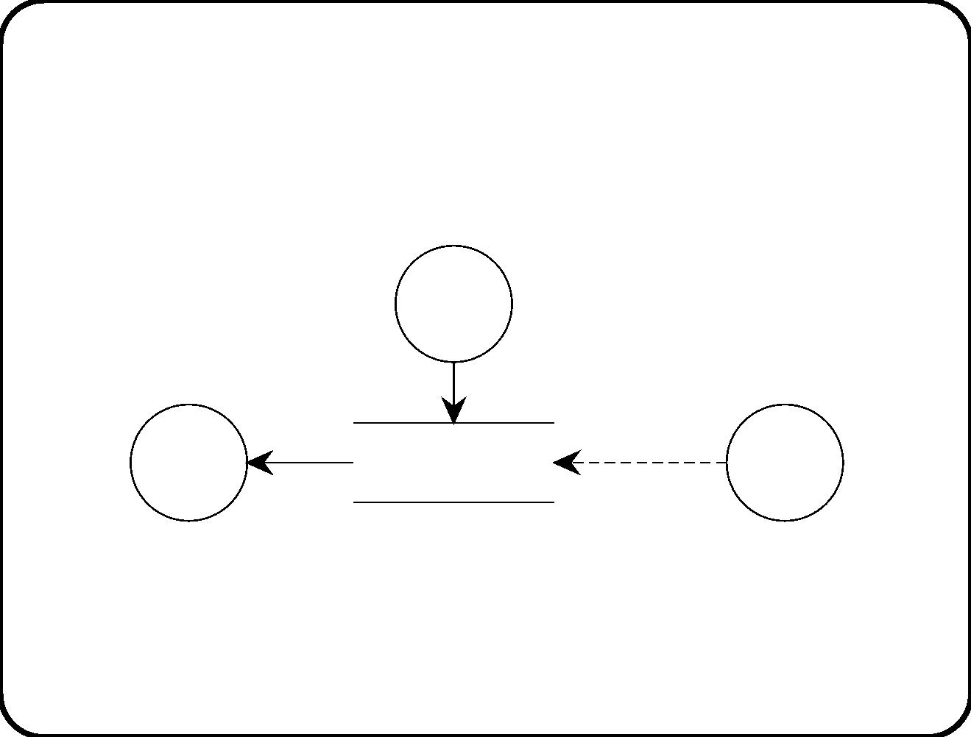
Stores
Remembers data until deleted explicitly.
Write
process
create,
read,
d1
update,
delete
Read
d2
Data store
Process
process
• NB. Event ﬂow access not allowed in Yourdon methods.
• Conceptual structure of subject domain data is represented by
subject domain ERD.
259

Slide 24
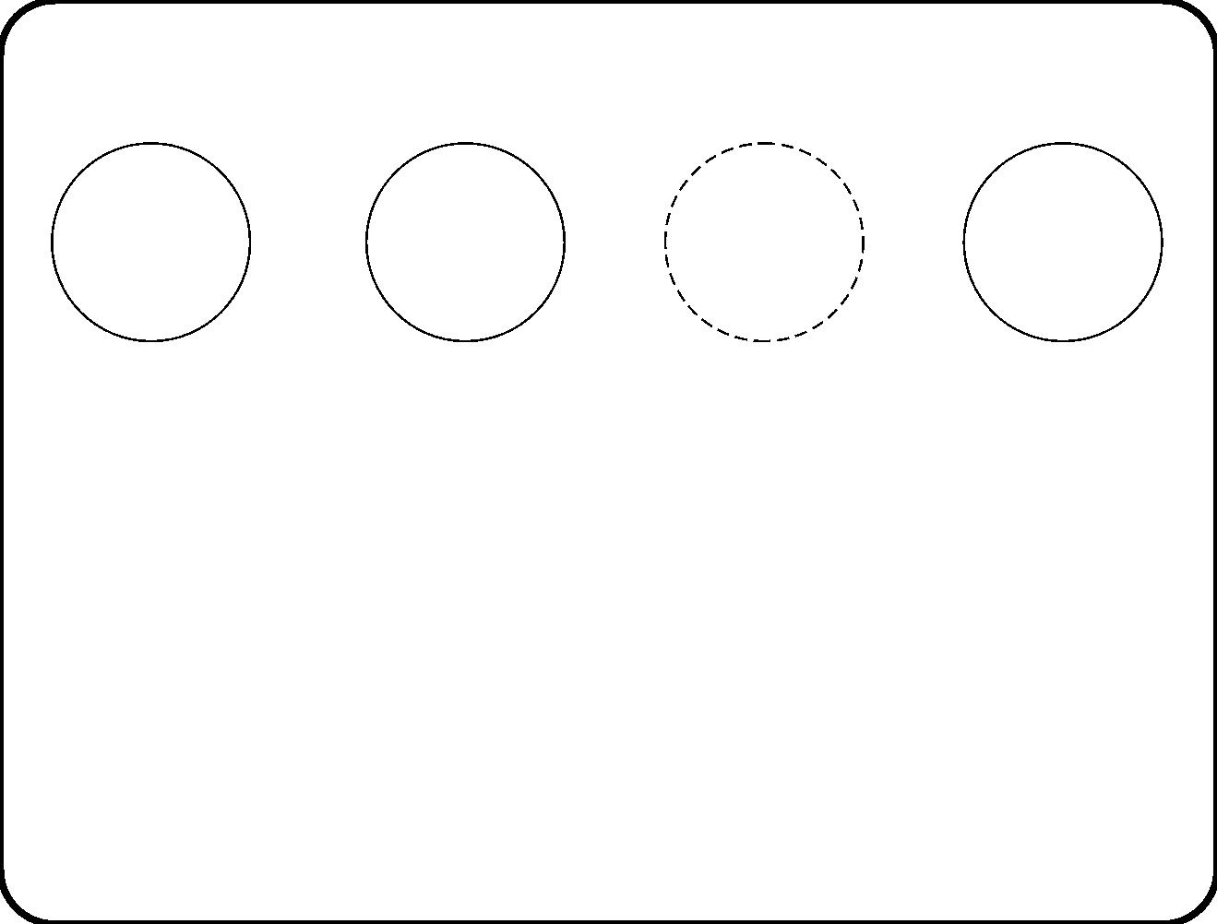
Processes
Data
transfor-
mation
Stateful
data process
(S)
Composite
process
>
Control
process
• Data process transforms input data into output data.
– Stateless: Data transformation. Can be triggered by a
prompt T.
– Stateful: Can be triggered by an enable/disable prompt
E/D.
• Control process transforms input events into output events.
Speciﬁed by an STT or STD.
• Composite process is speciﬁed by a lower-level DFD.
260

Slide 25
Speciﬁcation of a data transformation
2.1: Compare(i).
• When triggered, then let d be the desired batch temperature
from the Batch data store:
– if temperature(i) < d − 5 then too cold(i),
– if temperature(i) > d + 5 then too hot(i).
• Mathematical input-output relation.
• Interface must match DFD.
261

Slide 26

Speciﬁcation of stateful data process
3: Monitor end time.
• Local variable: end time.
This process is started by the reception of b and then is active
until a temporal event occurs.
• Initialization: When b is received, then
– Read duration of b from Batch data and set end time := now
+ duration.
• Process: When end time occurs, then
– read tank id’s of b from batch data,
– for each tank id do stop(tank id),
– send ﬁnished(b).
• Initialization is followed by state-dependent transformation
process.
• Interface must match DFD.
262

Slide 27
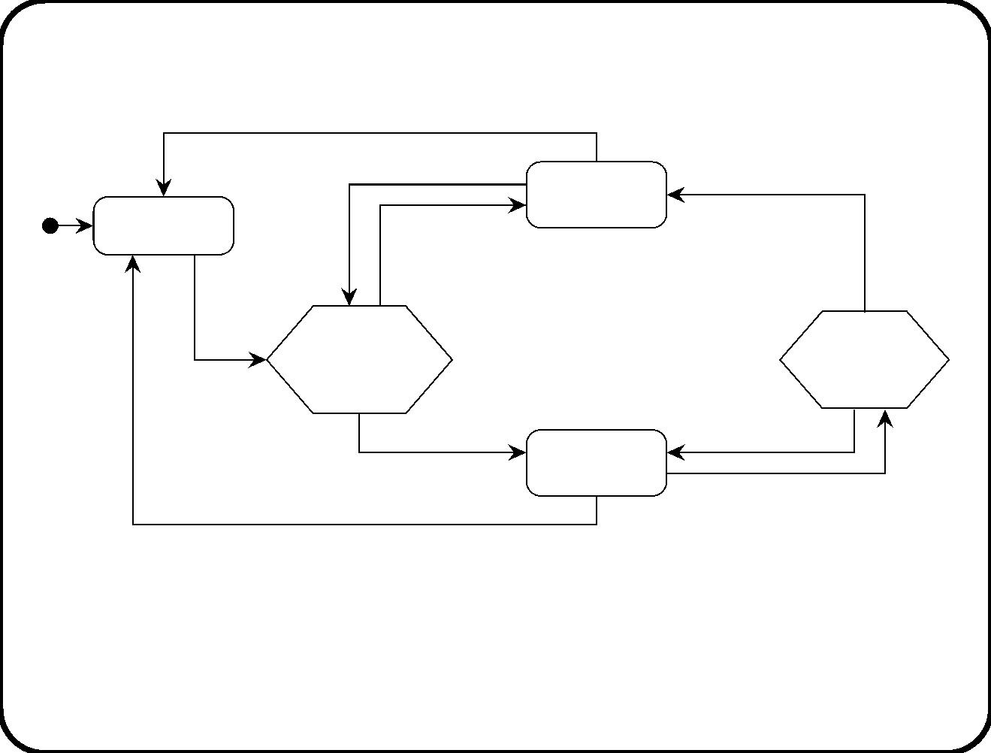
Speciﬁcation of control process by Mealy diagram
stop(i)
Ready(i)
after(60 secs) / T: Compare(i)
OK(i) /
too hot(i) / switch off(i)
Not heating(i)
start(i) /
T: Compare(i)
Comparing
Comparing
heating(i)
not heating(i)
OK(i)
stop(i) /
too cold(i) / switch on(i)
Heating(i)
switch off(i)
after(60 secs) / T: Compare(i)
• Interface must match DFD.
• Yourdon only allows Mealy diagrams. We allow any STT or
STD.
263

Slide 28
Parametrized DFDs
DFD is instance-level diagram. To simulate types of elements:
• Process names in a diagram can be parametrized by a process
identiﬁer.
• This causes some ﬂow names to contain process identiﬁers as
well.
264

Slide 29
Main points
• DFDs model a system as a collection of communicating data
stores and processes.
• Various kinds of processes, depending upon how they are
speciﬁed.
• DFDs can be hierarchical.
• Detailed information about ﬂows can be expressed.
• Instance-level notation.
265

Slide 30
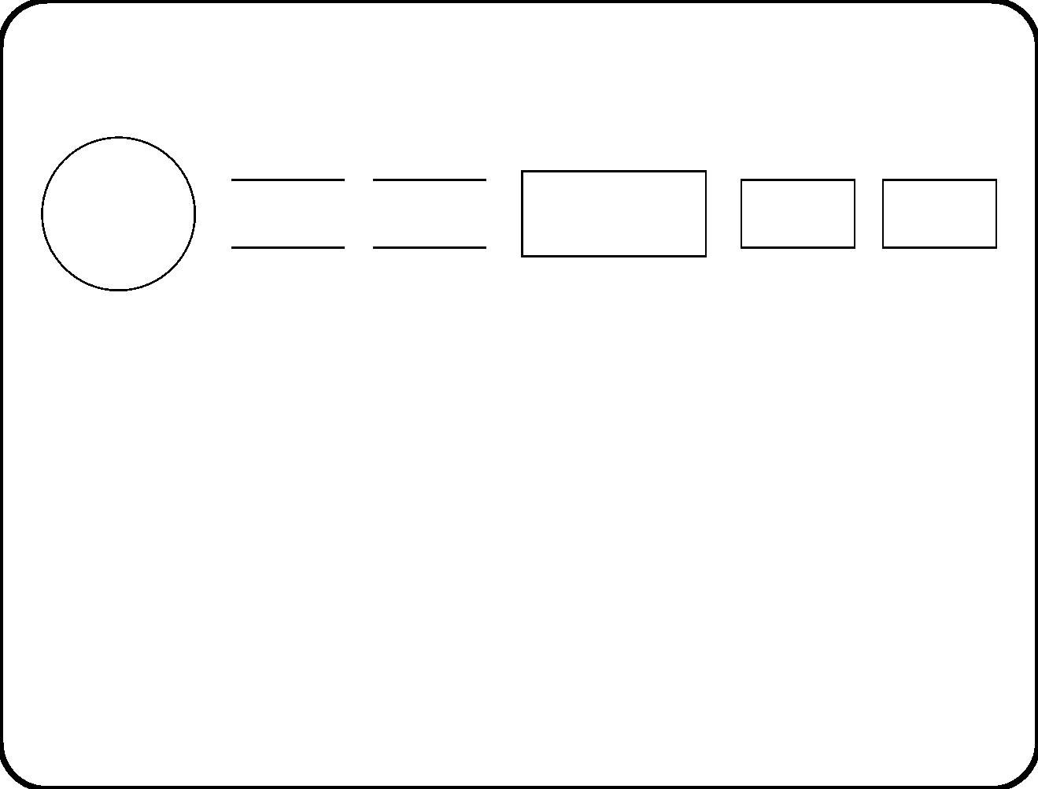
Chapter 16. Communication Diagrams
Data
transfor-
mation
Variable Database
(Sub)system
Object
Object
class
>
• Diﬀerence with DFD: Type-level diagram; more icons.
• Diﬀerence between variable and database is that database is
(viewed as) a set of instances.
• An object is a subsystem not decomposed by a communication
diagram.
• Object classes are not components of a system. They are types
of such components.
266

Slide 31
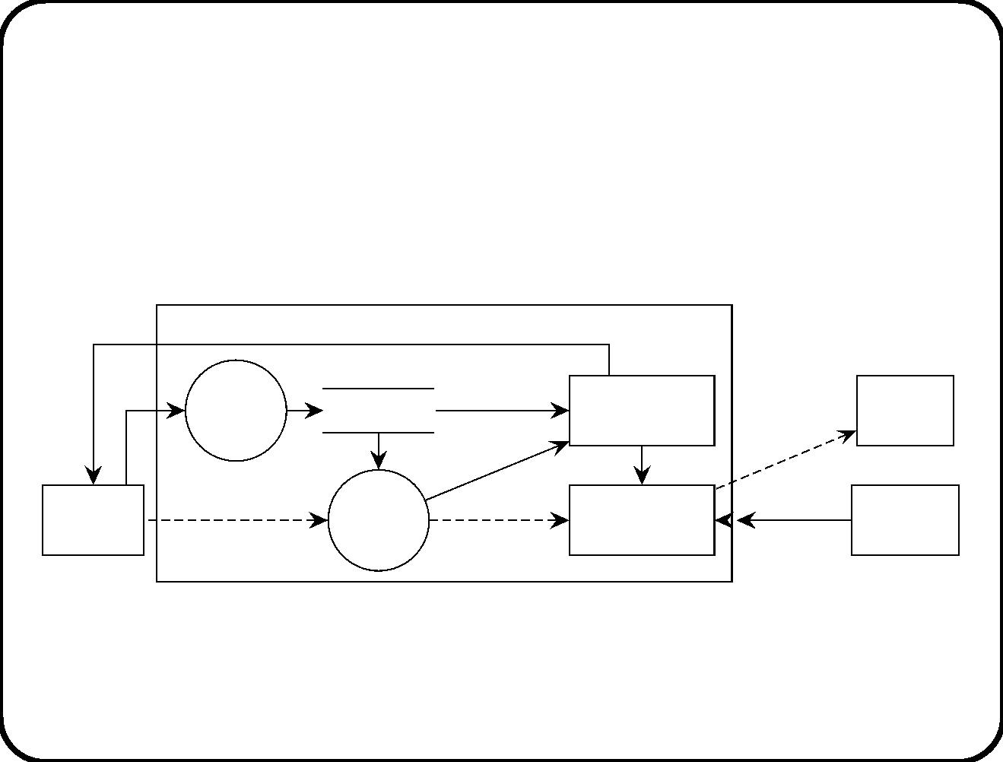
Communication diagram of heating controller
requirements-level architecture
finished
Heating controller
Enter
batch
data
tank id,
Batchdata
duration
Monitor
switch on,
switch off
Heater
end time
tank id
batch id
start
stop
Operator
console
start heating
Start
heating
batch
Tank
temp
Thermo−
meter
control
267

Slide 32
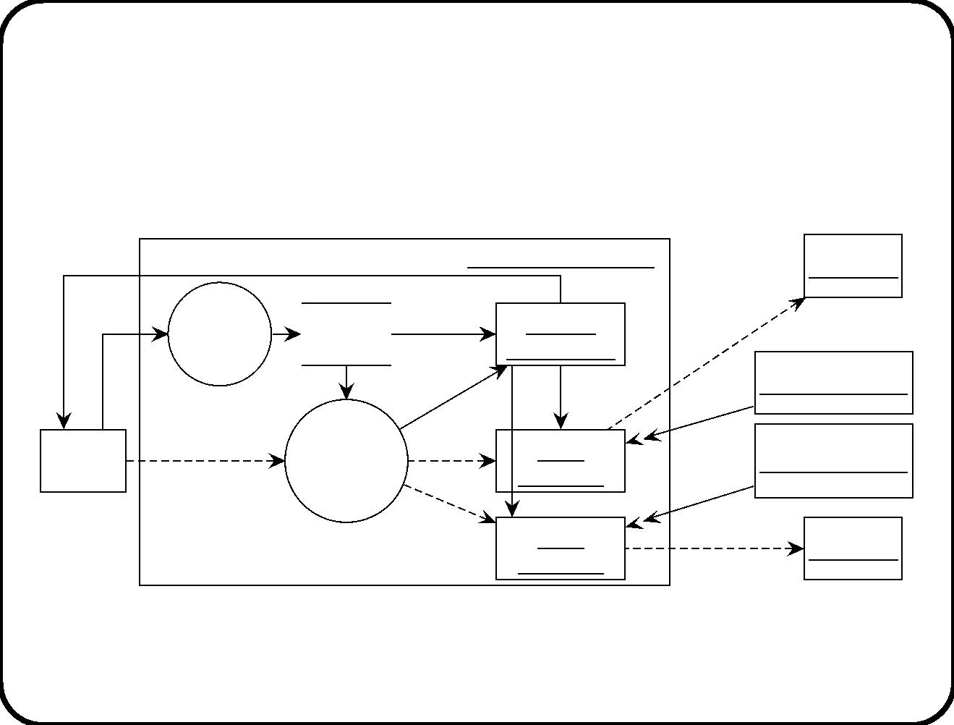
Instance diagram of a particular heating
controller in a particular context
finished(b)
Heating controller(b0)
Heater(t1)
switch on(i),
switch off(i)
Enter
batch
t1, t2,
Batch
data(b0)
duration
b0
Monitor
data(b0)
end time(b0)
t1, t2
stop(t1)
temp(t1)
temp(t2)
Thermometer(t1)
Thermometer(t2)
start
Operator
console
heating(b0)
Start
start(t1, b)
Tank
heating
batch(b0)
control(t1)
stop(t2)
start(t2, b0)
Tank
control(t2)
Heater(t2)
switch on(t2),
switch off()t2)
268

Slide 33
Components
Very overloaded term. For us: component = part of an executing
SuD that delivers service to its environment.
• Data transformation
• Data store
– Variable
– Database
• Subsystem
• Object
To deal with a time-varying collection of components, we can also
show object classes. These are not components themselves. (They
are types of components.)
269

Slide 34
Communication channels
Same as in DFDs.
• Event channel. Named after cause or eﬀect.
• Data channel. Time-discrete or time-continuous.
There are two kinds of addressing.
• Channel addressing. Item is sent to channel. Used in DFDs.
• Destination addressing. Item is sent to individual
destinations. Used in the UML.
270

Slide 35
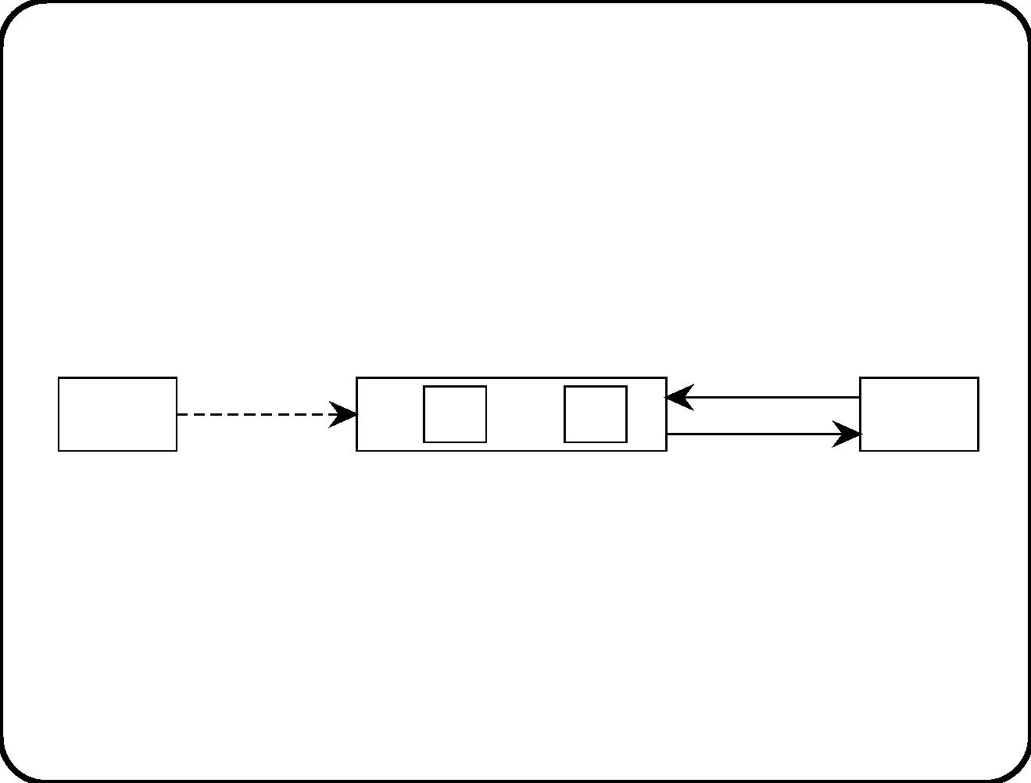
(De)composition
Represented by
• containment of nodes
• or simply specifying the component elsewhere.
e
x
y
C1
S
C2
• C1 and C2 can both be triggered by an occurrence of event e.
• C1 and C2 can both read the value of x.
• C1 and C2 can both write a value to y.
271

Slide 36
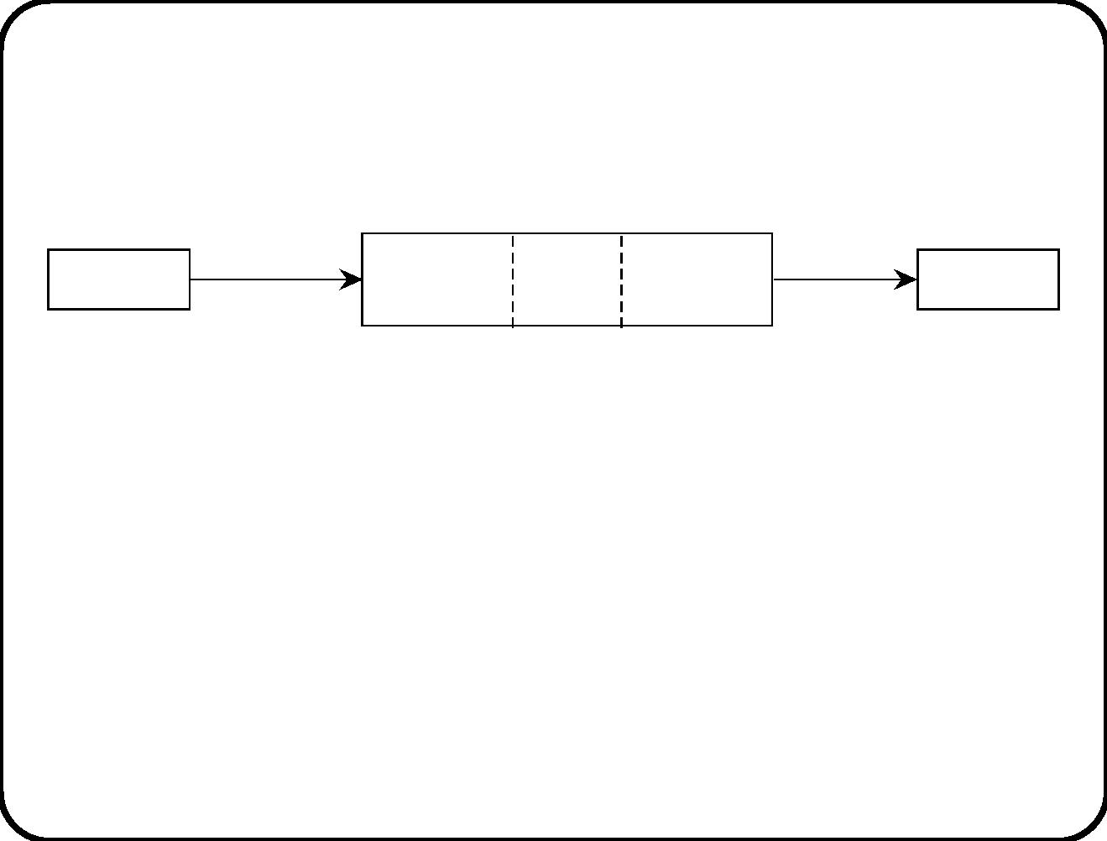
Closely coupled components
x
y
C1
C2
C3
• C1, C2 and C3 have same interface.
• Events generated in one component are sensed by the other
closely coupled components. (Event broadcasting)
• The state of any closely coupled component is readable to any
other closely coupled component. This permits the use of
in(State).
272

Slide 37
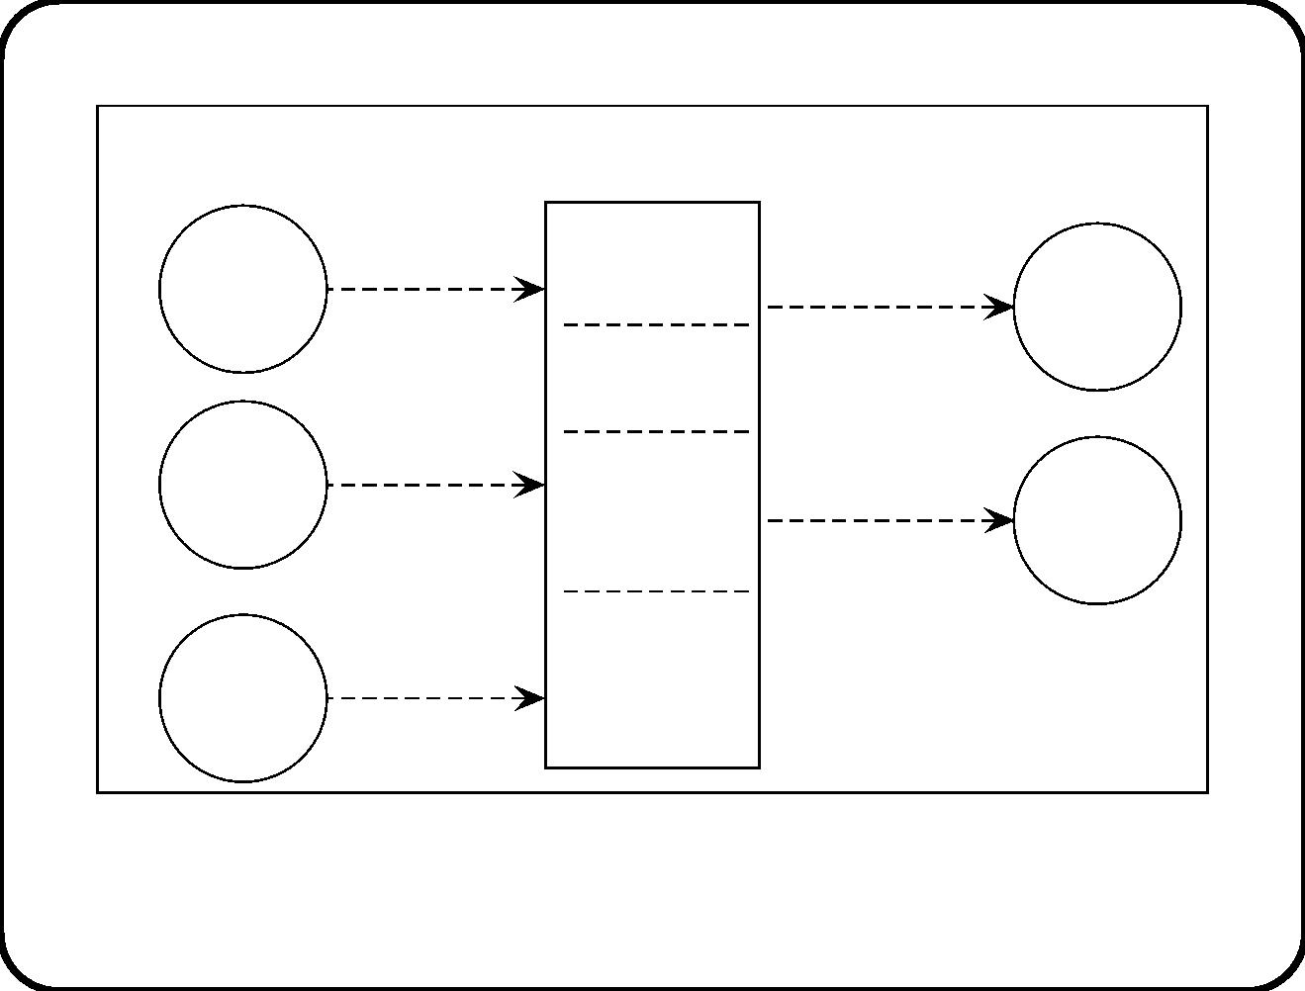
Elevator controller composition fragment
Elevator control
start motor(b, c),
Movement
continue(c),
reverse(c)
Arrive arrive(b, c)
stimulus
Motor
action
comp
control
rec
Door
doors
closed(c)
control
open doors(c),
close doors(c)
Door
stimulus
rec
Allocation
and button
control
Door
action
comp
pass
doors(c)
Direction
indicator
control
Entry
stimulus
rec
Arrows show possible interfaces of all four closely coupled
components.
273

Slide 38
Allocation of services to components
Functions
Compo-
nents
Create
Start
Switch on
heater
Switch oﬀ
heater
Finish
batch data
heating
heating
Enter
X
X
batch data
Batch
data
X
X
Start
heating
Tank
X
X
control
Monitor
X
end time
274

Slide 39
Flowdown
Functions
Compo-
nents
Create
Start
Switch on
heater
Switch oﬀ
heater
Finish
batch data
heating
heating
Enter
Accept
and store
data.
batch data
Batch
data
Store data
Provide
data
Start
Start
heating
heating
Tank
Switch on
when too
cold
Switch oﬀ
when too
hot
control
Monitor
Stop when
time is up.
end time
275

Slide 40
Main points
• Communication diagrams generalize DFDs.
• They allow us to represent objects and their classes in the
diagram, and to represent close coupling.
• Instance-level diagram represents snapshot of the system.
• Decomposition can be represented by containment of nodes.
• We must allocate and ﬂow down system services to component
services.
276

Slide 41
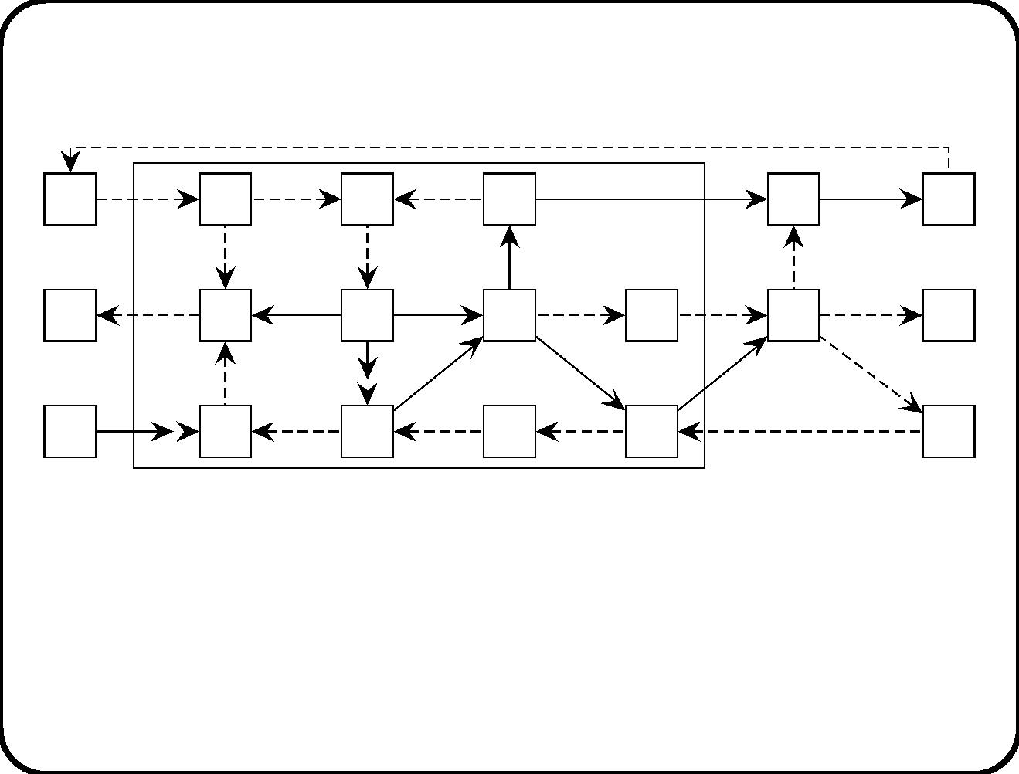
Chapter 17. Communication Semantics
e
SuD
What is the response to e?
• Depends upon the behavioral semantics of the components.
• We assume the semantics of component speciﬁcations is ﬁxed,
and concentrate on the remaining choices.
277

Slide 42
Input buﬀers: problem and possible solutions
Most combinations of semantic choices require a component to deal
with a backlog of events that occurred but have not yet been
responded to. Suppose components have input buﬀers.
• Size of buﬀer?
• Structure of buﬀer? (Set, bag, queue)
• Removal p olicy. (Even for queues, i.e. deferred events.)
Statemate: set of unlimited size.
UML: Queue (more or less) of unlimited size.
278

Slide 43
Component input and output: problem and
possible solutions
Computations during a step may need more input, or may produce
output.
• Eager read/lazy write: All input values are read eagerly, at
the start of the step, and all output (actions and data) is
written lazily, at the end of the step. Statemate.
• Lazy read/eager write: Input is read lazily, when needed,
and output is written eagerly, immediately when available.
UML.
279

Slide 44
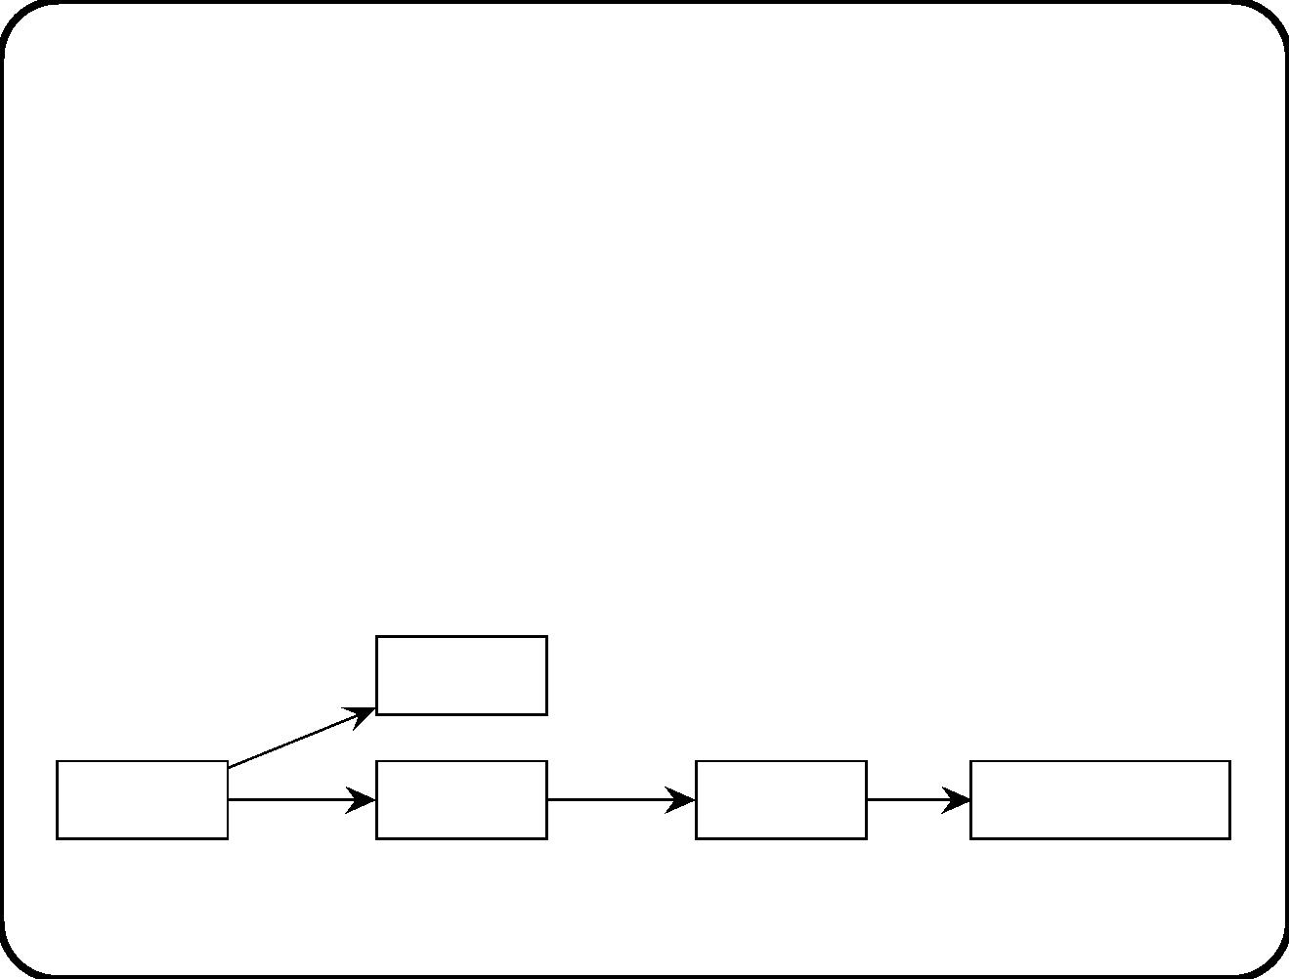
Semantics of communication channels
• There is no delay between sending and receiving,
• A message always arrives at its destination(s),
• It arrives at no other destinations and
• A message is never distorted.
We can always introduce these things explicitly:
Misdirection
Sender
Delay
Distortion
Intended receiver
280

Slide 45
Addressing mechanisms
• Channel addressing. “Deliver this communication to all
components at the other side of this channel.” DFDs and
Statemate. Good for broadcast, bad for point-to-point
communication; good for encapsulation.
• Destination addressing. “Deliver this message to this
component.” Good for point-to-point, bad for encapsulation.
UML.
281

Slide 46
Channel capacity: semantic options
• Zero channel capacity: Message immediately arrives at
receiver. If the receiver has no input buﬀer, a channel
represents a synchronous communication in which the
sender cannot put an item in a channel if the receiver does not
take it out at the same time.
• n-item channel capacity: A channel can contain n items at
the same time. When a sender wants to write something to a
channel that is full:
– Overwrite semantics. (Statemate and UML)
– Refusal semantics.
282

Slide 47
Blocking: semantic options
What happens when for some reason, a sender attempts a
communication through a channel, but this communication is not
possible?
• No blocking: Discard immediately.
• Finite blocking: Wait a ﬁnite time, then discard. else.
• Inﬁnite blocking: Wait.
Statemate and UML: Not applicable, because they use overwrite
semantics.
283

Slide 48
Temp oral semantics of network behavior
The SuD is a network of communication components.
Options for temporal semantics:
• Global time is indicated by global clock, immediately accessible
to all components.
• Local clocks may diﬀer.
284

Slide 49
Step semantics of network behavior
• Network step semantics. The SuD is ready to respond
when any of its components is ready.
• Network multistep semantics. The SuD is ready to
respond when all its components are ready.
Propagation strategy:
• Breadth-ﬁrst: Execute a triggered component after all
components triggered earlier, are executed.
• Depth-ﬁrst: Execute a triggered component immediately.
285

Slide 50
The Environment
• A communication diagram is not intended to specify
environment behavior. But it does make some assumptions
about environment behavior.
– Environment is able to absorb response at all times.
– The environment can produce stimuli at all times.
• The environment is continuous, the system is discrete.
– Arrival order of stimuli over diﬀerent channels may be
unknown by the SuD.
– Stimuli arriving over same channel may be lost.
– Time-continuous input is sampled.
286

Slide 51
Main points
• Components may have input buﬀers; may have size restrictions
and access policies.
• Communication channels are reliable and instantaneous.
• Addressing may be by channel or by destination.
• Channel capacity may be restricted.
• Communications have a blocking semantics.
• Time may be global or local.
• Steps may propagate through the network breadth-ﬁrst or
depth-ﬁrst.
• We assume that the environment is always able to absorb
responses.
287

Slide 52
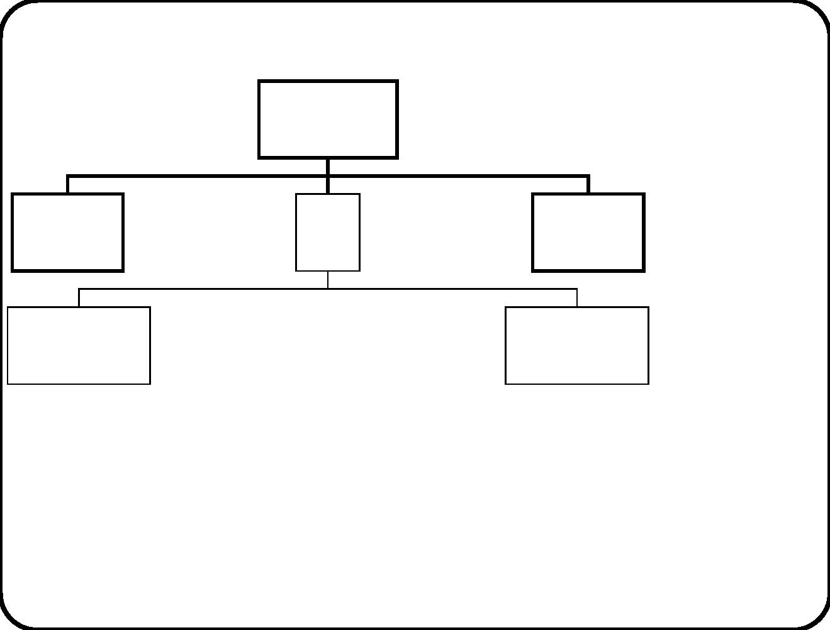
Chapter 18. Context Modeling Guidelines
Services
Composite
system
Behavior
Communication
External
entity
Services
Behavior
Communication
Services
SuD Behavior
External
entity
Services
Behavior
Communication
Communication
Services
Services
Subsystem 1 Behavior
Communication
......
Subsystem n Behavior
Communication
• To prepare for making design decisions, you ﬁrst collect
information about things given to you.
• This is modeling, not design.
• Consider system as black b ox.
288

Slide 53
Where is the system boundary?
√
Use function reﬁnement tree. This is a fully
implementation-independent description of system b oundary.
√
Use list of stimuli and responses. This is a behavior description
of the system b oundary.
289

Slide 54
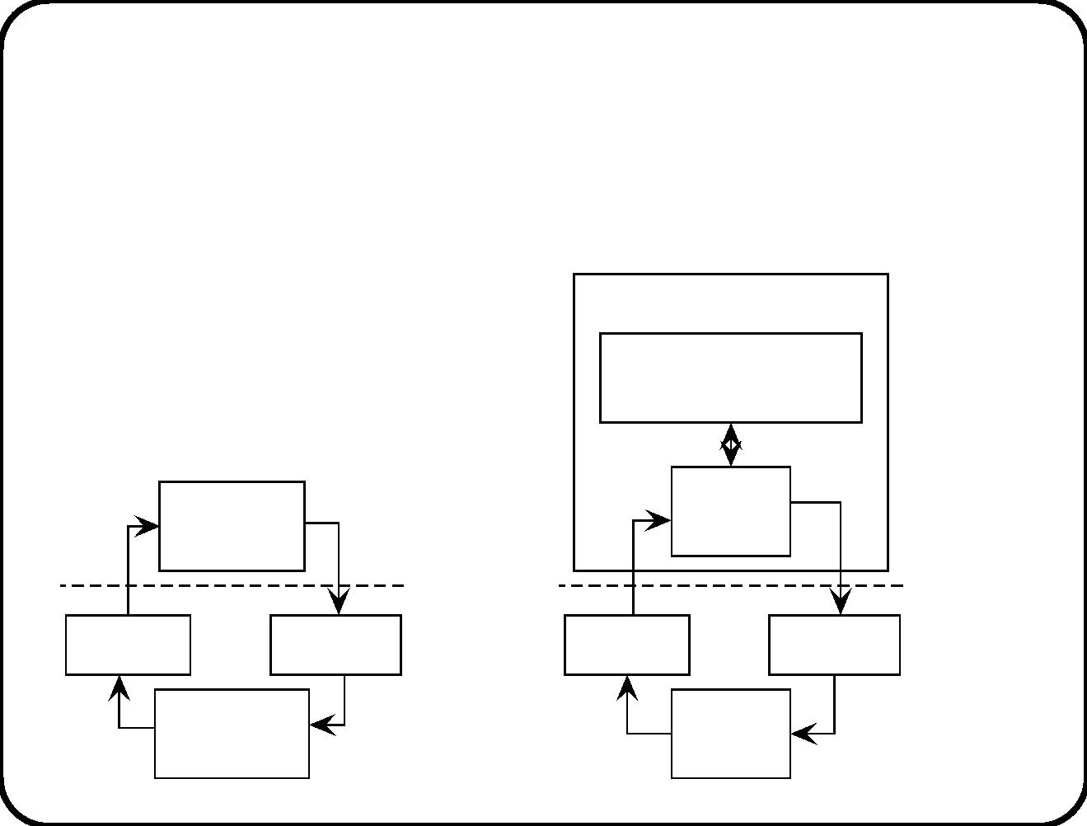
Tradeoﬀ between environment and SuD
• System engineering argument: A and S entail E.
• Responsibility for emergent properties is distributed over
environment (A) and system (S).
Elevator controller
Rest of the
elevator controller
Elevator
controller
Door
control
Sensor
Actuator
Sensor
Actuator
Intelligent
door
Dumb
door
290

Slide 55
Context diagram
Represents communication among the relevant entities in the
environment and the SuD.
√
External entities are
— Physical entities (people, devices, natural objects),
— Conceptual entities (organizations, obligations, rights),
— Lexical entities (software, contracts, speciﬁcations).
A context diagram must give overview; it should link clearly to the
purpose of the system.
291

Slide 56
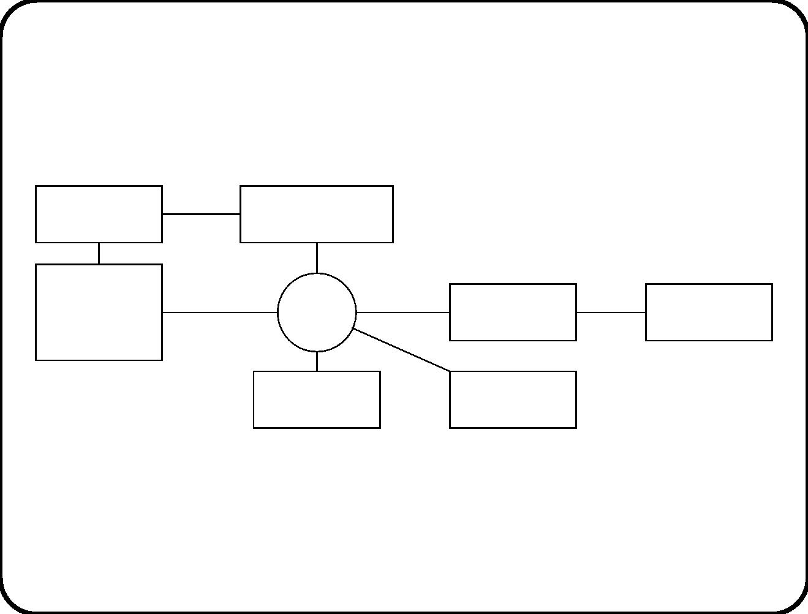
Teaching information system
Registration
Joiners
desk employee
Personnel
TIS
information
>
Course
Room
system
coordinator
Secretary
Printer
Not much detail needed here.
292

Slide 57
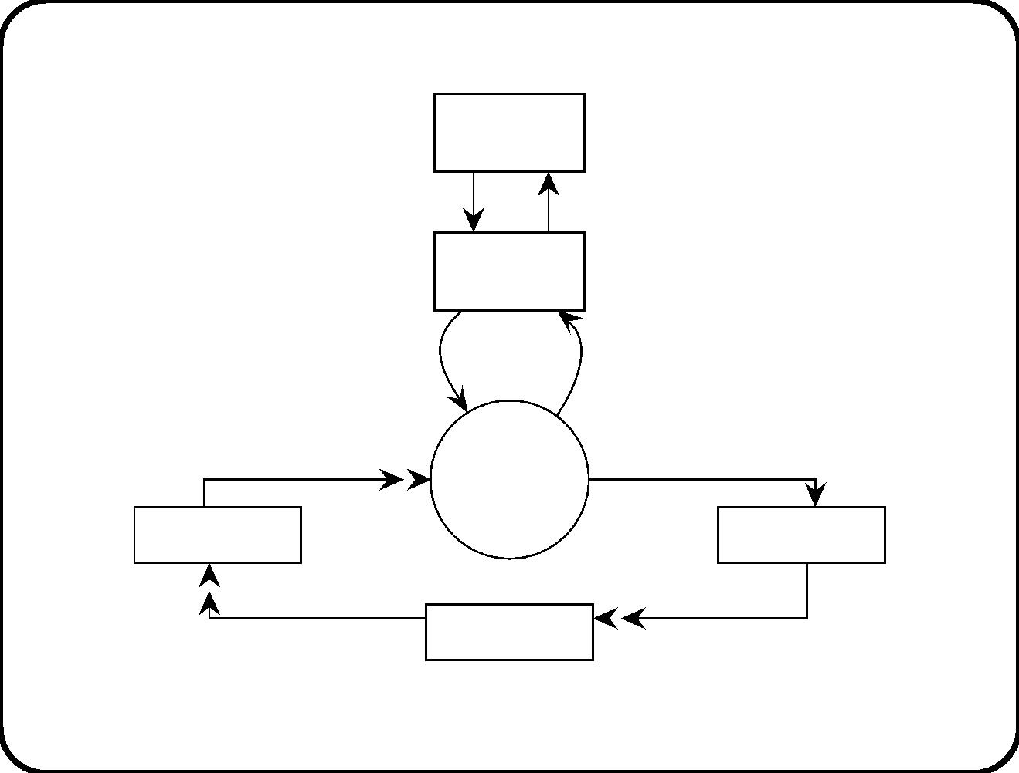
Heating controller
Operator
commands
data
Operator
console
operator
operator
commands
data
Heating
control
system
>
temperature
heater commands
Thermometer
Heater
heat
heat
Heating tank
More detail needed here.
293

Slide 58
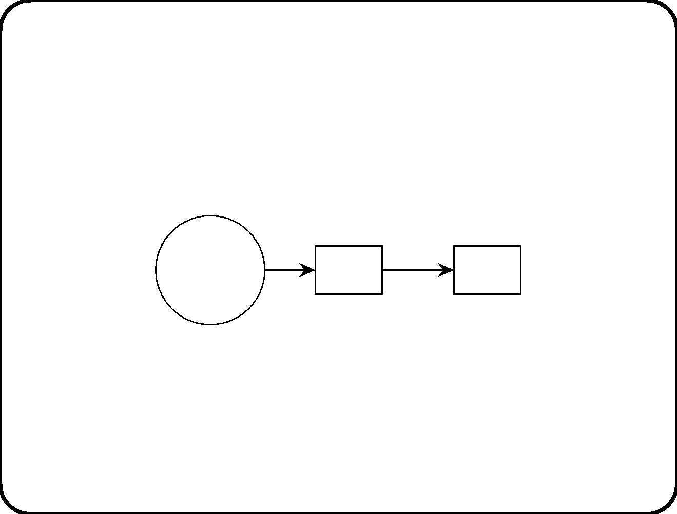
Choose an abstraction level
√
Communication channels represent a level of abstraction.
Heating
control
Wire
Heater
system
>
There is always a remaining level of abstraction.
294

Slide 59
Context boundary
√
Include entities needed to achieve goals of composite system.
√
Include entities in which SuD causes desired eﬀect.
√
Include entities about which SuD needs information to perform
its work.
√
Ignore entities where eﬀect is not felt / not relevant.
√
Ignore entities whose behavior is irrelevant for the task of the
SuD.
The context diagram shows which external entities are, together
with the SuD, involved in achieving the desired emergent properties
of the composite system.
295

Slide 60
Structuring the context
Three kinds of functionality:
• Information provision. To answer questions, produce reports,
or otherwise provide information about the subject domain.
• Direction. To control, guide, or otherwise direct its subject
domain.
• Manipulation. To create, change, display, or otherwise
manipulate lexical items in the subject domain.
296

Slide 61
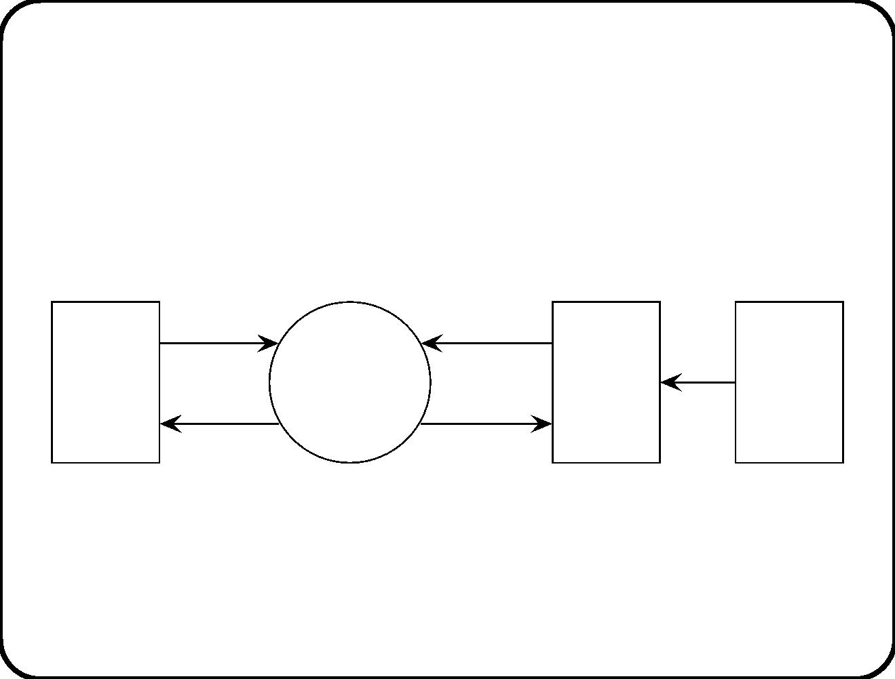
Typical structure in the context of an
information-provision system
query
stimulus
Information
provision
function
>
Con-
nec-
tion
event
Subject
domain
User
response
answer,
report
domain
297

Slide 62
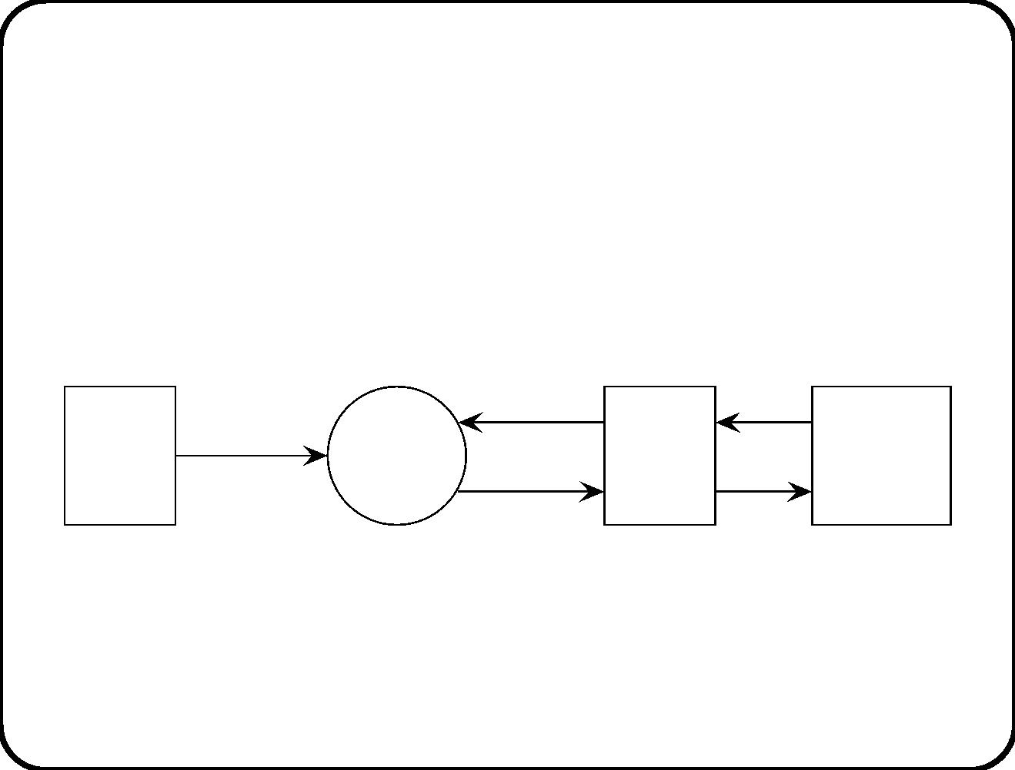
Typical structure in the context of a directive
system
stimulus
event
action
commands
Con-
nection
domain
Ope-
rator
Directive
function
>
Subject
domain
response
298

Slide 63
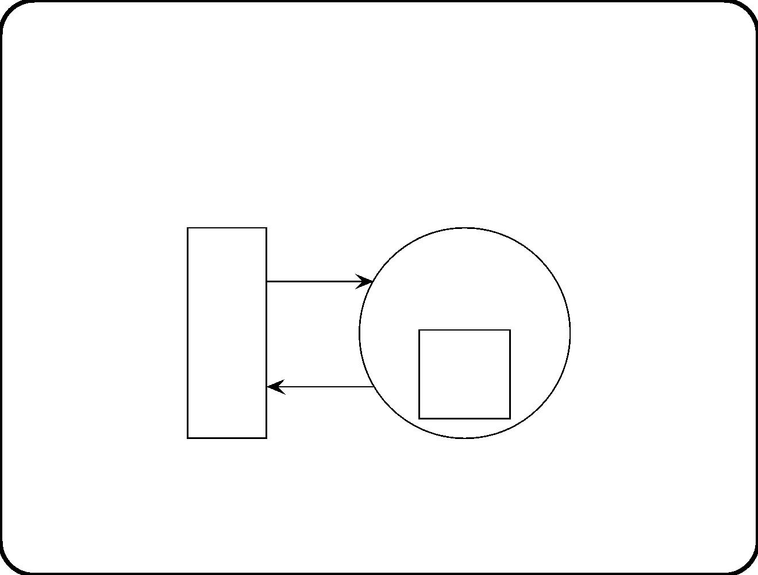
Typical structure in the context of a manipulative
system
Command Manipulative
function
>
User
Lexical
subject
feedback
domain
299

Slide 64
Main points
• Context is modeled, not designed.
• System boundary is determined by desired system services.
• Trade-oﬀ between functionality in the system and functionality
in the environment.
• Context ends where relevant eﬀects or relevant information
ends.
• Context models have typical structures that depend upon
typical system functionality.
300

