Slide 1
Reactive Systems VI, ch 19~23
Decompositions & Design
何明昕 HE Mingxin, Max
Send your email to c.max@yeah.net with
a subject like: SE345-Andy: On What …
Download from c.program@yeah.net
/文件中心/网盘/SoftwareEngineering26S

Slide 2

List of Slides
300 Chapter 19. Requirements-Level Decomposition Guidelines
323 Chapter 20. Postmodern Structured Analysis (PSA)
332 Chapter 21. Statemate
351 Chapter 22. The Uniﬁed Modeling Language (UML)
381 Chapter 23. Not Yet Another Method
3

Slide 3
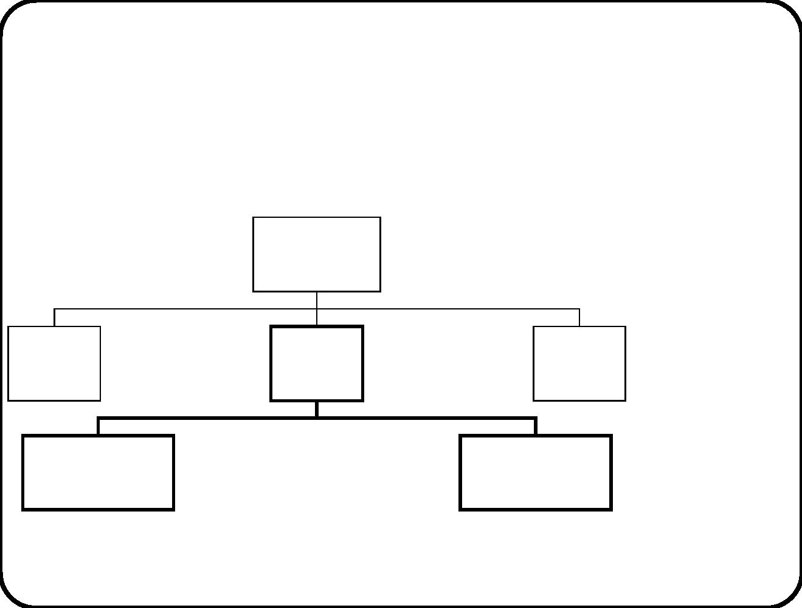
Chapter 19. Requirements-Level Decomposition
Guidelines
This is design, not modeling.
Services
Composite
system
Behavior
Communication
External
entity
Services
Behavior
Communication
Services
SuD Behavior
External
entity
Services
Behavior
Communication
Communication
Services
Services
Subsystem 1 Behavior
Communication
......
Subsystem n Behavior
Communication
301

Slide 4
Architecture and architectural style
Architecture = a structure of elements and their proper-
ties, and the interactions between these elements that realize
system-level properties.
• A system can have many architectures: e.g. requirements-level,
implementation-level, execution-level, code-level.
• Elements in an architecture must have synergy. They must
jointly produce emergent properties.
• An architectural style is a set of constraints on an
architecture.
302

Slide 5
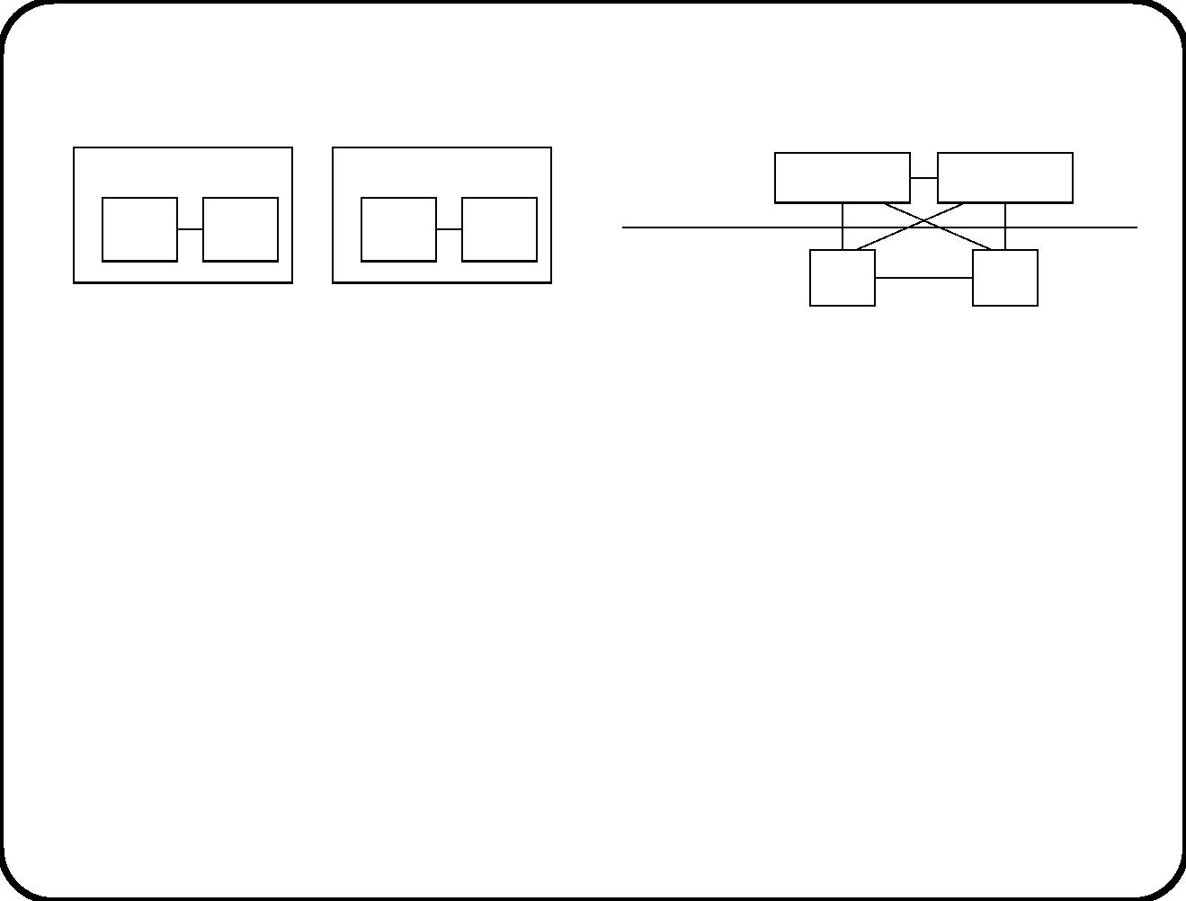
Basic style choice: Decomposition versus layering
S1
S2
Higher layer
Lower layer
S1
C1
S2
C2
C1
C2
C1’
C2’
• C1, C2 deliver services to
S1.
• C1, C2 deliver services to
S1 and S2.
• C1’, C2’ deliver services to
S2.
• C1, C2 are not encapsu-
lated by S1 or S2.
• S1 encapsulates C1, C2.
• S2 encapsulates C1’, C2’.
• Layering and decomposition can be mixed at various levels.
• Layering can be strict or loose.
303

Slide 6

Examples of layered contexts
Application layer
Presentation layer
Session layer
Presentation layer
Application layer
Transport layer
User interface layer
Business process layer
Application layer
Middleware layer
Network layer
Network layer
Data link layer
Operating system layer
Physical layer
Physical layer
Database layer
(a)
(b)
(c)
304

Slide 7
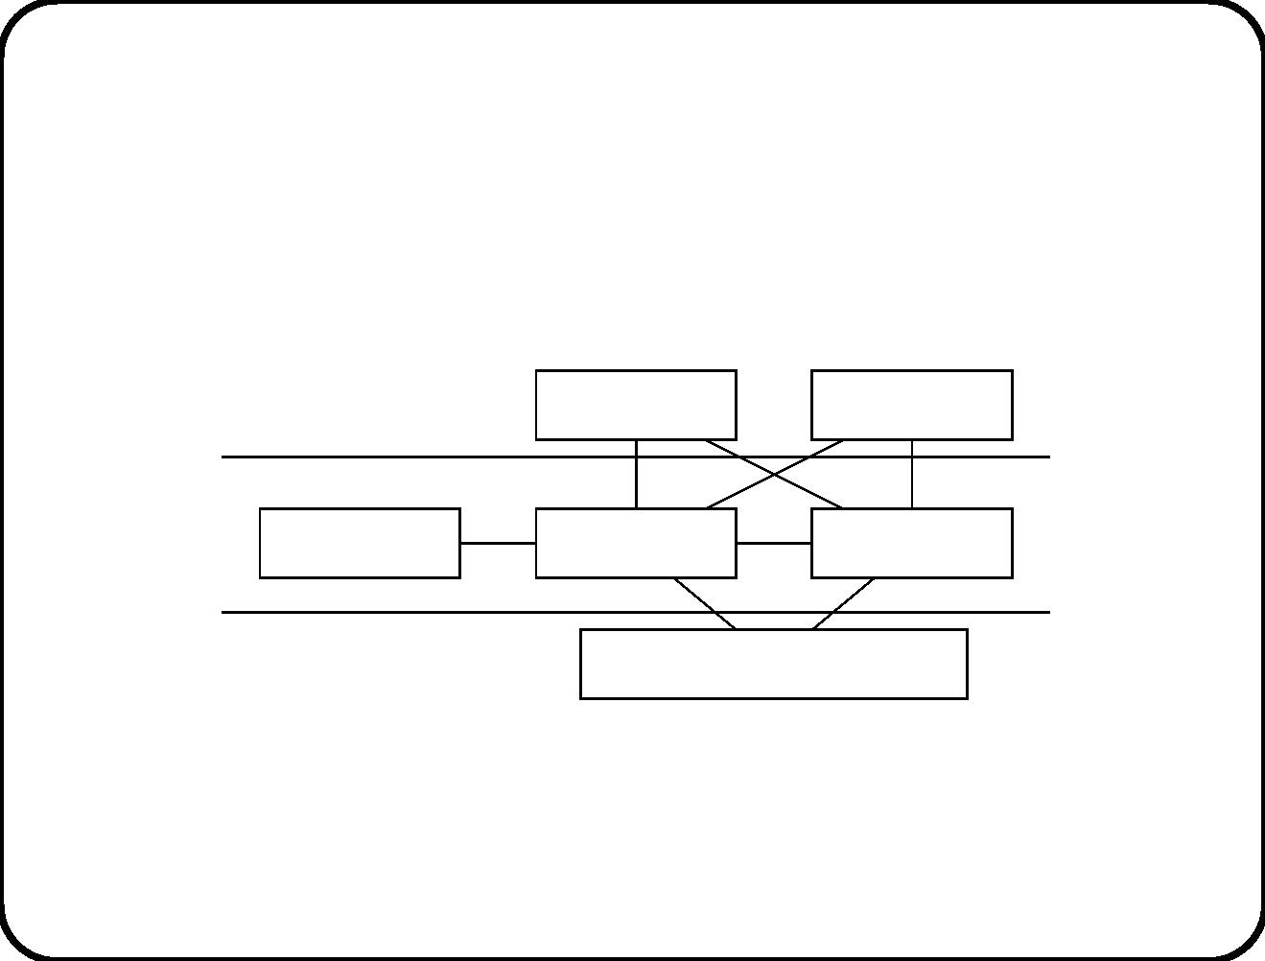
Layered context diagram
User
User
Operator
SuD
Peer system
Implementation platform
305

Slide 8
Structuring guidelines
√
Choose a context structure that reﬂects the problem structure.
√
Choose an SuD architecture that localizes changes.
• Keep related data together
• Keep related functions together
306

Slide 9
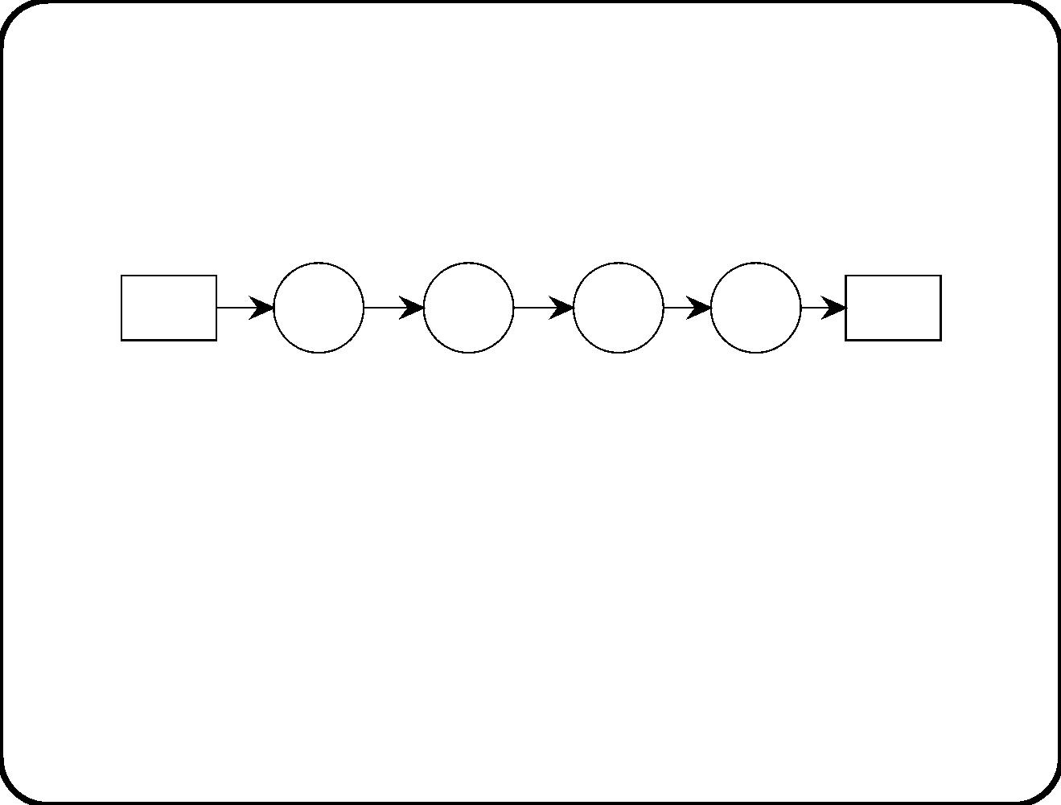
Architectural styles (1)
Data ﬂow style:
• Pure data ﬂow style: data ﬂows through a network of
transformations (that have no persistent memory).
• Many variants: E.g. batch, pipe-and-ﬁlter.
Not applicable to reactive systems, because these need a
(persistent) model of their environment.
307

Slide 10
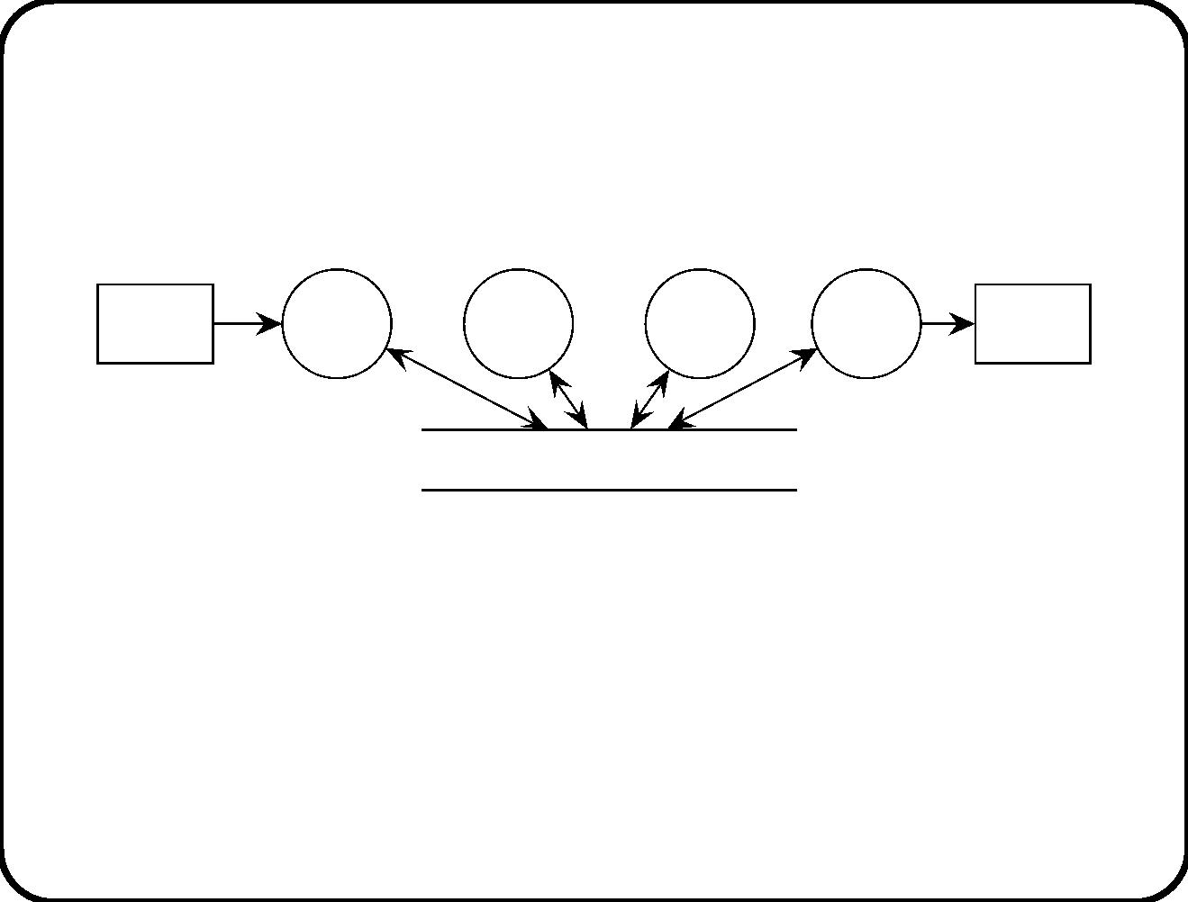
Architectural styles (2)
Vo n Neumann style:
Data store
• This is the classical information system architecture style:
Databases and application programs.
• Variant: Blackboard style: Intelligence in the data store(s).
These can announce that they have been updated.
308

Slide 11
Architectural styles (3)
Object-oriented style.
• All components are objects.
• Usually with destination addressing.
• Variant: publish-subscribe style: kind of dynamically
conﬁgurable channel addressing.
309

Slide 12
Requirements-Level Architecture Design Approach
• Requirements-level decomposition: Deﬁned only in terms
of requirements and environment models.
• Also called “conceptual architecture” or “logical architecture”
or “essential system model”.
• Requirements-level decomposition assumes “perfect
technology” because it ignores technology. It is a restatement
of the requirements in terms of a decomposition.
• Implementation decomposition: Mapping of
requirements-level decomposition to some implementation
platform.
310

Slide 13
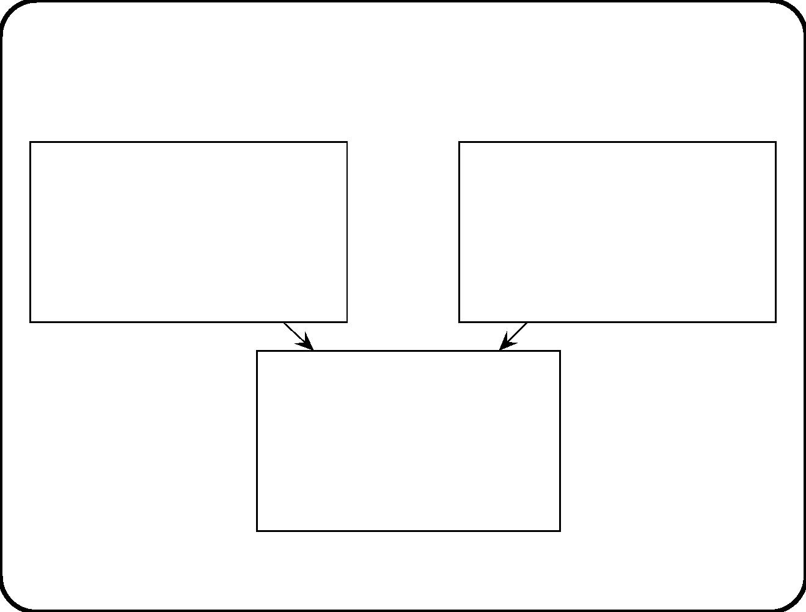
Sources of design decisions
Functional requirements
Use environment model
Environment goals
Desired SuD functions
Desired SuD communication
Desired SuD behavior
External communications
User behavior
Subject domain entities
Subject domain behavior
Requirements-level
architecture
Component functions
Component communications
Component behavior
311

Slide 14
Classiﬁcation of design decisions
Design decisions for the requirements-level architecture are made in
terms of
• Functions
• External communication
– Events
– Devices
– Users
• External behavior
• Subject domain structure
312

Slide 15
Design guidelines
√
Using functional decomposition, each system function is
allocated to a diﬀerent component.
√
Using subject-oriented decomposition, each group of
subject domain entities corresponds to a system component.
313

Slide 16
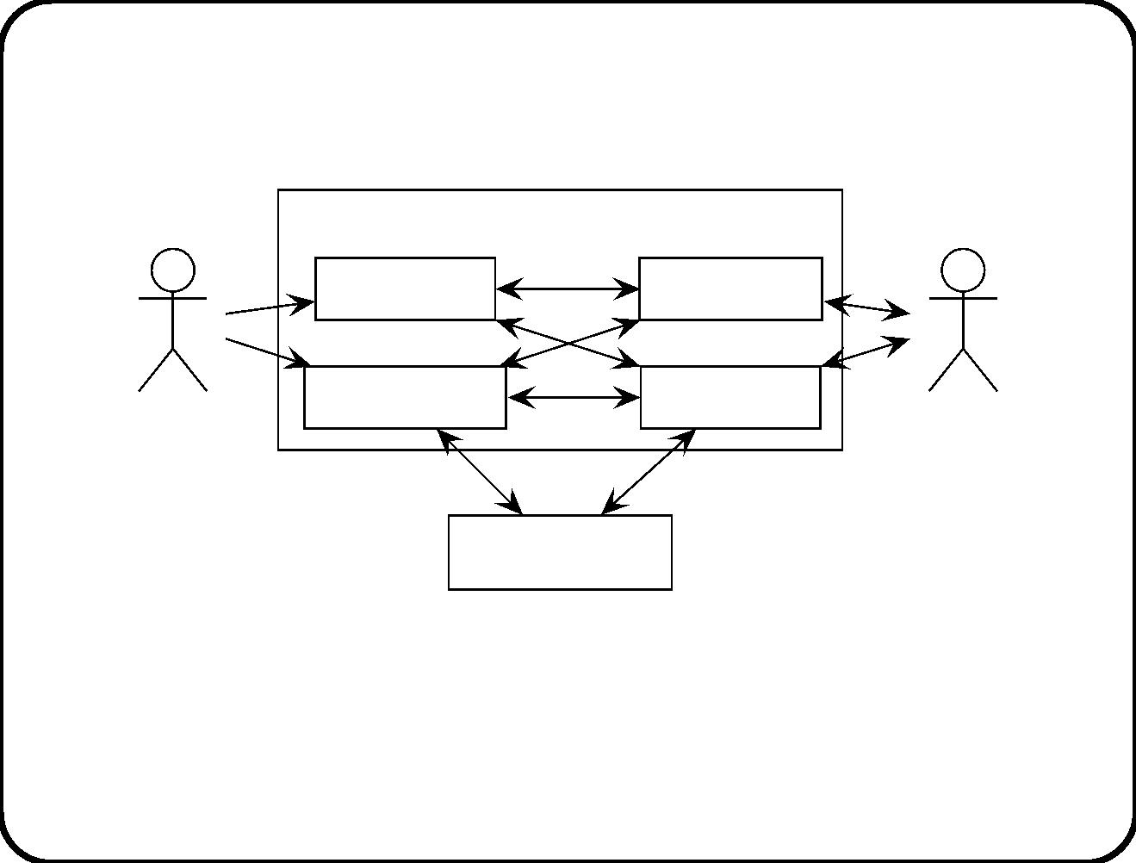
ETS example (1): Pure functional architecture
—object-oriented style
ETS
Use ticket
Show ticket
Sell ticket
Refund ticket
Conductor
Traveler
Clearing house
• All data encapsulated with functions!
• Ineﬃcient.
• Does not adequately represent problem structure.
314

Slide 17
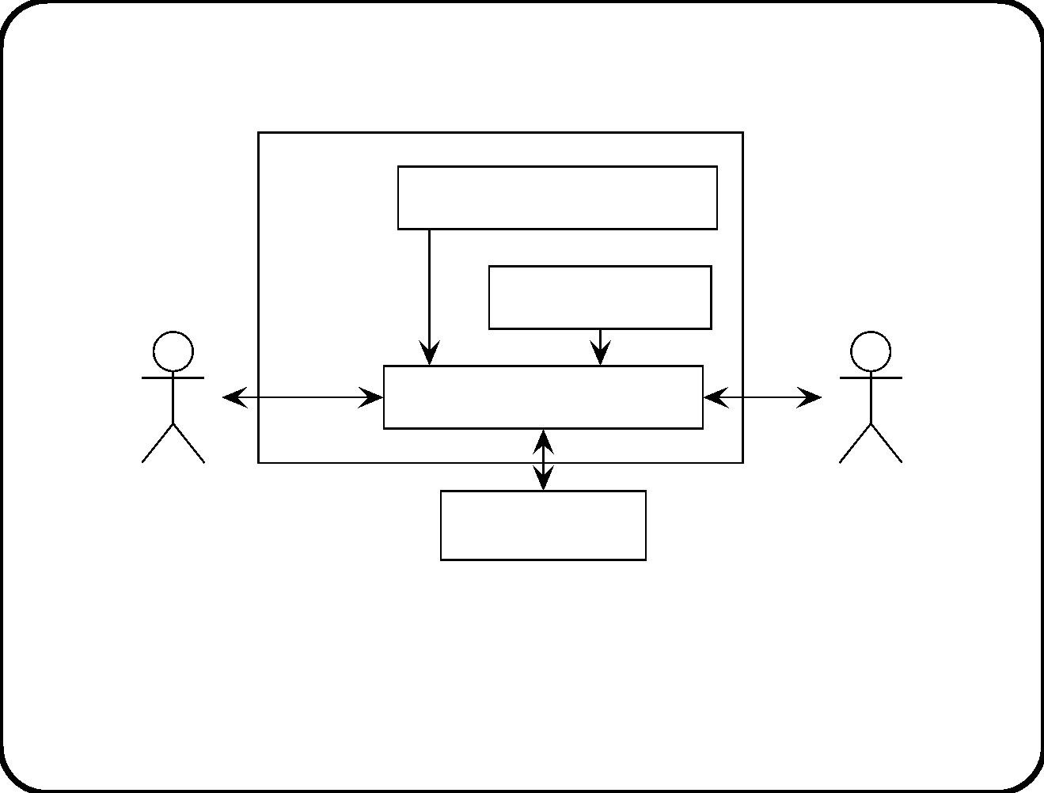
ETS example (2): Pure subject-oriented
architecture —object-oriented style
ETS
Rail network surrogate
Bank surrogate
Ticket and stamps
Conductor
Traveler
Clearing house
• All functions encapsulated in data!
• Ineﬃcient.
• Does not adequately represent problem structure.
315

Slide 18
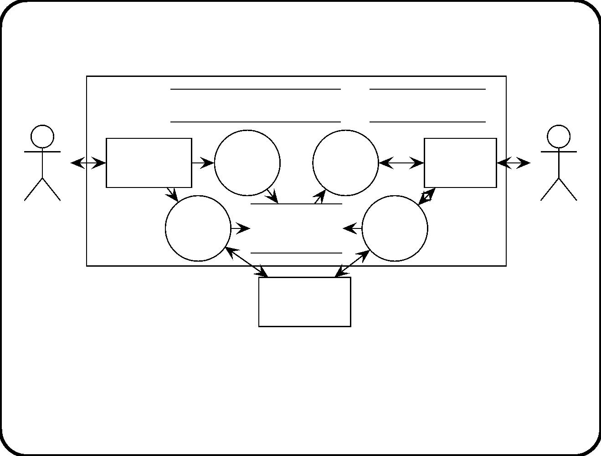
ETS example (3): Mixed architecture —Von
Neumann style
ETS Rail network database
Bank database
Conductor
interface
Use
ticket
Show
ticket
Traveler
interface
Conductor
Refund
ticket
Tickets and
Sell
ticket
Traveler
stamps
Clearing
house
Criteria used:
• Functional decomposition
• Subject-oriented decomposition
316

Slide 19
• User-oriented decomposition
317

Slide 20
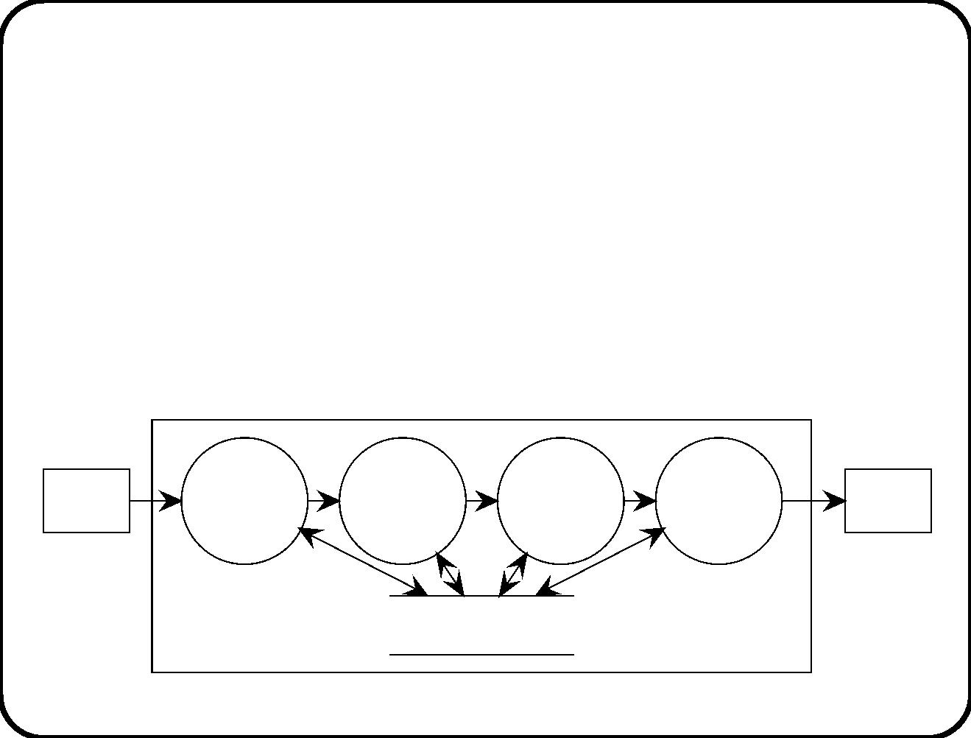
Communication-oriented decomposition
√
Using event-oriented decomposition, each event is handled
by a diﬀerent component.
√
Using device-oriented decomposition, each device is
handled by a diﬀerent component.
√
Using user-oriented decomposition, communications with
one kind of user are handled by one component.
SuD
Actor
Stimulus
Event
Action
Response
Actor
recognition
recognition
computation
computation
Environment data
318

Slide 21
Behavior-oriented decomposition
√
In behavior-oriented decomposition, monitoring assumed
behavior in the environment, or enforcing desired behavior in
the environment, is allocated to one component.
319

Slide 22
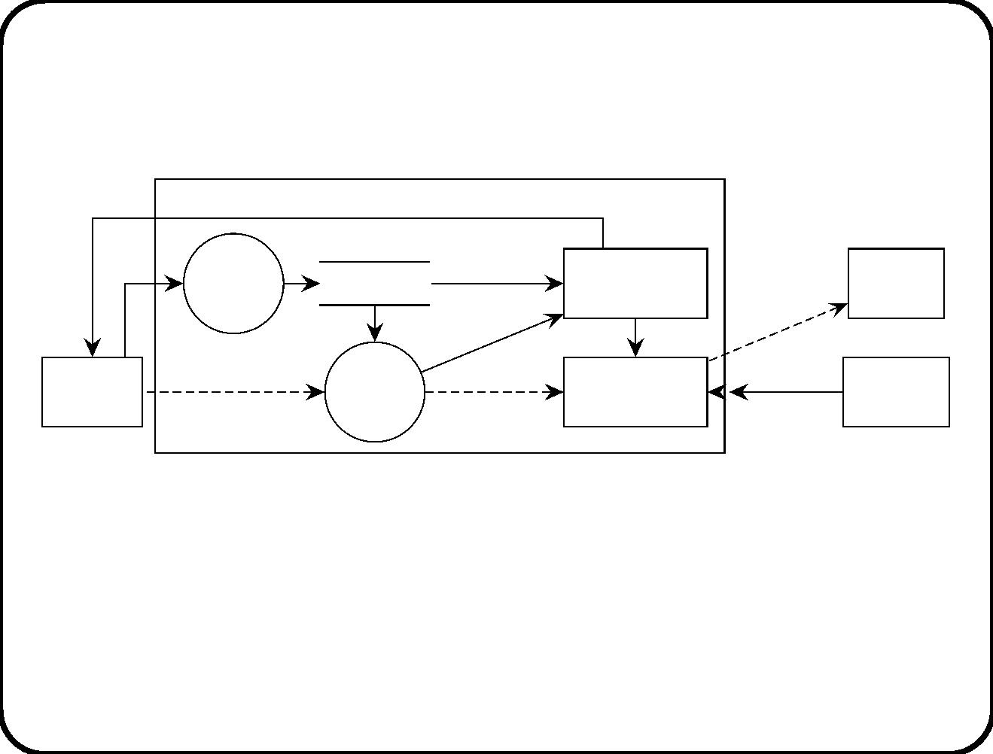
Heating controller example (1): Mixing functional
and subject-oriented decomposition
finished
Heating controller
Enter
batch
data
tank id,
Batchdata
duration
Monitor
switch on,
switch off
Heater
end time
tank id
batch id
start
stop
Operator
console
start heating
Start
heating
batch
Tank
temp
Thermo−
meter
control
Guidelines used:
• Functional
• Subject-oriented
Diﬀerent aspects of batch behavior are left scattered around.
320

Slide 23
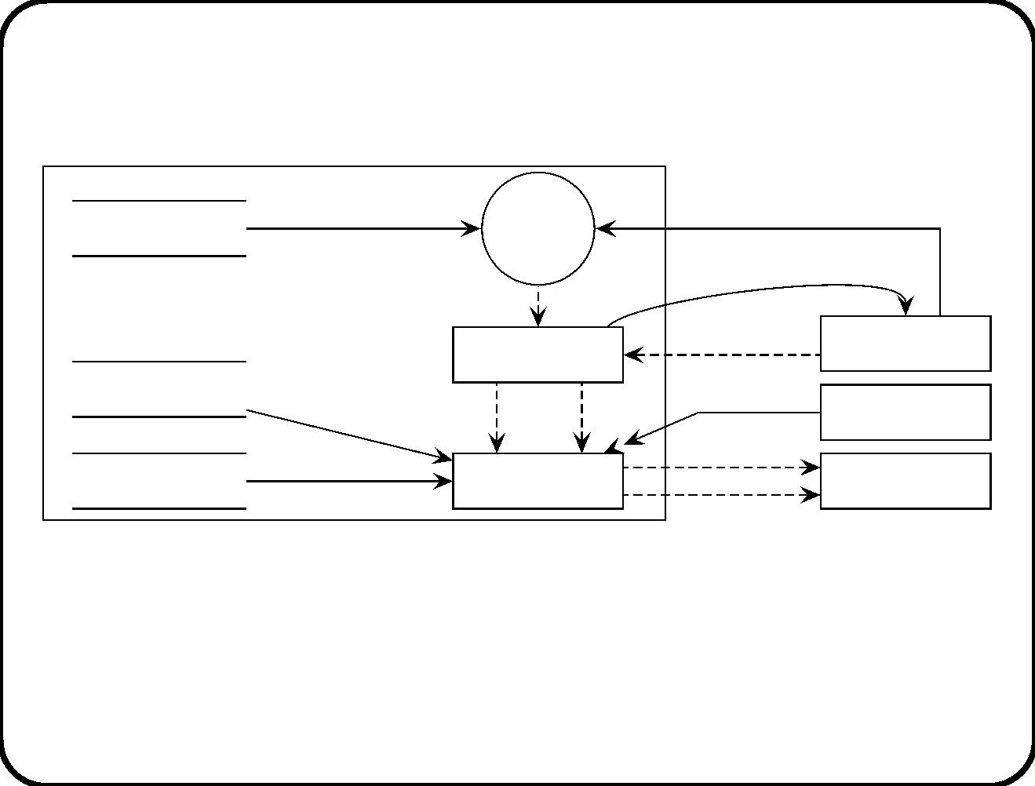
Heating controller example (2): Including
behavior-oriented decomposition
duration,
Create
batch data
Recipe data
desired temperature
batch
control
b finished
start heating
currtemp
Heating controller
create
Batch control
Operator
console
Heater data
start
stop
Thermometer
Heater
switch on
Thermometer data
Tank control
switch off
Guidelines used:
• Functional
• Subject-oriented
• Behavior-oriented
321

Slide 24
Evaluation criteria
√
Check that all data used is created, that all data created is
deleted.
√
Execute the model.
√
Produce a correctness argument that C and ... and C entail
1
n
S.
√
√
Check that quality attributes (eﬃciency, safety, reliability, etc.)
are realized.
Build a throw-away prototype and experiment with it.
322

Slide 25
Main points
• Distinguish requirements-level decomposition from
implementation decomposition.
• Basic architectural choice is between layering and
encapsulation.
• Other ma jor architectural styles: Data ﬂow, Vo n Neumann,
Object-oriented.
• Requirements-level decomposition guidelines:
– Functional,
– Subject-oriented,
– Communication-oriented: events, devices, users
– Behavior-oriented
These correspond to ma jor system aspects & subject domain.
323

Slide 26
Chapter 20. Postmodern Structured Analysis
(PSA)
History of structured analysis;
• Introduced in the 1970s as requirements speciﬁcation method.
• Abstracts structured programming to requirements level.
• Idea (1): SuD structure should match problem structure rather
than structure of implementation platform.
• Idea (2): The SuD should be modular.
Yourdon-style structured analysis claims that modularity is achieved
by functional decomposition. But:
– Functional decomposition is not modular if there are many
interfaces between the functions.
– Chapter 19 (Requirements-Level Architecture Guidelines) lists
many other decomposition guidelines.
324

Slide 27
Postmodern structured analysis (PSA)
Diﬀers from classical structured analysis:
• ERD used for subject domain only.
• Extended context diagram.
• Event ﬂows may contain data.
• STDs can be statecharts.
• STDs may have local variables.
325

Slide 28
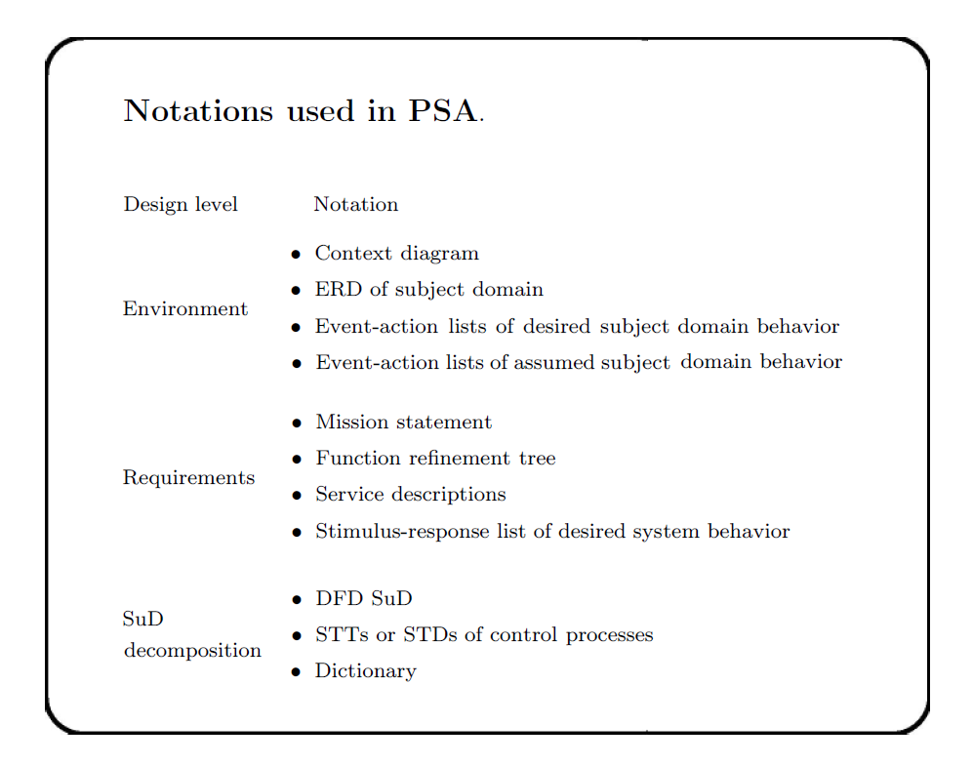

Slide 29
Coherence rules
• Environment models.
– Context diagram shows relevant communication paths
between SuD and subject domain.
– Event-action pairs refer to subject domain entities involved.
• Requirement speciﬁcations.
– Mission statement = root of function reﬁnement tree.
– Service descriptions = leaves of FRT.
– Each function is triggered by stimulus in SR list.
– Each stimulus-response pair is part of a function.
• Decomposition speciﬁcations.
– Each control process is speciﬁed by a behavior description.
– Each behavior description describes a process in the DFD.
327

Slide 30
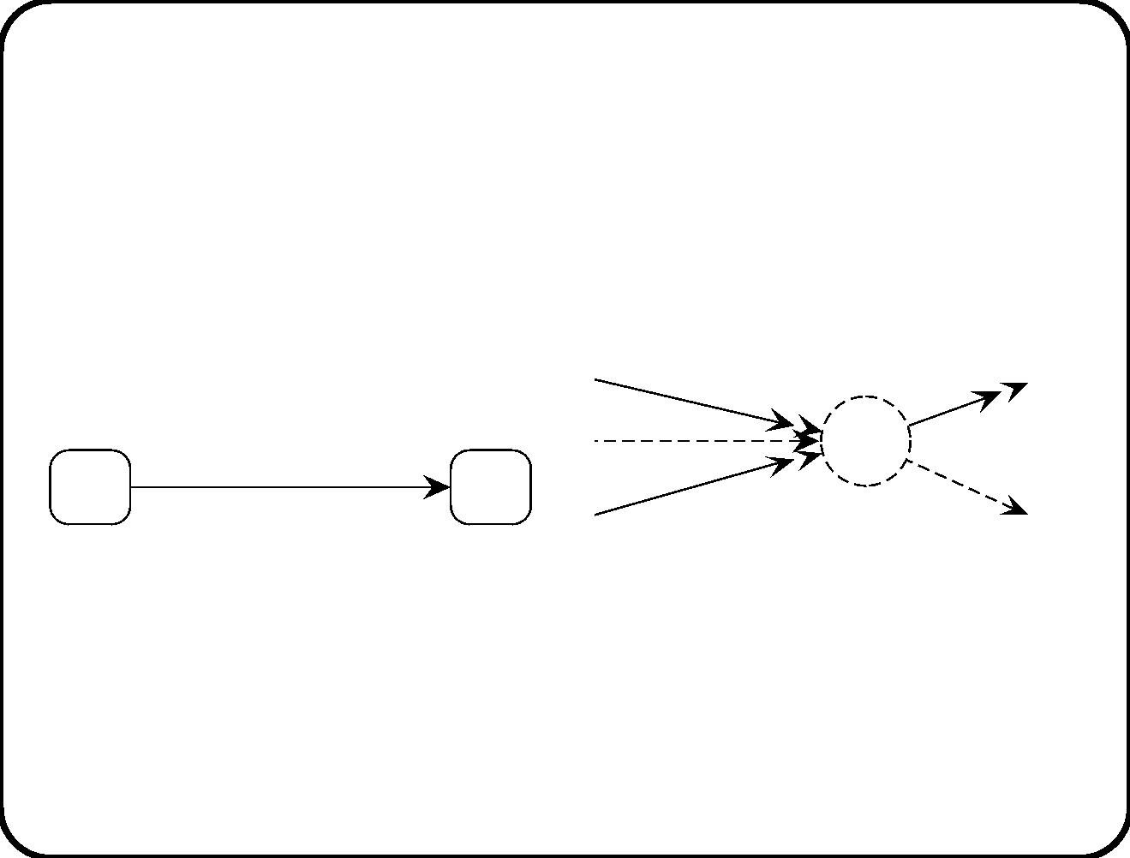
Relation between an STD and the control process
that it speciﬁes
y
z
e(x)
e(x) [g(y)] / z:= 1; a
a
g
(d)
(e)
328

Slide 31
Coherence across models
• Environment and requirements.
– Event stimulus and response action ...
– and each of these is a path in the context diagram.
• Requirements and decomposition.
– For each SR pair, there is a path through the DFD.
• Decomposition and environment.
– Context diagram is abstraction from DFD.
• Dictionary.
– The dictionary deﬁnes at least the relevant subject domain
terms for entities and events.
329

Slide 32
Flyweight to heavyweight
The weight of professional boxers is classiﬁed according to the
following scheme:
ﬂyweight
≤ 112 pounds
bantamweight ≤ 118 pounds
featherweight ≤ 126 pounds
lightweight
≤ 135 pounds
welterweight ≤ 147 pounds
middleweight ≤ 160 pounds
heavyweight
> 160 pounds
We can learn two things from this classiﬁcation:
1. Lightweight is not the lightest weight.
2. Heavyweights can be as heavy as they want.
330

Slide 33
Flyweight to heavyweight use of notations in PSA
Flyweight
Featherweight
Context diagr
ERD
Middleweight
Context diagr
ERD
Heavyweight
Context diagr
Context diagr
ERD
EA list
Mission stmt
Mission stmt
Function reft
Service descs
Mission stmt
Function reft
Service descs
Mission stmt
Function reft
Service descs
SR list
DFD
DFD
Behavior descs
Dictionary
Dictionary
Dictionary
331

Slide 34
Main points
• PSA is an extension of Yourdon structured analysis that uses
all notations of this book except communication diagrams.
• PSA can be used with any desired level of weightiness.
• PSA can be used with any of the decomposition guidelines of
chapter 19.
332

Slide 35
Chapter 21. Statemate
• Developed in the 1980s based on the idea of higraph:
Hierarchical hypergraphs.
– Hyperedges.
– Nodes can contain nodes, as in Venn diagrams.
• Activity charts are hierarchical DFDs.
• Control activities are speciﬁed by statecharts.
• There is a precisely deﬁned execution semantics for activity
charts and statecharts.
• Module charts represent computational resources (not treated
here).
Statemate can be used in combination with other PSA notations.
333

Slide 36
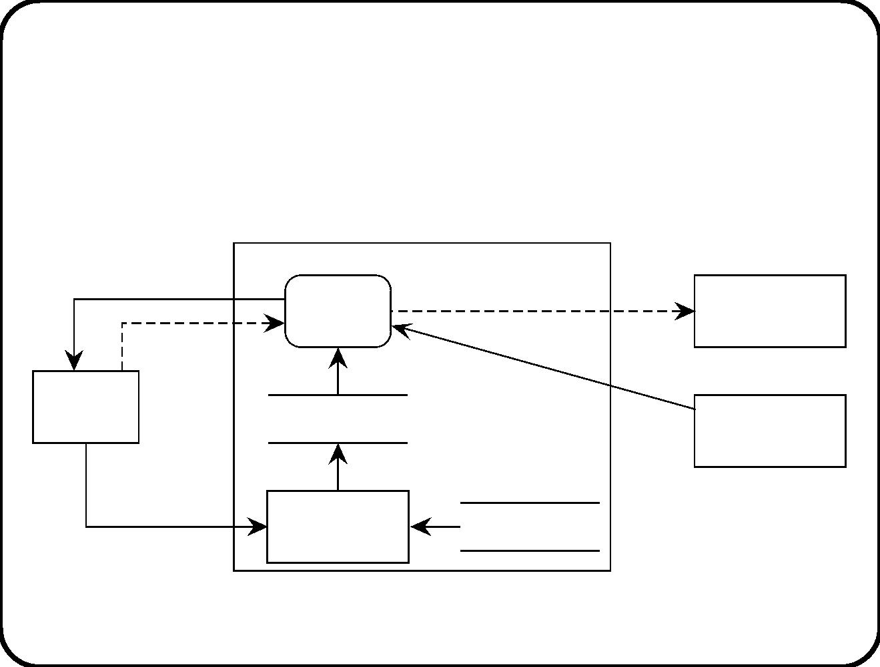
Activity chart
Statemate analogon of DFDs.
finished
Tank
switch on(i),
switch off(i)
Heater(i)
currtemp(i)
Thermometer(i)
control
start
Operator
console
duration, dtemp(i)
Batch data
Heating control
Enter
Recipes
batch data
batch data
334

Slide 37
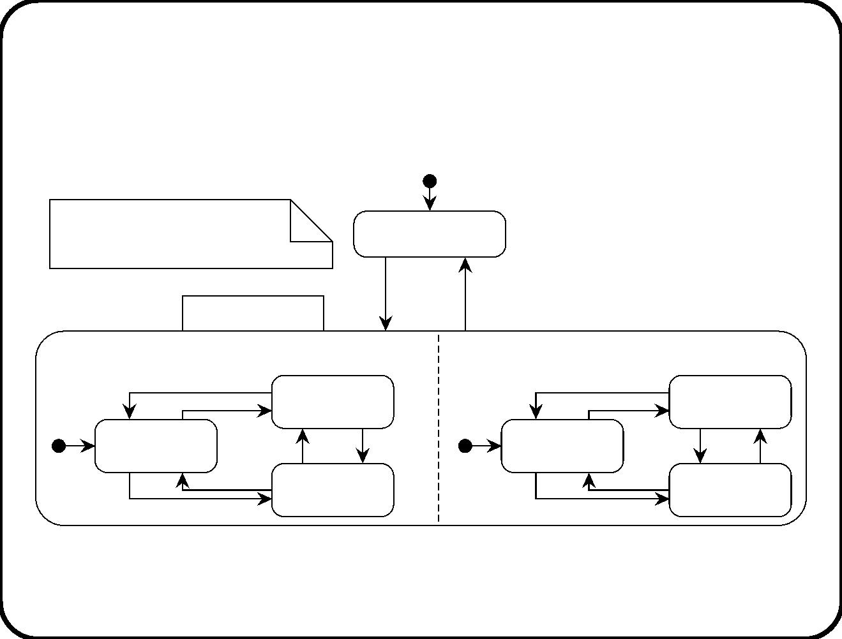
Statechart for the control activity
dtemp, currtemp: Rational
Not heating batch
i: tank
start
tm!(en(heating batch), duration) /
finished
Heating batch
Tank control 1
Not heating
Tank control 2
Not heating
tank(2)
tank(1)
Ready(1)
Ready(2)
Heating
tank(1)
Heating
tank(2)
335

Slide 38
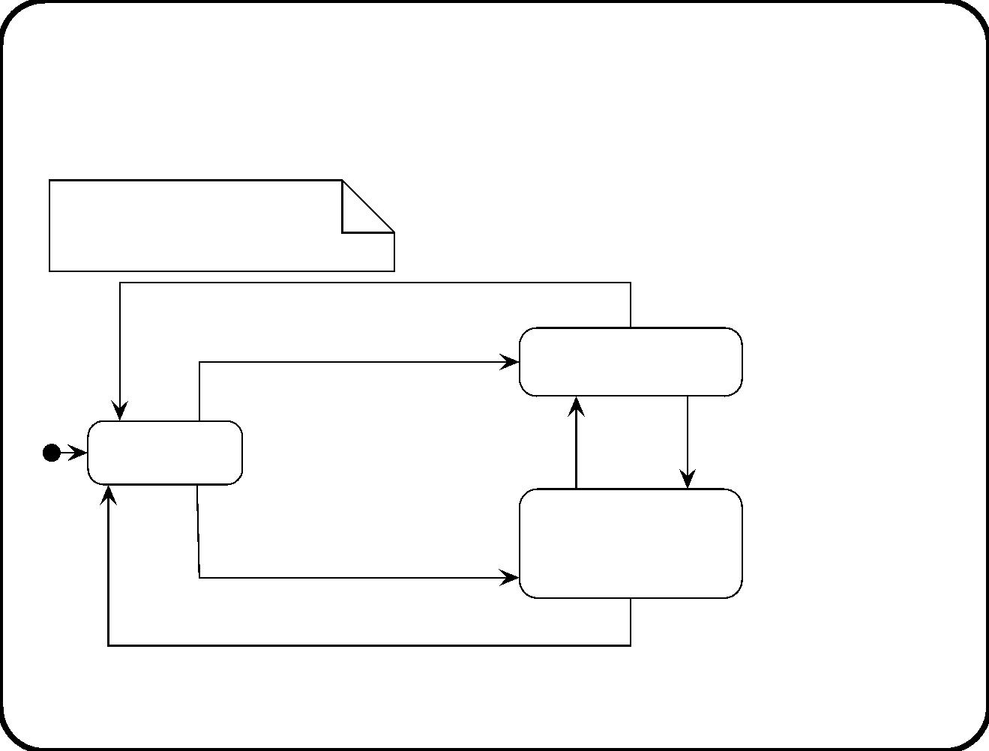
Substatecharts
dtemp. currtemp: Rational
i: tank
stop(i) /
start(t, dtemp)
[currtemp >= dtemp-5] /
Not heating tank(i)
after(60 secs)
[currtemp >= dtemp+5] /
after(60 secs)
[currtemp < dtemp-5] /
Ready(i)
Heating tank(i)
start(t, dtemp)
[currtemp < dtemp-5] /
enter / switch on(i)
exit / switch off(i)
stop(i) /
336

Slide 39
Temp oral events
Timeout:
• For each event e and natural number n, timeout(e, n),
abbreviated to tm!(e, n), occurs n time units after the most
recent occurrence of the event e.
An after(n) event that leaves state S can be deﬁned as tm!(en(S), n).
• When a statechart enters a state S, Statemate generates the
event en(s).
• When it exits S, it generates the event ex(S).
Scheduled action:
• For each action a and natural number n, the action schedule(a,
n), abbreviated sc!(a, n), schedules the action a to occur
exactly n time units later.
when(n) / a can now be expressed as sc!(a, n).
337

Slide 40
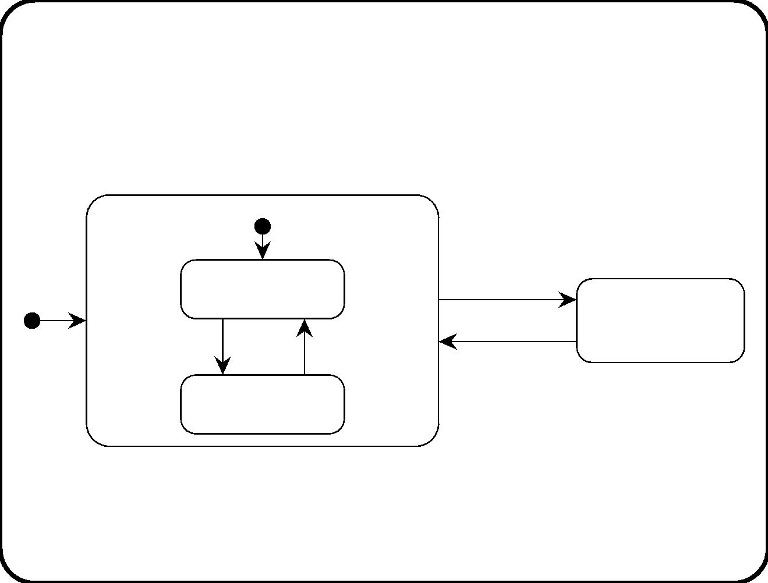
Activity states
Active(A)
sp!(A) / sp(A)
st!(A) / st(A)
Not hanging(A)
Not active(A)
sd!(A) / sd(A)
rs!(A) / rs(A)
Hanging(A)
338

Slide 41
Changing activity status
Actions that will cause a change in state of an activity:
sp!(A)
st!(A)
sd!(A)
rs!(A)
stop(A)
start(A)
suspend(A)
resume(A)
Events generated when an activity changes state:
sp(A)
st(A)
sd(A)
rs(A)
stopped(A)
started(A)
suspended(A)
resumed(A)
339

Slide 42
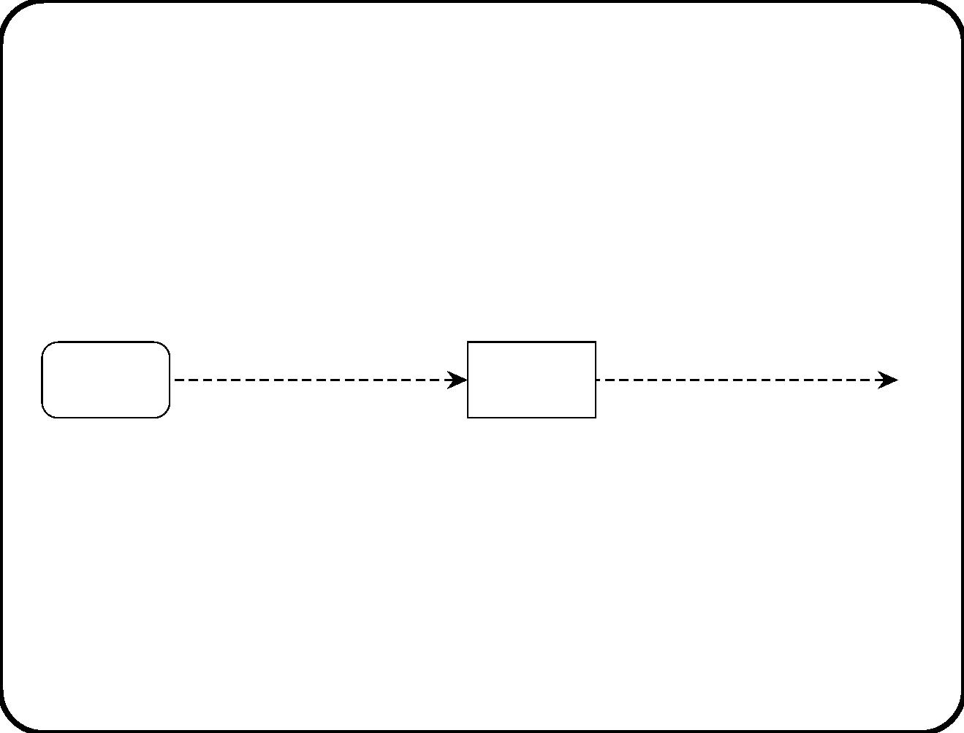
Interface between control activity and sibling
activities
Control
activity
st!(A), sp!(A), sd!(A), rs!(A)
st(A), sp(A), sd(A), rs(A)
A
This interface is always present, but it is not shown in an activity
chart.
340

Slide 43
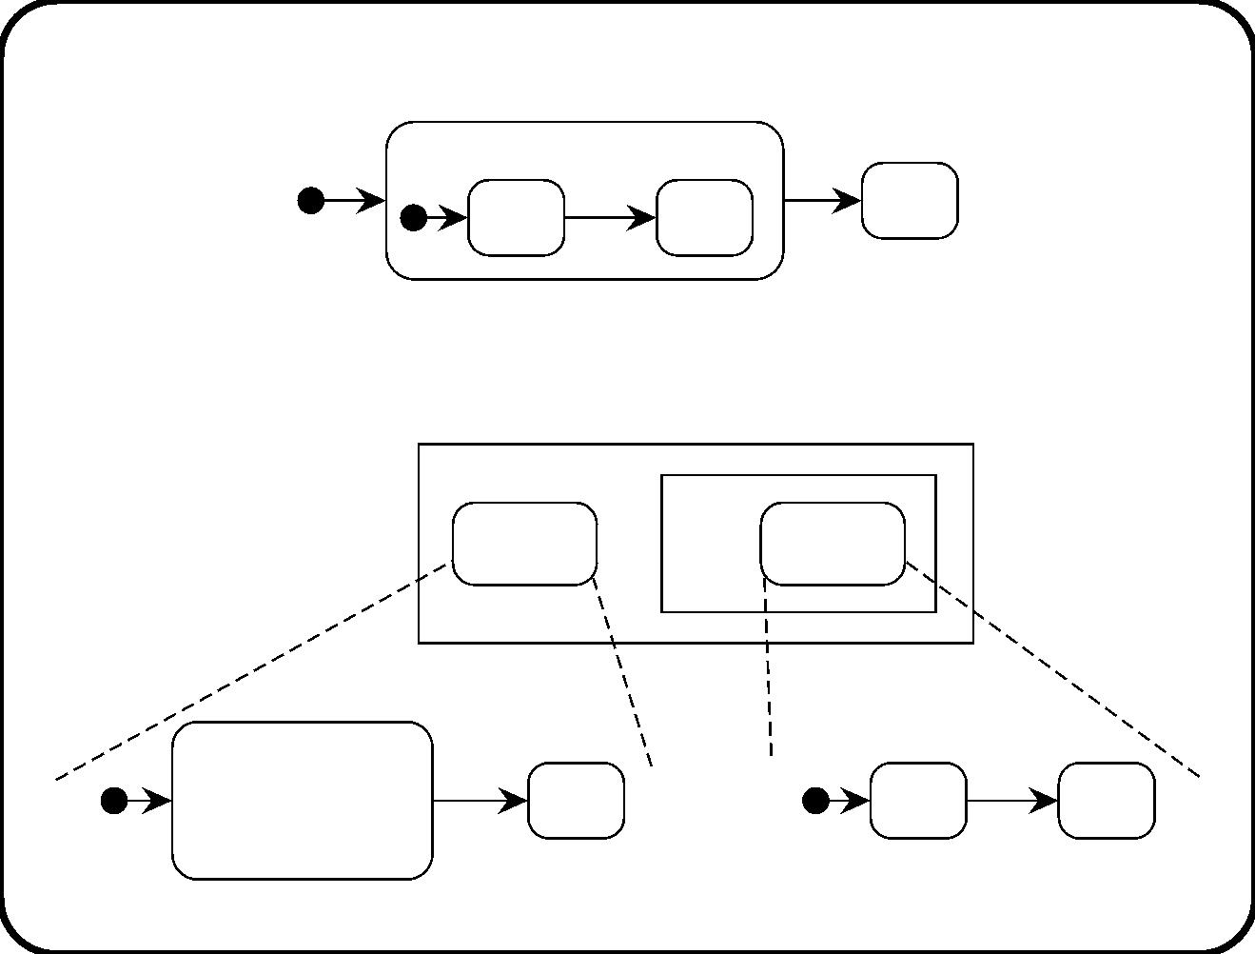
Hierarchy in statecharts and in activity charts (1)
S1
e2/
e1/
S2
S11
S12
Moving the activity to another statechart leads to an equivalent
model (having the same step semantics):
A
topSC
B
innerSC
S1
e2 /
e1 /
enter / start(B)
exit / stop(B)
S2
S11
S12
341

Slide 44
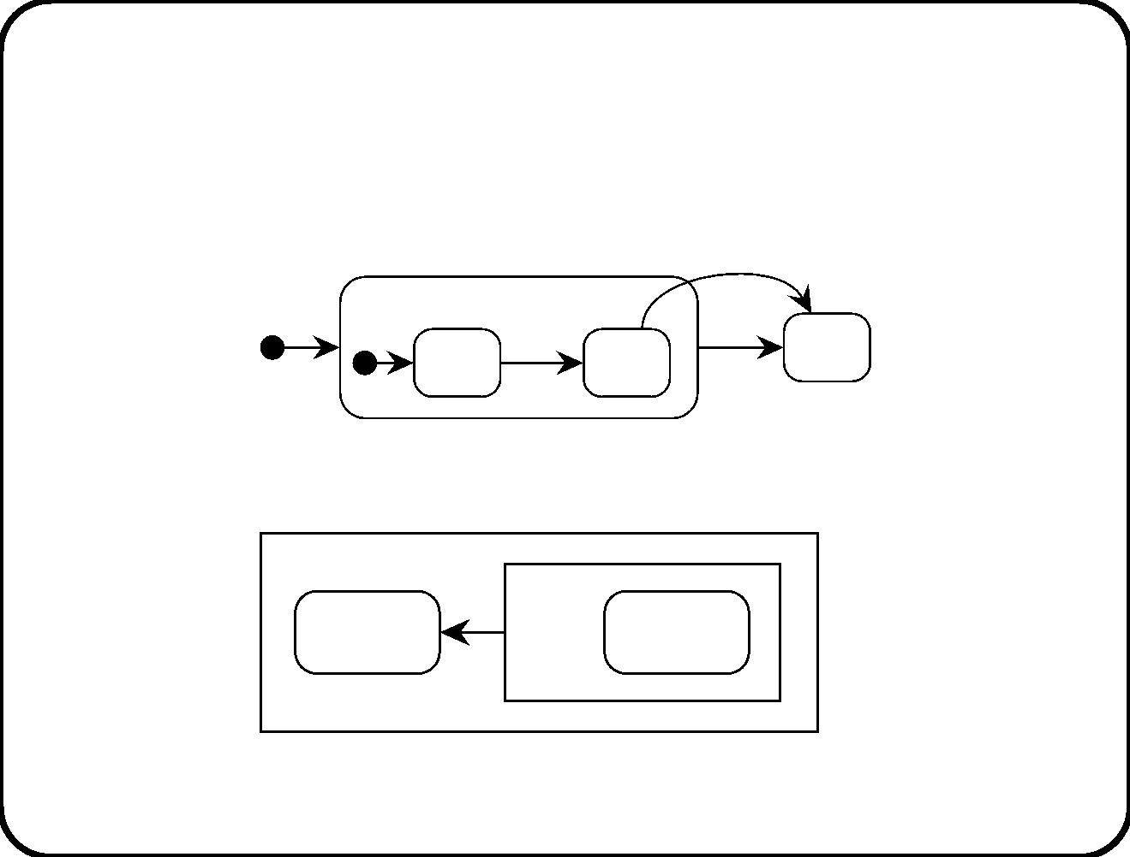
Hierarchy in statecharts and in activity charts (2)
This can be done too if there is an outward transition:
e4 /
S1
e2 /
e1 /
S2
S11
S12
can be replaced by the equivalent model (same step semantics):
A
X
SC1
B
SC2
342

Slide 45
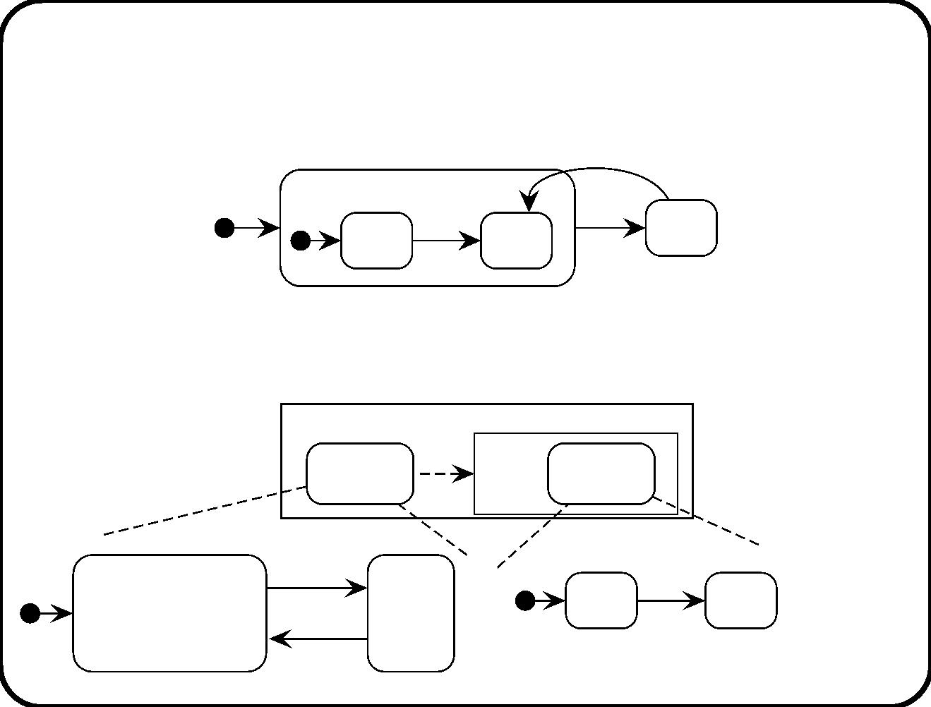
Hierarchy in statecharts and in activity charts (3)
When there is an inward transition this does not work:
e4 /
S1
e2 /
e1 /
S2
S11
S12
is not equivalent to this model (diﬀerent step and superstep
semantics):
A
e1
B
topSC
innerSC
S1
e2 /
e4 / e1
e1 /
S2
S11
S12
enter / start(B)
exit / stop(B)
343

Slide 46
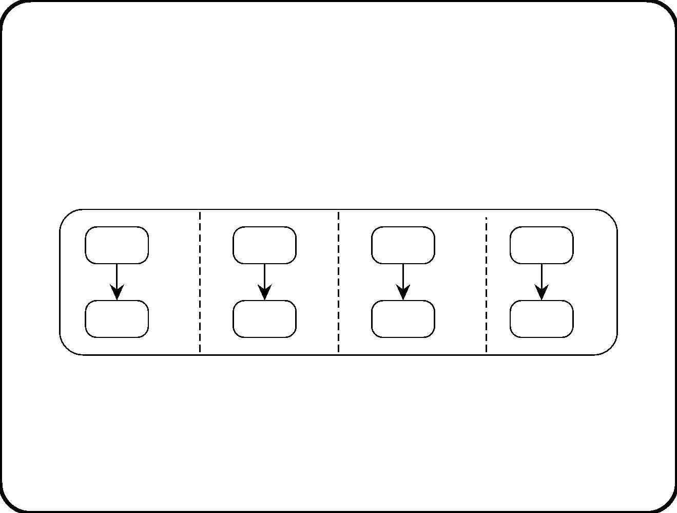
Parallelism statecharts and in activity charts (1)
S1
S2
S3
S4
S11
S12
S21
S22
S31
S32
S41
S42
b/d
a/b
b/c
c/e
344

Slide 47
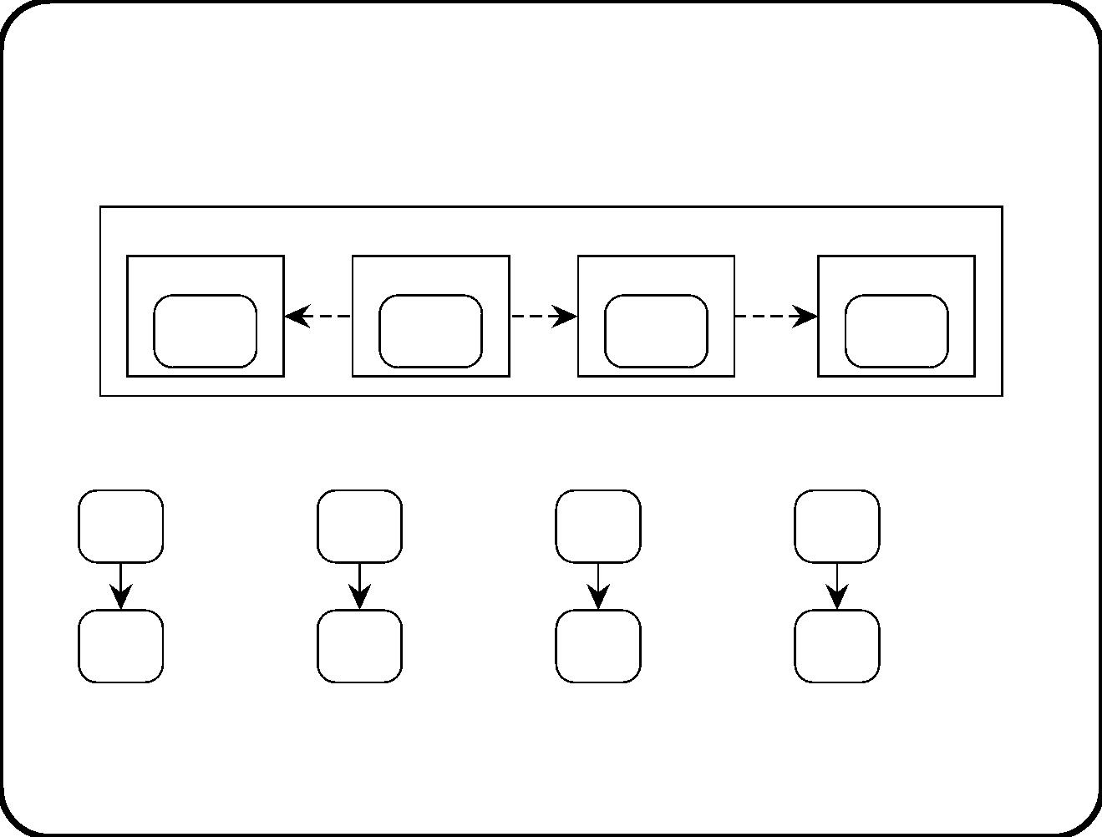
Parallelism statecharts and in activity charts (2)
A
A1
b
A2
b
A3
c
A4
SC1
SC2
SC3
SC4
S11
S12
S21
S22
S31
S32
S41
S42
b/d
a/b
b/c
c/e
345

Slide 48
Execution semantics (1): Choices made
• Channel capacity. Flows have capacity one.
• Time-continuous ﬂows. All ﬂows are time-continuous. They
behave as data stores.
• Input buﬀer. Each activity has an input buﬀer, which is a set.
• Priority. If a state transition conﬂicts with a state reaction,
then the transition has priority. If two transitions are in
conﬂict, then the highest-level one has priority.
• Step semantics. In a step, the system responds to all events
that occurred since the start of the previous step.
• Perfect technology. Steps do not take time.
• Breadth-ﬁrst. Activities are executed breadth-ﬁrst.
346

Slide 49
Execution semantics (2): Execution state
• The status of the system, which consists of the following items:
– The current conﬁguration of the statecharts;
– The values of all variables;
– The truth-values of all conditions;
– The activation state of each activity;
– A list of internal events generated during the previous step;
– A list of outstanding timeout events;
– A list of outstanding scheduled actions.
• The time currently indicated by the system clock;
• A list of external events that have occurred since the beginning
of the previous step.
347

Slide 50
Execution semantics (3): Execution step
Time is T during the step.
1. Construct the set E of events to be responded to. First, set E := 0.
(a) Collect all external events generated by the environment since
the previous step and add them to E.
(b) Collect all events generated in the previous step and add them to
E.
(c) Collect all events generated by the events in E, and add them to
E (recursively).
(d) Execute all scheduled actions whose time is due in (T, T+1].
(e) Process the list of timeout events. Fo r each tm(e, n) in the list,
• if e ∈ E compute and record the time at which tm(e, n) is to
be generated;
• else if the time for tm(e, n) to occur falls in the interval (T,
T+1], then generate the event e and deactivate the timeout
event.
348

Slide 51
2. Construct from E a maximal step S to be executed. First, set
S := 0. Then:
(a) Compute the set En of enabled transitions and state reactions,
i.e. those whose triggering event occurred and whose guard is
true. Remove from En those transitions or reactions that are in
conﬂict with a transition of higher priority in En.
(b) Compute from En maximal nonconﬂicting sets S of transitions.
Add to each set the state reactions that do not conﬂict with it.
Each resulting set is called a step.
(c) Select a step S to be executed.
3. Execute S.
(a) Add scheduled actions in the step to the list of scheduled actions.
(b) Perform all other actions in the step.
(c) Update the information on the history of states.
(d) Update the current conﬁguration.
349

Slide 52
Execution semantics (4): Superstep execution
1. Construct the set E of events to be responded to as for a step.
2. Repeat the following until E = ∅:
2.1 Construct from E a maximal system step S to be executed
as for a step. (There are no internal events at the beginning
of a superstep.)
2.2 Execute S as in the step execution semantics.
2.3 Reconstruct the set E of events to be responded to. First,
set E := ∅. Then:
(a) Collect all events generated on internal ﬂows and add
them to E.
(b) Generate derived events from the events in E and add
these to E (recursively).
350

Slide 53
Main points
• Activity charts are a syntactic variant of DFDs.
• Statecharts have an execution semantics in STM.
• The presence of hierarchy and parallelism in statecharts as well
as in activity charts increases the number of speciﬁcation
options for the author of a speciﬁcation.
351

Slide 54
Chapter 22. The Uniﬁed Modeling Language
(UML)
• Attempted uniﬁcation of notations for object-oriented software
design.
• Industrial standard deﬁned by the OMG.
• Standard is still being updated.
• Diﬀerent books present diﬀerent versions!
• We treat only a light-weight version, expected to be consistent
with future versions.
352

Slide 55
The UML contains eight notations
UML notations can be used in diﬀerent methods in diﬀerent ways.
We will use them as follows. (Notations between brackets are not
used by us.)
• Activity diagrams. User workﬂow.
• (Use case diagrams. System functions and context.)
• Static structure diagrams. Decomposition into software
objects.
• Statecharts. Object life cycles.
• Sequence diagrams. Message-passing during a scenario.
• Collaboration diagrams. Message-passing during a scenario.
• (Component diagrams. Dependencies between executables.)
• (Deployment diagrams. Network of computing resources.)
353

Slide 56
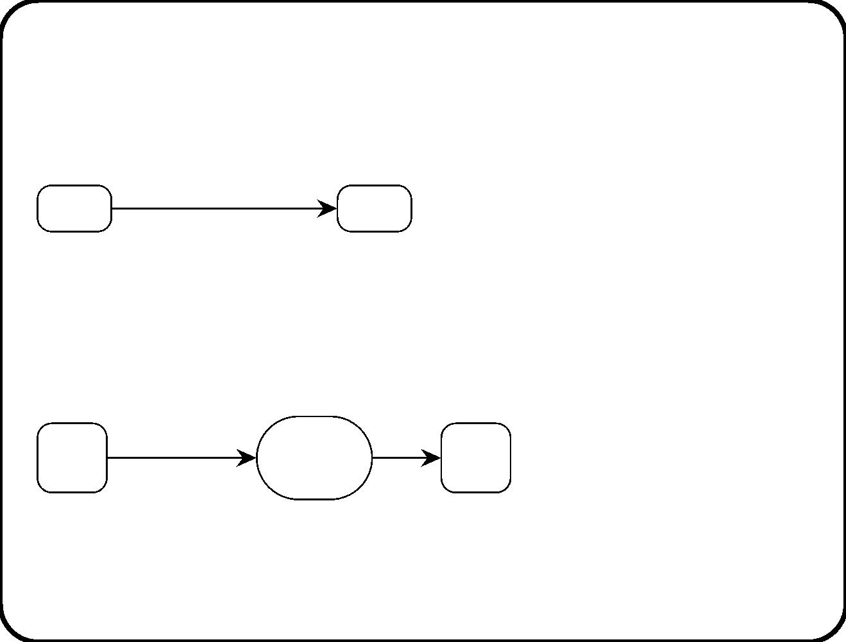
Activity diagrams
event [guard] / activity
S1
S2
• A transition in a statechart is instantaneous.
• If we want to represent that an action takes time, turn it into a
activity state:
event [guard]
activity
S1
S2
state
• Transitions are still instantaneous.
354

Slide 57
Workﬂow
• We will use activity diagrams to represent user workﬂows.
• Each individual workﬂow handles a case.
• Each individual workﬂow has local variables: state of the
workﬂow, state of the case, list of events to be responded to.
• The variables are usually stored in a database.
• Guards are conditions on these variables.
355

Slide 58
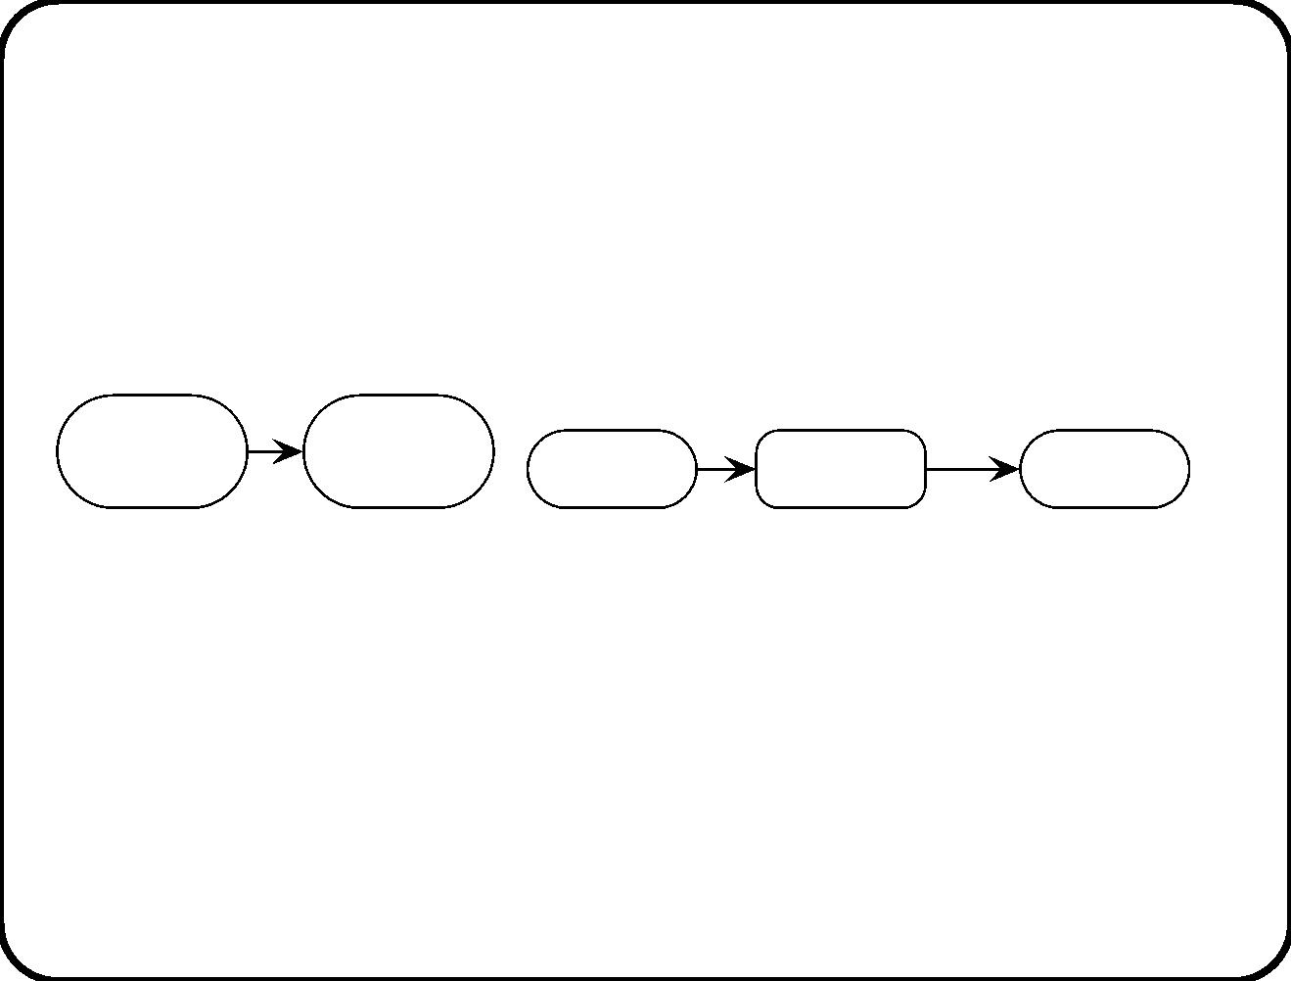
Representing sequence
activity 1
activity 2
e [g]
Activity 1
Wait
Activity 2
(k) When activity 1 termi-
nates, activity 2 starts.
(l) When activity 1 terminates, the work-
ﬂow waits for e to occur when g is true,
before starting activity 2.
356

Slide 59
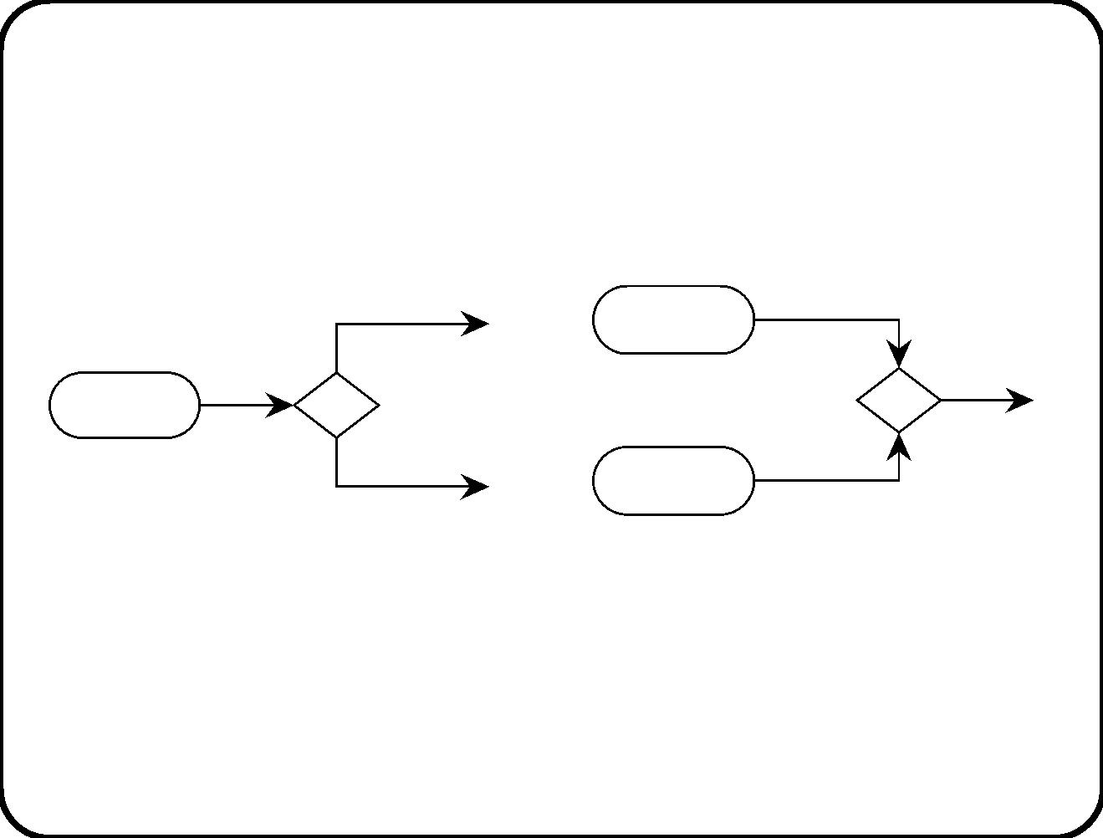
Representing choice
[g]
......
......
Activity1
Activity 2
Activity
......
[not g]
(m) Or-split.
(n) Or-join.
Guards are tested on the workﬂow variables.
357

Slide 60
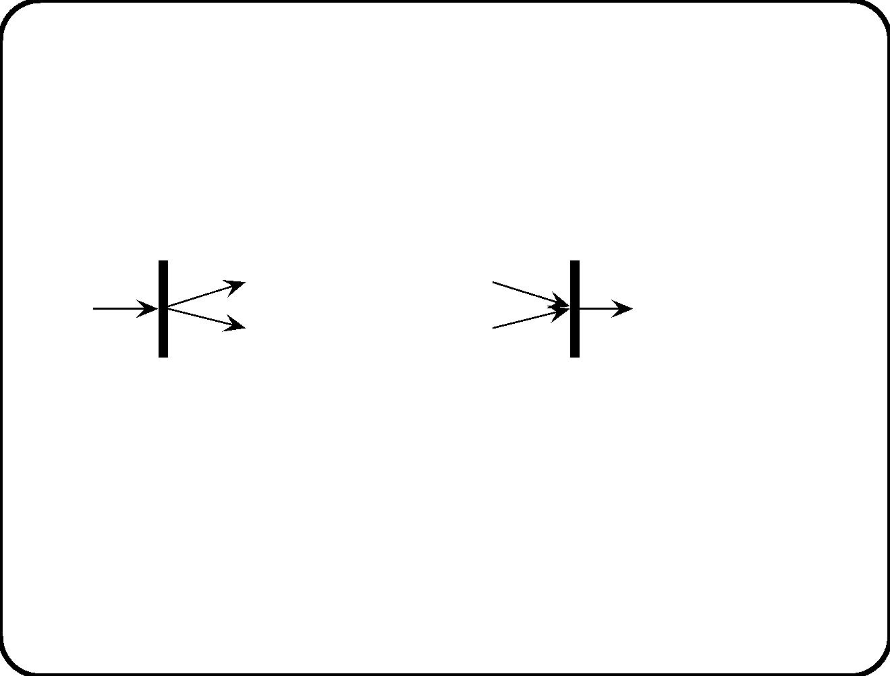
Representing parallelism
t1
t2
......
......
......
......
t3
t4
......
......
(o) And-split. t1 and
t2 are executed simul-
taneously.
(p) And-join. t3 and t4 are ex-
ecuted simultaneously.
358

Slide 61
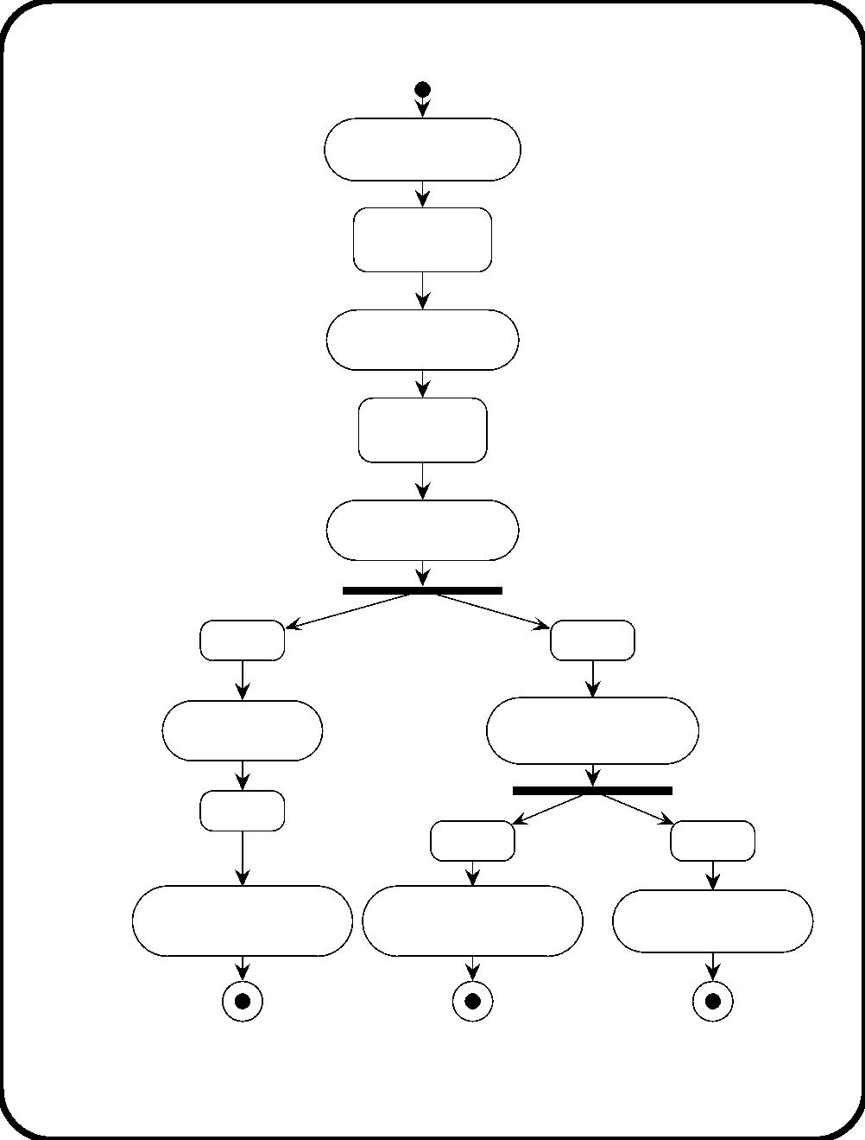
Workﬂow of the course coordinator
Download
list of joiners
List of joiners
downloaded
decide to allocate rooms
Allocate rooms
Rooms
allocated
decide to allocate joiners
Allocate joiners
Wait
decide to print badges
Wait
decide to print lists
Print badges
Print lists
of group members
Wait
decide to give badges
to registration desk
Give badges
to registration desk
Wait
Wait
Give lists
Give lists
to registration desk
to speakers
Activities in italics to be supported by TIS.

Slide 62
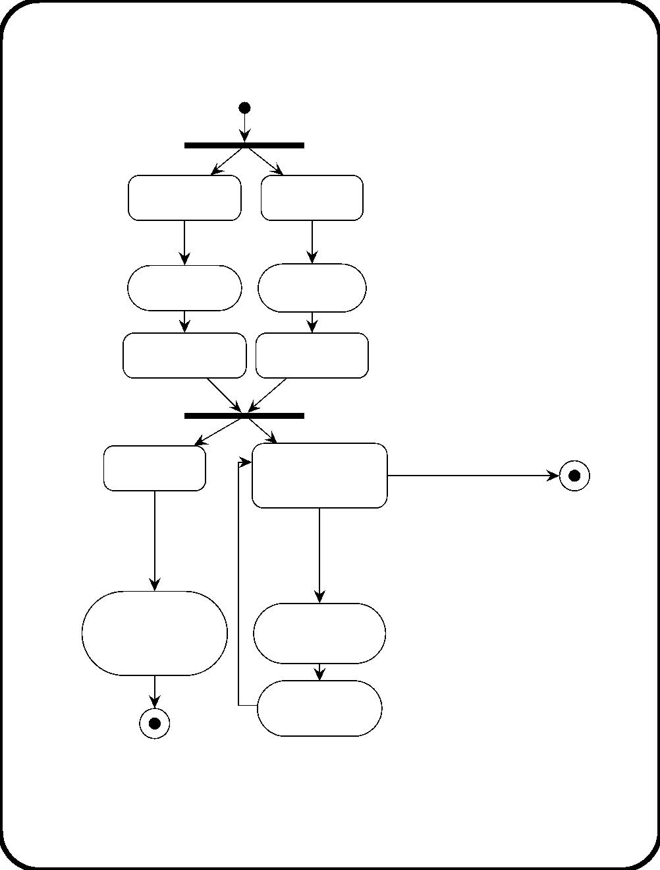
Workﬂow at the registration desk
Ready to
Ready to
receive badges
receive lists
receive
badges /
Receiving
receive
lists /
Receiving
badges
lists
Badges received
Lists received
[Lists received]
[Badges received]
Waiting a bit
Ready to register
unexpected
[registration period closed]
decide to put
participants
badges and
material
E10: unexpected
participant arrives /
enter participation
request
on table /
Putting badges
Registering
and material
on table
Exit / print badge
Giving course
material
More examples in appendix H
(www.mkp.com/dmrs)

Slide 63
Static Structure Diagrams (SSDs)
• Also known as class diagrams.
• An ob ject is a software entity with a ﬁxed identity, a local
state and an interface through which it oﬀers services to its
environment.
• An ob ject class is an object type.
– Class intension: All properties shared by all instances.
– Extension: All possible instances.
– Extent: Set of currently existing instances.
361

Slide 64
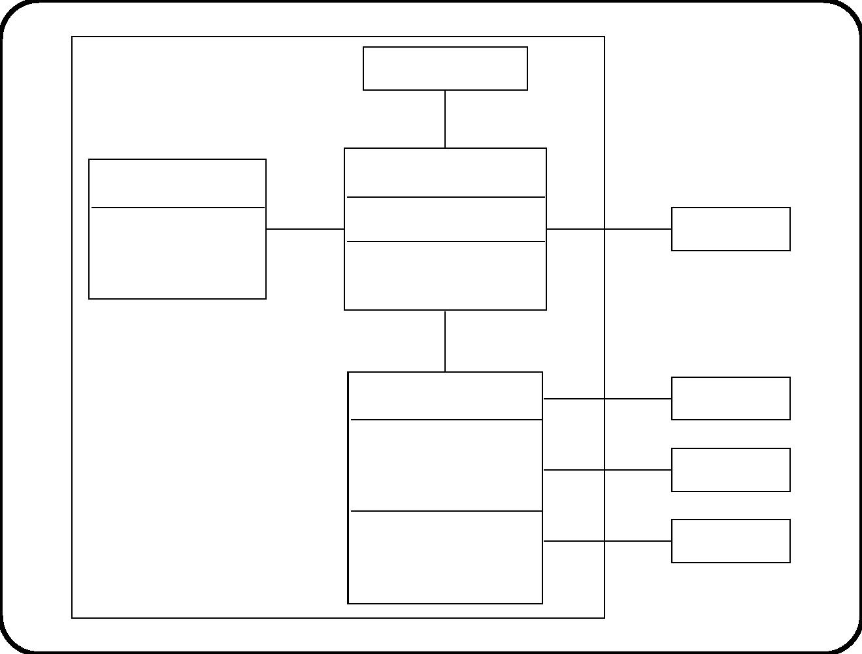
Heating controller
Create batch control
1
Recipe
Batch control
name
amount
batchID
1
desired temperature
duration
1
*
0..1
Batch
<<signal receptions>>
start heating(b: Batch)
0..1
Allocation
1..2
Tank control
Thermometer
Tank
1
0..1
1
1
volume
date last cleaned
destemp
tankID
1
<<signal receptions>>
start(desired temp)
stop
1
Heater
362

Slide 65
Meaning of an SSD
• Which classes of objects can exist in the software system,
• and how many of them can exist.
• Attributes are local variables of the object.
• Associations are access paths!
• Services can be operations or signal receptions.
– Operation = computation performed by object.
– Signal = named data structure that can be sent as a
message to objects.
363

Slide 66
ERDs and SSDs
ERD
SSD
entity typ e
entity
class
object
relationship
tuple
association
link
association entity
association object
association entity typ e association class
cardinality property
multiplicity property
The ma jor diﬀerences are:
• ERD used to represent structure of subject domain.
• SSD used to represent structure of software objects.
• Objects oﬀer services.
364

Slide 67
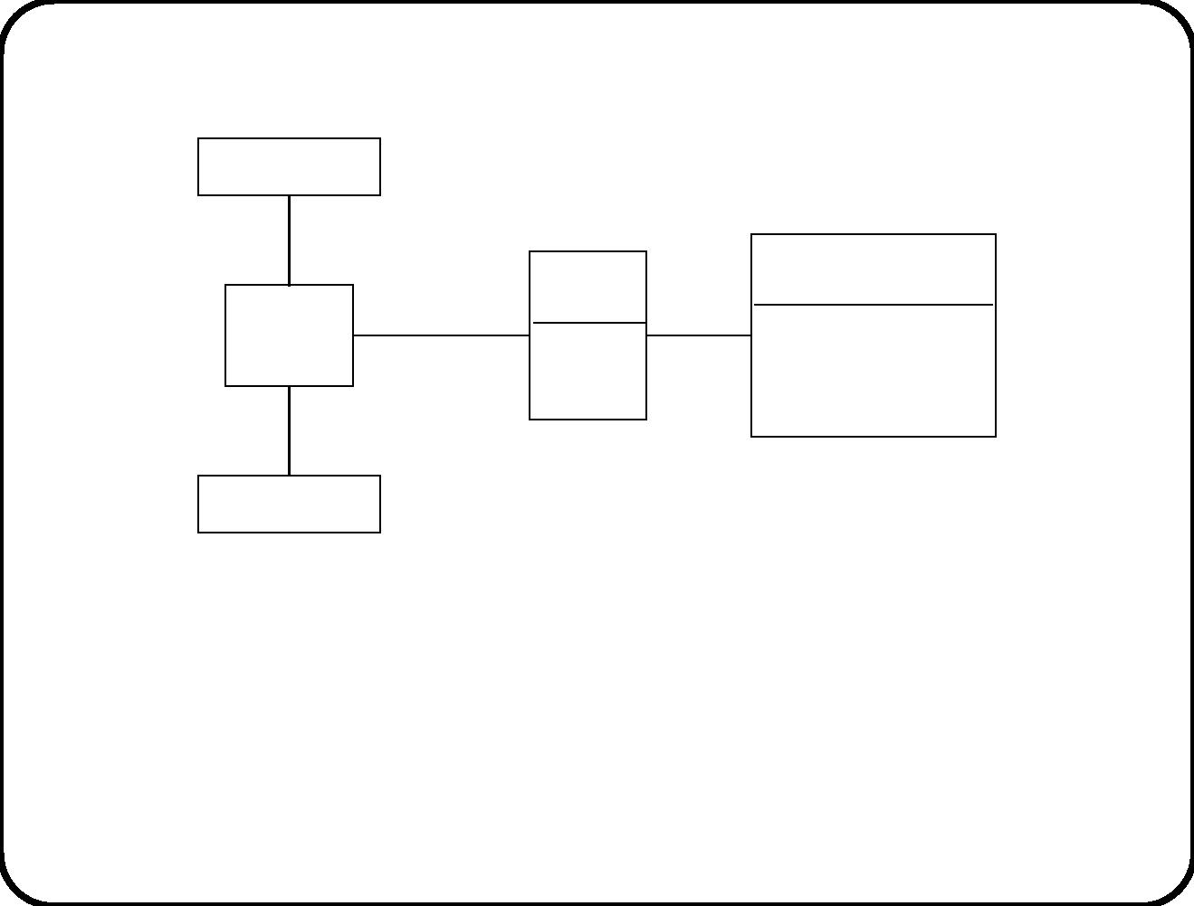
Sub ject domain of the heating controller
Thermometer
1
1
Batch
Recipe
Heating
tank
Allocation
1..2 0..1
name
batchID
amount
*
1 desired temperature
duration
1
1
Heater
Guidelines used to design heating controller:
• Subject-orientation
• Functional decomposition
• Device-orientation
How are these guidelines used?
365

Slide 68
Heating controller
Create batch control
1
Recipe
Batch control
name
amount
batchID
1
desired temperature
duration
1
*
0..1
Batch
<<signal receptions>>
start heating(b: Batch)
0..1
Allocation
1..2
Tank control
Thermometer
Tank
1
0..1
1
1
volume
date last cleaned
destemp
tankID
1
<<signal receptions>>
start(desired temp)
stop
1
Heater
366

Slide 69
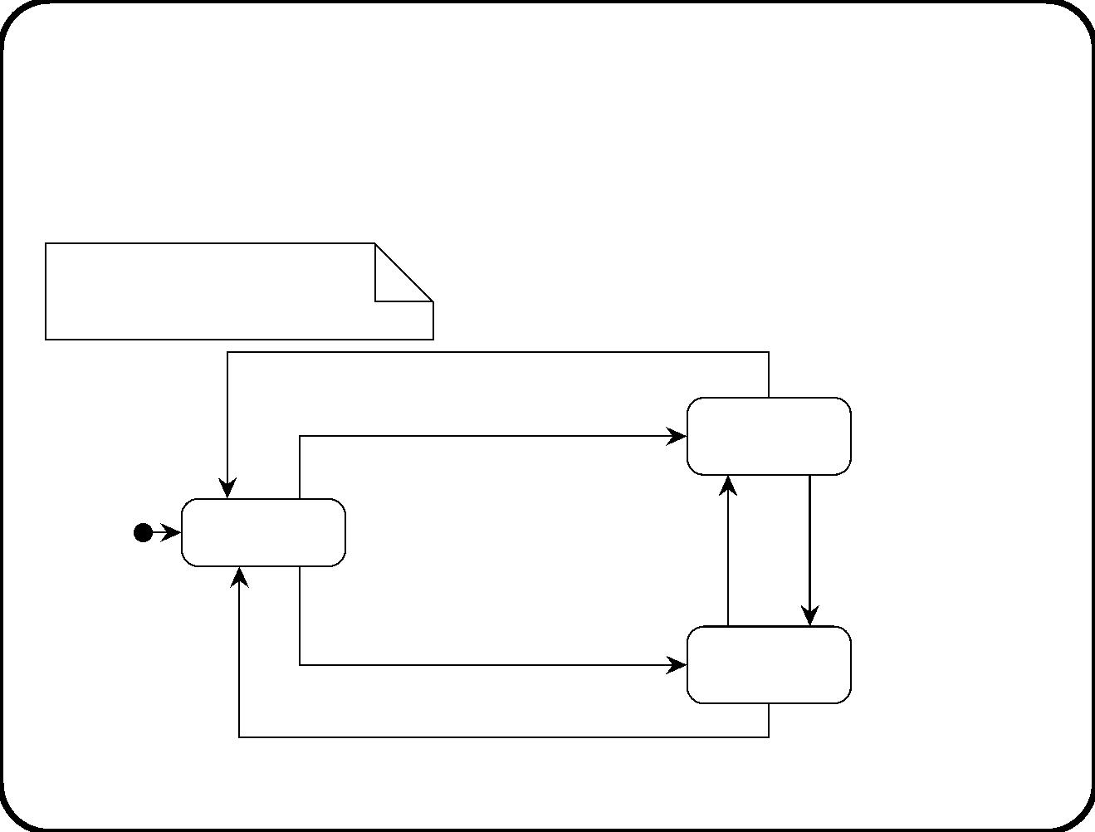
Statecharts in the UML (1)
Tank control
dtemp. currtemp: Rational
i: tank
stop(i) /
start(t, dtemp) [currtemp >= dtemp−5]
Not heating(i)
Ready(i)
after(60 secs)
after(60 secs)
[currtemp >= dtemp+5] /
switch off(i)
[currtemp < dtemp−5] /
switch on(i)
start(t, dtemp) [currtemp < dtemp−5] /
switch on(i)
Heating(i)
stop(i) / switch off(i)
367

Slide 70
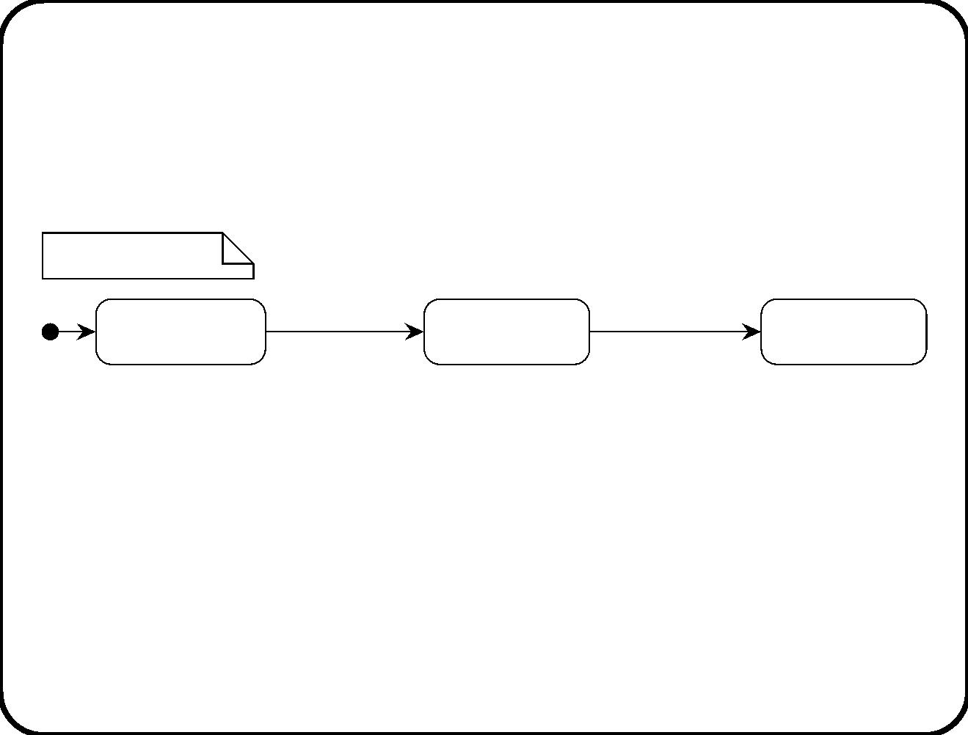
Statecharts in the UML (1)
Batch control
b: Batch control
after(b. duration) /
stop tanks(b),
start heating(b) /
start tanks(b)
Ready(b)
Heating(b)
send ‘‘b finished’’
Finishedb)
Dictionary:
• start tanks(b: Batch).
.
.
– For all tanks t in b
heating tank, send start(t, b recipe
.
desired temperature).
• stop tanks(b: Batch).
– For all tanks t in b
.
heating tank, send stop(t).
368

Slide 71
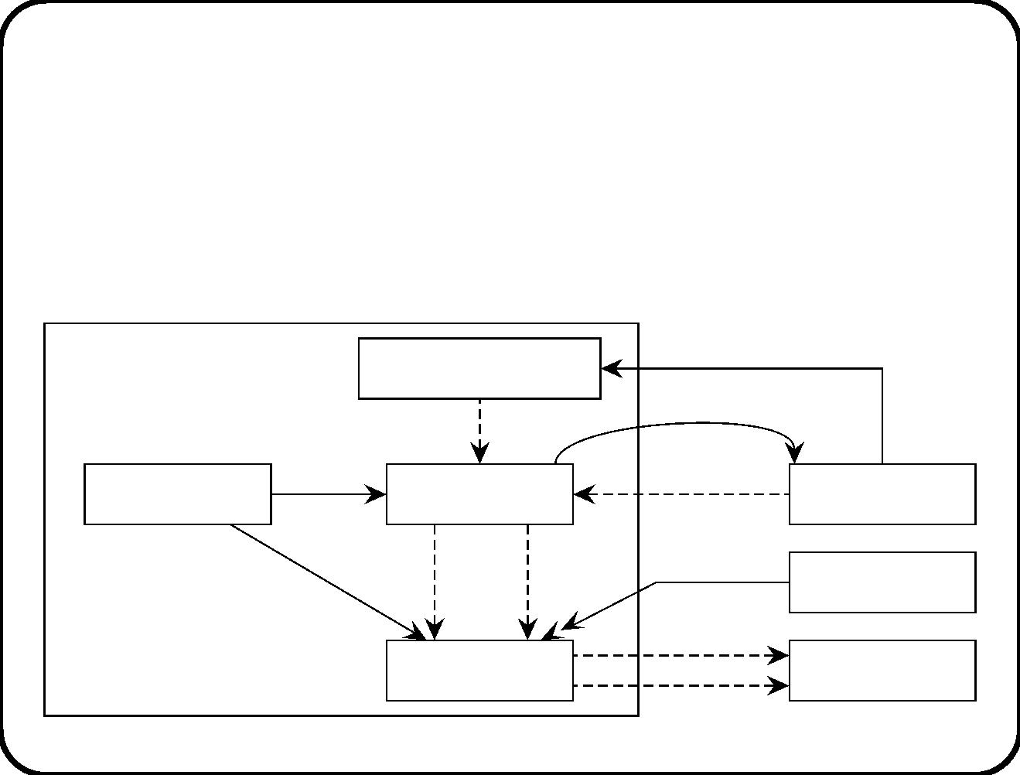
Coherence between SSD and statecharts (1)
• Attributes, identiﬁers, interface data declared as local variables.
• Signals can trigger transitions.
• Actions can be operation calls or signal sending.
• Illustrate this coherence by an architecture diagram:
batch data
Heating
Create batch control
controller
b finished
create
duration
start heating
Operator
console
Recipe
Batch control
currtemp
switch on
switch off
desired
temperature
start
stop
Thermometer
Heater
Tank control
369

Slide 72
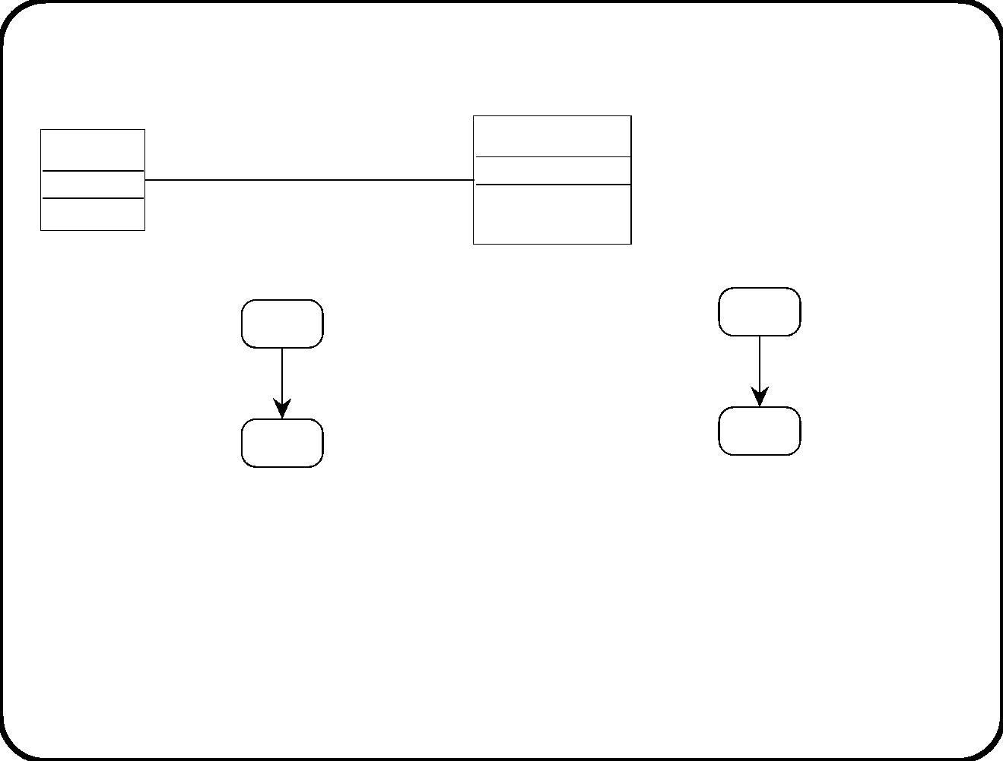
Coherence between SSD and statecharts (2)
A
B
<<signal receptions>
s ( params )
... / send s(...)
s(...) / ...
Statechart of instances of B.
Statechart of instances of A.
Transitions can be triggered by s(...).
Instances of A can send messages to instances of B because there is
an association from A to B.
370

Slide 73
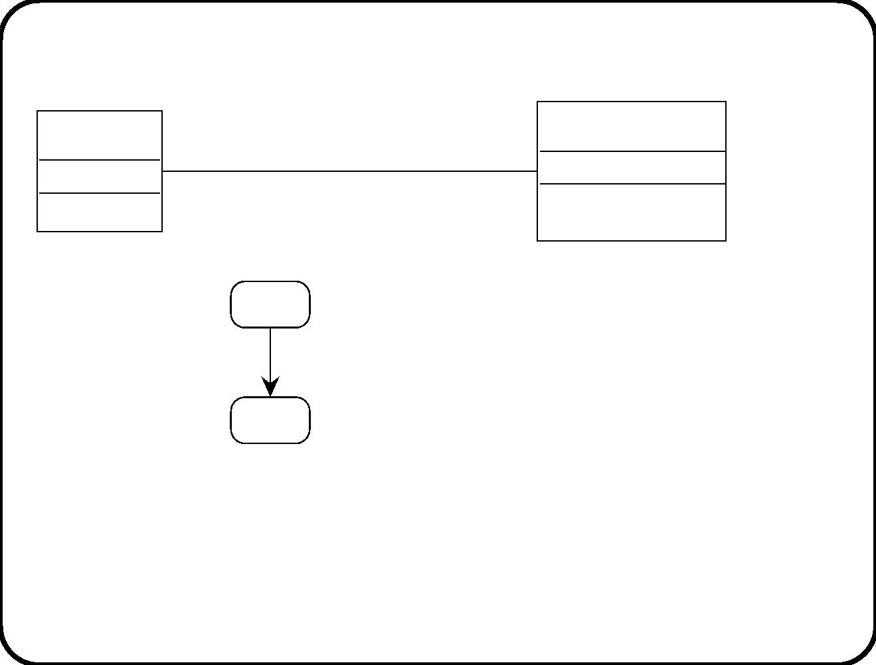
Coherence between SSD and statecharts (3)
A
B
<<operations>>
o(params) : v
... / call o(...)
Statechart of instances of A.
Operation o must be deﬁned for instances of B.
371

Slide 74
How to ﬁnd an SSD
Considerations:
• A communication diagram shows communication channels
among components.
• An SSD shows cardinality properties of components and access
paths between classes.
• The SSD shows the access paths needed by each object to do
its job.
• To ﬁnd the access paths, we need to ﬁnd out the job of each
object ﬁrst.
• To ﬁnd the job of each object, we draw the communication
diagram ﬁrst.
372

Slide 75
Guidelines for ﬁnding an SSD
√
Consider one stimulus-response pair.
√
Draw a communication diagram of the stimulus-response
process.
– Use architecture guidelines to ﬁnd components. See section
19.4.
√
Draw an SSD of the classes and access paths needed by each
component in the communication diagram.
– Deﬁnition of operations tell us where each object must ﬁnd
its data.
– Use subject domain ERD as inspiration to ﬁnd multiplicity
properties.
373

Slide 76
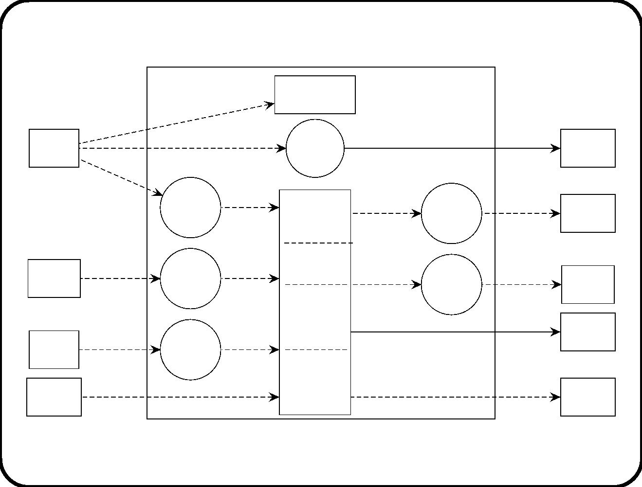
Cage
Elevator control
surrogate
arrive(a)
arrive(a)
Arrival
sensor
arrive(a)
Location
number
Location
indicator
indication
start motor(b, c),
start up(m),
start down(m)
stop(m)
Arrive arrive(b, c)
continue(c),
reverse(c)
stimulus
rec
Motor
action
comp
Movement
control
Motor
Door
stimulus
rec
doors
Door
open doors(c),
close doors(c)
open(d),
close(d)
*
closed(d)
closed(c)
Door
action
comp
Elevator
doors
control
*
Elevator
Allocation
and button
control
doors
pass
direction
Direction
indicator
Entry
pass(e)
push(b)
Entry
stimulus
rec
doors(c)
sensor
Direction
indicator
control
*Request
button
light on(b), light off(b)
*Request
button
374

Slide 77
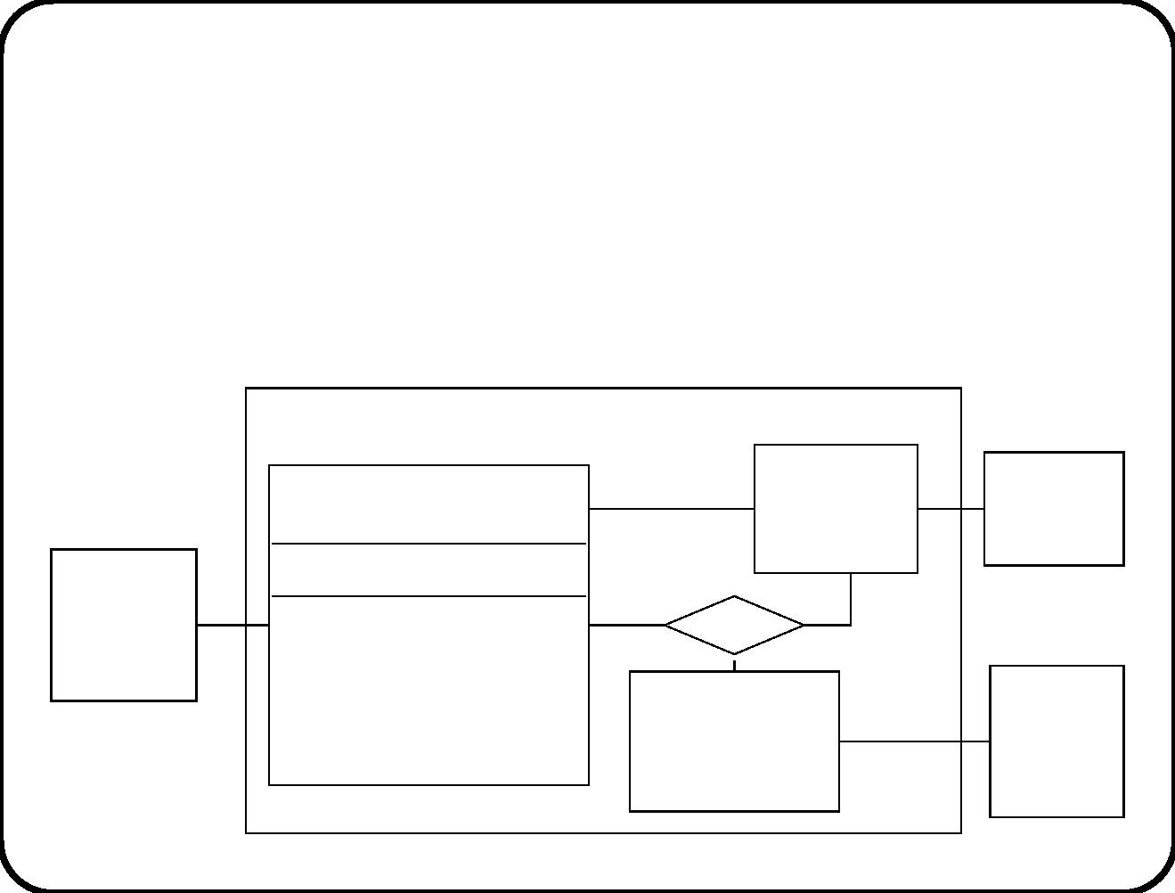
What information does a cage surrogate need? Here is its job:
c: Cage surrogate
arrive(a) / update ﬂoor(c, a), where update ﬂoor(c, a) =
.
.
c
current ﬂoor := a ﬂoor.
Here are the access paths needed:
Elevator controller
current
floor
2
10
Floor
surrogate
10
Floor
Cage surrogate
1
1
1
1
2
Elevator
<<signal receptions>>
arrive(a)
<<operations>>
update floor(c, a)
cage
1
1
20
20
Arrival
sensor
Arrival sensor
surrogate
1
375

Slide 78
Here is the job of the location indicator:
Location indication:
• When arrive(a),
• do set number(a
.
.
.
cage
location indicator, a cage
.
.
current ﬂoor number).
376

Slide 79
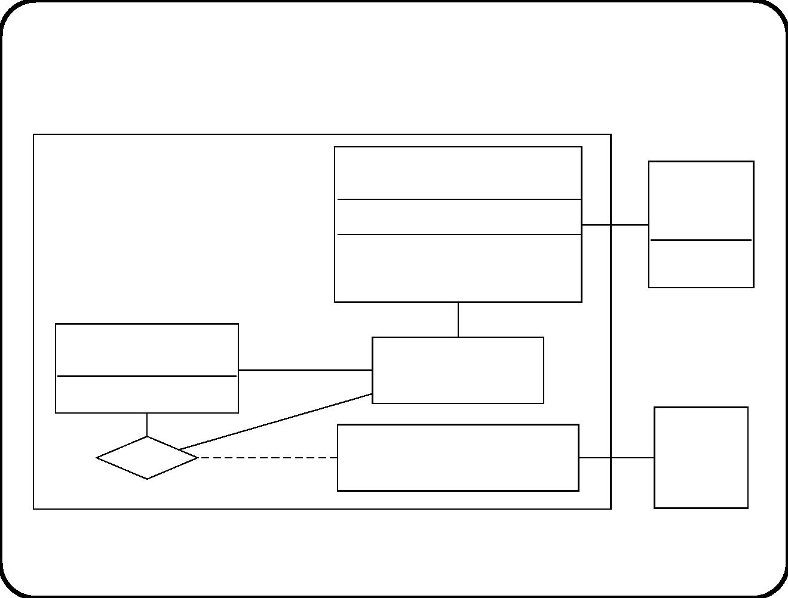
Here are the access paths through which it gets its information:
2
2
Location indication
Location
indicator
Elevator controller
<<signal receptions>>
arrive(a)
1 1
number
1
1
10
current
floor
Floor surrogate
2
number
1
Cage surrogate
20
Arrival
sensor
20
Arrival sensor surrogate
1
1
377

Slide 80
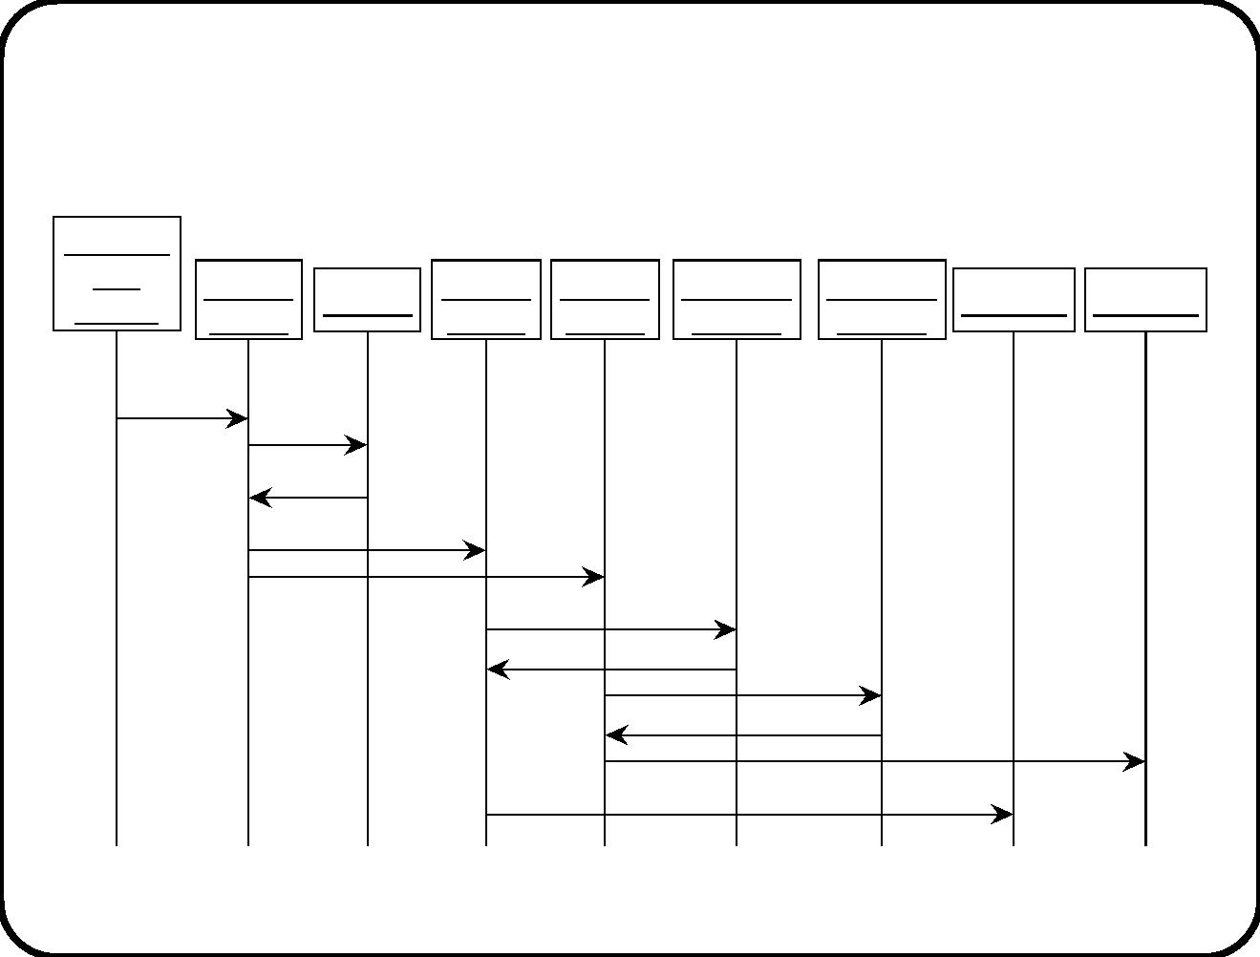
Sequence diagrams can be used to illustrate
scenarios
op: Ope−
rator
b: Batch
control
r: Recipe
tk1: Tank tk2: Tank th1: Ther−
th2: Ther−
mometer
h1: Heater h2: Heater
console
control
control
mometer
start
heating
get
duration
duration
start
start
get
temperature
temperature
get
temperature
temperature
switch on
switch on
378

Slide 81
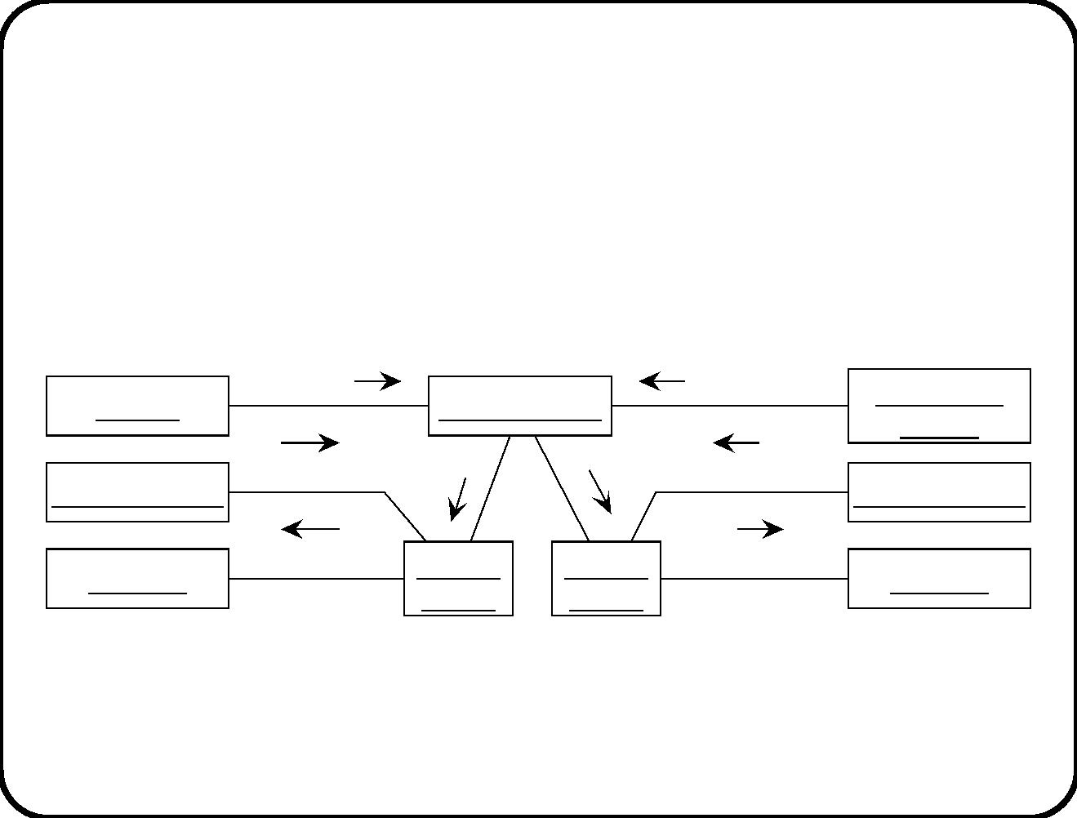
Collaboration diagrams can be used to illustrate
scenarios too
2: duration
1: start heating
5: temperature
8: switch on
op: Operator
console
r: Recipe
th2: Thermometer
h2: Heater
b: Batch control
6: temperature
7: switch on
4: start
3: start
th1: Thermometer
h1: Heater
tk2: Tank
control
tk1: Tank
control
379

Slide 82
Possible uses of sequence and collaboration
diagrams
• As illustration: The system must be able to execute this
scenario.
• As speciﬁcation: All executions of the system must contain this
scenario.
• To specify patterns: The diagram represents roles that objects
in the system play.
380

Slide 83
Main points
• Activity diagrams can be used to specify user workﬂow.
• Class diagrams represent decomposition of system into objects.
• Statecharts can be used to represent object life cycles.
• Use architecture diagrams to keep track of relationship between
SSDs and statecharts.
• Find SSD by identifying access paths needed in
stimulus-response processing.
• Illustrate executions by means of sequence or collaboration
diagrams.
381

Slide 84
Chapter 23. Not Yet Another Method
The weight of professional boxers is classiﬁed according to the
following scheme:
ﬂyweight
≤ 112 pounds
bantamweight ≤ 118 pounds
featherweight ≤ 126 pounds
lightweight
≤ 135 pounds
welterweight ≤ 147 pounds
middleweight ≤ 160 pounds
heavyweight
> 160 pounds
We can learn two things from this classiﬁcation:
1. Lightweight is not the lightest weight.
2. Heavyweights can be as heavy as they want.
382

Slide 85
Keep it simple.
383

Slide 86
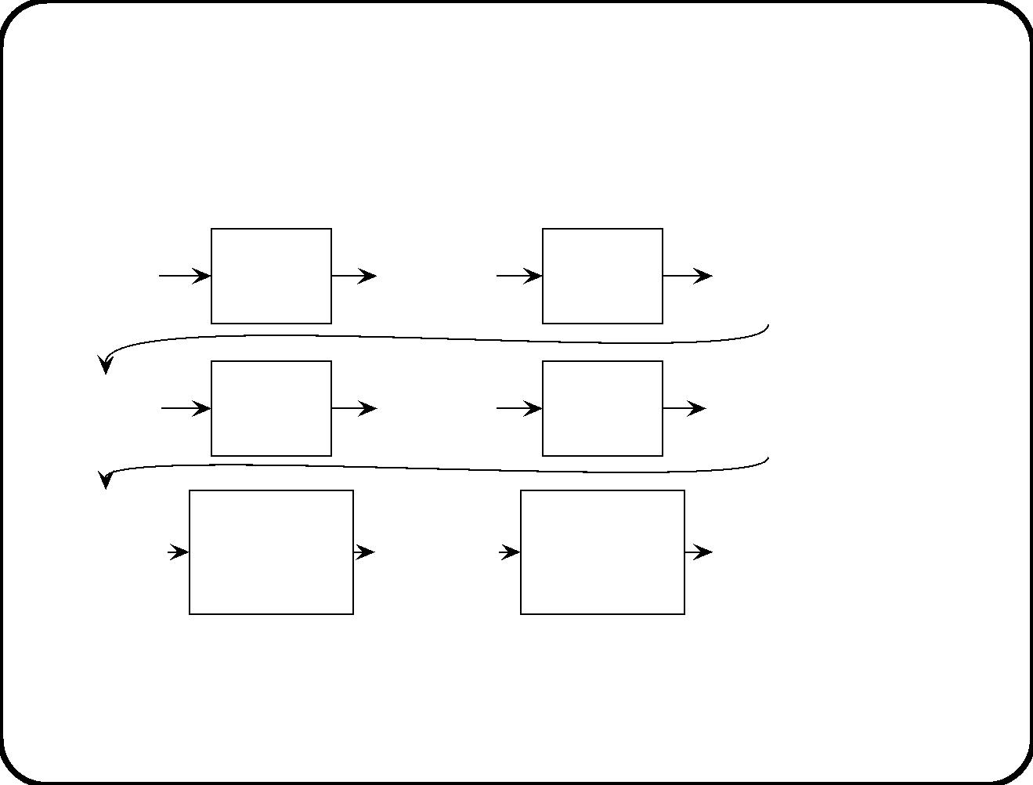
Problem-solving levels
Business
problem
Business
problem
analysis
Business
problem
description
Business
design
process
Business
solution
specification
Decompo-
sition
Software
problem
Software
problem
analysis
Software
problem
description
Software
design
process
Software
requirements Refine-
specification
ment
Software
decompo-
sition
Software
decomposition
problem
Software
decompo-
sition
problem
description
Software
decomposition
design
Software
decompo-
sition
Decompo-
sition
problem
analysis
process
specification
384

Slide 87
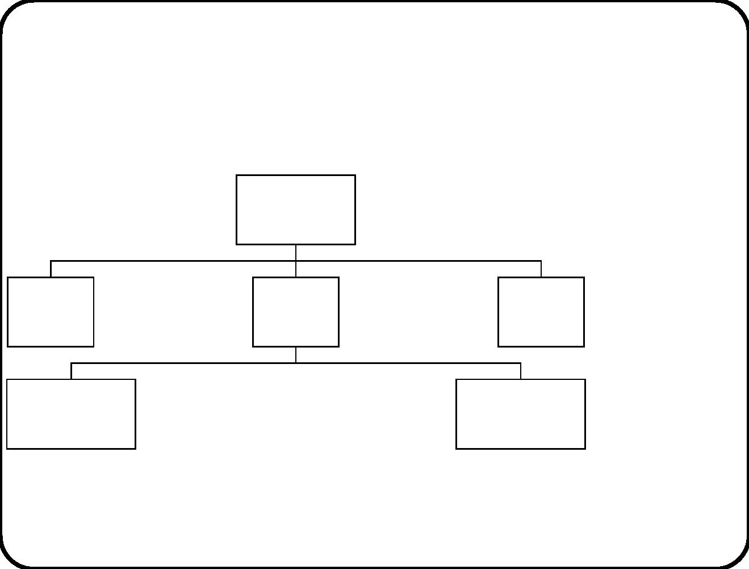
The system hierarchy
Composite
system
Services
Behavior
Communication
Services
External
Services
SuD Behavior
Communication
External
entity
Services
Behavior
Communication
entity
Behavior
Communication
Services
Services
Subsystem 1 Behavior
Communication
......
Subsystem n Behavior
Communication
385

Slide 88
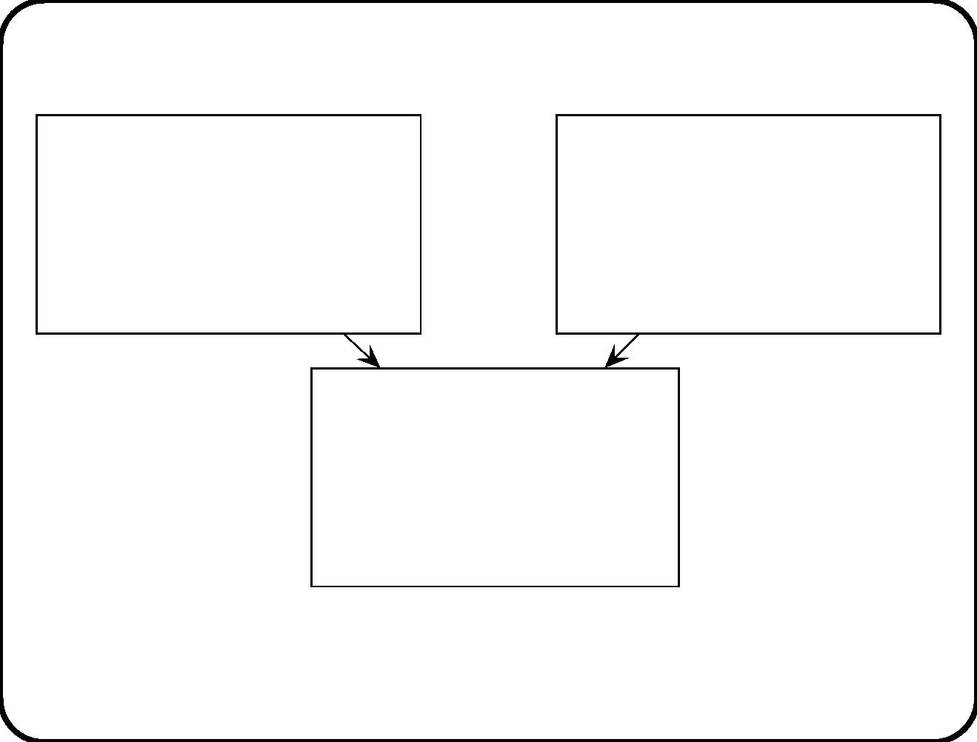
Software design approach
Functional requirements
Use environment model
Environment goals
Desired SuD functions
Desired SuD communication
Desired SuD behavior
External communications
User behavior
Subject domain entities
Subject domain behavior
Requirements-level
architecture
Component functions
Component communications
Component behavior
• Requirements-level decomposition.
• Independent from changes in implementation platform.
386

Slide 89

Notations treated in the book
Com-
mu-
De-
Func-
tions
Beha-
vior
com-
posi-
tion
nica-
tion
Mission stmnt
X
X
Funct. reﬁnmnt
tree
Service descr.
X
State trans. list
X
X
State trans. table
State trans. di-
agr.
X
X
Activity diagram
Data ﬂow diagr.
Arch. diagram
X
X
ERD
SSD
X
X

Slide 90

Our use of notations
• Context diagram
• Subject domain ERD
Use environment of SuD
• Activity diagram of user workﬂow
• STT or STD of desired subj. dom. behavior
• STT or STD of assumed subj. dom. behavior
• Mission statement
Functional speciﬁcation
of SuD
• Function reﬁnement tree
• Service descriptions
• Stimulus-response descriptions
• Architecture diagram
Decomposition of SuD
• STT or STD of component behavior
• Static structure diagram
388

Slide 91
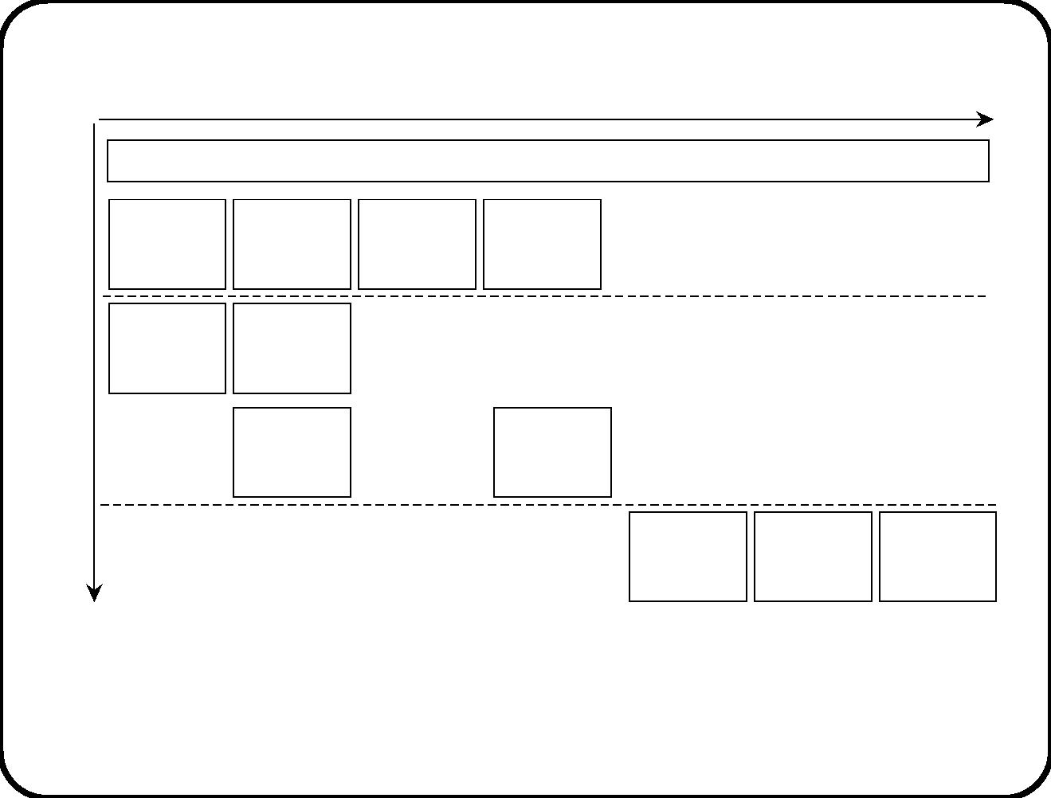
Ordering of design decisions
Refinement
Dictionary
Context
diagram
Workflow
Subject
Subject
domain
activity
domain ERD
Usage environment
diagram
STDs/STTs
Mission
Function
refinement
tree
statement
SuD
Service
Stimulus−
descriptions
response list
Architecture Component
SSD
diagram
STDs/STTs
Lower−level
service provision
SuD components
Often, in order to make a lower-level design model, the designer has
to ﬁrst make a more reﬁned higher-level description.
389

Slide 92
• Problem bounding. Environment modeling.
• Service description. System design.
• Deﬁning key terms. Environment modeling.
• Identifying desired and assumed behavior. System design.
• Decomposition. System design.
390

Slide 93
Engineering arguments
• Engineers predict product properties from product
speciﬁcation.
• Tinkerers ﬁddle around with the product and discover how it
behaves.
Feed forward versus feedback loop.
⇒ We use product descriptions, among others, to produce
engineering arguments. Ranges from very informal to very formal.
391

Slide 94
Using engineering knowledge:
• Products with this kind of decomposition usually have
properties P;
• Since this product will have this kind of decomposition,
• It will probably have properties P.
392

Slide 95
Using throw-away prototyping:
• Since the prototype has properties P,
• And the prototype is similar to the ﬁnal product,
• The ﬁnal product probably has properties P.
393

Slide 96
Using model execution:
• Since the model execution has properties P,
• If the system implements this model exactly,
• Then the system will have properties P.
394

Slide 97
Using model checking:
• Since the state transition graph has properties P,
• If the system implements this graph correctly,
• the system will have properties P.
395

Slide 98
Using theorem-proving:
• Since the decomposition has been proved to have properties P,
• If the system correctly implements this decomposition,
• The system will have properties P.
396

Slide 99
Formality versus precision
• A description is precise if it expresses as brieﬂy as possible
what is intended.
• It is formal if it uses a language for which formal,
meaning-preserving manipulation rules have been deﬁned.
⇒
• Formal descriptions can be very imprecise: Statechart with
superﬂuous transitions and states.
• Precise descriptions can be very informal: Function
descriptions.
The attempt to be precise has priority over the attempt to be
formal.
397

Slide 100
C.J. Smith, Synonyms Discriminated. G. Bell and Sons, Ltd., 1926.
• Precise denotes the quality of exact limitation, as
distinguished from the vague, loose, doubtful, inaccurate; ...
The idea of precision is that of casting aside the useless and
superﬂuous.
• Exactness is that kind of truth which consists in conformity
to an external standard or measure, or has an internal
correspondence with external requirement ... an exact amount
is that which is required.”
• Accuracy, by contrast, refers to the attention spent upon a
thing, and the exactness which may be expected from it.
Accuracy is designed whereas exactness may be coincidental.
• Correctness, ﬁnally, applies to what is conformable to a
moral standard as well as to truth generally, as “correct
behavior”.
398

Slide 101
C.J. Smith, Synonyms Discriminated. G. Bell and Sons, Ltd., 1926.
“It is most desirable that men should be exact in duties and
obligations, accurate in statements and representations,
correct in conduct, and precise in the use of words.”
399

Slide 102
Omit needless words
W. Strunk Jr. & E.B. White, The Elements of Style. Fourth
edition. Allyn and Bacon 2000.
Rule 17
Vigorous writing is concise. A sentence should contain no
unnecessary words, a paragraph no unnecessary sentences,
for the same reason that a drawing should have no
unnecessary lines and a machine no unnecessary parts.
This requires not that the writer make all sentences short,
or avoid all detail and treat subjects only in outline, but
that every word tell.
400

