Slide 1
Algorithm Analysis

Slide 2


Algorithm Analysis (Amortized) (1)

Slide 3

Algorithm Analysis (Amortized) (1)

Slide 4

Algorithm Analysis (Amortized) (1)

Slide 5


Algorithm Analysis (Amortized) (2)

Slide 6
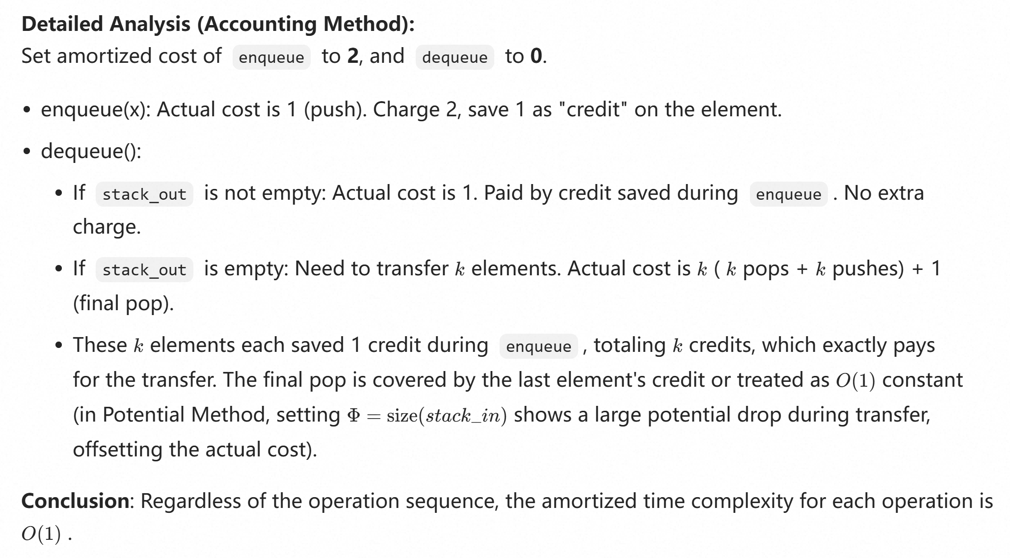

Slide 7


Algorithm Analysis (Amortized) (3)

Slide 8
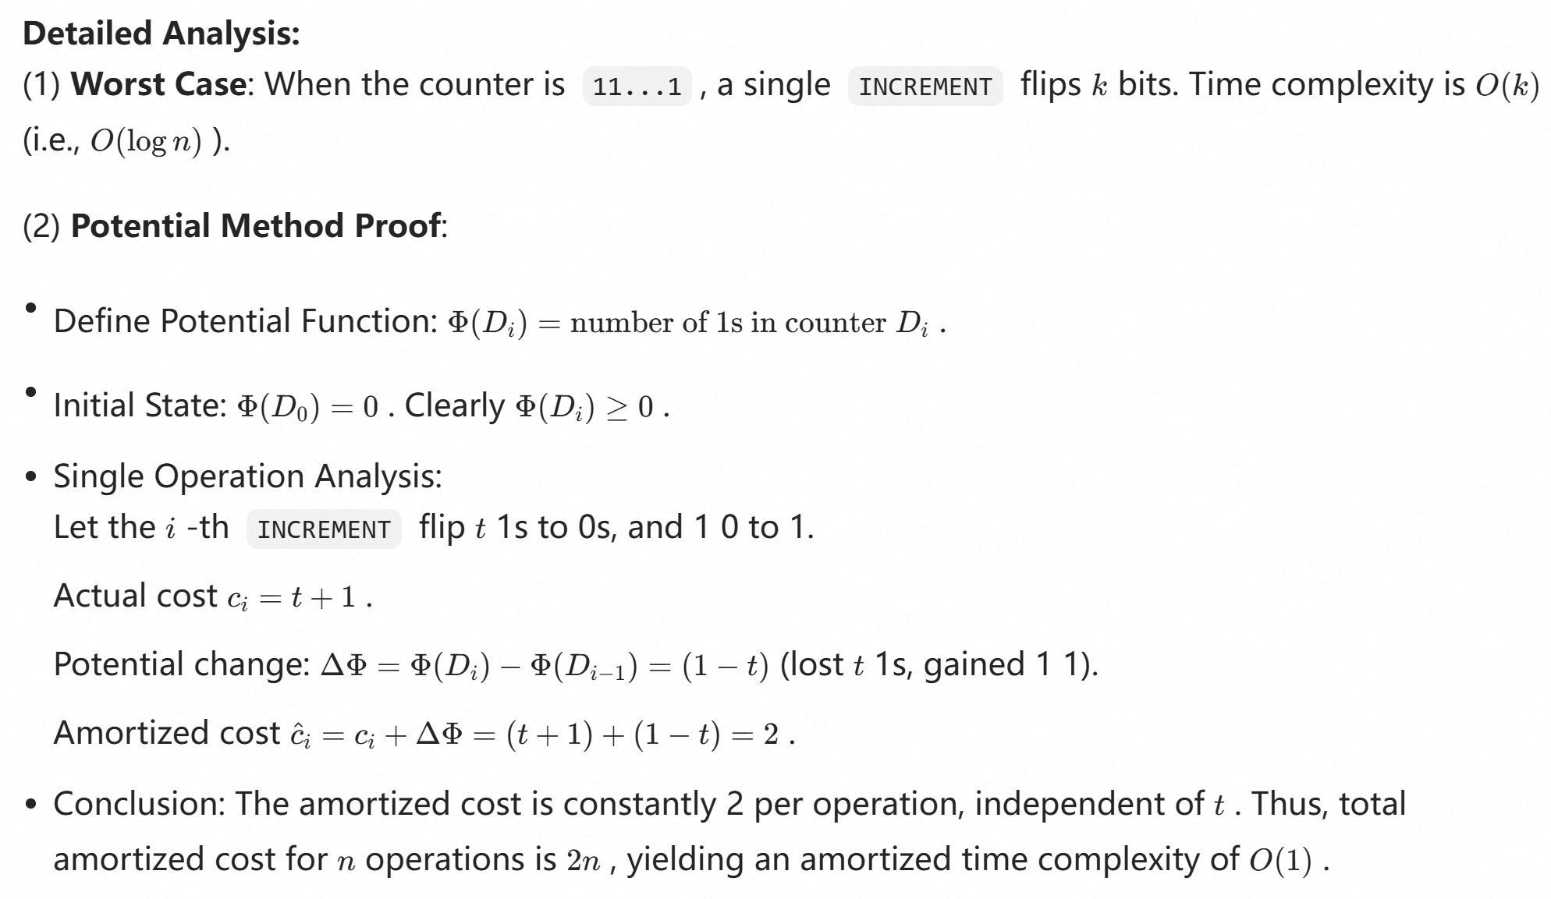

Slide 9


Algorithm Analysis (4)
Answer:

Slide 10
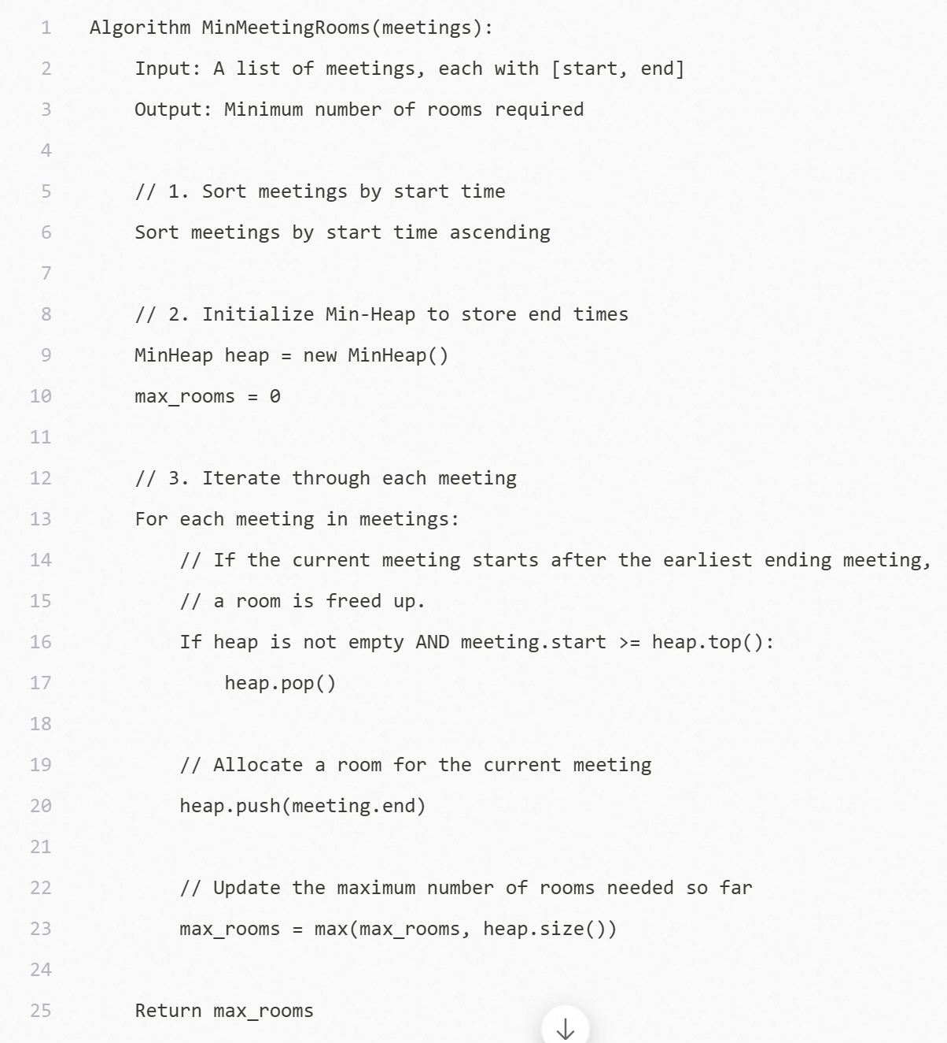

Algorithm Analysis (4)

Slide 11


Algorithm Analysis (5)

Slide 12
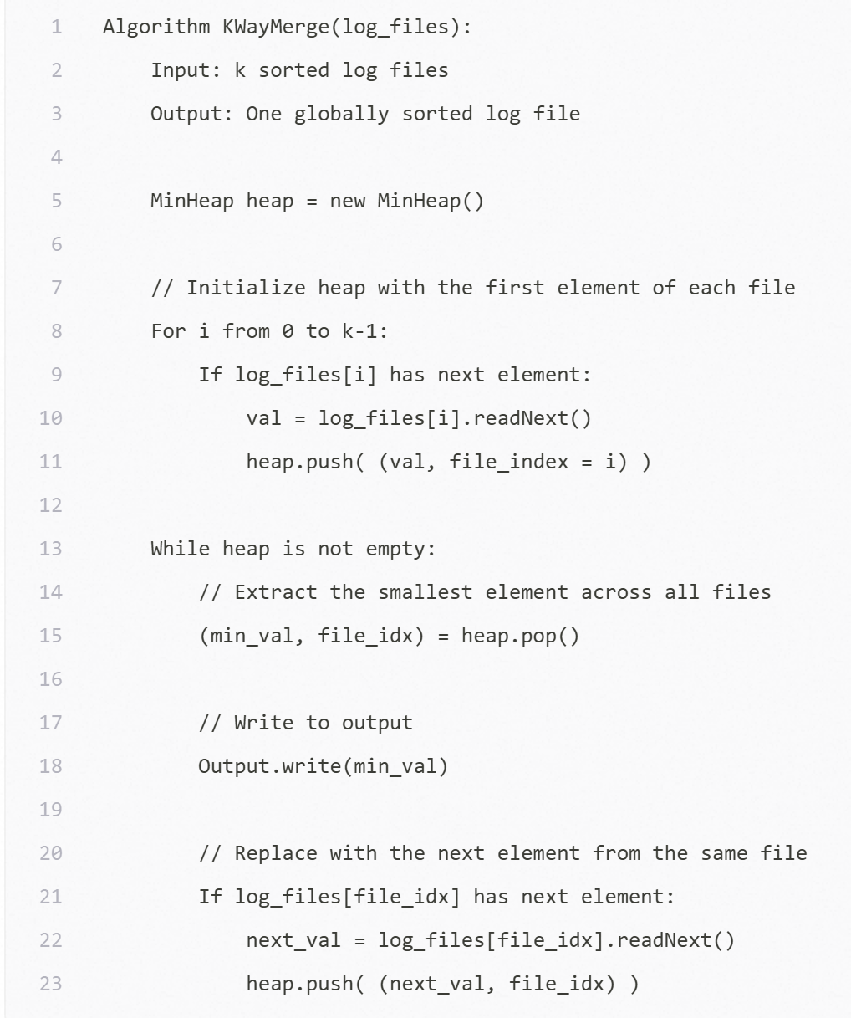

Algorithm Analysis (5)

