Slide 1
Operating Systems
Lab 2: Message Queues
Dr. 何明昕 HE Mingxin, MX, Max
Send your email to c.max@yeah.net with
a subject like: OS-id-Andy: On What …
Download from c.program@yeah.net
/文件中心/网盘/OperatingSystems26S
Book site: https://codex.cs.yale.edu/avi/os-book/OS10/index.html

Slide 2
Contents (Ch14.3 Message Queues, BLP-4e book)
Message Queues, IPC
Create or get the flag of a messsage queue:
int msgget(key_t key, int msgflag)
Send message to the specified message queue:
int msgsnd(int msgid, struct msgbuf *msgp, int size, int type, int flag)
Receive message from the specified message queue:
int msgrcv(int msgid, struct msgbuf *msgp, int size, int type, int flag)
Control messsage queue: state query, modify and remove queue：
int msgctl(int msgid, int cmd, struct msgid_ds *buf)

Slide 3
Task 1：IPC with Message Queues
Use Message Queue, IPC, to implement sending & receive messages。
Sending Process sndfile.c gets messages (line by line) inputed from keybord, and send to the message que, end with a “end”
Receiving Process rcvfile.c read and display messages one by one from the message queue, until reach a “end”
The key of the message queue is set to 1234
Objective：Learn to work with message queue to implement inter-process communication.
Key Points：
struct my_msg is the struct of msgbuf, need to be definedby users
Learn to use msgget()、msgsnd()、msgrcv()
Try to execute the two processes in diferrent order and see the results

Slide 4
Task 1：IPC with Message Queues (cont.)
Ideas of 2 programs，sndfile.c and rcvfile.c
sndfile.c
1) Define message buffer (my_msg);
2) Use msgget() to create the message queque;
3) while (1) {
Display tips for input messages;
Get info from stdin to buffer；
Copy from buffer to message buffer;
Use msgsnd() to send message;
Message “end” to end;
}
rcvfile.c
1) Define message buffer (my_msg);
2) Use msgget() to get the message queque;
3) while (1) {
Use msgrsv() to receive message;
Display Message；
Message “end” to end;
}

Slide 5
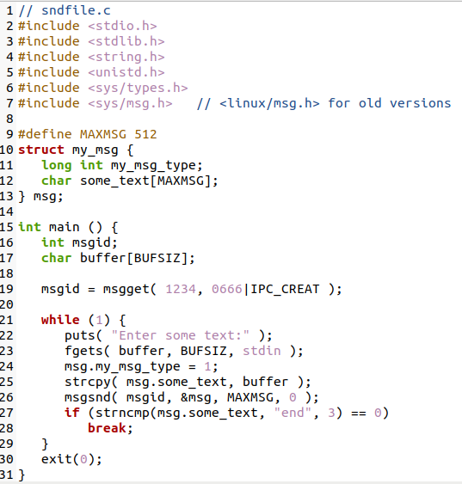
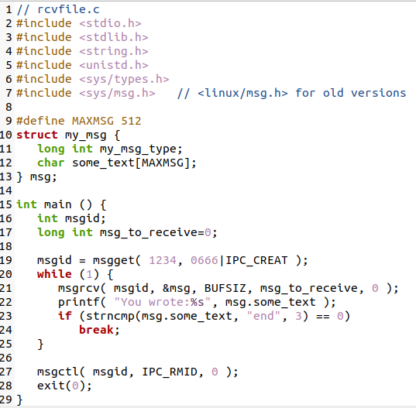
BUFSIZ? 512 or 1024 ... in stdio.h -- Have a try!

Slide 6
Open 2 Terminals to run ./sndfile and ./rsvfile

Slide 7
Task 2：Programming with Message Queues, IPC
Modify sndfile.c & rcvfile.c to sender.c & receiver.c
sender.c
Repeat to read a record from stdin with following info:
name, gender, age, mobile
Send the record to the message buffer msgid
Continue to read next record from stdin until to read a name “end”，then exit.
There should have some tips displayed for inputs.
receiver.c
Repeat to receive person info from the message queue
Display each person info in a line, better with a header
When receive a person info named “end”，then exit.

Slide 8
Task 2：Programming with Message Queues, IPC
Tips：
struct my_msg {
long int my_msg_type;
char some_text[MAXMSG];
} msg;
struct my_msg {
long int my_msg_type;
struct stdmsg {
char name[**];
char gender[*];
char age[*];
char mobil[**];
} std;
} msg;

Slide 10
Part of sender.c :

Slide 12
What should you do in Lab 3:
0) Test sndfile.c and rcvfile.c provided by the instructor.
Please submit a zip file which includes the C code for task 2 with file names: sender.c, receiver.c
A short report to show: your idea, your code structure, and execution results.
Your zip file should be named as: “学号+姓名+ OS26S-Lab3.zip”，e.g.: 1234567-何明昕-OS26S-Lab3.zip
Please submit your zip file by sending email to Mr. He as attachment with an email subject like “OS26S-Lab3 from 1234567-何明昕” before (including) April 20. My email address for the OS & SE courses is: c.max@yeah.net

