Slide 1
Operating Systems
Lab0: WarmUp -- C Prog. with files in Linux
Dr. 何明昕 HE Mingxin, MX, Max
Send your email to c.max@yeah.net with
a subject like: OS-id-Andy: On What …
Download from c.program@yeah.net
/文件中心/网盘/OperatingSystems26S
Book site: https://codex.cs.yale.edu/avi/os-book/OS10/index.html

Slide 2
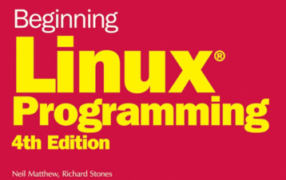
Content
Chapter 1: Getting Started . . . . . . . . (week 3, Lab Practice)
Chapter 2: Shell Programming . . . . . (optional, week 3 - week 6)
Chapter 3: Working with Files . . . . . .(week 3, Lab Practice)
Chapter 4: The Linux Environment . . (self learning, week 3 - week 6)
NO submit for Lab 0 !!!

Slide 3
Objectives
C Programming environment in Linux
Programming with files

Slide 4
Chapter 1: Getting Started
hello.c - Try your GCC compiler first.
program.c - A simple program that uses header files and library files.

Slide 5
Chapter 3: Working with Files
simple_write.c - A simple program that uses write.
simple_read.c - A simple program that uses read and write.
copy_system.c - A program that uses low-level system calls to copy one file to another.
copy_block.c - An improved version of system.c that copies blocks of data between the files.
copy_stdio.c - A program uses library calls to further improve the speed of the above programs by buffering the file input and output.
printdir.c - A program that prints out the contents of the home directory.
printdir2.c - An improved version of printdir.c that takes the directory as an argument.
mmap.c - A program that maps a file into memory as an array and then alters its contents.

