Slide 1
Time series application
SOUTH KOREA AQUACULTURE YEARLY PRODUCTION

Slide 2
STUDY FRAMEWORK
Clean the data and observe a trend over time
Decompose the time series observations
Split the data into the training and test periods
Check the stationarity of the training data
Run ACF and PACF to decide inputs for AR and MA
Build ARIMA models
Build a rolling forecast model
Forecast the fish production over the test period
Compare the forecasts from the models and actual observations

Slide 3
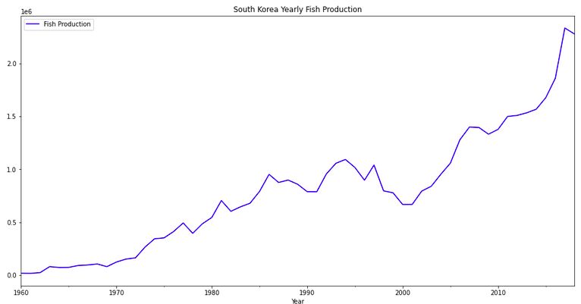
S. Korea yearly aquaculture production

Slide 4
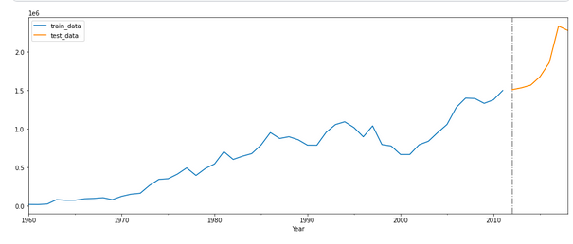
Training(1960-2011) and test (2012-2019) periods

Slide 5
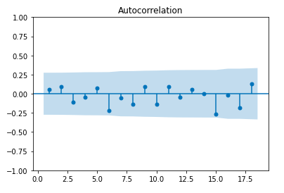
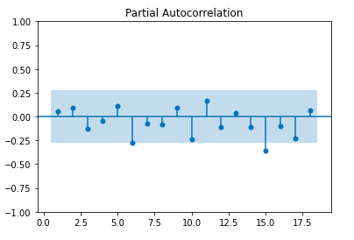
Stationarity test
After one time difference operation, the Augmented Dickey-Fuller Test is passed. Using this information as the value of d in ARIMA model.
ACF Test
PACF Test

Slide 6
Build time series models
ARIMA(0 1 0)
ARIMA(6 1 0)
ARIMA(15 1 0)
Rolling forecasting original model

Slide 7
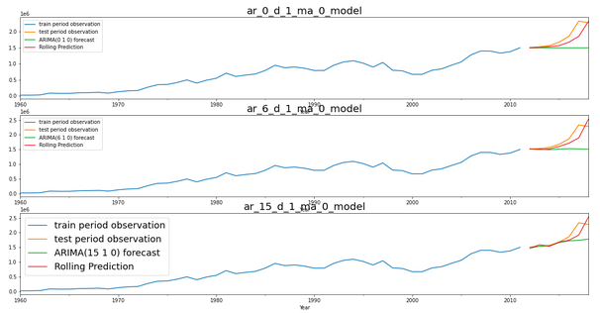
Model performances comparison
Finding: With this data, the rolling origin forecasting based on ARIMA performs better than ARIMA itself.

Slide 8
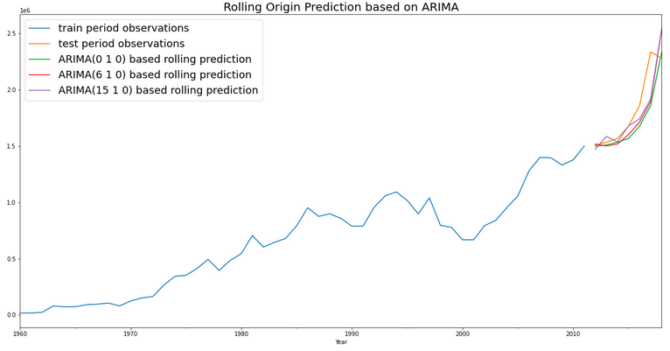
Rolling origin forecasting comparison

Slide 9
Data Source: from Kaggle
https://www.kaggle.com/datasets/sergegeukjian/fish-and-overfishing
Python Code:
https://www.kaggle.com/code/amikang/s-korea-aquaculture-time-series-prediction

