Slide 1
Agile Software Development
敏捷软件开发
Institute of Computer Software
Nanjing University

Slide 2
摘要
Introduction
Agile Development
Agile Design
Institute of Computer Software
Nanjing University

Slide 3
摘要
Introduction
Agile Development
Agile Design
Institute of Computer Software
Nanjing University

Slide 4

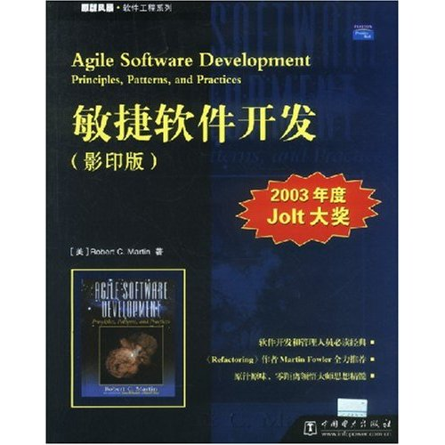
Introduction
Robert C. Martin: “Agile Software Development Principles, Patterns, and Practices”, Prentice Hall (October 25, 2002)
Jolt Award
2003
Institute of Computer Software
Nanjing University

Slide 5

Introduction
Robert C. Martin
“Designing Object Oriented C++ Applications using the Booch Method ”, 1995
“Pattern Languages of Program Design 3”, 1997
“More C++ Gems”, 1999
“Extreme Programming in Practice”, 2003
“UML for Java Programmers ”,2003
Uncle Bob
http://www.objectmentor.com
Institute of Computer Software
Nanjing University

Slide 6
Agile 敏捷
敏捷开发是一种面临迅速变化的需求快速开发软件的能力。
  提供必要的纪律和反馈的实践 -- practice
  保持软件灵活、可维护的设计原则 -- principle
  针对特定问题的设计模式 -- pattern
适应变化和以人为中心，迭代、循序渐进
Institute of Computer Software
Nanjing University

Slide 7
The Agile Alliance 敏捷联盟
The Manifesto of the Agile Alliance 敏捷联盟宣言， 2001
http://www.agilealliance.org/
We are uncovering better ways of developing software
by doing it and helping others do it. Through this work
we have come to value:
Individuals and interactions over processes and tools
Working software over comprehensive documentation
Customer collaboration over contract negotiation
Responding to change over following a plan
Kent Beck, Alistair Cockburn, Robert C. Martin, etc.
Institute of Computer Software
Nanjing University

Slide 8
敏捷联盟宣言
个体和交互胜过过程和工具
可以工作的软件胜过面面俱到的文档
客户合作胜过合同谈判
响应变化胜过遵循计划
Institute of Computer Software
Nanjing University

Slide 9
Principles
我们最优先要做的是通过尽早的、持续的交付有价值的软件来使客户满意。
即使到了开发的后期，也欢迎改变需求。敏捷过程利用变化来为客户创造竞争优势。
经常性地交付可以工作的软件，交付的间隔可以从几个星期到几个月，交付的时间间隔越短越好。
Institute of Computer Software
Nanjing University

Slide 10
Principles
在整个项目开发期间，业务人员和开发人员必须天天都在一起工作。
围绕被激励起来的个体来构建项目。给他们提供所需的环境和支持，并且信任他们能够完成工作。
在团队内部，最具有效果并富有效率的传递信息的方法，就是面对面的交谈。
Institute of Computer Software
Nanjing University

Slide 11
Principles
工作的软件是首要的进度度量标准。
敏捷过程提倡可持续的开发速度。责任人、开发者和用户应该能够保持一个长期的、恒定的开发速度。
不断地关注优秀的技能和好的设计会增强敏捷能力。
Institute of Computer Software
Nanjing University

Slide 12
Principles
简单——使未完成的工作最大化的艺术——是最根本的。
最好的构架、需求和设计出于自组织团队。
每隔一定时间，团队会在如何才能更有效地工作方面进行反省，然后相应地对自己的行为进行调整。
Institute of Computer Software
Nanjing University

Slide 13
Agile Processes
SCRUM
Crystal
Feature Driven Development 特征驱动软件开发
Adaptive Software Development 自适应软件开发
eXtreme Programming (XP) 极限编程
…
Institute of Computer Software
Nanjing University

Slide 14
摘要
Introduction
Agile Development
Agile Design
Institute of Computer Software
Nanjing University

Slide 15
Agile Development
Extreme Programming（XP，极限编程） 是一种轻量级的软件开发方法，它使用快速的反馈，大量而迅速的交流，经过保证的测试来最大限度的满足用户的需求。
  XP强调用户满意，开发人员可以对需求的变化作出快速的反应。
  XP强调team work。项目管理者，用户，开发人员都处于同一个项目中，他们之间的关系不是对立的，而是互相协作的，具有共同的目标：提交正确的软件。
Institute of Computer Software
Nanjing University

Slide 16
Extreme Programming
XP强调4个因素：
  交流（communication），XP要求程序员之间以及和用户之间有大量而迅速的交流
  简单（simplicity），XP要求设计和实现简单和干净
  反馈（feedback），通过测试得到反馈，尽快提交软件并根据反馈修改
  勇气（courage），勇敢的面对需求和技术上的变化
Institute of Computer Software
Nanjing University

Slide 17
Extreme Programming
XP特别适用于需求经常改变的领域，客户可能对系统的功能并没有清晰的认识，可能系统的需求经常需要变动。
XP也适用于风险比较高的项目，当开发人员面对一个新的领域或技术时，XP可以帮助减低风险
XP适用于小的项目（人员上），人员在2-12人之间，XP不适用于人员太多的项目
Institute of Computer Software
Nanjing University

Slide 18
Practices of XP
客户作为团队成员
用户素材 user stories
短周期交付
  迭代计划
  发布计划
验收测试
结对编程 pair programming
Institute of Computer Software
Nanjing University

Slide 19
Practices of XP
测试驱动的开发方法 Test-Driven Development
集体所有权
持续集成
可持续的开发速度
开放的工作空间
计划游戏 planning game
简单的设计
重构 Refactoring
隐喻 Metaphor：将整个系统联系在一起的全局视图
Institute of Computer Software
Nanjing University

Slide 20
摘要
Introduction
Agile Development
Agile Design
Institute of Computer Software
Nanjing University

Slide 21
What is Design?
“After reviewing the software development life cycle as I understood it, I concluded that the only software documentation that actually seems to satisfy the criteria of an engineering design is the source code listings.”
-- Jack Reeves
Institute of Computer Software
Nanjing University

Slide 22
Design Smells
Rigidity 僵化性 → 难于修改
Fragility 脆弱性 → 一改便乱
Immobility 牢固性 → 难于重用
Viscosity 粘滞性 → 做好事难
Needless Complexity 不必要的复杂性
Needless Repetition 不必要的重复
Opacity 晦涩性
Institute of Computer Software
Nanjing University

Slide 23
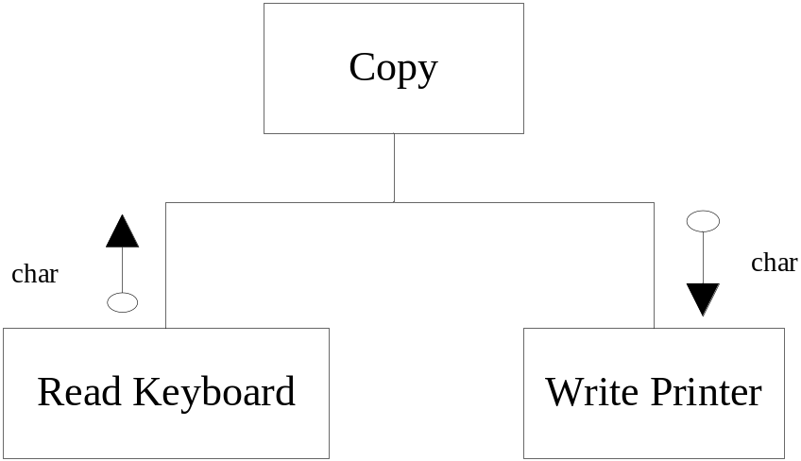
The “Copy” Program
Initial Design
void copy(){
int c;
while ((c=RdKbd())!= EOF)
WrtPrt(c);
}
Institute of Computer Software
Nanjing University

Slide 24
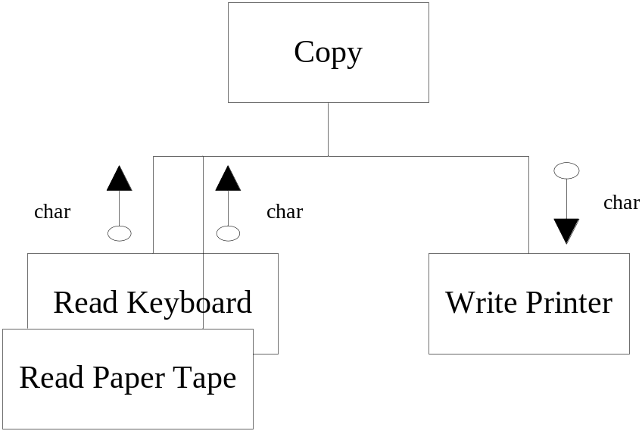
Requirement changes
bool ptFlag = false;
//remember to reset this flag
void Copy(){
int c;
while ((c=(ptFlag?RdPt(): RdKbd())!=EOF)
WrtPrt(c);
}
Institute of Computer Software
Nanjing University

Slide 25
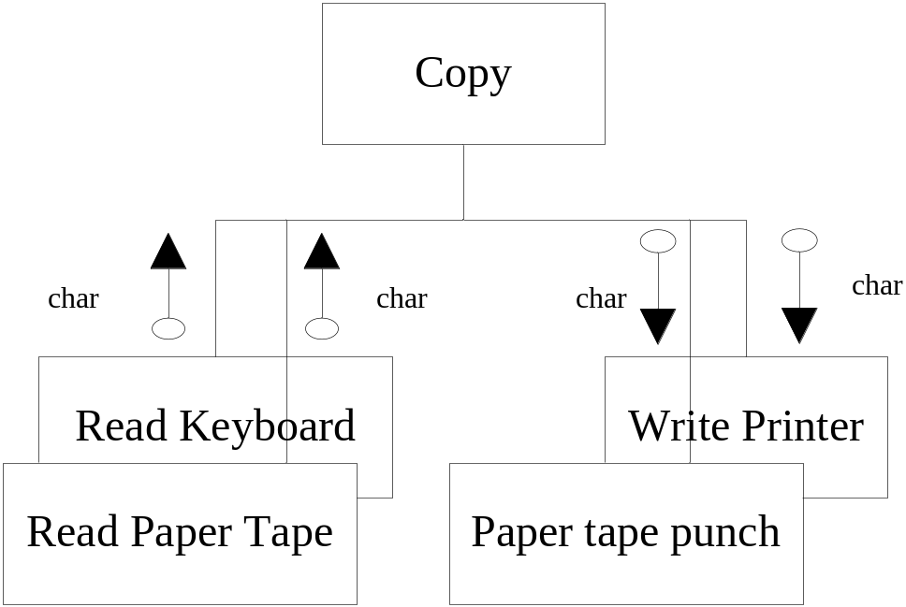
Requirement changes again!
bool ptFlag = false;
bool punchFlag = false
//remember to reset these flags
void Copy(){
int c;
while ((c=(ptFlag?RdPt(): RdKbd())!=EOF)
punchFlag ? WrtPunch(c) : WrtPrt(c);
}
Institute of Computer Software
Nanjing University

Slide 26
Agile design of the “copy” example
int RdKbd();
void WrtPrt(int);
const int EOF = -1;
class Reader{
public: virtual int read() = 0;
};
class KeyboardReader : public Reader{
public: virtual int read() {return RdKbd();}
};
KeyboardReader GdefaultReader;
void Copy(reader& reader = GdefaultReader){
int c;
while ((c=reader.read()) != EOF)
WrtPrt(c);
}
Institute of Computer Software
Nanjing University

Slide 27
Agile developers
Knew what to do because
  Detect the problem by following agile practices;
  Diagnose the problem by applying design principles
  Solve the problem by applying the appropriate design pattern
The interplay between these three aspects of software development is the act of design.
Institute of Computer Software
Nanjing University

Slide 28
A more complex example:
Multi-panel interactive systems
问题
简单方案
结构化的方案
面向对象的方案
讨论
Institute of Computer Software
Nanjing University

Slide 29
Multi-panel interactive systems
问题：
  业务流程
    每个会话（session）须经历多个步骤
  当前步骤
    显示panel（对话框），获取用户输入（选择），若输入错，给提示，直至正确；依据输入进行处理并转入下一步骤（转入哪个步骤可能依赖于用户的输入）；
  对话界面
  例如
    航空订票
Institute of Computer Software
Nanjing University

Slide 30
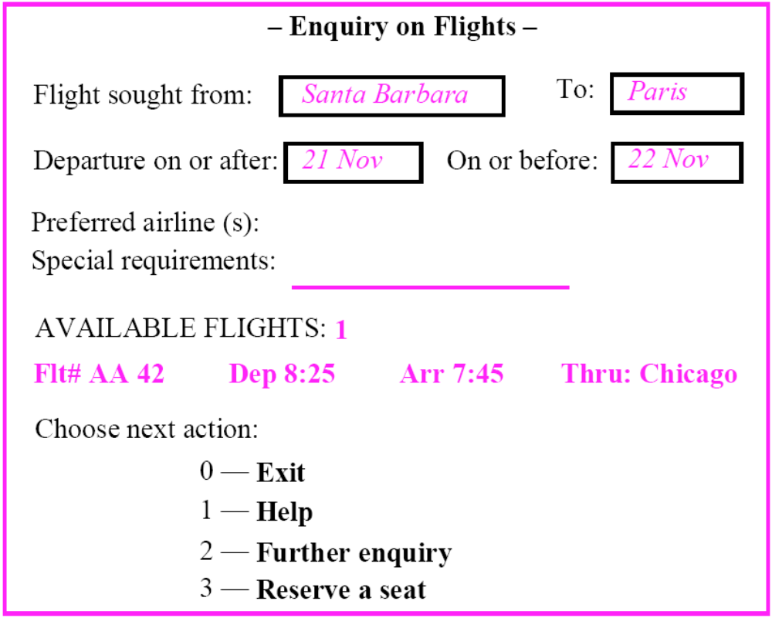
Institute of Computer Software
Nanjing University
Institute of Computer Software
Nanjing University

Slide 31
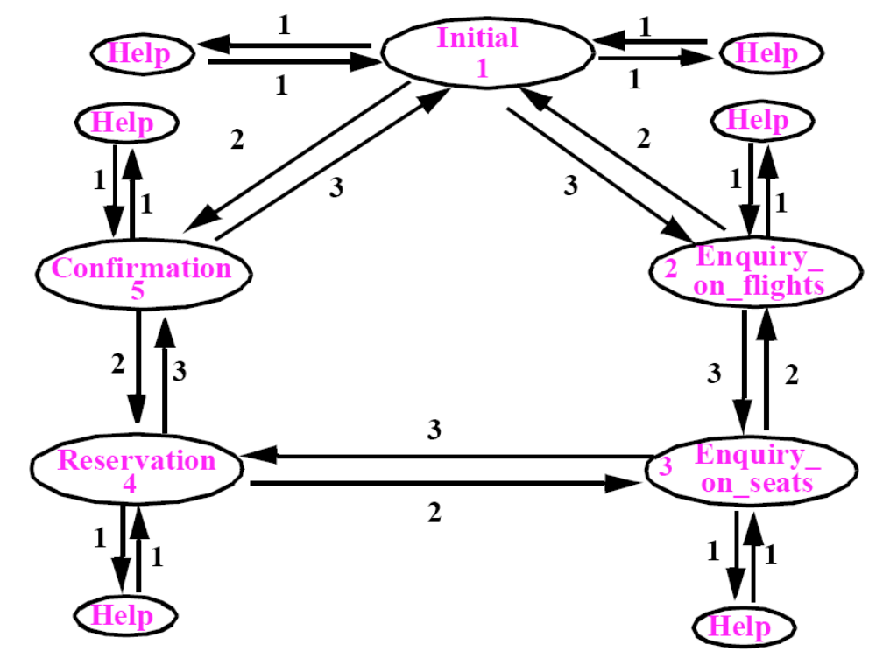
状态转换图
Institute of Computer Software
Nanjing University

Slide 32
设计要点
图可能很大
图可能变化
要考虑复用
软件设计之难在于多种
（可能冲突）的需求之间
的均衡取舍
Institute of Computer Software
Nanjing University

Slide 33
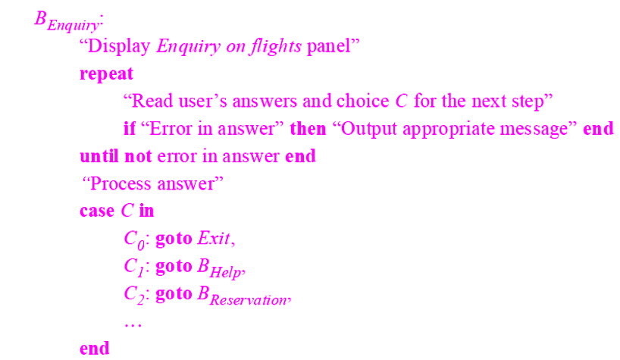
A Simple-minded solution
Institute of Computer Software
Nanjing University

Slide 34
A Simple-minded solution
问题
  “Goto”!
  本质：
    转换图结构分散地hardwired到各个模块的算法中
    若增加状态或改动流程？
    如何复用？
Institute of Computer Software
Nanjing University

Slide 35
A functional, top-down solution
好，我们消除goto,并将流程独立出来，放到一个函数中
transition(state,choice)
Institute of Computer Software
Nanjing University

Slide 36
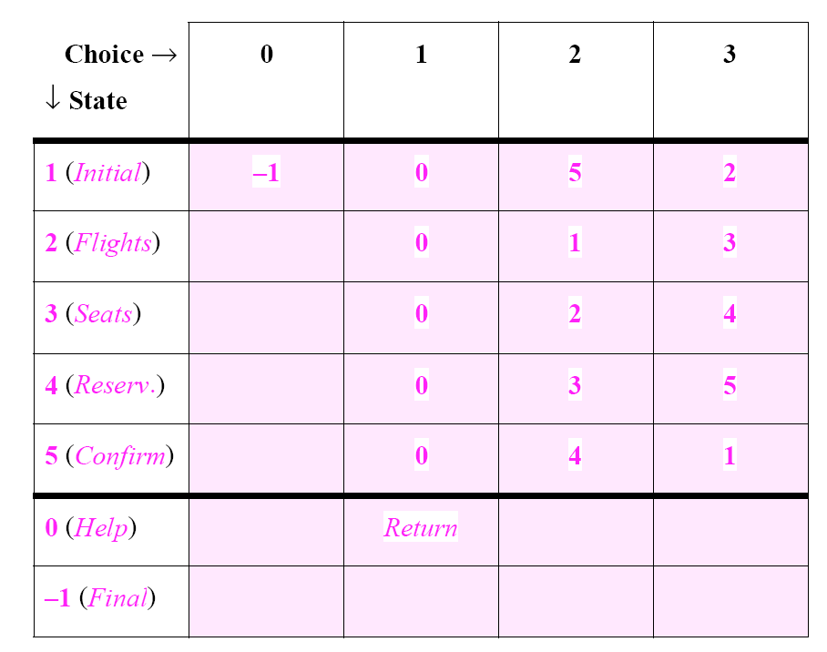
Institute of Computer Software
Nanjing University

Slide 37
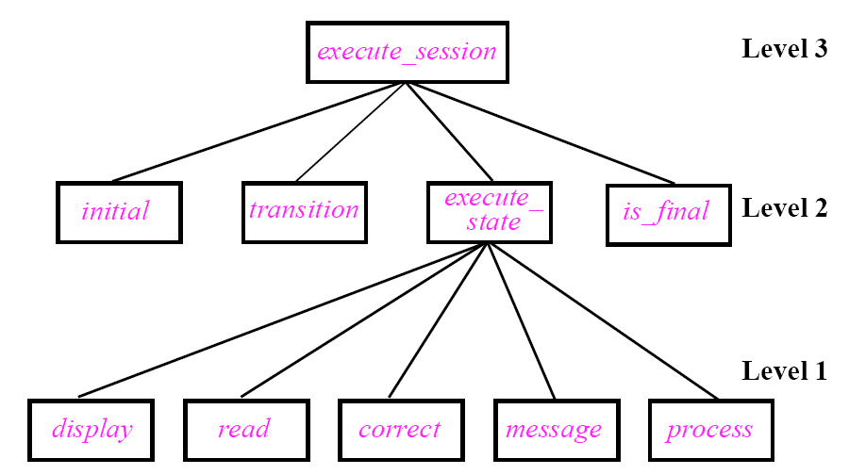
Top-down decomposition
Institute of Computer Software
Nanjing University

Slide 38
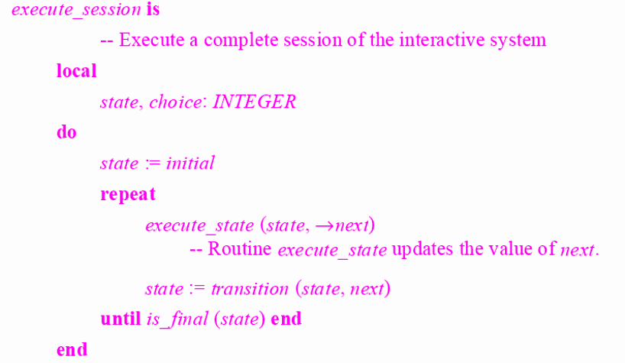
The top
Institute of Computer Software
Nanjing University

Slide 39
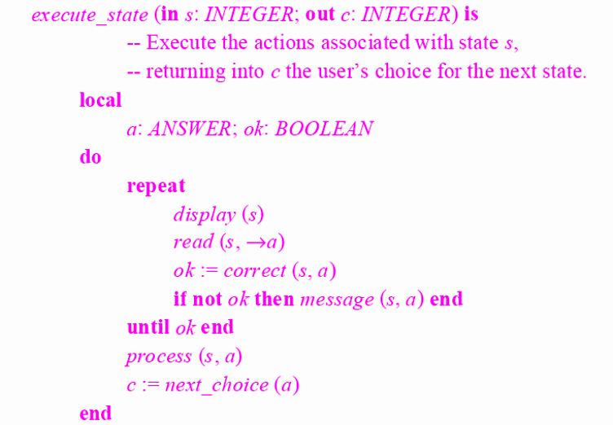
Institute of Computer Software
Nanjing University

Slide 40
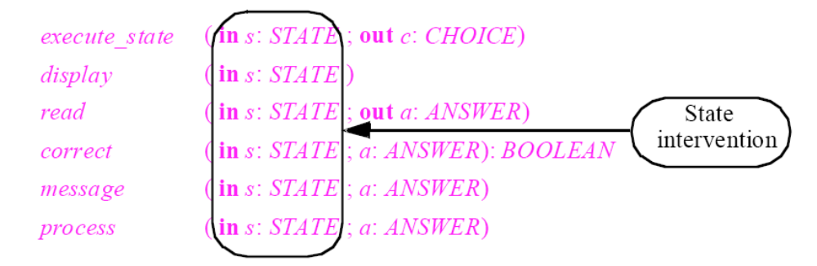
Critique
Institute of Computer Software
Nanjing University

Slide 41
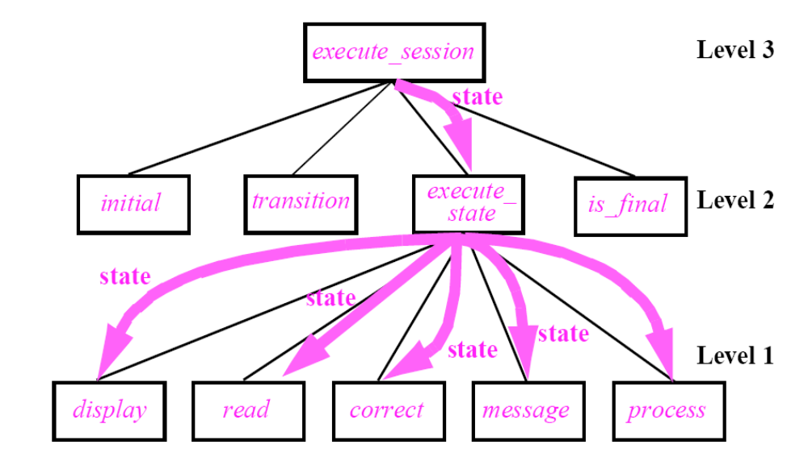
Institute of Computer Software
Nanjing University

Slide 42
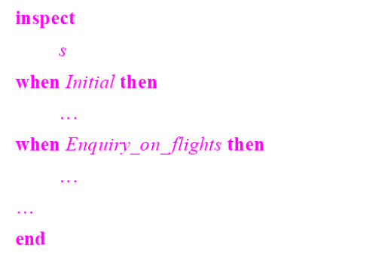
Fragileness
增加状态怎样？
如何在不同应用间复用?
Institute of Computer Software
Nanjing University

Slide 43
object-oriented architecture
Law of inversion
  If your routines exchange too many data, put your routines in your data.
Institute of Computer Software
Nanjing University

Slide 44
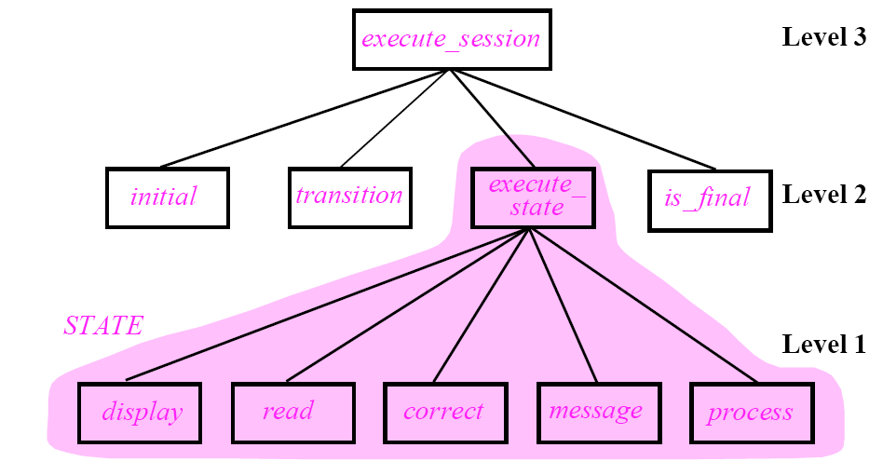
State as a class
Institute of Computer Software
Nanjing University

Slide 45
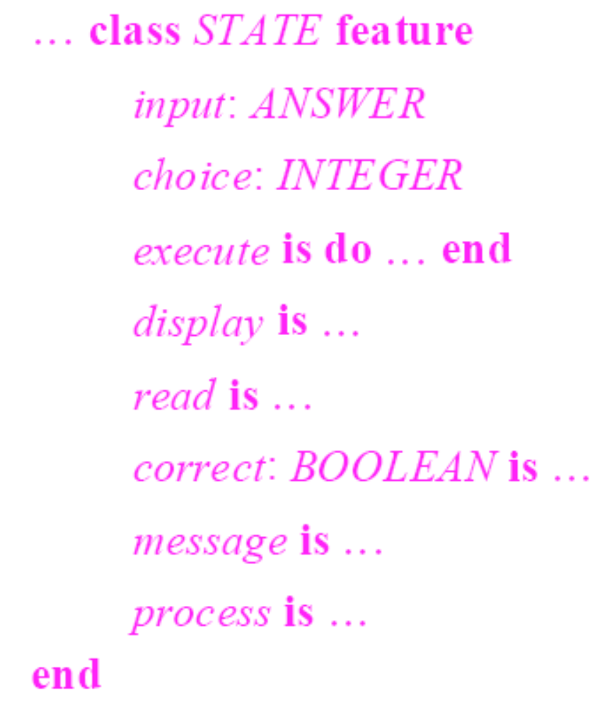
Institute of Computer Software
Nanjing University

Slide 46
Use inheritance and deferred class
Institute of Computer Software
Nanjing University

Slide 47
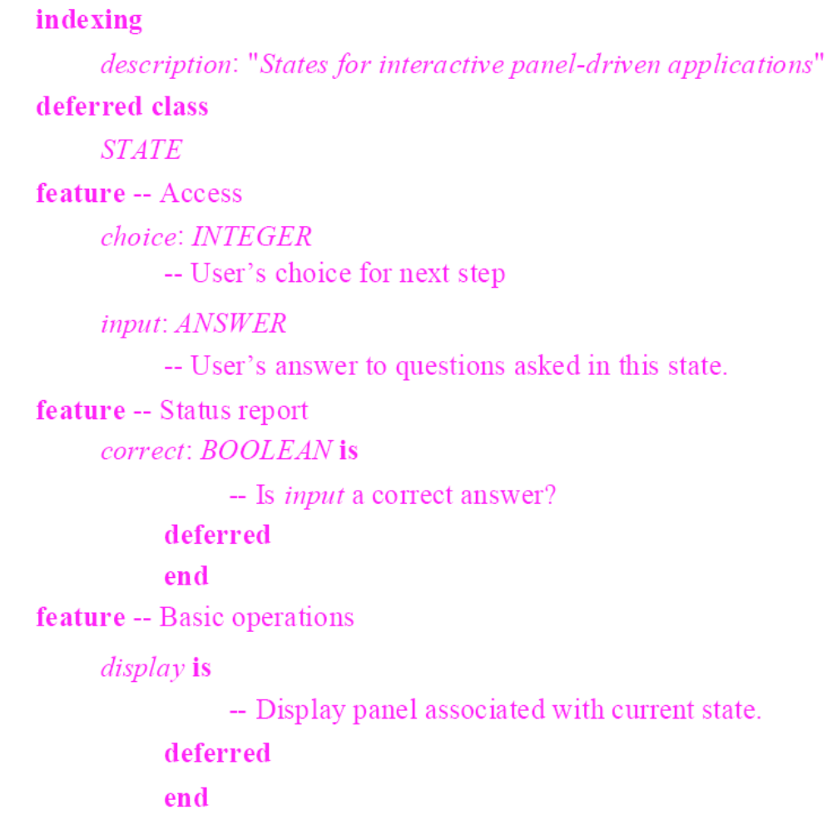

Slide 48
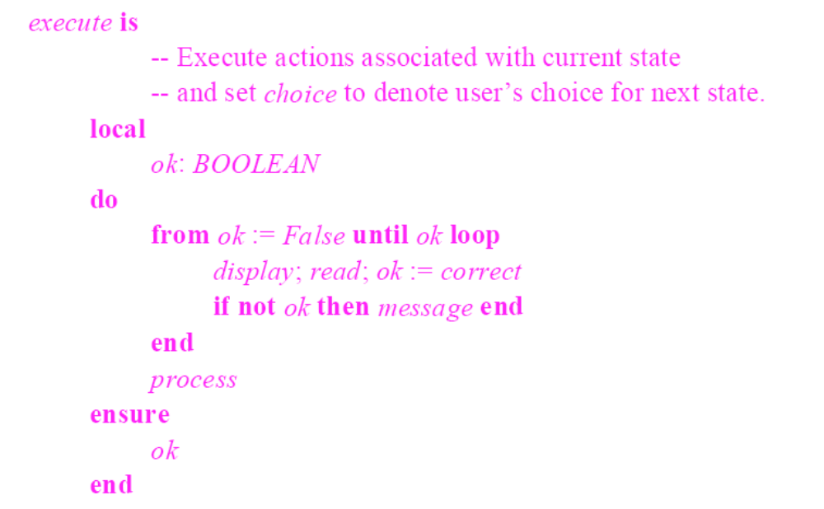
Institute of Computer Software
Nanjing University

Slide 49
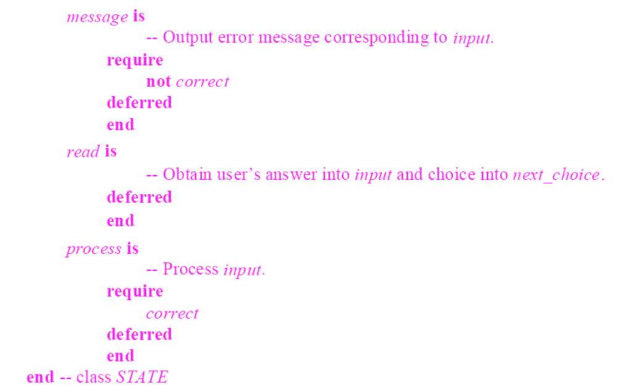
Institute of Computer Software
Nanjing University

Slide 50
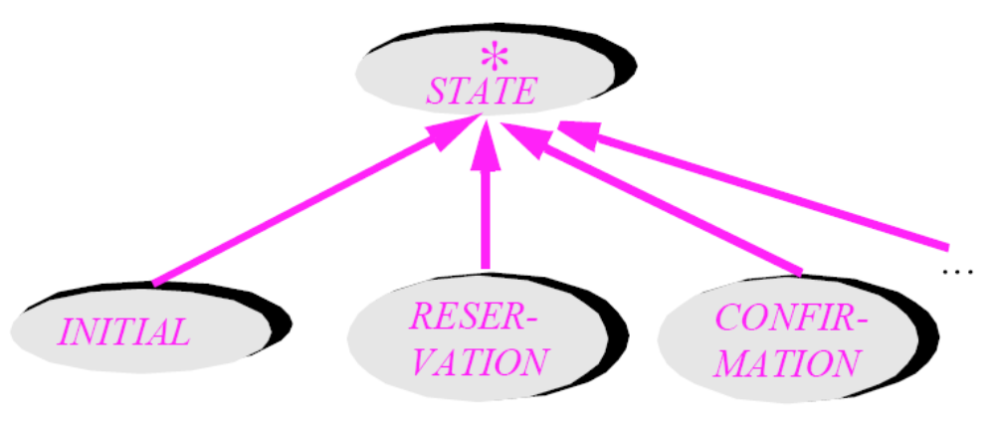
Institute of Computer Software
Nanjing University

Slide 51
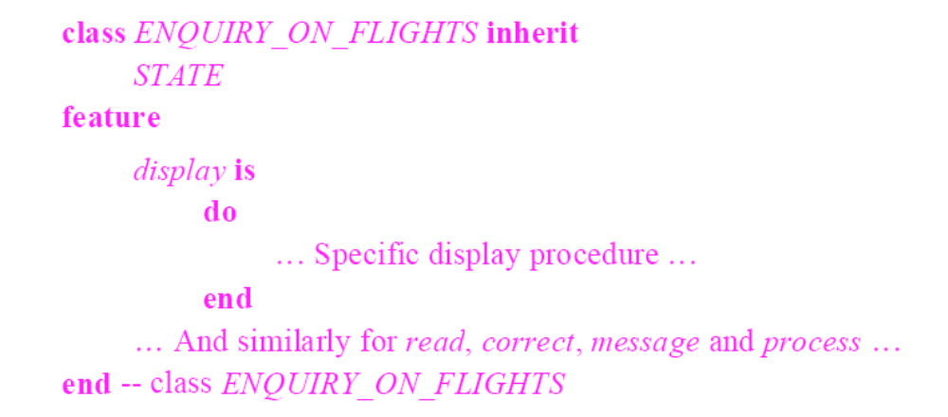
Institute of Computer Software
Nanjing University

Slide 52
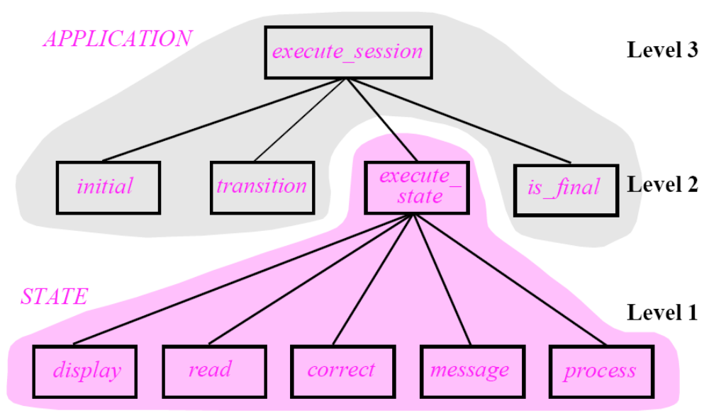
The system? – An ADT, not a “main” function
Institute of Computer Software
Nanjing University

Slide 53
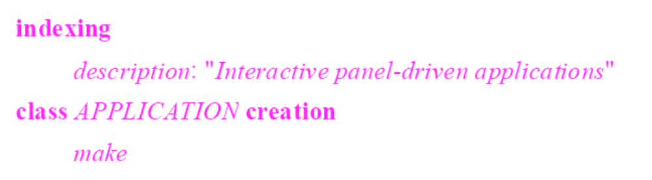
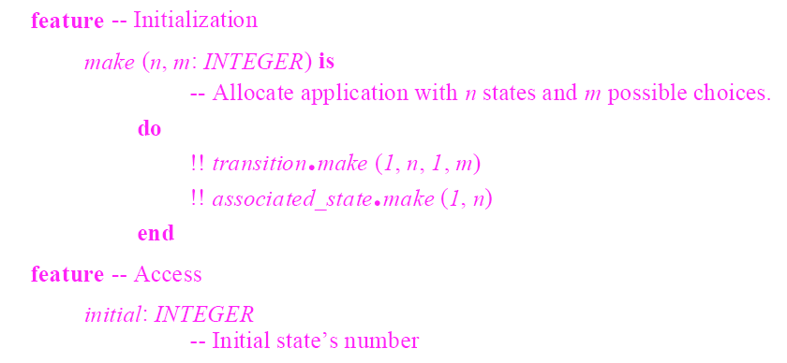
Institute of Computer Software
Nanjing University

Slide 54
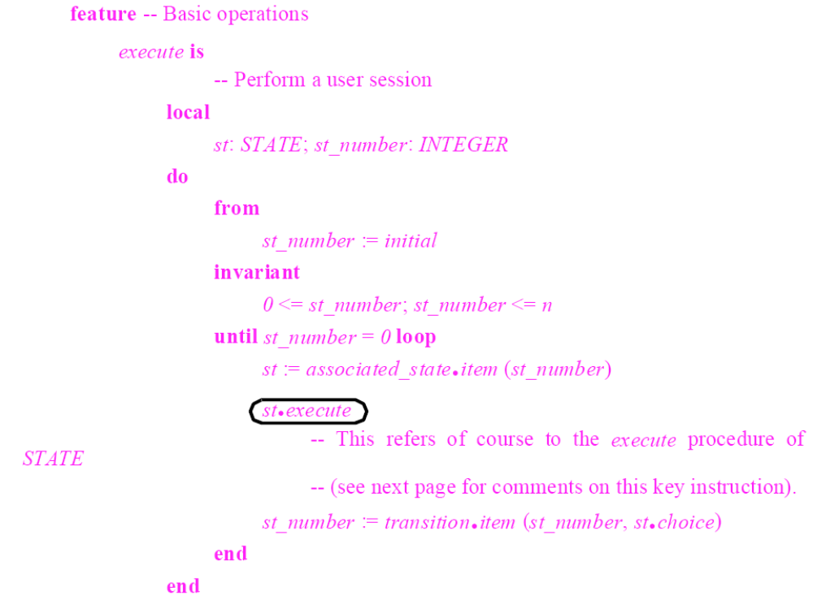
Institute of Computer Software
Nanjing University
Institute of Computer Software
Nanjing University

Slide 55
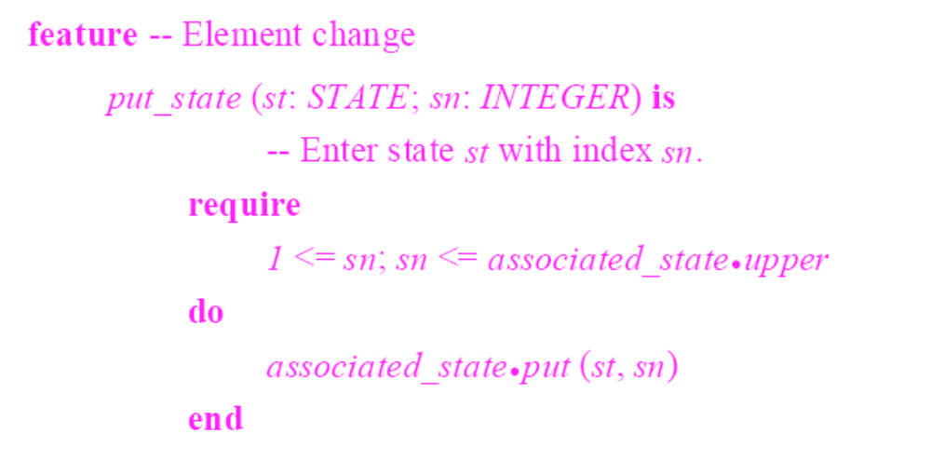
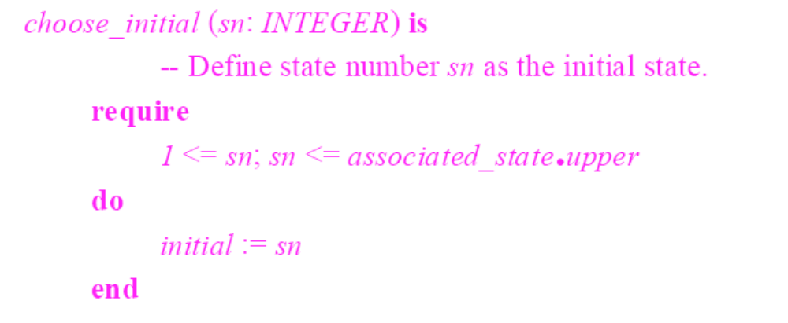
Institute of Computer Software
Nanjing University

Slide 56
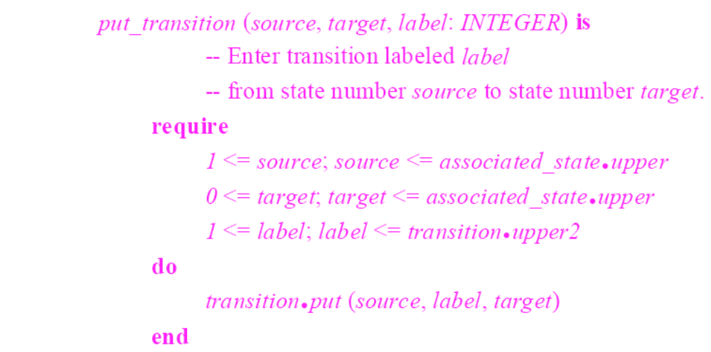
Institute of Computer Software
Nanjing University

Slide 57
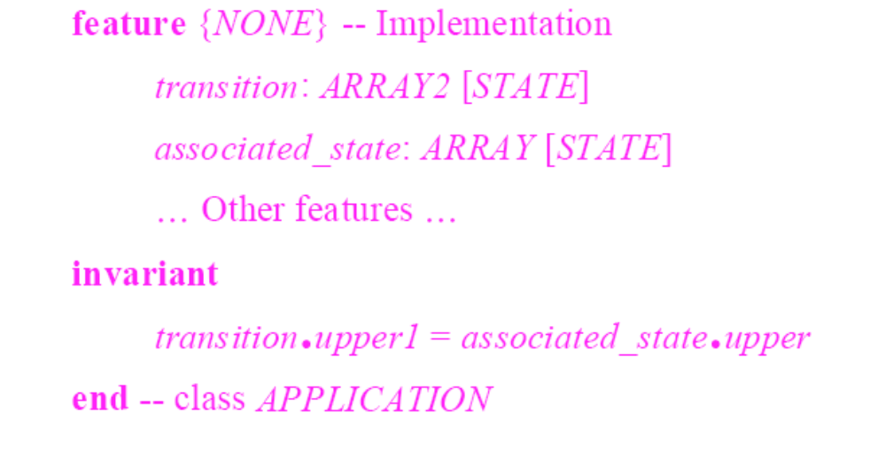
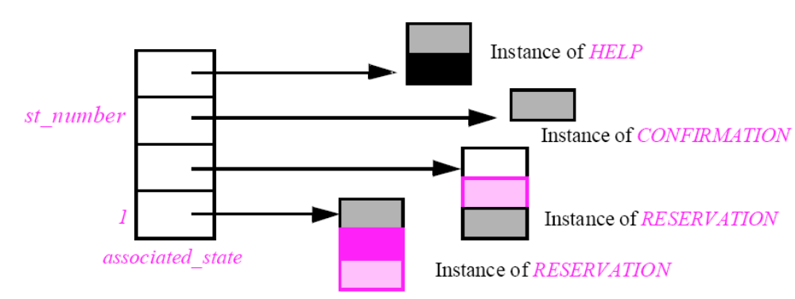
Institute of Computer Software
Nanjing University

Slide 58
讨论
Focus on data abstraction
  “Forget” the “main” function of the system, resist the constant temptation to ask “What does the system do?”
Law of inversion
Realworldliness is not a significant difference between OO and other approaches; what counts is how we model the world
Institute of Computer Software
Nanjing University

Slide 59
摘要
Introduction
Agile Development
Agile Design
  design principles
Institute of Computer Software
Nanjing University

Slide 60
Design Principles
SRP (The Single-Responsibility Principle) 单一职责原则
OCP (The Open-Closed Principle) 开放-封闭原则
LSP (The Liskov Substitution Principle) Liskov替换原则
DIP (The Dependency-Inversion Principle) 依赖倒置原则
ISP (The Interface-Segregation Principle) 接口隔离原则
Institute of Computer Software
Nanjing University

Slide 61
SRP 单一职责原则
A class should have only one reason to change. 就一个类而言，应该仅有一个引起它变化的原因。
What is a Responsibility?
  A reason for change 变化的原因。每个职责都是变化的一个轴线，当需求变化时，该变化会反映为职责的变化。
An axis of change is an axis of change only if the changes actually occur. 变化的轴线仅当变化实际发生时才具有真正的意义。
Institute of Computer Software
Nanjing University

Slide 62
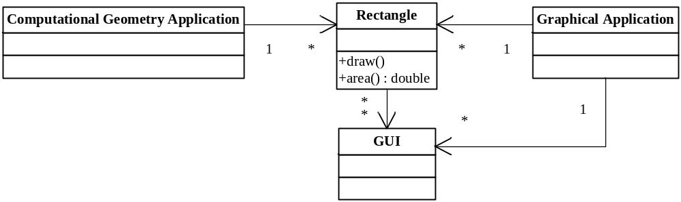
Example
矩形数学模型
矩形绘制
Institute of Computer Software
Nanjing University

Slide 63
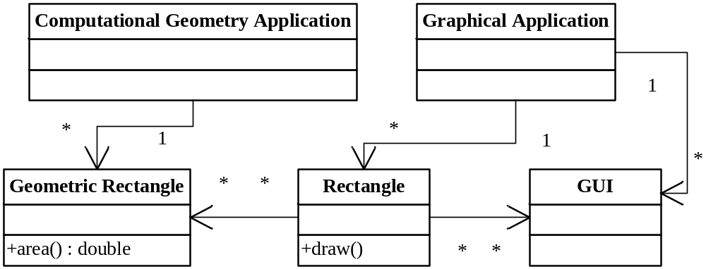
Example: applying SRP
矩形数学模型
矩形数学模型
Institute of Computer Software
Nanjing University

Slide 64
Example: SRP violation
interface Modem{
public void dial (String pno);
public void hangup();
public void send (char c);
public char recv();
}
connection
management
data
communication
Institute of Computer Software
Nanjing University

Slide 65
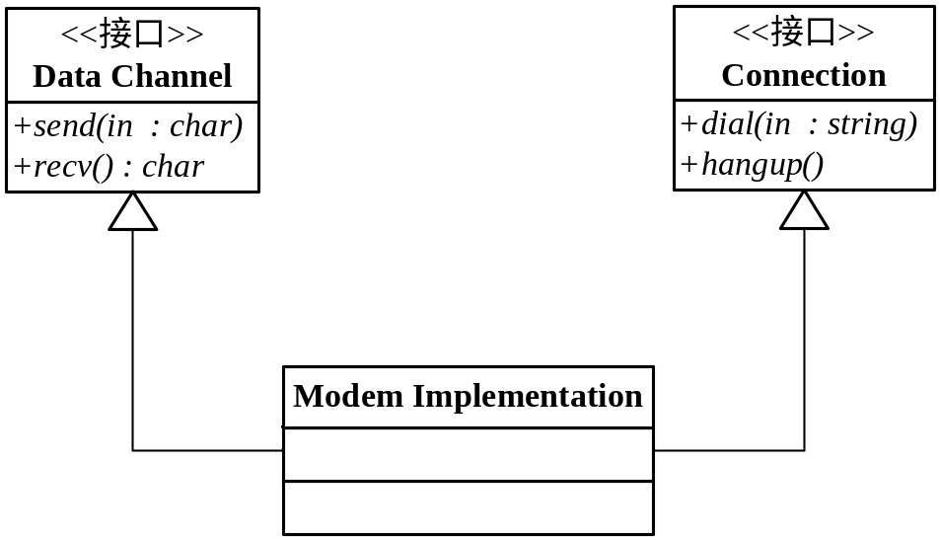
Example
Separated modem interface
如果应用程序的变化方式总是导致这两个职责同时变化，那么就不必分离它们！
Institute of Computer Software
Nanjing University

Slide 66
OCP 开放-封闭原则
Software entities (classes, modules, functions, etc.) should be open for extension, but closed for modification. 软件实体（类、模块、函数等）应该是可以扩展的，但是不可修改的。
OCP is the heart of OO design!
Institute of Computer Software
Nanjing University

Slide 67
OCP Description
Two primary attributes:
  Open for extension: the behavior of the module can be extended
  Closed for modification: extending the behavior of a module does not result in changes to the source or binary code of the module.
本质：不改源码，改行为
Is it possible?
Institute of Computer Software
Nanjing University

Slide 68
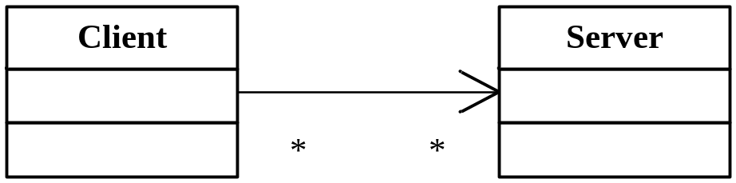
Abstraction is the key!
Client is neither open nor closed
Institute of Computer Software
Nanjing University

Slide 69
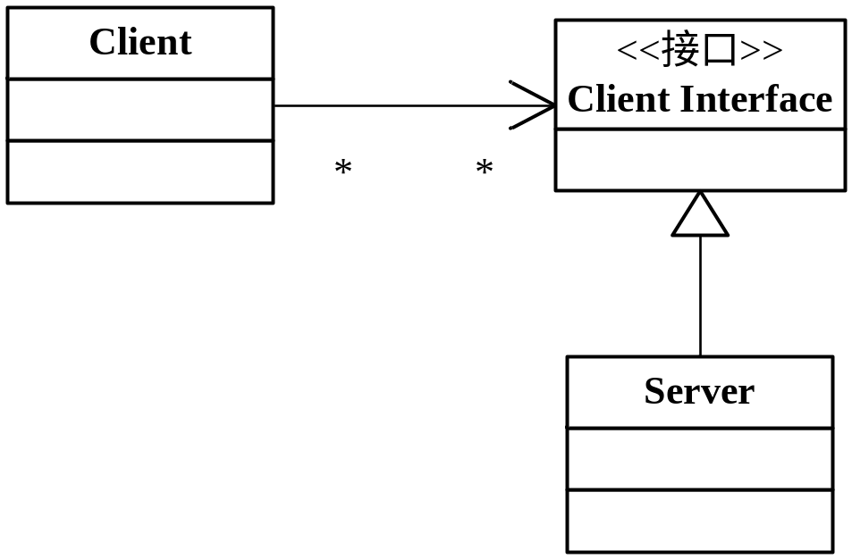
Strategy Pattern
Client is both open and closed
Institute of Computer Software
Nanjing University

Slide 70
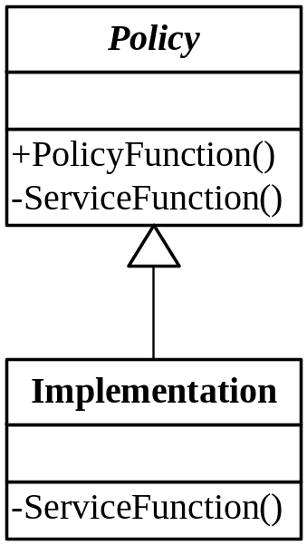
Template Method Pattern
A clear separation of generic functionality from the detailed implementation of that functionality
Institute of Computer Software
Nanjing University

Slide 71
Shape应用程序
过程化解决方案
--------drawAllShape.cc---
typedef struct Shape *ShapePointer;
void DrawAllShapes(ShapePointer list[], int n){
int i;
for (i=0;i<n;i++){
struct Shape* s=list[i];
switch (s->itsType){
case square: DrawSquare((struct Square*)s);
break;
case circle: DrawSquare((struct Circle*)s);
break;
}
}
}
--------shape.h----------
enum ShapeType{circle,square};
struct Shape{
ShapeType itsType;
};
--------circle.h---------
struct Circle{
ShapeType itsType;
double itsRadius;
Point itsCenter;
};
--------square.h---------
struct Square{
ShapeType itsType;
double itsSide;
Point itsTopLeft;
};
Institute of Computer Software
Nanjing University

Slide 72
遵循OCP
OOD解决方案
class Shape{
public: virtual void Draw() const=0;
};
class Square:public Shape{
public: virtual void Draw() const;
};
class Circle:public Shape{
public: virtual void Draw() const;
};
void DrawAllShapes(vector<Shape*>& list){
vector<Shape*>::iterator I;
for (i=list.begin();i!=list.end();i++)
(*i)->Draw();
}
Institute of Computer Software
Nanjing University

Slide 73
并非100%封闭！
如果要求所有的圆形必须在正方形之前绘制，那么？
无论模块是多么“封闭”，总有一些无法对之封闭的变化！
Institute of Computer Software
Nanjing University

Slide 74
Heuristics
OCP是面向对象设计的核心所在！
  灵活性、可重用性、可维护性
  使用OOPL不代表遵循了OCP
  肆意抽象亦不是一个好主意
100%的封闭不可能，必须有策略地对待这个问题。
  对程序中呈现出频繁变化的那些部分做出抽象，拒绝不成熟的抽象和抽象本身一样重要。
Institute of Computer Software
Nanjing University

Slide 75
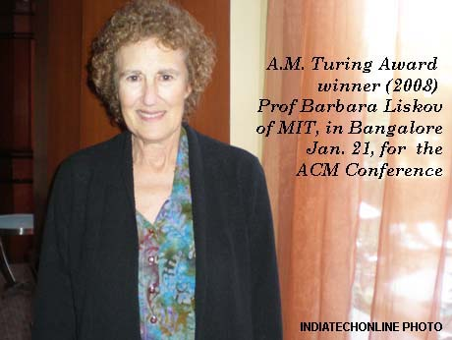
LSP: Liskov替换原则
Institute of Computer Software
Nanjing University

Slide 76
LSP: Liskov替换原则
Subtypes must be substitutable for their base types. 子类型必须能够替换掉它们的基类型。
If for each object o1 of type S there is an object o2 of type T such that for all programs P defined in terms of T, the behavior of P is unchanged when o1 is substituted for o2 then S is a subtype of T. [Liskov88] 若对每个类型S的对象o1，都存在一个类型T的对象o2，使得在所有针对T编写的程序P中，用o1代替o2后，程序P行为功能不变，则S是T的子类型。
Institute of Computer Software
Nanjing University

Slide 77
LSP Violation (I)
RTTI（运行时类型识别）
struct Shape{
enum ShapeType {square, circle} itsType;
Shape(ShapeType t):itsType(t){ }
};
struct Circle: public Shape{
Circle():Shape(circle){ };
void Draw() const;
};
struct Square: public Shape{
Square():Shape(square){ };
void Draw() const;
};
void DrawShape(const Shape& s ){
if(s.itsType == Shape::square){
static_cast<const Square&>(s).draw()
else if (s.itsType == Shape::circle)
static_cast<const Circle&>(s).draw()
}
Institute of Computer Software
Nanjing University

Slide 78
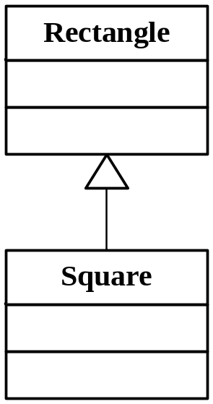
LSP Violation (II)
class Rectangle{
public:
void SetWidth(double w) {itsWidth=w;}
void SetHeight(double h) {itsHeight=h;}
…
private:
double itsWidth;
double itsHeight;
…
}
IS-A Relationship
Institute of Computer Software
Nanjing University

Slide 79
LSP Violation (II)
void Square::SetWidth(double w){
Rectangle::SetWidth(w);
Rectangle::SetHeight(w):
}
void Square::SetHeight(double w){
Rectangle::SetWidth(w);
Rectangle::SetHeight(w):
}
void f (Rectangle& r){
r.SetWidth(32); //call Rectangle::SetWidth
}
Square Violated!
:Square
Institute of Computer Software
Nanjing University

Slide 80
LSP Violation (II)
Are Rectangle and Square
self-consistent?
class Rectangle{
public:
virtual void SetWidth(double w) {itsWidth=w;}
virtual void SetHeight(double h) {itsHeight=h;}
…
private:
double itsWidth;
double itsHeight;
…
}
:Square
void g (Rectangle& r){
r.SetWidth(5);
r.SetHeight(4);
assert(r.Area()==20);
}
True or false?
Violated!
Institute of Computer Software
Nanjing University

Slide 81
The real problem
Validity is not intrinsic! 有效性并非本质属性
  模型的有效性只能通过它的客户程序来表现。
IS-A is about Behavior
  Behaviorally, a Square is not a Rectangle.
Recall DbC principle about inheritance
  Precondition 更弱；Postcondition 更强
Institute of Computer Software
Nanjing University

Slide 82
The real problem
Rectangle::SetWidth(double w)的后置条件
  Postcond: (itsWidth==w)&&(itsHeight==old.itsHeight)
  但是Square::SetWidth(double w)不能满足该条件
可以通过编写单元测试的方法来指定契约
Institute of Computer Software
Nanjing University

Slide 83
Heuristics and Conventions
Violation 1:
  Degenerate functions in derivatives 派生类中的退化函数
Violation 2:
  Throwing exceptions from derivatives 从派生类中抛出异常
public class Base{
public void f() { /*some code*/ }
}
Public class Derived extends Base{
public void f() { }
}
Institute of Computer Software
Nanjing University

Slide 84
LSP
One of the enablers of the OCP。
LSP是使OCP成为可能的主要原则之一。
It is the substitutability of subtypes that allows a module, expressed in terms of a base type, to be extensible without modification. 正是子类型的可替换性才使得使用基类类型的模块在无需修改的情况下就可以扩展。
Institute of Computer Software
Nanjing University

Slide 85
DIP 依赖倒置原则
High level modules should not depend on low-level modules. Both should depend on abstractions. 高层模块不应该依赖于低层模块，二者都应该依赖于抽象。
Abstractions should not depend on details. Details should depend on abstractions. 抽象不应该依赖于细节，细节应该依赖于抽象。
Inversion: 相对于结构化方法而言
Institute of Computer Software
Nanjing University

Slide 86
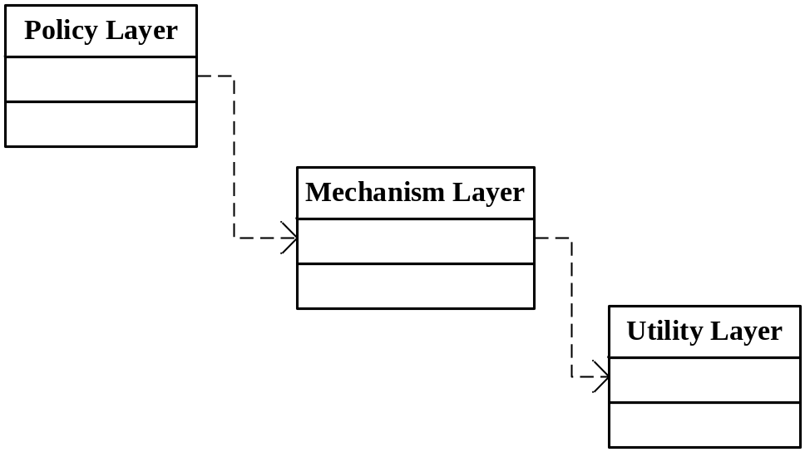
Laying
Booch: “… all well structured OO architectures have clearly defined layers, with each layer providing some coherent set of services through a well-defined and controlled interface.”
Unfortunate!
Institute of Computer Software
Nanjing University

Slide 87
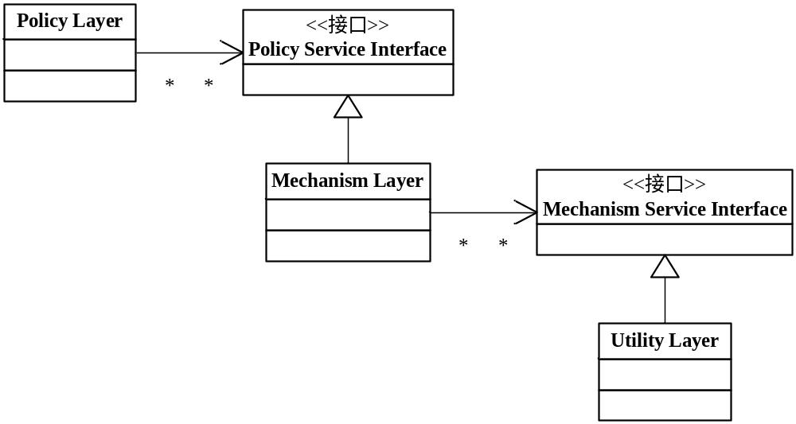
Laying
Hollywood principle: “don’t call us, we’ll call you.” 低层模块实现了在高层模块中声明并被高层模块调用的接口。
Inverted layers
also an inversion of interface ownership: 客户拥有抽象接口，服务者则从这些抽象接口派生。
Institute of Computer Software
Nanjing University

Slide 88
Example
？
Button
Lamp
+poll()
+turnOn()
+turnOff()
public class Button{
private Lamp itsLamp;
public void poll(){
if (/* some condition */)
itsLamp.turnOn();
}
}
Institute of Computer Software
Nanjing University

Slide 89
Example
Button
ButtonServer
SwitchableDevice
+poll()
+turnOn()
+turnOff()
!
Lamp
public class Button{
private ButtonServer bs;
public void poll(){
if (/* some condition */)
bs.turnOn();
}
}
Institute of Computer Software
Nanjing University

Slide 90
Heuristic
“Depend on abstractions” 依赖于抽象
  不应该依赖于具体类——程序中所有的依赖关系都应该终止于抽象类或者接口
According to it:
  任何变量都不应该持有一个指向具体类的指针或引用
  任何类都不应该从具体类派生
  任何方法都不应该覆写它的任何基类中的已经实现了的方法
  例外：可以依赖稳定的具体类，比如String
Institute of Computer Software
Nanjing University

Slide 91
DIP
依赖关系的倒置正是好的面向对象设计的标志所在。
如果程序的依赖关系是倒置的，它就是面向对象的设计，否则就是过程化的设计。
DIP是实现许多OO技术所宣称的好处的基本低层机制。它的正确应用对于创建可重用的框架来说是必须的。
Institute of Computer Software
Nanjing University

Slide 92
ISP 接口隔离原则
Clients should not be forced to depend on methods that they do not use. 不应该强迫客户依赖于它们不用的方法。
Deals with the disadvantage of “fat” interfaces – whose interfaces are not cohesive. 处理接口不是内聚的胖接口的缺点
Institute of Computer Software
Nanjing University

Slide 93
Example
common door!
class Timer {
public:
void Register (int timeout, TimeClient* client );
}
class Door {
public:
virtual void Lock() = 0;
virtual void Unlock() = 0;
virtual bool IsDoorOpen() = 0;
}
class TimerClient {
public:
virtual void TimeOut () = 0;
}
How about a timed door?
Institute of Computer Software
Nanjing University

Slide 94
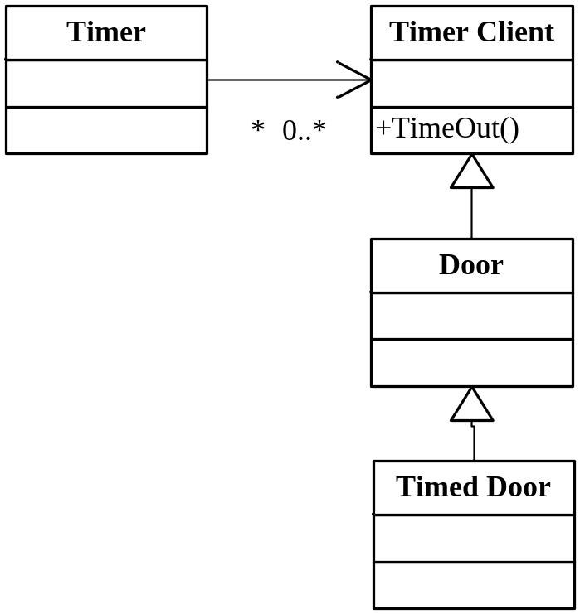
Interface Pollution
But not all varieties of Door need timing!
Institute of Computer Software
Nanjing University

Slide 95
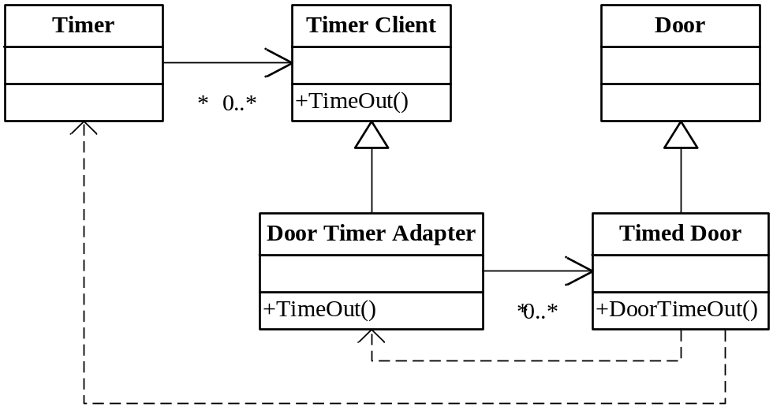
Separate Interfaces
Solution 1: adapter 使用委托分离接口
Institute of Computer Software
Nanjing University

Slide 96
Separate Interfaces
class TimedDoor: public Door{
public: virtual void DoorTimeOut(int timeoutId);
}
Class DoorTimerAdapter: public TimeClient {
pubic:
DoorTimerAdapter(TimedDoor& theDoor): itsTimedDoor(theDoor){}
virtual void TimeOut(int timeoutId){
itsTimedDoor.DoorTimeOut(timeoutId);}
private:
TimedDoor& istTimedDoor;
}
Institute of Computer Software
Nanjing University

Slide 97
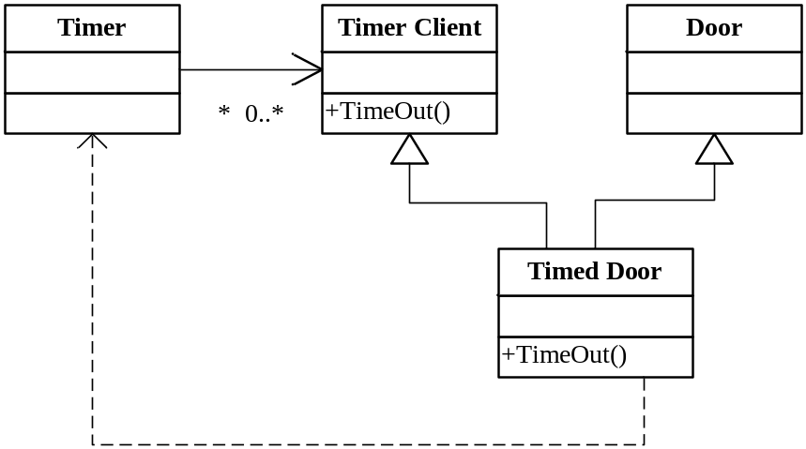
Separate Interfaces
Solution 2: multiple inheritance
class TimedDoor: public Door, public TimerClient{
public: virtual void TimeOut(int timeoutId);
}
Institute of Computer Software
Nanjing University

Slide 98
Heuristic
客户程序应该仅仅依赖于它们实际调用的方法！
方法：把胖类的接口分解为多个特定于客户程序的接口
目标：高内聚，低耦合！
Institute of Computer Software
Nanjing University

Slide 99
Design Principles
SRP (The Single-Responsibility Principle) 单一职责原则
OCP (The Open-Closed Principle) 开放-封闭原则
LSP (The Liskov Substitution Principle) Liskov替换原则
DIP (The Dependency-Inversion Principle) 依赖倒置原则
ISP (The Interface-Segregation Principle) 接口隔离原则
Institute of Computer Software
Nanjing University

Slide 100
How to design Packages?
在向包中分配类时应该依据什么原则？
应该使用什么设计原则来管理包之间的关系？
包的设计应该先于类呢（自顶向下）？还是类的设计应该先于包（自底向上）？
如何实际表现出“包”？C++？Java？某种开发环境？
包创建好后，应当将它们用于何种目的？
Institute of Computer Software
Nanjing University

Slide 101
粒度：包的内聚性原则
REP (The Reuse-Release Equivalence Principle)，重用发布等价原则，重用的粒度就是发布的粒度。
CRP (The Common-Reuse Principle)，共同重用原则，一个包中的所有类应该是共同重用的。
CCP (The Common-Closure Principle)，共同封闭原则，包中的所有类对于同一类性质的变化应该是共同封闭的。
Institute of Computer Software
Nanjing University

Slide 102
REP
当你重用一个类库时，对这个类库的作者有什么期望呢？-- 维护？通知修改？
REP指出，一个包的重用粒度（granule of reuse）可以和发布粒度（granule of release）一样大。所重用的任何东西都必须同时被发布和跟踪。
可重用的包必须包含可重用的类！
可重用性不是唯一标准，也要考虑重用这些软件的人。即一个包中的所有类对于同一类用户来说都是可重用的。
Institute of Computer Software
Nanjing University

Slide 103
CRP
一个包中的所有类应该是共同重用的，如果重用了包中的一个类，那么就要重用包中的所有类。
  趋向于共同重用的类应该属于同一个包。
  相互之间没有紧密联系的类不应该在同一个包中。
jar的修改和发布
Institute of Computer Software
Nanjing University

Slide 104
CCP
包中的所有类对于同一类性质的变化应该是共同封闭的。一个变化若对一个包产生影响，则将对该包中的所有类产生影响，而对于其它的包不造成任何影响。
  回顾下SRP，OCP
把可能由于同样的原因而更改的所有类共同聚集在同一个地方。
Institute of Computer Software
Nanjing University

Slide 105
稳定性：包的耦合性原则
ADP (The Acyclic-Dependencies Principle)，无环依赖原则，在包的依赖关系图中不允许存在环。
SDP (The Stable-Dependencies Principle)，稳定依赖原则，朝着稳定的方向进行依赖。
SAP (The Stable-Abstractions Principle)，稳定抽象原则，包的抽象程度应该和其稳定程度一致。
Institute of Computer Software
Nanjing University

Slide 106
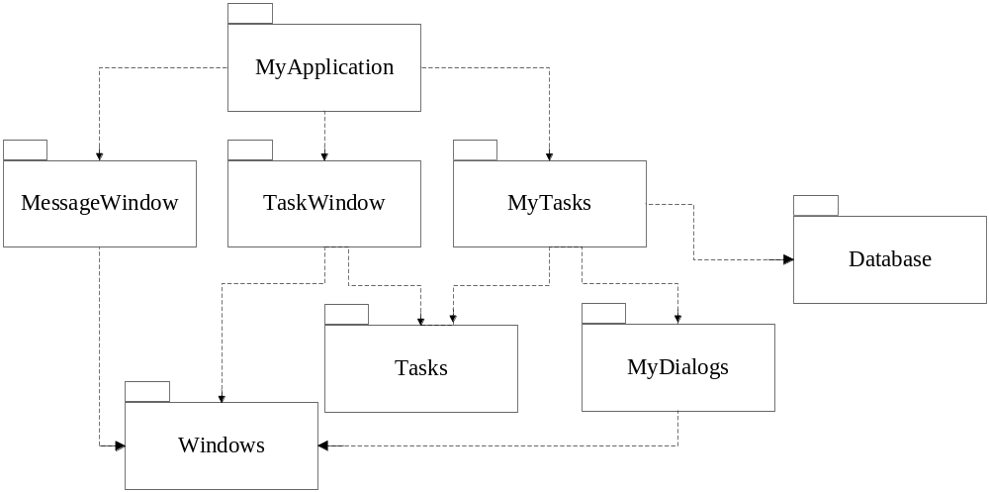
ADP
“晨后综合症”
每周构建
消除依赖环
  DAG
Institute of Computer Software
Nanjing University

Slide 107
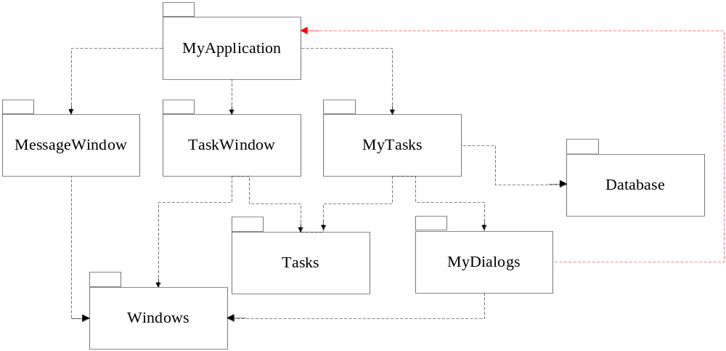
ADP
具有依赖环的包图
  发布MyTasks…
  测试MyDialogs…
Institute of Computer Software
Nanjing University

Slide 108
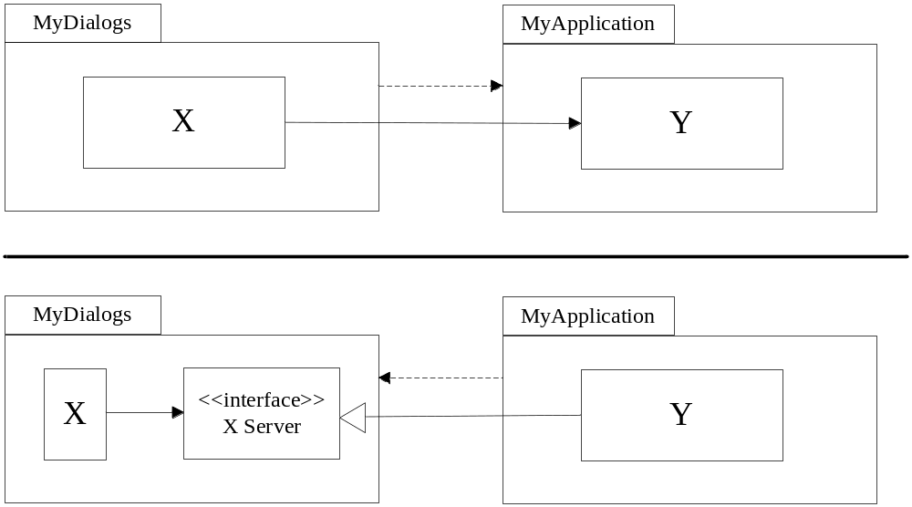
解除依赖环
方法1: 使用依赖倒置原则
Institute of Computer Software
Nanjing University

Slide 109
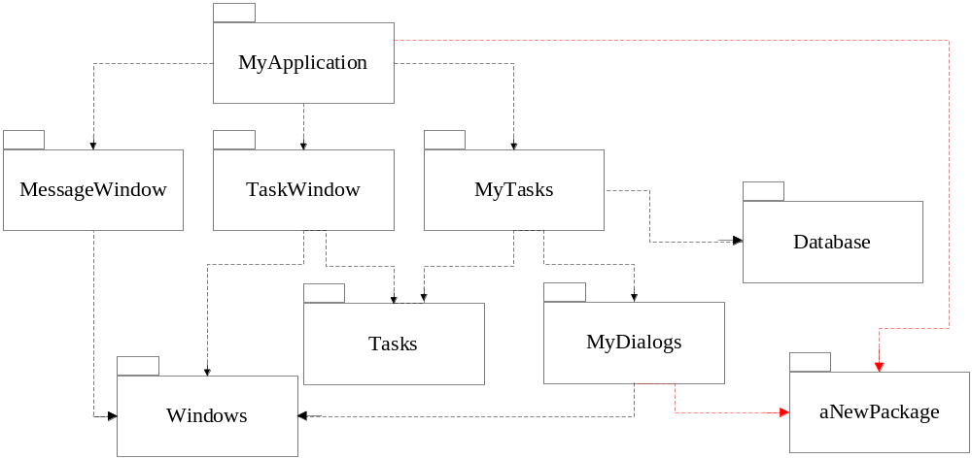
解除依赖环
方法2: 新创建一个彼此都依赖的包，将依赖的类移到这个新包中
Jitter和增长
Institute of Computer Software
Nanjing University

Slide 110
Heuristic
不能自顶向下设计包的结构
  包结构是随着系统的增长、变化而逐步演化的
包的依赖关系图和描绘应用程序的功能之间几乎没有关系，相反，它们是应用程序可构建性的映射图。
Institute of Computer Software
Nanjing University

Slide 111
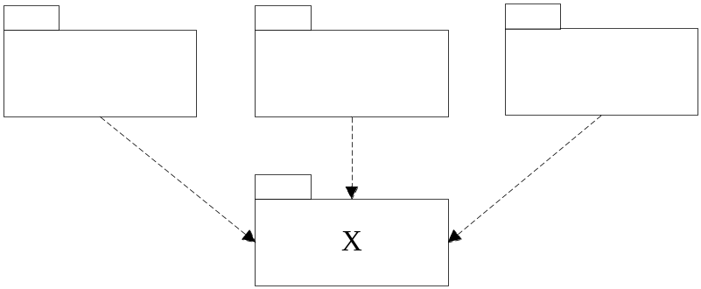
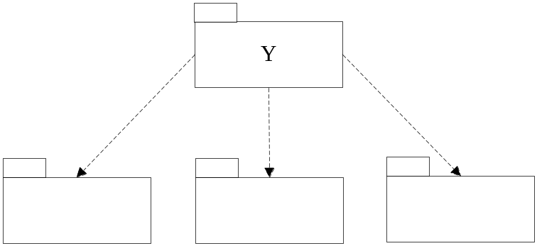
SDP
不要依赖不稳定的包
对于任何包而言，如果期望它是可变的，就不应该让一个难以更改的包依赖于它，否则，可变的包同样也难以更改。
不稳定
稳定
Institute of Computer Software
Nanjing University

Slide 112
稳定性度量
(Ca)输入耦合度：指处于该包的外部并依赖于该包内的类的类的数目
(Ce)输出耦合度：指处于该包的内部并依赖于该包外的类的类的数目
不稳定性I: [0,1]
  I=0 最稳定
  I=1 最不稳定
SDP规定一个包的I度量值应该大于它所依赖的包的I度量值（即I度量值应该顺着依赖的方向减少）
I =
Ce
Ca+Ce
Institute of Computer Software
Nanjing University

Slide 113
稳定性度量
Pa
Pb
q
r
s
Pc
Pd
t
u
v
Pc: Ca=3, Ce=1, I=1/4
Institute of Computer Software
Nanjing University

Slide 114
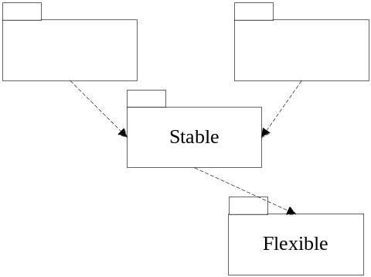

稳定 vs. 不稳定
并非所有的包都应该是稳定的
思考题：HOW TO?
i=1
i=1
i=0
理想的包配置
违反了SDP
Institute of Computer Software
Nanjing University

Slide 115
稳定 vs. 不稳定
Stable
Stable
U
DIP
U
Flexible
UInterface
Flexible
C
《interface》IU
C
Institute of Computer Software
Nanjing University

Slide 116
SAP
包的抽象程度应该和其稳定性一致。
  一个稳定的包应该也是抽象的，这样它的稳定性就不会使其无法扩展
  一个不稳定的包应该是具体的，因为它的不稳定性使得其内部的具体代码易于更改。
依赖应该朝着抽象的方向进行！
Institute of Computer Software
Nanjing University

Slide 117
Remember
As with all principles, care must be taken not to overdo it.
Institute of Computer Software
Nanjing University

Slide 118
作业 （本次作业不用提交）
熟记并理解每种面向对象的设计原则。
查看JDK中Collection框架的源代码，考察一个优秀的框架是如何遵循面向对象的设计原则的。
Institute of Computer Software
Nanjing University

