Slide 1
Advanced Object-oriented Design – Principles and Patterns
OO Design Principles

Slide 2
Elements of Bad Design
糟糕地软件设计
RFIV

Slide 3
僵化性 Rigility
僵化性意味着难以对软件进行改动，即使最简单的改动也很麻烦.
现象:每次改动都导致对相关联模块的一系列层层改动.
后果:此种软件行为将导致管理人员不愿意让开发人员做哪怕是微小的改动 。因为他们无法确切地知道何时开发人员才能完成改动

Slide 4
脆弱性 Fragility
每当软件在某处修改时，软件会在多个地方产生崩溃。
而且往往崩溃点在概念上与修改点没有关系
现象: 每次修改后软件变得更加糟糕，修改导致的问题多于修改解决的问题。
后果:每次管理人员授权修订，都让他们心惊胆颤 ，担心软件会在某处莫名崩溃。

Slide 5
牢固性 Immobility
牢固性 无法从其他的项目或相同的项目中实现软件重用
现象: 开发者存在发现其他开发人员写的一个类似的模块，但是将此模块从其他软件中分离出来的工作量和风险太大.
后果:软件重新写一遍，而不是重用

Slide 6
粘质性 Viscosity
粘质性 软件本身或开发环境的原因使得软件变更需要通过怪异的手法，而不是保持原有的良好的设计
现象: 做正确的事情是困难的，做错误的事情是容易的。
后果: 由于使用怪异技巧、临时补丁、简便措施导致软件的可维护性持续下降

Slide 7
什么导致糟糕的设计
明显原因: 缺少设计技巧与实际锻炼，变更管理技术、时间资源约束、领域复杂性等。
不明显的原因:
  软件腐化是个缓慢的过程。。即使原有的设计是简洁而优雅的也会随时间的推移而退化 ..
  未预期的和不正确的模块依赖关系、未管理的模块依赖关系。
  经常产生原始设计中未考虑的需求变更。

Slide 8
OO Design Principles （11条）
  The Single Resposbility Principle (SRP) 单一职责原则
  The Open/Closed Principle (OCP) 开发封闭原则
  The Liskov Substitution Principle (LSP) Liskov替换原则
  The Dependency Inversion Principle (DIP) 依赖倒置原则
  The Interface Segregation Principle (ISP)接口分离原则
  The Reuse/Release Equivalency Principle (REP) 重用/发布等价原则
  The Common Closure Principle (CCP) 共同封闭原则
  The Common Reuse Principle (CRP) 共同重用原则
  The Acyclic Dependencies Principle (ADP) 无环依赖原则
  The Stable Dependencies Principle (SDP) 稳定抽象原则
  The Stable Abstractions Principle (SAP) 稳定抽象原则
类/接口设计原则
包设计原则
包依赖原则

Slide 9
Topic 1: The Open/Closed Principle (OCP)
A module should be open for extension but closed for modification.

Slide 10
The open/ closed principle (OCP)
We should write our modules so that they can be extended, without requiring them to be modified. In other words, we want to be able to change what the modules do, without changing the source code of the modules.
How?: Abstraction and Polymorphism

Slide 11
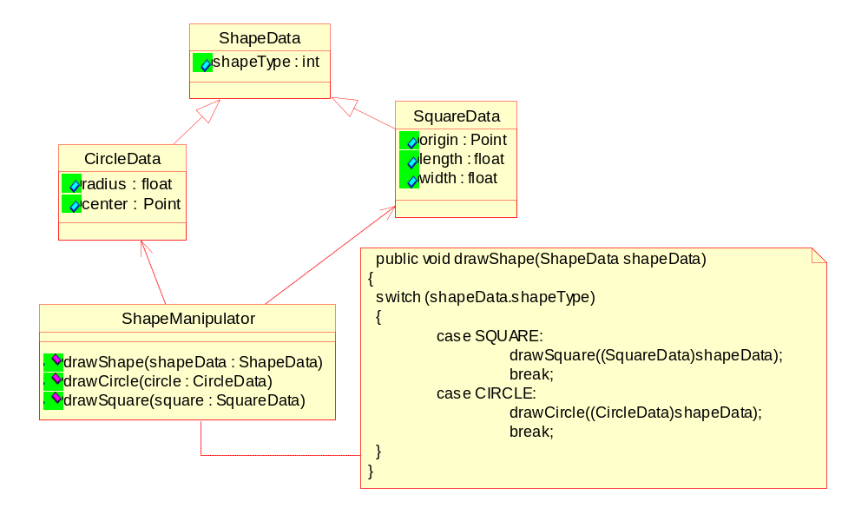
The open/ closed principle (OCP) Example

Slide 12
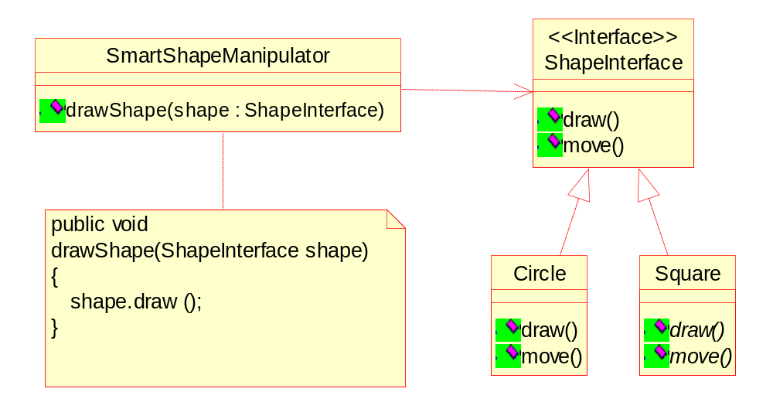
The open/ closed principle (OCP) Example

Slide 13
The open/ closed principle (OCP) Discussion
If I need to create a new shape, such as a Triangle, I must modify the ‘drawShape()' function.
In a complex application the switch/case statement above is repeated over and over again for every kind of operation that can be performed on a shape .
Worse, every module that contains such a switch/case statement retains a dependency upon every possible shape that can be drawn, thus, whenever one of the shapes is modified in any way, the modules all need recompilation, and possibly modification
However, when the majority of modules in an application conform to the open/closed principle, then new features can be added to the application by adding new code rather than by changing working code. Thus, the working code is not exposed to breakage.

Slide 14
Topic 2: The Liskov Substitution Principle (LSP)
Subclasses should be substitutable for their base classes.

Slide 15
The Liskov Substitution Principle (LCP)
A client of a base class should continue to function properly if a derivative of that base class is passed to it.
In other words, if some function takes an argument ot type Policy, then it should be legal to pass in an instance of Personal Auto Policy to that provided Personal Auto Policy is directly/ indirectly derived from Policy.

Slide 16
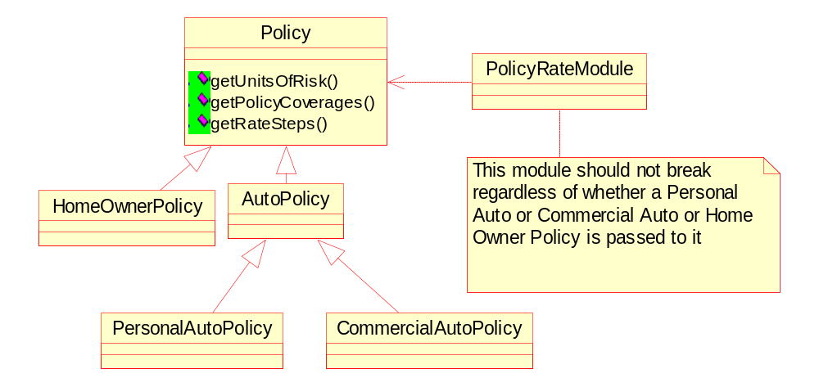
The Liskov Substitution Principle (LCP) Example

Slide 17
The Liskov Substitution Principle (LCP) Discussion
Is Square a Rectangle ? Mathematically yes, Behaviorally, a Square is not a Rectangle and it is behavior that software is really all about.
It is only when derived types are completely substitutable for their base types that functions which use those base types canbe reused with impunity, and the derived types can be changed with impunity.
Violations of LSP are latent violations of OCP.

Slide 18
Topic 3: The Dependency Inversion Principle (DIP)
Depend upon Abstractions. Do not depend upon concretions.

Slide 19
The Dependency Inversion Principle (DIP)
Dependency Inversion is the strategy of depending upon interfaces or abstract functions and classes, rather than upon concrete functions and classes.
Every dependency in the design should target an interface, or an abstract class. No dependency should target a concrete class.

Slide 20
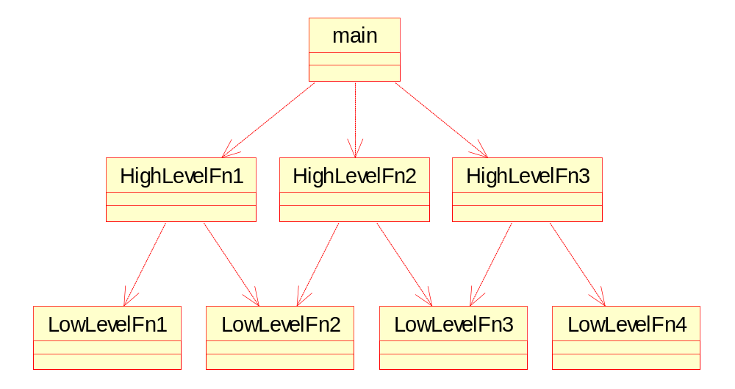
The Dependency Inversion Principle (DIP) Example
Dependency Structure of a Procedural Architecture

Slide 21
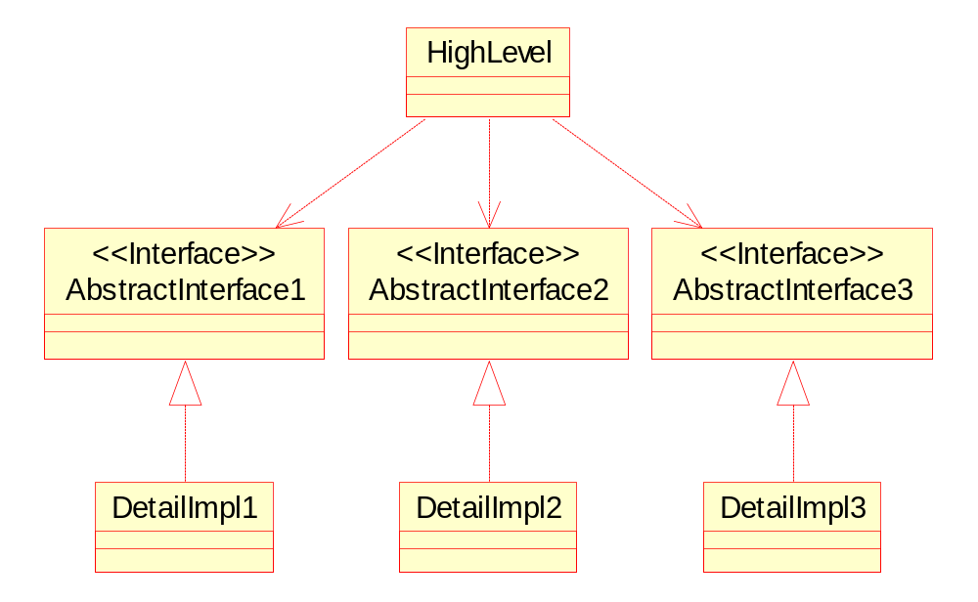
The Dependency Inversion Principle (DIP) Example
Dependency Structure of an Object Oriented Architecture

Slide 22
The Dependency Inversion Principle (DIP) Discussion
One motivation behind the DIP is to prevent you from depending upon volatile modules.
Typically, Concrete things change a lot, abstract things change much less frequently.
Abstractions are “hinge points”, they represent the places where the design can bend or be extended, without themselves being modified (OCP)
One of the most common places that designs depend upon concrete classes is when those designs create instances. By definition, you cannot create instances of abstract classes. There is an elegant solution to this problem named Abstract Factory

Slide 23
Topic 4: The Interface Segregation Principle (ISP)
Many client specific interfaces are better than one general purpose interface

Slide 24
The Interface Segregation Principle (ISP)
If you have a class that has several clients, rather than loading the class with all the methods that the clients need, create specific interfaces for each type of client and multiply inherit them into the class.

Slide 25
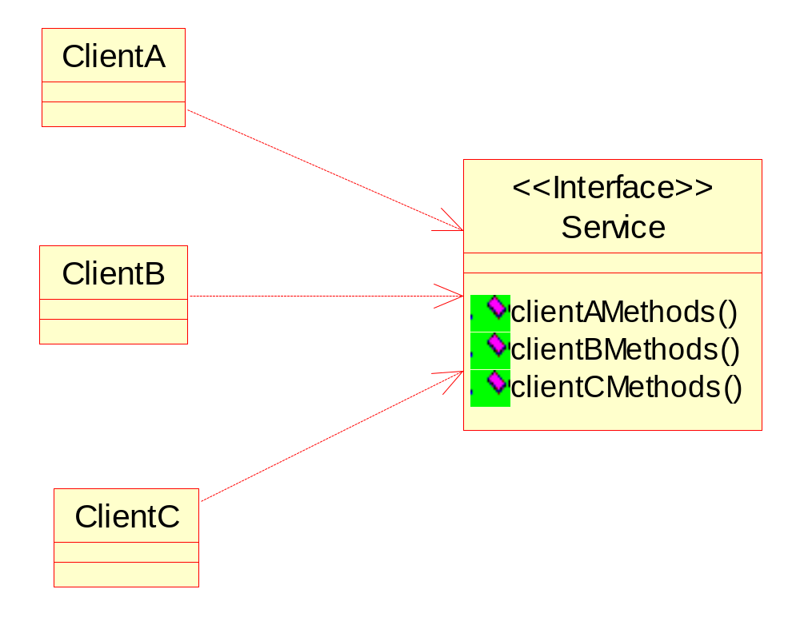
The Interface Segregation Principle (ISP) Example
Fat Service with Integrated Interfaces

Slide 26
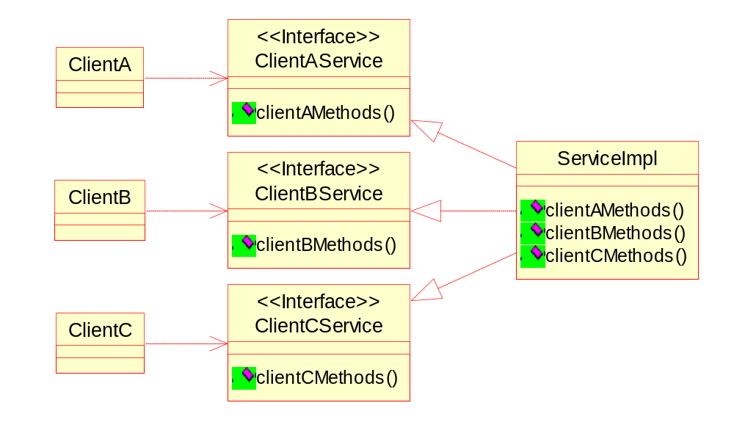
The Interface Segregation Principle (ISP) Example
Segregated Interfaces

Slide 27
The Interface Segregation Principle (ISP) Discussion
Without segregation whenever a change is made to one of the methods that ClientA calls, ClientB and ClientC may be affected. It may be necessary to recompile and redeploy them. With segregation if the interface for ClientA needs to change, ClientB and ClientC will remain unaffected.
The ISP does not recommend that every class that uses a service have its own special interface class that the service must inherit from. Rather, clients should be categorized by their type, and interfaces for each type of client should be created. If two or more different client types need the same method, the method should be added to both of their interfaces.

Slide 28
Topic 5: The Release Reuse Equivalency Principle (REP)
The granule of reuse is the granule of release.

Slide 29
The Release Reuse Equivalency Principle (REP)
A reusable element, be it a component, a class, or a cluster of classes, cannot be reused unless it is managed by a release system of some kind.
Clients will/ should refuse to reuse an element unless the author promises to keep track of version numbers, and maintain old versions for awhile.Therefore, one criterion for grouping classes into packages is reuse.
Since packages are the unit of release in JAVA, they are also the unit of reuse. Therefore architects would do well to group reusable classes together into packages.

Slide 30
Topic 6: The Common Closure Principle (CCP)
Classes that change together, belong together.

Slide 31
The Common Closure Principle (CCP)
The work to manage, test, and release a package is non-trivial in a large system. The more packages that change in any given release, the greater the work to rebuild, test, and deploy the release. Therefore we would like to minimize the number of packages that are changed in any given release cycle of the product.
To achieve this, we group together classes that we think will change together.

Slide 32
Topic 7: The Common Reuse Principle (CRP)
Classes that aren’t reused together should not be grouped together.

Slide 33
The Common Reuse Principle (CRP)
A dependency upon a package is a dependency upon everything within the package. When a package changes, and its release number is bumped, all clients of that package must verify that they work with the new package - even if nothing they used within the package actually changed.
Hence, Classes that aren’t reused together should not be grouped together in a package.

Slide 34
The Package Cohesion Principles (REP/CCP/CRP) Discussion
These three cannot simultaneously be satisfied.
The REP and CRP makes life easy for re-users, whereas the CCP makes life easier for maintainers.
The CCP strives to make packages as large as possible (after all, if all the classes live in just one package, then only one package will ever change). The CRP, however, tries to make packages very small.
Early in a project, architects may set up the package structure such that CCP dominates for ease of development and maintenance. Later, as the architecture stabilizes, the architects may re-factor the package structure to maximize REP and CRP for the external re-users.

Slide 35
Topic 8: The Acyclic Dependencies Principle (ADP)
The dependencies betwen packages must not form cycles.

Slide 36
The Acyclic Dependencies Principle (ADP)
Once changes to a package are made, developers can release the packages to the rest of the project. Before they can do this release, however, they must test that the package works. To do that, they must compile and build it with all the packages it depends upon.
A single cyclic dependency that gets out of control can make the dependency list very long.
Hence, someone needs to be watching the package dependency structure with regularity, and breaking cycles wherever they appear.

Slide 37
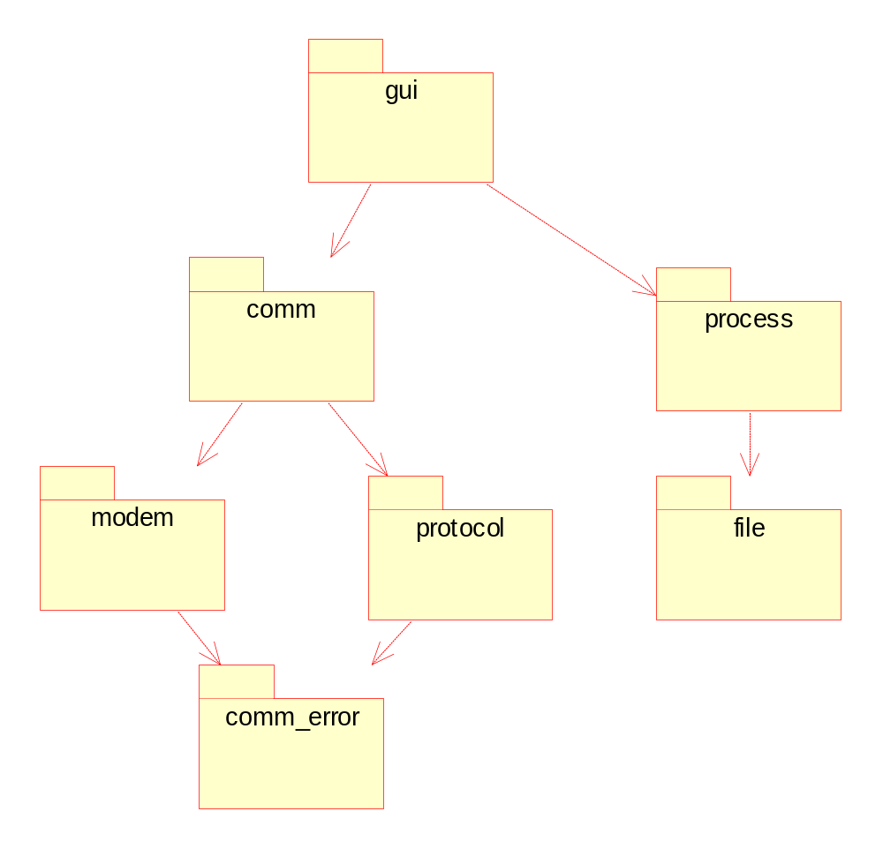
The Acyclic Dependencies Principle (ADP) Example
Acyclic Package Network

Slide 38
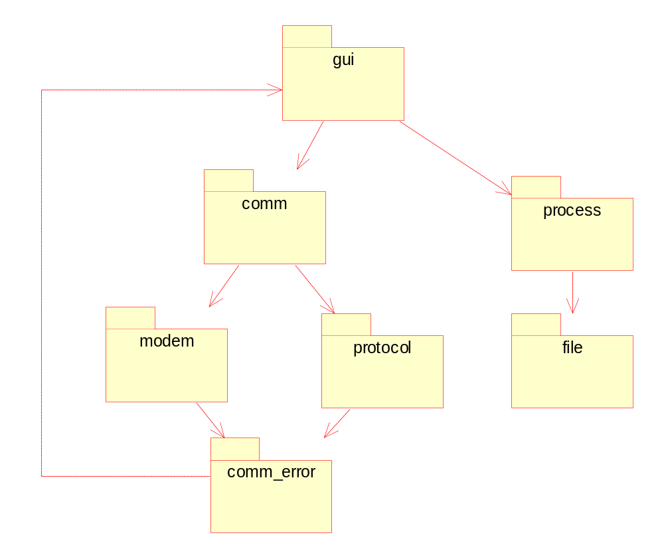
The Acyclic Dependencies Principle (ADP) Example
Cyclic Package Network

Slide 39
The Acyclic Dependencies Principle (ADP) Discussion
In the acyclic scenario to release the protocol package, the engineers would have to build it with the latest release of the comm_error package, and run their tests.
In the cyclic scenario to release protocol, the engineers would have to build it with the latest release of the comm_error, gui, comm, process, modem, file and run their tests.
Breaking the cycle:
  Add new package in between
  Add a new Interface

Slide 40
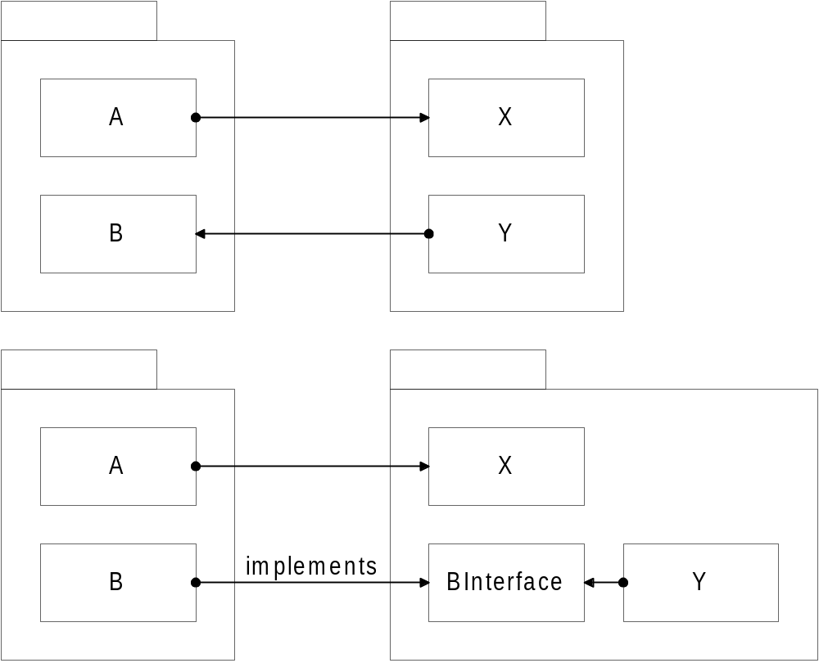
The Acyclic Dependencies Principle (ADP) Discussion
Breaking Cycle by introducing an Interface

Slide 41
Topic 9: The Stable Abstractions Principle (SAP)
Stable packages should be abstract packages.

Slide 42
The Stable Abstractions Principle (SAP)
Stability is related to the amount of work required to make a change. A package with lots of incoming dependencies is very stable because it requires a great deal of work to reconcile any changes with all the dependent packages.

Slide 43
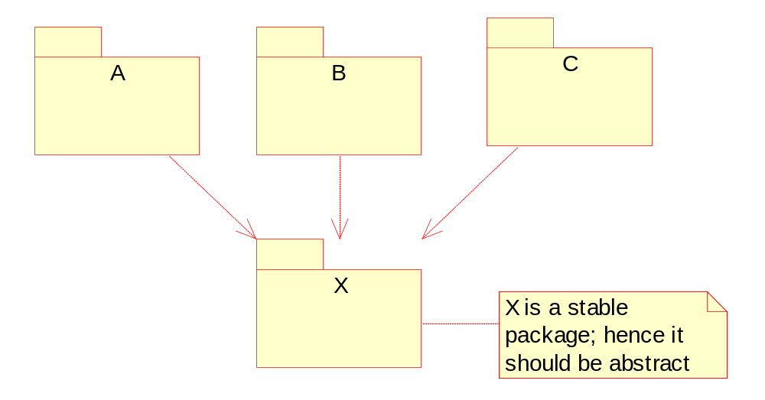
The Stable Abstractions Principle (SAP) Example

Slide 44
The Stable Abstractions Principle (SAP) Discussion
The packages at the top are instable and flexible. But those at the bottom are very difficult to change.
The highly stable packages at the bottom of the dependency network may be very difficult to change, but according to the OCP they do not have to be difficult to extend. If the stable packages at the bottom are also highly abstract, then they can be easily extended.
It is possible to compose our application from instable packages that are easy to change, and stable packages that are easy to extend.
The SAP is just a restatement of the DIP.

Slide 45
Resources: Principles and Patterns
敏捷软件开发 原理模式与实践
Head.First.Object.Oriented.Analysis.and.Design
Head First Design Pattern
http://butunclebob.com/ArticleS.UncleBob.PrinciplesOfOod
http://www.cetus-links.org/oo_patterns.html
http://hillside.net/patterns/patterns.html

Slide 46
Don’t do THIS
Rather than using patterns to solve problems, they began to look for ways to apply these pattern solutions.

