Slide 1
Firewall Configuration
In this presentation:
Introduction
Lab Scenario
Lab Procedures (Outline)
Firewall Configuration

Slide 2
Introduction
The purpose of a firewall is to moderate and control network traffic, for the purpose of logging network activity and/or blocking potentially harmful traffic.
Firewalls provide a layer of protection between private (trusted) networks and public (untrusted) networks. This need has become increasingly important as more and more individuals and organizations are connected to the Internet.
An improperly configured firewall can provide a false sense of security, so it is important to be able to tailor a firewall configuration to the needs of an organization.
Firewall Configuration > Introduction

Slide 3
Introduction (cont’d)
One common category of firewalls is a packet filtering router, a device which forwards packets between networks.
The router checks each network packet to determine whether it should be forwarded to its intended destination or rejected, based on its set of rules. When a rule which matches the packet is found, the corresponding rule action is obeyed.
The rules are searched in order, so only the first match counts; for this reason, these rules are referred to as “rule chains.”
Firewall Configuration > Introduction

Slide 4
Introduction (cont’d)
The router in your ICS lab kit is powered by DD-WRT (based on an embedded Linux kernel), so the firewall rules can be configured at the command line using IPTABLES. The default rules provide a reasonable starting point.
Changes made to the configuration take effect immediately, but they are not be permanently saved, so the default configuration can be restored by rebooting the router.
This is an ideal way of testing a new configuration, which can be made permanent later by creating a script.
Firewall Configuration > Introduction

Slide 5
Introduction (cont’d)
The firewall rule chains are divided into tables; the default table is the filter table, which includes the following chains:
INPUT (for packets destined to or entering the router’s local sockets)
OUTPUT (for packets sourced from or leaving the router’s local sockets)
FORWARD (for packets being forwarded through the router)
Your router’s WAN port will be connected to the lab network, and your workstation(s) to the router’s internal network. We will test a variety of firewall rules by simulating an attack on the internal network from “Internet hosts” (workstations on the lab network).
Firewall Configuration > Introduction

Slide 6
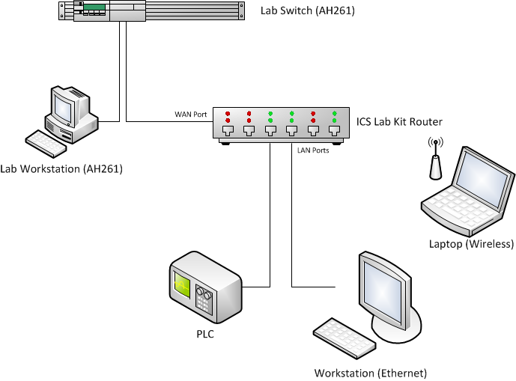
Lab Scenario
Firewall Configuration > Lab Scenario

Slide 7
Lab Procedures
This hands-on lab is intended to walk you through the following steps:
Configure the PLC with simple firmware which uses Modbus
Test connectivity with a simple HMI
Configure the firewall to enable remote Modbus access
Configure the firewall to deny Modbus access from a specific host
Configure the firewall to deny and log all Modbus access attempts
An important principle which will guide our firewall configuration is layering, the idea that multiple policies (in the form of firewall rules) should be in place to protect important services; if one policy fails, the others will prevent exploitation.
Firewall Configuration > Lab Procedures

