Slide 1
DevOps By
Anil Mikkili

Slide 2
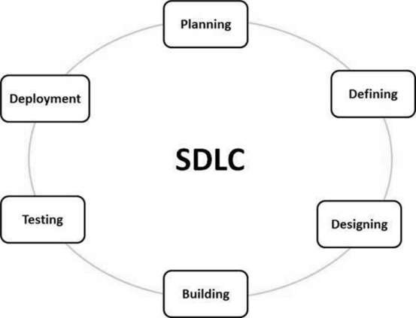
What is SDLC?
Software Development Life Cycle (SDLC) is a process used by the software industry to design, develop and test high quality software's. The SDLC aims to produce a high-quality software that meets or exceeds customer expectations, reaches completion within times and cost estimates.
SDLC is the acronym of Software Development Life Cycle.
SDLC is a framework defining tasks performed at each step in the software development process.
It is also called as Software Development Process.

Slide 3
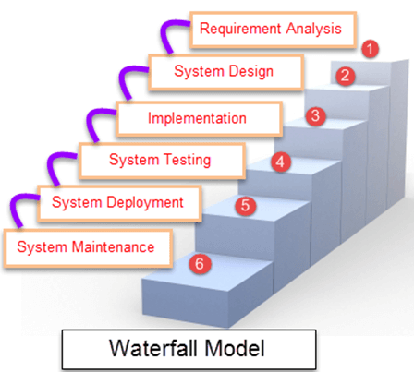
Waterfall Model
Waterfall Model is a sequential model that divides software development into pre-defined phases.
Each phase must be completed before the next phase can begin with no overlap between the phases.
Each phase is designed for performing specific activity during the SDLC phase.
It was introduced in 1970 by Winston Royce.

Slide 4
Waterfall Model-Disadvantages
It is difficult to estimate time and cost for each phase of the development process.
Once an application is in the testing stage, it is very difficult to go back and change something that was not well-thought out in the concept stage.
Not a good model for complex and object-oriented projects.
Not suitable for the projects where requirements are at a moderate to high risk of changing.

Slide 5
Agile Methodology
Agile development model is also a type of Incremental model.
Software is developed in incremental, rapid cycles.
This results in small incremental releases with each release building on previous functionality.
Each release is thoroughly tested to ensure software quality is maintained.
Agile software development method emphasis on iterative, incremental, and evolutionary development.

Slide 6
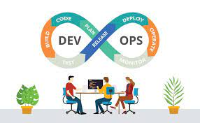
DevOps is the combination of cultural philosophies, practices, and tools that increases an organization's ability to deliver applications and services at high velocity: evolving and improving products at a faster pace than organizations using traditional software development and infrastructure management processes. DevOps—the amalgamation of development (Dev) and operations (Ops) teams—is an organizational approach that enables faster development of applications and easier maintenance of existing deployments

Slide 7
Why DevOps
By enabling organizations to create stronger bonds between Dev, Ops and other stakeholders in the company, DevOps promotes shorter, more controllable iterations through the adoption of best practices, automation and new tools.
DevOps is not a technology per se, but it covers everything from the organisation to culture, processes and tooling.
Initial steps usually include Continuous integration and continuous delivery (CI/CD), real-time monitoring, incident response systems and collaboration platforms.

Slide 8
Benefits of DevOps
Maximizes Efficiency with Automation
The late DevOps authority Robert Stroud said DevOps is all about "fueling business transformation" that encompasses people, process and culture change.
The most effective strategies for DevOps transformation focus on structural improvements that build community
Optimizes the Entire Business
It forces organizations to "optimize for the whole system," not just IT siloes, to improve the business as a whole.
In other words, be more adaptive and data-driven for alignment with customer and business needs.
Improves Speed and Stability of Software Development and Deployment.

Slide 9
The Future of DevOps The future of DevOps will likely bring changes in tooling and organizational strategies, but its core mission will remain the same
Automation Will Play a Major Role
Automation will continue to play a major role in DevOps transformation, and artificial intelligence for IT operations
AIOps—will help organizations achieve their DevOps goals.
The core elements of AIOps—machine learning, performance baselining, anomaly detection, automated root cause analysis (RCA) and predictive insights—work together to accelerate routine operational tasks
This emerging technology, which can transform how IT operations teams manage alerts and resolve issues, will be a crucial component of the future of DevOps.

Slide 10
DevOps Tools
Continuous Development: - Git, SVN, CVS, Mercurial
Continuous Integration: - Jenkins, TeamCity, Travis
Continuous Testing: - Selenium TestNG, Junit
Continuous Deployment: - Jenkins
Configuration Management Tools : - Chef, Puppet, Ansible
Continuous Monitoring: - Splunk, ELK Stack, Nagios, New Relic

Slide 11
LINUX Commands
What is OS?
It’s an interface between user and Hardware
Ex:- windows, Linux, Mac, Unix
Windows contains GUI and command line interface
Linux is secure , no virus attacks and no downtime.
Virus:- its in the form of .exe and it corrupts the kernel or system files.
Because Linux uses shell and its doesn’t identify .exe files so no virus attacks happens in it.
Kernel:- core of OS.
Shell :- interface between user and kernel and it executes the commands.
Windows → user->OS-> Hardware
Linux → User → Shell → Kernel→ Hardware.
Windows having Desktop versions and Server Versions
Desktop Versions:- Win 7,8,9,10,11,12
Server versions:- Win 2003, 2008, 2012, 2016

Slide 12
What is VPC? Amazon Virtual Private Cloud (Amazon VPC) enables you to launch AWS resources into a virtual network that you've defined. This virtual network closely resembles a traditional network that you'd operate in your own data center, with the benefits of using the scalable infrastructure of AWS.
What is subnet?
A subnet is a range of IP addresses in your VPC.
You can attach AWS resources, such as EC2 instances and RDS DB instances, to subnets.
You can create subnets to group instances together according to your security and operational needs.

Slide 13
ANSIBLE
Ansible is a open source, configuration management tool.
Ansible is Deployment tool maintained by Redhat.
Ansible is written by Python.
Ansible manages

