Slide 1
MuleSoft-Online- Training By
Anil Mikkili

Slide 2
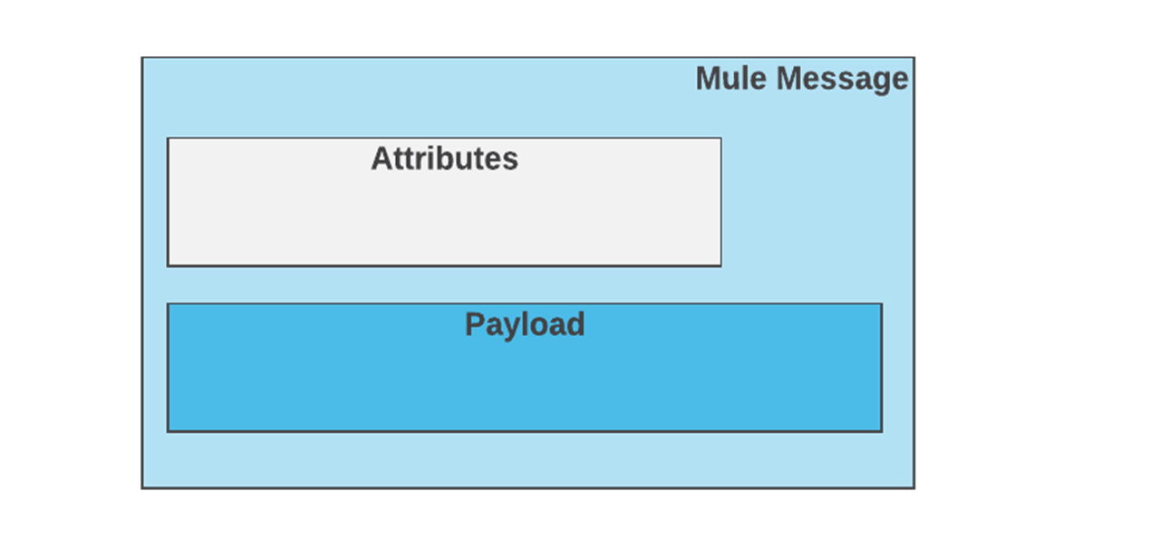
Mule Message Structure
A Mule message is the part of the Mule event that serves as a container for message content and metadata, typically from external sources, as processed within flows of a Mule app.
Attributes contain the metadata associated with the body (or payload) of the message.

Slide 3
Message Processor
Once Mule receives a message from a message source, the work of message processor starts. The Mule uses one or more message processors to process the message through a flow. The main task of message processor is to transform, filter, enrich and process the message as it passes through the Mule flow.
Categorization of Mule Processor
Following are the categories of Mule Processor, based on functions −
Connectors − These message processors send and receive data. They also plug data into external data sources via standard protocols or third-party APIs.
Components − These message processors are flexible in nature and perform business logic implemented in various languages like Java, JavaScript, Groovy, Python or Ruby.
Filters − They filter the messages and allow only specific messages to continue to be processed in a flow, based on specific criteria.
Routers − This message processor is used to control the flow of message to route, resequencing or split.
Scopes − hey basically wrap snippets of code for the purpose of defining fine-grained behavior within a flow.
Transformers − The role of transformers is to convert message payload type and data format to facilitate communication between systems.
Business Events − They basically capture data associated with key performance indicators.
Exception strategies − These message processors handle errors of any type that occur during message processing.

Slide 4
Types of flows in Mule
There are three different types of flows in Mule
Flow : A flow is a connected collection of Mule components.
Each flow may have a processing strategy as well as an exception handling strategy associated with it.
A flow may also reference another flow using a flow reference component.
Subflow: We use subflows to group common logic. Subflows are processed synchronously; that is, execution of the calling flow halts until the subflow is complete.
The subflow is called using a flow reference component
Additionally, subflows inherit the processing strategies and exception handling strategies of the calling flow.
We can call a subflow from multiple different flows. Should we not wish to inherit these strategies, we could call a synchronous flow.
Private Flow: its also like flow but does.t contains its source.

Slide 5

Debugging In Mule
Anypoint Studio comes with Runtime, which lets you deploy the Mule application and test your app in your machine. It provides step-based debugging to check your application.
Anypoint Studio comes with StudioVisual Debugger, which allows you to run the application in debug mode and stop its execution to check the contents of previous building blocks.
Steps to debug the api:
For running the application in debug mode, first, you need to set up a breakpoint on the building block. When the application runs in debug mode, it stops immediately after executing the building block with the breakpoint.
When debugging an application on your local machine, Studio Visual Debugger listens for incoming connections on port 6666 and ensure that the firewall is not blocking the port.

Slide 6
Benefits of MEL: Using MEL makes your application more consistent and provides an efficient and standardized method for evaluating expressions in Mule applications.
MEL makes use of Mule-specific context objects, you can code it with the help of auto-complete
Great tool for evaluating expressions in your flows
Most importantly, MEL enforces consistency when accessing information in the Mule message: rather than using multiple expression evaluators, you can use MEL, the default expression evaluator, to consistently access and manipulate information.
Based on information Mule extracts from the message or its environment at runtime, Mule evaluates expressions to complete three types of tasks:
1. Extract:
#[payload]
2. Evaluate conditions:
#[payload.age > 10]
3. Define a targe:
#[vars.name]

Slide 7

API-Led Connectivity
Few of the traditional approaches in digital transformation
Peer to Peer(P2P) Approach:
In the P2P approach, one business operation is connected to another operation by direct connection.
In an organization where a lot of applications need to be integrated, it becomes a mess with the P2P approach.
E2E Approach:
This approach focusses on centralizing information as much as possible.
In this approach, an integration platform is used (ESB), which serves as the base for collecting all the information and serving them to the final receiver.
the digital transformation of today's age, it is still not efficient enough, because "time to market" is still longer with this approach.
Api-Led Connectivity:
The main purpose of API-led connectivity is to enable the integration flows to be reused by many parties and to be reused inside the integration platform.
The reduced development time reduces the integration costs by around 70% (as per the statistics).
In this approach, the APIs are based on three distinct layers: System, Process, and Experience
1. Sysytem Api
2. Process Api
3. Experience Api

Slide 8

RAML (RESTful API Modeling Language )
What is Raml?
RAML was introduced in 2013
RESTful API Modeling Language (RAML) is a YAML-based language for describing RESTful APIs.
It provides all the information necessary to describe RESTful APIs, providing a simpler way to design APIs.
Where Should We Write/Design RAML for the API?
MuleSoft API designer provides a web-based graphical environment for designing, documenting, and testing APIs.
API designer makes it easy to engage API consumers at multiple stages in the design process.
You can design your APIs and test it there itself using a mocking service within API designer.

Slide 9
MUnit’s in MuleSoft
MUnit is a Mule Application Testing Framework that allows you to easily build automated tests for your Integration and APIs.
It provides a full suite of integration and unit test capabilities, and it is fully integrated with Maven.
MUnit is fully integrated with Anypoint Studio and allows you to create, design, and test your MUnit tests just like you would Mule Applications.
Steps to create Munit :-
Create a New project in Anypoint Studio.
Right-click on the flow created. Select MUnit -> Create new MUnit.xml suite.
This will create an MUnit test suite, which will be present in src/test/munit.
After Creation Run the MUnit Test
Right-click on flow or canvas of MUnit test flow. Select Run MUnit Suite.
After running MUnit suite, it will provide test result, errors, failures (if any) and other details on the console in Anypoint Studio.

