Slide 1
Advanced Web Development

Slide 2
Hi
I am Piusha Kalyana
Software Engineer

Slide 3
Course Out Line
M1 - Introduction to Advanced Web Technologies.
M2 – Understanding the Web Project Development Methodologies
M3 – Cord Versioning and Branching with GIT
M4 – Object Oriented Development and Design Pattern
M5 – Working in Linux environment for PHP Developers
M6 – Desining Advance Database Architecture in MySql/MsSql
M7 - Object Oriented Development and Design pattern in PHP
M8 - Understanding REST API
M9 - Introduction to Content Management System (CMS)
M9 – Understanding JavaScript programming
M10 – Practical
There will be 5 Case Studies that student need to pick one and Implement course outcomes
End of course Student will be able to deploy their application through GIT.
Project Documentations
Working Project Source code.

Slide 4
Introduction to Advanced Web Technologies
How do web servers work?
What happens when you enter http://www.facebook.com in address field?
http://: This part indicates that the document you want to access can be retrieved from web server, which understands the HTTP protocol. The HTTP protocol is a standardized language of communication between browsers and web servers.
www. facebook.com: This is the host name of the computer from which the document can be downloaded.
/doc/sample.html: This is the virtual path of the document in the www. facebook.com's web server.

Slide 5
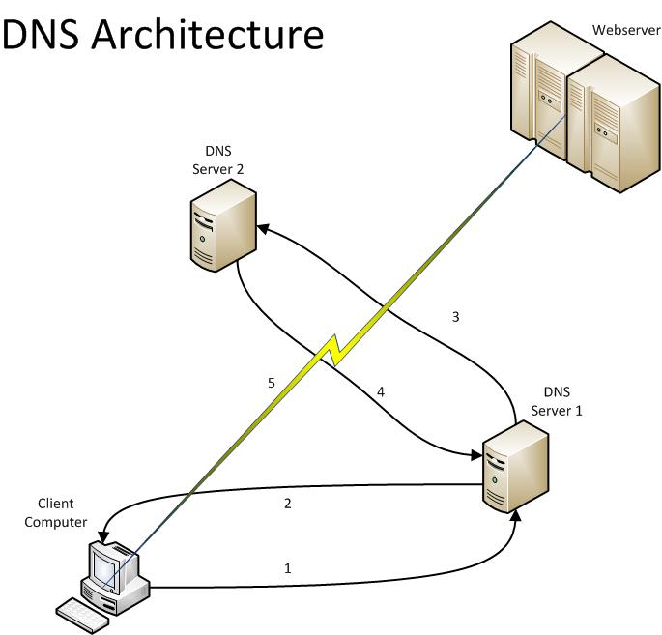
DNS
How does DNS work?

Slide 6
Domain names
Domain names are used to identify one or more IP addresses. For example, the domain name microsoft.com represents about a dozen IP addresses.
Domain names are used in URLs to identify particular Web pages. For example, in the URL http://www.pcwebopedia.com/index.html, the domain name is pcwebopedia.com.

Slide 7

Domain Register

Slide 8
Web Hosting
VPS Hosting (Virtual Private Server) AWS , Rackspace
Shared Hosting ()
The technology behind VPS hosting is similar to that of VMware or Virtual Box
Benefits of VPS
Privacy As you don't share your OS with anyone else, there are no other websites on your server that potentially have access to your files.
Customization With a VPS Server, you have your own Operating System. This also means that you have your own instances of all server applications such as Apache, PHP, and MySQL. If you need to have any of these services customized, you can make changes to suit the server to your needs.
Control If you're installing server applications that require a system restart, you can do so at any time. Even though technically you share a server with other VPS servers, your VPS server can be restarted without affecting anyone else.
Dedicated Resources On a VPS Server, you have dedicated amounts of RAM available to you at any time. Unlike shared hosting, there is no one else on your server that can use utilize all the RAM when you need it most!

Slide 9
Current Evolution in Internet
http://www.evolutionoftheweb.com/

Slide 10
HTML -> HTML5
HTML5 is a markup language used for structuring and presenting content on the World Wide Web. It was finalized, and published, on 28 October 2014 by the World Wide Web Consortium (W3C). This is the fifth revision of the HTML standard since the inception of the World Wide Web.

Slide 11
What is New in HTML5?
The DOCTYPE declaration for HTML5 is very simple:
<!DOCTYPE html>
The character encoding (charset) declaration is also very simple:
<meta charset="UTF-8”>(Unicode Transformation Format)
<!DOCTYPE html>
<html>
<head>
<meta charset="UTF-8">
<title>Title of the document</title>
</head>
<body>
Content of the document......
</body>
</html>

Slide 12
New HTML5 Elements ;
New semantic elements like <header>, <footer>, <article>, and <section>.
New form control attributes like number, date, time, calendar, and range.
New graphic elements: <svg> and <canvas>.
New multimedia elements: <audio> and <video>.
Adding New Elements to HTML
You can also add any new element to HTML with a browser trick.
This example adds a new element called <myHero> to HTML, and defines a display style for it:

Slide 13
CSS3
Media Queries - enhancement of @media rules and "media" HTML markup element.
Selectors Level 3 - describes the element selectors used in CSS
Grid template layout - describes new way to position elements using constraints on their alignment to each other and on their flexibility.
Aural Style sheets -
Backgrounds and borders - describes background colors and images and the style of borders.
Basic user interface - describes styling for web pages
Basic Box model - describes the layout of block-level content in normal flow.
Extended Box model - provides extra control over positioning of floats and the size of boxes.
Marquee - describes the marquee effect.
Cascading and inheritance - describes how values are assigned to properties.
Color - describes color-relates aspects of CSS.
Fonts - describes fonts and font adjustments.
Generated Content for paged media
Page floats - contains properties to float elements to the top, bottom or side of a page in paginated renderings.

Slide 14
JavaScript
It’s a great time for JavaScript is becoming a much more respected language
As more browsers begin to implement the features of the ECMAScript 5th edition standard, JavaScript becomes an even more powerful platform for you to develop

Slide 15
What is ECMAScript 5?
ECMAScript is the official name of what we all call JavaScript. That doesn't mean we're wrong; it's just that the name "JavaScript" is a trademark of Oracle; so Ecma International (originally the European Computer Manufacturers Association—hence ECMA) uses the term "ECMAScript" to refer to the standard of JavaScript. The latest version of this standard is the 5th edition, and it was approved just over a years ago (on December 3, 2009). It encompasses a huge range of great additions, and several of those are starting to show up in browsers. The implementations of ECMAScript 5 is called JavaScript 1.8.5.
In this tutorial, we're going to be looking at the JavaScript 1.8.5 functions that are available to us in the Firefox 4 betas. You'll be happy to discover that most of the latest versions of other browsers have these, too . . . except for one. This time, it's Opera, as IE9 has included many of these.

Slide 16
JS Frameworks
Angular JS - AngularJS was born in 2009
Backbone.JS - Backbone.js is a lightweight MVC framework. Born in 2010
Ember - Ember.js is an open-source client-side JavaScript web application framework predicated on the model-view-controller (MVC) software architectural pattern
React - JavaScript most popular framework

Slide 17
Server Side JavaScript
Client-side components usually consist of HTML, CSS, JavaScript, Ajax, JS libraries, images, and whatever other files that are to be downloaded to the browser. On the server, you need a listener to process requests, fetch resources or information, and manipulate them so that they can be sent back to the client.
Node.js

Slide 18
Server Side Scripting Lng
Server-side scripting is a technique used in web development which involves employing scripts on a web server which produce a response customized for each user's (client's) request to the website
PHP (*.php, *.php3, *.php4, *.phtml)
ASP.NET MVC (*.cshtml)
Go (*.go)
Python (*.py) (examples: Pyramid, Flask, Django)
R (*.rhtml) - (example: rApache)
Ruby (*.rb, *.rbw) (example: Ruby on Rails)
SMX (*.smx)
C (*.c, *.csp) via CGI
ColdFusion Markup Language (*.cfm)
Java (*.jsp) via JavaServer Pages
JavaScript using Server-side JavaScript (*.ssjs, *.js) (example: Node.js)

Slide 19
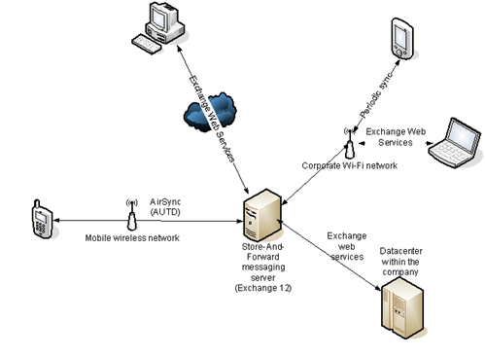
Mobile communicate with Server

Slide 20
API
(Application Programming Interface) A language and message format used by an application program to communicate with the operating system or some other control program such as a database management system (DBMS) or communications protocol.

