Slide 1
Improved Arneson Control System(ACS) for P444 series Super Dvora Mk III
By LT (IT) DSA AS Gunashinghe

Slide 2

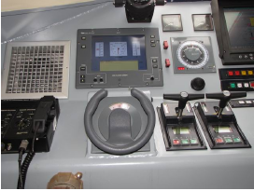
Introduction:
The ACS is an innovative craft/ship digital steering and trim control system based on the well-known Arneson Surface Drive (ASD) system. The system uses state of the art hardware and software technology to implement PID (Proportional Integral Differential) control algorithm to drive and control the craft propellers.

Slide 3
Project Aim:
Improve low cost and more reliable system to control the craft propulsion system.

Slide 4
Why need this system:
By looking at previous defects and number of occurrence ,PC is not suitable for such environment because of pitching and rolling, it will effect to PC hard disk directly though the mount on shock absorber. Also PC is general purpose machine and runs other process rather than ACS application.

Slide 5
Why need this system cont..:
Supper Dovra MK III , has encountered with one of defect in steering system which non synchronizing of propeller movement with the wheel moment (Error message popped up as “System encountered an uncorrectable hardware error”) . due to instability of current system
The above error occurs periodically in P444 series craft. Ship builder attend to above error during the warranty period. But after warranty they won’t attend this issue free

Slide 6
Advantages:
Improve system reliability.
Reduce maintenance cost .
By looking at previous defects and number of occurrence ,PC is not suitable for such environment because of pitching and rolling, it will effect to PC hard disk directly though the mount on shock absorber. Also PC is general purpose machine and runs other process rather than ACS application

Slide 7
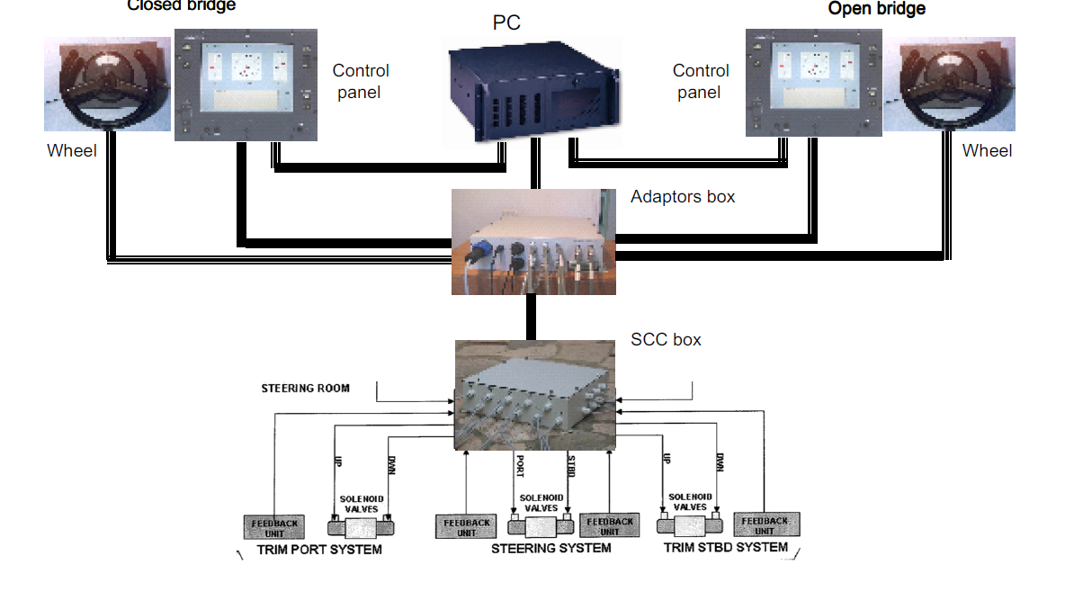
Present system

Slide 8
Main parts of the ACS system :
The main parts of the ACS system are:
Two control panels (which are also uses as displays)
An industrial PC
An Adaptors box
An SCC (Solenoids Control Card) box
Steering wheels
Three dual proportional solenoids
Four Electronic In Cylinder Transducer (EICT)

Slide 9
Block Diagram:
CONTROL STATION (OPEN)
WHEEL(OPEN)
WHEEL
(CLOSE)
CONTROL STATION (CLOSE)
WHEEL_OPEN
WHEEL_CLOSED
DVI_OPEN
CAN-1_OPEN + NFU + POWER
DVI
CLOSED
CAN-2_OPEN + NFU + POWER
CAN-1_CLOSED + NFU + POWER
CAN-1_SOLENOID + NFU + POWER
CAN-2_CLOSED + NFU + POWER
CAN-2_SOLENOID + NFU + POWER
ADAPTORS BOX
220 VAC
SCC BOX
PC
USB_CAN
6
4
6
USB_NMEA
SENSORS
ICT
SOLENOIDS
DC POWER INPUT
10-36 VDC
GPS

Slide 10
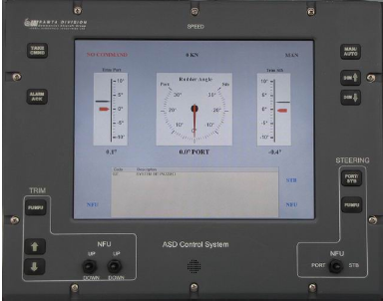
System Interface:

Slide 11
Advantage of System Modification :
Increase the system reliability.
Reduce maintenance cost ( After warranty period ).

Slide 12
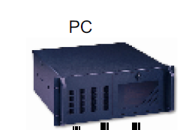
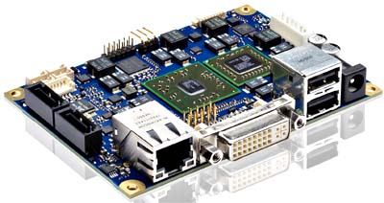
System modification :
This project for replace conventional pc to single board computer .
SBC

Slide 13
System modification Diagram:
SBC

Slide 14
Steps to be completed in ACS System:
Analysis CAN(Control Area Network) Signal.
Develop application to control CAN device via single board computer.
Design user interface and test the system.

Slide 15
Item Requirement & estimated cost

Slide 16
Time Schedule
Milestone | Time In Months
 | 1 | 2 | 3 | 4 | 5 | 6 | 7 | 8 | 9 | 10 | 11 | 12 | 13 | 14 | 15
Study CAN Signal in current system
Process control signal
Design circuit and developing CAN controller
Design UI and testing system

Slide 17


