Slide 1
Improved Arneson Control System(ACS) for P444 series Super Dvora Mk III
By LT (IT) DSA AS Gunashinghe

Slide 2

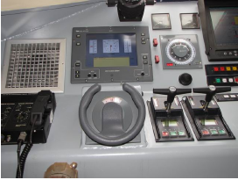
INTRODUCTION:
The ACS is an innovative craft/ship digital steering and trim control system
This system based on the well-known Arneson Surface Drive (ASD) system.

Slide 3
PROJECT AIM:
Develop new digital steering and trim control system.

Slide 4
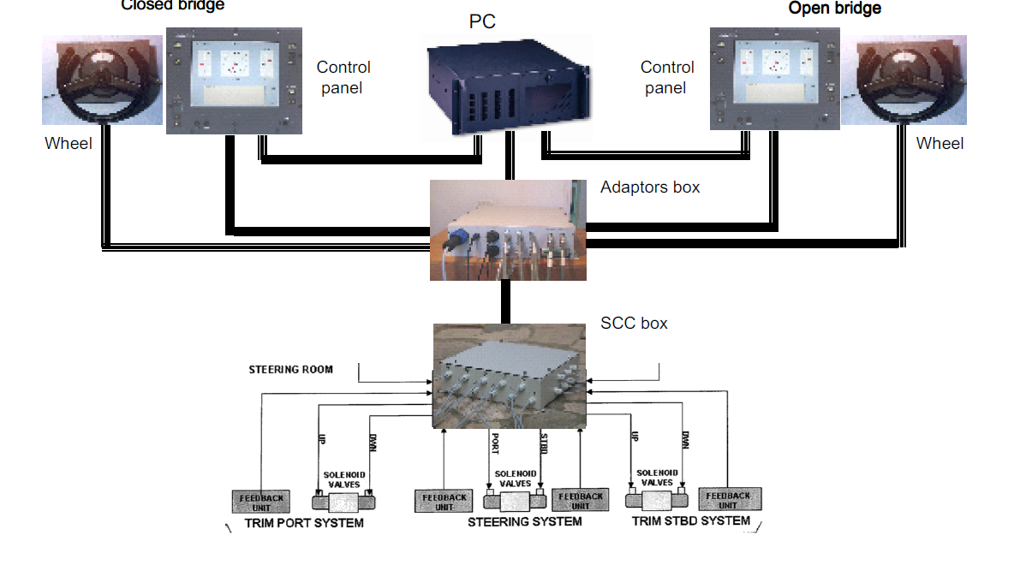
PRESENT SYSTEM

Slide 5
BLOCK DIAGRAM OF PRESENT SYSTEM:
CONTROL STATION (OPEN)
WHEEL(OPEN)
WHEEL
(CLOSE)
CONTROL STATION (CLOSE)
WHEEL_OPEN
WHEEL_CLOSED
DVI_OPEN
CAN-1_OPEN + NFU + POWER
DVI
CLOSED
CAN-2_OPEN + NFU + POWER
CAN-1_CLOSED + NFU + POWER
CAN-1_SOLENOID + NFU + POWER
CAN-2_CLOSED + NFU + POWER
CAN-2_SOLENOID + NFU + POWER
ADAPTORS BOX
220 VAC
SCC BOX
PC
USB_CAN
6
4
6
USB_NMEA
SENSORS
ICT
SOLENOIDS
DC POWER INPUT
10-36 VDC
GPS

Slide 6
DISADVANTAGE OF PRESENT SYSTEM:
Recurrent system defect
PC is general purpose it’s not seaworthy.
Ship builder attend to above error during the warranty period. But after warranty they won’t attend this issue free.
High maintenance cost .

Slide 7
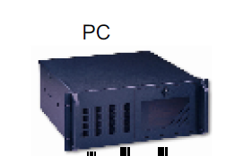
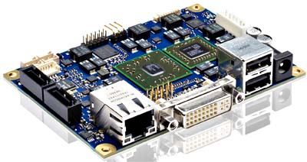
SYSTEM MODIFICATION :
Replace conventional pc to single board computer and develop linux base application .
SBC

Slide 8
Modified system design:
SBC

Slide 9
ADVANTAGES AFTER MODIFICATION:
Increase the system reliability.
Reduce maintenance cost.
This is an indigene system further which can upgrade as per requirement.

Slide 10
STEPS TO BE COMPLETED :
Analysis CAN(Control Area Network) Signal.
Develop application to control CAN device via single board computer.
Design user interface and test the system.

Slide 11
ITEM REQUIREMENT & ESTIMATED COST

Slide 12
Time Schedule
Milestone | Time In Months
 | 1 | 2 | 3 | 4 | 5 | 6 | 7 | 8 | 9 | 10 | 11 | 12
Study CAN Signal in current system
Process control signal
Design circuit and developing CAN controller
Design UI and testing system

Slide 13


