Slide 1
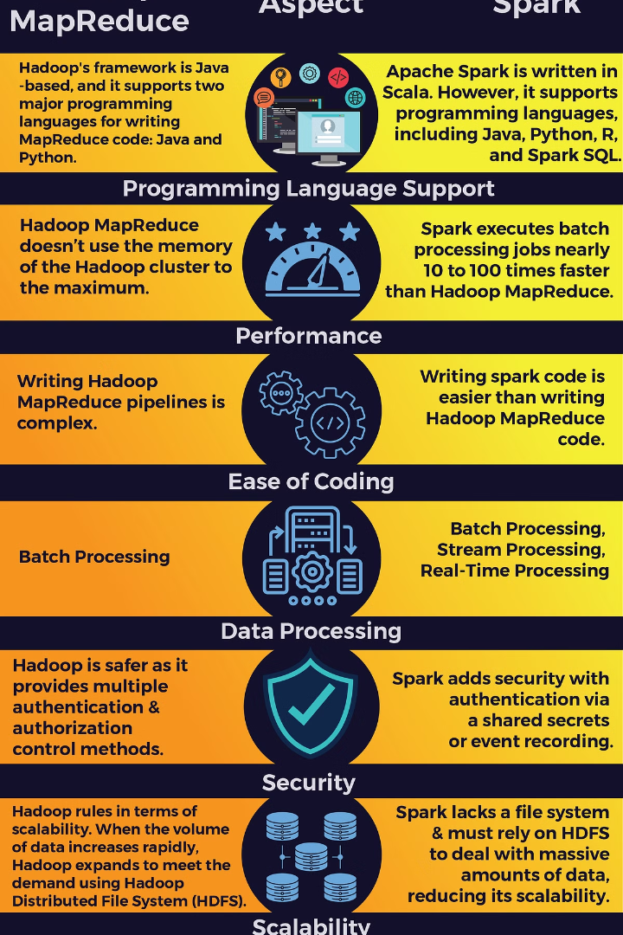

Apache Spark vs Hadoop MapReduce
by Amila Wijesooriya
Index No: 248385K
wijesooriyadap.24@uom.lk

Slide 2
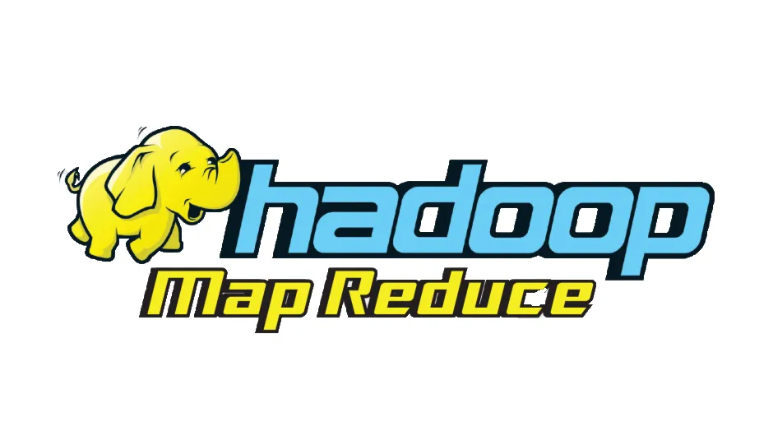

Hadoop MapReduce:
Introduced in 2004 as part of the Apache Hadoop project
Pioneering framework in the big data landscape
Provides a distributed computing model for processing massive datasets across clusters of computers
Breaks down data processing into two phases: Map phase (parallel processing) and Reduce phase (result aggregation)
Gained popularity due to its ability to handle large datasets efficiently
Fault-tolerant nature, making it suitable for batch processing workloads
Apache Spark:
Developed in 2009 at the University of California, Berkeley
Became an Apache project in 2013
Designed to address limitations of Hadoop MapReduce, particularly in terms of performance and flexibility
Introduces an in-memory computing model, processing and storing data in memory whenever possible
Results in much faster processing speeds compared to disk-based systems like Hadoop MapReduce
Provides a more general-purpose computing framework
Supports a wide range of workloads: batch processing, real-time streaming, machine learning, and graph processing
Offers a rich set of APIs in multiple programming languages
More accessible and easier to use for developers
Gained significant adoption and popularity due to its performance, versatility, and active community support

Slide 3
Feature | Hadoop MapReduce | Apache Spark
Data Processing Model | Batch processing using Map and Reduce stages | Directed Acyclic Graph (DAG) for batch and real-time processing
In-Memory Computing | Writes intermediate results to disk | Leverages in-memory computing using Resilient Distributed Datasets (RDDs)
Latency and Performance | Higher latency due to disk-based processing | Lower latency and faster performance with in-memory computing
Ease of Use and APIs | Low-level API, requires writing custom Map and Reduce functions | High-level API with built-in operators, supports multiple languages
Ecosystem and Libraries | Rich ecosystem including Hive, Pig, and Mahout | Spark ecosystem with Spark SQL, MLlib, GraphX, and Spark Streaming
Resource Management | Relies on Hadoop YARN for resource management | Can run on various cluster managers, including YARN, Mesos, and Spark's standalone cluster manager
Suitable Use Cases | Large-scale batch processing jobs with higher latency tolerance | Real-time data processing, interactive queries, iterative algorithms
Data Storage | Reads from and writes to a distributed file system (HDFS) | Can read from and write to various data sources, including HDFS, databases, and streaming sources
Fault Tolerance | Achieved through replication of data across nodes | Achieved through lineage tracking and data recomputation
Scalability | Scales well for large datasets and clusters | Scales well for large datasets and clusters, with added benefits of in-memory computing
Learning Curve | Steeper learning curve, requires understanding of MapReduce paradigm | Easier to learn and use due to high-level APIs and multiple language support
Iterative Processing | Less efficient for iterative algorithms due to disk I/O | Efficient for iterative algorithms due to in-memory computing
Real-time Processing | Not well-suited for real-time processing | Supports real-time processing through Spark Streaming
SQL Support | Supported through Hive, which translates SQL queries to MapReduce jobs | Native SQL support through Spark SQL, allowing interactive querying

Slide 4
Conclusion
Fast Processing:
Apache Spark:
In-memory computing capabilities, allowing for faster processing speeds
Avoids disk I/O overhead by keeping data in memory whenever possible
Optimized execution engine with lazy evaluation and intelligent task scheduling
Efficient for iterative algorithms and interactive data analysis
Supports real-time processing through Spark Streaming
Faster performance compared to Hadoop MapReduce for many workloads
Hadoop MapReduce:
Disk-based processing model, resulting in higher latency
Writes intermediate results to disk between Map and Reduce phases
Suitable for batch processing of large datasets
Slower performance compared to Spark for iterative and interactive workloads
Not well-suited for real-time processing or low-latency requirements
Can be slower than Spark for certain types of data processing tasks
Ease of Use:
Apache Spark:
High-level APIs in multiple programming languages (Java, Scala, Python, R)
Intuitive and expressive APIs for data processing and analysis
Rich ecosystem of libraries and tools for various use cases
Interactive shell for quick data exploration and prototyping
Seamless integration with various data sources and storage systems
Hadoop MapReduce:
Lower-level API, requiring more code and configuration
Primarily based on Java programming language
Requires understanding of MapReduce paradigm and writing custom Map and Reduce functions
Less intuitive and more verbose compared to Spark
Limited ecosystem and interoperability with other tools

