Slide 1

3D Modeling

Slide 2
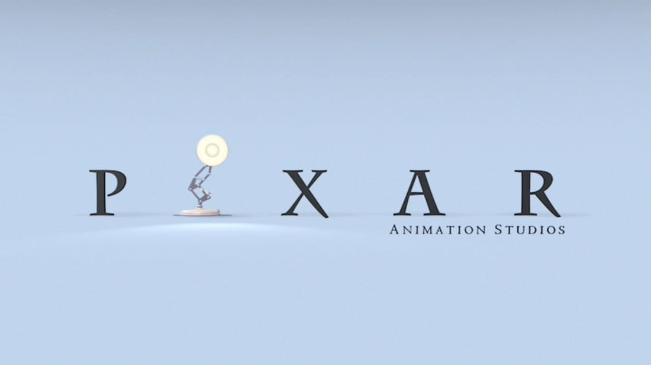
What is 3D Modeling?
Process that creates and shows a shape based on mathematical representation of its surface
Can be drawn with vertices, edges, and faces
Colloquially, it is the art style of the creators of Toy Story, Pixar

Slide 3
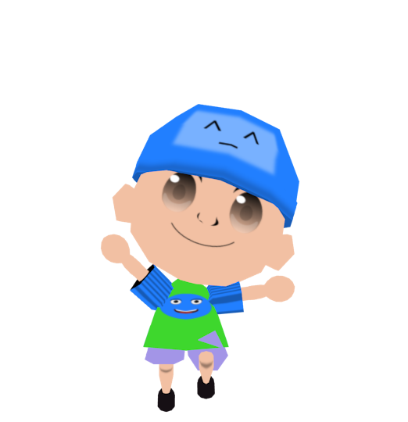
3D Modeling for Software Development
3D Models appear in:
  Video Games
  Movies
  Computer Aided Design
My experience was a senior design project:
“Teaching Children Safety Through an Interactive Gaming Experience”

Slide 4
How to make 3D model assets
Planning
  What object do you want to make?
  How should it look?
  What limiting factors control how complex your model can be if any?
  Who is your audience and what do they expect your models to look like?
From my senior design example:
  Objects will be kids and environments associated with kids
  They should look colorful and non-threatening
  The project had 6 months time limit and had to be both a computer game and have mobile support
  We eventually chose Animal Crossing as our inspiration

Slide 5

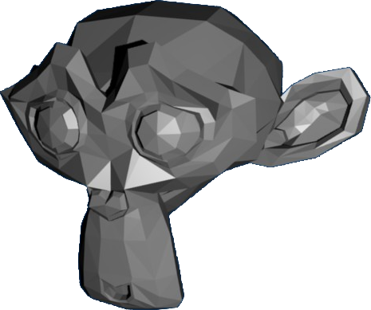
The Tool Belt: Blender
Blender Helps With 3D Model:
  Geometry
  UV Mapping
  Rigging
  Animations

Slide 6
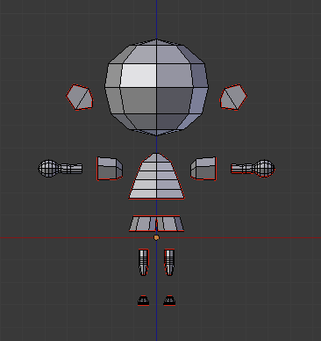
How to make 3D model assets
  Geometry
  Object geometry is made up of vertices, edges, and faces
  More of these elements mean the model is more complicated, harder to calculate and therefore requires more processing power to appear onscreen
  A “UVMap” needs to be made for the next step. This “unwraps” the object so a 2D image can be applied to the model’s surface

Slide 7

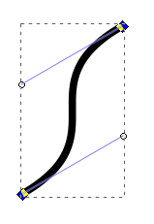
The Tool Belt: Inkscape
Inkscape Helps Make Textures:
It is intended to make 2-dimensional art, AKA a picture, AKA a photograph
Vector manipulation handles make lines and curves easy to draw, even if you don’t have a steady hand.

Slide 8
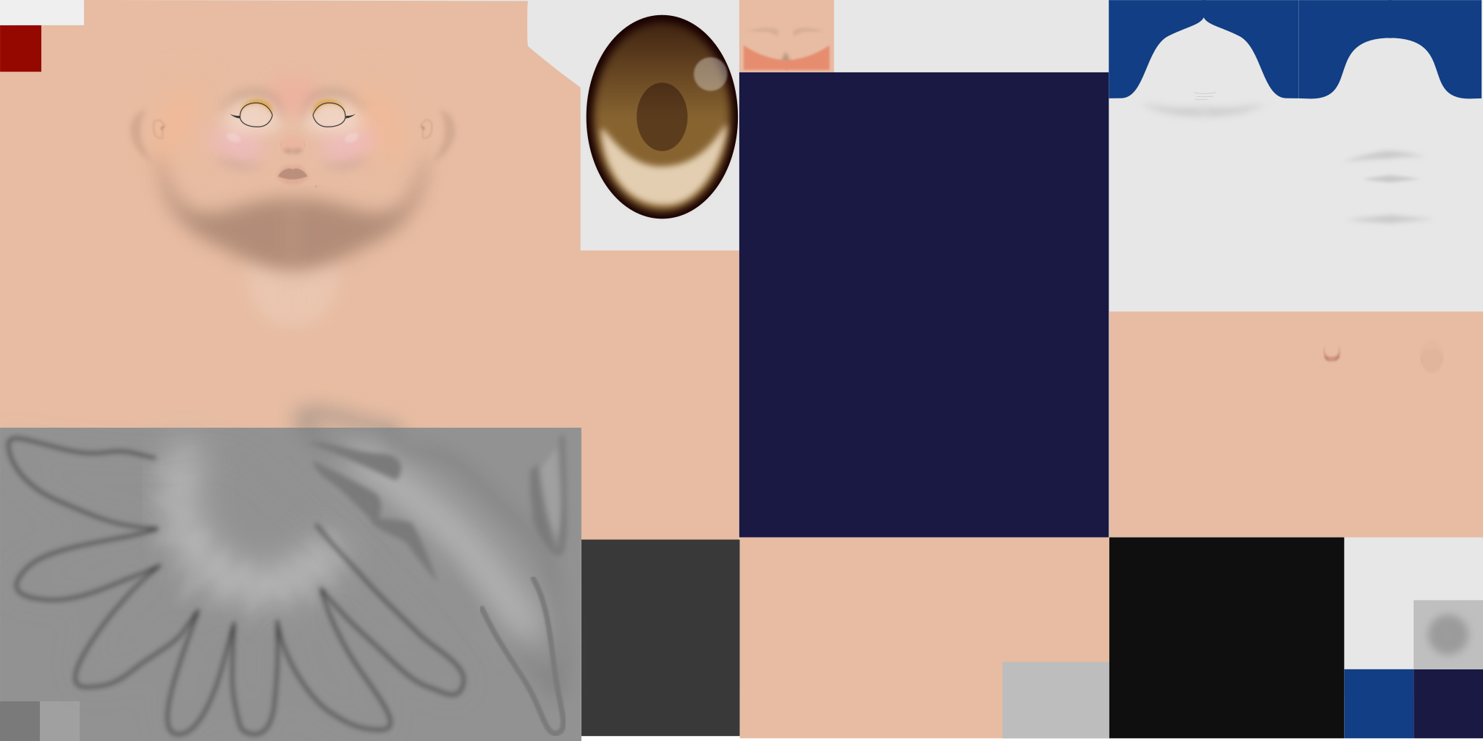
How to make 3D model assets
Texturing
Inkscape vectors can be lines, filled in, have blur effects, and snap to other vectors
The image to the left uses all of these to create a face texture you will see being applied to a 3D model on the next slide

Slide 9
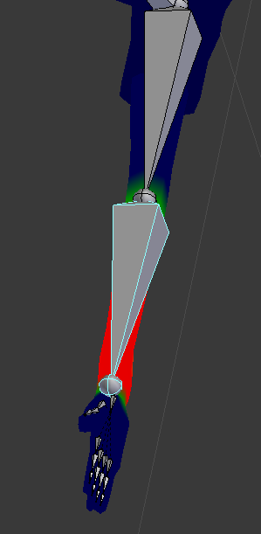
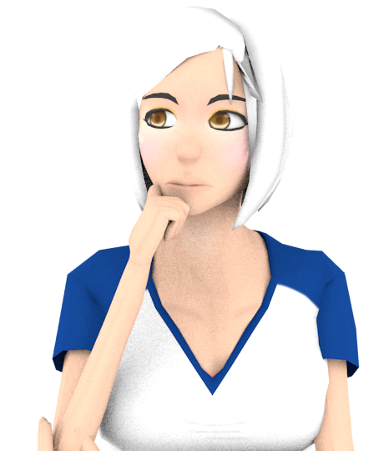
How to make 3D model assets
  Animation
  The best way to make animations in Blender is manipulating armatures/bones (bones pictured to the left)
  Bones work by grouping vertices and associating individual bones with these vertex groups
  Then whenever the bone is moved, its associated vertices move with it
  More bones and vertex groups means more complex animations are possible
  “Vertex Brushing” enables more complex relationships when some bones have a “stronger” association than other bones

Slide 10
That’s It!
Of course there is way more complexity to how Blender and Inkscape work, but this is supposed to be a five minute presentation, so I can’t cover everything.
Give them a try yourself and have fun!

