Slide 1
Can Spiders fly?

Slide 2
Yes!

Slide 3
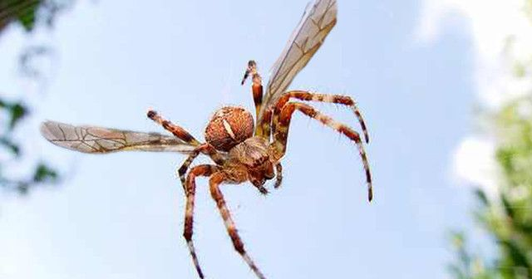

Slide 4
No!

Slide 5
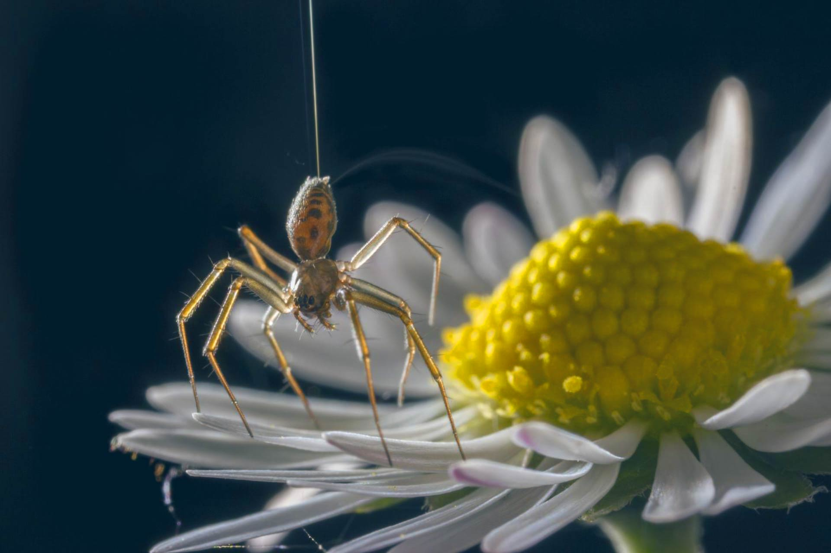

Slide 6
No!

Slide 7
Electricity!

Slide 8
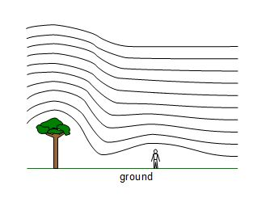

Slide 9
This is the end.

