Slide 1

Object Oriented Programming for Scientific Python
Ray Pauszek

Slide 2
Outline
Data types: what are they and why are they important?
Procedural vs OOP
Dynamic vs Static typing
Interpreted vs Compiled languages
OOP: defining custom data types
Encapsulation
Inheritance
Polymorphism
OOP in action: smTIRF data structures
OOP syntax
Value vs Reference
Data Storage
Modules & Packages

Slide 3
Data types
i = 3 # int
x = 9.4832 # float
s = "hello" # str
b = True # bool
Types define how data is represented in the processor (binary)
And how data can be used or interact with other data types. This is referred to as a data type’s interface
2**3 # = 8
2**'a' # TypeError
a = "23" # str
b = a + " is a letter" # str + str (concatenation)
int(a) # type casting (str -> int)
c = a + " is not a letter" # TypeError

Slide 4
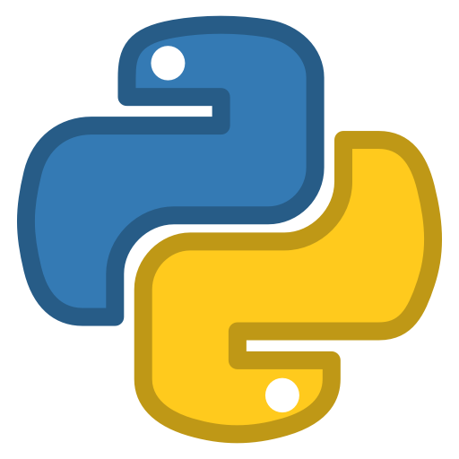

Procedural vs Object Oriented
print("Hello, world!")
a = 1
b = 2
c = a + b
print(c)
public class HelloWorld {
public static void main(String[] args) {
System.out.println("Hello, world!");
int a, b, c;
a = 1;
b = 2;
c = a + b;
System.out.println(c);
}
}

Slide 5
Dynamic vs Static Typing
def pow(x, y):
return x**y
x = 2.4
y = 3
z = pow(x,y)
y = 3.1
z2 = pow(x,y)
import java.lang.Math;
public class MathStuff {
public static float pow(float x, int y) {
return Math.pow(x, y);
}
public static void main(String[] args) {
float x = 2.4;
int y = 3;
float z = pow(x,y);
y = 3.1; // error
float z = pow(x,y);
}
}

Slide 6
Interpreted vs Compiled languages
source code → interpreter → machine code
source code → compiler → interpreter → machine code
def pow(x, y):
return x**y
def foo():
# 3-hour calculation goes here...
x = 2.4
y = "hello"
foo()
z = pow(x,y) # fails at runtime
import java.lang.Math;
public class MathStuff {
public static float pow(float x, int y) {
return Math.pow(x, y);
}
public static void foo() {
// 3-hour calculation goes here...
}
public static void main(String[] args) {
float x = 2.4;
String y = "hello";
foo();
float z = pow(x,y); // fails at compile time
}
}

Slide 7
An object is just a custom data type
Object-oriented programming (OOP) is a programming paradigm based on the concept of "objects", which can contain:
data, in the form of fields (often known as attributes or properties),
code, in the form of procedures (often known as methods).
A feature of objects is an object's procedures that can access and/or modify the data fields of the object with which they are associated
objects have a notion of "this" or "self"
In OOP, computer programs are designed by making them out of objects that interact with one another.
Important features of the OOP paradigm are:
Encapsulation
Inheritance
Polymorphism
a = np.array([[0,1,2],
[3,4,5]]) # type = np.ndarray
print(a.ndim) # = 2
print(a.shape) # = (2,3)
print(a.ravel()) # == np.array([0,1,2,3,4,5])

Slide 8
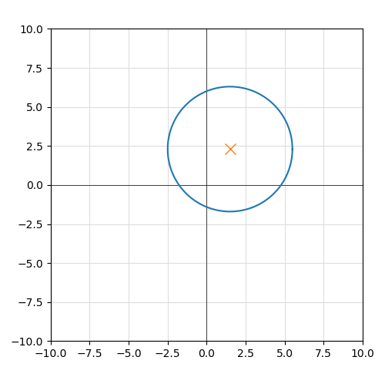
Toy example: Circle Object

Slide 9
Encapsulation
class
Circle
attributes
x
y
r
D = 2*r
C = 2*np.pi*r
properties
methods
translate(dx,dy)
resize(dr)

Slide 10
Encapsulation
x1, y1, r1 = 0, 0, 1
D1 = 2*r1
C1 = 2*np.pi*r1
x2, y2, r2 = 5, -3, 8
D2 = 2*r2
C2 = 2*np.pi*r2
Circle
x
y
r
D = 2*r
circ1 = {"x": 0, "y": 0, "r": 1}
circ1["D"] = 2*circ1["r"]
circ1["C"] = 2*np.pi*circ1["r"]
circ2 = {"x": 5, "y": -3, "r": 8}
circ2["D"] = 2*circ2["r"]
circ2["C"] = 2*np.pi*circ2["r"]
C = 2*np.pi*r
circ1 = Circle(x=0, y=0, r=1)
circ2 = Circle(x=5, y=-3, r=8)

Slide 11
Encapsulation
Canvas
[ ]
circles
c0
c1
c2
c3
nCircles
get_circle_at(index)

Slide 12
Inheritance
Shape
Circle
x
y
translate(dx,dy)
r
get_area() = np.pi*r**2
Square
w
get_area() = w**2
Rectangle
h
get_area() = w*h

Slide 13

Polymorphism (duck typing)
Circle
“If it looks like a duck, swims like a duck, and quacks like a duck … it’s probably a duck”
x
y
r
get_area() = np.pi*r**2
Square
x
y
w
Rectangle
get_area() = w**2
x
y
w
h
get_area() = w*h

Slide 14
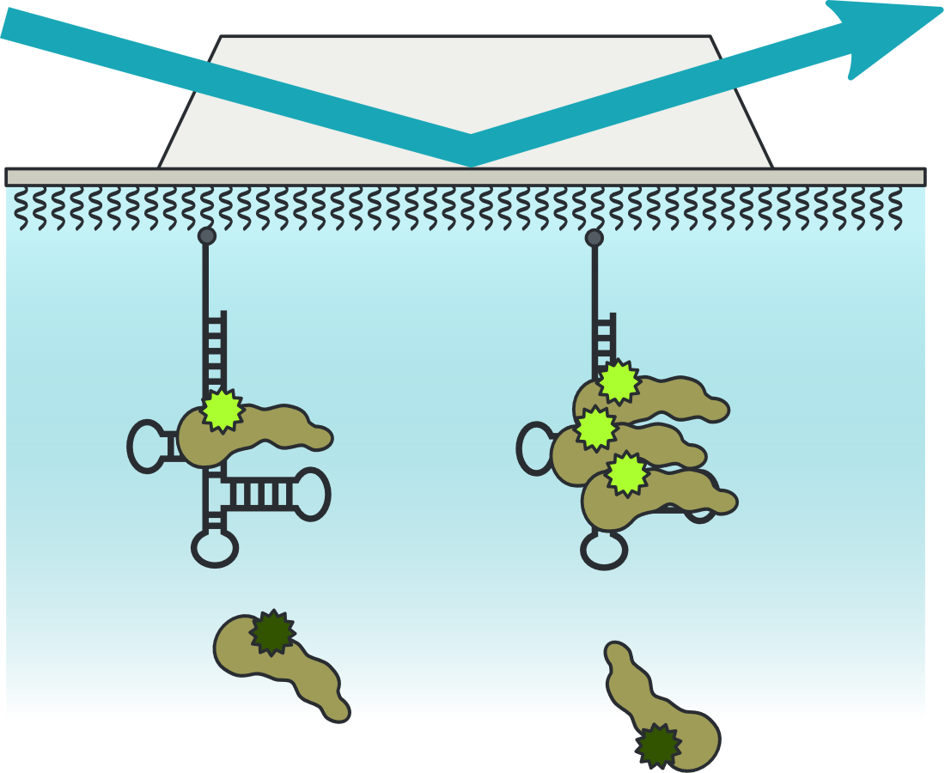
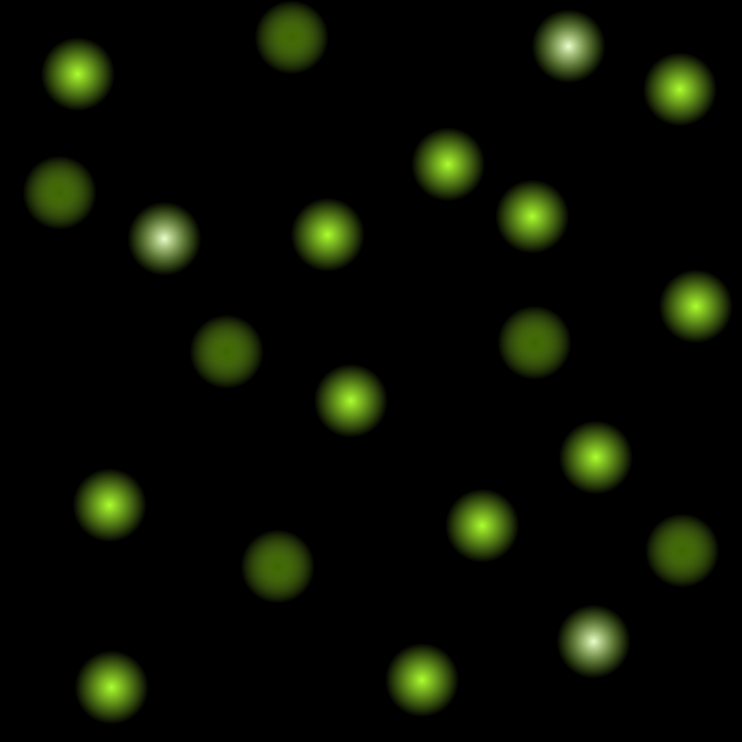
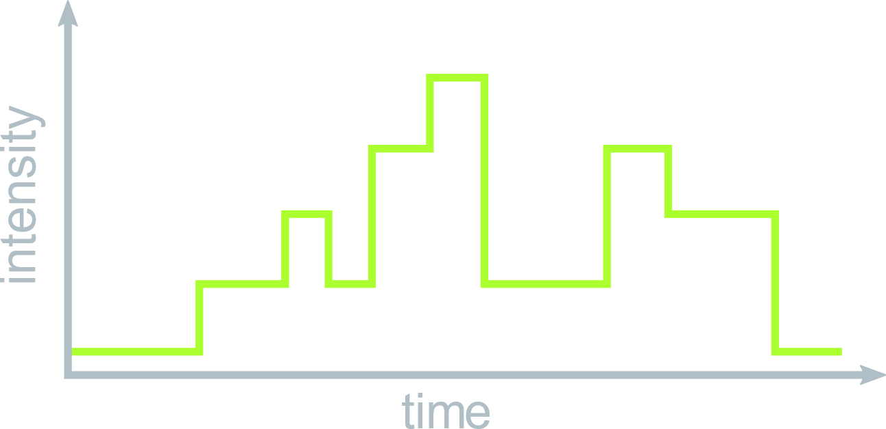
smTIRF
Movie
frameLength
traces
Trace
sort_traces()
D
t
offset
model
HMM
train_model()
K
pi
A
mu
sigma
p_X()
update_parameters()
estimate_statepath()

Slide 15
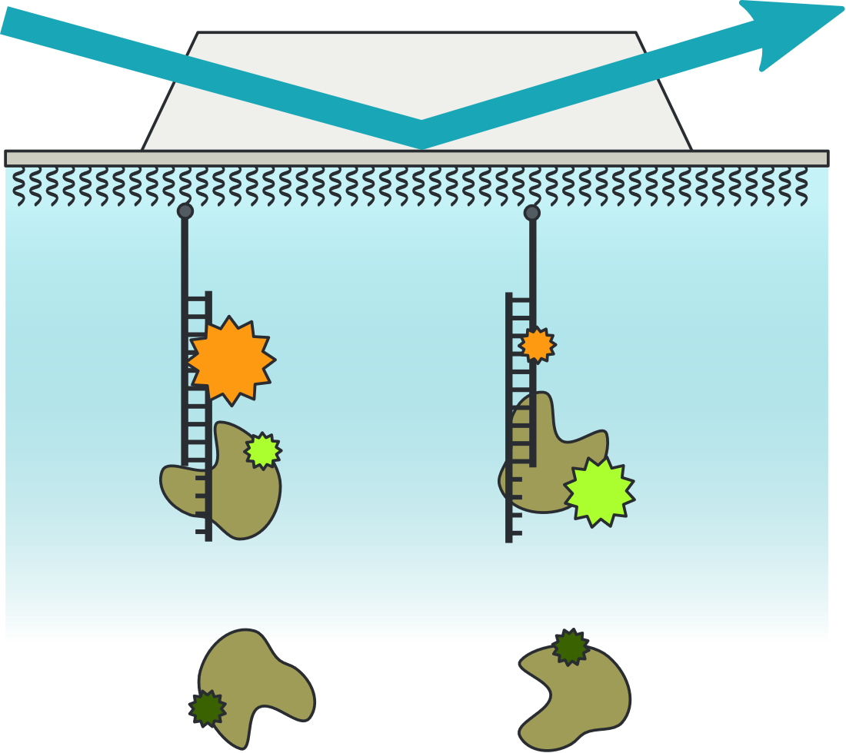
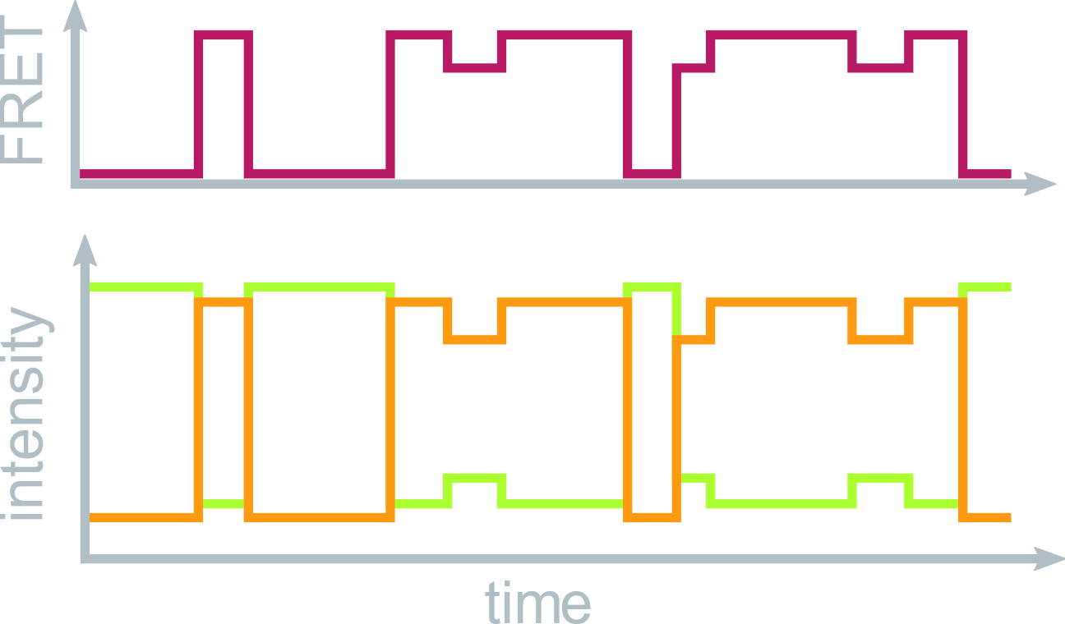
smTIRF
Trace
D
t
offset
model
X = D
train_model(self.X)
FretTrace
A
E = A/(A+D)
X = E

Slide 16
Syntax: Object construction
class Circle():
def __init__(self, r): # constructor method
self.r = r # attribute
@property
def D(self): # property
return 2*self.r
def expand(self, mag): # method
self.r *= mag
if __name__ == "__main__":
circ1 = Circle(1)
print(circ1.D) # 2
circ1.r = 2
print(circ1.D) # 4
circ1.expand(5)
print(circ1.D) # 20
def make_circle(r):
return {"r": r, "D": 2*r}
def expand(circ, mag):
circ["r"] *= mag
circ["D"] = 2*circ["r"]
if __name__ == "__main__":
circ1 = make_circle(1)
print(circ1["D"]) # 2
circ1["r"] = 2
print(circ1["D"]) # 2
expand(circ1, 5)
print(circ1["D"]) # 20

Slide 17
Syntax: inheritance
class Circle():
def __init__(self, r): # constructor method
self.r = r # attribute
@property
def D(self): # property
return 2*self.r
def expand(self, mag): # method
self.r *= mag
if __name__ == "__main__":
circ1 = Circle(1)
print(circ1.D) # 2
circ1.r = 2
print(circ1.D) # 4
circ1.expand(5)
print(circ1.D) # 20
def make_circle(r):
return {"r": r, "D": 2*r}
def expand(circ, mag):
circ["r"] *= mag
circ["D"] = 2*circ["r"]
if __name__ == "__main__":
circ1 = make_circle(1)
print(circ1["D"]) # 2
circ1["r"] = 2
print(circ1["D"]) # 2
expand(circ1, 5)
print(circ1["D"]) # 20

Slide 18
Value vs Reference
a = 2
b = a
a = 5
print(b)
c = [a, b]
d = c
c[0] = 0
print(d)
a
a
b
c
2
5
2
5
2
a
b
a
b
c
d
2
2
5
2
5
2
a
b
a
b
c
d
5
2
5
2
0
2

Slide 19
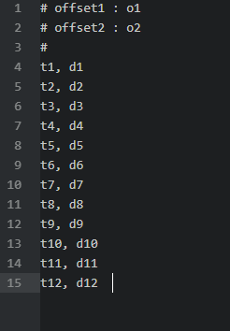
Data storage formats: text-based delimited (CSV)
Movie
frameLength -> int
traces -> [Trace()]
Trace
D -> ndarray[t]
t -> ndarray[t]
offset -> [float, float]
model -> HMM()
HMM
K -> int
pi -> ndarray[K]
A -> ndarray[K,K]
mu -> ndarray[K]
sigma -> float

Slide 20
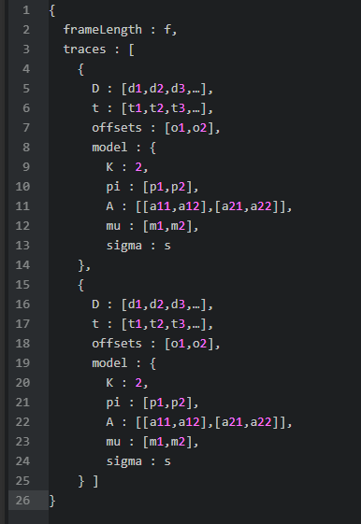
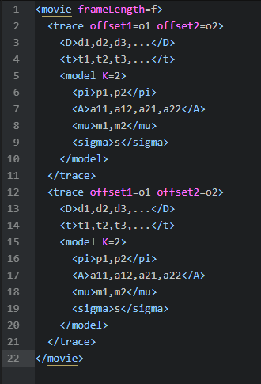
Data storage formats: text-based hierarchical (JSON, XML)
Movie
JSON
XML
frameLength -> int
traces -> [Trace()]
Trace
D -> ndarray[t]
t -> ndarray[t]
offset -> [float, float]
model -> HMM()
HMM
K -> int
pi -> ndarray[K]
A -> ndarray[K,K]
mu -> ndarray[K]
sigma -> float

Slide 21
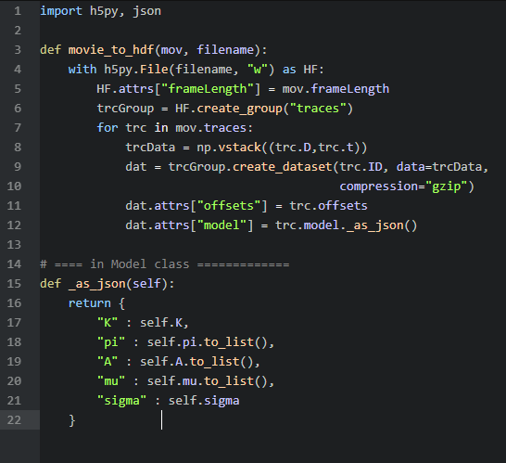
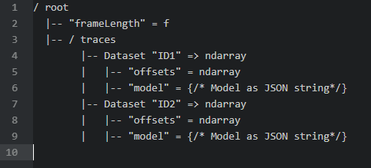
Data storage formats: binary hierarchical (HDF5)
Movie
frameLength -> int
traces -> [Trace()]
Trace
D -> ndarray[t]
t -> ndarray[t]
offset -> [float, float]
model -> HMM()
HMM
K -> int
pi -> ndarray[K]
A -> ndarray[K,K]
mu -> ndarray[K]
sigma -> float

Slide 22
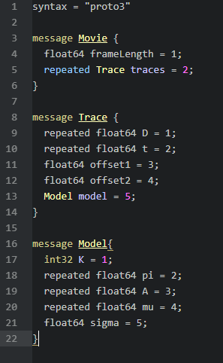
Data storage formats: binary schema (protobuf)
Movie
frameLength -> int
traces -> [Trace()]
Trace
D -> ndarray[t]
t -> ndarray[t]
offset -> [float, float]
model -> HMM()
HMM
K -> int
pi -> ndarray[K]
A -> ndarray[K,K]
mu -> ndarray[K]
sigma -> float

