Slide 1

Blockchain Art
Sculptures, Painting, and More!
Phil(ip) Daian : IC3 @ Cornell

Slide 2

Why Blockchain Art?
Insight into how people are viewing social trend
It’s beautiful and fun!
Good chance to educate, inform public
Art is awesome!

Slide 3
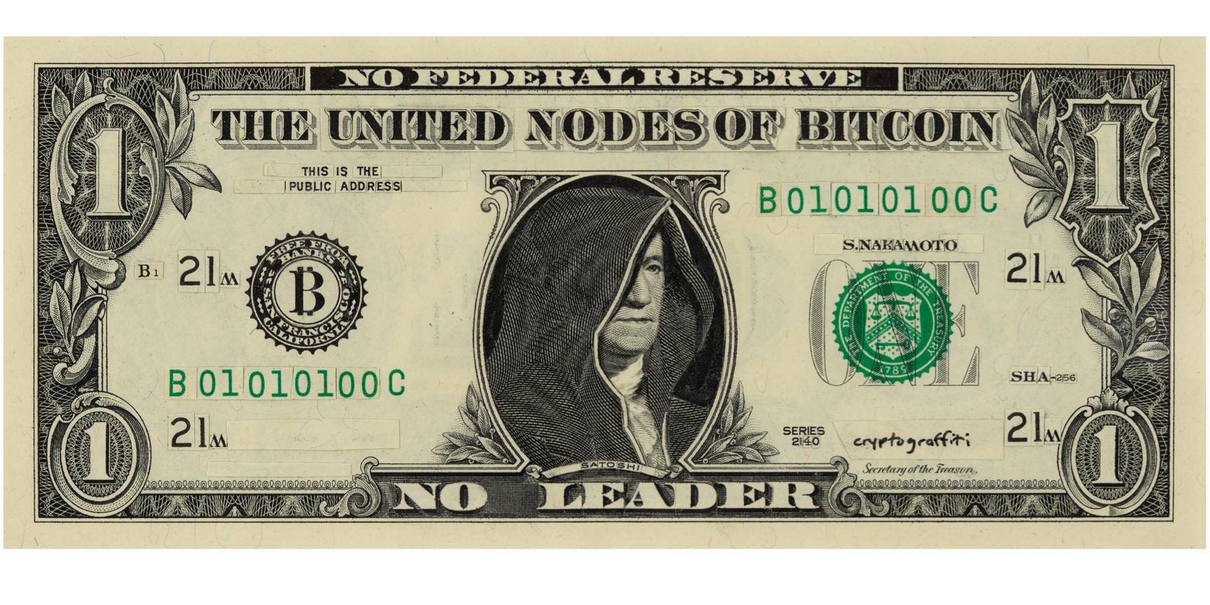
Proof of Money
On display at forthcoming exhibit, Proof of Art, 5/25 in San Francisco

Slide 4
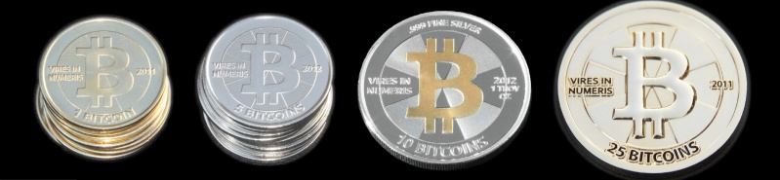
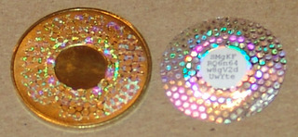
Rise of the Physical Coins Cassacius (@Bitcointalk)

Slide 5
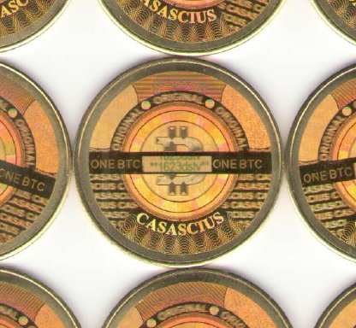
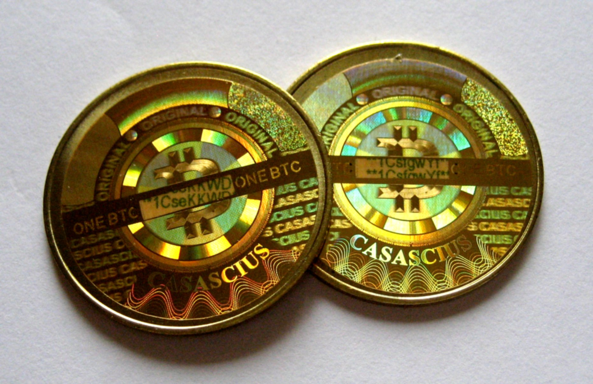
Rise of the Physical Coins: Cassacius

Slide 6
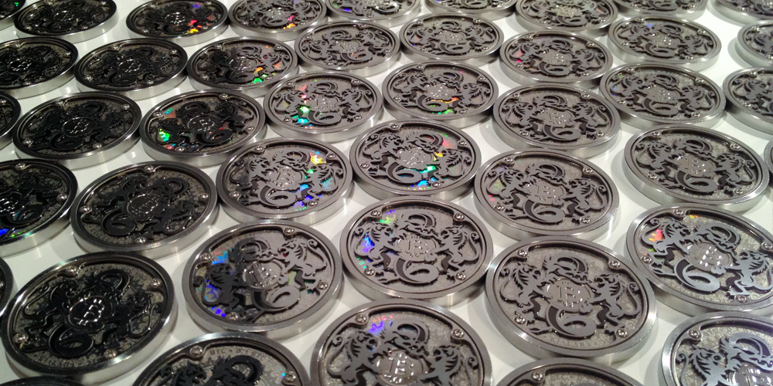
Rise of the Physical Coins: Kialara

Slide 7
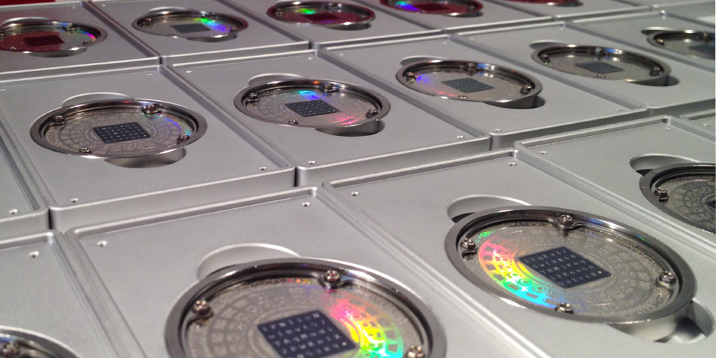
Rise of the Physical Coins: Kialara

Slide 8
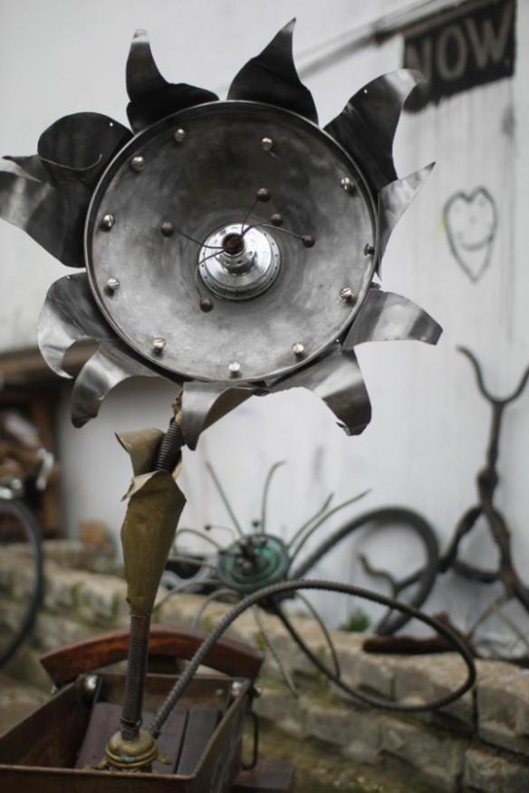
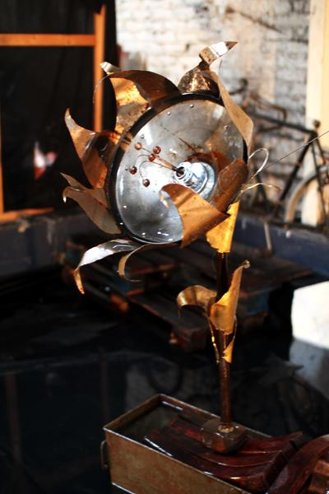
Plantoid (2015, Okhaos)

Slide 9
And my Bitcoin Gallery!
http://btcartgallery.com/
http://cryptoart.com/
http://art4bitcoin.net/

Slide 10
Blockchain Statue - Goals
Educate and inform – informative animations
Show off trustless nature of contracts (Proof of statue?)
Extend Bitcoin art to any blockchain!
Fun, interactive way to spread cryptocurrency
Eventually: Something beautiful and timeless
Self funding DAO statue!
Now: Rough plywood prototype

Slide 11
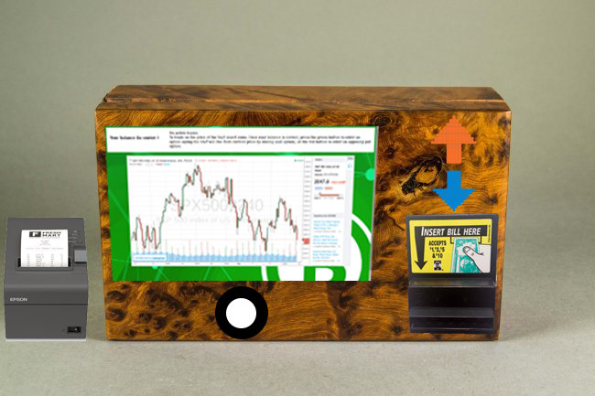
Blockchain Statue – One Example

Slide 12
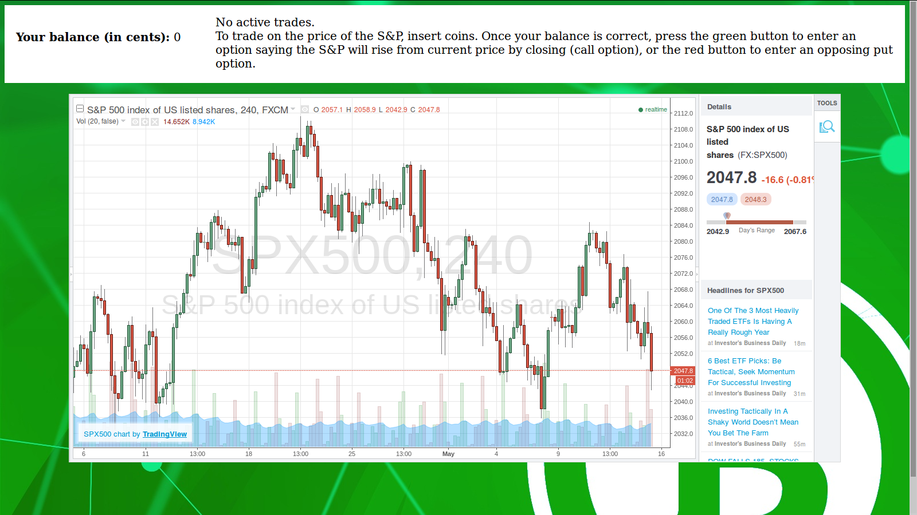
Blockchain Exchange, 2016 (Preproduction, IC3)

Slide 13
Blockchain Statue – Prototype Limitations
That would be no fun!
Can anyone think of any?
(Hint: Town Crier)

