Slide 1
Net Neutrality– no
Alex Miller and Anna Claire

Slide 2
The internet is fine
success of the internet independent of government regulation
issues with infrastructure/peering relationships for individuals... there aren't any
ISPs acted right under Trump without net neutrality

Slide 3
Net neutrality: what and why
fears of censorship and throttling by ISPs
support from web-based tech companies like Google, Amazon, Facebook, and Netflix

Slide 4
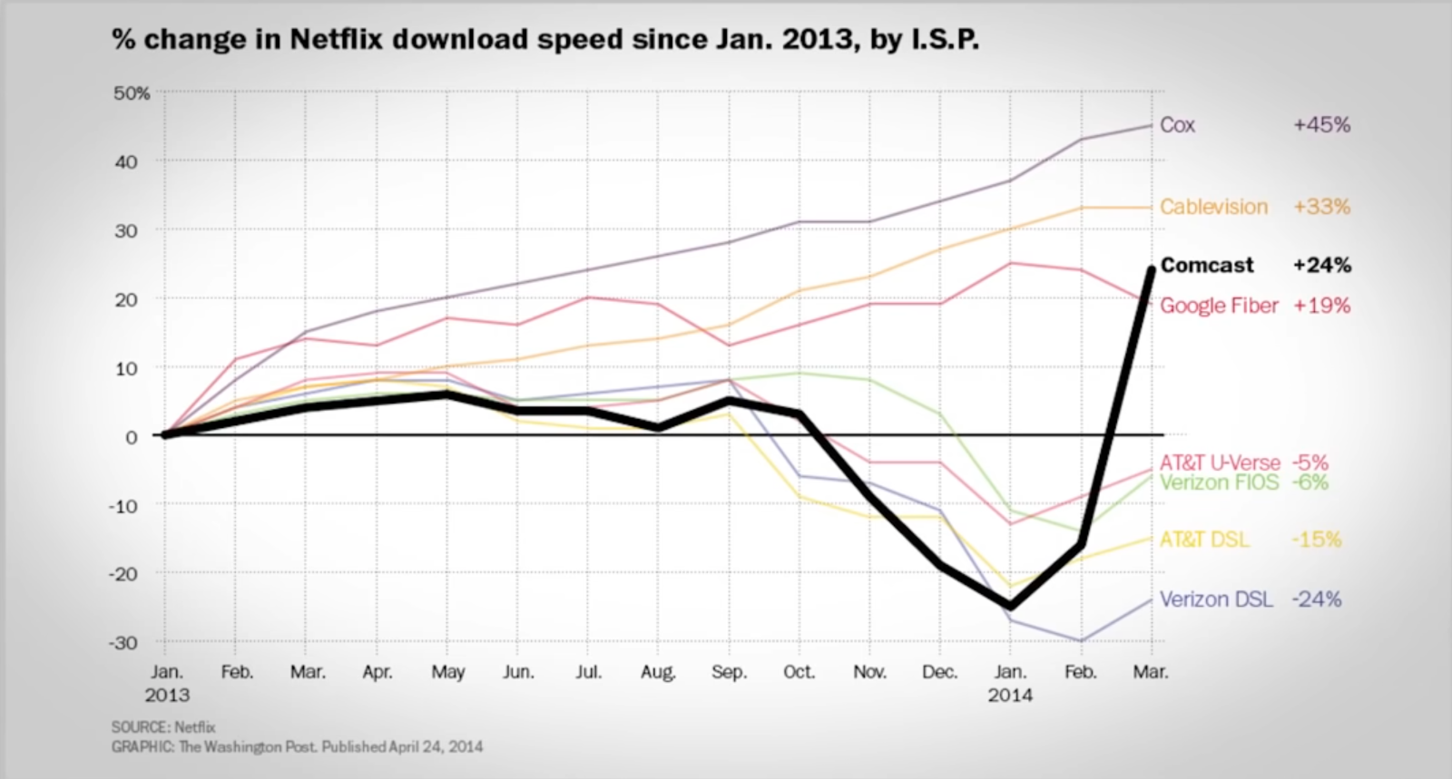
but are our fears realized?

Slide 5
are they?
No

Slide 6
Problems
Doesn't address primary issue of infrastructure
Lack of incentive for ISP's to invest
Tech giants passing off costs to consumers
Can't optimize user experience

Slide 7
Stay in your lane
Headache for ISPs
Outside authority of FCC
extension into peering
If there are laws to be made, they need to refer to infrastructure

