Slide 1

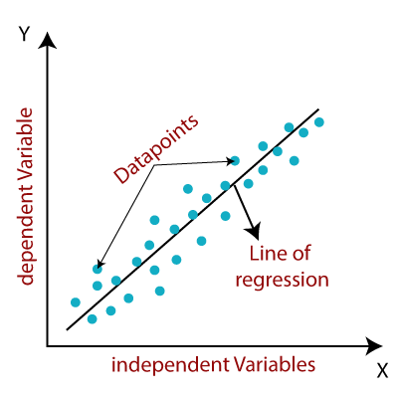
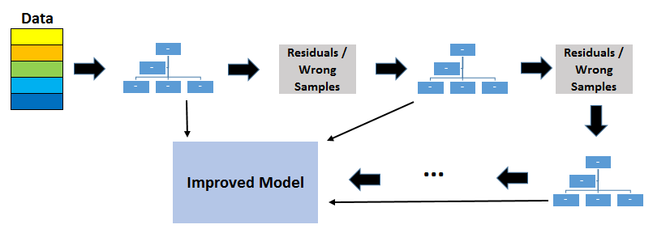
Machine Learning: XGBoost and Caret: Cheat Sheet
Installation
Datasets
Prediction Models
CRAN:
Install.packages(“xgboost”)
Install.packages(“caret”)
Github (recommended):
install.packages("drat", repos="https://cran.rstudio.com")
drat:::addRepo("dmlc")
install.packages("xgboost", repos="http://dmlc.ml/drat/", type = "source")
Included Training and Testing dataset
data(agaricus.train, package='xgboost')
data(agaricus.test, package='xgboost')
xgb.train
Partitioning Data
In most cases you will have to split your own data into a test and train set which can be done using the caret package
(iris data used for example)
data = | Insert the DMatrix
nrounds = | max number of boosting iterations
max.depth = | Max depth of the boosting trees
Verbose = | 0: No output 1: print evaluation metric 2: print information about tree
booster = | Allows for different models of regression “gblinear” “tree”
objective = | Specify the learning task and the corresponding learning objective
Basics
set.seed(101)
Data(iris)
parts = createDataPartition( y = data$Species, p = 0.8, list = F)
Make Two New Data Sets (test and train)
train = data[parts, ]
test = data[-parts, ]
X_train = data.matrix(train[,-5]) y_train = train[,5]
X_test = data.matrix(test[,-5])
y_test = test[,5]
Machine Leaning allows for a program to make predictions based off a test data set. The packages allow for model training and application
Example Models
Linear Regression Model – booster = "gblinear”
Data Structure
Xgboost provides a data storage method that allows for increased memory efficiency and decreased learning time
Xgb.DMatrix
model <- xgb.train(data = xgboost_train, max.depth=3, nrounds=50,
Verbose = 0,
objective = binary:logistic)
Gradient Boosted Decision Tree
xgboost_train = xgb.DMatrix(data = X_train, label = y_train)
xgboost_test = xgb.DMatrix(data= X_test, label= y_test)
There are many option for customizing your test for maximum efficiency: https://xgboost.readthedocs.io/en/latest/parameter.html#parameters-for-tree-booster
RStudio® is a trademark of RStudio, Inc. • CC BY SA Andrew Miller-Klugman • amillerklugman2002@gmail.com

Slide 2
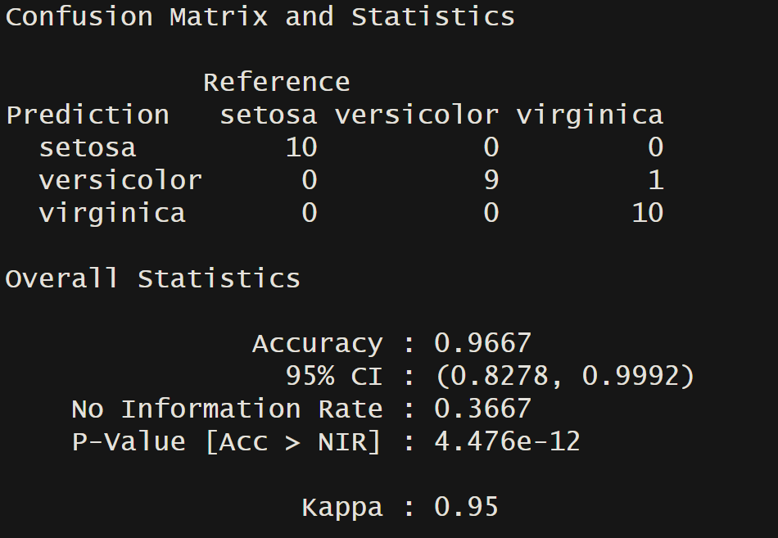
Predictions
Model Accuracy
Application
Use the model to predict the outcomes of the test data set
The caret packages provides a simple and easy to understand way to view model accuracy in the form of a confusion matrix
Let's apply the model to a new dataset!
pred_test = predict(object = model, newdata = xgboost_test)
new_data <- data.frame(Sepal.Length = c(5.1, 5.9, 7.3, 0.6, 4.3), Sepal.Width = c(3.5, 3.0, 5.6, 2.5, 6.7), Petal.Length = c(1.4, 4.2, 5.6, 2.2, 1.2), Petal.Width = c(0.2, 1.5, 0.5, 01.2, 0.7))
conf_mat = confusionMatrix(y_test, pred_y)print(conf_mat)
print(conf_mat(
However, this will output the prediction in numeric form. We want the data to match the output in the test matrix which can be achieved using base code!
pred_test[(pred_test>3)] = 3
pred_y = as.factor ((levels(y_test))[round(pred_test)])print(pred_y)
Now we can make a prediction about the new data set using the new_data matrix we just created, following the previous steps
new_data_pred <- predict(object = model, newdata = as.matrix(new_data))
new_data_pred[(new_data_pred>3)] = 3
pred_y = as.factor((levels(y_test))[round(new_data_pred)])print(pred_y)
Now we can find the accuracy of our model!
The matrix outputs useful statistics such as outputs, accuracy, and P-values. All of which can be used to measure model accuracy
Credits
XGBoost - The XGBoost Contributors
Caret - Max Kuhn
Linear Regression Model Image - https://www.javatpoint.com/linear-regression-in-machine-learning
Gradient Boosting Tree Model - https://towardsdatascience.com/gradient-boosted-decision-trees-explained-9259bd8205af
RStudio® is a trademark of RStudio, Inc. • CC BY SA Andrew Miller-Klugman • amillerklugman2002@gmail.com

