Slide 1
DenseNet-BC-100-12
Dense
256
Avg Pooling
Softmax
3
64
512
64+32*6
128
1024
128+32*12
1024
256
256+32*24
512
C1
D1
T1
D2
512+32*16
1024
32
T2
D3
T3
D4
56
56
28
28
14
14
7
7
1
96
128
160
192
224
256
64
64+32
96+32
128+32
160+32
192+32
224+32
DL1
DL2
DL3
DL4
DL5
DL5
56
56
56
56
56
56
56
64
128
P=0
S=1
128
56
1
56

Slide 2
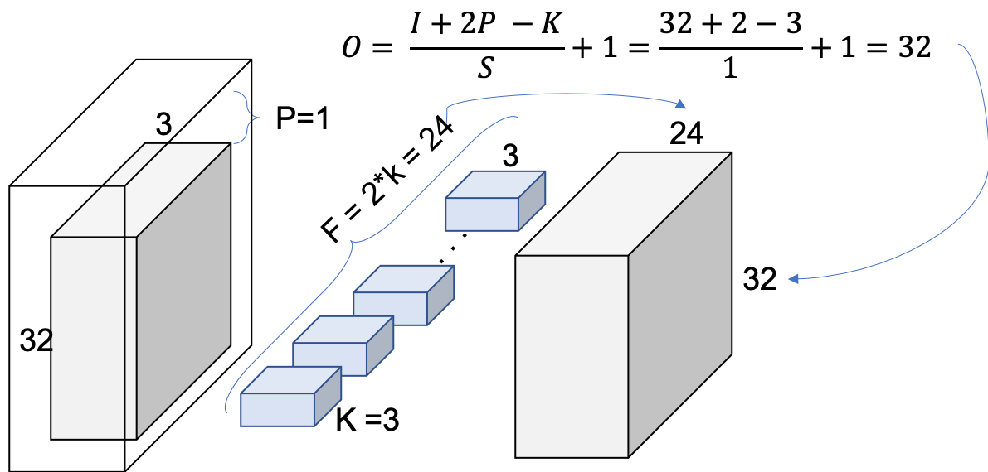
DenseNet-BC-100-12
K = 12
L = 100 → N = (100-4) // 3 = 16
Dense
Softmax
216
Avg Pooling
3
24
24+12*16
300
342
108
108+12*16
150
256+12*16
C1
D1
T1
D2
342
32
32
T2
D3
1
32
16
16
8
8
16 dense layers
24
36
48
60
216
216*0.5
= 108
108
S=2
K=2
108
…
32
DL1
DL2
DL2
DL4
DL16
32
16
24
P=0
S=1
48
P=1
S=1
k=12
12
Concatenation
4*12=48
24
12
32
32
32
32
1
3

Slide 3
Dense
Softmax
216
Avg Pooling
3
24
24+12*16
300
342
108
108+12*16
150
256+12*16
C1
D1
T1
D2
342
32
32
32
16
16
T2
D3
1
8
8

Slide 4
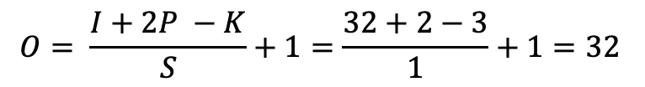
Convolution 1
$$O= \frac{I+2P −K}{S}+1=\frac{32+2−3}{1}+1=32$$
3
P=1
24
3
F = 2*k = 24
. . .
32
32

Slide 5
Dense
Softmax
216
Avg Pooling
3
24
24+12*16
300
342
108
108+12*16
150
256+12*16
C1
D1
T1
D2
342
32
T2
D3
1
32
16
16
8
8
16 dense layers
24
36
48
60
216
216*0.5
= 108
108
S=2
K=2
108
…
32
DL1
DL2
DL2
DL4
DL16
32
16

Slide 6
3
Avg Pooling
Dense
Softmax
256
512
64
64+32*6
128
1024
1024
DenseNet 121
128+32*12
256
256+32*24
512
224
C1
D1
T1
D2
T2
D3
512+32*16
1024
56
T3
D4
1
56
28
28
14
14
7
7

