Slide 1
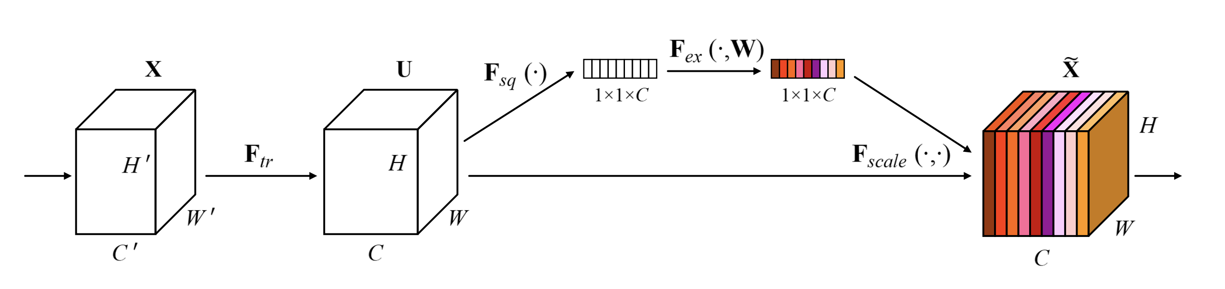
Transformation
Squeeze - Excitation
Scale

Slide 2








$$\vec{X}$$
$$\vec{U}$$
C’
C’
$${\vec{U}}_{1}$$
$${\vec{U}}_{C}$$
$${\vec{v}}_{C}$$
C
. . .
. . .
H
H’
W’
$${\vec{v}}_{2}$$
W
. . .
. . .
1
S
C’
$${\vec{v}}_{1}$$
$${{\vec{v}}_{1}}^{s}$$

Slide 3











$$\vec{U}$$
$${\vec{U}}_{1}$$
$${\vec{U}}_{C}$$
$$\vec{z}$$
For 1 single channel, $c$:
C
$${\vec{z}}_{c}=\vec{F_{sq}}\left(U_{c}\right)=\frac{1}{HxW} \sum_{i=1}^{H}{\sum_{j=1}^{W}{U_{c}\left(i,j\right)}}$$
. . .
$$\vec{F_{sq}}$$
1
H
W
1
$For c=C$:
$${\vec{z}}_{C}=\vec{F_{sq}}\left(U_{C}\right)=\frac{1}{HxW}\left[\left(U_{c}\left(0,0\right)+…+U_{c}\left(0,W\right)\right)+\left(U_{c}\left(1,0\right)+…+U_{c}\left(1,W\right)\right)+…+\left(U_{c}\left(H,0\right)+…+U_{c}\left(H,W\right)\right)\right]$$
Sigmoid
$$\vec{z}$$
W2
$$\vec{s}$$
W1
ReLU
$$\frac{1}{r}·C$$

Slide 4



$$\vec{\tilde{X}}$$
$$\vec{U}$$
$${\vec{U}}_{1}$$
$${\vec{U}}_{C}$$
C’
$${\vec{F}}_{sc}$$
. . .
H
$$\vec{s}$$
W
W

Slide 5
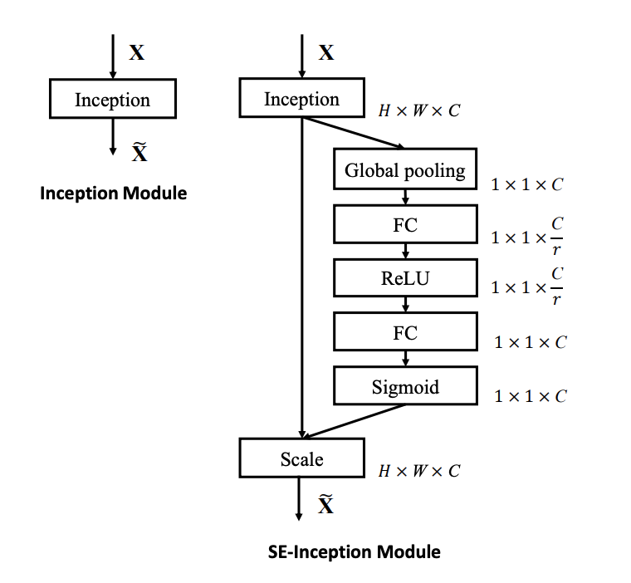
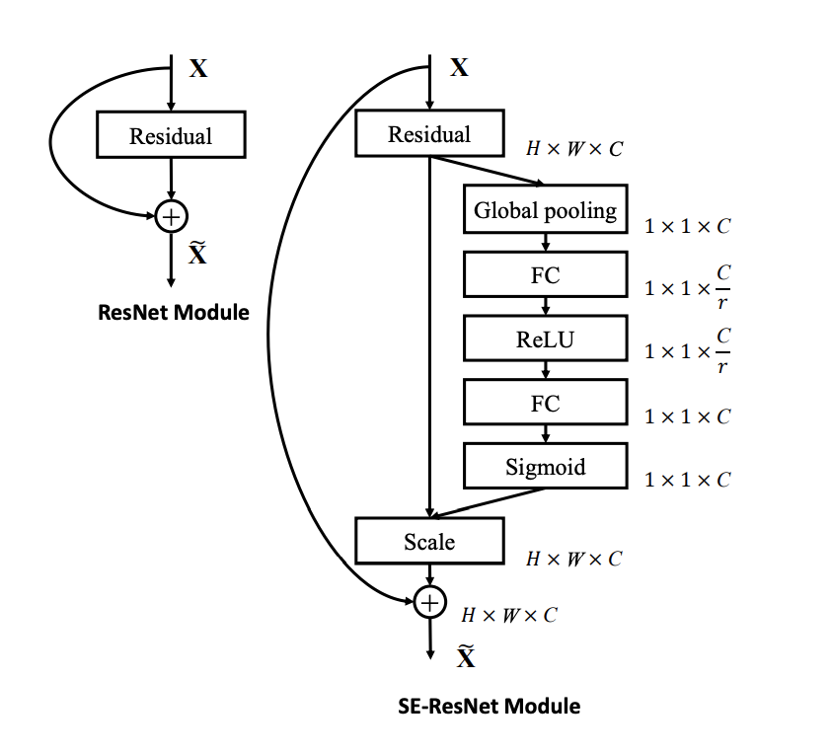

Slide 6










$$\vec{F_{ex}}$$
$$\vec{X}$$
$${\vec{F}}_{tr}$$
$$\vec{U}$$
$$\vec{F_{sq}}$$
Sigmoid
$$\vec{\tilde{X}}$$
$$\vec{z}$$
W2
$$\vec{s}$$
W1
ReLU
C
. . .
$${\vec{F}}_{sc}$$
. . .
H
. . .
. . .
W
1
S
C’
$$\frac{1}{r}·C$$

