Slide 1
Design phase
Patient Registration
Group CS_IS_A05
Designers:
Azmat
Matiullah

Slide 2
Information:
The patient will be coming to the hospital and he will be registered here.
Information about patient are his id , name , sex , sickness and so on.
In this ERD we have full information about employees of the hospital.

Slide 3
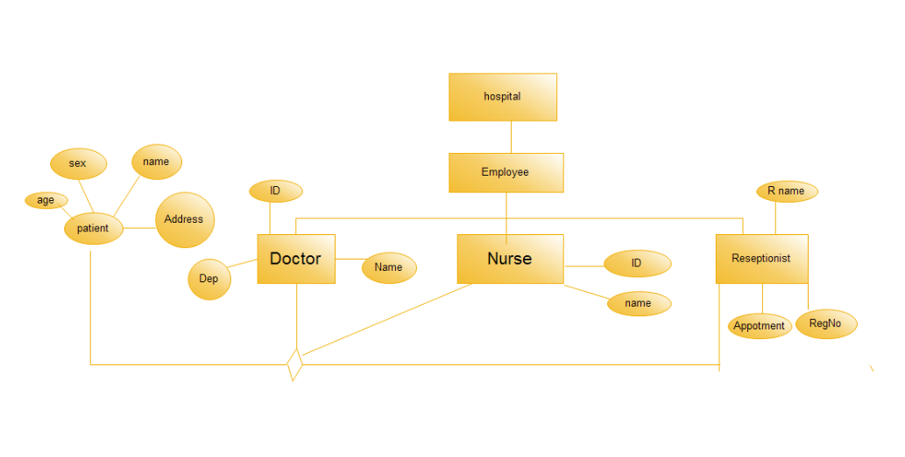
ERD

Slide 4
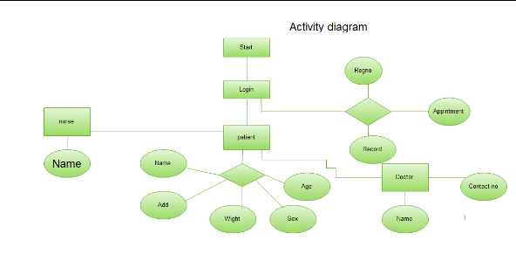
ACTIVITY DIAGRAM

Slide 5
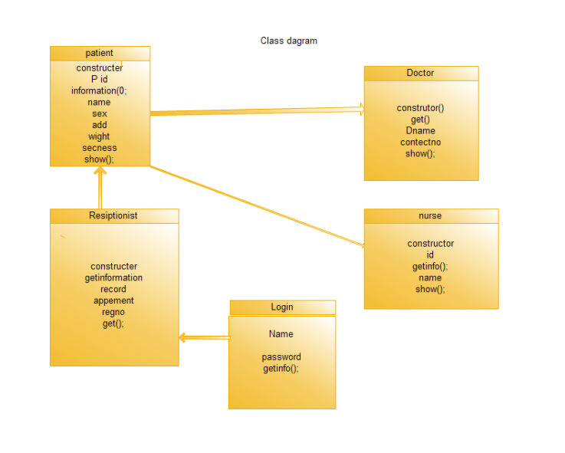
CLASS DIAGRAM

Slide 6
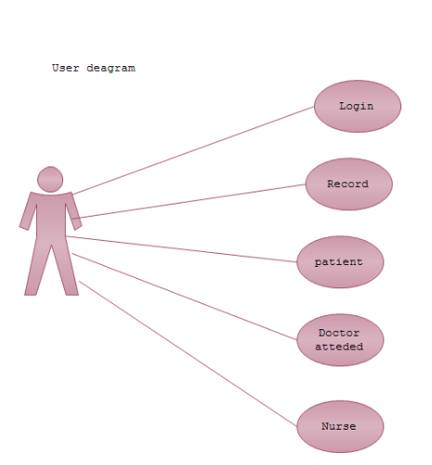
USE CASE DIAGRAM

