Slide 1
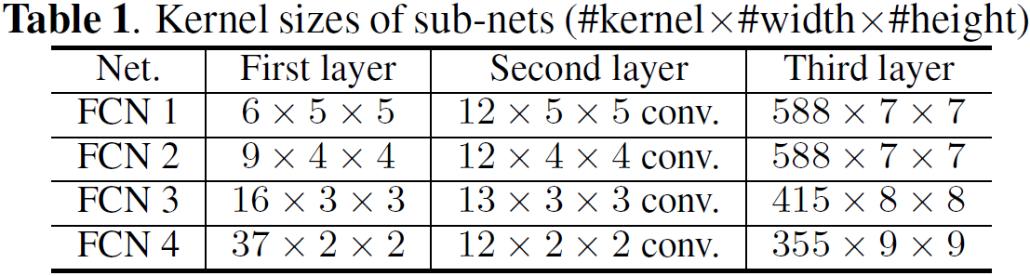
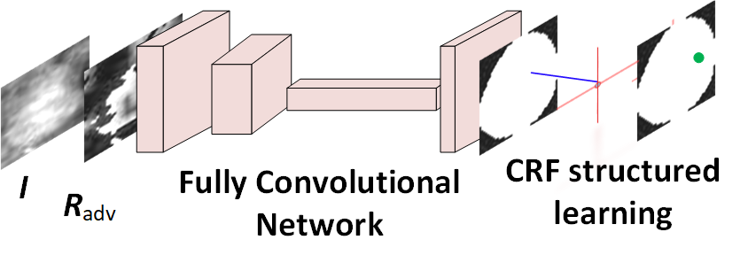

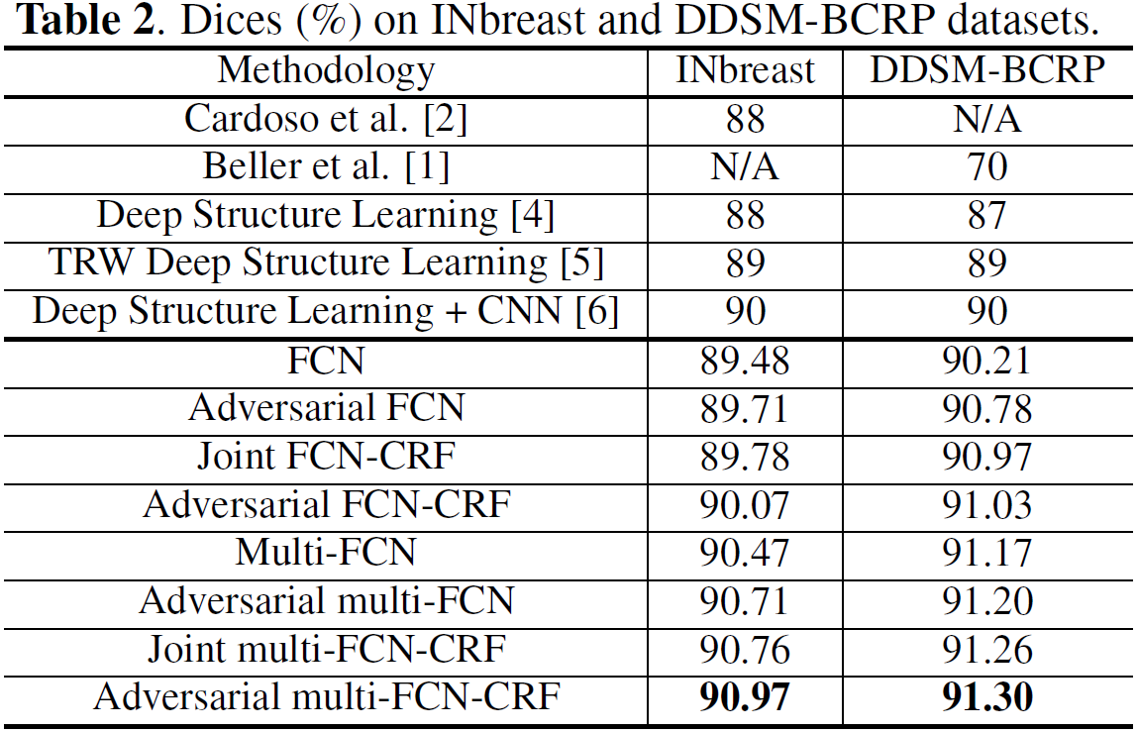
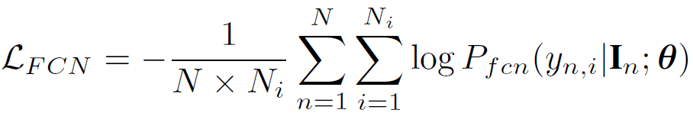
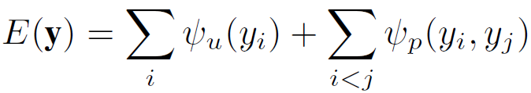
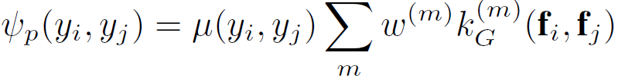
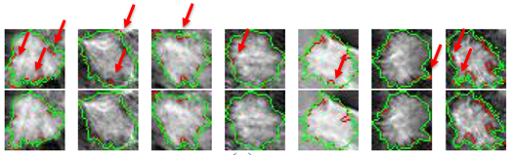
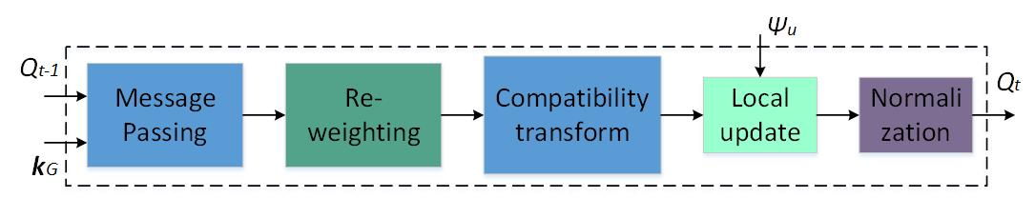
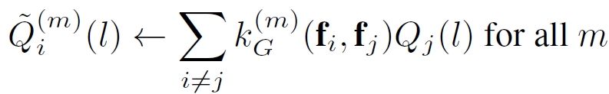
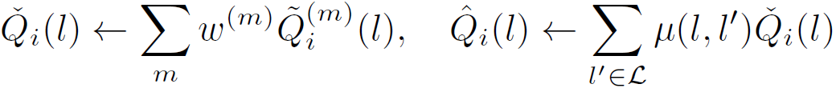



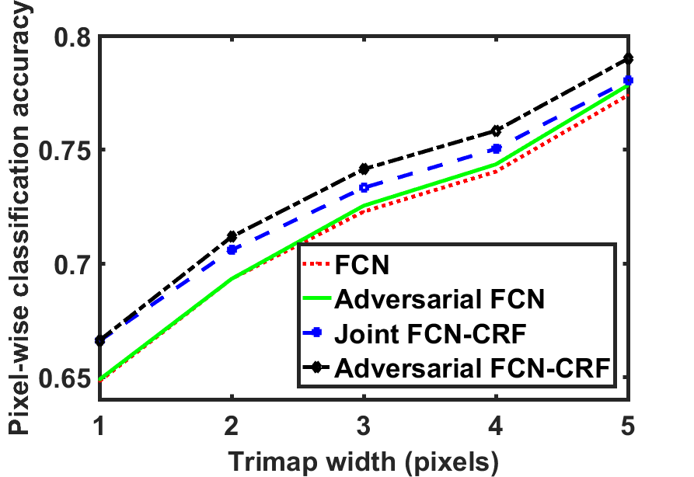
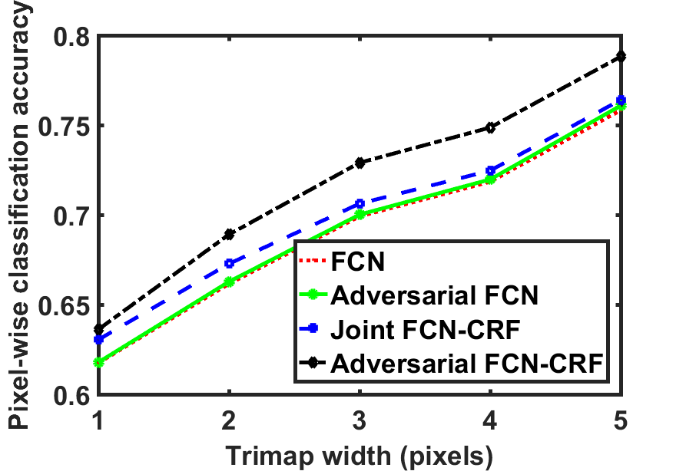
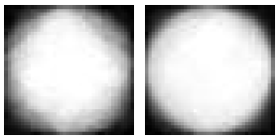




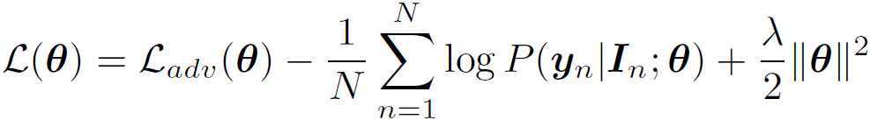
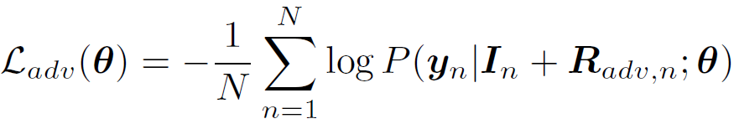
Adversarial Deep Structured Nets for Mass Segmentation from Mammograms Wentao Zhu¹, Xiang Xiang², Trac D. Tran², Gregory D. Hager², Xiaohui Xie¹ 1 University of California, Irvine 2 Johns Hopkins University
SUMMARY
RESULTS
Propose an unified end-to-end training framework integrating FCN+CRF and adversarial training.
Employ an end-to-end network to do mass segmentation while previous works require a lot of hand-designed features or multi-stage training.
Our model achieves the best results on INbreast and DDSM-BCRP.
Code: https://github.com/wentaozhu/adversarial-deep-structural-networks.git
1. Datasets
INbreast consists of 58 masses for training, 58 masses for test. DDSM-BCRP consists of 84 masses for training, 87 masses for test. Augment each training samples by flipping horizontally, flipping vertically, flipping horizontally and vertically and data enhancement.
Multi-FCN model
FRAMEWORK
1. Overall framework
Evaluation Dice index:
P-value < 0.001
Adversarial deep FCN-CRF network employs generated adversarial examples and consists of four convolutional layers followed by CRF for structured learning.
2. FCN-CRF network
FCN
CRF energy function
Pair-wise potential function
Comparison between Joint FCN-CRF and Adversarial FCN-CRF
Feature vector
CRFasRNN inference
Ground truth Trimap width 2 width 3
Classification accuracy on Trimap area
3. Adversarial FCN-CRF network
Statistical property of mass ground truth on INbreast and DDSM-BCRP
Weighted FCN
Adversarial training: Robust model to avoid over-fitting
Generate perturbation
First order approximation
Adversarial FCN-CRF loss
INbreast
DDSM-BCRP
CONTACT
A strong and new regularization
Wentao Zhu (wentaozhu1991@gmail.com). Xiang Xiang (xxiang@jhu.edu ). Trac D. Tran (trac@jhu.edu ). Gregory D. Hager (hager@jhu.edu ). Xiaohui Xie (xhx@ics.uci.edu )

