Slide 1
GLOBAL SUPERSTORE
Does Sales Growth Translate Into Profit?
A Discount-Driven Profitability Analysis | 2011–2014
51,290 orders • Python / Pandas / Seaborn / Plotly
Prepared by Amin Reda

Slide 2
Business Problem
Sales are growing strongly across markets — but is that growth translating into proportional profit? Or are specific products, markets, and customers quietly losing the company money?
KEY ANALYTICAL QUESTIONS
01
Is there a discount level beyond which orders stop being profitable?
02
Which products generate high sales but negative profitability?
03
Which markets underperform — and is it a product issue or a pricing issue?
04
Which customers drive the majority of revenue, and who is at risk of churn?
2

Slide 3
Dataset Overview
51,290
1,590
4 Years
23
Orders
Unique Customers
2011 – 2014
Analysis Columns
CORE VARIABLES USED IN THIS ANALYSIS
Variable | Type | Note
Sales / Profit / Discount | Numerical | Core financial variables
Category / Sub-Category | Categorical | 3 categories, 17 sub-categories
Market / Region | Categorical | 7 global markets, 13 regions
Order Date / Ship Date | Temporal | Mixed formats — parsed & validated
3

Slide 4
Data Cleaning & Methodology
1
Mixed Date Formats
Order/Ship dates used both '/' and '-' separators. Parsed with dayfirst logic, then validated.
2
Logical Validation
Asserted Ship Date ≥ Order Date across all 51,290 rows — 0 violations confirmed the parsing was correct.
3
Feature Engineering
Derived 'Processing Time' (days) — cross-checked against Order Priority for consistency.
4
Column Pruning
Dropped Postal Code (80% missing) and Row ID (identifier only, no analytical value).
assert (df['Ship Date'] >= df['Order Date']).all() ← validation, not assumption
4

Slide 5
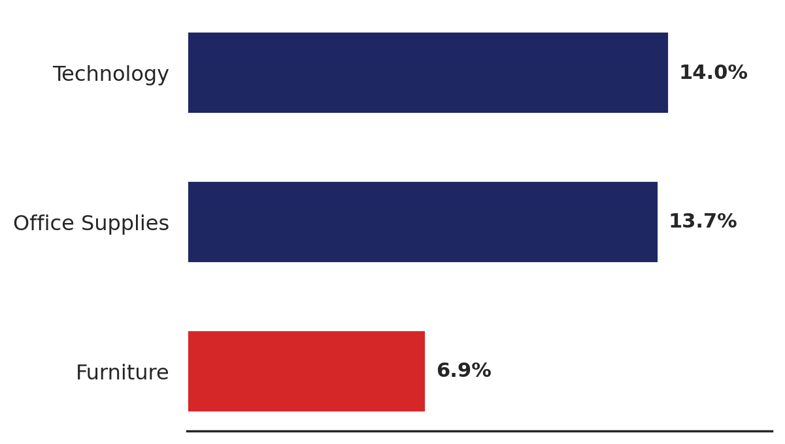
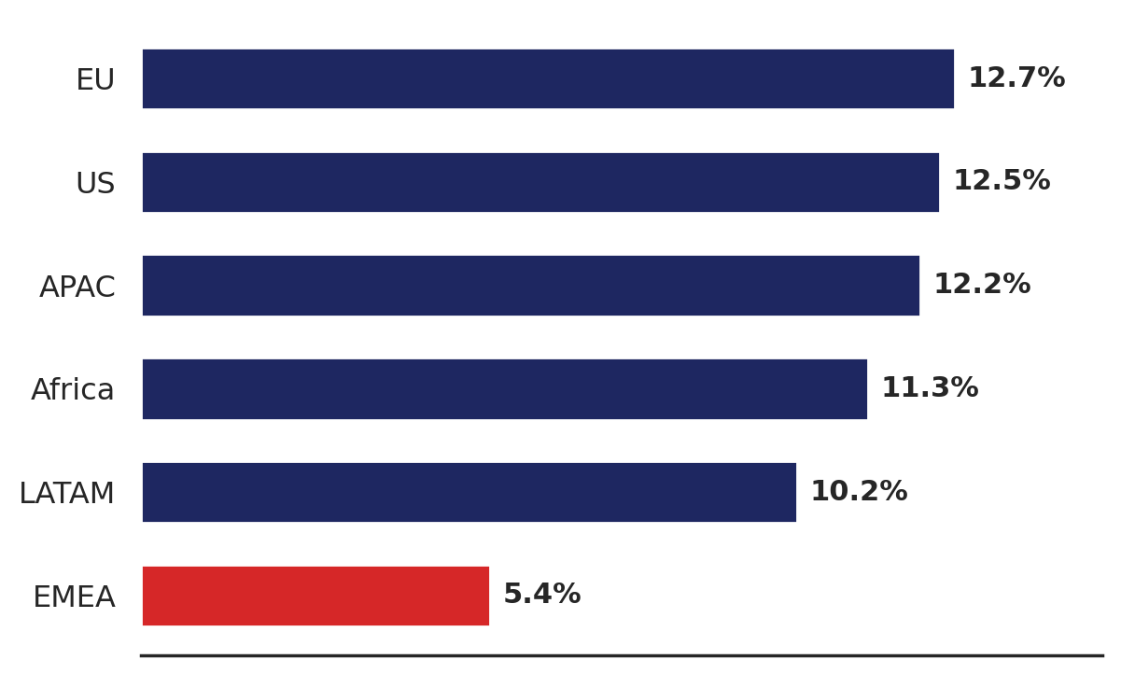
KPI Dashboard
$12.6M
$1.47M
11.6%
$505
Total Revenue
Total Profit
Overall Margin
Avg Order Value
22.1% of all orders are discounted above 20%
89.9%
Net impact: –$814,682
of those orders lose money
PROFIT MARGIN BY CATEGORY
PROFIT MARGIN BY MARKET
5

Slide 6
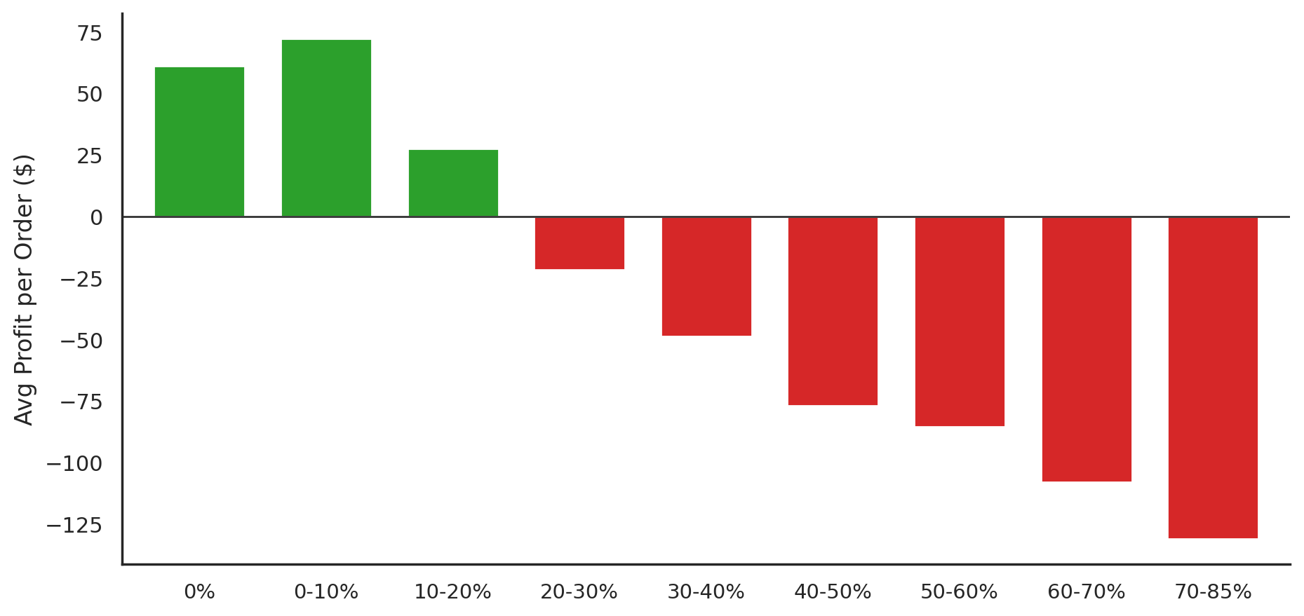
The Discount Breaking Point
Average profit per order turns negative once discount passes ~20% — and keeps falling
EVIDENCE
Date parsing validated with 0 logical violations across 51,290 rows
318–29,009 orders per discount bucket — no small-sample noise
Worst 10 Tables orders = only 29% of total Tables loss → not driven by a few outliers
Correlation: –0.316 (moderate, consistent across markets)
6

Slide 7
Same Root Cause, Two Places
PRODUCT-LEVEL: TABLES
MARKET-LEVEL: EMEA
–$64,083
5.4%
total loss, despite $757K in sales
weakest market margin (vs. ~11–13% elsewhere)
Market | Avg Disc. | Margin
EU | 37% | –19.9%
APAC | 33% | –8.9%
EMEA | 16% | +7.0%
Africa | 13% | +11.6%
Category | Margin (EMEA)
Furniture | 5.0%
Office Supplies | 5.4%
Technology | 5.8%
All 3 categories underperform uniformly → not a product issue, a pricing policy issue. EMEA avg. discount: 19.6% vs. 14.3% company-wide.
7

Slide 8
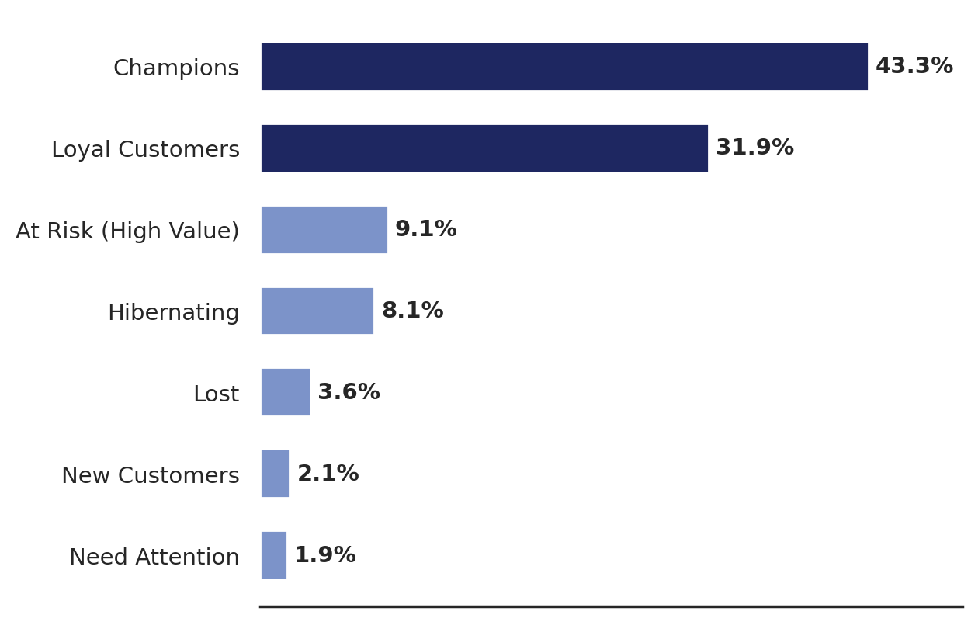
Who Actually Drives Revenue?
RFM segmentation — Recency, Frequency, Monetary — across 1,590 customers
43.3%
of revenue from just
21.8% of customers
(“Champions”)
TESTED HYPOTHESIS
Does discounting explain why “At Risk (High Value)” customers are disengaging?
Refuted. This segment received the LOWEST average discount (13.3%) of any segment — the cause lies elsewhere and needs further investigation.
% of total revenue contributed by each RFM segment
8

Slide 9
Key Insights
Uncontrolled discounting above 20% is the root cause of the company's weakest profitability points.
1
Tables loses money specifically where discount exceeds 25–30% — the same product is profitable elsewhere.
2
EMEA underperforms systemically across all categories due to a higher baseline discount rate.
3
Company-wide growth is healthy (23.9% CAGR) with a stable ~11–12% margin — issues are localized, not systemic.
4
Ship Mode and Processing Time were tested and ruled out as profitability drivers (correlation ≈ 0).
5
9

Slide 10
Recommendations
Global 20% discount cap
Recover share of –$814,682 annual loss
HIGH
+ approval workflow for exceptions
Dedicated cap on Tables
Flip –$64,083 to net positive
HIGH
discount ≤ 20% specifically
Review EMEA pricing policy
Potential 5–7 point margin gain
MEDIUM
benchmark against EU (10.3% avg. discount)
Maintain growth strategy
Preserve 23.9% CAGR
ONGOING
no changes needed
10

Slide 11
Conclusion
Growth is healthy — but not every part of the business is profitable at the same rate.
Uncontrolled discounting is the single root cause behind the weakest points: Tables, EMEA, and high-discount order clusters broadly.
The fixes are specific and actionable — not generic advice — at the product, market, and customer level.
Implementing these recommendations could recover a significant share of the company's annual discount-driven losses — without slowing sales growth.
11

