Slide 1
A Slides Presentation
Created Using PresentLang

Slide 2
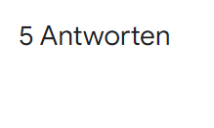
PresentLang Benefits
PresentLang makes creating presentations similar to html, where you can simply type away.

