Slide 1
Distributed Tracing
Amin Ziaei
Neshan Boot Camp
September 2023

Slide 2
Presentation titles
What is distributed tracing?
Why do we need distributed tracing
Distributed Tracing Tools
Comparison

Slide 3
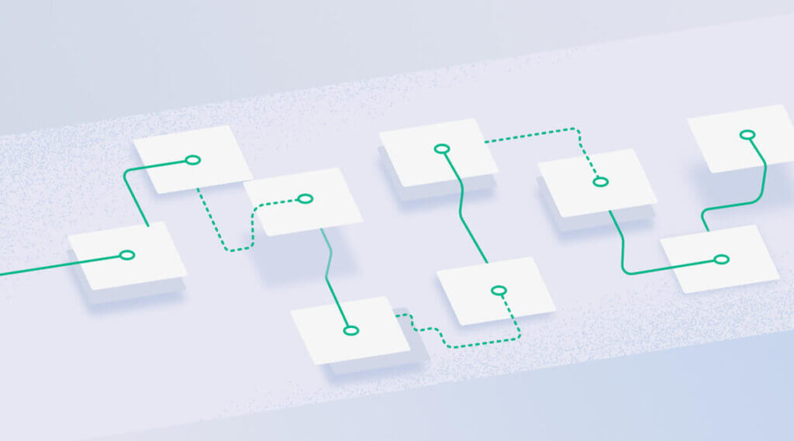
What is distributed tracing?
Tracing, or more specifically distributed tracing or distributed request tracing, is the ability to follow a request through a system, joining the dots between all the individual system calls required to service a particular request.

Slide 4
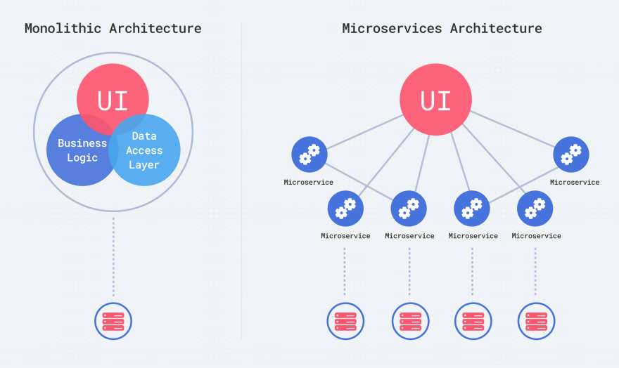

Slide 5
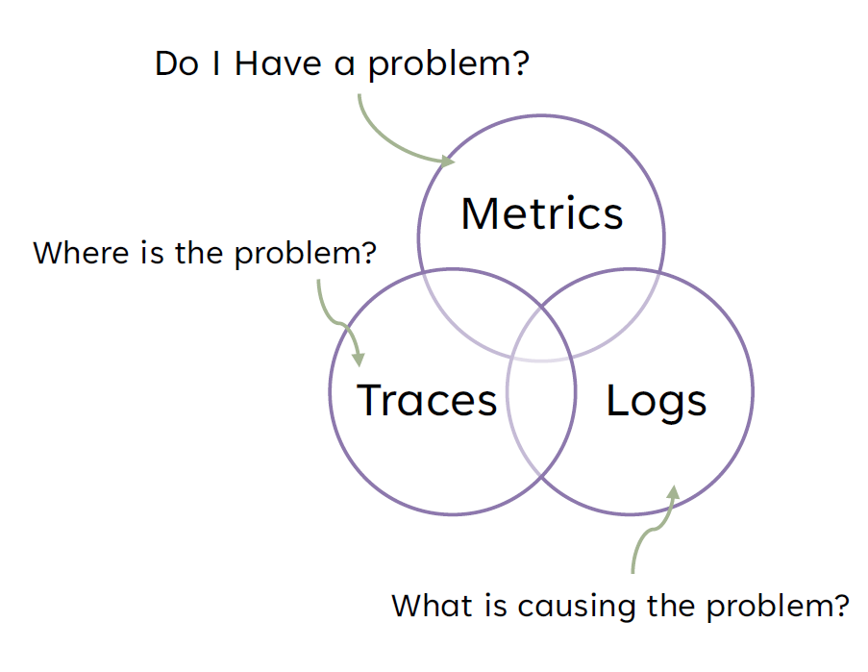
Observability

Slide 6
Distributed Tracing Tools
Jaeger
OpenTelemetry
Zipkin
Grafana Tempo
SigNoz

Slide 7
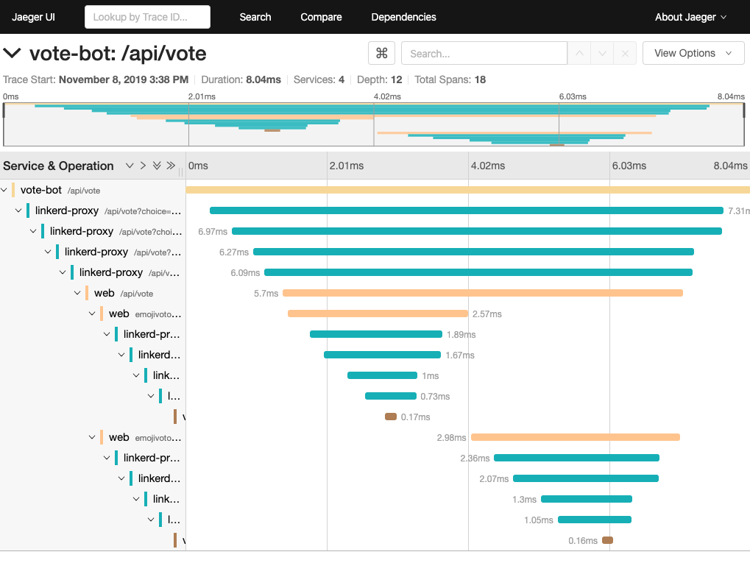
Jaeger
Jaeger is a distributed tracing system that helps you understand how requests flow through your distributed systems. It's a powerful tool that can help you identify performance bottlenecks, troubleshoot errors, and improve the overall reliability of your systems.

Slide 8
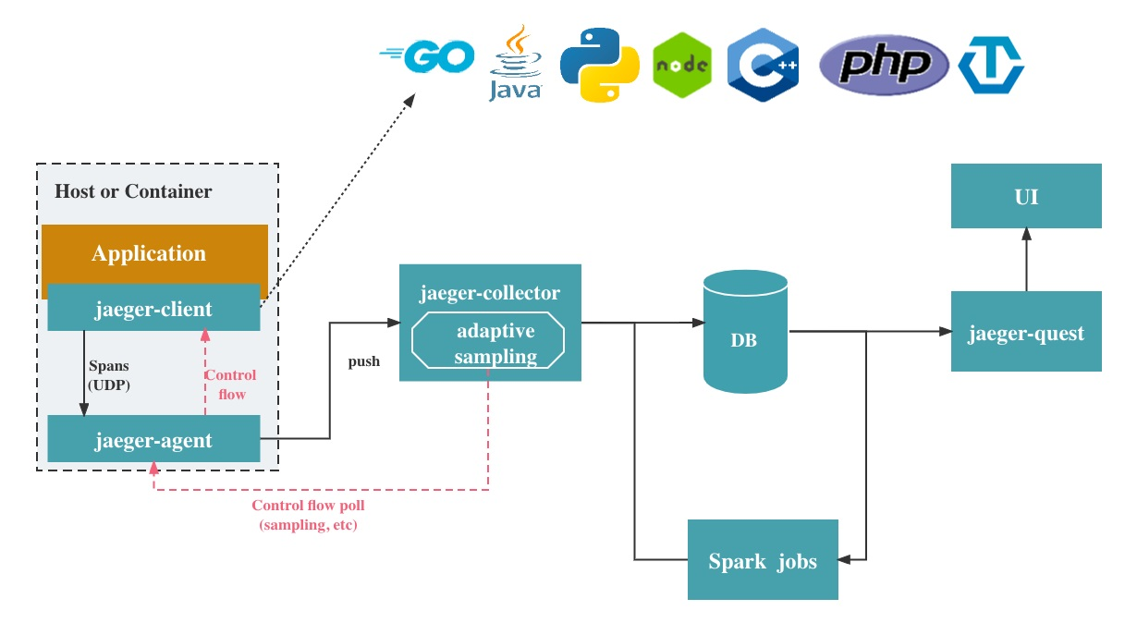
Agents: These are small programs that run in each service in your system. Agents collect data about requests as they enter and exit each service.
Collectors: These are servers that collect data from the agents.
Query engines: These are servers that allow you to query and visualize data from Jaeger.
By default, Jaeger uses a PostgreSQL database to store data. You can also use other databases, such as MySQL, Cassandra, and Elasticsearch.

Slide 9
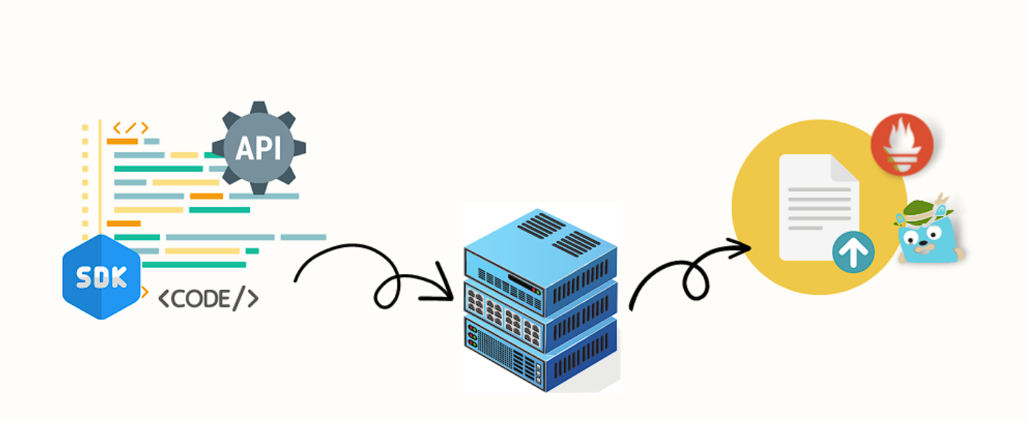
OpenTelemetry
OpenTelemetry (OT) is a vendor-agnostic and open-source observability framework that allows developers to generate, collect, and manage telemetry data from distributed systems. With OT, developers can use standardized instrumentation for easy observation and troubleshooting of a single application or complex environment with a microservices-based architecture

Slide 10
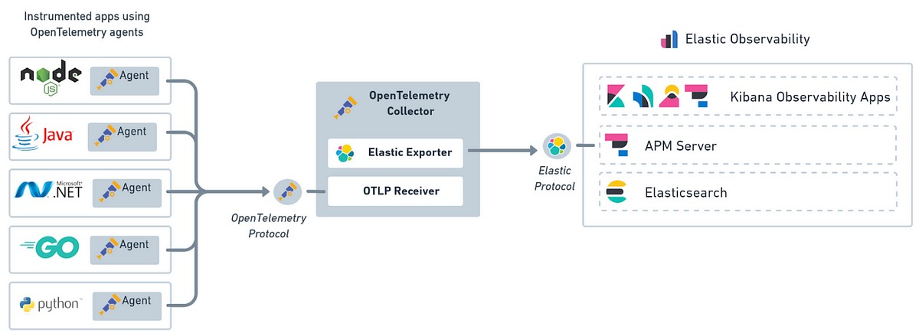
Vendor neutrality: OT is not tied to any specific vendor or product, so developers can choose the tools and technologies that best meet their needs.
Comprehensiveness: OT supports all three pillars of observability: traces, metrics, and logs. This gives developers a complete view of their system's performance and behavior.
Ease of use: OT provides a standardized set of APIs and SDKs for collecting telemetry data. This makes it easy for developers to get started with OT, even if they have no prior experience with observability.

Slide 11
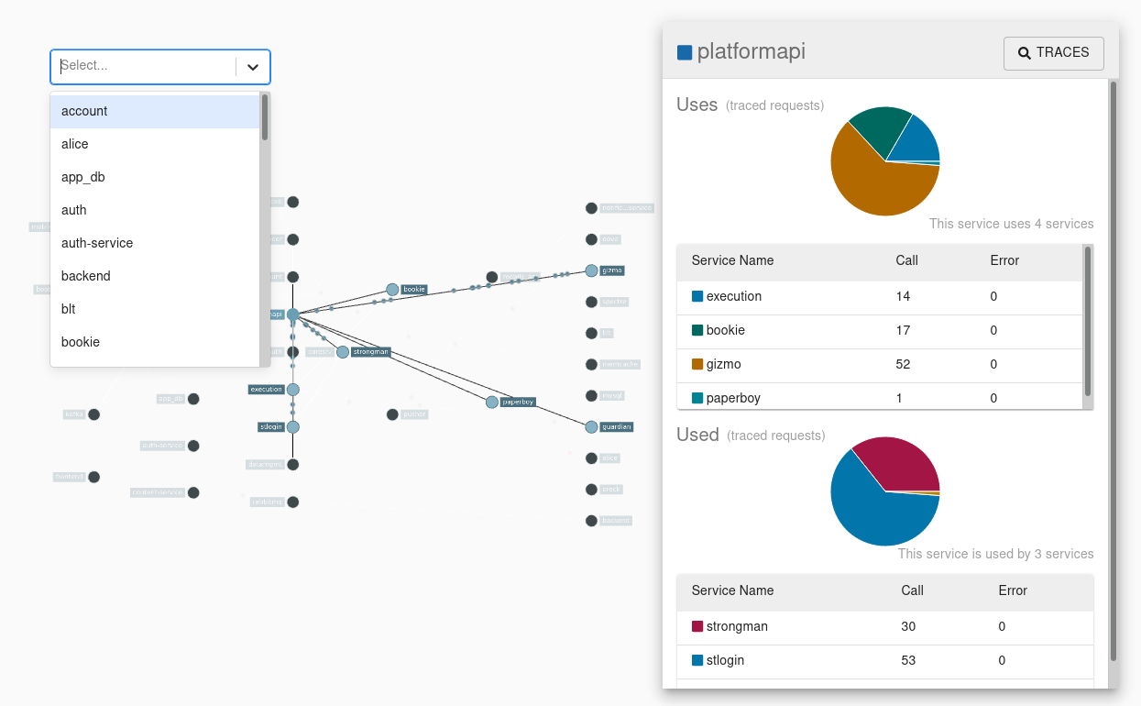
Zipkin
Zipkin is a distributed tracing system that helps developers troubleshoot latency problems in service architectures. It gathers timing data needed to identify slow services and bottlenecks. Zipkin was created by Twitter and is open-sourced under the Apache 2.0 license

Slide 12
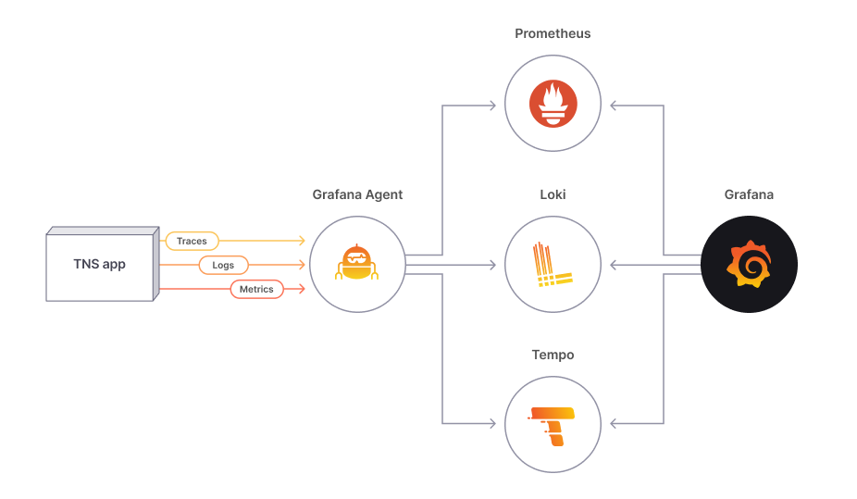
Grafana Tempo
Grafana Tempo is an open source, easy-to-use, and high-volume distributed tracing backend. It is cost-efficient, requiring only object storage to operate, and is deeply integrated with Grafana, Prometheus, and Loki. Tempo can ingest common open source tracing protocols, including Jaeger, Zipkin, and OpenTelemetry.

Slide 13
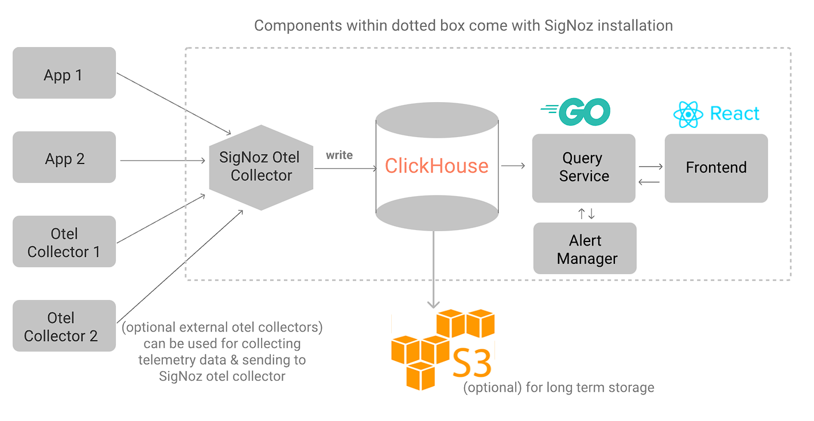
SigNoz
SigNoz is a full-stack open-source APM and observability tool. It captures both metrics and traces with log management currently in the product roadmap

Slide 14
Comparison
Feature | Jaeger | OpenTelemetry | Zipkin | Grafana Tempo | SigNoz
Type | Distributed tracing | Observability framework | Distributed tracing | Distributed tracing | Observability suite
Open source | Yes | Yes | Yes | Yes | Yes
Cloud native | Yes | Yes | Yes | Yes | Yes
OpenTelemetry support | Yes | Native | Yes (but not native) | Yes | Yes
Community support | Large | Large | Large | Medium | Small
Visualization | Built-in | Can use Grafana or other visualization tools | Built-in | Built-in | Built-in
Metrics format | Prometheus | Prometheus | Prometheus | Prometheus | Prometheus
Log format | JSON | JSON | JSON | JSON | JSON
Other features | Supports gRPC, HTTP, Kafka, and other protocols | Supports a wide range of telemetry data, including traces, metrics, and logs | Supports gRPC, HTTP, and other protocols | Supports gRPC, HTTP, and other protocols | Provides metrics and logs in addition to traces
Pricing | Free and commercial versions available | Free | Free and commercial versions available | Free and commercial versions available | Free and commercial versions available

Slide 15
Thanks

