Slide 2
One-Way Binding
@Component({
selector: 'app-test',
template: `
<div>
<h2>Welcome {{name}}</h2>
`,
})
export class TestComponent implements OnInit {
public name = "Jay Amin";
}
Pass public name value to templatre

Slide 3
public url = window.location.href;

Slide 4
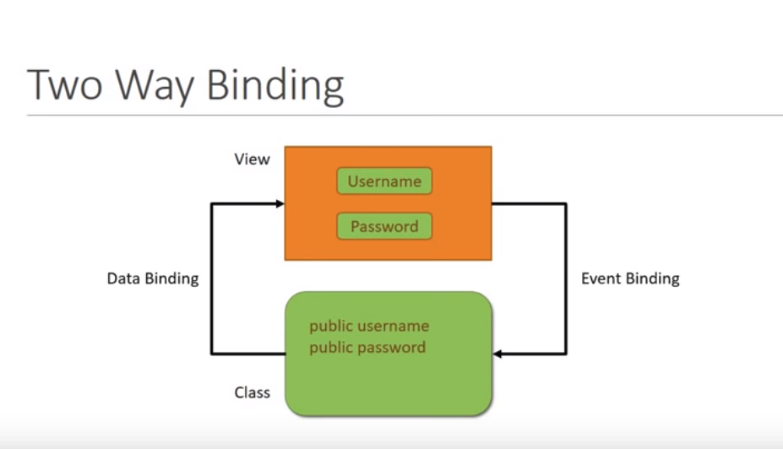

Slide 5
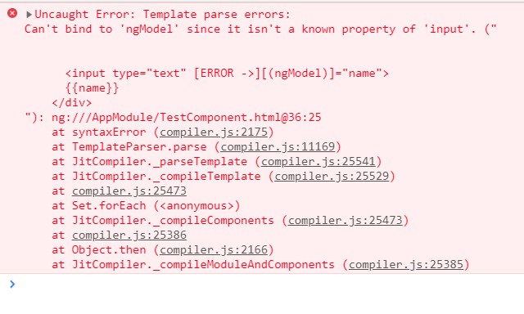
Binding
@Component({
selector: 'app-test',
template: `
<input type="text" [(ngModel)]="name">
{{name}}
`]
})
This will shown error

Slide 6
Binding
For solve this error need to add FormsModule in app.module.ts file

