Slide 1

Your daily routine in the school app
Quick and Detailed Manual/Instructions
For Teachers/Instructors
AMIN PAKNEJAD
Notes:
Today is only what you do most days—not every admin feature.

Slide 2
What you'll learn
Find your sessions for today or this week
Open Manage Session for each class
Finish with the right session status (Completed) and Save session
My Schedule
Pick Session/Class
Fill out required fields and Done
Teacher daily routine
Notes:
If you can use email, you can do this.

Slide 3
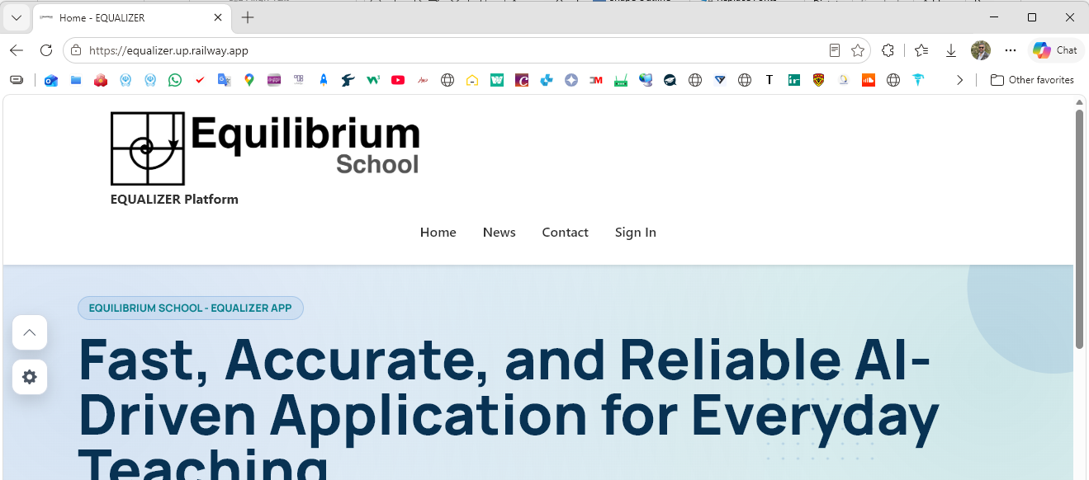
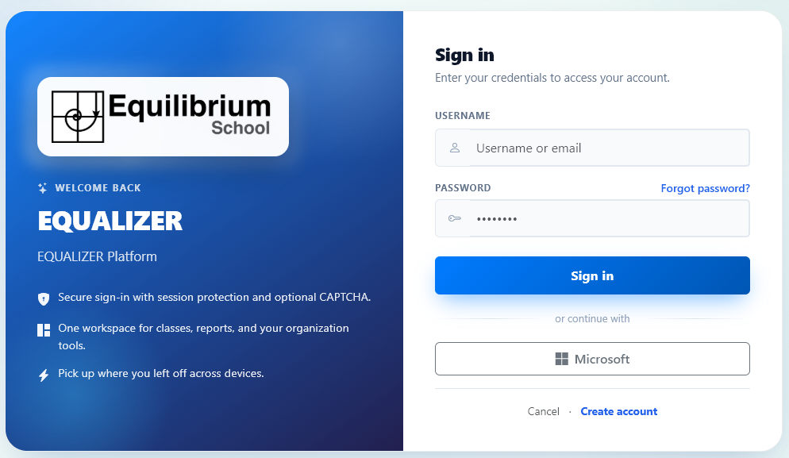
1
Where to start
How to get to the School dashboard
2
Log in into the app.
1- Open your internet browser and type in this URL in the address bar:
https://equalizer.up.railway.app/
2- Click on the Sign In option in the main menu.
3- On the Login page click on Microsoft to log in with your official Equilibrium email account. Then follow the on-screen steps to log in into the app.
3
Where to start
Notes:
This is the only front door they need for planning.

Slide 4
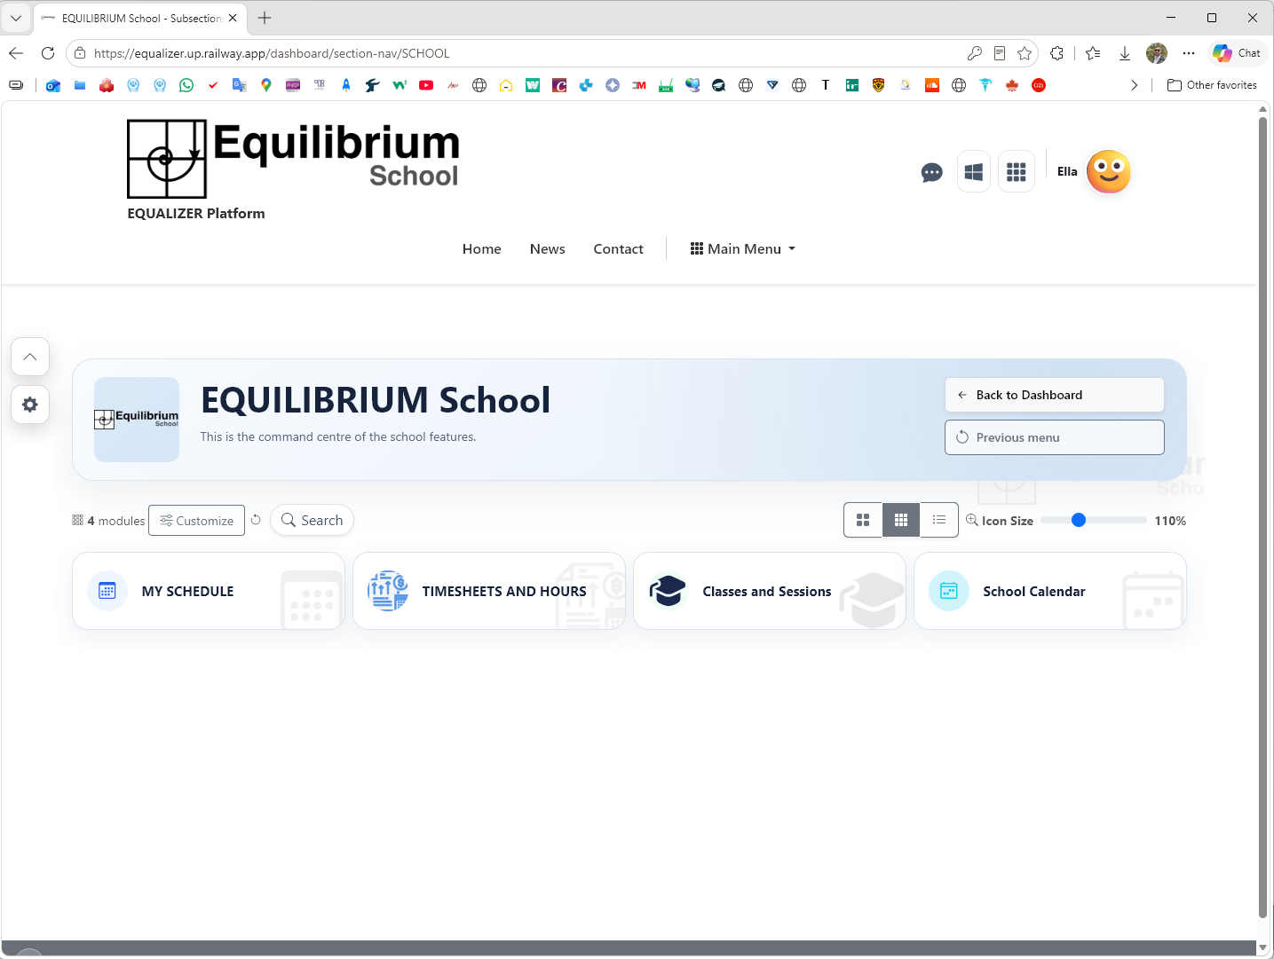
Main Dashboard Cards
School dashboard
After successful login, you will see your dashboard, similar the image on the right.
Your Name and Profile image* will be displayed on the Site Header.
There are Four Cards** on the Main Dashboard page.
  MY SCHEDULE
  TIMESHEETS AND HOURS
  Classes and Sessions
  School Calendar
1
2
3
4
* If profile image has not been set, your initials will be displayed instead.
** You might see additional cards than these four cards, but If you do not see these fours cards, contact APP Admin.
Where to start
Notes:
This is the only front door they need for planning.

Slide 5
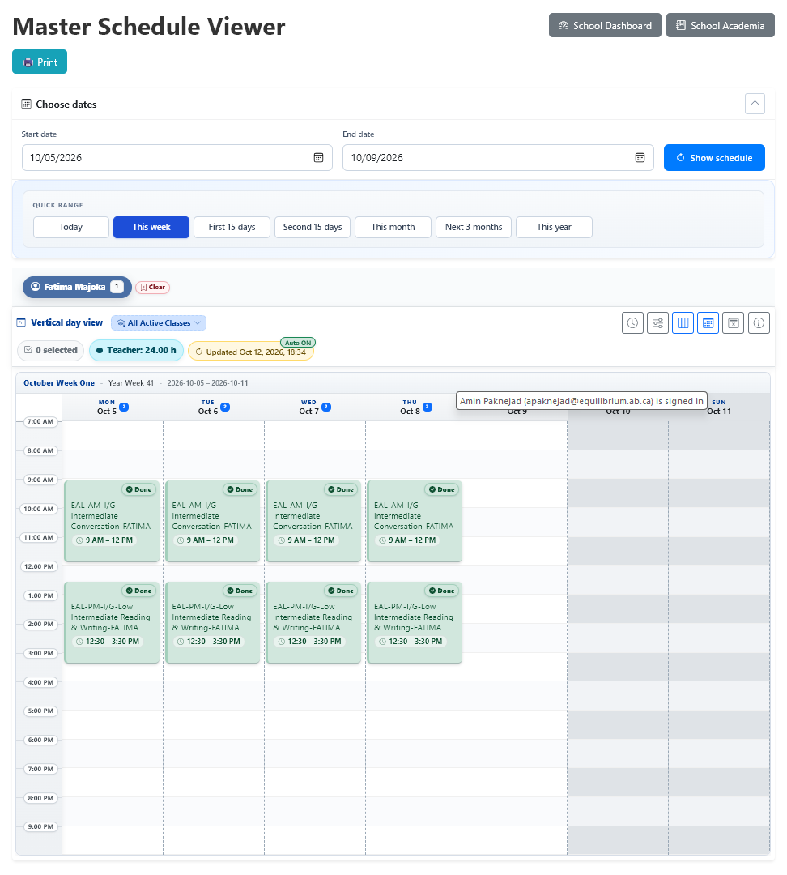
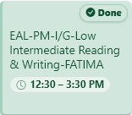

MY SCHEDULE
Sessions/Cards
1
To see your scheduled classes/sessions* click on the “MY SCHEDULE” card on the Main Dashboard. (1)
The Master Schedule Viewer page will open, and by default displays your scheduled sessions for the current week.
Depending on your schedule, you might see different cards (2) on different days in the week view form. On each session/card you can easily find the start and end time, class name, and the status of each session. The session’s status is also displayed on top right of the card.
To access each session, you just need to click on the session/card. Then it opens the Manage Session page for that session/card on a new tab. The Master Schedule Viewer tab remains opened in your browser. You can click on its tab to active it again.
Teachers might have different session/cards on each day, and days also might be different. This page should exactly reflect your actual schedule at school. If you do not see your expected session(s) on this page, you can contact school or APP Admin.
You can change the start and end date in the ‘Choose dates’ section to see the schedule of other days.
2
status
Class Name
Time
MY SCHEDULE
Notes:
This is the only front door they need for planning.

Slide 6
MY SCHEDULE
Details and Customize Buttons
1- You can pick any Start and End date in the ‘Choose dates’ section or click on any buttons in the ‘QUICK RANGE’ to change the Start and End date.
After entering the dates or picking a button from ‘QUICK RANGE’, click on ‘Show schedule’ button to load your schedule.
2- You see the summary and other info about your scheduled session in this section for the selected dates. You can also pick one of your classes from the dropdown in front of the Vertical day view label, to only see the session of that class. If you want to Automatically/Manually reload your schedule, you can mange it from this section.
3- You have access to some View Managing tools to change and customize the display of the sessions/cards.
The background colour of the cards shows the status of the session. Green is for Completed sessions.
1
2
3
MY SCHEDULE
Notes:
This is the only front door they need for planning.

Slide 7
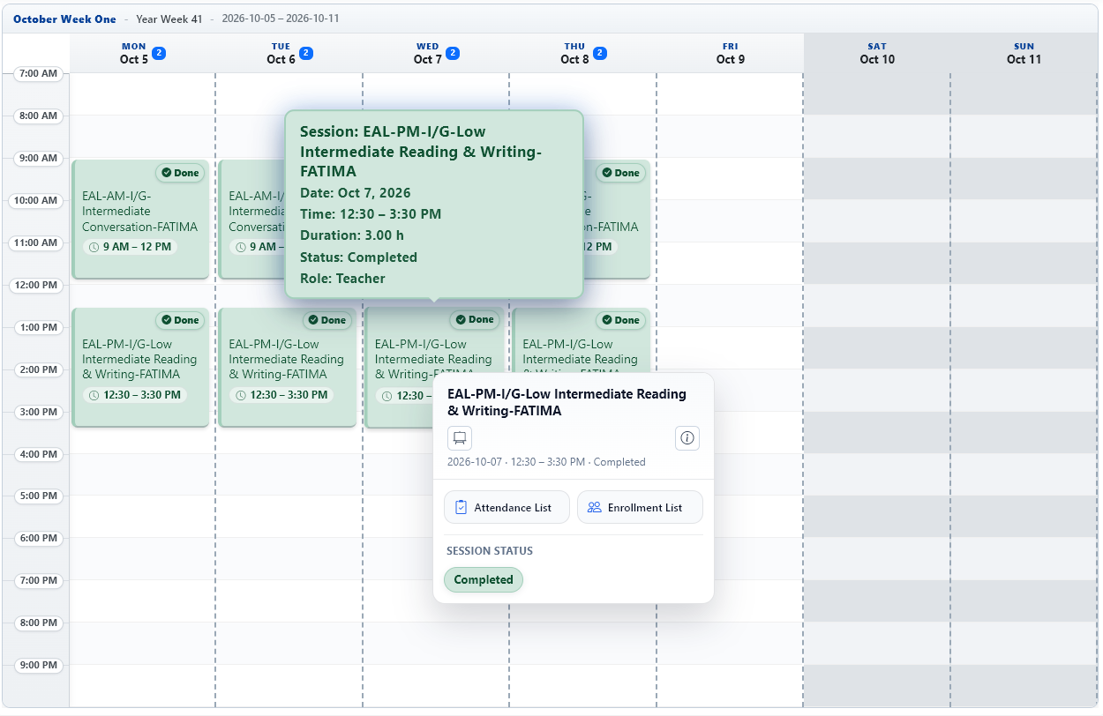
MY SCHEDULE
Details and Customize Buttons
1- Click on a session/card to open the Manage Session page.
You just need to hover the mouse on the session/card you wish to open, then click (Left Click) somewhere on the card.
You can also Right-Click on the session/card, and then
1
MY SCHEDULE
Notes:
This is the only front door they need for planning.

Slide 8
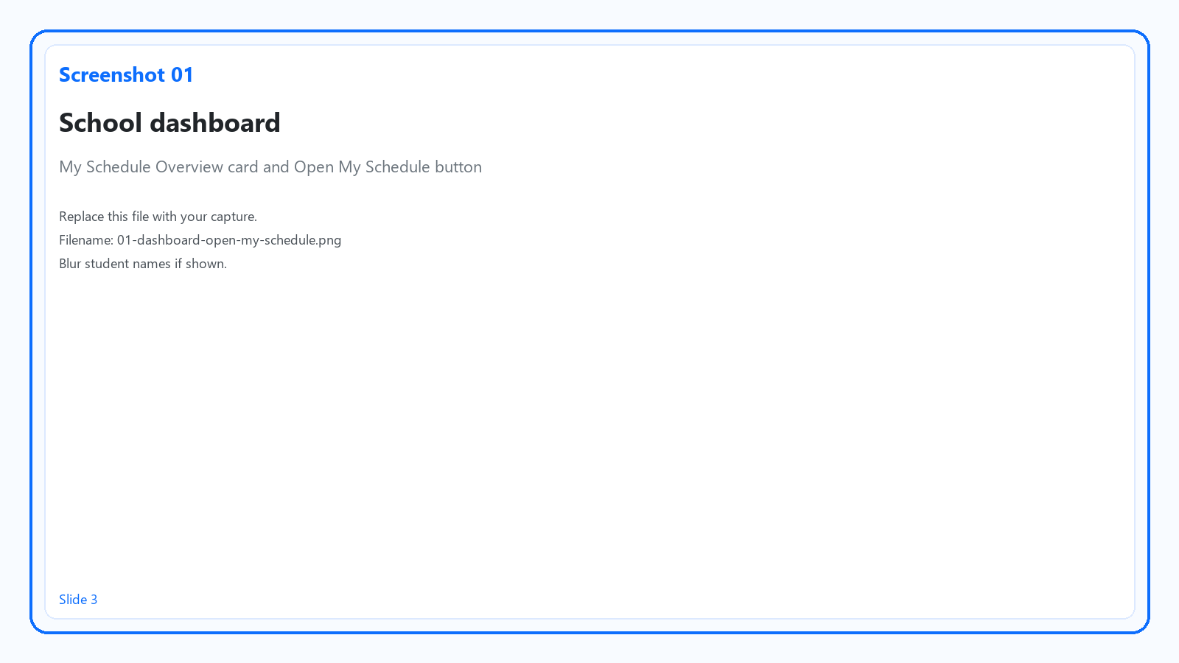
Where to start
School dashboard
Log in into the app → Find card My Schedule Overview
Click Open My Schedule
Teacher daily routine
Notes:
This is the only front door they need for planning.

Slide 9
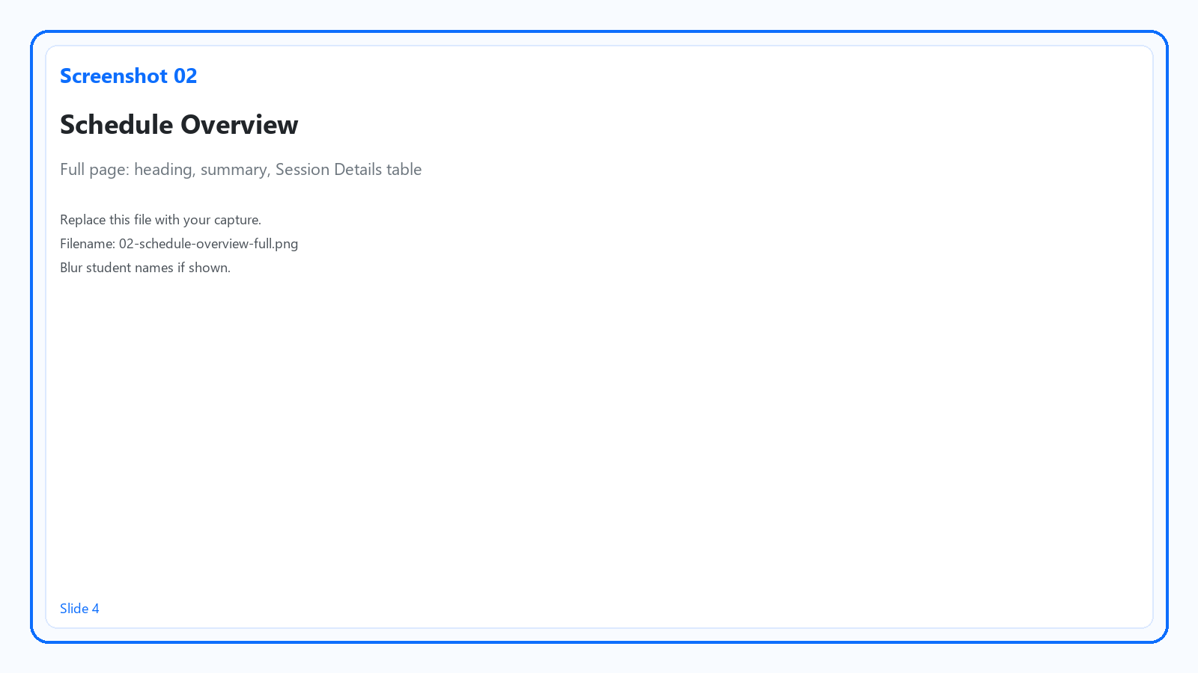
Schedule Overview at a glance
What am I teaching, when, and what's already done?
Page heading: Schedule Overview
My Profile / Self View (always you)
Summary: Active Range, hours, Items
Table: Session Details
Teacher daily routine
Notes:
Date, Time, Class, Status are enough—they don't need every column.

Slide 10
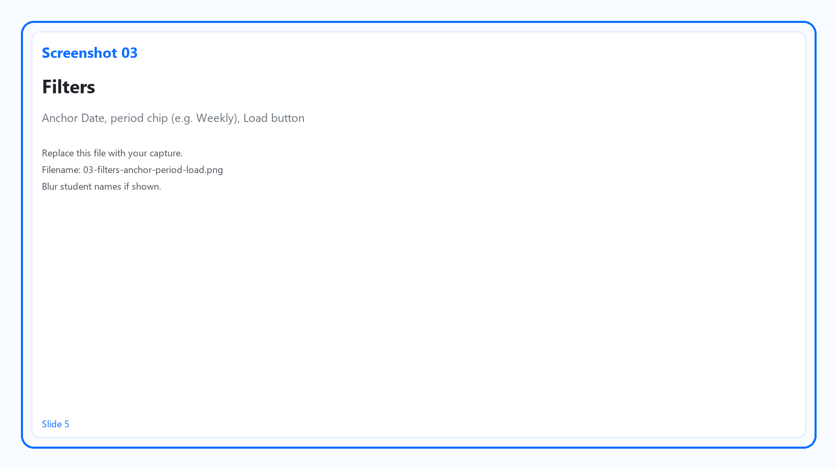
Set your filters
1. Anchor Date — often today
2. Period — Daily, Weekly, Monthly, Seasonal, or Yearly
3. Optional: With cases only (if your school uses cases)
4. Click Load
Tip: No list? Check Anchor Date + period, then Load again.
Teacher daily routine
Notes:
Weekly + today's anchor for Monday planning; Daily on teaching days.

Slide 11
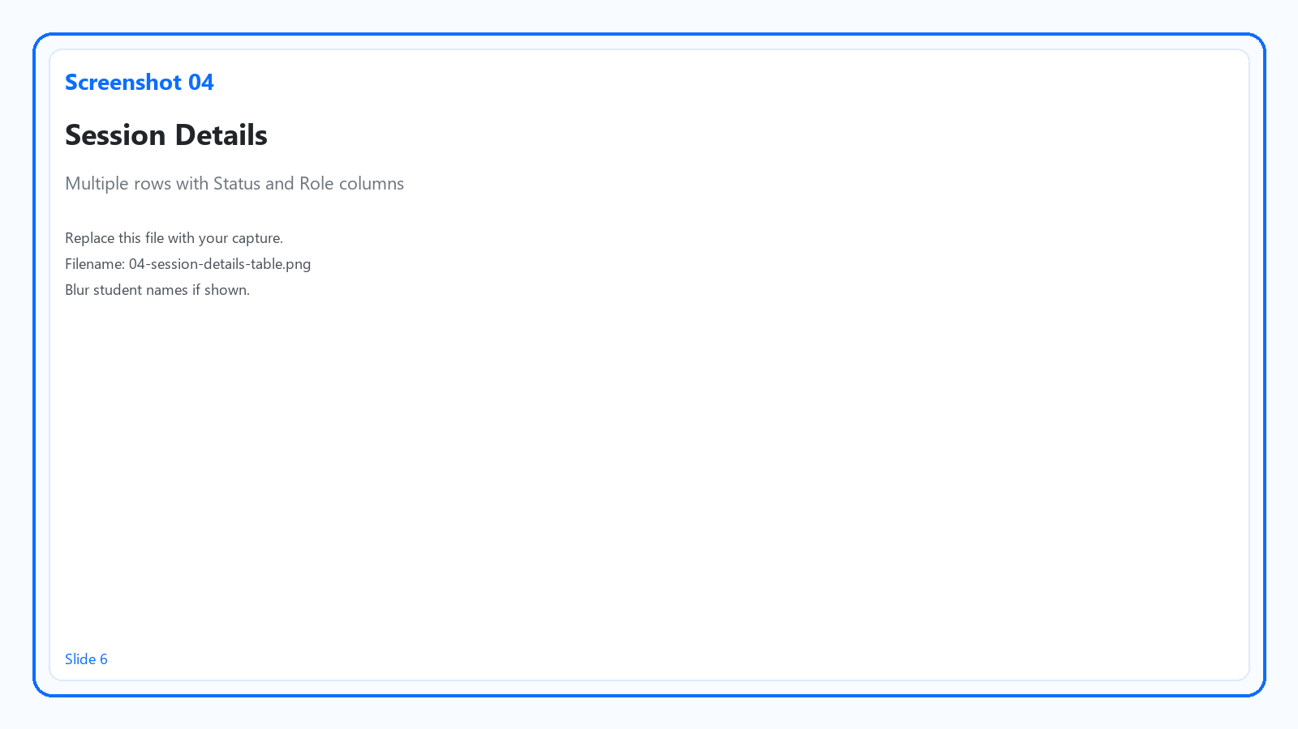
Read your schedule
Session Details
Each row = one class session
Status shows open vs done (colors)
Role should show Teacher for sessions you lead
Teacher daily routine
Notes:
Scan status summary pills above the table when present.

Slide 12
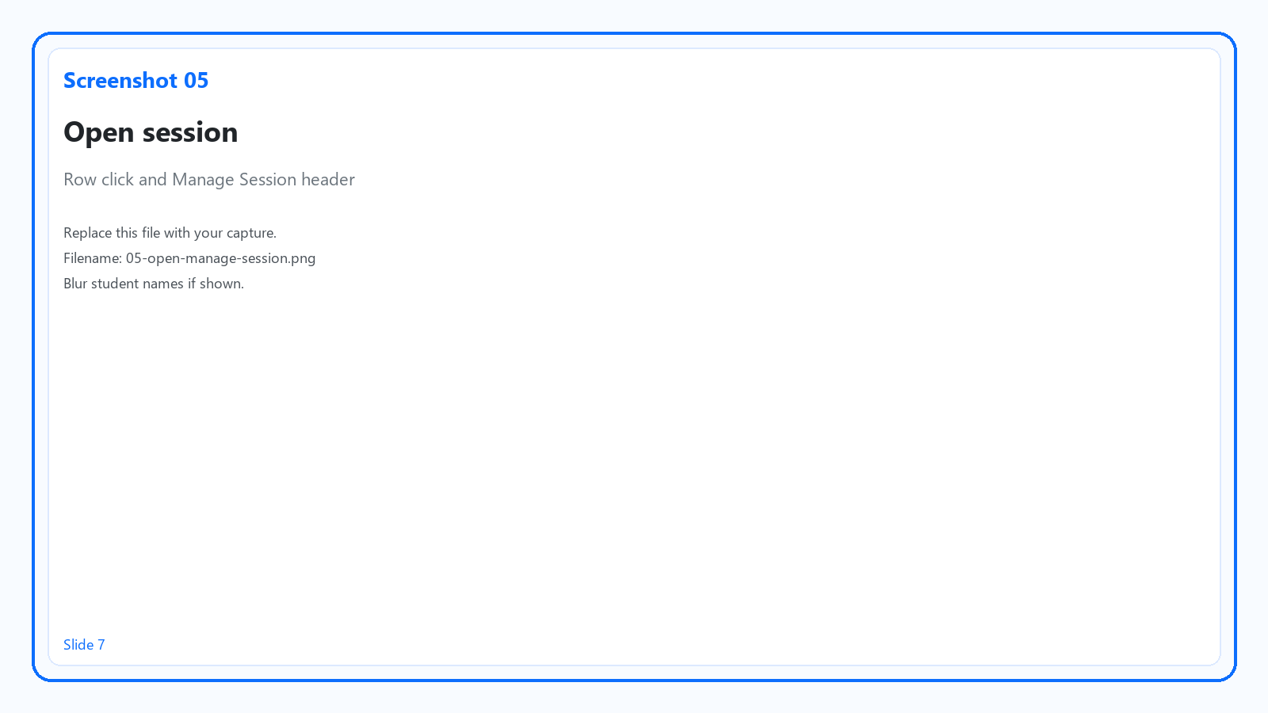
Open Manage Session
Click the session row (or Details)
You land on Manage Session for that date and time
Teacher daily routine
Notes:
One session at a time—same steps every class.

Slide 13
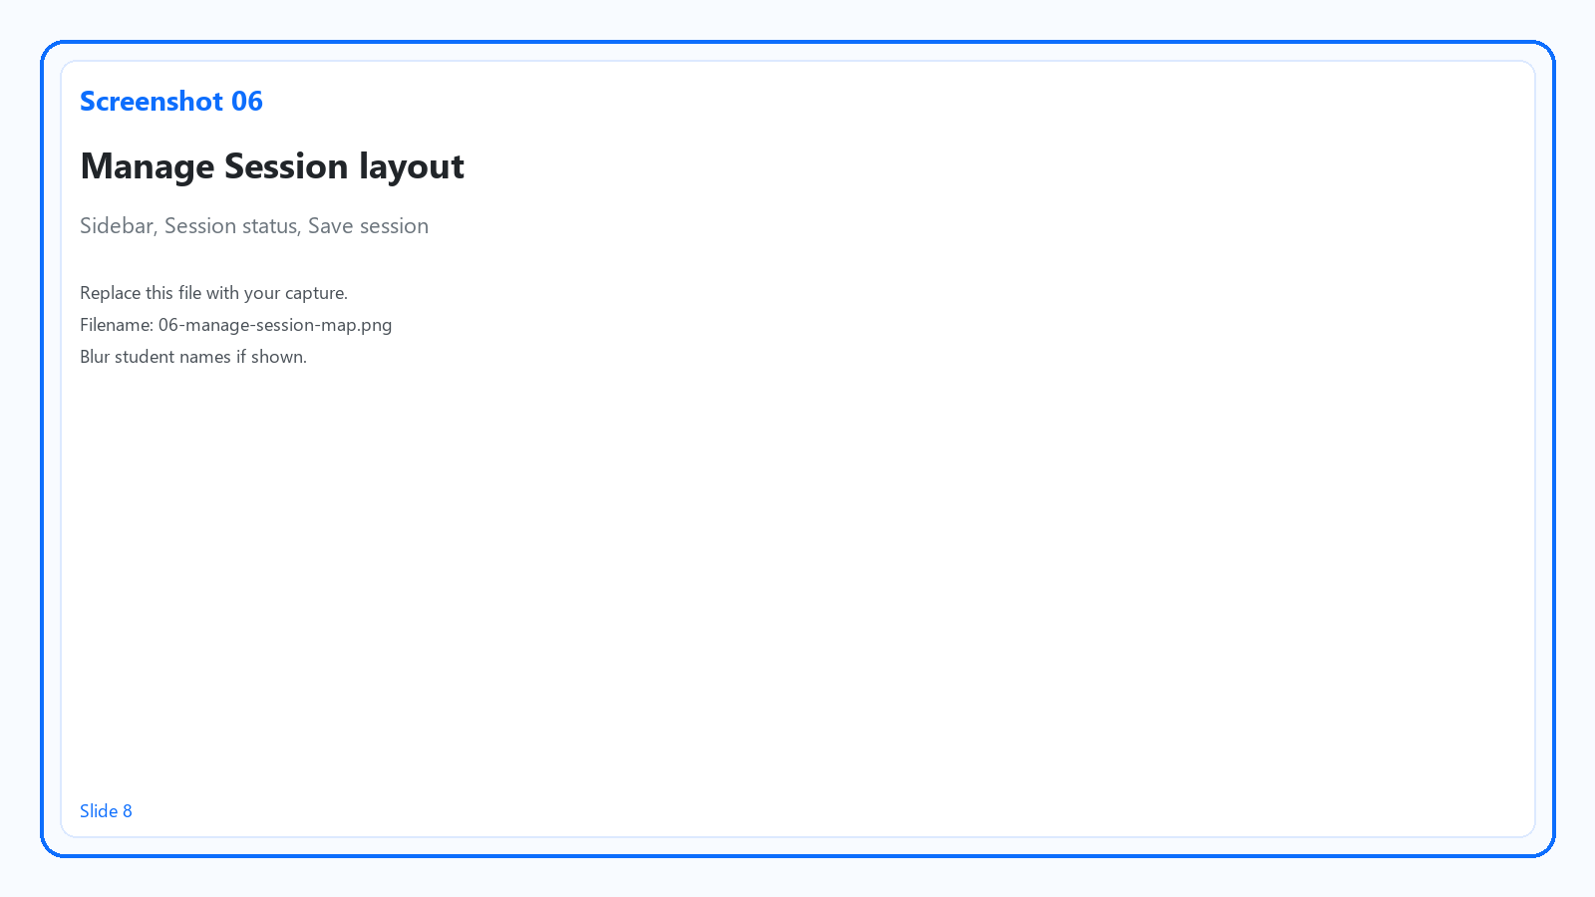
Manage Session — quick tour
Top: class name, date, time
Session status (Required until finished)
Left menu: work areas
Save session and Close
Teacher daily routine
Notes:
Next slide is the daily checklist.

Slide 14
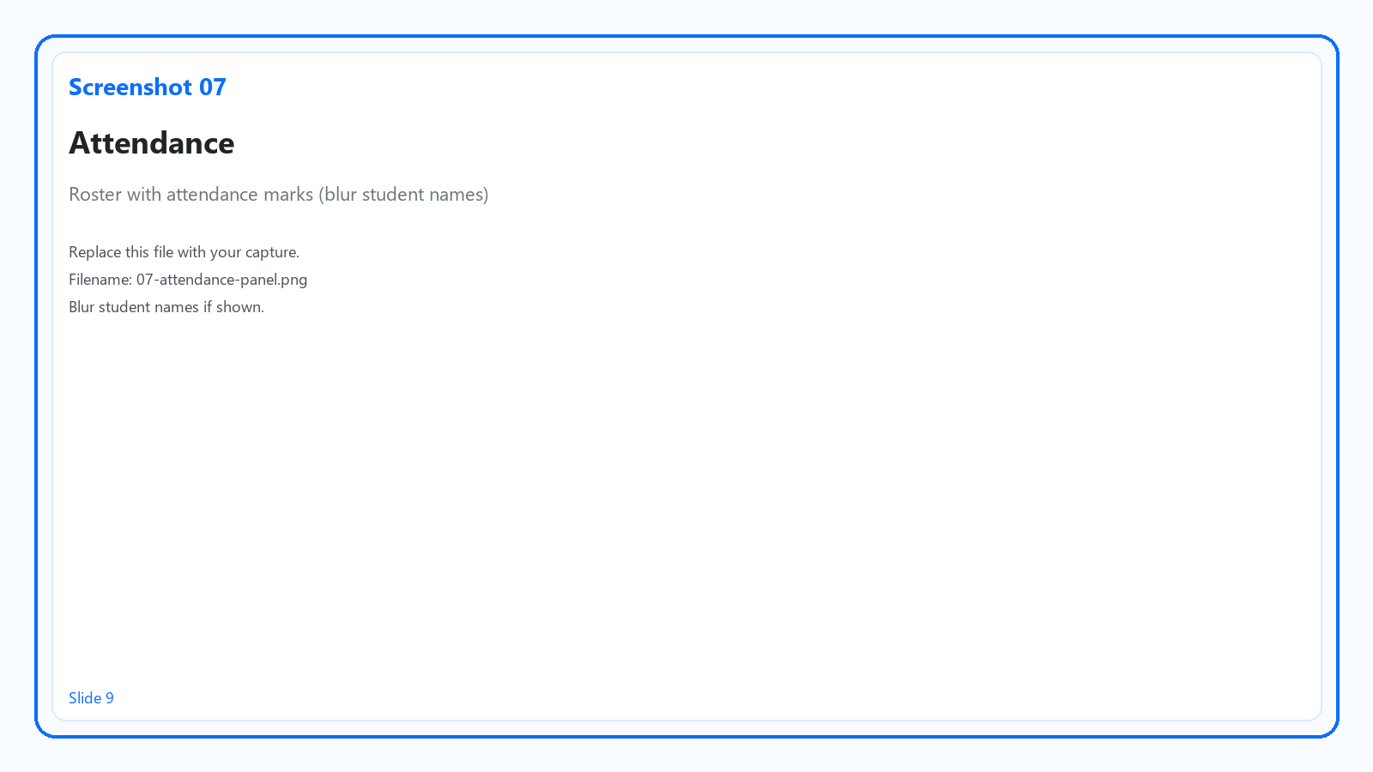

During class — your checklist
Attendance — mark Present, Late, Absent, etc.
Class Conduct — if your school requires it
Session & notes — what happened today
Curriculum — Covered content (what you taught)
Reports, Book covering, Student Cases — if you see them
Teacher daily routine
Notes:
If a section is missing, focus on what you see on screen.

Slide 15
Save as you go
Tap Save session after attendance, notes, or curriculum changes
Leaving without saving can lose work — Close may warn you
Teacher daily routine
Notes:
Save before switching sessions or closing the browser tab.

Slide 16

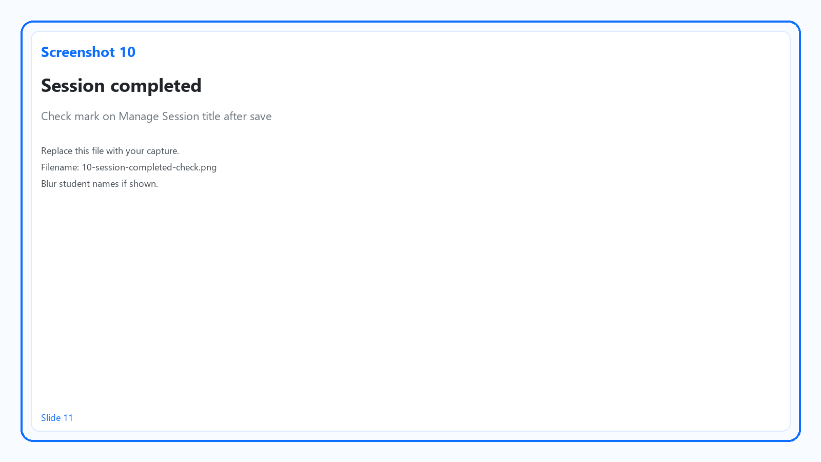
Finish the session — set status to Completed
Open Session status at the top of Manage Session
Choose Completed (your school's completed status)
Confirm Session completed check by the title when shown
Click Save session again
Teacher daily routine
Notes:
Status is not the same as attendance—you need both where required.

Slide 17

Back on Schedule Overview — verify
Return to Schedule Overview → Load (or refresh)
That row's Status should show Completed
Teacher daily routine
Notes:
This is how you know you're caught up for the week.

Slide 18
Quick fixes — keep calm
I don't see my class → wrong Anchor Date / period / forgot Load
I can't change status → session locked or edit window closed — contact office
Save is disabled → session may be read-only — contact office for corrections
Need help? Contact your school office or IT support.
Teacher daily routine
Notes:
Normalize asking for help—reduces fear of breaking the app.

Slide 19
Your daily routine — recap
1
Open My Schedule
2
Anchor Date + period → Load
3
Click session → Manage Session
4
Attendance · Notes · Curriculum (and other visible sections)
5
Session status = Completed → Save session
Handout: save this slide as PDF for your desk
Notes:
Offer 5 minutes hands-on if training is in person.

