Slide 1
Why we use the school app
EQU Portal
Migration · Teachers · Staff · Leadership · Daily routine
Training deck — replace screenshot placeholders with your captures
Notes:
Goals: why we adopted the app, who it helps, and what teachers do every teaching day.

Slide 2
One place for the school day
Single source of truth for schedules, sessions, and records
Less duplicate spreadsheets, email threads, and paper handoffs
Everyone works from the same dates, classes, and session statuses
School app adoption
Notes:
Emphasize consistency: when data lives in one system, fewer surprises for families and staff.

Slide 3
Accountability and Access
Role-based permissions —
teachers see their work; offices see what they need
Changes are tied to accounts, not anonymous files
Audit-friendly history for attendance and session completion
School app adoption
Notes:
You are not being watched for micromanagement — the system protects everyone when questions come up later.

Slide 4
Better Outcomes
Continuity for students when staff or teachers change
Compliance with school policies and reporting requirements
Cleaner handoff to payroll and timesheet processes where linked
School app adoption
Notes:
Keep this high level; policy details live with your admin team.

Slide 5
What "Good" Looks Like
Every taught session is opened in Manage Session
Attendance, notes, and assigned reports are filled
Session status moves to Completed and Save session is used
School app adoption
Notes:
Good is complete sessions, not perfect prose in every note field.

Slide 6
Why we moved to this app
Scheduling, session work, and attendance live in one platform
Security and hosting aligned with school IT standards
One codebase we can improve — fixes and features benefit everyone
School app adoption
Notes:
Migration is about sustainability and reliability, not change for its own sake.

Slide 7
What changes for you
Your teaching in the classroom stays the same
You record the day in the app instead of scattered tools
Daily habit:
School dashboard →
Schedule Overview →
Each session
School app adoption
Notes:
Acknowledge learning curve; the daily path is short and repeatable.

Slide 8
Three groups, one system
Teachers
See today's sessions
One Manage Session workspace
Clear completion status
Staff
Enrollment & records
Less chasing missing data
Shared student picture
Managers
Visibility & reports
Policies & access windows
Oversight without micromanaging
School app adoption
Notes:
Same data, different lenses — teachers enter, staff operate, managers oversee.

Slide 9
How the app helps teachers
Schedule Overview shows what you teach and what's already done
Manage Session is one workspace per class meeting
Completed status makes 'caught up' visible to you and the office
School app adoption
Notes:
Point to the short daily deck in docs/training/teacher-daily-app for a refresher.

Slide 10
How the app helps staff
Enrollment, Books, Reporting, and communications pull from shared data
Fewer calls to chase attendance sheets or session paperwork
Student cases and reports arrive in context of the right session
School app adoption
Notes:
Staff slides are overview only — their training is role-specific.

Slide 11
How the app helps leadership
Dashboards and reports without opening every teacher's files
Session access and completion policies enforced in the app
Support teachers with clear expectations, not cell-by-cell policing
School app adoption
Notes:
Leadership cares about completion rates and audit readiness.

Slide 12
Your daily routine
Every teaching day
Open Schedule Overview → each session → Manage Session → save → verify
School app adoption
Notes:
Transition to hands-on walkthrough with screenshots.

Slide 13
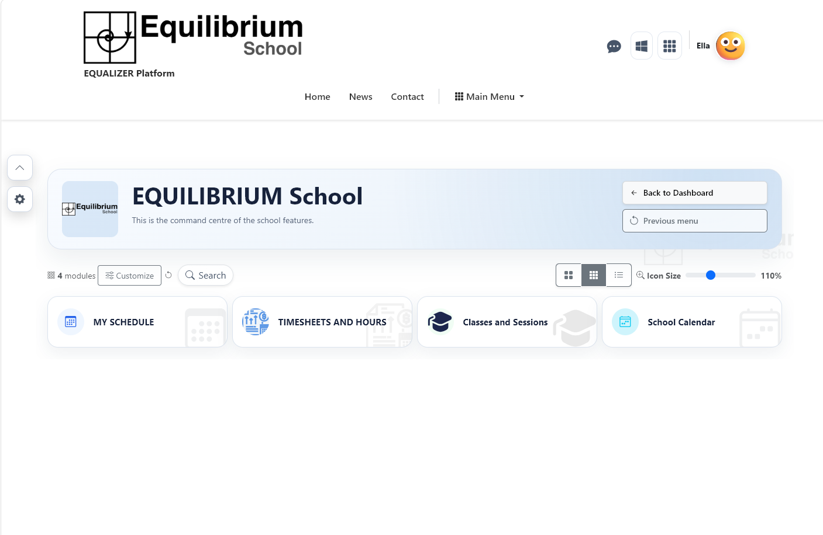
Start on the dashboard
School dashboard
Log in and on the main Dashboard
Find My Schedule
Click Open My Schedule
School app adoption
Notes:
This is the front door for teachers.

Slide 14
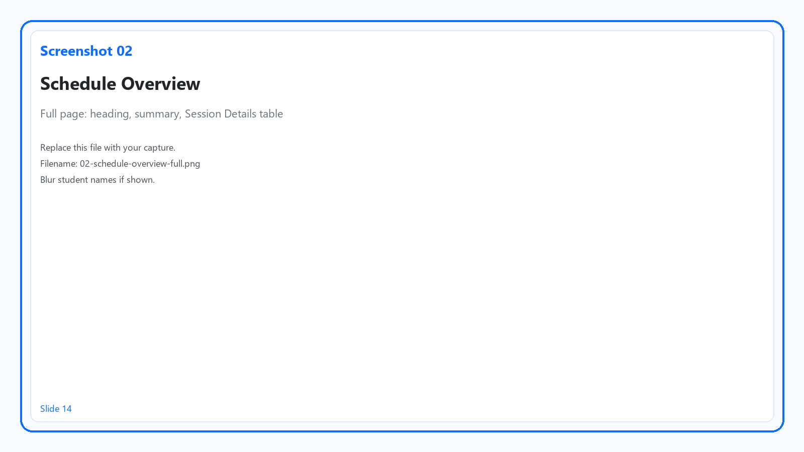
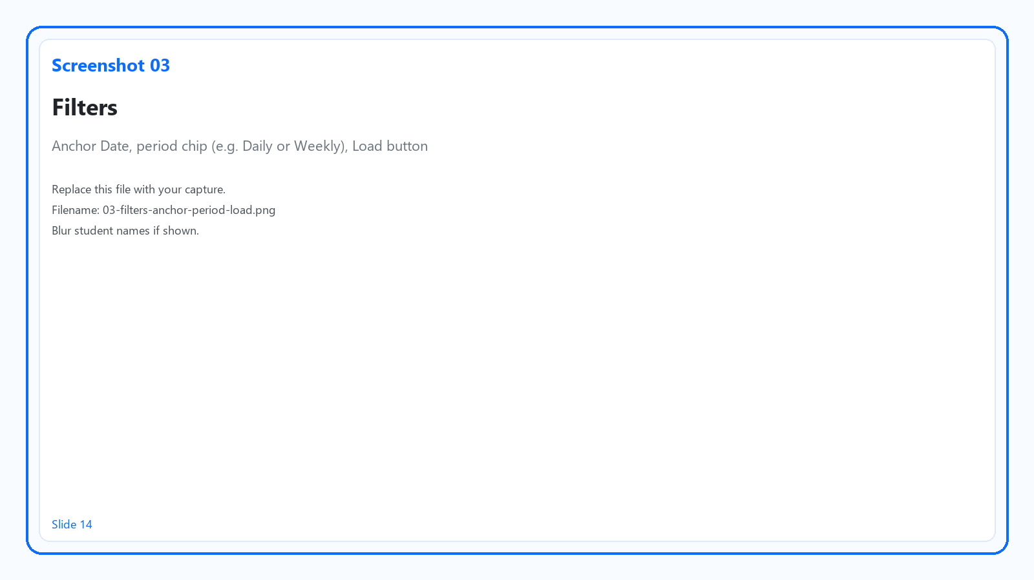
Open Schedule Overview every day
What am I teaching, when, and what's done?
Page title: Schedule Overview
Set Anchor Date — usually today
Choose period (Daily, Weekly, …) → Load
Scan Session Details for status colors
School app adoption
Notes:
Weekly + today's anchor for planning; Daily on teaching days.

Slide 15
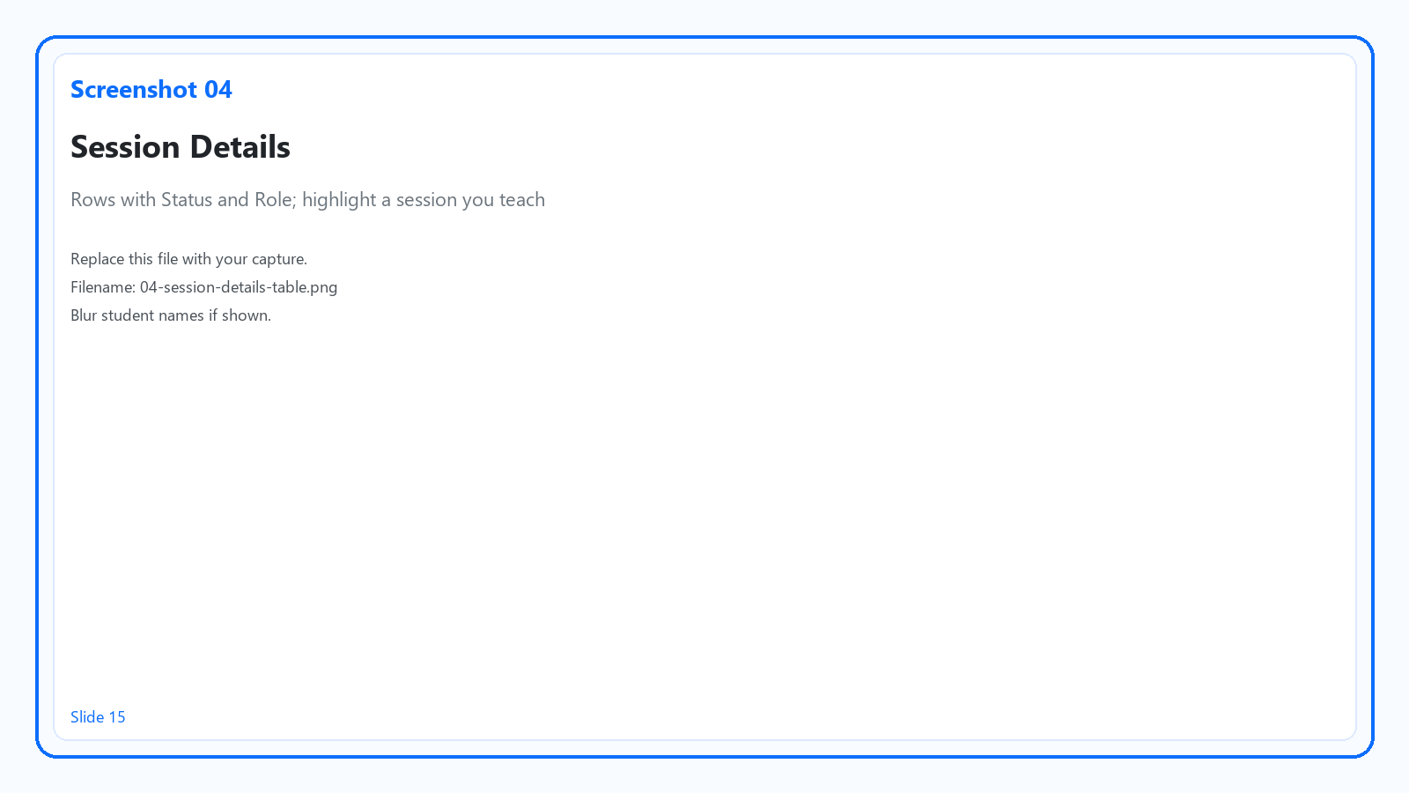
Pick your session
Session Details
Each row = one class session
Confirm Role shows Teacher for sessions you lead
Click the row to open Manage Session
School app adoption
Notes:
One session at a time — repeat for every class today.

Slide 16
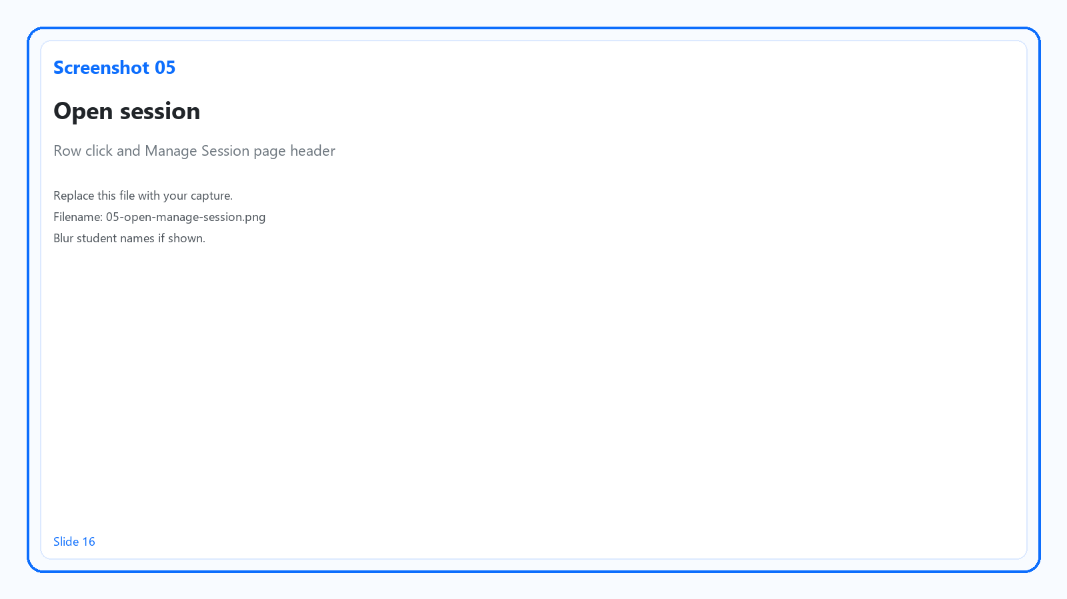
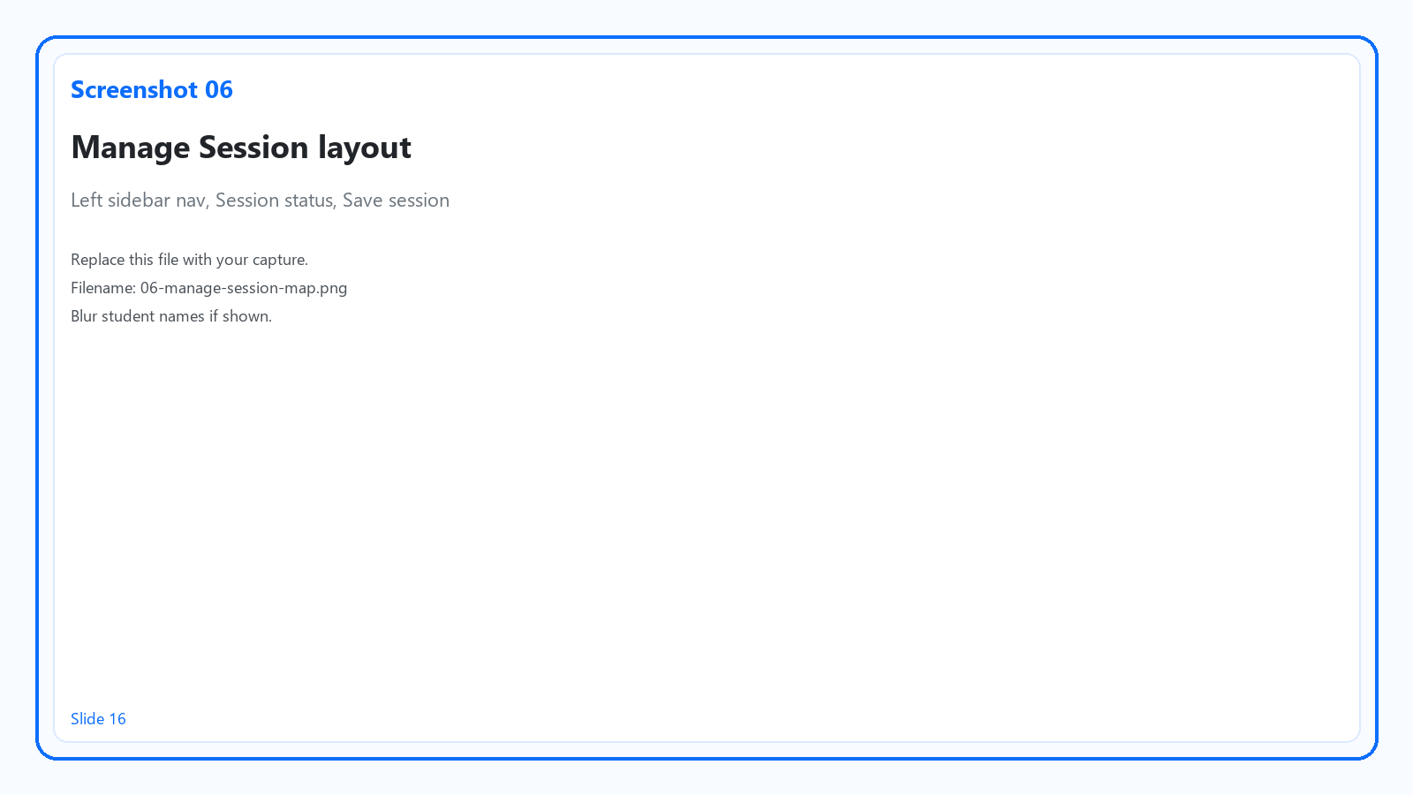
Review session details
Check date, time, room, and roster context
Note current Session status before you edit
Use the left menu to move between work areas
Save session often while you work
School app adoption
Notes:
Tour the layout before diving into attendance.

Slide 17
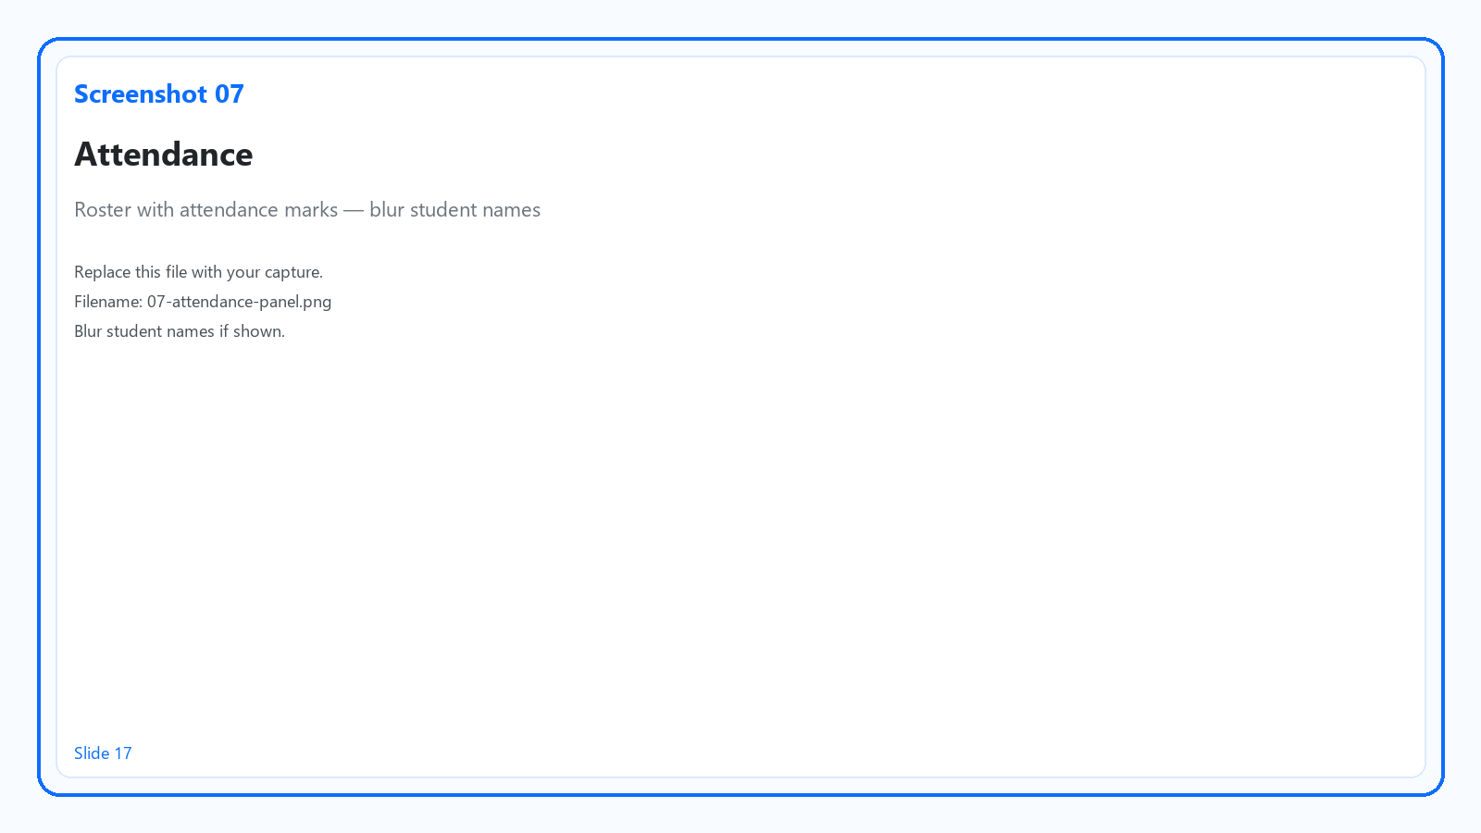
Mark attendance
Open the Attendance panel
Mark Present, Late, Absent, and other codes your school uses
Use Open attendance matrix when your school links matrix edits
School app adoption
Notes:
Blur student names in training screenshots.

Slide 18
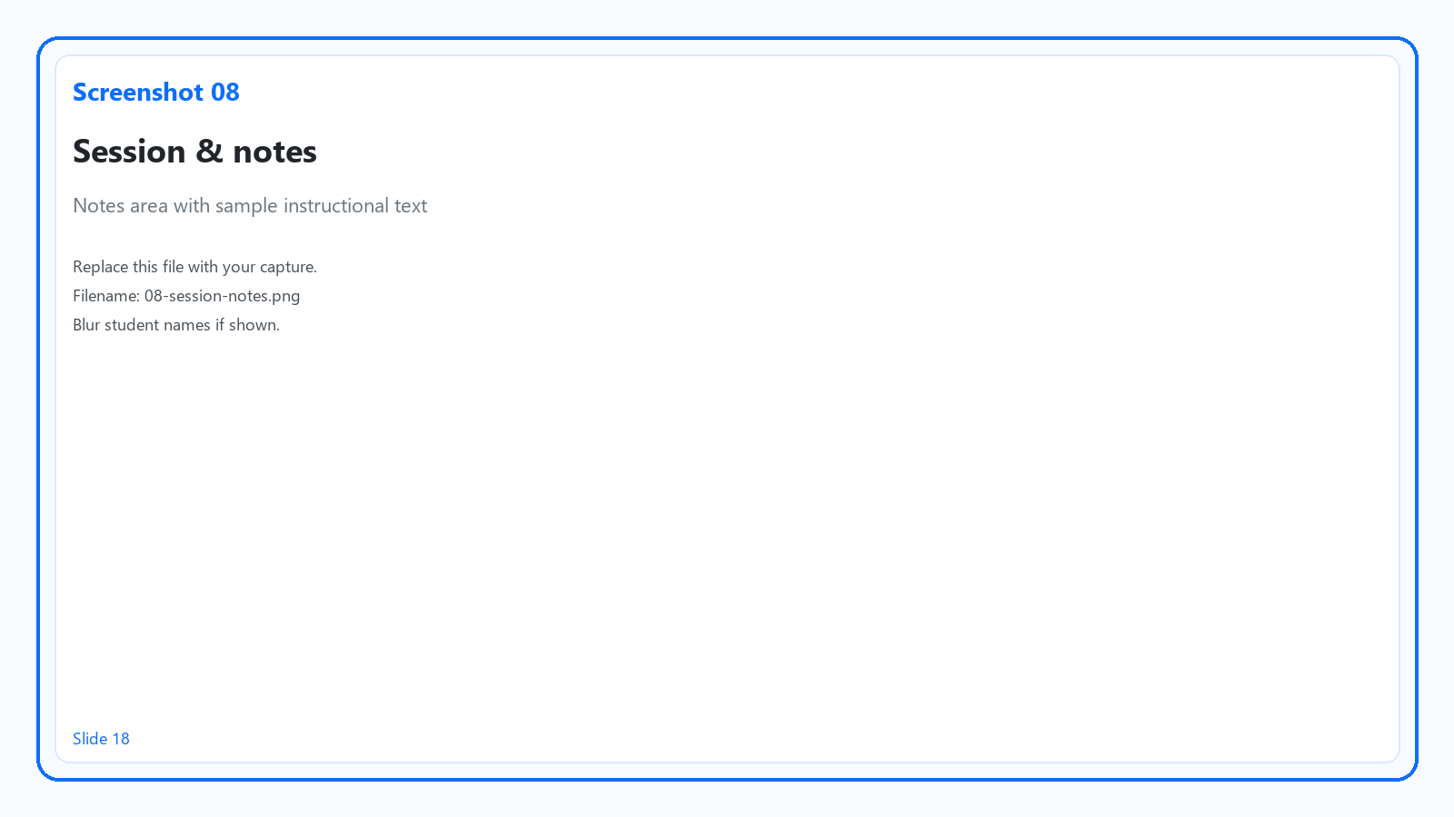
Session notes
Open Session & notes
Record what happened instructionally
Enough detail for the next teacher or admin follow-up
School app adoption
Notes:
Skip only if your school explicitly allows empty notes — default is fill them.

Slide 19
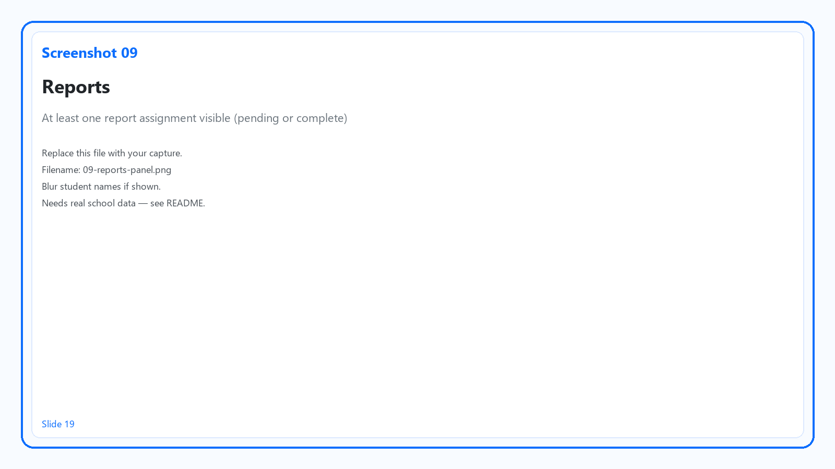
Assigned reports
Open Reports in the sidebar
Complete every report assigned to you for this session
Save session after filling reports
School app adoption
Notes:
If no assignments show, your school may not use session reports yet.

Slide 20
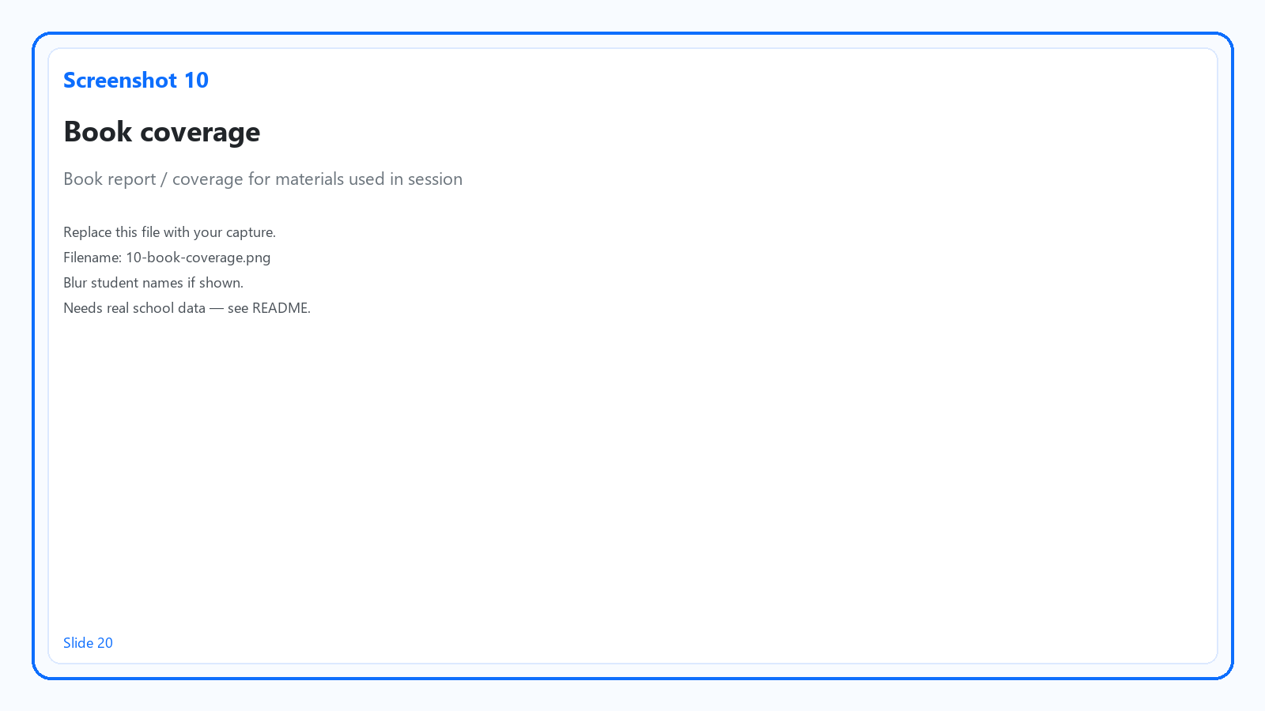
Book coverage
Open Book coverage
Log books or materials used in this session
Required where your program tracks library or curriculum resources
School app adoption
Notes:
Skip when no book was used — only when truly N/A.

Slide 21

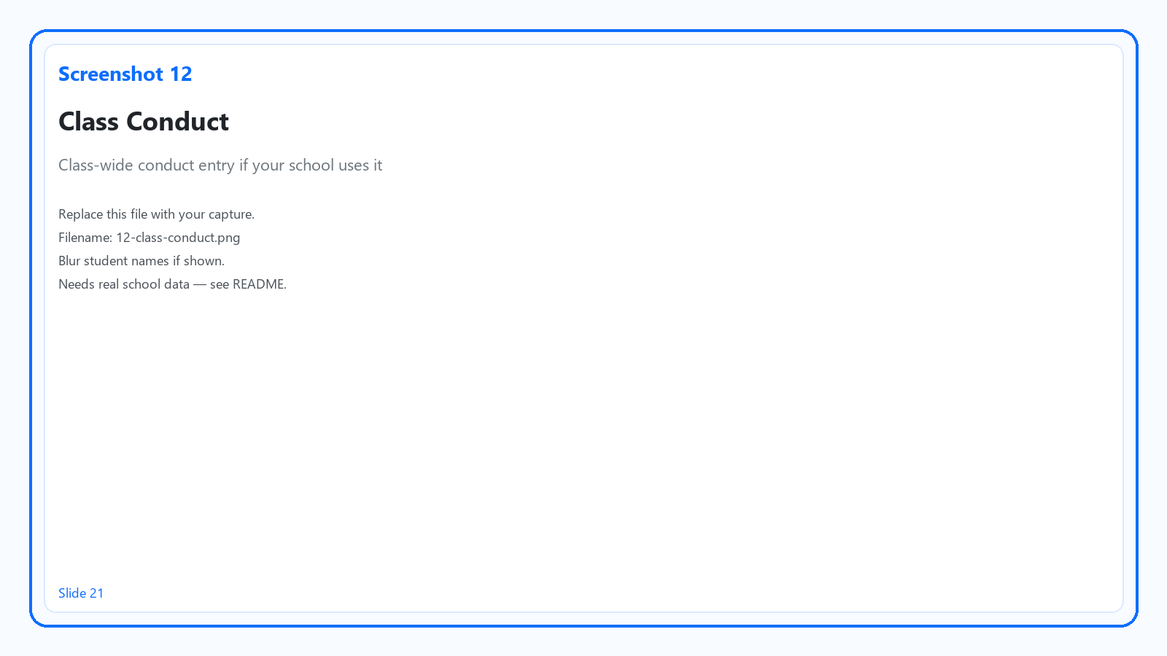
Student and class records
Student Cases — per-student follow-ups tied to the session
Class Conduct — class-wide conduct when your school uses it
Report incidents and cases when policy requires it
School app adoption
Notes:
Not every session needs cases — use when something must be documented.

Slide 22

Activities and scores
Open Grade book when enabled for your classes
Record scored and unscored activities as your program requires
Aligns student progress with the session date
School app adoption
Notes:
If Grade book is disabled or 'coming soon', skip and note for your admin.

Slide 23

Finish the session — Completed
Open Session status at the top of Manage Session
Choose Completed
Look for the session completed indicator when shown
School app adoption
Notes:
Session status is separate from attendance — both may be required.

Slide 24

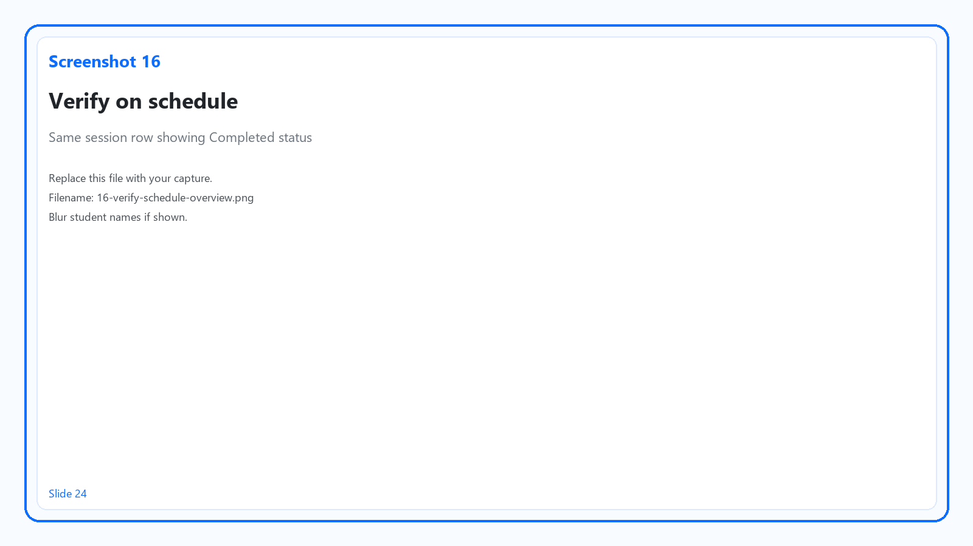
Save and verify
Click Save session
Return to Schedule Overview → Load or refresh
Confirm the row shows Completed
School app adoption
Notes:
Verification is how you know the week is caught up.

Slide 25
Daily checklist + Q&A
1
Open My Schedule from the School dashboard
2
Schedule Overview: Anchor Date + period → Load
3
Open each session → Manage Session
4
Attendance · Notes · Reports · Book coverage · Cases · Grade book (as shown)
5
Session status = Completed → Save session → verify on schedule
Contact your school office or IT support.
Handout PDF matches this checklist
Notes:
Leave time for questions; offer 5 minutes hands-on if in person.

