Slide 1
Lineup Cohesion
A Network-Based Approach to Starting Eleven Optimization
Amin Nabavi
NEU Soccer Data Analytics Hackathon | February 2026
Bundesliga 2023/24 · IMPECT Open Data · 306 Matches

Slide 2
Research Question
Can we quantify team cohesion from passing networks
to predict match outcomes and optimize lineups?
Stakeholder Value
Network Science
Actionable Insight
Coaches need objective metrics beyond intuition for lineup decisions
Passing patterns encode team chemistry that box scores miss
Identify key hubs, optimal pairings, and substitution strategies

Slide 3
Cohesion Metric: Four Components
Cohesion = 0.50·Connectivity + 0.25·Chemistry + 0.15·Hub + 0.10·Progression
Connectivity
50%
Chemistry
25%
Network density + clustering coefficient
Strength of midfield→attack connections
r = +0.785***
r = +0.448*
Hub Dependence
15%
Progression
10%
Gini coefficient (star-player reliance)
Pre-shot pass ratio in network edges
r = +0.714***
r = +0.133
Weights empirically optimized from correlation with season points (n=18 teams)

Slide 4
Key Insight: The Hub Dependence Paradox
Initial Expectation
Metric Improvement
Balanced teams (equal pass distribution) should perform better.
Before (equal weights)
r = 0.314
Actual Finding
p = 0.204 (not significant)
Star-dependent networks win more. Elite teams funnel play through hub players (Xhaka, Kimmich).
Original 'Balance' showed r = -0.714 with points.
After inverting → Hub Dependence r = +0.714***
After (optimized weights)
r = 0.728
p = 0.0006*** (highly significant)
+132% improvement in predictive power

Slide 5
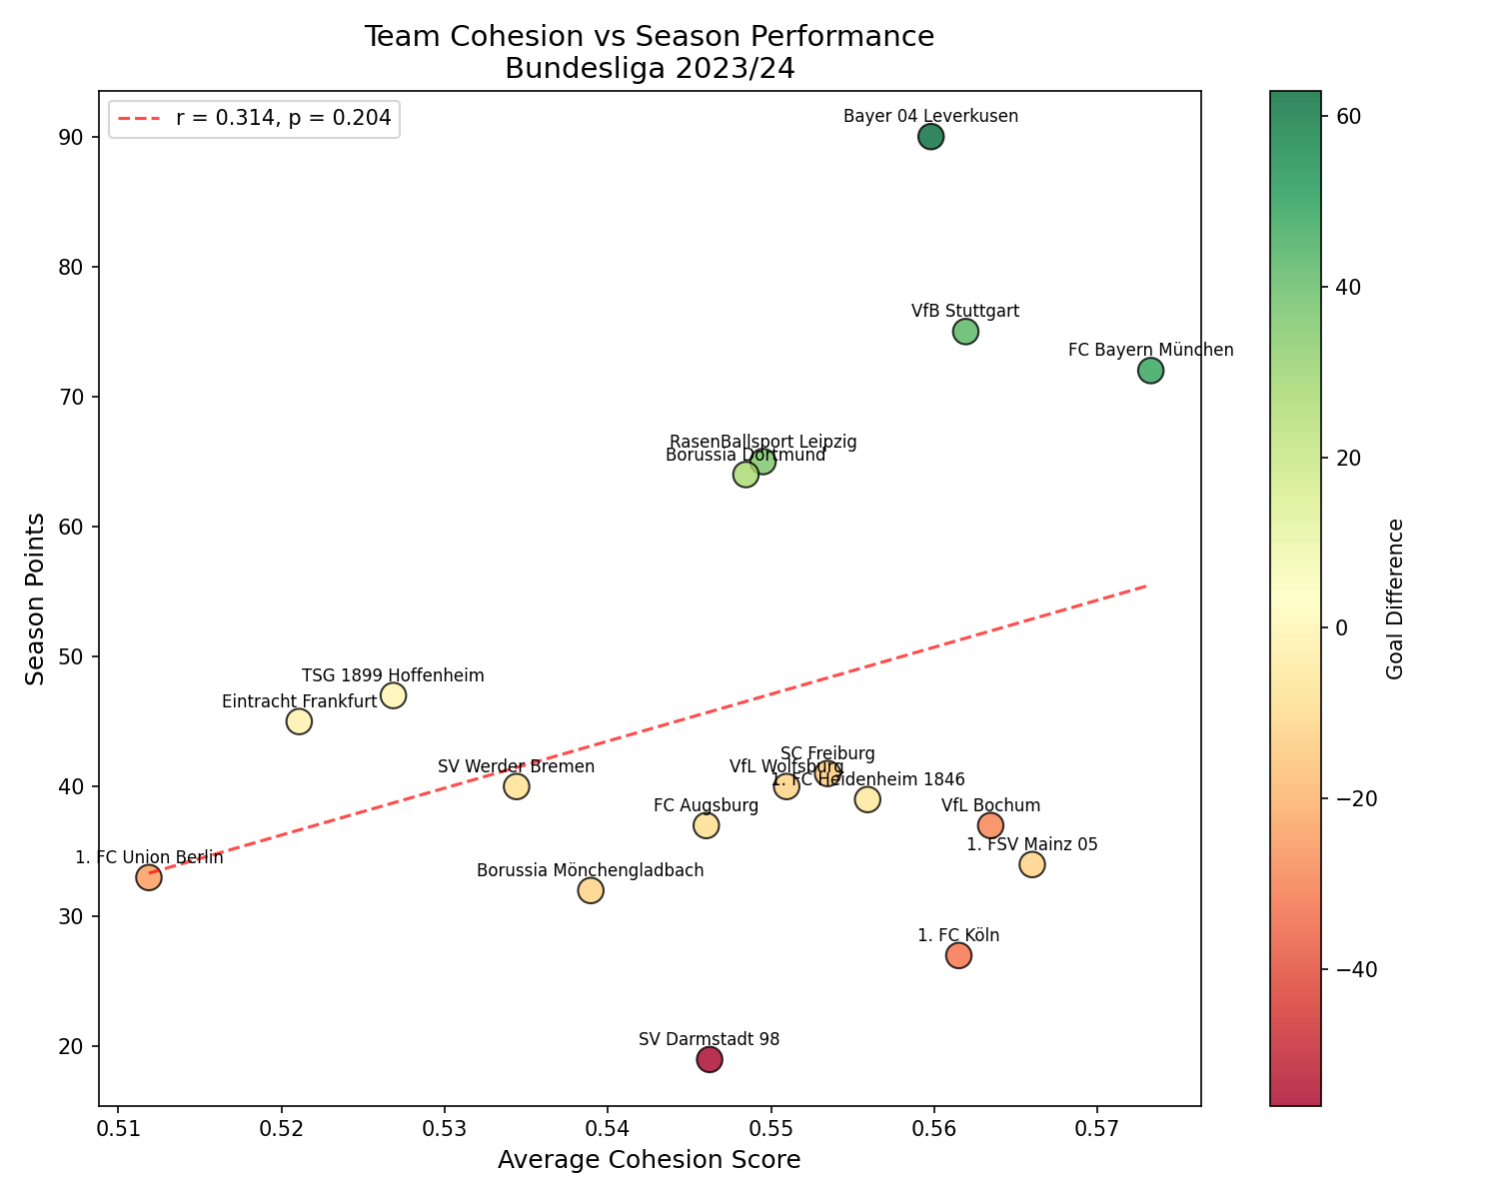
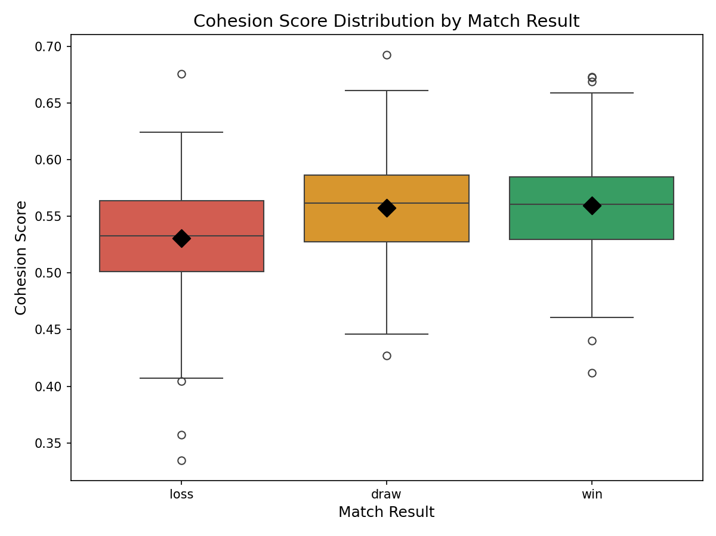
Validation: Season & Match Level
[cohesion_vs_points.png]
[cohesion_by_result.png]
Season Level: Cohesion vs Points
Match Level: Cohesion by Result
ANOVA: F = 36.64, p < 0.0001 — Significant difference between Win/Draw/Loss

Slide 6
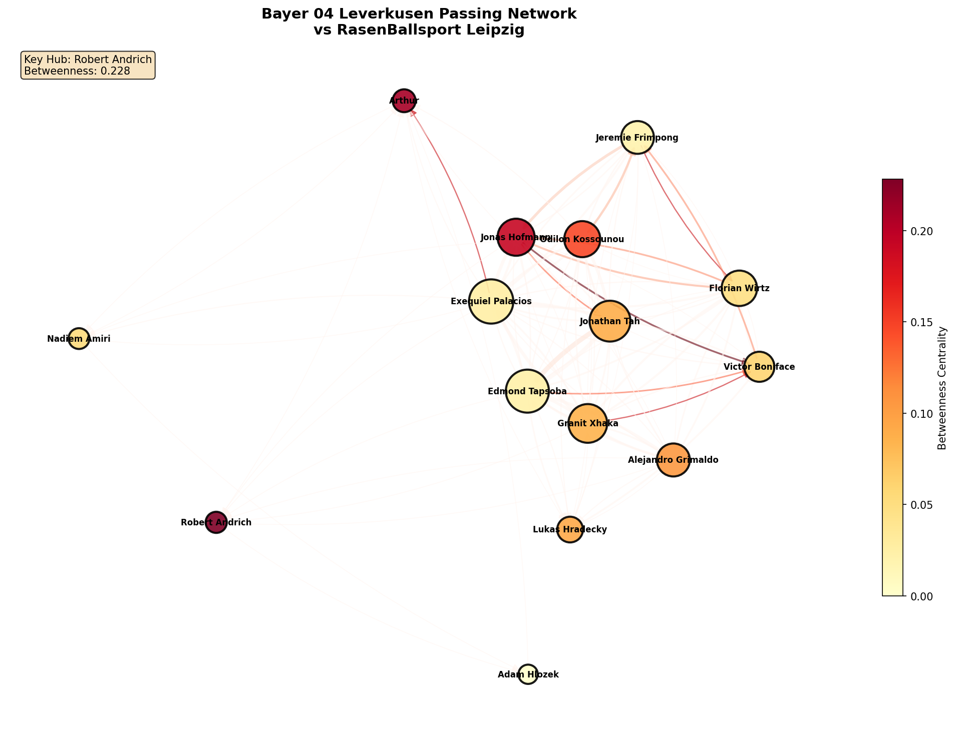
Case Study: Leverkusen's Undefeated Season
28W
6D
0L
90 pts
87 GF
24 GA
Two Hub Types Discovered
Granit Xhaka
Volume Hub — 558 passes with Palacios alone
Recycles possession, dictates tempo
Florian Wirtz
Attack Hub — Highest max betweenness (0.448)
Wirtz→Boniface: 22 pre-shot passes (23.4%)
[leverkusen_network.png]
The Killer Chain: Xhaka → Wirtz → Boniface → GOAL

Slide 7
Application: Lineup Optimization
Starting XI Selection
Substitution Strategy
Score candidate lineups by predicted cohesion. Select players who maximize connectivity with existing starters.
Identify which subs preserve hub structure vs. which disrupt it. Avoid removing high-betweenness players.
Transfer Targets
Opponent Analysis
Project how a new signing integrates: simulate their historical passing patterns into the team's network.
Identify opponent's hub players to mark/isolate. Disrupting their Xhaka-equivalent drops cohesion.

Slide 8
Conclusions
1. Network cohesion predicts season performance
r = 0.728 (p < 0.001) — explains 53% of variance in points
2. Hub dependence > balance for elite teams
Star-player reliance is a feature, not a bug
3. Different hub types serve different functions
Xhaka (volume) vs Wirtz (attack) — both essential
Limitations
• Single season (n=18 teams)
• ~24% passes lack receiver ID
• Position data from metadata only
• No tracking data (spatial context)
Future: Multi-season validation,
player-level predictions
GitHub: https://github.com/amin8448/lineup-cohesion-hackathon| Contact: aminnabavi@cmail.Carleton.ca, amin8448@gmail.com
AI Disclosure: Claude assisted with code development and slide formatting

