Slide 1

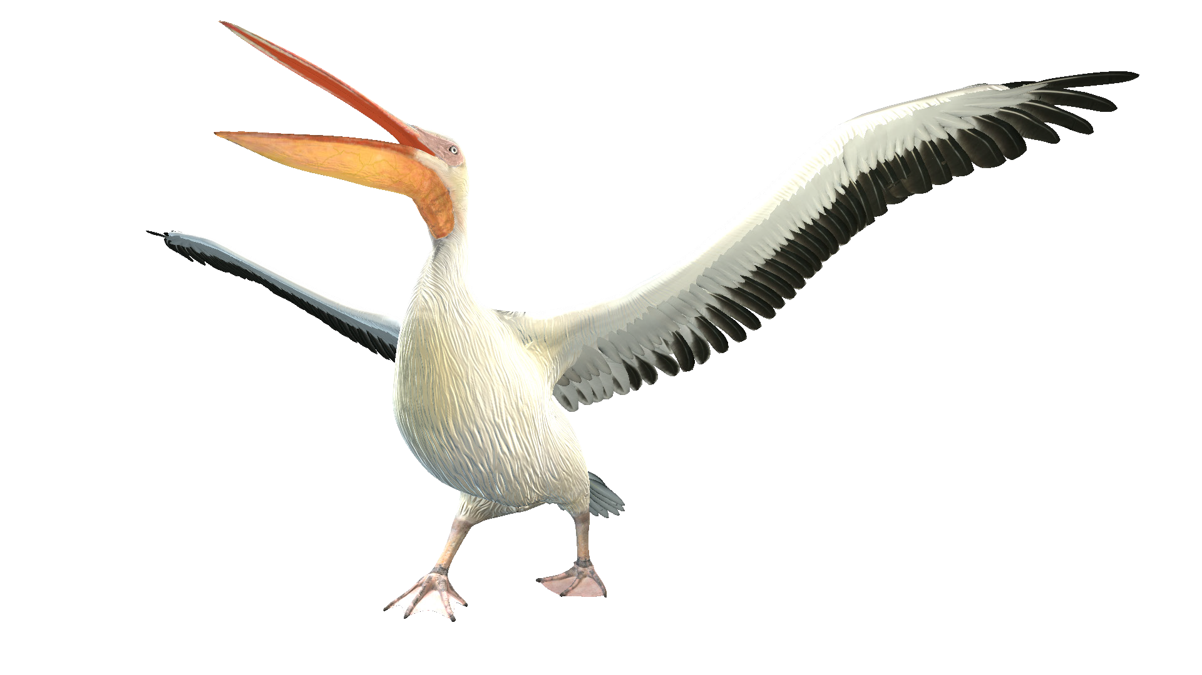

Duration: 30 min
Primary School
Grade: 3
Lesson 8
Animals and their habitats

Slide 2
LESSON OVERVIEW
This Lesson is all about Animals, A conversation takes place at a Zoo. A student and a Zoo Keeper have a conversation about the animals they see.
OBJECTIVES
Teach The students how to Use A and An correctly
Teach The student 10 new Animals – Vocabulary
Have a simple Conversation with the student, The student should be able to both ask and answer: What Animal is that? It is a/an ________.
VOCABULARY/GRAMMAR
Animals: Dog, Cat, Hen, Shark, Camel, Lion, Monkey, Ox, Elephant, Whale
People: Student, Zoo Keeper
Grammar: A/An

Slide 3
10
min
Vocabulary: Animals

Slide 4


Vocabulary: Animals
10
min

Slide 5

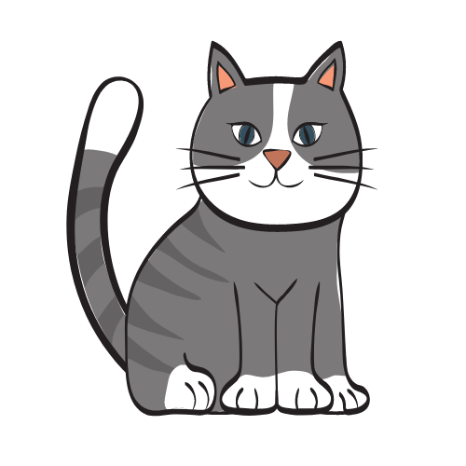
Vocabulary: Animals
10
min

Slide 6

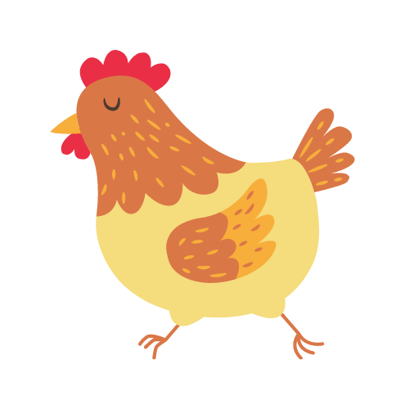
Vocabulary: Animals
10
min

Slide 7


Vocabulary: Animals
10
min

Slide 8
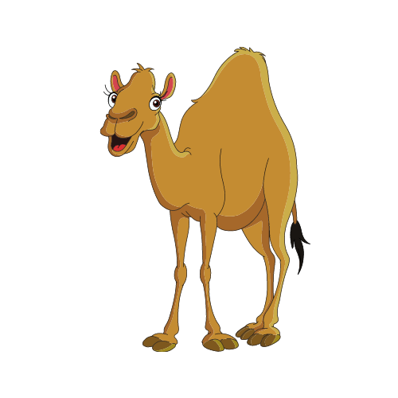

Vocabulary: Animals
10
min

Slide 9


Vocabulary: Animals
10
min

Slide 10
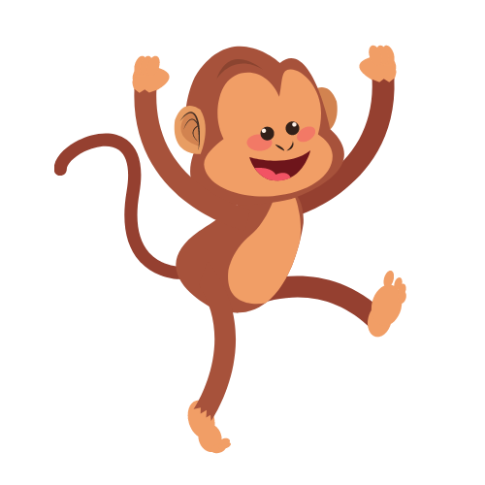

Vocabulary: Animals
10
min

Slide 11
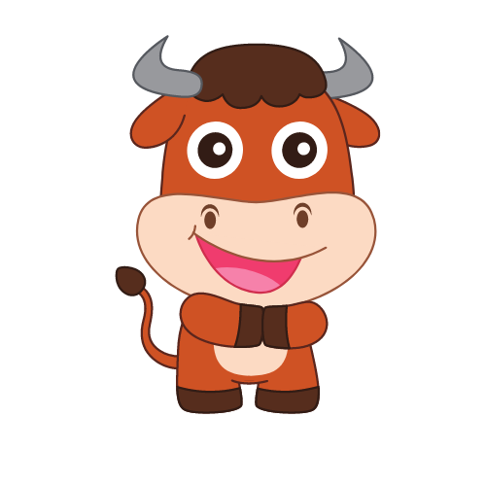

Vocabulary: Animals
10
min

Slide 12
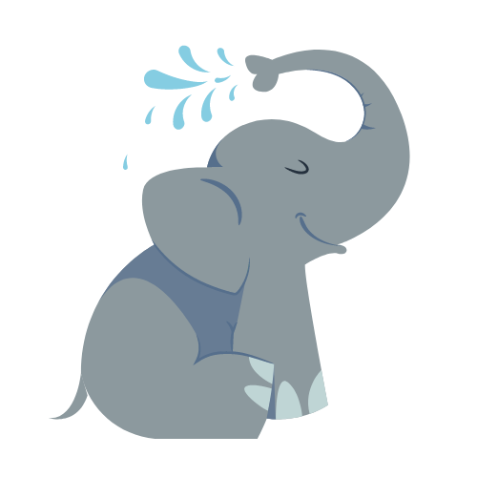

Vocabulary: Animals
10
min

Slide 13


Vocabulary: Animals
10
min

Slide 14


Dialogue: Context
Tip: An = A,E,I,O,U
A = NOT A,E,I,O,U
10min
A
An

Slide 15
Review
Tip: An = A,E,I,O,U
A = NOT A,E,I,O,U
10min

Slide 16
Review
Tip: An = A,E,I,O,U
A = NOT A,E,I,O,U
10min

Slide 17

GAME
10min

Slide 18
10
min
Dialogue: At the Zoo

Slide 19
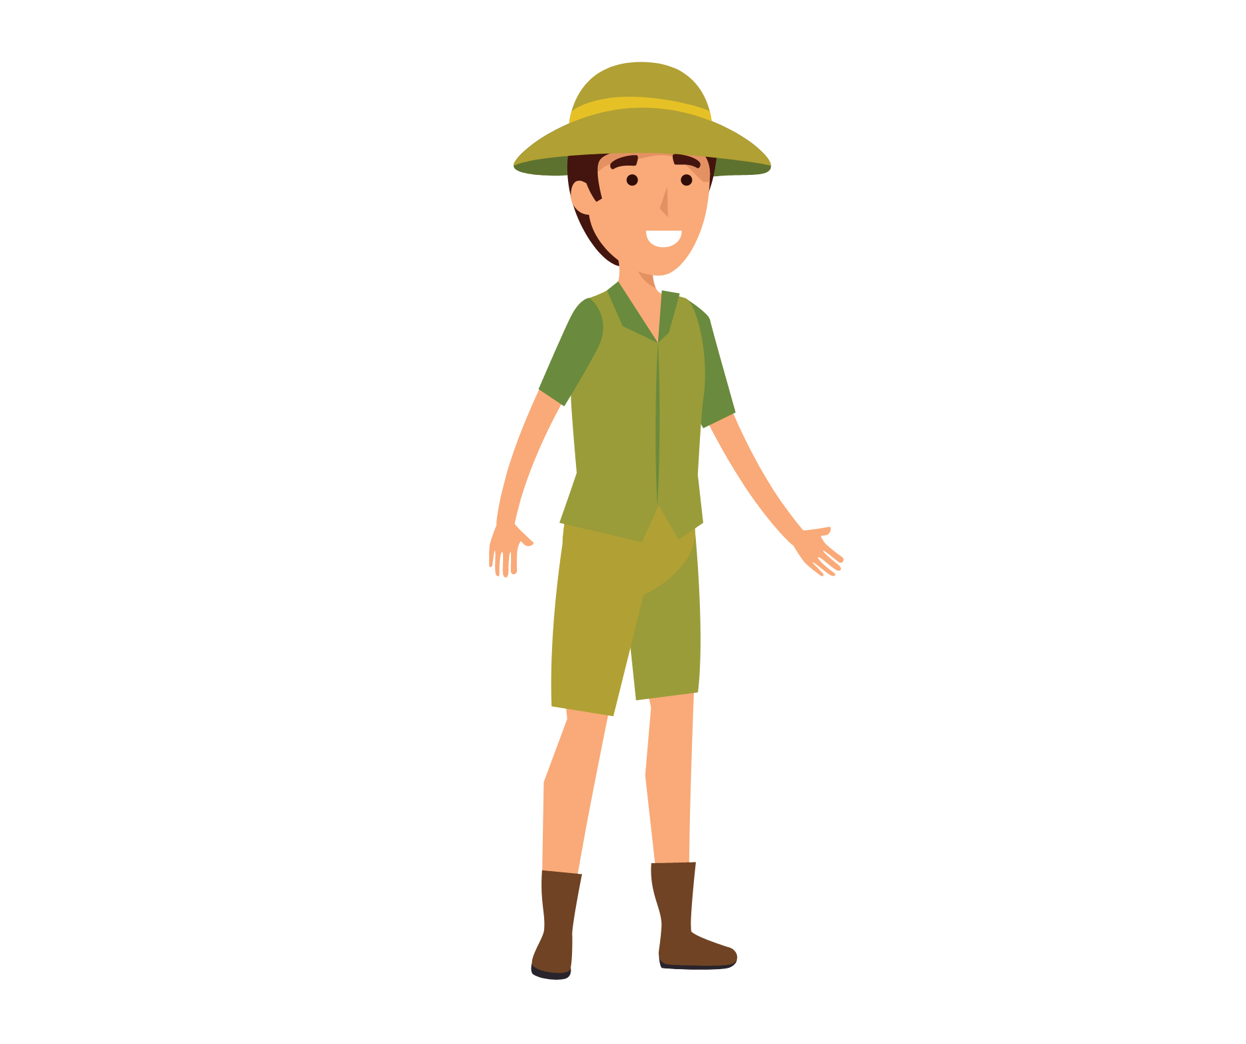
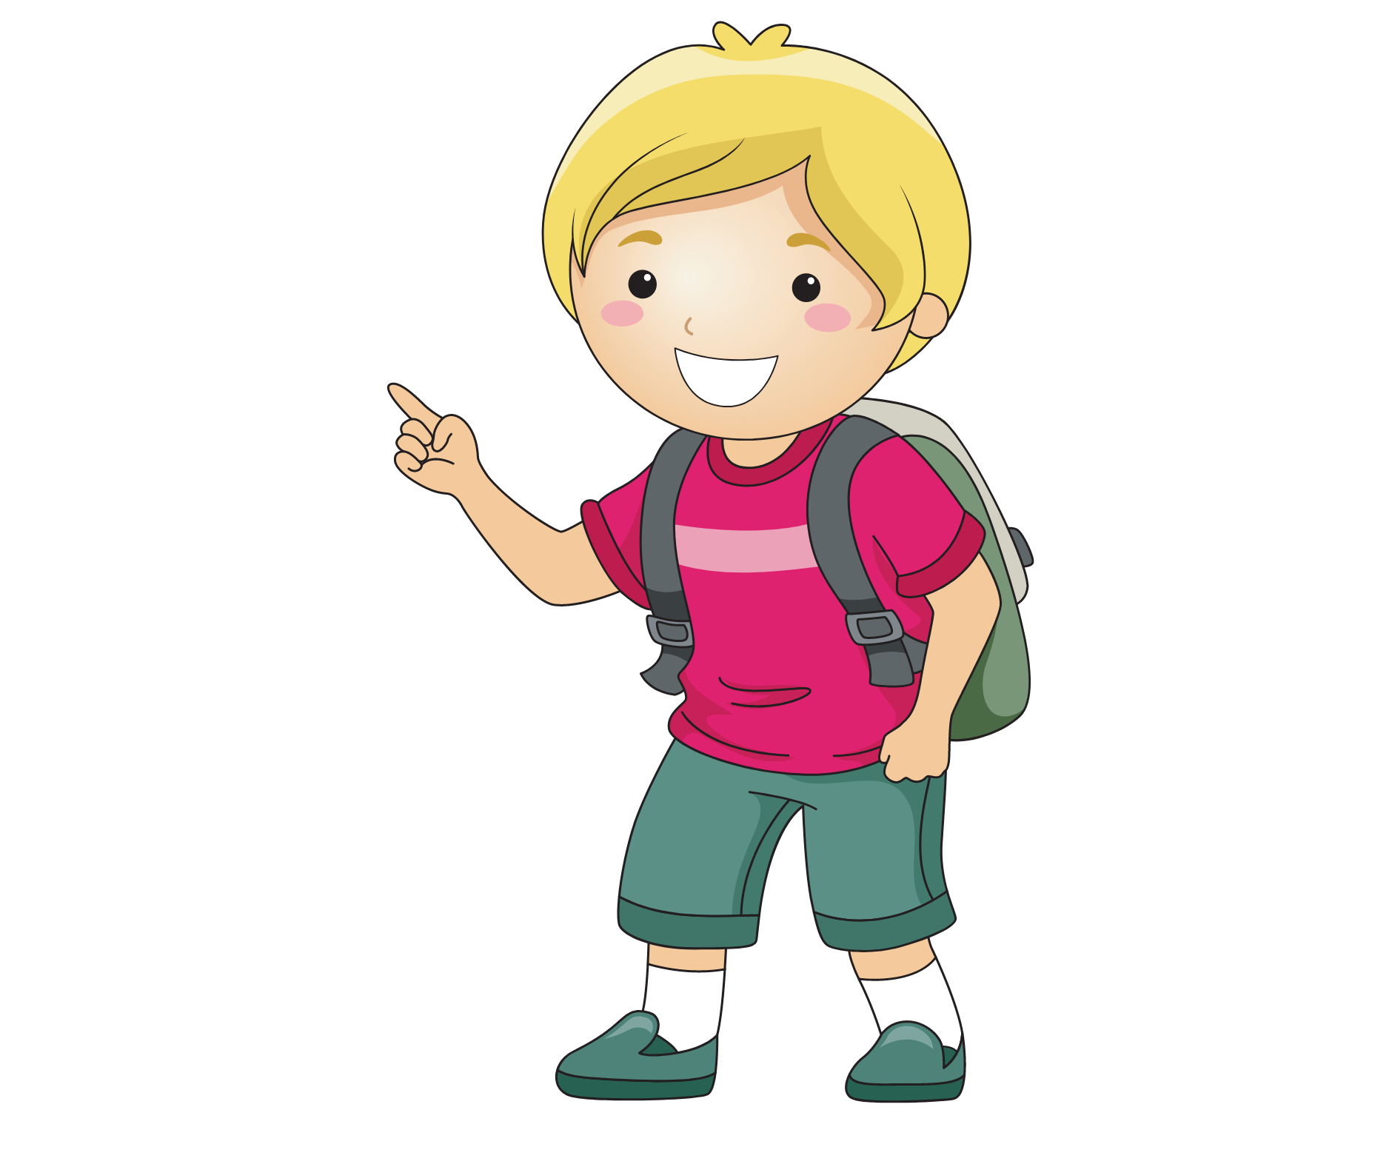

Dialogue: Context
10
min
WHO
WHERE?
ZOO KEEPER
STUDENT
AT THE ZOO

Slide 20

Dialogue: Practice
Tip: An = A,E,I,O,U
A = NOT A,E,I,O,U
10min
What Animal is that?
Dog
Its A/An_______

Slide 21
Dialogue: Practice
Tip: An = A,E,I,O,U
A = NOT A,E,I,O,U
10min
What Animal is that?
Cat
Its A/An_______

Slide 22
Dialogue: Practice
Tip: An = A,E,I,O,U
A = NOT A,E,I,O,U
10min
What Animal is that?
Hen
Its A/An_______

Slide 23
Dialogue: Practice
Tip: An = A,E,I,O,U
A = NOT A,E,I,O,U
10min
What Animal is that?
Shark
Its A/An_______

Slide 24
Dialogue: Practice
Tip: An = A,E,I,O,U
A = NOT A,E,I,O,U
10min
What Animal is that?
Camel
Its A/An_______

Slide 25
Dialogue: Practice
Tip: An = A,E,I,O,U
A = NOT A,E,I,O,U
10min
What Animal is that?
Lion
Its A/An_______

Slide 26
Dialogue: Practice
Tip: An = A,E,I,O,U
A = NOT A,E,I,O,U
10min
What Animal is that?
Monkey
Its A/An_______

Slide 27
Dialogue: Practice
Tip: An = A,E,I,O,U
A = NOT A,E,I,O,U
10min
What Animal is that?
Elephant
Its A/An_______

Slide 28
Dialogue: Practice
Tip: An = A,E,I,O,U
A = NOT A,E,I,O,U
10min
What Animal is that?
Whale
Its A/An_______

Slide 29
Dialogue: Practice
Tip: An = A,E,I,O,U
A = NOT A,E,I,O,U
10min
What Animal is that?
Ox
Its A/An_______

Slide 30
GAME
10min

Slide 31
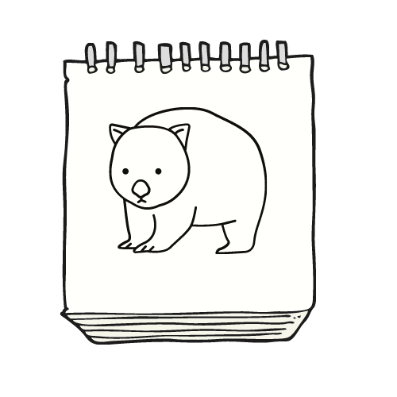
HOMEWORK
10min
Draw your favourite Animal and show it to the Teacher next Lesson!

Slide 32
HOMEWORK
10min
Goodbye! See you next lesson!

