Slide 1

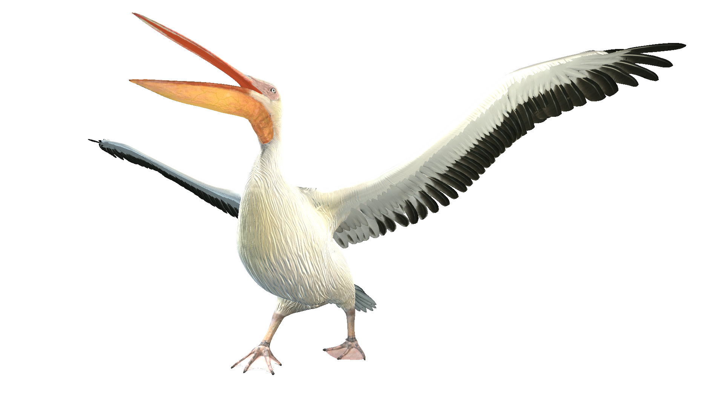

Duration: 60 min
Primary School
Grade: 3
Lesson 8
Animals and their habitats

Slide 2
LESSON OVERVIEW
Magnets are common items in our daily lives. Playing around with some magnets, we can see some basic features:
Magnets exert force on each other, as well as on certain metals.
This force is strongest when they are touching, but also acts at a distance.
Magnets can either attract or repel each other, depending on how they are held.
OBJECTIVES
Know how to determine the direction of a permanent magnetic field.
Know that a current-carrying wire creates a magnetic field.
Know how to determine the direction of the magnetic field produced by a current-carrying wire.
VOCABULARY
Magnetic Domains, Magnetic Poles, Magnetism, Right-Hand Rule

Slide 3
10
min
Vocabulary: Animals

Slide 4


Vocabulary: Animals
10
min

Slide 5

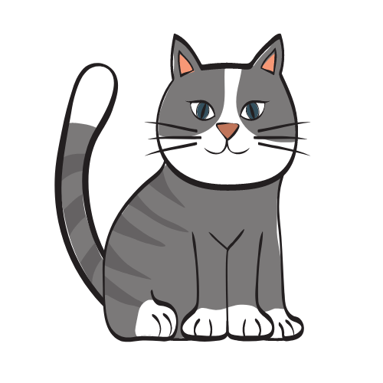
Vocabulary: Animals
10
min

Slide 6

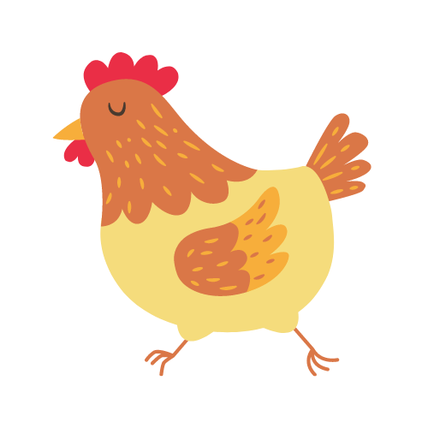
Vocabulary: Animals
10
min

Slide 7


Vocabulary: Animals
10
min

Slide 8
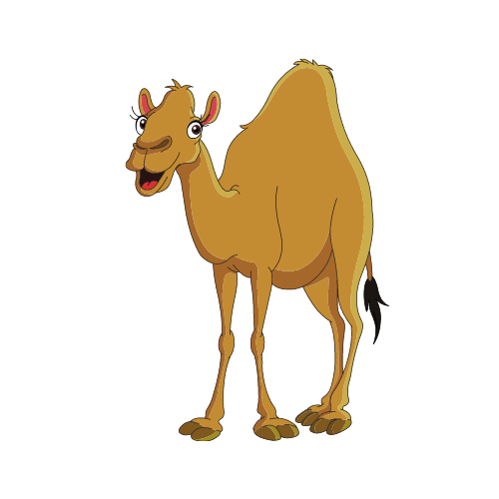

Vocabulary: Animals
10
min

Slide 9


Vocabulary: Animals
10
min

Slide 10
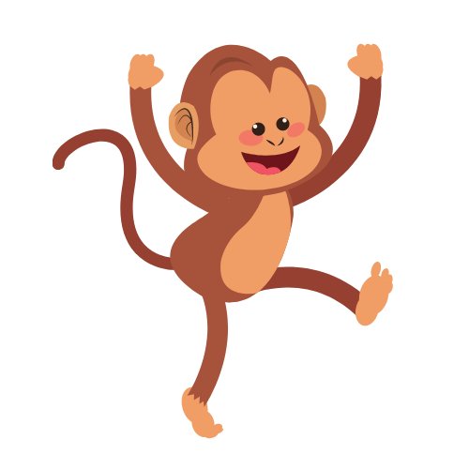

Vocabulary: Animals
10
min

Slide 11
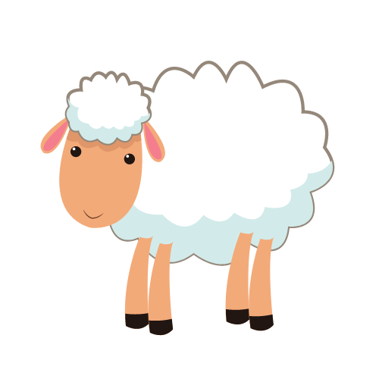

Vocabulary: Animals
10
min

Slide 12
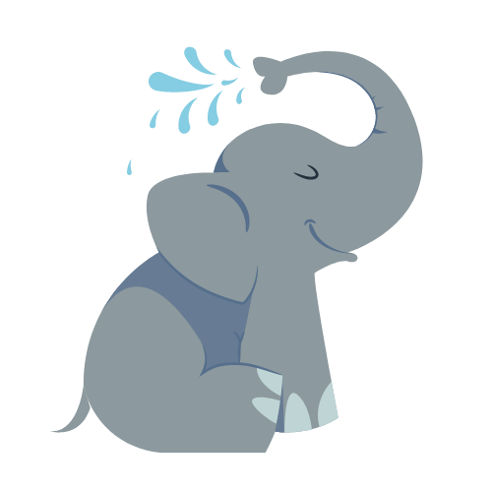

Vocabulary: Animals
10
min

Slide 13


Vocabulary: Animals
10
min

Slide 14
10
min
Dialogue: At the Zoo

Slide 15
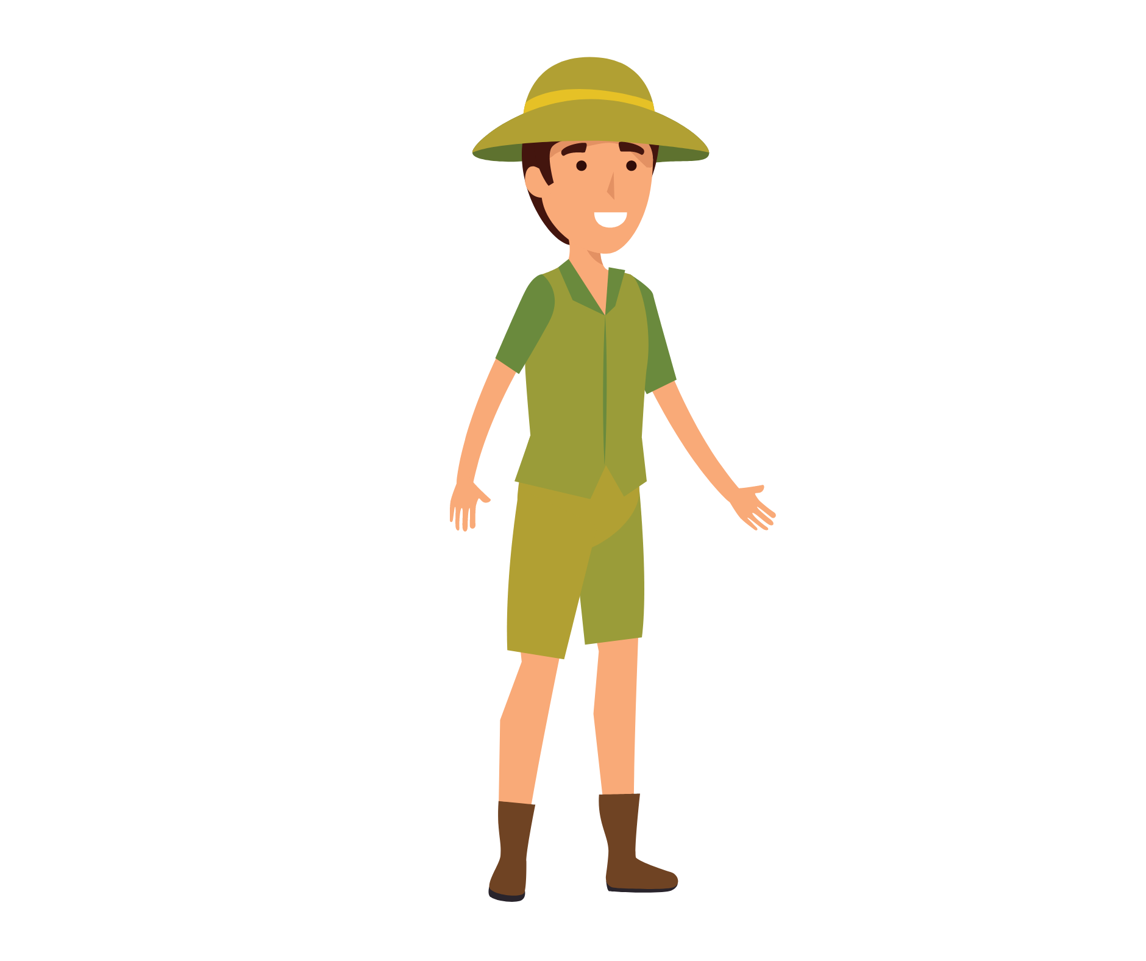

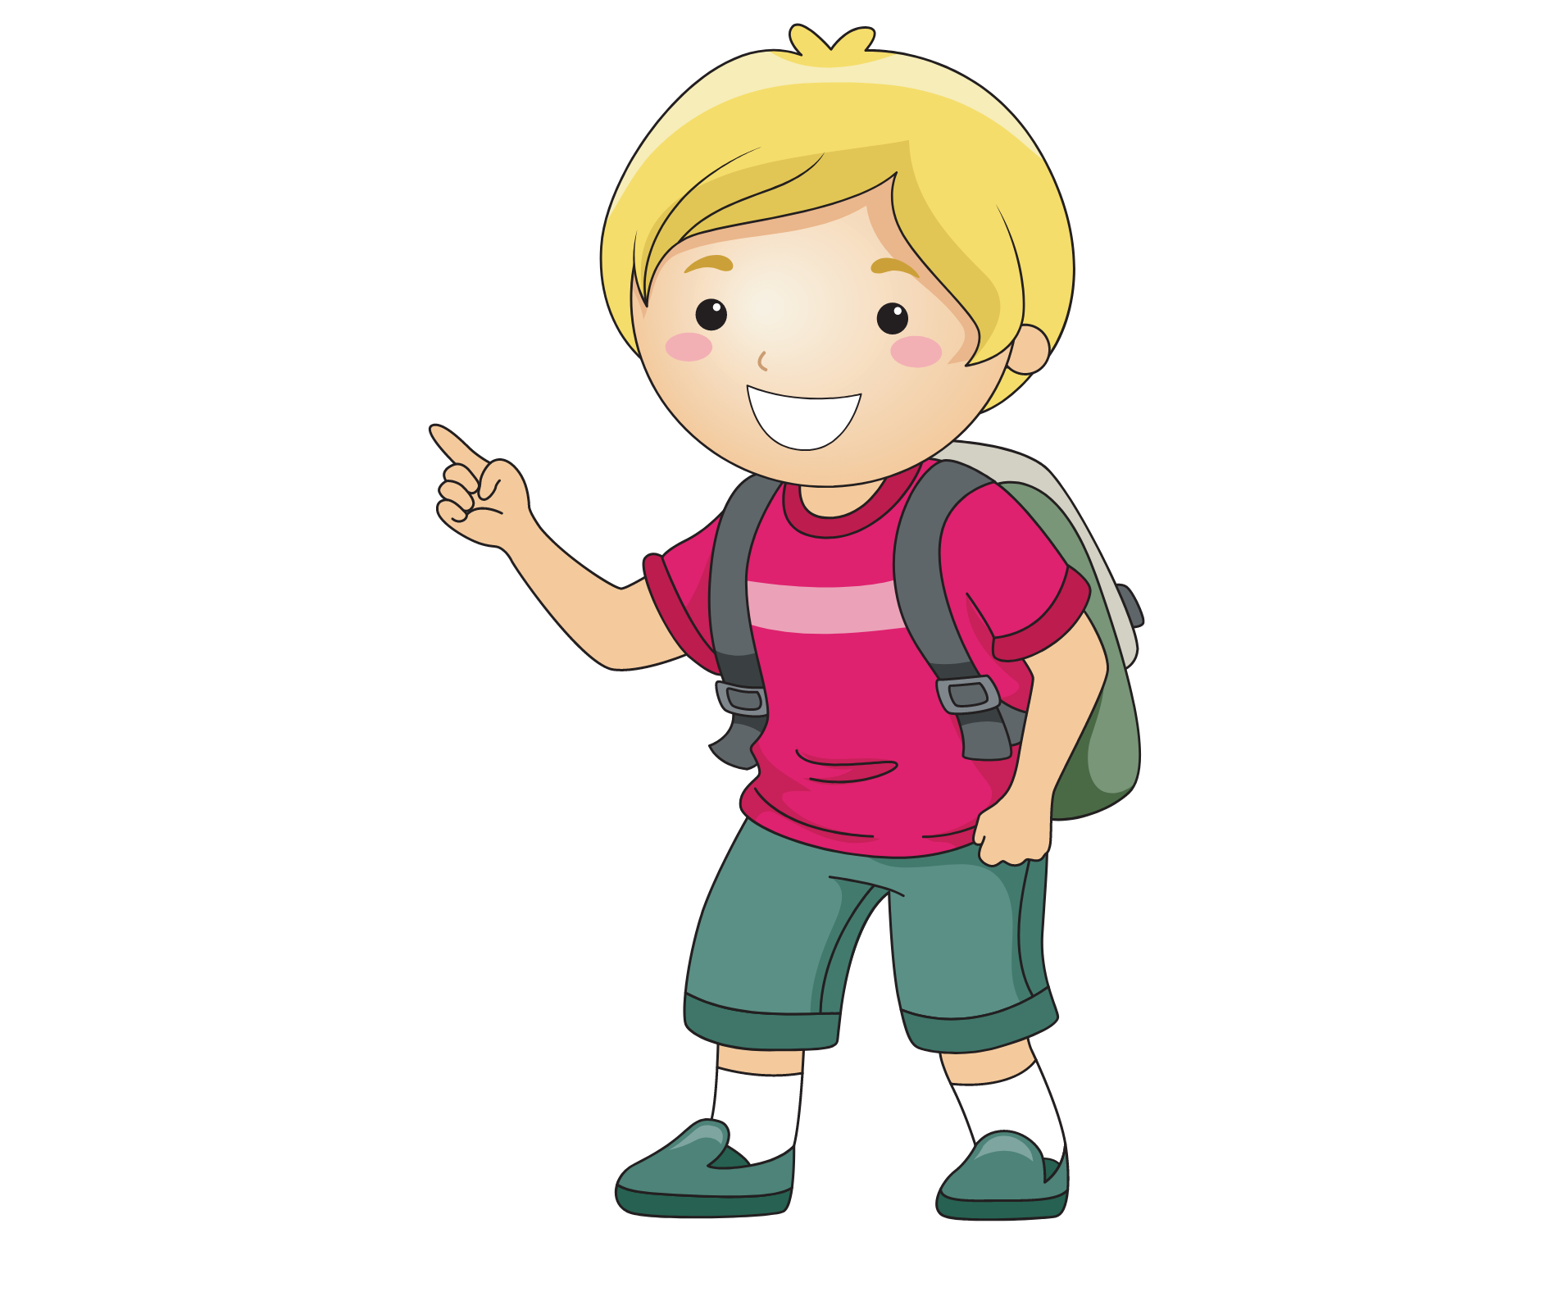
Dialogue: Context
10
min
ZOO KEEPER
STUDENT
AT THE ZOO

Slide 16
Dialogue: Context
Tip: An = A,E,I,O,U
A = NOT A,E,I,O,U
10min
A
An

Slide 17
Dialogue: Context
Tip: An = A,E,I,O,U
A = NOT A,E,I,O,U
What Animal is that?
10min
It’s a/an ________
ZOO KEEPER
STUDENT

Slide 18

Dialogue: Practice
What Animal is that?
10min
It’s a/an ________

Slide 19
Vocabulary: Animals
Tip: An = A,E,I,O,U
A = NOT A,E,I,O,U
10
min
What Animal is this?
It is a/an ________

Slide 20
Vocabulary: Animals
10
min
What Animal is this?
It is a/an ________

