Slide 1
Research Project Course: CS 555 Fundamentals of Machine Learning Prepared BY: Amina Bauyrzhan Title: Analysis of Direct Marketing Campaign Effectiveness for Term Deposit Subscriptions at a Portuguese Bank
Abstract: This report evaluates bank marketing dataset to determine the key predictors of client subscriptions to term deposits. The logistic regression with ridge regularization was constructed to analyze the effects of demographic and campaign-related factors on subscription rates.

Slide 2
About Dataset
The dataset direct marketing campaigns of a Portuguese banking institution was taken. The bank has collected data from direct telephone marketing campaigns to understand the effectiveness of their marketing strategies
The dataset contains 45,211 observations and 17 variables
The data consists of both numerical (7 features) and categorical (9 features) variables, all complete without any null entries.
The class distribution was assessed, highlighting an imbalance with 88.3% non-subscribers and 11.7% subscribers.

Slide 3
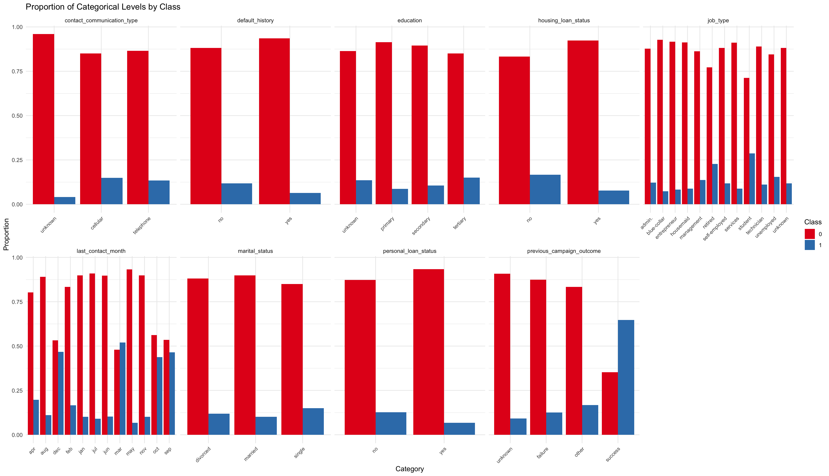
Exploratory Data Analysis
Class 1 seems to have a higher proportion of individuals with no default history, higher education levels, and no loans, suggesting a potential profile of a more financially secure or risk-averse group.
The previous campaign outcomes are strongly differentiated by class, with 'success' significantly more prevalent in Class 1.
Individuals with a 'cellular' contact type, 'secondary' or higher education, and no default or loans tend to be more frequently associated with Class 1.
Job types are variably represented in both classes, but some jobs, such as 'management' and 'blue-collar', are notably more frequent in Class 1.
Marital status shows that single individuals are proportionally higher in Class 1 than in Class 0
Figure 2 Bar charts with proportion of categorical levels by class

Slide 4
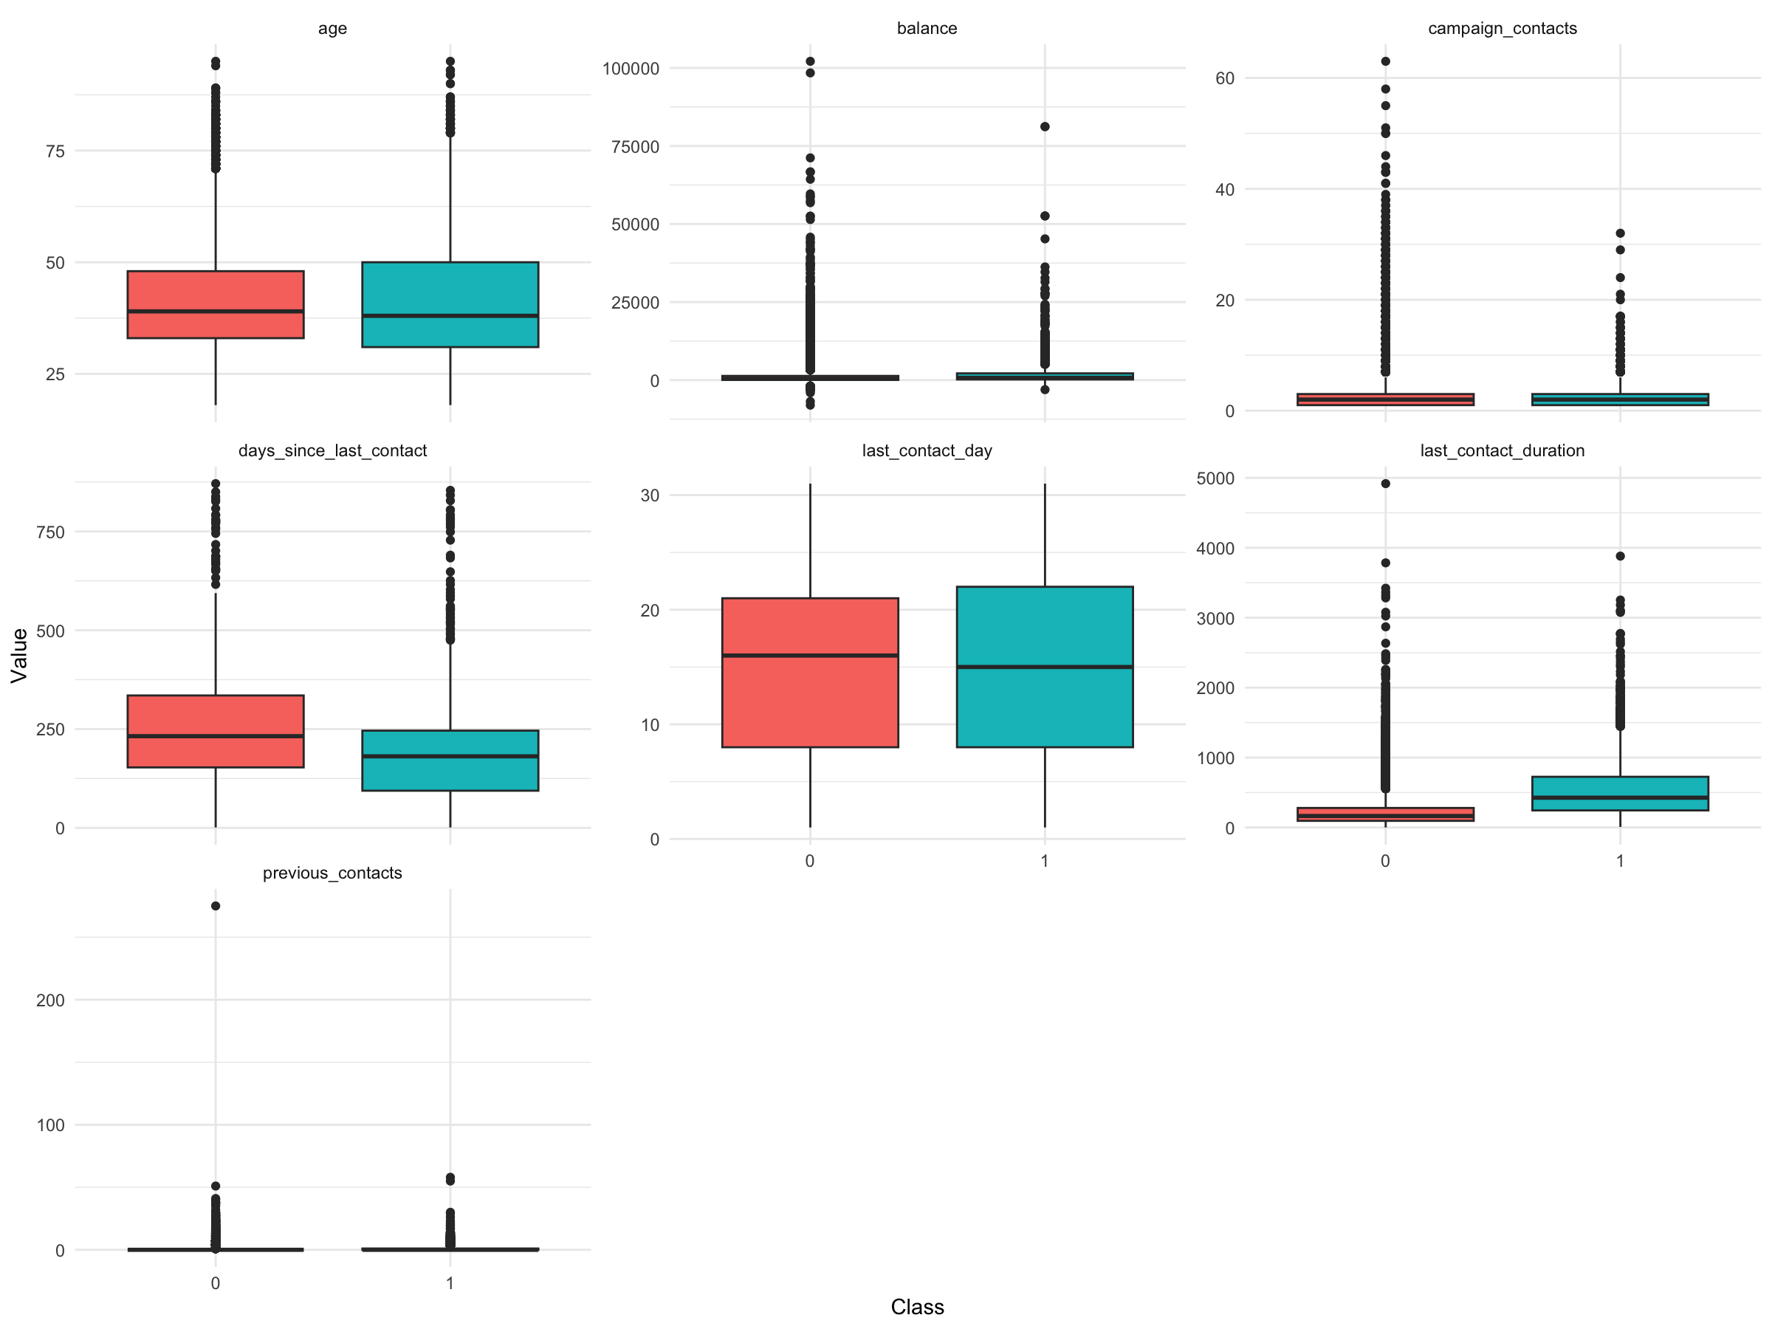
Exploratory Data Analysis
Age: Distribution is fairly consistent across classes, with a wider range of ages in the non-subscriber class.
Balance: Exhibits a right-skewed distribution in both classes, with subscribers having a marginally higher median balance.
Campaign Contacts: Non-subscribers were contacted more frequently, suggesting a correlation between the number of contacts and subscription outcome.
Days Since Last Contact: Outliers indicate a mix of recent and very old last contact days in both classes.
Last Contact Duration: Generally longer for subscribers, with some particularly long conversations.
Previous Contacts: A similar pattern of contacts prior to the current campaign, with non-subscribers having more prior interactions.
Figure 5. Boxplots by class for numeric variables

Slide 5
Preprocessing
Outliers were removed
To address class imbalance, downsampling method was used
Numerical variables were subsequently standardized—centered and scaled
Categorical variables were transformed into dummy variables
The final dataset was partitioned into training and test sets in an 80/20 split, maintaining reproducibility by setting a seed

Slide 6
Logistics Regression with Ridge Regularization
Logistic regression is widely used method for binary classification tasks. It is easy to implement and interpret.
Ridge regularization (also known as L2 regularization) introduces a penalty term to the cost function that prevents the coefficients of the model from reaching large values, which can lead to overfitting
The coefficients of the model can be examined to understand the influence of each predictor, unlike other complex models
By choosing the appropriate regularization parameter (lambda), the model can be prevented from being too complex, which helps in achieving better generalization on unseen data.

Slide 7
Model Results
Job Type: Being a student (0.8531) significantly increases the likelihood of subscription, while blue-collar, entrepreneur, housemaid, and unemployed categories negatively impact it.
Marital Status: Single individuals (0.1719) are more likely to subscribe than married ones.
Education: Tertiary education (0.2971) is a strong positive predictor, implying higher subscription rates among the well-educated.
Credit History: Having a credit default slightly decreases the likelihood of subscription.
Loans: Clients with housing loans are less likely to subscribe, with a strong negative coefficient (-0.7208).
Contact Communication Type: An 'unknown' contact type greatly reduces the likelihood (-1.2557).
Contact Timing: Contacts in December, March, October, and September show positive associations with subscription, with March being particularly influential (1.4668).
Previous Campaign Outcome: A successful previous campaign outcome is the strongest predictor of subscription (1.5236).
Numerical Variables: Age, balance, and last contact day have minimal effects; however, longer last contact duration (1.2562) and previous contact frequency (0.1299) are associated with higher subscription chances, while more frequent contacts in the current campaign decrease the likelihood (-0.1807).

Slide 8
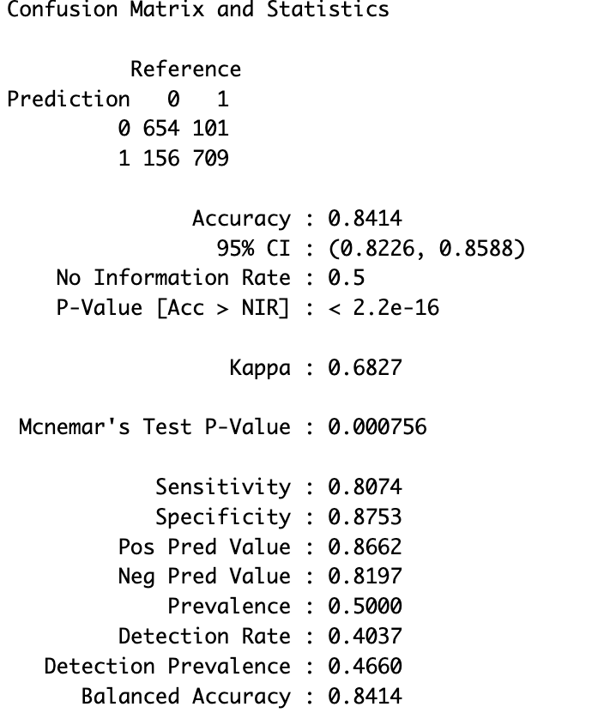
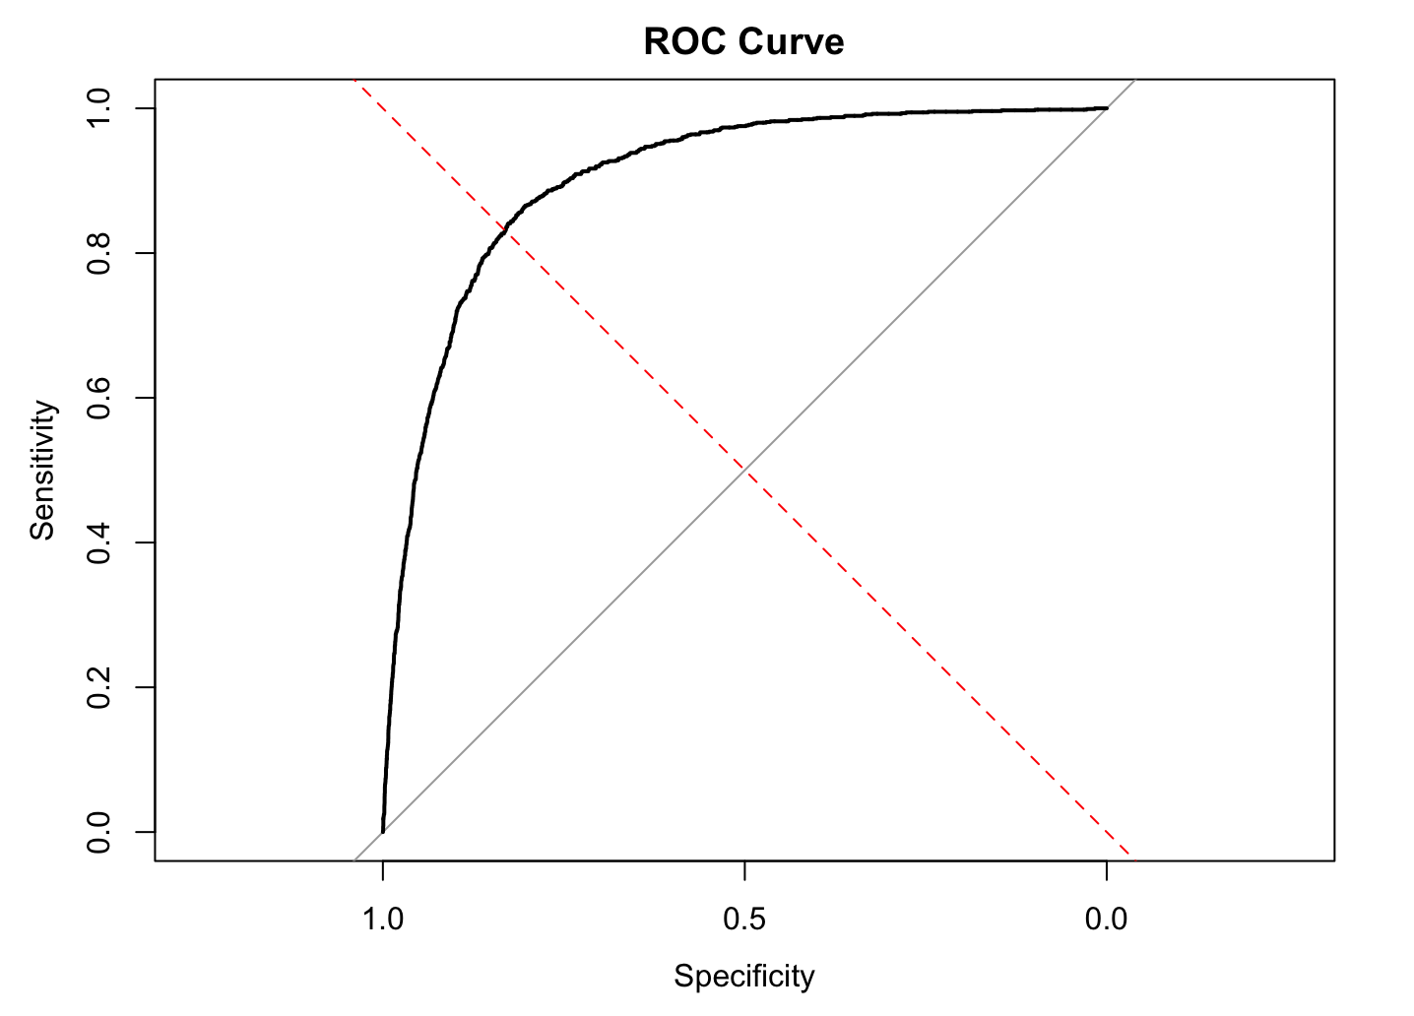
Evaluation Metrics

Slide 9
Conclusion
The model's ability to distinguish between subscribers and non-subscribers was demonstrated with high accuracy, sensitivity, and specificity, as evidenced by an AUC of 0.913. The research revealed that individuals with characteristics like being a student, unmarried, or having had a successful outcome in previous campaigns were more likely to subscribe to term deposits. On the contrary, the presence of housing or personal loans negatively impacted subscription likelihood.
By focusing on the significant predictors identified, the bank can optimize its resource allocation and maximize campaign success rates.

