Slide 1
Using Machine Learning to Differentiate Cammeo and Osmancik Varieties
Amina Bauyrzhan

Slide 2
Variables
Variable Name | Role | Type | Description | Missing Values
Area | Feature | Integer | Returns the number of pixels within the boundaries of the rice grain | no
Perimeter | Feature | Continuous | Calculates the circumference by calculating the distance between pixels around the boundaries of the rice grain | no
Major_Axis_Length | Feature | Continuous | The longest line that can be drawn on the rice grain, i.e. the main axis distance, gives | no
Minor_Axis_Length | Feature | Continuous | The shortest line that can be drawn on the rice grain, i.e. the small axis distance, gives | no
Eccentricity | Feature | Continuous | It measures how round the ellipse, which has the same moments as the rice grain, is | no
Convex_Area | Feature | Integer | Returns the pixel count of the smallest convex shell of the region formed by the rice grain | no
Extent | Feature | Continuous | Returns the ratio of the region formed by the rice grain to the bounding box | no
Class | Target | Binary | Cammeo and Osmancik | no

Slide 3
Dataset and Exploratory Data Analysis
 |  | 0 | 1 | Overall
Area | mean | 14162,89 | 11549,78 | 12667,73
 | std | 1286,77 | 1041,91 | 1732,37
Perimeter | mean | 487,44 | 429,42 | 454,24
 | std | 22,18 | 20,15 | 35,6
Major_Axis_Length | mean | 205,48 | 176,29 | 188,78
 | std | 10,33 | 9,36 | 17,45
Minor_Axis_Length | mean | 88,77 | 84,48 | 86,31
 | std | 5,35 | 5,3 | 5,73
Eccentricity | mean | 0,9 | 0,88 | 0,89
 | std | 0,01 | 0,02 | 0,02
Convex_Area | mean | 14494,43 | 11799,59 | 12952,5
 | std | 1309,42 | 1062,8 | 1776,97
Extent | mean | 0,65 | 0,67 | 0,66
 | std | 0,08 | 0,07 | 0,08

Slide 4
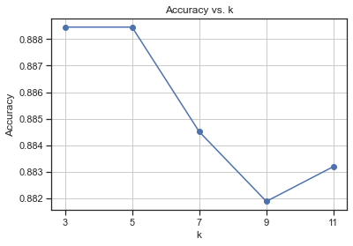
KNN classifier and Feature Selection
Scenario: Just Area is missing, Accuracy: 0.92
Scenario: Just Perimeter is missing, Accuracy: 0.88
Scenario: Just Major_Axis_Length is missing, Accuracy: 0.88
Scenario: Just Minor_Axis_Length is missing, Accuracy: 0.89
Scenario: Just Eccentricity is missing, Accuracy: 0.89
Scenario: Just Convex_Area is missing, Accuracy: 0.91
Scenario: Just Extent is missing, Accuracy: 0.89
As a result Area was dropped

Slide 5
Random Forest

Slide 6
Results
 | TP | FP | TN | FN | TPR | TNR | Accuracy
KNN | 397 | 39 | 301 | 25 | 0,94 | 0,89 | 0,916
Logistic Regression | 396 | 30 | 310 | 26 | 0,94 | 0,91 | 0,927
Naive Bayes | 394 | 37 | 303 | 28 | 0,93 | 0,89 | 0,915
Decision Tree | 385 | 43 | 297 | 37 | 0,91 | 0,87 | 0,895
Random Forest | 401 | 32 | 308 | 21 | 0,95 | 0,91 | 0,930
Linear SVM | 396 | 28 | 312 | 26 | 0,94 | 0,92 | 0,929

