Slide 1
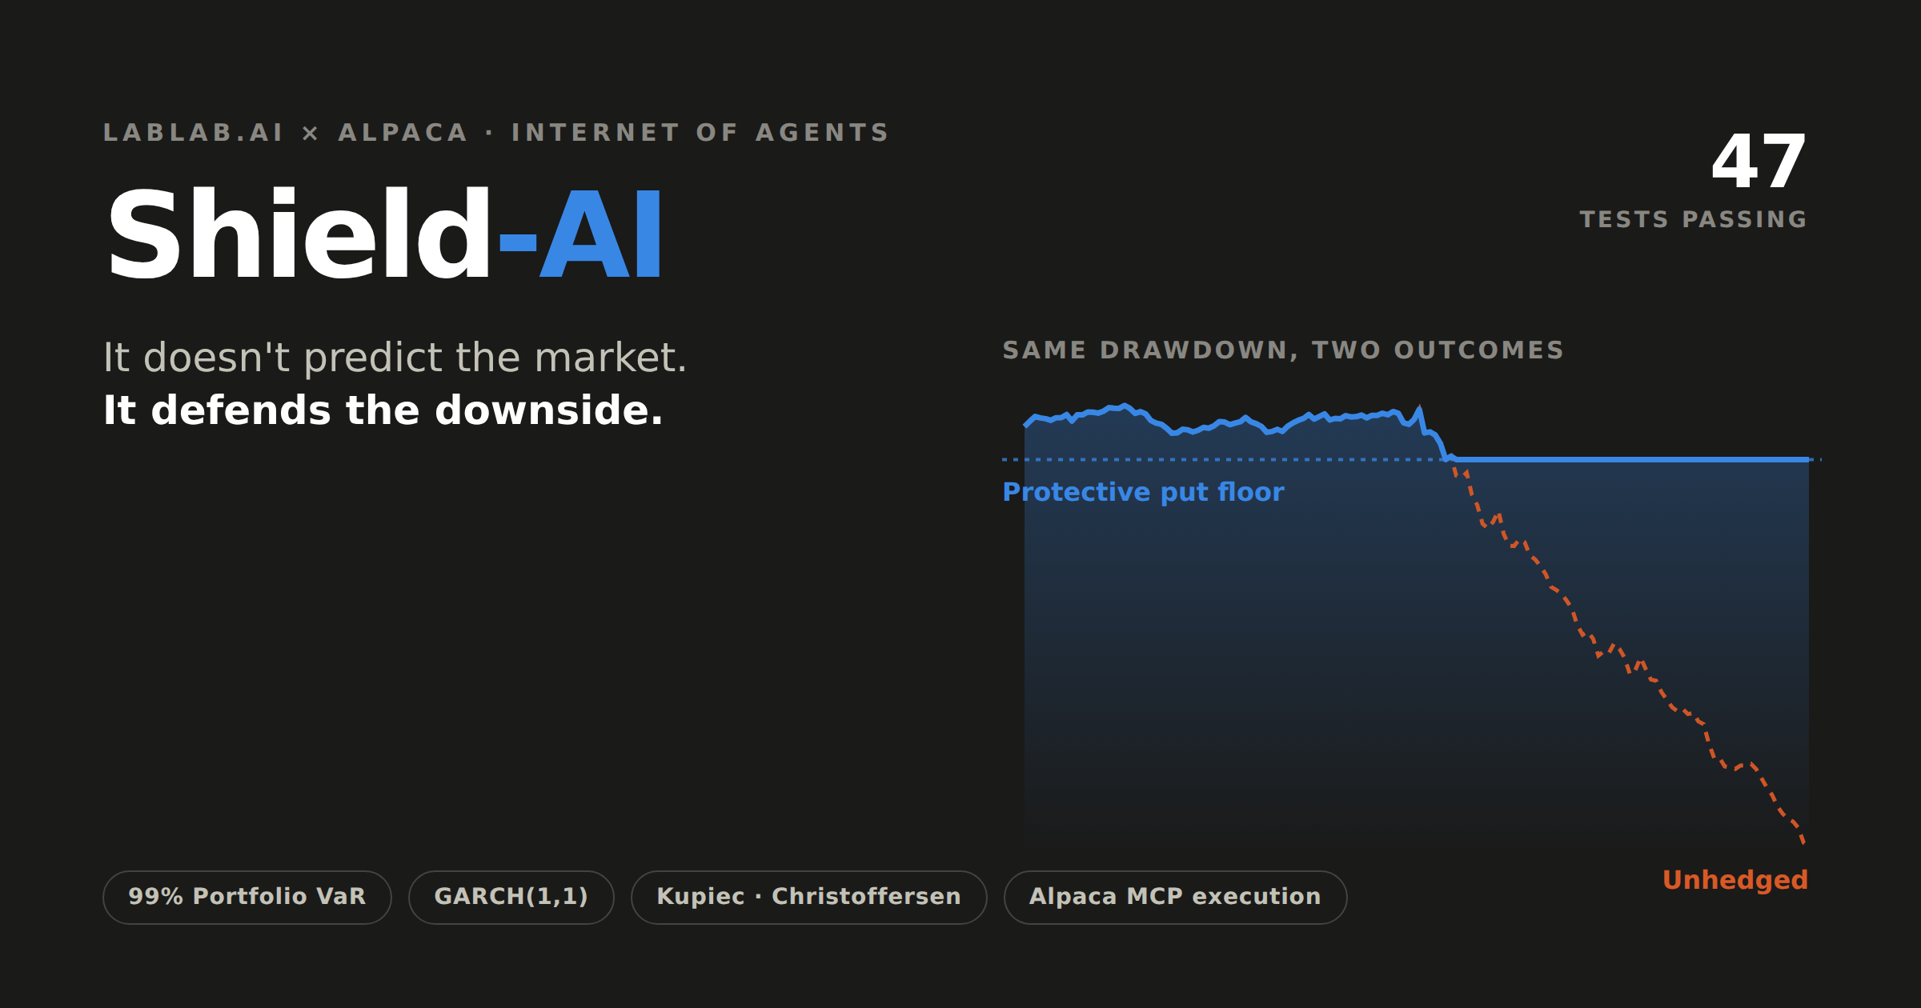
Notes:
Shield-AI: an autonomous risk agent for the Lablab.ai x Alpaca hackathon. It does not predict direction; it defends the downside.

Slide 2
THE PROBLEM
Confidence is not a risk framework.
Hand a language model a brokerage key and tell it to pick winners, and you have not built a quant system. You have built a leveraged guess.
“
The model is confident, not calibrated.
1
No covariance matrix
Exposures across names cannot be added up
Shield-AI inverts the design: deterministic mathematics defines the boundary, and the language model only ever operates inside it.
2
No tail estimate
Crash risk is invisible to the model
3
No loss budget
Nothing defines how much is too much
Notes:
Most AI trading agents chase alpha with no risk scaffolding. Shield-AI inverts it.

Slide 3
THE INSIGHT
The scoring rule decides the architecture.
Performance is judged on terminal account equity. There is no benchmark column.
5
30%
0
trading days in the scoring window
drawdown that cannot be recovered in that time
benchmarks — only the final number counts
Maximising final equity is therefore a risk-management problem, not a prediction problem.
Notes:
I derived the architecture from the scoring function rather than from a hunch.

Slide 4
ARCHITECTURE
Five layers, one boundary.
1
Data
Alpaca Market Data · News API · Option chain with Greeks
2
Quant engine
99% VaR three ways · CVaR · GARCH(1,1) · beta-weighted Delta
3
Cognitive layer
News Sentiment Agent (veto) · Risk-Manager Agent (selection)
4
Policy filter
Options level · liquidity · coverage · cost · buying power
5
Execution
Alpaca MCP Server → place_option_order → audit log
Execution runs over MCP — an open protocol, not a hard-coded SDK binding. The same agent could be pointed at any MCP-compliant venue.
Notes:
MCP is the interoperability layer — that is the Internet of Agents thesis.

Slide 5
THE STRATEGY
One model, two jobs.
GARCH forecasts realised volatility. Options imply their own. The gap between them is the variance risk premium — and it is both the risk metric and the trading signal.
IV ≫ forecast
IV ≪ forecast
VaR breached
Options are rich
Options are cheap
Risk event
Sell premium
cash-secured put
Buy protection
long put
Hedge — regardless
of how rich the premium
Order of precedence is the thesis: a VaR breach outranks any income opportunity, however rich.
Sizing is solved for, never chosen — a position may consume at most half the remaining headroom to the limit.
Notes:
One GARCH model drives both the risk budget and the entry signal.

Slide 6
WHY A LANGUAGE MODEL AT ALL
GARCH cannot read that the
FDA decision is on Thursday.
Selling volatility into a known catalyst is a classic way to destroy an account. Implied volatility is elevated because the market knows something is coming — so the "edge" is not an edge. It is compensation for a risk the volatility model structurally cannot perceive.
The agent holds a VETO,
never a vote.
It proposes nothing and sizes nothing. It answers one question: is there an unresolved catalyst inside the life of this option?
Notes:
This is the honest justification for the cognitive layer: it supplies information the mathematics cannot see.

Slide 7
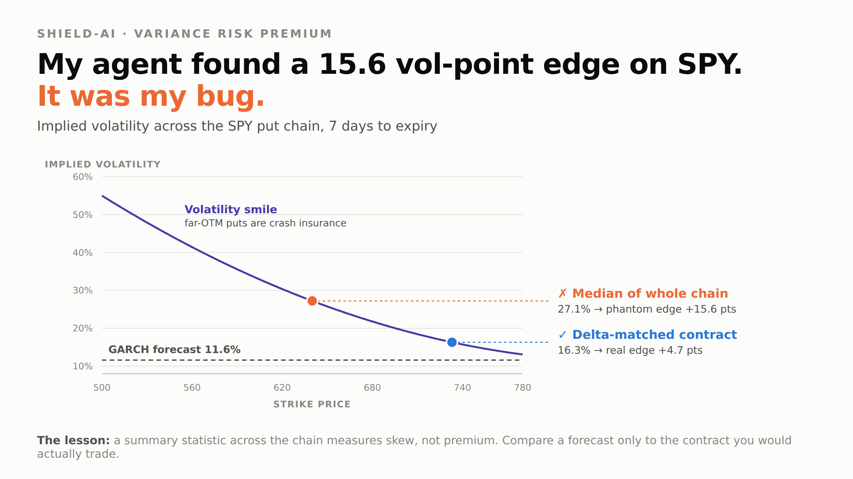
WHAT THE AGENT CAUGHT
It found a 15.6-point edge. It was my bug.
I compared the GARCH forecast to the MEDIAN implied volatility across the whole option chain. But far out-of-the-money puts trade at much higher IV — they are crash insurance. The median sat on that wing.
I was measuring skew
and calling it alpha.
Fixed to read IV from a single delta-matched contract. Now guarded by a regression test.
Notes:
A spectacular edge on the most efficiently priced instrument on earth is not an edge. It is a bug.

Slide 8
EVIDENCE
A log of refusals proves judgement.
47
3
2
verification tests passing
independent VaR estimators
formal backtests: Kupiec + Christoffersen
First live cycle, 1 September 2026
NVDA
GARCH 41.9% vs IV 29.8% → protection 12 points cheap. Bought 4 protective puts, $396 of a $1,500 budget. Order 6c693bae…
4 refusals
Edge inside the no-trade band, or open interest too thin to trust the quote. Every refusal logged with its reason.
A record of only executed trades proves an agent traded. A record of refusals proves it had judgement.
Notes:
Every decision is written to an append-only JSONL log, including the ones where the agent chose not to trade.

Slide 9
Risk management — not alpha —
is the killer app for agentic finance.
Shield-AI · github.com/amina178/shield-ai
Lablab.ai × Alpaca AI Trading Agents Hackathon · Agent Builder track
Notes:
Thank you.

