Slide 1
Final Presentation AMUSEMENT PARK SIMULATION
CSE-4550 Simulation and Modeling Lab

Slide 2
TEAM MEMBERS
Abdullah
200041126
Amina
200041155

Slide 3
TABLE OF CONTENTS
01
02
03
Problem Statement
Our Goals
Our Objectives

Slide 4
PROBLEM STATEMENT
Let’s consider an Amusement park system consisting of a ticket counter system and 7 ride systems.
Ticket entrance system
The ticket counter system is a multi server multi queue system which has 4 servers to serve ticket and 4 queues for visitors. It has uniform service time.

Slide 5
PROBLEM STATEMENT
Route System
Events:
Route Proceed Event
Route End Event

Slide 6
PROBLEM STATEMENT
Roller Coaster
Single server single queue
Batch system processing
Batch wait time
Uniform service time
Events:
Arrival Event
Departure Event
Load Event

Slide 7
PROBLEM STATEMENT
Carousel
Single server single queue
Batch system processing
Batch wait time
Uniform service time
Events:
Arrival Event
Departure Event
Load Event

Slide 8
PROBLEM STATEMENT
Water ride
Single server single queue
Token system processing
Multiple token
Exponential service time with mean lambda
Events:
Arrival Event
Departure Event

Slide 9
PROBLEM STATEMENT
Ferris wheel
Multi server single queue
Batch system processing
Multiple batches
Uniform service time
Events:
Arrival Event
Departure Event
Load Event

Slide 10
PROBLEM STATEMENT
Cable car
Multi server single queue
Batch system processing
Multiple batches
Uniform service time
Events:
Arrival Event
Departure Event
Load Event

Slide 11
PROBLEM STATEMENT
Haunted Tunnel
Multi server single queue
Batch system processing
Multiple batches
Uniform service time
Events:
Arrival Event
Departure Event
Load Event

Slide 12
PROBLEM STATEMENT
Local North / South Ticket Counter
Single server single queue
Immediate system processing
Normal service time
Events:
Arrival Event
Departure Event

Slide 13
PROBLEM STATEMENT
Food System
Single server single queue
Immediate system processing
Normal service time
Events:
Arrival Event
Departure Event

Slide 14
OUR GOALS
Maximize Revenue Generation
Enhance Visitor Experience
Improve Crowd Sentiment

Slide 15
OUR OBJECTIVES
Waiting time analysis
Delay at ticket counter
Delay in ride queues
Delay in ride service
Average delay at ticket counter
Average delay in ride queues
Average delay in ride service
Sentiment analysis
Visitor feedback on rides
Average visitor feedback on rides
Overall theme park review
Revenue analysis
Maintenance cost vs Total income

Slide 16
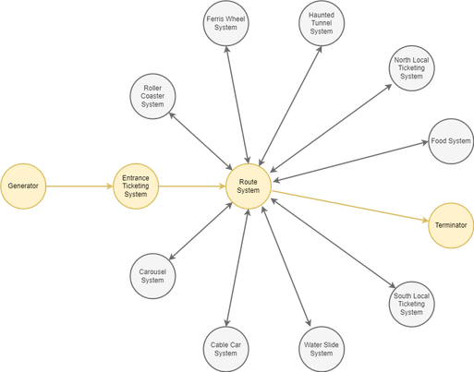
BASIC SYSTEM DESIGN

Slide 17
CONCEPTUAL MODEL
Ticket Counter Systems:
Entrance Ticket Counter System
State Variables
Status, s_{i}
Queue Length, q_{i}
where, i = 0, 1, 2, 3 and N = 4
Input Variables
Departure Mean, dm_{i} (exponential random variate)
where, i = 0, 1, 2, 3 and N = 4
Events
Arrival Event (arrival of a visitors)
Departure Event (departure of a visitors)
Jockey Event (jockey of a visitor to other queue)
Output Variables
Total Waiting Time
Average Waiting Time
Total Visitor-Queue Time
Average Visitor-Queue Time
Total Visitor-System Time
Average Visitor-System Time

Slide 18
CONCEPTUAL MODEL
Ticket Counter Systems:
Local Ticket Counter System (North and South)
State Variables
Status, s_{i}
Queue Length, q_{i}
_{where, i = 0, 1, 2 and N = 3}
Input Variables
Departure Mean, dm_{i} (exponential random variate)
_{where, i = 0, 1, 2 and N = 3}
Events
Arrival Event (arrival of a visitors)
Departure Event (departure of a visitors)
Output Variables
Total Waiting Time
Average Waiting Time
Total Visitor-Queue Time
Average Visitor-Queue Time
Total Visitor-System Time
Average Visitor-System Time

Slide 19
CONCEPTUAL MODEL
General Systems:
Route System
State Variables
Status, s (number of visitors on the route)
Input Variables
Duration Mean, dm (normal random variate)
Duration Variance, dv (normal random variate)
Events
Route Proceed Event (starting the route to particular point for a visitor)
Route End Event (end of the route to particular point for a visitor)
Output Variables
Total Route Time (per route)
Average Route Time (per route)

Slide 20
CONCEPTUAL MODEL
General Systems:
Food System
State Variables
Status, s
Queue Length, q
Input Variables
Departure Mean, dm (exponential random variate)
Events
Arrival Event (arrival of a visitors)
Departure Event (departure of a visitors)
Output Variables
Total Waiting Time
Average Waiting Time
Total Visitor-Queue Time
Average Visitor-Queue Time
Total Visitor-System Time
Average Visitor-System Time

Slide 21
CONCEPTUAL MODEL
Ride Systems:
Roller Coaster System and Carousel System
State Variables
Status, s
Queue Length, q
Input Variables
Service Time, st (fixed time duration)
Waiting Mean, wm (normal random variate)
Events
Arrival Event (arrival of a visitors)
Departure Event (departure of a visitors)
Load Event (wait for loading the ride)
Output Variables
Total Waiting Time
Average Waiting Time
Total Visitor-Queue Time
Average Visitor-Queue Time
Total Visitor-System Time
Average Visitor-System Time

Slide 22
CONCEPTUAL MODEL
Ride Systems:
Haunted Tunnel System and Water Ride System
State Variables
Status, s_{i}
Queue Length, q
where, i = 0, 1, 2, 3, …N and N = number of rides
Input Variables
Departure Mean, dm_{i} (exponential random variate)
where, i = 0, 1, 2, 3, …N and N = number of rides
Events
Arrival Event (arrival of a visitors)
Departure Event (departure of a visitors)
Output Variables
Total Waiting Time
Average Waiting Time
Total Visitor-Queue Time
Average Visitor-Queue Time
Total Visitor-System Time
Average Visitor-System Time

Slide 23
CONCEPTUAL MODEL
Ride Systems:
Ferris Wheel System and Cable Car System
State Variables
Status, s
Queue Length, q
Number of Loaded carriage, c
Input Variables
Inter-carriage Swap Time, it (fixed time duration)
Unloading Mean, um_{i} (exponential random variate)
where, i = 0, 1, 2, 3, 5 and N = 5
Events
Arrival Event (arrival of a visitors)
Load Event (loading of a carriage)
Unload Event (unloading of a carriage)
Output Variables
Total Waiting Time
Average Waiting Time
Total Visitor-Queue Time
Average Visitor-Queue Time
Total Visitor-System Time
Average Visitor-System Time

Slide 24
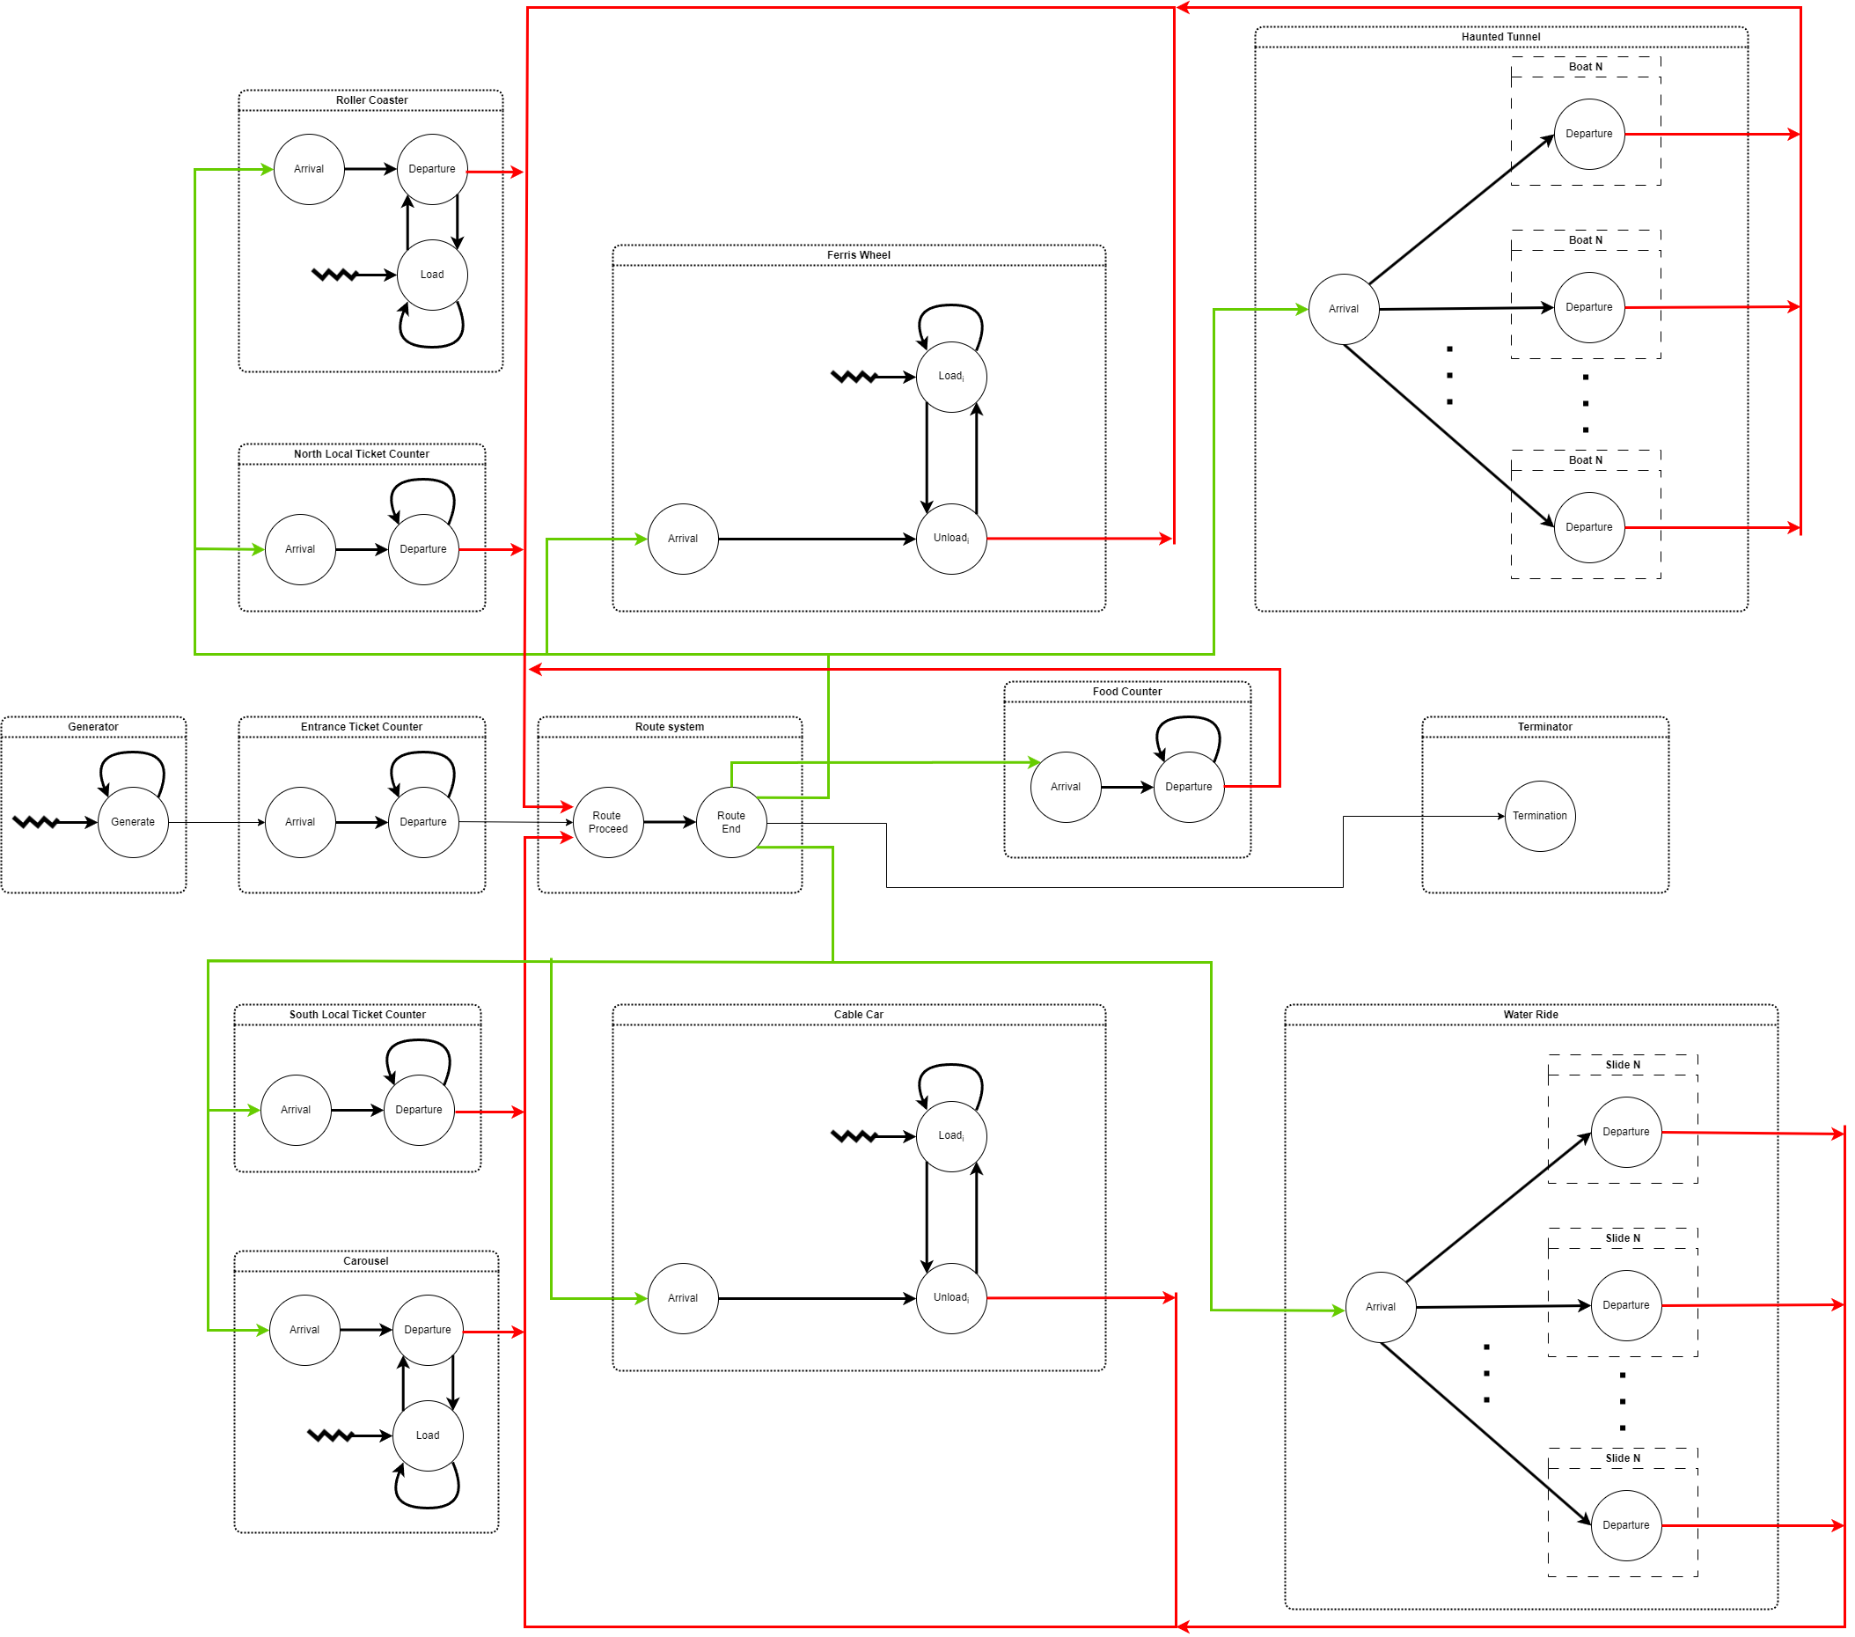
EVENT DIAGRAM

Slide 25
CODE

Slide 26
SIMULATION

Slide 27
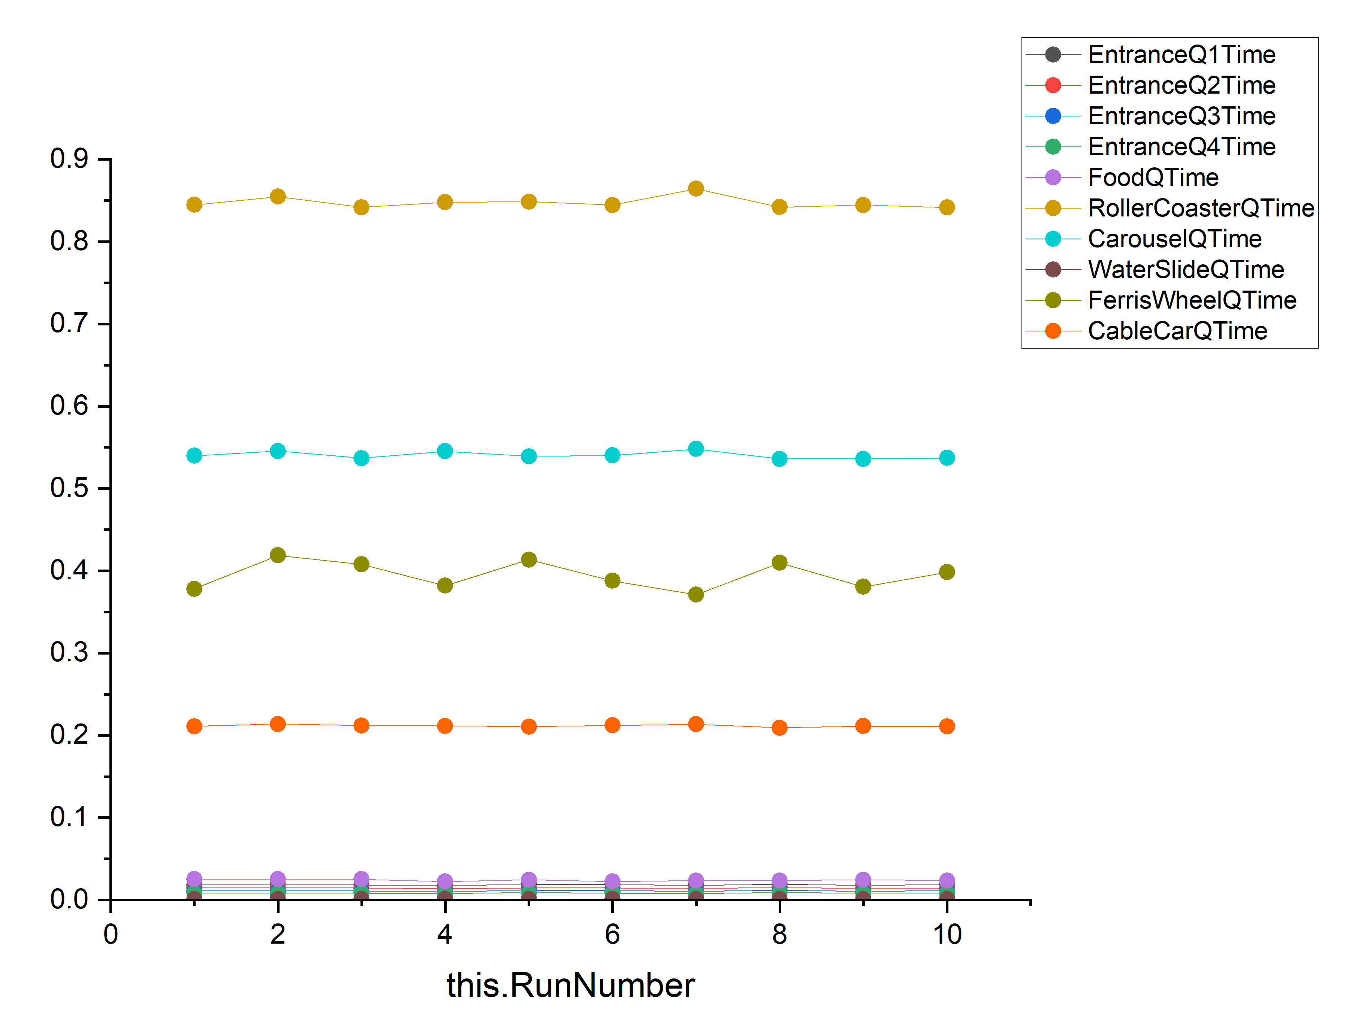
OUTPUT ANALYSIS

Slide 28
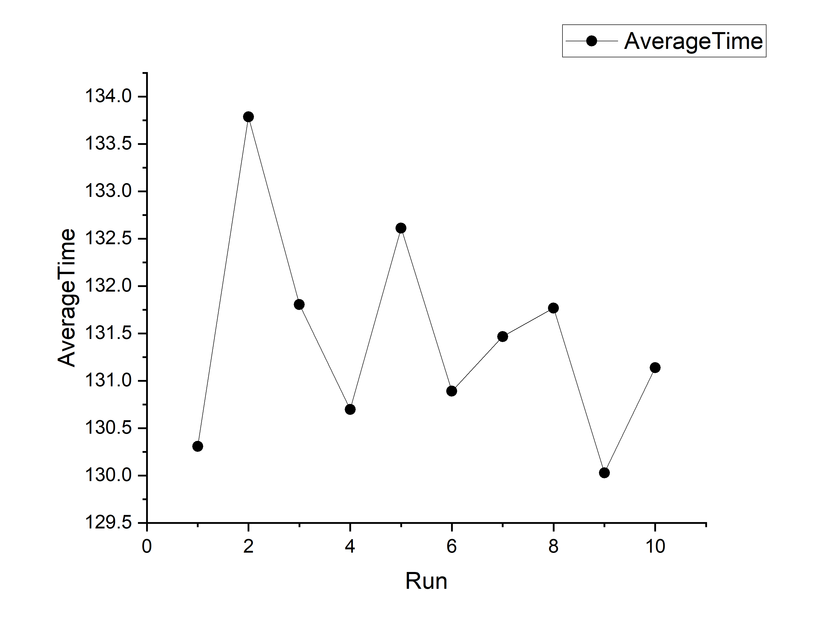
OUTPUT ANALYSIS

Slide 29
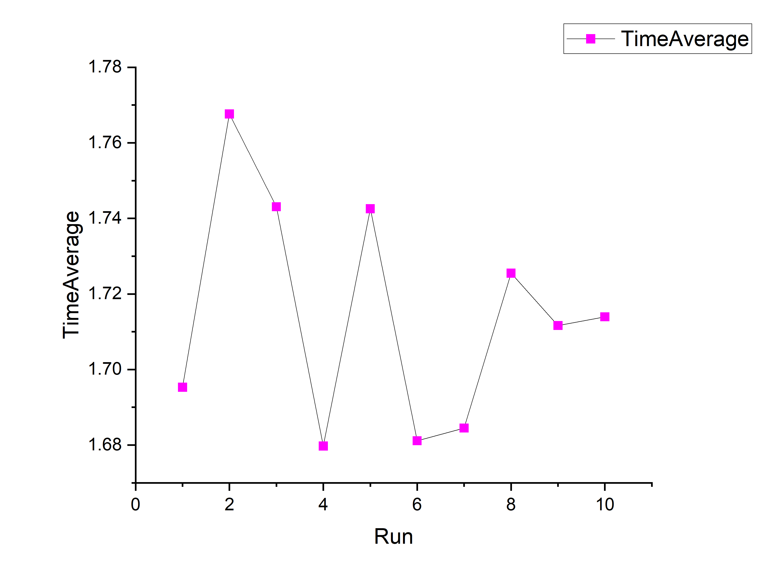
OUTPUT ANALYSIS

Slide 30
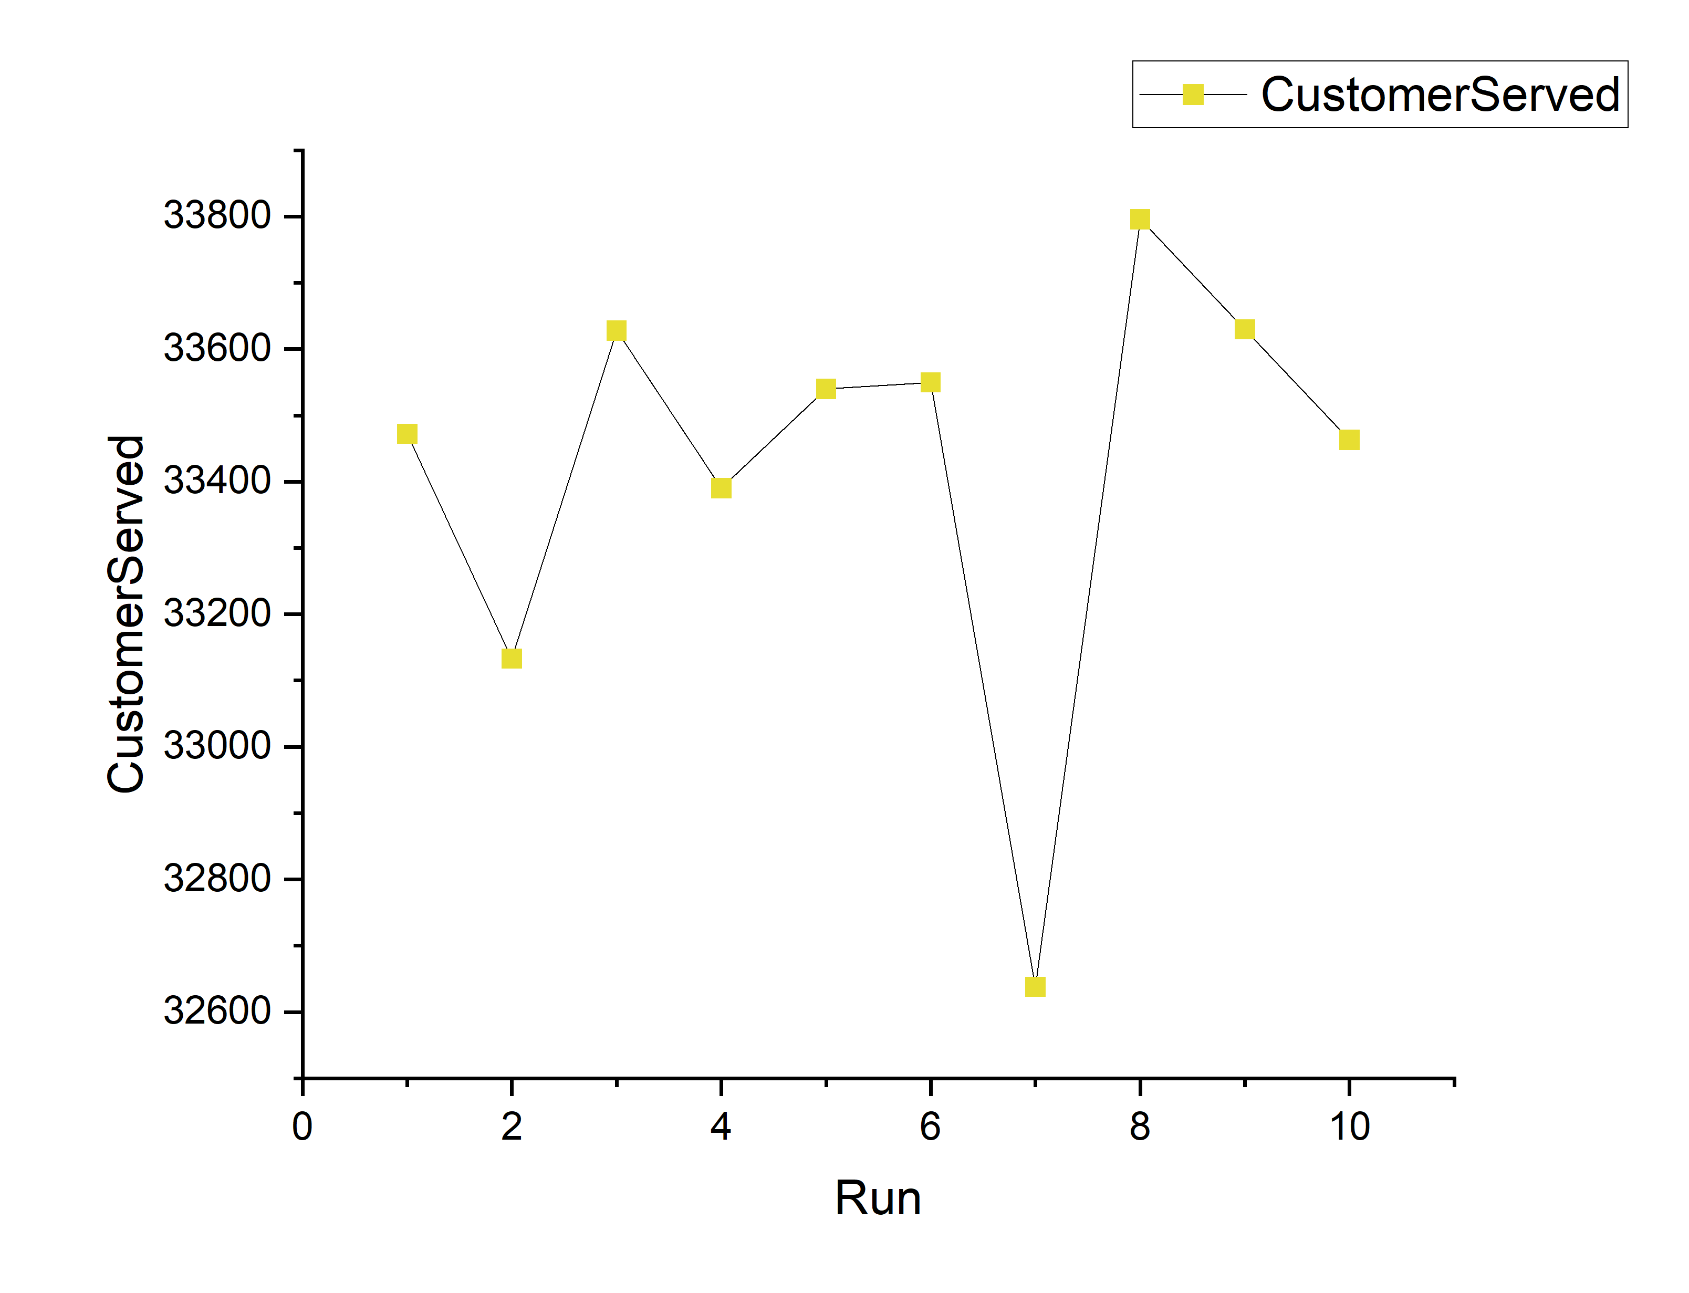
OUTPUT ANALYSIS

Slide 31
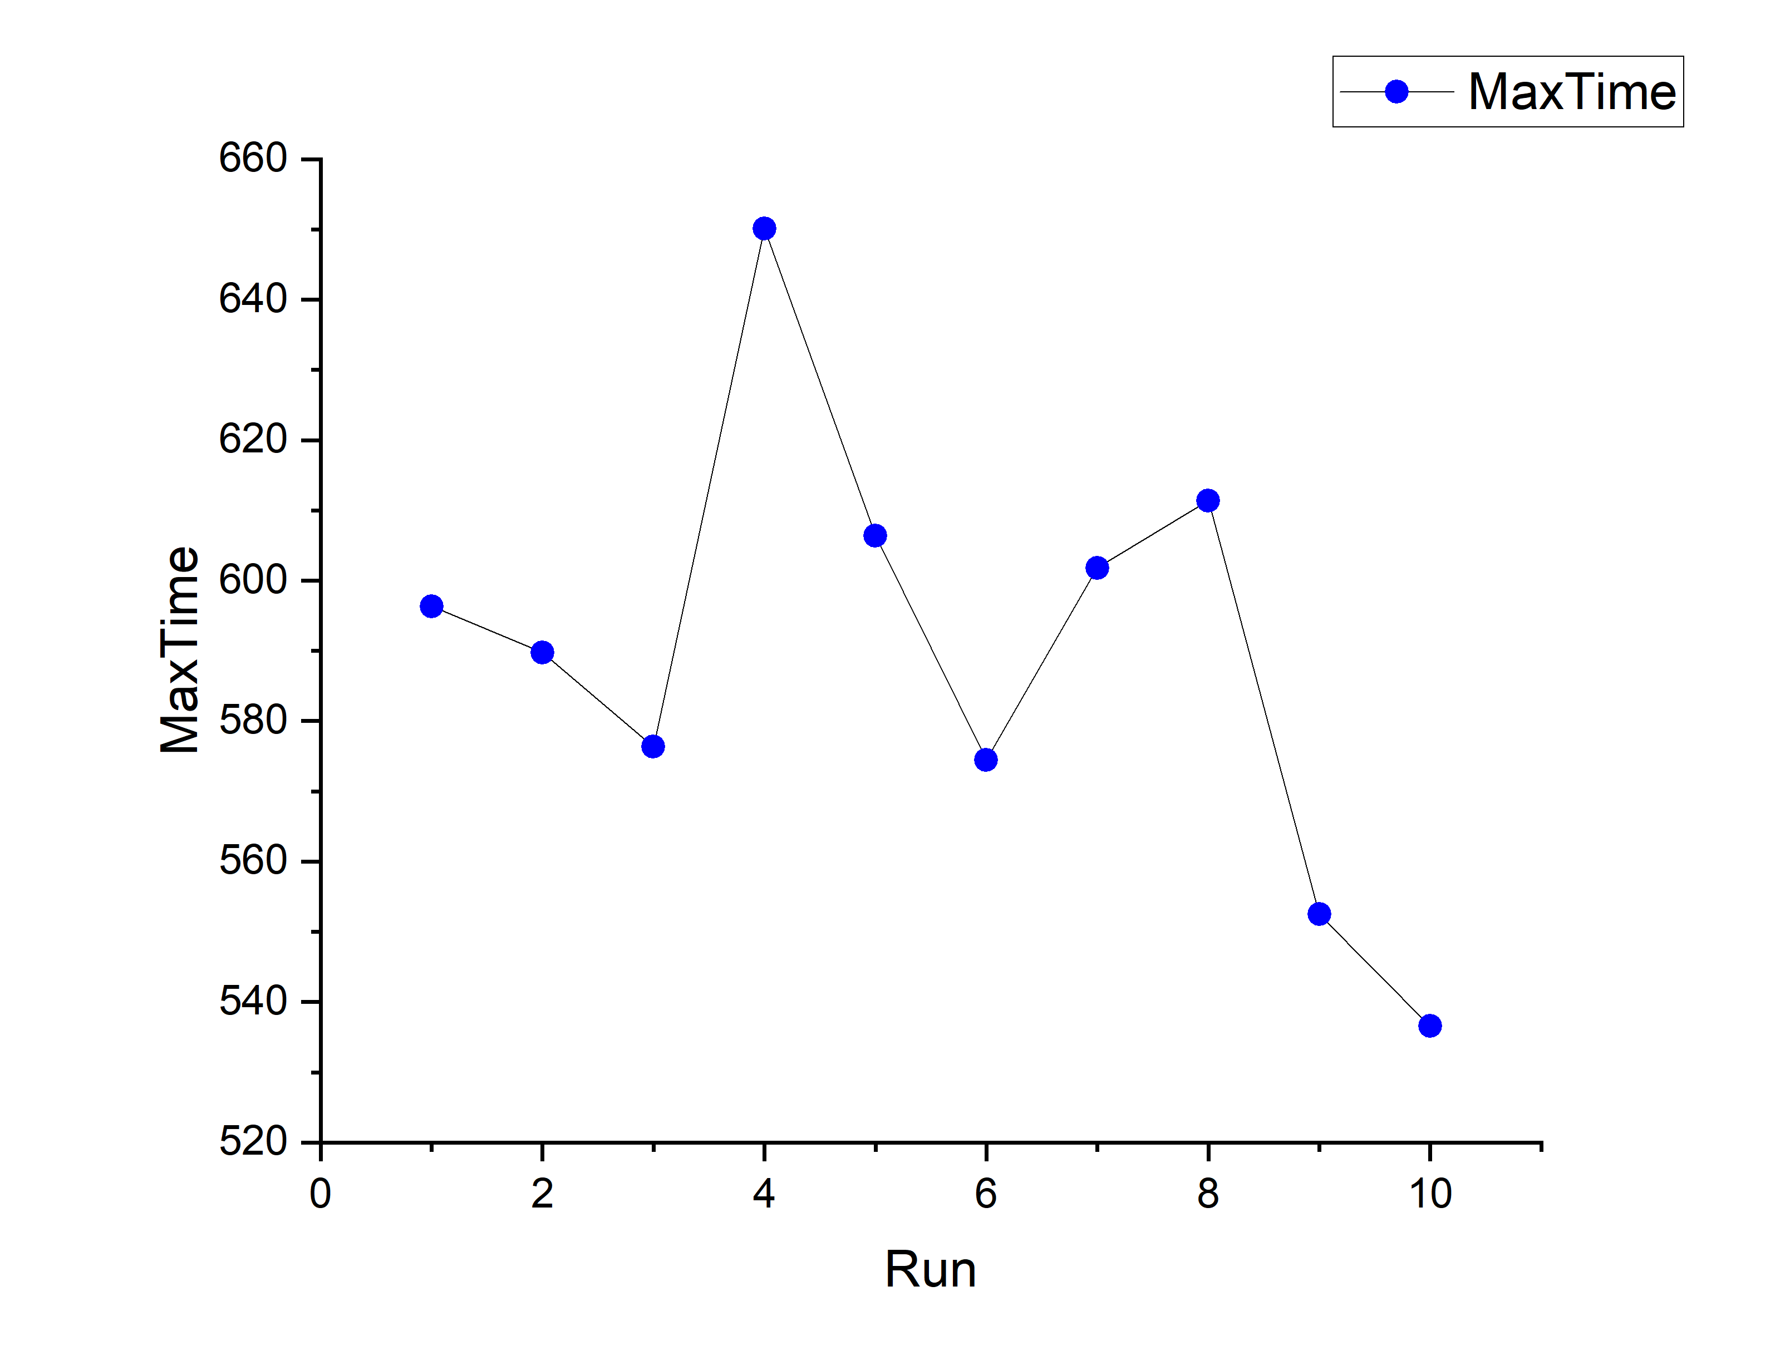
OUTPUT ANALYSIS

Slide 32
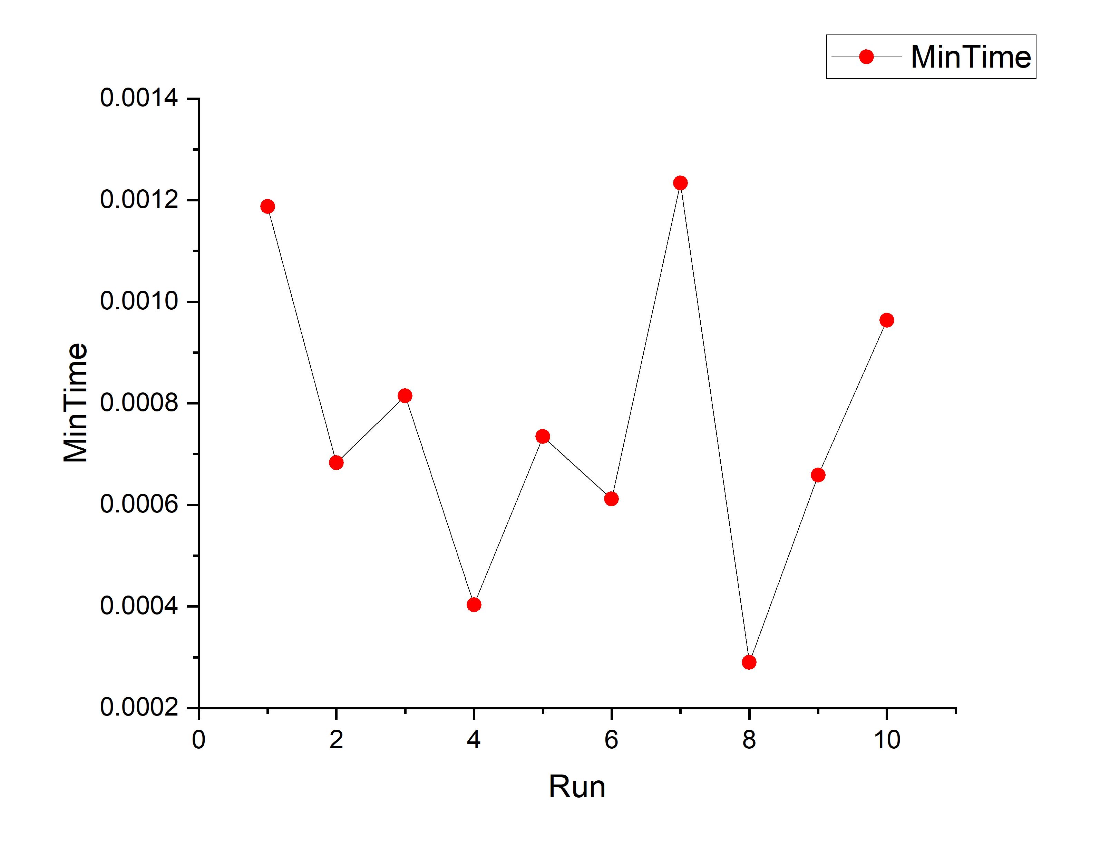
OUTPUT ANALYSIS

Slide 33
THANK YOU !

