Slide 1
Using Google Scholar
A quick guide

Slide 2
Why Google Scholar?
Google Scholar is part of the Google search engine. Unlike the search engine you normally use, Google Scholar only shows scholarly articles from – academic journals, books and theses amongst others.
It helps you find relevant research easily and even allows you to find similar studies that you are interested in.

Slide 3
Searching for information on Google Scholar
For instance, if you want to conduct a “Diet Coke and Mentos” investigation, you can search for it on Google Scholar as seen in the image on the right.
As you can see there are 7,720 scholarly articles on ”Diet Coke and Mentos” investigation.

Slide 4
Searching for information on Google Scholar
The first result from the search turned up an article from the American Journal of Physics. This is a respected academic journal. So now you have a source that you can potentially use to back or dismiss your claims in your own investigation.
You can see the number of times this article has been cited. Highly cited articles are those that scholars hold in high regards. So this is a source that you might want to consider using.

Slide 5
Searching for information on Google Scholar
If you click on ”. It would bring you to the citation pop up.
And this is another feature of Google Scholar that can make life so much easier for you. You can easily copy the citation and paste it into your document.
It is still recommended for you to learn MLA formatting so that you can check if the recommended citation has been done correctly.

Slide 6
Searching for information on Google Scholar
When you click on related articles, Google scholar will return results that are similar to the initial article. Saves you a lot of time.

Slide 7
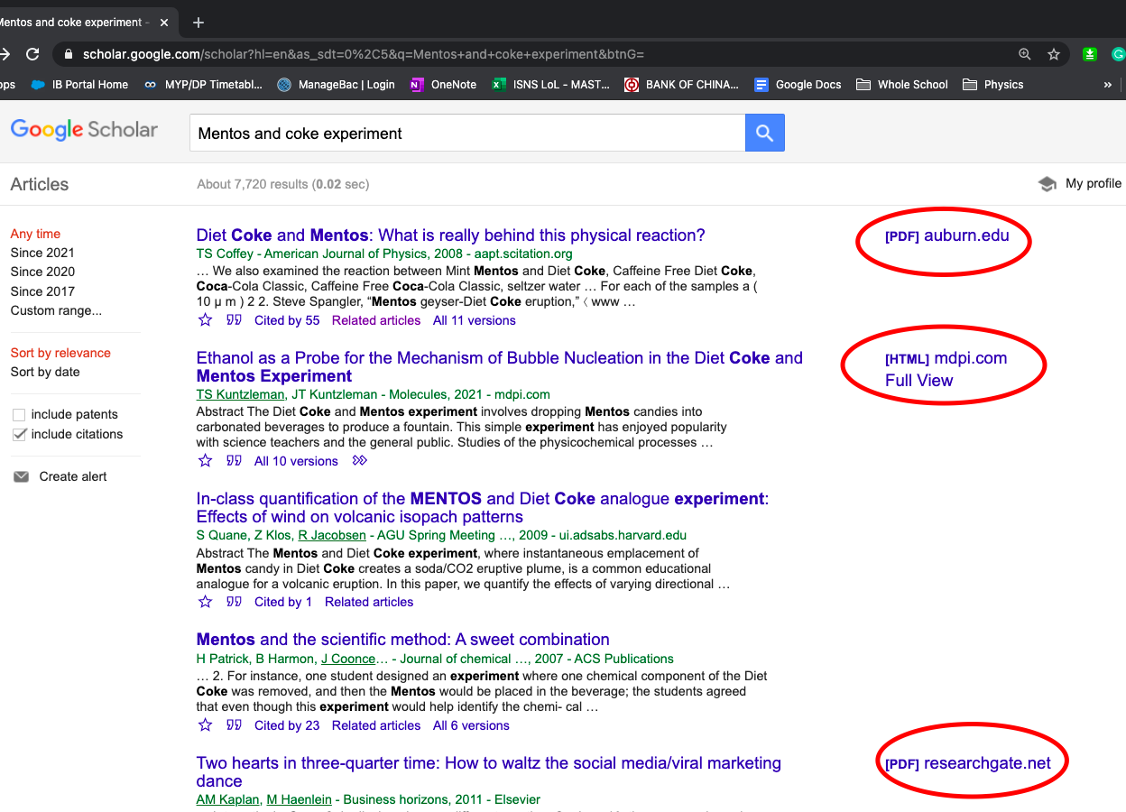
Searching for information on Google Scholar
Unfortunately, we don’t have access to all the articles found on Google Scholar. If you see a hyperlink on the right of an article, that would mean that you can access the article.

Slide 8
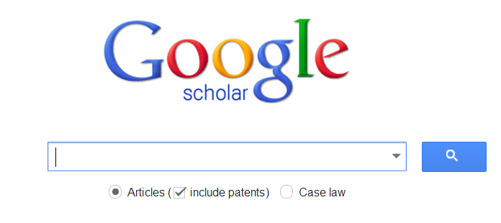
Happy Googling

