Slide 1
Controlling Smart Green House Using Fuzzy Logic Method

Slide 2
introduction
Climate change is happening today has made farmers difficulties for increasing agricultural product
Smart greenhouse allows for plants to grow optimally, because the temperature and humidity can be controlled so that no drastic changes.
Smart greenhouse technology is an alternative solution to control the micro-climatic conditions in the plant. The use of smart greenhouse in the cultivation of plants is one way to provide an environment that is closer to better conditions for plant growth
In this study, the authors use fuzzy logic to make the duration of watering the plants more dynamic in accordance with the input temperature and humidity that can be regulated by watering when the value of high temperatures and low humidity

Slide 3
CONTROL SYSTEM OF SMART GREENHOUSE
plants watering process is performed automatically in accordance with the desired watering schedule. Schedule watering is done at 07.00 in the morning and at 17.00 in the afternoon
Conditioning system for temperature and humidity inside the greenhouse smart refers to climatic factors that affect plant growth

Slide 4
Design Fuzzy Logic System for Smart Greenhouse
Smart greenhouse has a system of spraying plants that use water pumps. An Arduino-Uno controller use as a link between the power source to the water pump.
Fuzzy logic method begins by receiving input from a temperature sensor and humidity sensor then their value will be calculated to produce the output as the duration of watering in ths smart green house.
The first input is a temperature sensor with conditions of low, medium and high. The range values from 0 to 40 express the magnitude of the temperature in the green house.
A second input of humidity with level of membership function low, medium and high, here, it is using the sigmoid function type for representative of membership function.
The duration of the output condition there are short, medium and long conditions.

Slide 5
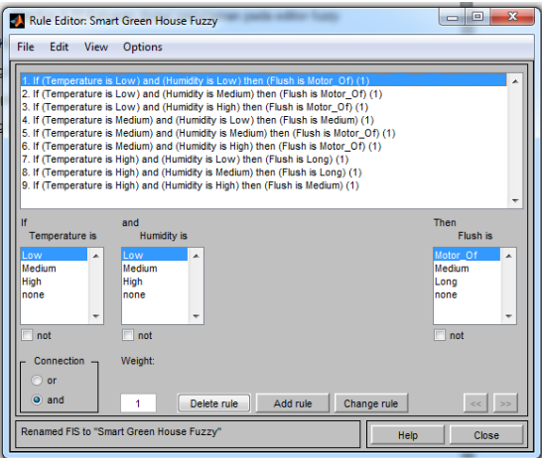
Running The Output
There are 9 rules used in setting the duration of the water pump at this Greenhouse

Slide 6
How the pump works
For and example when the temperature of 340 C and humidity indicate 31%, the output obtained output watering for 90.4 seconds.
The value of this watering output varies depending on the value of the input temperature and humidity in the green house.
The temperature and the humidity data has been obtained used as input variables in this system to get the duration of watering plants as the output variable. The data has been obtained and then inserted into the rule to get the duration of the pump. For the duration of the pump that produced less than 20 seconds otherwise the pump is not running and if the duration of the pump is greater than 20 seconds otherwise the pump running

Slide 7
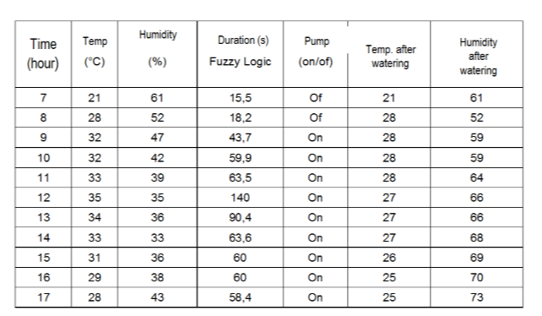
Result of greenhouse system using fuzzy logic

Slide 8
conclusions
Simulation of watering duration was success using Matlab. The result was duration of watering which inputs of temperature and humidity in smart green house.
Watering duration system using fuzzy logic method was effective to keep the temperature on 24 °C – 32 °C dan humidity on 40 % - 80 %.
The fuzzy logic method is available to implement at smart greenhouse, which has two or more inputs and single output.

