Slide 1
Smart Greenhouse
A quick review on some of published papers

Slide 2
A ROADMAP FROM INTERNET OF THINGS TO INTELLIGENT AGRICULTURE
The Technology Roadmap (TRM) concept is a consultative process that is designed to help industry, its supply-chain, academic and research groups, and governments come together to jointly identify and prioritize the technologies needed to support strategic R&D, marketing and investment decisions.

Slide 3
IOT Definition
A global ICT infrastructure linking physical objects and virtual objects (as the informational counterparts of physical objects) through the exploitation of sensor and actuator data capture, processing and transmission capabilities. As such, the IOT is an overlay above the ‘generic’ Internet, offering federated physical-object-related services (including, if relevant, identification, monitoring and control of these objects) to all kinds of applications.

Slide 4
Suitable Infrastructure
5G
Low Power Wireless Sensors
IPV6
Web of Things

Slide 5
Intelligence is Needed!
Web intelligence
“What, where, when, how” “Web services” and can be hosted on “cloud like” infrastructures
Embedded intelligence
“Encoded existing knowledge. “ “Algorithms (data mining) that can analyze data records.“

Slide 6
Design and Implementation a Smart Greenhouse
This paper proposes an efficient automatic irrigation system based on computing various changes necessary in green house using wireless sensor network and using server and client web service for control and monitoring. Our model has two main factors which are reduces the power and controlling and monitoring over long distances ---- Plants found in greenhouse is affected by various factors, such as water in soil, and climatic conditions (temperature, humidity,..etc.). In this work, we've been focused on design and implementation for monitored climate conditions and to control the different devices on output (shutter, solenoid valve, and fan). Various inputs (sensors) and output (motors) are installed and connected to PC via controller circuit (Arduino UNO) determined as data acquisition. A graphical user interface has been designed using MS Visual Basic 2012 to retrieve and display the condition of climate by sensing data.

Slide 7
Introduction
The governor of temperature, air humidity, light intensity, soil moisture, amount of carbon dioxide and wind velocity by specialists influence productivity. These parameters are related to each other --- It is intended to variety of monitoring for automation by using input parameter (temperature, light intensity, soil moisture, and the amount of carbon dioxide) in intended system based on Android devices[2]. Also, the input and output parameters used in greenhouse control were displayed within Android device. Finally, process of the input and output parameters of the system were measured and information was given about the rule base.

Slide 8
Sensors used in Greenhouses
There are five sensors adapted in the proposed design system, soil moisture, humidity, temperature, CO2, and light sensor, each of these sensors has measure changes in environment inside the greenhouse. Since, irrigation always starts when depletion different ratios available of all sensors to operate the devices plugged for different operations.

Slide 9
Inputs
DHT11 (Humidity and Temperature Sensor) : DHT11 sensor is used to measure temperature and humidity values. Data form of DHT11 is 8bit integral RH data + 8bit decimal RH data + 8bit integral T data + 8bit decimal T data + 8bit check sum
LDR : This sensor has located on outside of the greenhouse to receive the “sun” light. The receives flux (light intensity) and feedback loop moves the servo motor into the direction to close or open the shutter.
CO2 Gas Sensor : . The detection range of CO2 sensor is 0-5000ppm. When concentration of CO2 is too high, then the design system will operate circulation fan.
Moisture sensor : The set threshold value of sensing data of moisture soil sensor has been conditioned to switch the solenoid valve on output port. When the soil has get dry (less than 50%), will send a command to output port to operates the solenoid valve to start irrigating the soil.

Slide 10
Outputs
Shutter : The light and temperature inside greenhouse has been controlled by shutter which operated using servo motor. as soon as the value set of light reaches different values will control device to open or close the shutter by moves the servo to the angle based on the value of light intensity.
Fan Control : In the proposal design, if the temperature inside the greenhouse rise above 50 degree, there are two fans will be run. One if the fan operated to exhaust the heated air from inside greenhouse, meanwhile, other fun will operate to let the fresh air get inside the greenhouse.
Solenoid Valve Control : In the proposed design, we've used moisture soil sensor to measure if the soil needs to be irrigated or not, If the soil dries less than (50%), the solenoid valve will be operate to flow the water to soil from a water tank.
System Monitoring Design : In client side (data logger interface) has been designed a Windows application to display data of sensors and transceiver the data to/from web server. The system monitoring designed to monitor different real-time data transmitted via interfaced electronic circuit deigned to get data of various sensors. The system monitoring design in client side has been designed using Microsoft Visual Studio 2012 .NET
Server Database Design : The design of the server in this project used to publish the data of sensors and control commands uploaded by remote system monitoring. Google Docs server has provides several types of documents (word, spreadsheet, and presentation documents). In this project, we've design a spreadsheet to upload and retrieve data from master system monitoring and remote system monitoring.

Slide 11
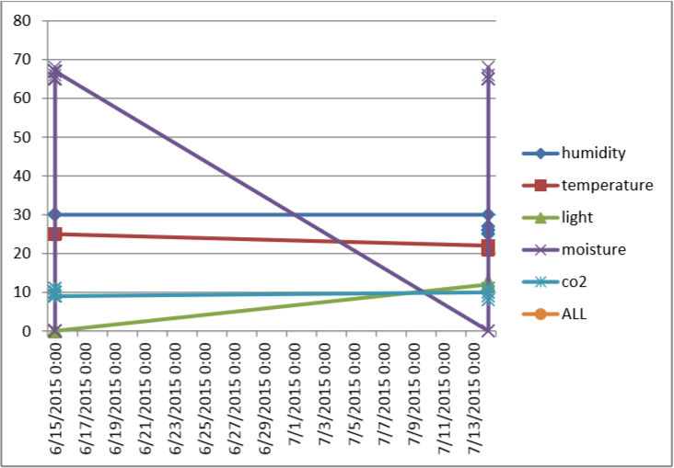
Sample Diagram

Slide 12
The Last Paper!
This paper analyzes the IoT intelligent networking system technical architecture, the network structure of the variation of the potential failure types. Put forward agriculture IoT and automatic control system of combined application of the principle and implementation method. Proposed pump frequency regulator PID control algorithm, analyzes information systems and networking basic framework of automatic control system and on this basis to achieve agricultural Things agricultural park system integrated application and demonstration.
agriculture IoT technology includes not only the digital agriculture sensing technology, including agricultural technology farming practices, important wireless information network transmission, it is to reverse the traditional scientific means to save resources, protect environment, is the main direction of the future development of agriculture.

Slide 13
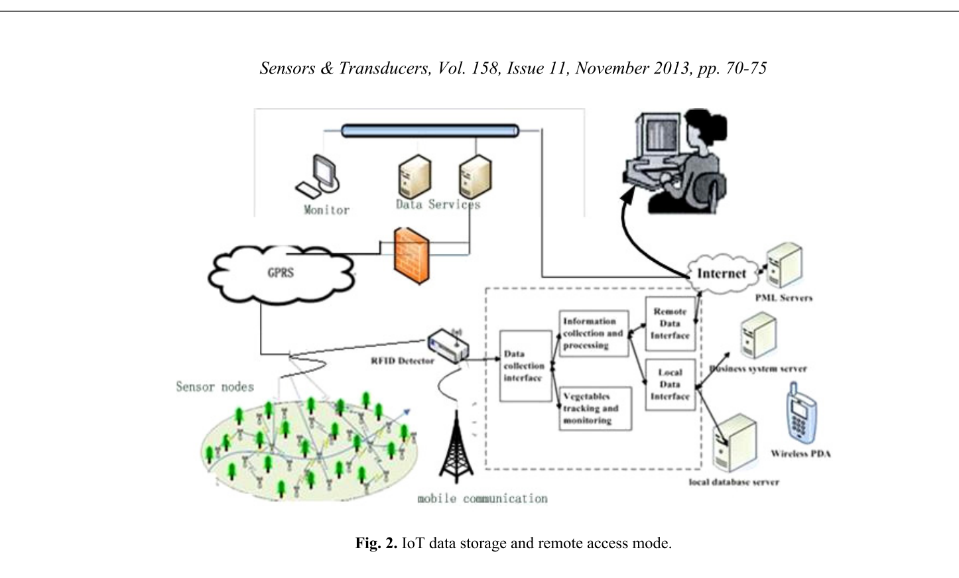
Data Collection System Architecture
Each sensor nodes deployed in the farmland production site are responsible for collecting environmental information, agricultural meteorological soil water content, soil temperature and crop nutrition information, physiological information around itself Get through the network transmission to the rear of the computer, data processing and data storage

Slide 14
IOT Data Storage and Remote Access Model Analysis
On site data collecting need carries on the scene debugging on the system, researchers can live through the PDA query network data content, direct sensor nodes running parameters in the system as well as other debugging,
Remote control site can access via Internet/Intranet and control of sensor nodes, in addition to install and mobile nodes do not need to manage and maintain The IoT information collection interface and network interface.

Slide 15
Agriculture IoT Backend
The agricultural production mainly includes automatic irrigation control, automatic control, automatic spraying fertilizer control and intelligent control of greenhouse environment control. Different control modes of several are from the information to the data processing, and then to the decision system sends commands to control.
Network control system in the back by the PLC programmable controller as the core. the control terminal of PLC has two, namely the control cabinet of the industrial touch operation state can control the whole system, the computer can also control the running state of the system.

Slide 16
PID Control Algorithm
Traditional water pump switch control line pressure often prone to leaving the motor overloading and excessive damage or burst pipe to happen farmland, seriously affecting agricultural safety.
this paper uses PID control algorithm pump for frequency control. Frequency applications in the fields of water supply environment, to improve the pump motor speed control sensitivity, accuracy and stability in the conventional position paper on the basis of type PID formula has been improved.
K is the sampling number, u(k) calculate the output k sampling time counter ; e(k) is the deviation of the k sampling input values; e(k-1) is the k deviation of sampling time input the value;ki = KpT/Tj , K is the deffrential coeficient Kd=KpTd/Tj.

Slide 17
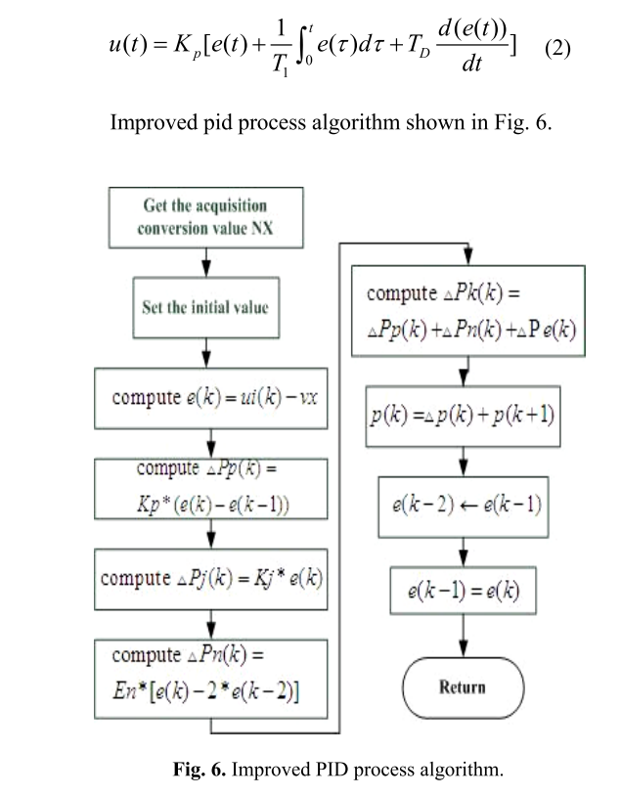
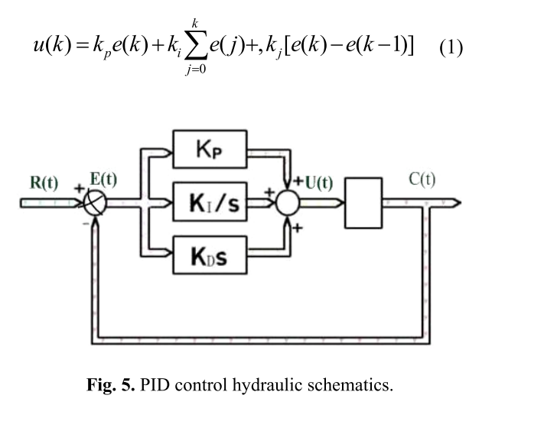
PID Control Algorithm

Slide 18
Automatic Control Mode of Agriculture Irrigation
Automatic irrigation system is a complex control system, which is not the only input variable soil moisture, but also time, temperature, humidity, crop varieties, crop seasons. This article focuses on networking information under automatic irrigation control methods.

Slide 19
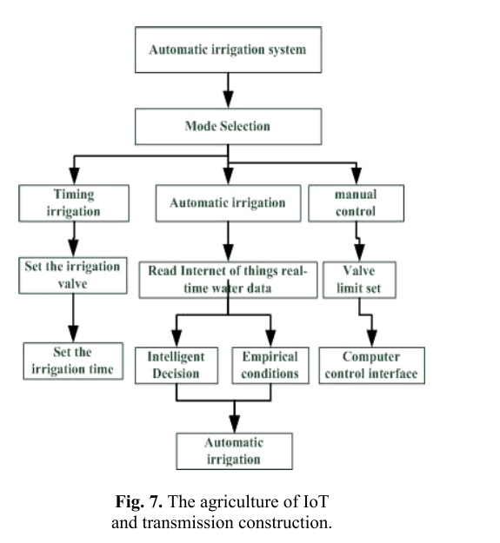
Block Diagram

Slide 20
Applied machine vision of plants – a review with implications for field deployment in automated farming operations
Automated visual assessment of plant condition, specifically foliage wilting, reflectance and growth parameters, using machine vision has potential use as input for real-time variable-rate irrigation and fustigation systems in precision agriculture. This paper reviews the research literature for both outdoor and indoor applications of machine vision of plants, which reveals that different environments necessitate varying levels of complexity in both apparatus and nature of plant measurement which can be achieved. Deployment of systems to the field environment in precision agriculture applications presents the challenge of overcoming image variation caused by the diurnal and seasonal variation of sunlight.

Slide 21
Introduction Outdoor vision systems
The outdoor agricultural environment presents complexities that make such automation challenging. These complexities include variable natural lighting, both intensity and direction, and the occlusion and obscuration of plant features by foliage from neighboring plants and background material.

Slide 22
Introduction Indoor vision systems
Controlled indoor environments (e.g. laboratories and factories) remove many of the variables that complicate outdoor agricultural machine vision systems. Applications of machine vision systems to plants in the greenhouse/laboratory environment include automatic irrigation management, fruit harvesting and flower grading.

Slide 23
Introduction Paper overview
• Monocular vision with an RGB camera; • Stereo vision and 3D structure; • Multispectral imaging; and • Range sensing

Slide 24
Monocular vision with an RGB camera
Single-camera systems can potentially identify small changes to foliage orientation and color in plant canopies. The average petiole angle was extracted from greyscale vine images using line detection techniques and results from images with the light source in different positions were combined in order to reduce occlusion by shadows.
Color distribution in plant leaves to identify paleness, and hence the onset of stress.

Slide 25
Stereo vision and 3D structure
Stereo vision can be used to monitor plant parameters including height, leaf shape and leaf area for young plants and overall canopy dimensions for larger crops. Automated measurement of 3D plant structure has application to crop and plant growth monitoring and species discrimination.
Typically smaller plants with less dense canopies have greater success of detailed automated 3D measurement.
As with monocular imaging, identification of plant structure using stereo vision enjoys greater success for smaller plants. Applications in the outdoor environment typically provide overall canopy geometry which is useful for monitoring crop growth in areas of a paddock or identifying plant height changes, for example between different species (i.e. weed and crop).

Slide 26
Multispectral imaging Species identification
Whilst LEDs provide monochromatic light, halogen lamps provide a continuous spectrum of light from visible to near-infrared wavelengths, thereby making it a suitable illuminator for spectral measurements.

Slide 27
Multispectral imaging Plant material identification
A differential two-waveband infrared vision system was designed and tested that made use of the spectral differences in fruit and leaves at 850 and 970 nm wavelengths to identify cucumbers on a vine (van Henten et al., 2002).
Noordam et al. (2005) presented a comparison of a variety of methods for locating a cutting position on a rose stem, for the purpose of automation in the cut flowers industry. One of the methods evaluated was X-ray imaging and it was demonstrated that thin leaves were completely invisible in X-ray images.

Slide 28
Multispectral imaging Stress detection
Potential multispectral imaging technologies for detecting plant water stress include visible, IR, NIR, UV and microwave radiation.

Slide 29
Discussion
Multispectral imaging provides information about properties of plants that are not visible to humans. The techniques potentially discern stress level or plant materials without requiring complex image analysis algorithms to replicate a human’s visual appraisal of plant appearance. However, the expense of systems such as X-ray, tunable filters and thermal cameras restricts their application on-farm. Low-cost cameras are potentially sensitive to the visible and near infrared regions of the electromagnetic spectrum. Therefore, the addition of narrowband illumination or interference filters to a low-cost vision system has potential to accentuate plant features of interest at discriminatory wavelengths.

Slide 30
Design and implementation of a computer vision-guided greenhouse crop diagnostics system
The system consisted of five main components including (1) a stepper motor-driven camera positioning system, (2) an image acquisition system, (3) a data logger monitoring root and aerial zone of the growing environment, (4) a dynamic SQL database module for data storage, and (5) a host computer running the collection, processing, storage, and analysis functions.

Slide 31
Introduction : Computer vision can be used to extract various information from a targeted object including morphological (size, shape, texture), spectral (color, temperature, moisture), and temporal data (growth rate, development, dynamic change of spectral and morphological states). it is more advantageous to develop a real-time plant canopy health, growth and quality monitoring system with multi-sensor platforms.
1.1 Overall system hardware, layout and signal processing : Figure 1 illustrates the connectivity of the system components and Fig. 2 identifies the flow diagram of the system developed for plant sensing and monitoring.
1.2 Robotic camera positioning system : The robotic camera positioning system consisted of three joined rails. Two parallel beams defined the y-axis coordinate and the third beam crossing perpendicular on top of the two y-axis beams formed the x-axis coordinate allowing the camera platform to be positioned anywhere within this x-y coordinate system, above the crop canopy in the NFT system.
1.3 Image acquisition : The imaging unit consisted of three GigE vision cameras (tri-cameras): (1) color camera with a built-in NIR blocker ,(2) grayscale with NIR 850 nm band pass-filter, and (3) thermal camera.
1.4 Panoramic image stitching : All images with their respective displaced x–y location were applied to a stitching function, which automatically blended the images together forming a single large panoramic image.
1.5 Image analysis and feature extraction :image. Therefore, the only plant (or plant canopy) portion of the image was segmented from the overall panoramic image. The extraction method used was a Hue–Saturation–Luminance (H–S–L) filtering which actively selects the plant’s green color as foreground from the rest of the image as background, which was never green in color.

Slide 32
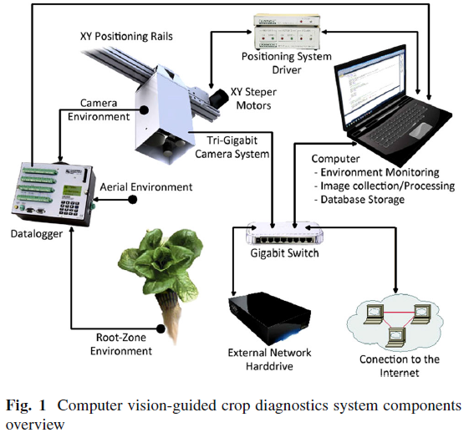
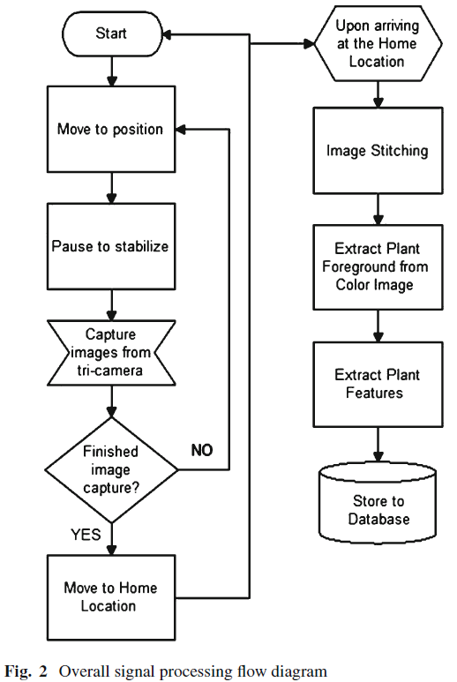
Visual Diagrams

Slide 33
With the image segmented into two regions, the image was again processed to remove small noises. Agray-level co-occurrence matrix was created by
converting the color plant image to grayscale, capturing the spatial dependence of gray-level values contributing to the perception of the plant’s texture.
Analyzing a plant’s temperature or mainly the plant’s temperature regulating mechanism (the stomata cells) through transpiration, one can identify
the plant’s health and specifically responses to water stress. When the stomata cells are open, carbon dioxide enters the plant while oxygen and water
vapor leave the plant. The exiting of the water vapor provides two internal functions: (1) the process cools the plant and (2) the process causes suction,
drawing up more water and nutrients from the root system. When the plant is under stress, the function of the stomata cells reflects this stress and in turn alters the plant’s overall temperature.
2_Camera positioning, image processing and feature extraction :
2.1 Positioning system’s movement : the best movement pattern to execute was a zigzag pattern.
2.2 Image processing and feature extraction : After the camera system acquired the targeted 49 images, the host computer then stitched the images together to generate a large panoramic image. it is necessary to segment the plant image into two regions: the focused plant as the foreground and everything else as the background. Feature normalization or adjustment (i.e., shadow removal) based on the environmental conditions can be used to improve the feature’s quality.
2.3 Crop monitoring application in greenhouse : a final canopy output image which indicated the level of water stress observation and locality with color coding (i.e., red-severe, orange-moderate, and yellow-low level)
3 Conclusion : A machine vision-guided plant sensing and monitoring system was constructed to continuously monitor color, morphological, textural, and spectral (crop indices and temperature) features from a crop canopy. The machine vision system extracted these identified plant features which can be used to determine the overall plant growth and health status.

Slide 34
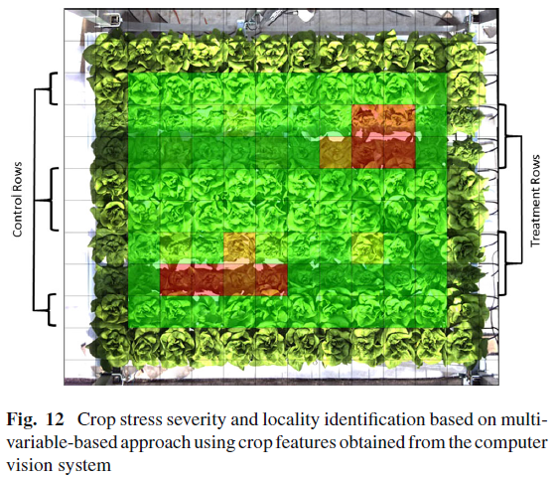
Example

