Slide 1

Rattlesnake Rush Team (play crazy)
Presented by
Raja Abdullah Shafique
Lhakpa Tamang
Amina khan
Destiny otto
Vanesa

Slide 2
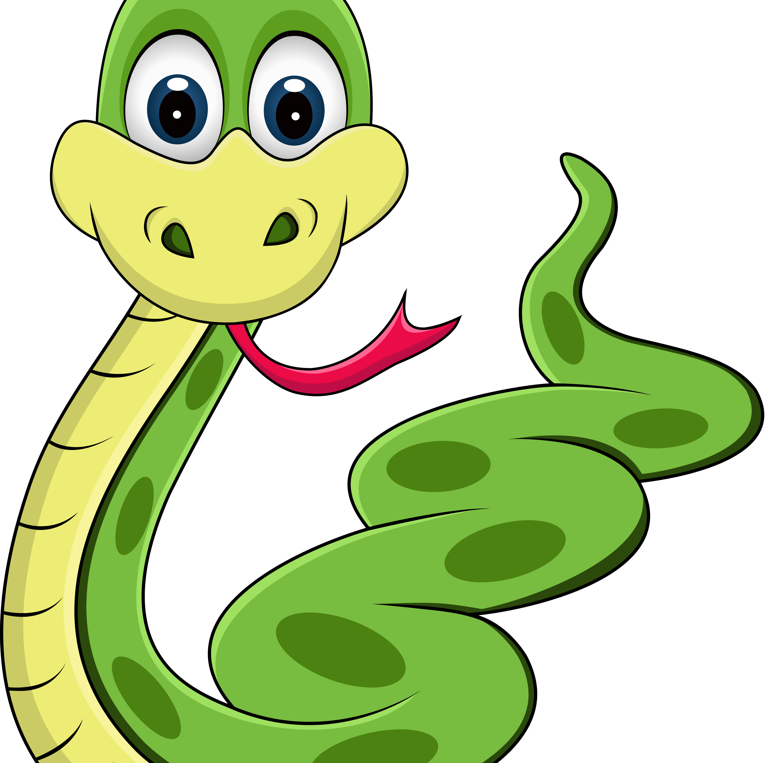
Story line
Slyther is friendly but ferocious Rattlesnake who live in the green forest. Slyther is constantly searching for his next meal since he had insatiable desire for the mouthwatering foods that grew in the forest. still, there remained an issue there are many obstacles in the forest like walls, that got in his path.
.

Slide 3

Game overview
This game is simple, yet addicting game has attracted players of all ages for generations. Our main goal is to lead a snake through a small play area, avoiding collisions with walls and the snake's own tail while feeding it food to grow longer
Rules
Snake moves continuously in the chosen direction by the players
Snake should consume foods to grow its length
Game will continue until the snake hit the wall or itself

Slide 4

Classes
. Game
. Snake
. apple

Slide 5
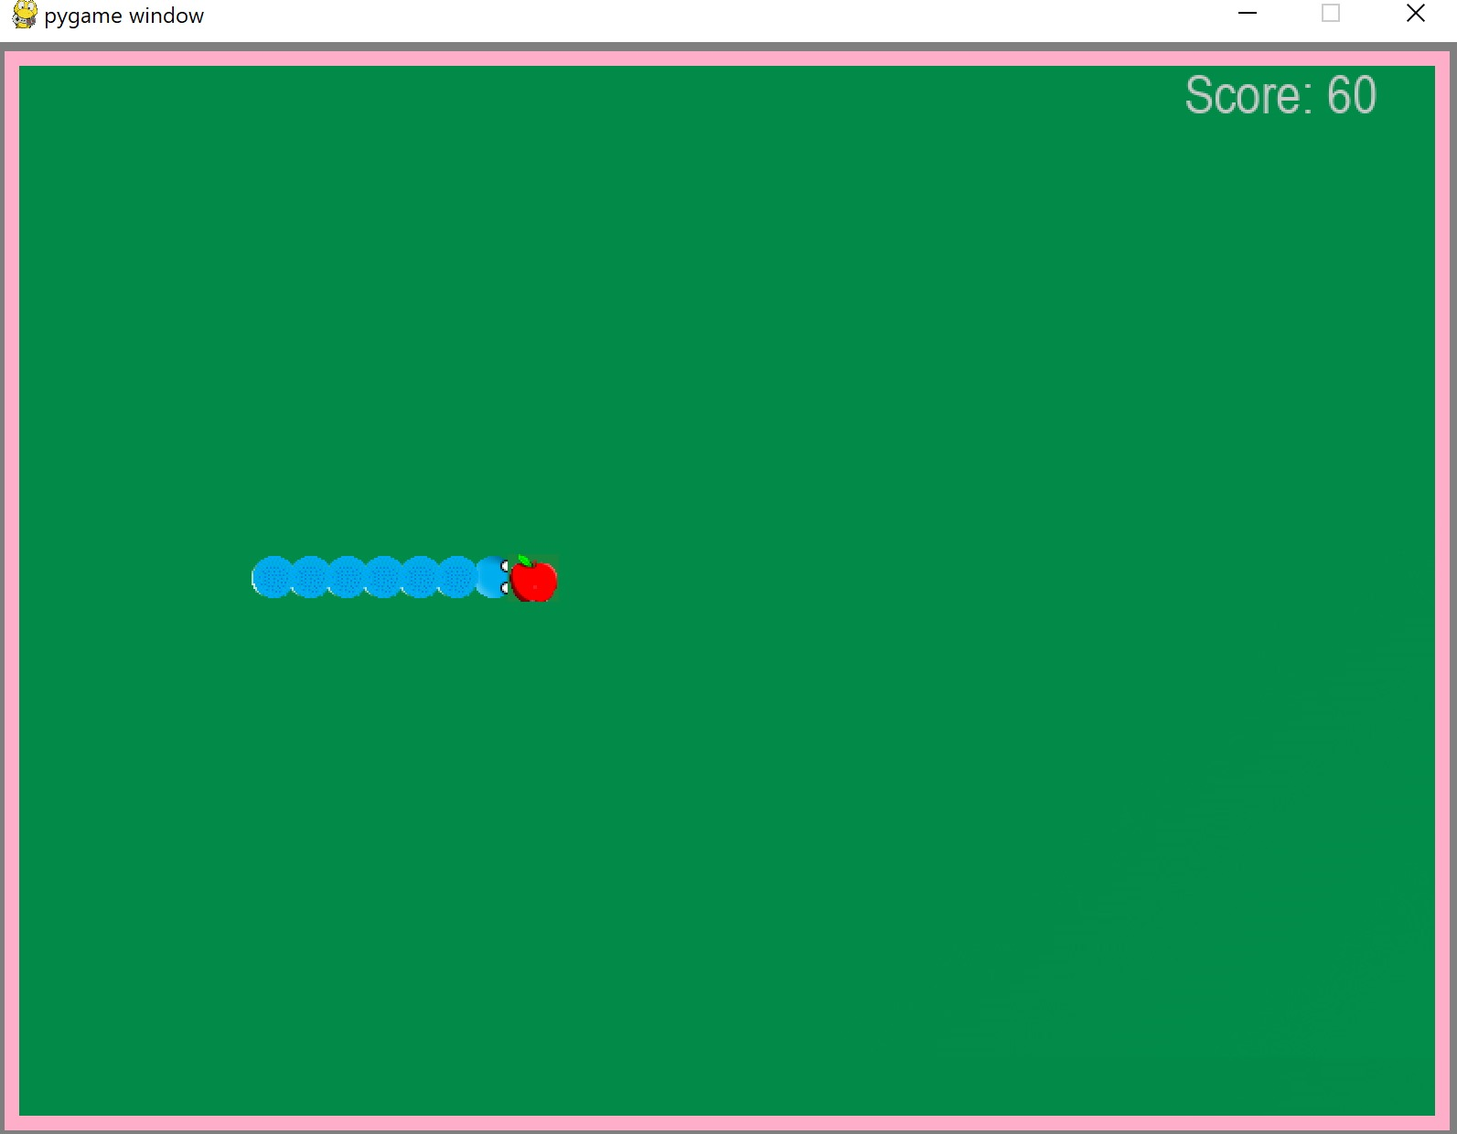
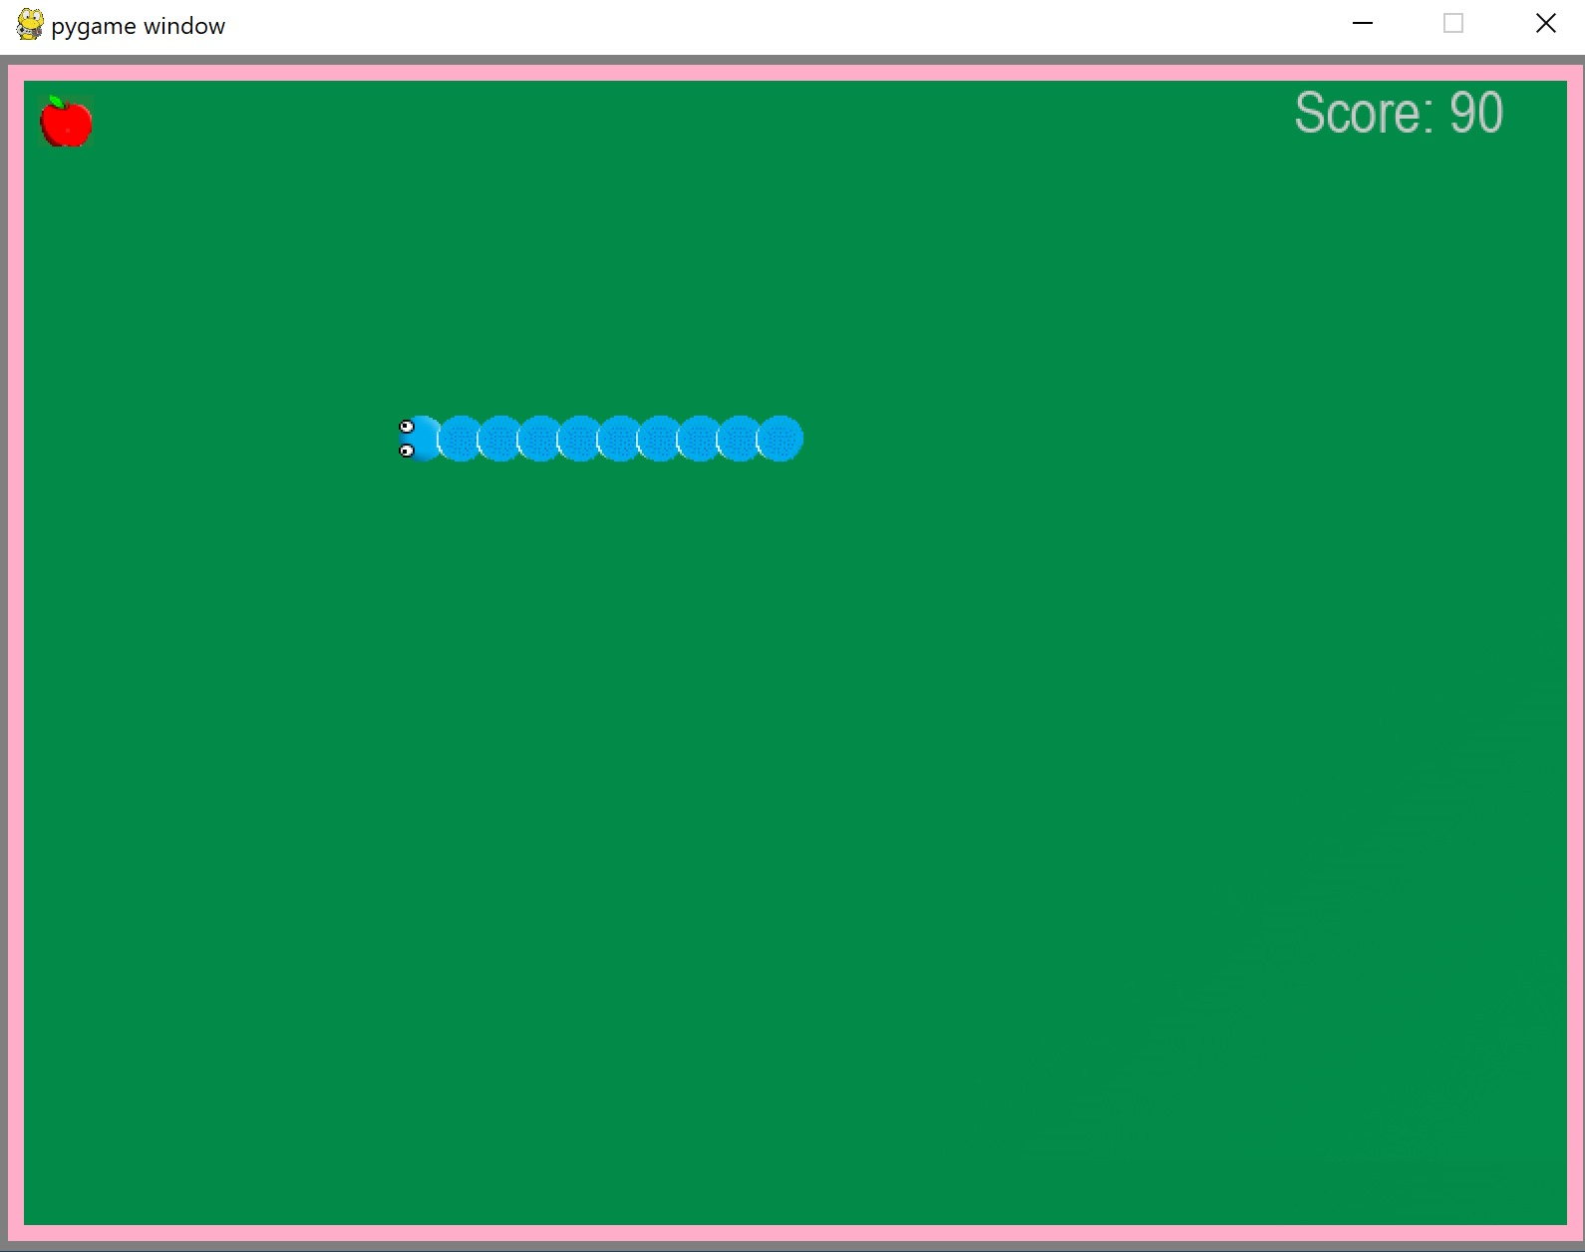
Game play

Slide 6
Development process
game concept objective and features
Game board size ,rules , snake and apple
Implement apple generation
Handel Collison outcome
Manage scoring , game progression and game over conditions
Creating graphics
Sound effect and music

Slide 7
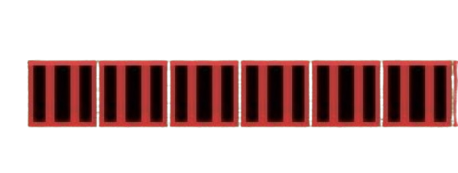


Design
Beginning snake
Final snake

Slide 8

Issues/Errors
Joining snake segment
Sounds effects
Timing when sakes eat apple
Background border
snakes' eyes

Slide 9
Live Demonstration put link to game

