Slide 1

IT 334 – DevOps Engineering on AWS Cloud
Project – Building a Highly Available, Scalable Web Application
Group 3: Amina Merić
Selma Imširović
6 June, 2024
Teacher: Dzenana Dzevlan

Slide 2
Business scenario overview
Objectives
Our project is about the development and deployment of a Highly Available, Scalable Web Application on the AWS Cloud. With the increased need for online services, every business today faces the critical challenges of ensuring their applications are robust, resilient, and capable of handling fluctuating workloads while maintaining high performance. Our goal is to address these challenges by using AWS services and implementing best practices outlined in the AWS Well-Architected Framework.
Problem Statement:
Traditional web applications often struggle to cope with sudden spikes in traffic, leading to downtime, degraded performance, and ultimately, dissatisfied users. Additionally, ensuring the security and reliability of the infrastructure poses significant challenges. Moreover, accurately estimating the costs associated with deploying and maintaining such applications can be complex and prone to errors.
Notes:
You can also go more in depth about the design considerations and trade-offs that you made.

Slide 3
Business scenario overview
Solution Requirements:
High Availability: The web application must remain accessible and operational even if the hardware fails, or the traffic increases. Achieving high availability requires distributing the application across multiple availability zones and implementing load balancing mechanisms.
Scalability: The infrastructure should be able to dynamically scale resources up or down based on demand. This includes utilizing auto-scaling capabilities and deploying resources across multiple instances.
Security: Robust security measures must be implemented to protect data and resources from unauthorized access, breaches, or malicious attacks. This includes setting up secure network configurations, access controls, and encryption mechanisms.
Cost Efficiency: Estimating and optimizing costs is crucial to ensure the project remains within budget constraints. The usage of AWS cost management tools and adopting cost-effective resource provisioning strategies are essential components of our solution.
Notes:
You can also go more in depth about the design considerations and trade-offs that you made.

Slide 4
Solution overview
Our solution entails the development and deployment of a Highly Available, Scalable Web Application on the AWS Cloud. We have meticulously designed an architecture that leverages various AWS services to ensure reliability, performance, and cost-efficiency.
High-level Description:
Resilient Architecture: Our architecture is designed to withstand failures and maintain uptime by distributing resources across multiple availability zones (AZs) and implementing redundant components.
Scalability: The solution is capable of dynamically scaling resources in response to changing demands, ensuring optimal performance during peak usage periods and minimizing costs during idle times.
Security Measures: Robust security measures are implemented to protect data and resources from unauthorized access, including network segmentation, encryption, and access controls.
Notes:
Explain at a high level what you have built.
For example: “I built a web application for a company to host their blog.“
Talk about why you chose certain parts of the solutions and any tradeoffs that you made. Focus on how you designed the solutions and how you applied the AWS Well-Architected Framework as part of the process (AWS Well-Architected Framework: https://docs.aws.amazon.com/wellarchitected/latest/framework/welcome.html).
For example: “I configured load balancers and auto scaling to make the application highly available and reliable.”
Include the use cases that you are addressing. Think about who your users are and how they would want to interact with your solution to solve their problem.
For example: “Users can view, upload, edit, and delete blog posts. Administrators can approve blog posts.”
Talk about the use cases that you addressed as part of the minimum viable product (MVP) that you scoped and built.
Note:
An above-bar description is concise and includes the most important benefits. For example: “The solution allows customers to quickly upload, store, and search large catalogs of images and videos in Amazon S3.”
A below-bar description is too detailed or not specific. For example: “Our solution analyzes media files.”

Slide 5
Solution overview
Design Considerations:
Multi-AZ Deployment: Deploying resources across multiple AZs ensures high availability and fault tolerance, minimizing downtime due to hardware failures or maintenance activities.
Auto-scaling: Utilizing auto-scaling groups allows the infrastructure to automatically adjust resource capacity based on workload fluctuations, optimizing performance and cost-efficiency.
Data Encryption: Data at rest and in transit is encrypted using industry-standard encryption algorithms to protect sensitive information from unauthorized access.
Cost Optimization: Employing cost-effective resource provisioning strategies and utilizing AWS cost management tools help optimize costs and ensure the project remains within budget constraints.
Notes:
Explain at a high level what you have built.
For example: “I built a web application for a company to host their blog.“
Talk about why you chose certain parts of the solutions and any tradeoffs that you made. Focus on how you designed the solutions and how you applied the AWS Well-Architected Framework as part of the process (AWS Well-Architected Framework: https://docs.aws.amazon.com/wellarchitected/latest/framework/welcome.html).
For example: “I configured load balancers and auto scaling to make the application highly available and reliable.”
Include the use cases that you are addressing. Think about who your users are and how they would want to interact with your solution to solve their problem.
For example: “Users can view, upload, edit, and delete blog posts. Administrators can approve blog posts.”
Talk about the use cases that you addressed as part of the minimum viable product (MVP) that you scoped and built.
Note:
An above-bar description is concise and includes the most important benefits. For example: “The solution allows customers to quickly upload, store, and search large catalogs of images and videos in Amazon S3.”
A below-bar description is too detailed or not specific. For example: “Our solution analyzes media files.”

Slide 6
Solution overview
Use Cases:
E-commerce Platform: The solution is suitable for e-commerce platforms experiencing varying levels of traffic throughout the day. It ensures consistent availability and performance, even during peak shopping seasons.
Media Streaming Service: Media streaming services can benefit from the scalability of our solution, allowing them to handle surges in viewership during popular events without compromising on user experience.
SaaS Applications: Software as a Service (SaaS) providers can utilize our architecture to deliver their applications reliably and securely to customers, with the ability to scale resources as their user base grows.
.
Notes:
Explain at a high level what you have built.
For example: “I built a web application for a company to host their blog.“
Talk about why you chose certain parts of the solutions and any tradeoffs that you made. Focus on how you designed the solutions and how you applied the AWS Well-Architected Framework as part of the process (AWS Well-Architected Framework: https://docs.aws.amazon.com/wellarchitected/latest/framework/welcome.html).
For example: “I configured load balancers and auto scaling to make the application highly available and reliable.”
Include the use cases that you are addressing. Think about who your users are and how they would want to interact with your solution to solve their problem.
For example: “Users can view, upload, edit, and delete blog posts. Administrators can approve blog posts.”
Talk about the use cases that you addressed as part of the minimum viable product (MVP) that you scoped and built.
Note:
An above-bar description is concise and includes the most important benefits. For example: “The solution allows customers to quickly upload, store, and search large catalogs of images and videos in Amazon S3.”
A below-bar description is too detailed or not specific. For example: “Our solution analyzes media files.”

Slide 7
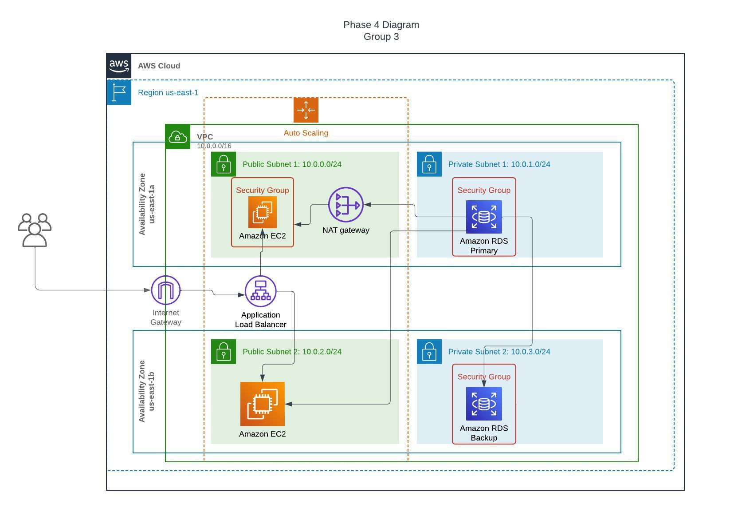
Architecture diagram of the solution : EXAMPLE
Notes:
Note: Remove this slide from your final presentation.
This example architecture diagram shows a solution to configure a webhook to link Git with AWS. You can find this example in the Toolkits for PowerPoint at https://aws.amazon.com/architecture/icons.

Slide 8
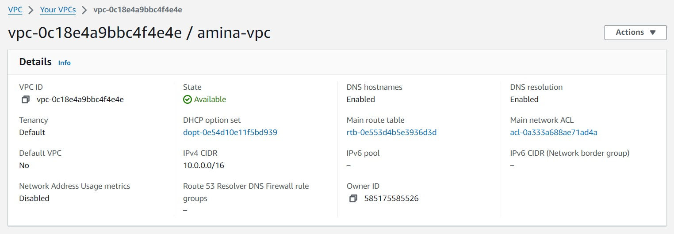
Demo
VPC
Notes:
For the demo, guide the audience through the two to three most important benefits of the solution and how it addresses the requirements.
Your demo materials can be screen captures, recordings, or to show AWS console.

Slide 9
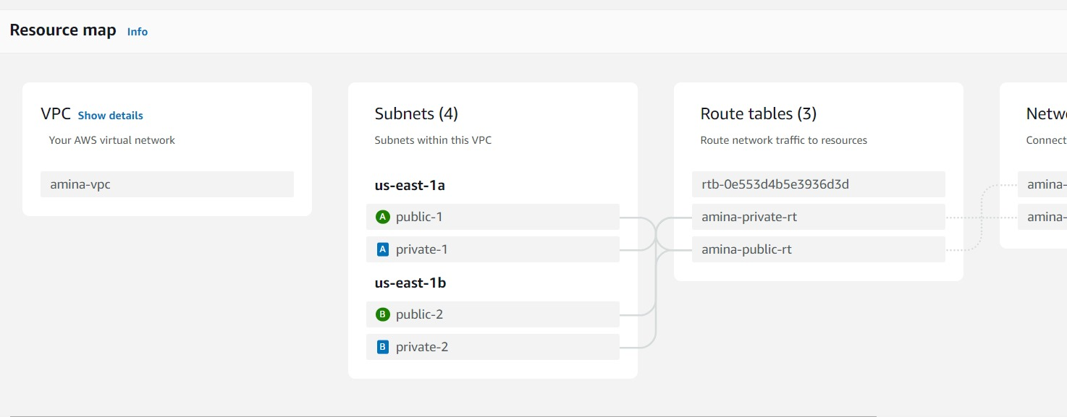
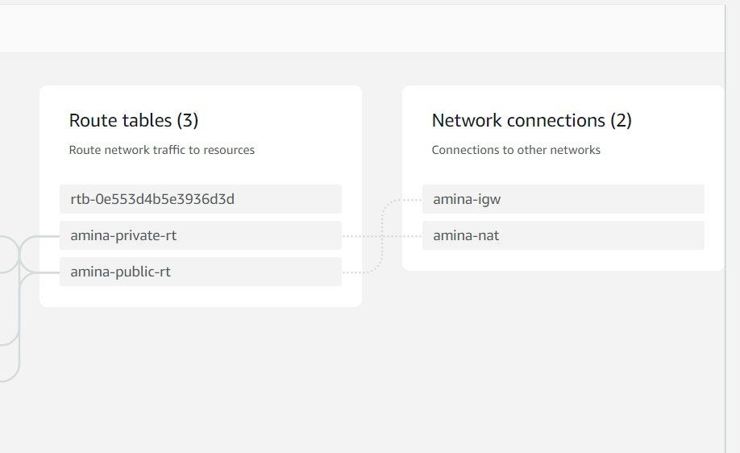
Demo
Notes:
For the demo, guide the audience through the two to three most important benefits of the solution and how it addresses the requirements.
Your demo materials can be screen captures, recordings, or to show AWS console.

Slide 10
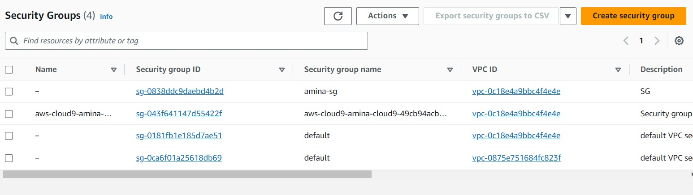
Demo
Security Groups
Notes:
For the demo, guide the audience through the two to three most important benefits of the solution and how it addresses the requirements.
Your demo materials can be screen captures, recordings, or to show AWS console.

Slide 11
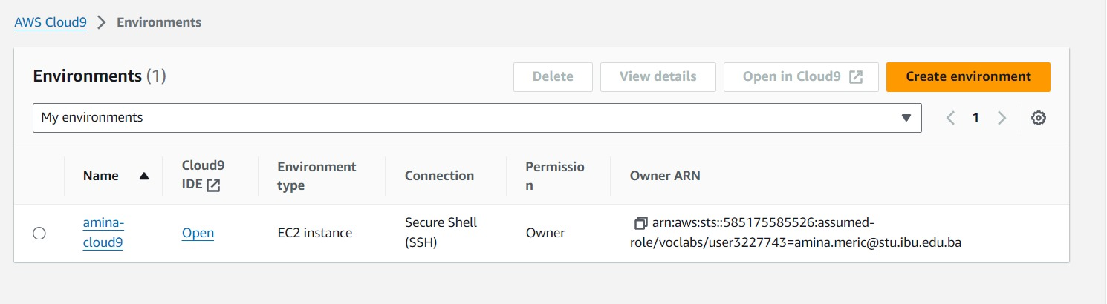
Demo
Cloud9
Notes:
For the demo, guide the audience through the two to three most important benefits of the solution and how it addresses the requirements.
Your demo materials can be screen captures, recordings, or to show AWS console.

Slide 12
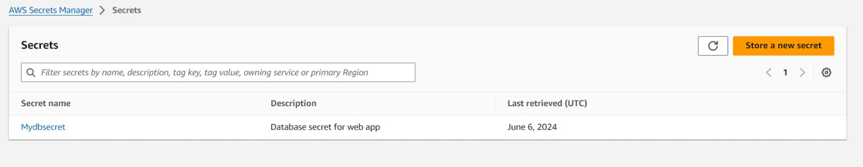
Demo
Secret Manager
Notes:
For the demo, guide the audience through the two to three most important benefits of the solution and how it addresses the requirements.
Your demo materials can be screen captures, recordings, or to show AWS console.

Slide 13
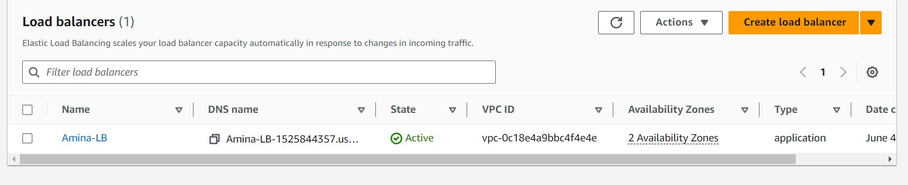
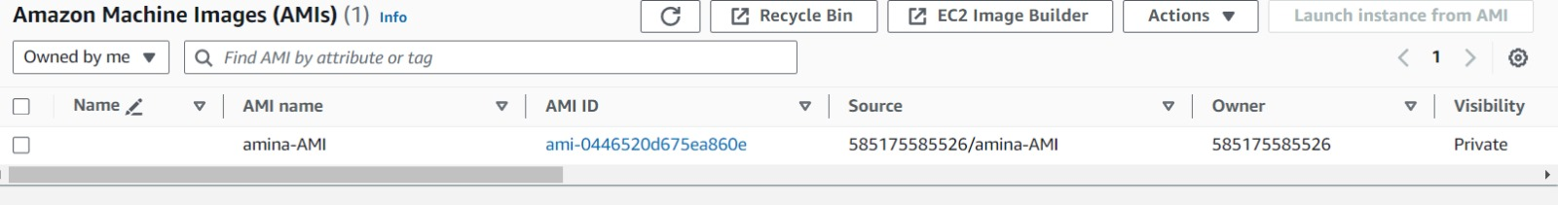
Demo
Load Balancer
AMI
Notes:
For the demo, guide the audience through the two to three most important benefits of the solution and how it addresses the requirements.
Your demo materials can be screen captures, recordings, or to show AWS console.

Slide 14
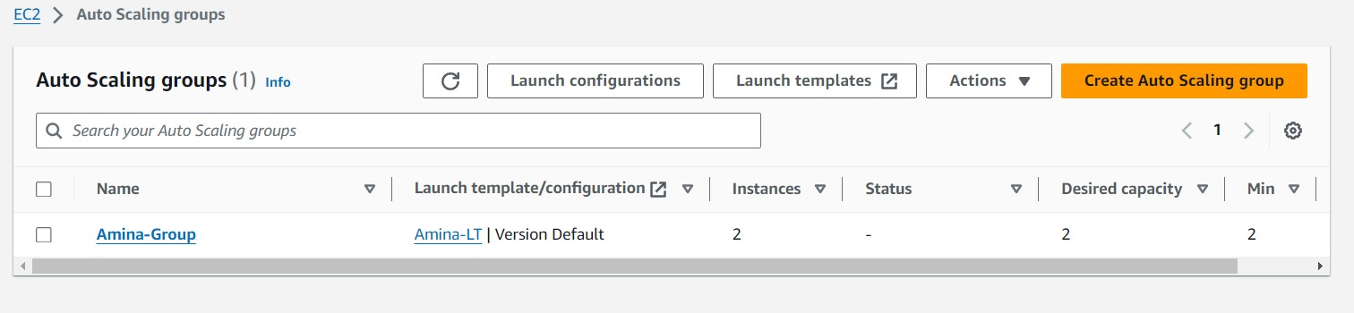
Demo
Auto Scaling Group
Notes:
For the demo, guide the audience through the two to three most important benefits of the solution and how it addresses the requirements.
Your demo materials can be screen captures, recordings, or to show AWS console.

Slide 15
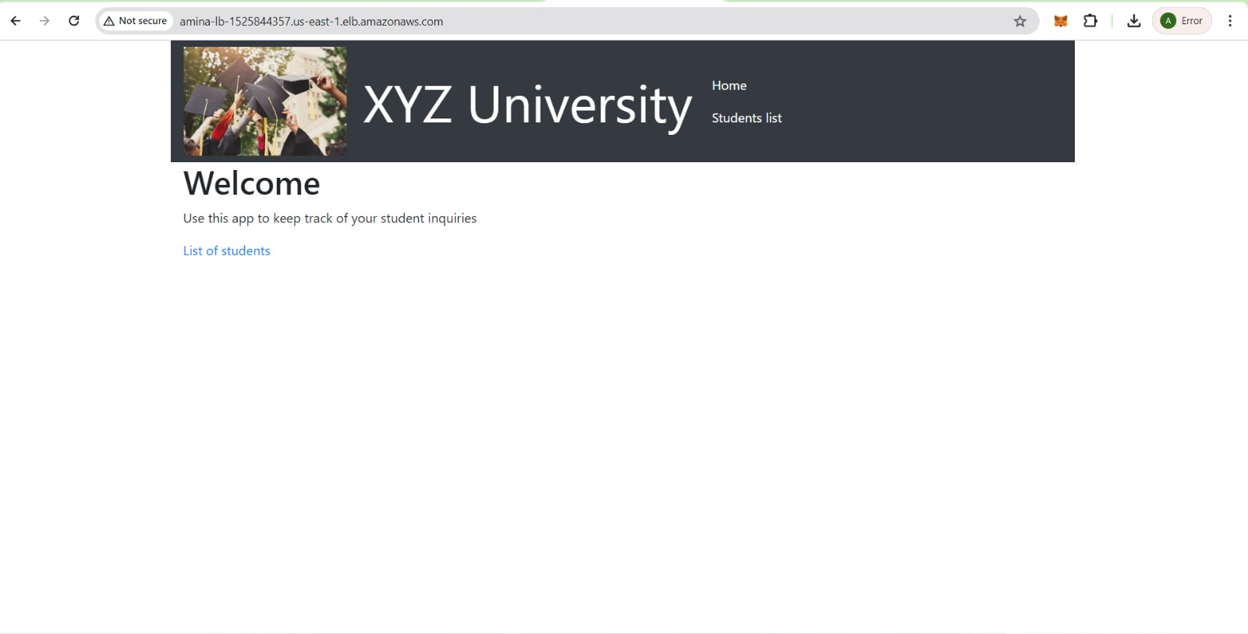
Demo
End Result of Web Application
Notes:
For the demo, guide the audience through the two to three most important benefits of the solution and how it addresses the requirements.
Your demo materials can be screen captures, recordings, or to show AWS console.

Slide 16
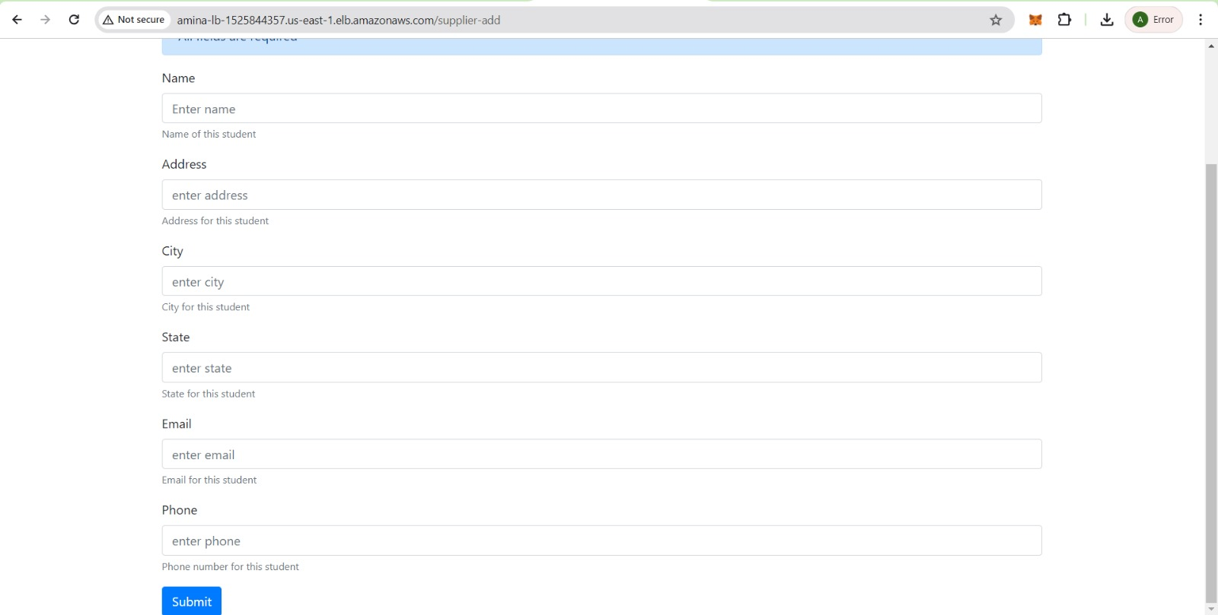
Demo
End Result of Web Application
Notes:
For the demo, guide the audience through the two to three most important benefits of the solution and how it addresses the requirements.
Your demo materials can be screen captures, recordings, or to show AWS console.

Slide 17
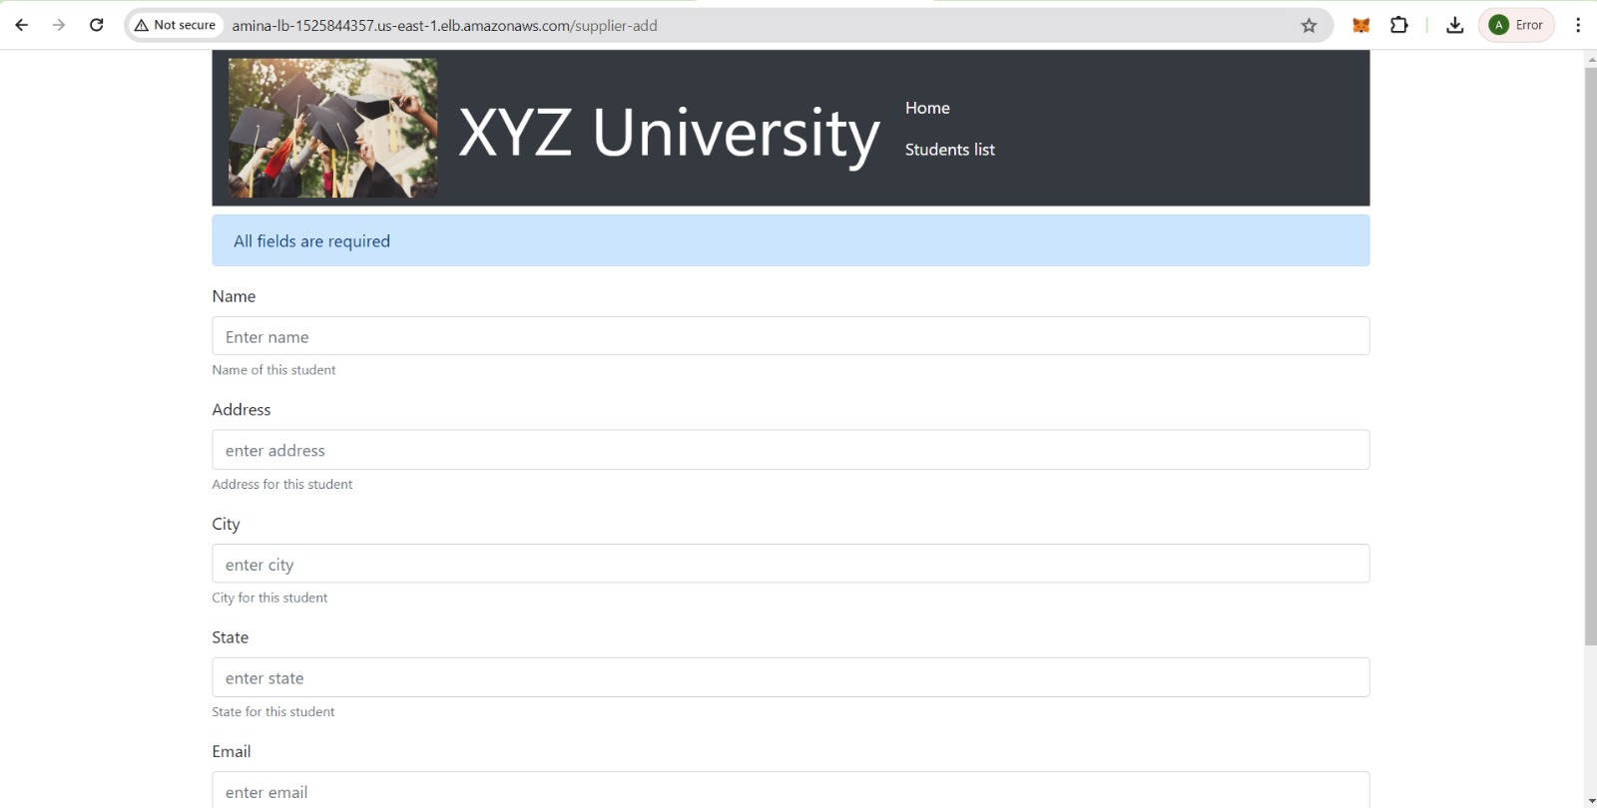
Demo
End Result of Web Application
Notes:
For the demo, guide the audience through the two to three most important benefits of the solution and how it addresses the requirements.
Your demo materials can be screen captures, recordings, or to show AWS console.

Slide 18
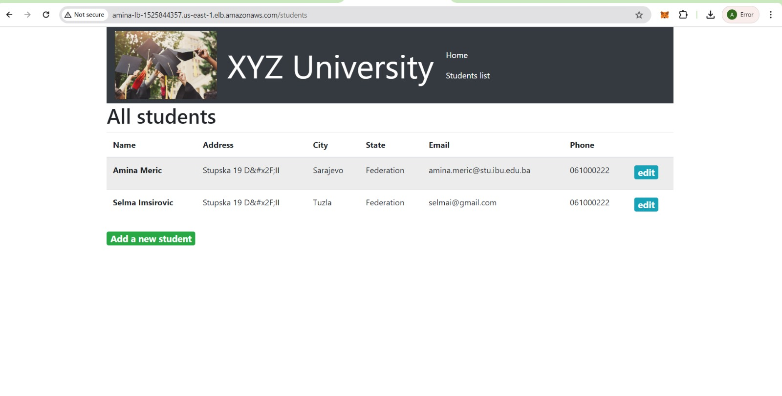
Demo
End Result of Web Application
Notes:
For the demo, guide the audience through the two to three most important benefits of the solution and how it addresses the requirements.
Your demo materials can be screen captures, recordings, or to show AWS console.

Slide 19
Lessons learned
Challenges that we overcame
Setting up a VPC with multiple subnets, an internet gateway, and a NAT Gateway correctly was a challenge for us as we encountered difficulty configuring the NAT Gateway to properly handle outbound traffic from private subnets while maintaining security and proper routing.
To overcome these challenges we referred to AWS documentation: AWS Academy Cloud Architecting – Lab: Creating a Virtual Private Cloud. We reviewed route tabels and security groups. We ensured that the route table associated with your private subnets has a route pointing to the NAT Gateway
Database connection - The database migration was difficult, and we encountered many difficulties, specifically with connecting the web application to the RDS database instance.
We believe it occurred because of Network misconfigurations, such as incorrect security group settings and subnet configurations that blocked database connections. But we went back and review setting up the connection and overcomed the difficulties.
Notes:
Describe any challenges that you encountered and how you overcame those challenges.
For example: “I got stuck when I was creating an EC2 instance to host the application. I used the resources that were listed in the instructions to walk myself through the process to create a new EC2, and I was able to complete the task. The links to labs in other courses were very helpful.”
Describe any new skills that you learned from this project.
For example: “I learned how to set up auto scaling correctly so my resources were automatically adjusted and allocated at the lowest possible cost.”
Discuss any future, out-of-scope use cases in the next steps.
For example: “I would like to scale out the web application so that multiple departments can use it.”

Slide 20
Lessons learned
Helpful Resources
AWS Academy Lab Project - Cloud Web Application Builder [81170]
AWS Pricing Calculator
AWS Academy Cloud Architecting – Lab: Creating a Virtual Private Cloud
AWS Academy Cloud Architecting – Lab: Migrating a Database to Amazon RDS
AWS Academy Cloud Architecting – Lab: Creating a Highly Available Environment (Load Balancer)
Creating Cloud9 Environment
Code Snipets (Scripts) given my the Lab
Notes:
Describe any challenges that you encountered and how you overcame those challenges.
For example: “I got stuck when I was creating an EC2 instance to host the application. I used the resources that were listed in the instructions to walk myself through the process to create a new EC2, and I was able to complete the task. The links to labs in other courses were very helpful.”
Describe any new skills that you learned from this project.
For example: “I learned how to set up auto scaling correctly so my resources were automatically adjusted and allocated at the lowest possible cost.”
Discuss any future, out-of-scope use cases in the next steps.
For example: “I would like to scale out the web application so that multiple departments can use it.”

Slide 21
Lessons learned
Describe a New Skill that you used
During this project, we applied previously developed skills such as creating a VPC, configuring subnets, setting up route tables, connecting to an internet gateway, and launching EC2 instances.
Additionally, we had the opportunity to develop new skills, including database migration and integration, and connecting all these components to build a web application. It was fascinating to see and learn how end-to-end development on AWS Cloud works, providing us with a better understanding of cloud-based development.
Explain next steps
Learn how to make even better and more scalable applications that can support even more users, as well as aim to work on similar and other projects to strengthen our skills.
Notes:
Describe any challenges that you encountered and how you overcame those challenges.
For example: “I got stuck when I was creating an EC2 instance to host the application. I used the resources that were listed in the instructions to walk myself through the process to create a new EC2, and I was able to complete the task. The links to labs in other courses were very helpful.”
Describe any new skills that you learned from this project.
For example: “I learned how to set up auto scaling correctly so my resources were automatically adjusted and allocated at the lowest possible cost.”
Discuss any future, out-of-scope use cases in the next steps.
For example: “I would like to scale out the web application so that multiple departments can use it.”

Slide 22

Questions?

Slide 23
THANK YOU!

