Slide 1
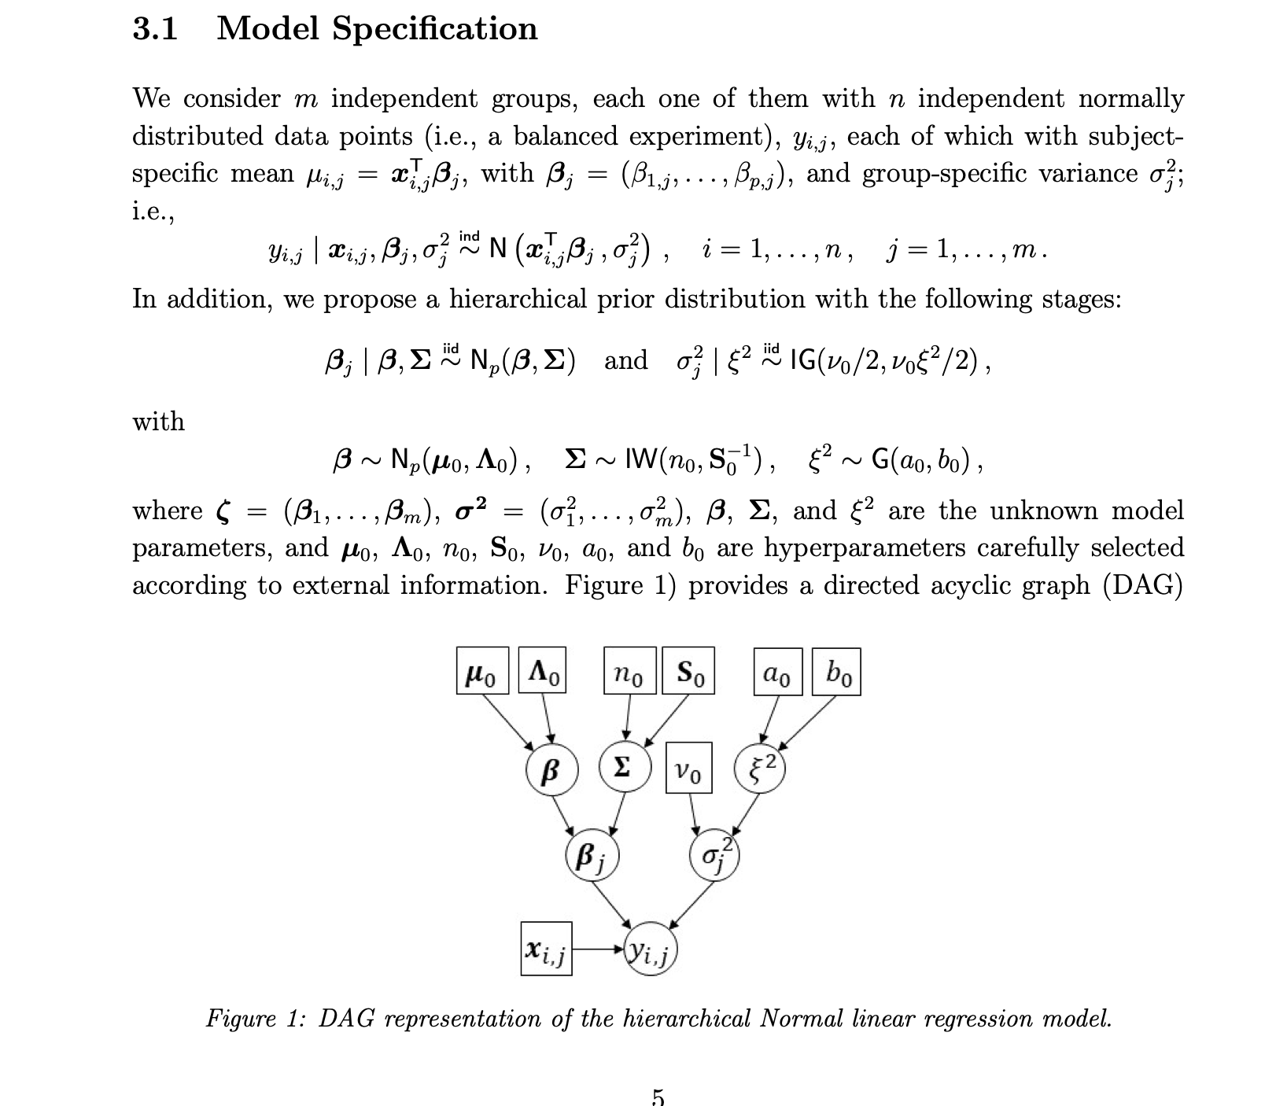
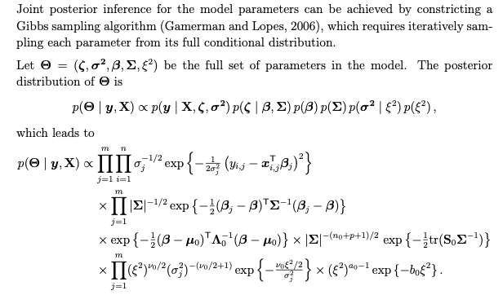
The Model
Ref: https://arxiv.org/pdf/2110.10565.pdf
For posterior inference

Slide 2
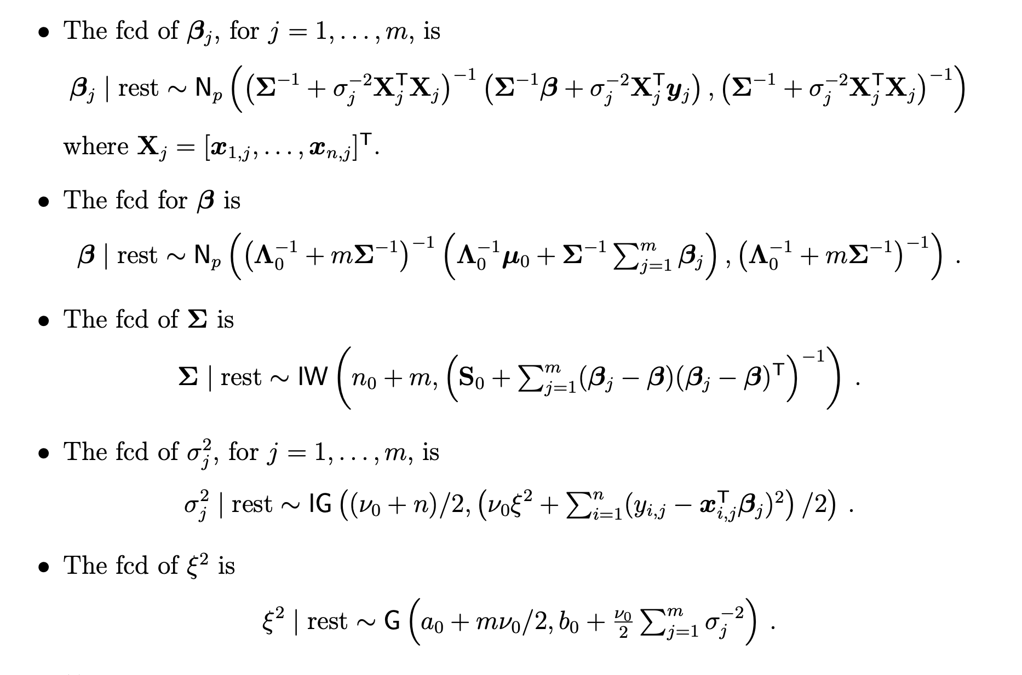
The Model
For Gibbs sampler: Sample posterior as below

Slide 3
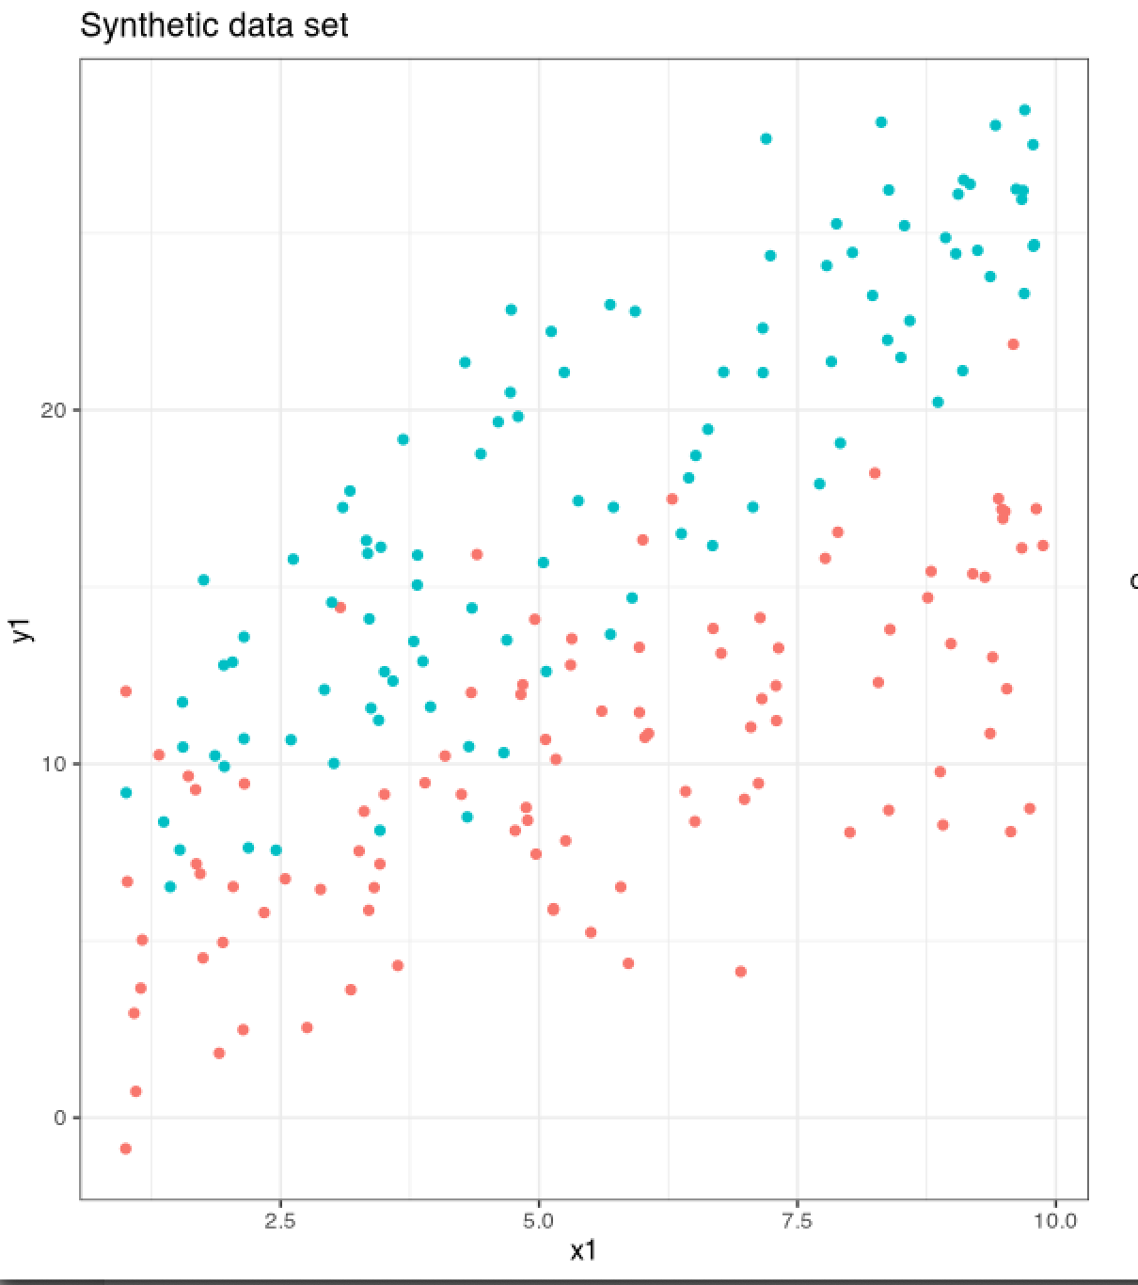
The data
Assume:
2 groups, each with 100 observations
For grp1, (beta0, beta1) = (5,1)
For grp2, (beta0, beta1) = (7,2)
For grp1, noise = 10
For grp2, noise =10

Slide 4
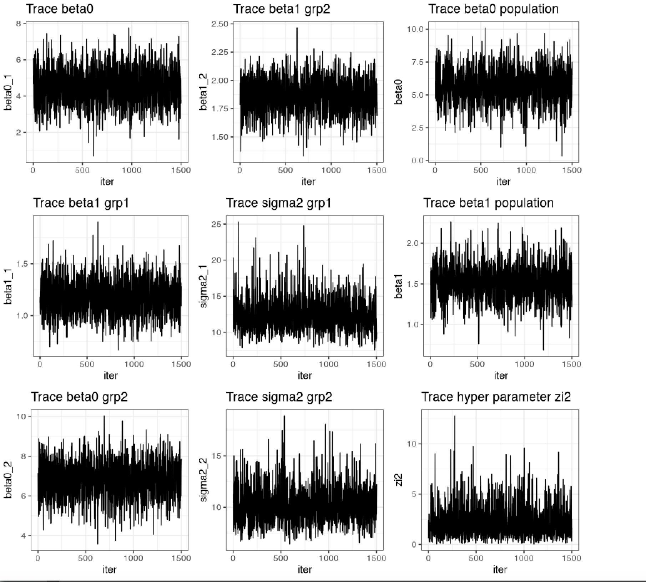
Trace plots

Slide 5
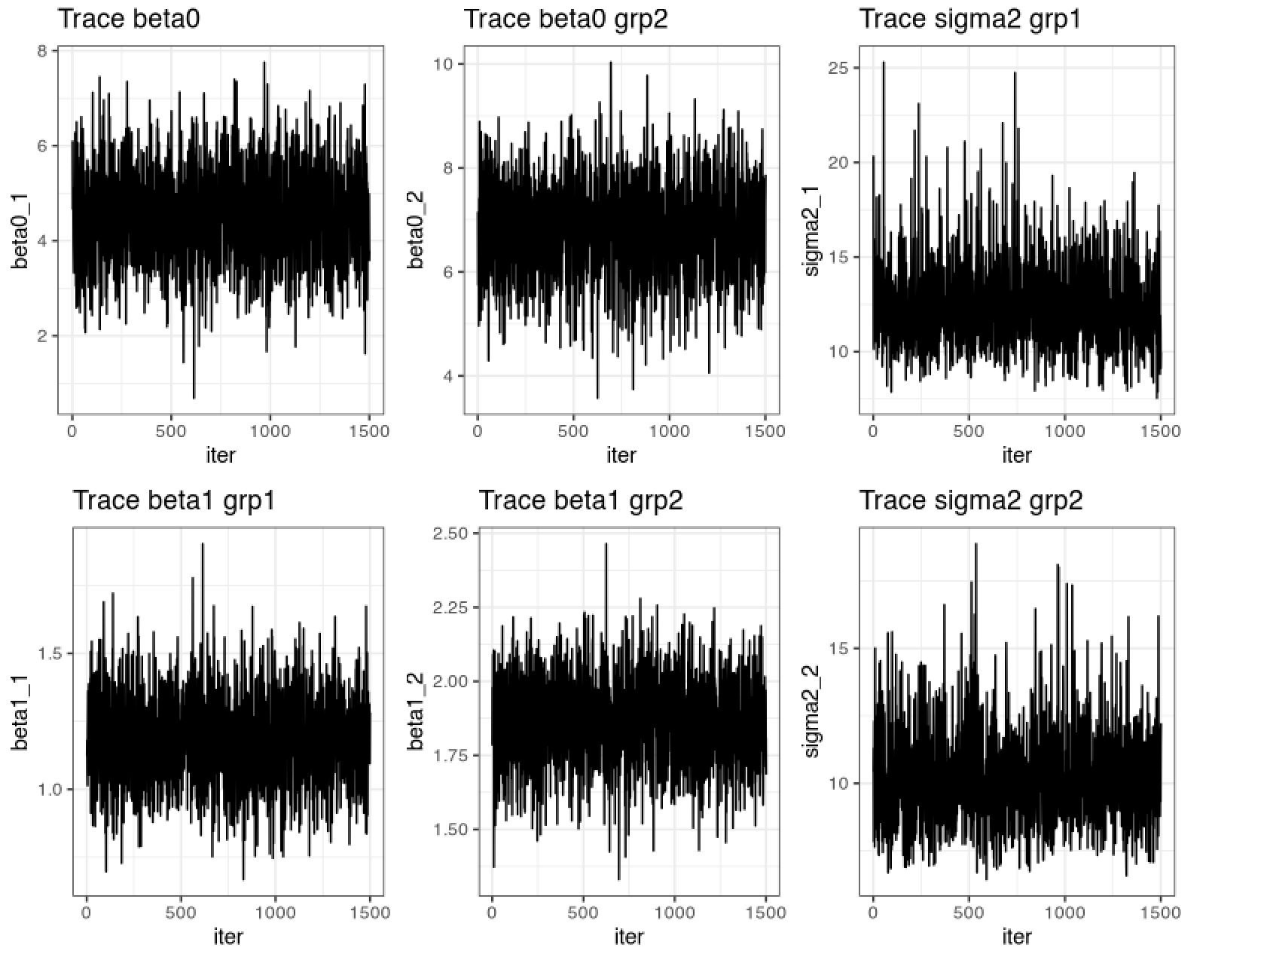
Trace plots

Slide 6
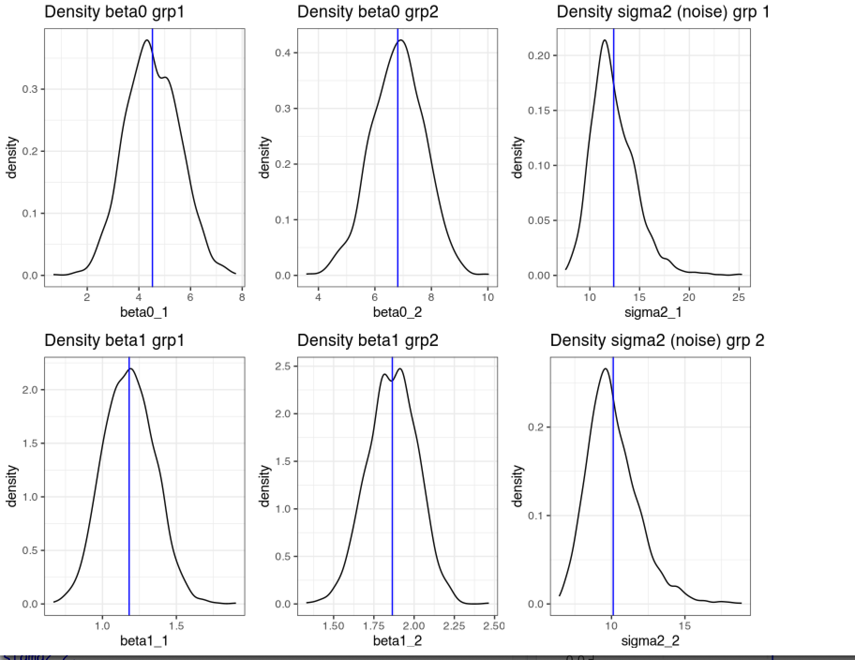
Posterior Density plots

Slide 7
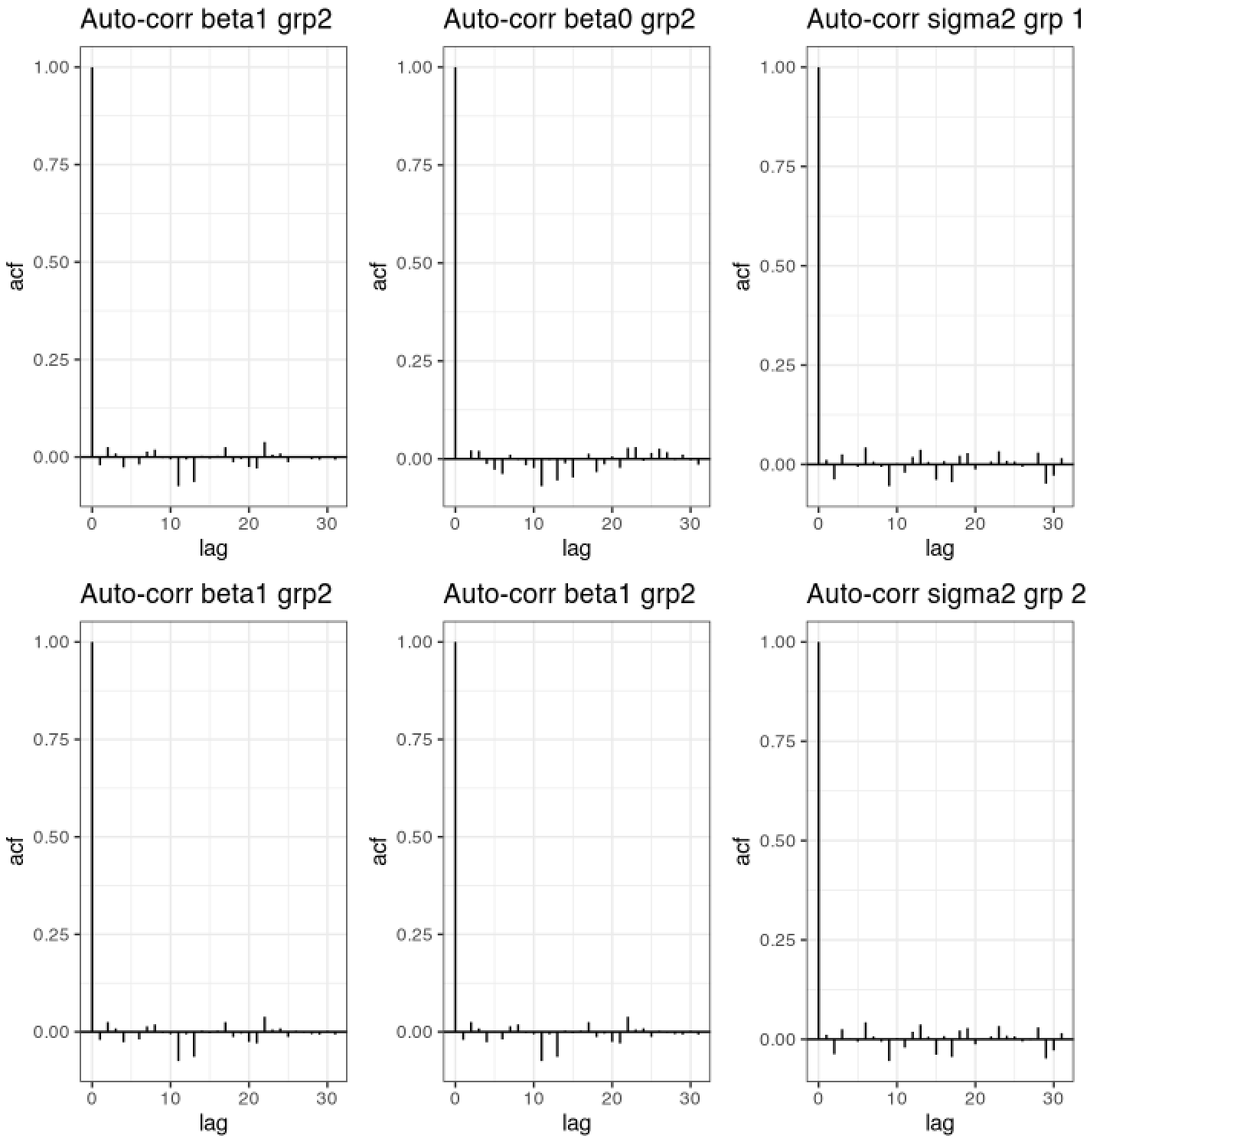
Autocorrelation plots

Slide 8
Posterior summary
parameter posterior.mean low.ci high.ci Solution
beta0_1 4.52 2.60 6.51 5.0
beta1_1 1.18 0.87 1.51 1.0
beta0_2 6.81 4.89 8.59 7.0
beta1_2 1.86 1.57 2.15 2.0
sigma2_1 12.39 8.87 17.68 10.0
sigma2_2 10.12 7.35 14.36 10.0

