Slide 1
Patient Management System

Slide 2
Why ? What's the need?
Incomplete Information
Inappropriate health procedures
Time- Consuming
Piles of Paper records
First Medical Index

Slide 3
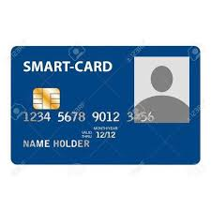
The Solution we got !
Notes:
The intention is that via this card the person will get the information of the patient and can upload its information via two factor authentication.

Slide 4
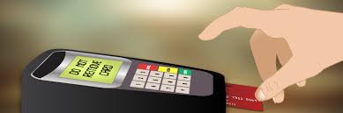


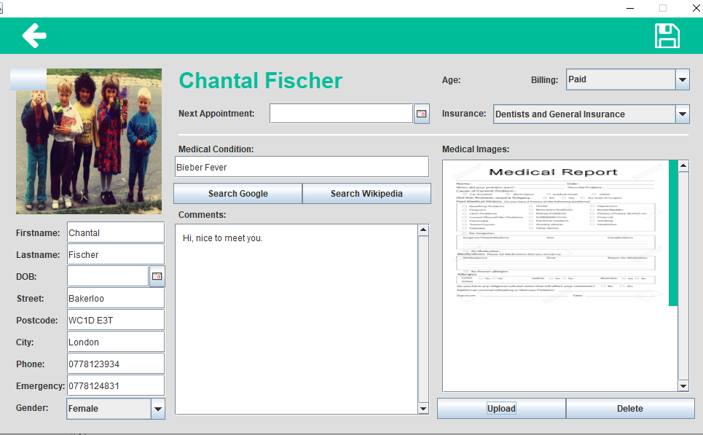


But ? How does it work ?
Notes:
So basically the patient takes the card to the receptionist. The receptionist take the “First medical index” and stores it in the hospital records. The doctor gets to analyse the disease and the servierity of the disease and edit the patient database.

Slide 5

So ?
Notes:
So the main point of all this is – the patient when changes the hospital , the prescription also changes and hence from patient point of view this becomes hassle for him to keep and show the records everytime he/she goes.

Slide 6
Thank You ………………………………………………………………………………………………………………………………………………………………………………….

