Slide 1

BeSA:
Benchmarks for Simulating
Agent-based Models in Architecture Research
Amina Sokoli A. Giray Yağlıkçı
November 1, 2026
The Fourth Workshop on Architecture for Health, MICRO 2026
https://s4lresearch.org

Slide 2
Executive Summary
Agent-based modeling (ABM) is a powerful simulation tool used in many fields including health
Problem:
  ABMs do not work efficiently and do not scale well
  No prior work identifies ABM’s performance bottlenecks
  No benchmark suite exists for architecture research on accelerating and scaling ABMs
Goal: Understand and improve the performance of large-scale agent-based simulations
Key Observations:
  Short computation wrapped around irregular walks over a neighbor structure
  Most of the execution time goes to waiting for memory
  Limited by the memory capacity
BeSA:
  The first ABM benchmark suite for architecture research (work in progress)
  Covers different health use cases
  Compatible with gem5 simulator

Slide 3

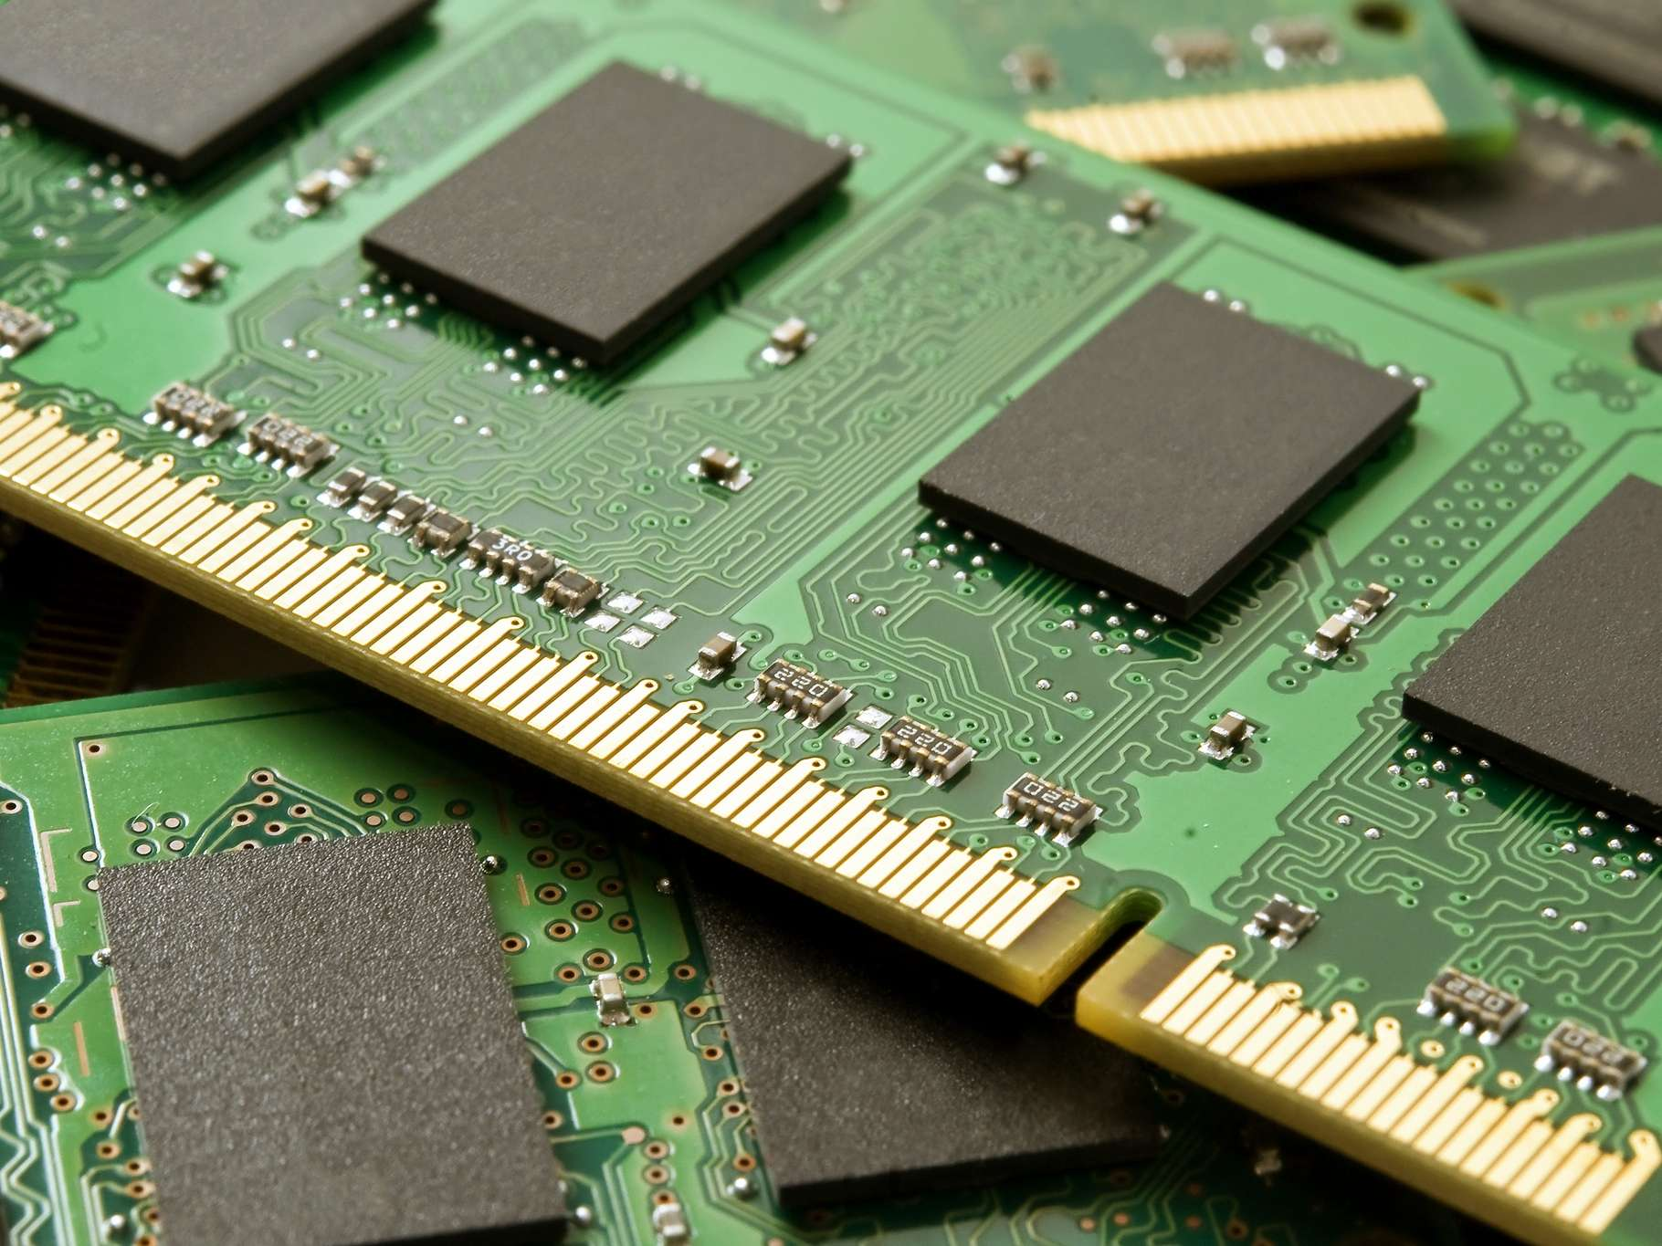
Two Different Types of Research
Cancer Research
Computer Architecture Research

Slide 4
Two Different Types of Research
Cancer Research
Very complex biological systems
Experiments take months or years
Very expensive
Low statistical significance
  Reproducing results is expensive
  Small sample sets
  Inevitable variations
  Low fidelity of metrics
Slow and expensive
scientific progress
Computer Architecture Research
Less complex
Just hours
Not expensive
Higher statistical significance
  Reproducibility is low-cost
  Larger sample sets
  Controllable variations
  High fidelity of metrics
Fast and low-cost
scientific progress

Slide 5
Simulations enable
fast and low-cost scientific progress
in computer architecture research
Why not leverage them for cancer research?

Slide 6
Bad news:
Accelerating scientific progress demands
low-cost and fast simulations of complex systems
Ugly news:
Cancer research is just one example;
there are many others
Good news:
Yes, we can make scientific progress low-cost and fast
with the help of agent-based models

Slide 7
Outline
Agent-based Modeling Overview
Understanding Performance Bottlenecks
BeSA
Future Steps

Slide 8
Agent-based Modeling
A bottom-up simulation technique modeling real-world complex systems
Agent: an autonomous individual with own state and rules
Environment: where agents live
Interactions: agent-agent and agent-environment
Simulate ABM (agents, environment, interactions)
Simulation output: Large-scale behavioral pattern
Simulation step (i.e., iteration):
  For each interaction an agent updates its own state
  Each update is small, but is repeated for millions of agents
  Neighbors of an agent change as the agent moves
Simulation = many iterations

Slide 9
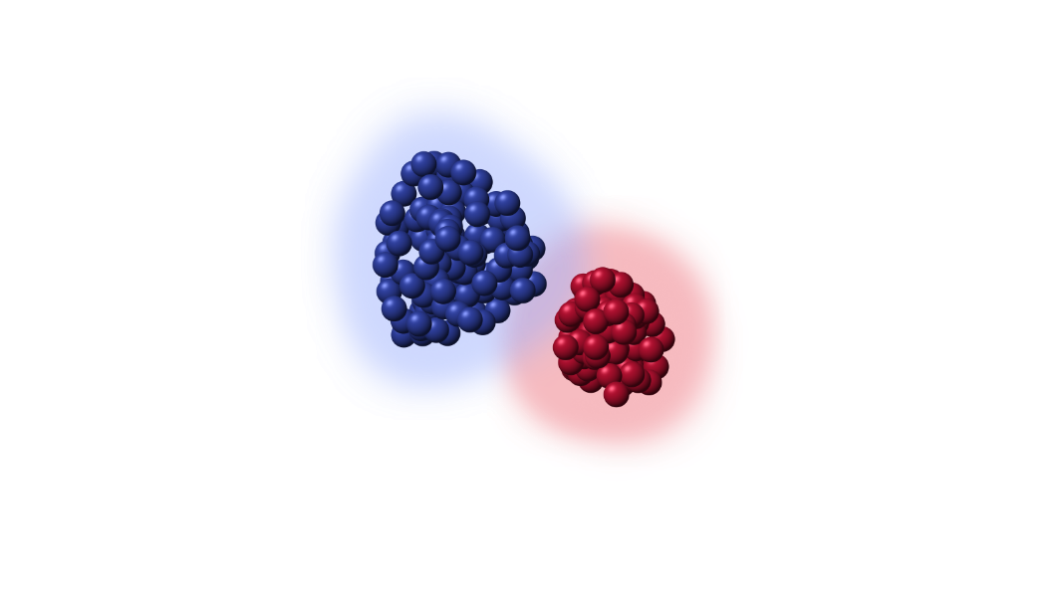
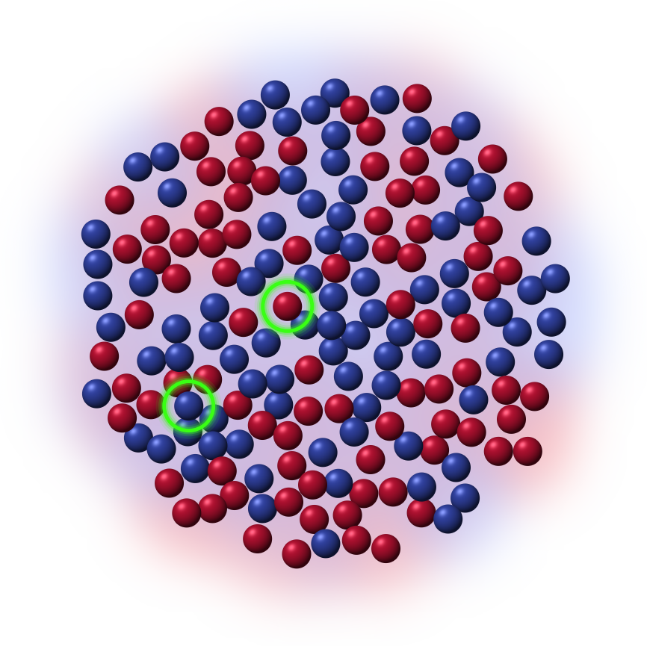

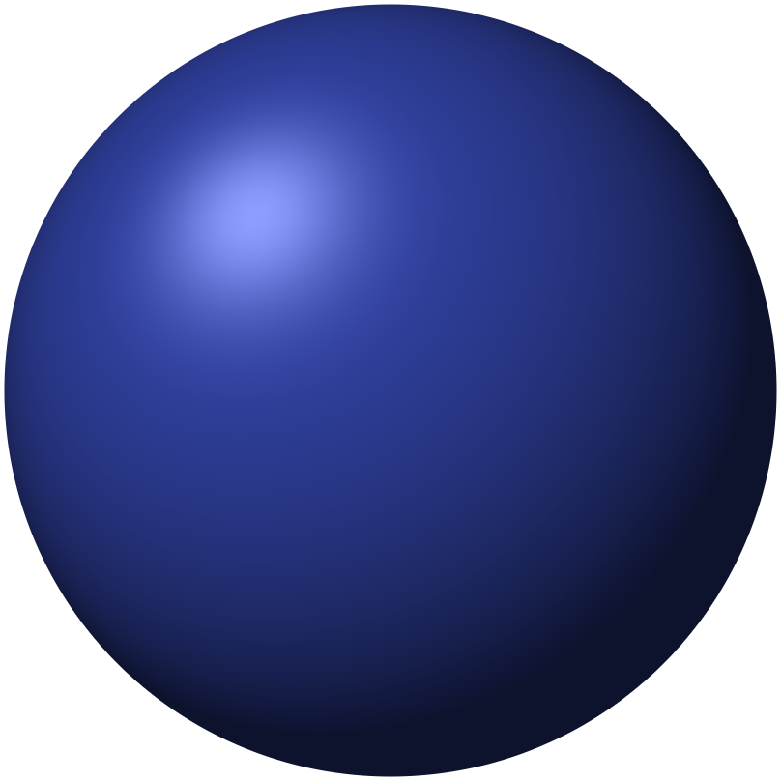
Soma Clustering Example
GOAL: Pull cell bodies tightly together in space to connect and form functional structures
RESULT
Randomly scattered cells
sort themselves into
separate and dense colonies over time
ENVIRONMENT
AGENTS
STATE: Type, Position, Geometry data
RULES: Substance secretion, chemotaxis, mechanical displacement

Slide 10





ABM is used in many domains
Social Sciences
Epidemics
Neurosciences
Finance
Ecology

Slide 11
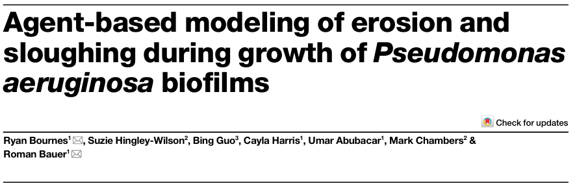
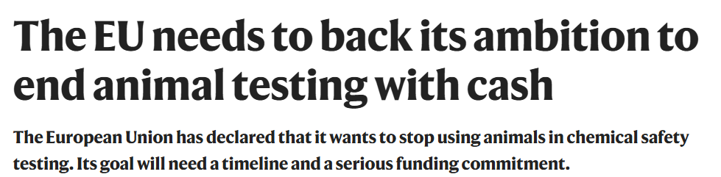
ABM is used in many domains
July 2026
June 2026

Slide 12
With great ABMs comes great health research
Large agent count = finer details
Many iterations = looking further into the future
Faster simulations = faster decisions

Slide 13
But, ABMs are not great yet
Performance bottlenecks are unknown
Porting to different platforms is not studied (e.g., PiM, GPU)
Scaling strategies are unclear: scale up or scale out?
Without this understanding, ABMs stay limited
  Limited complexity: up to half a trillion agents
  Limited scalability: requires access to gigantic server clusters

Slide 14
Our Goal
Understand and improve the performance
of large-scale agent-based simulations

Slide 15
Outline
Agent-based Modeling Overview
Understanding Performance Bottlenecks
BeSA
Future Steps

Slide 16
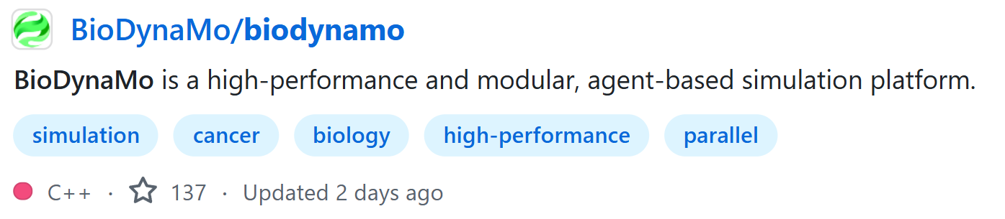
BioDynaMo
The state-of-the-art open-source framework
Written in C++
Fully parallel, built for multi-core CPUs
NUMA-aware
1.72 billion agents on a single server
  One to three orders of magnitude larger than state-of-the-art ABM platforms

Slide 17

Experimental Setup
Aspect | Details
Framework | BioDynaMo
Use case | Epidemiology simulation
Scale | 10M – 1B agents
Repetitions | 3 runs per agent count
Platform | Google Cloud C4 VMs, 16 vCPUs
Methodology | Top-down analysis
Tooling | Perf, sampled at 1 Hz
Derived metrics | IPC, L2 MPKI, memory-bound fraction

Slide 18
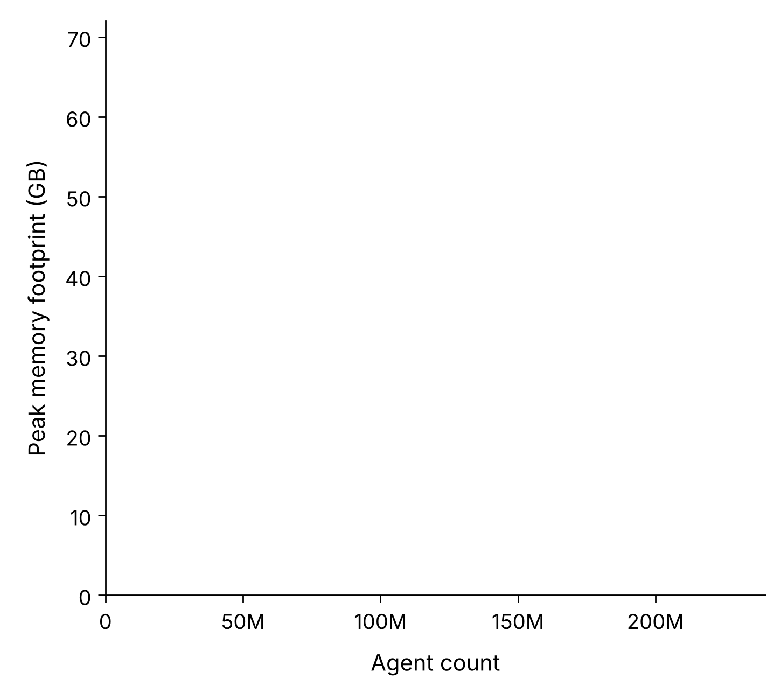
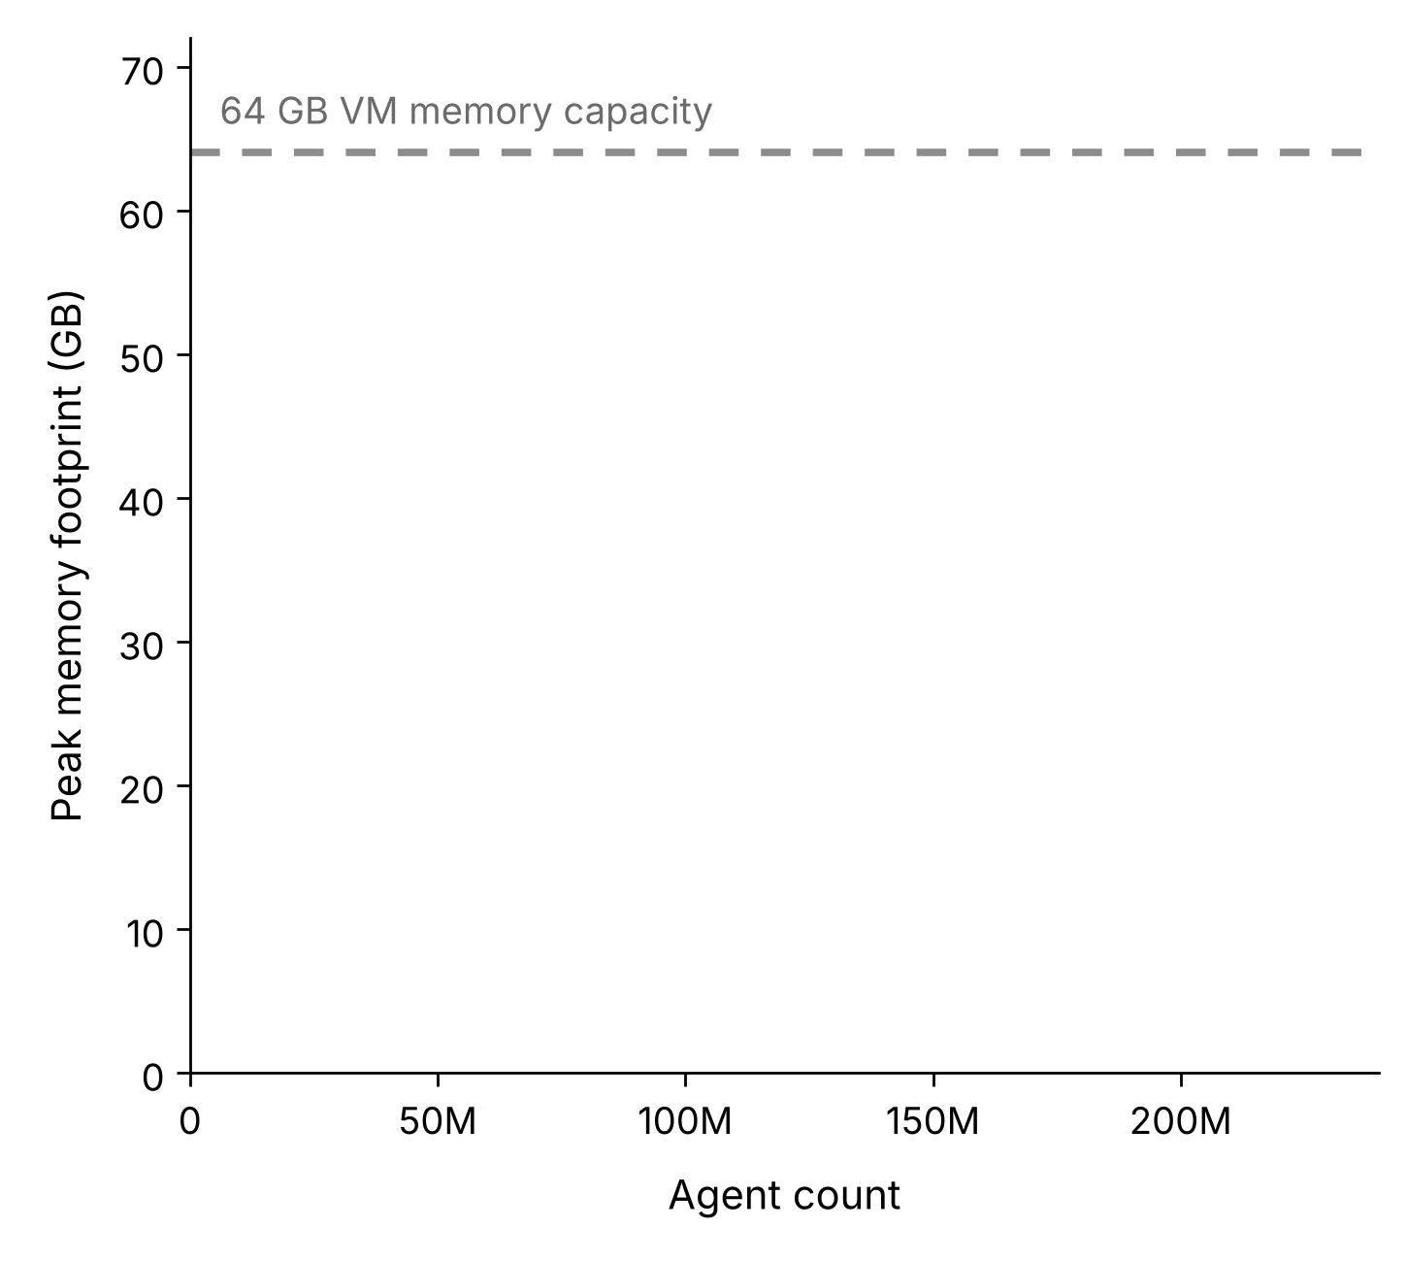
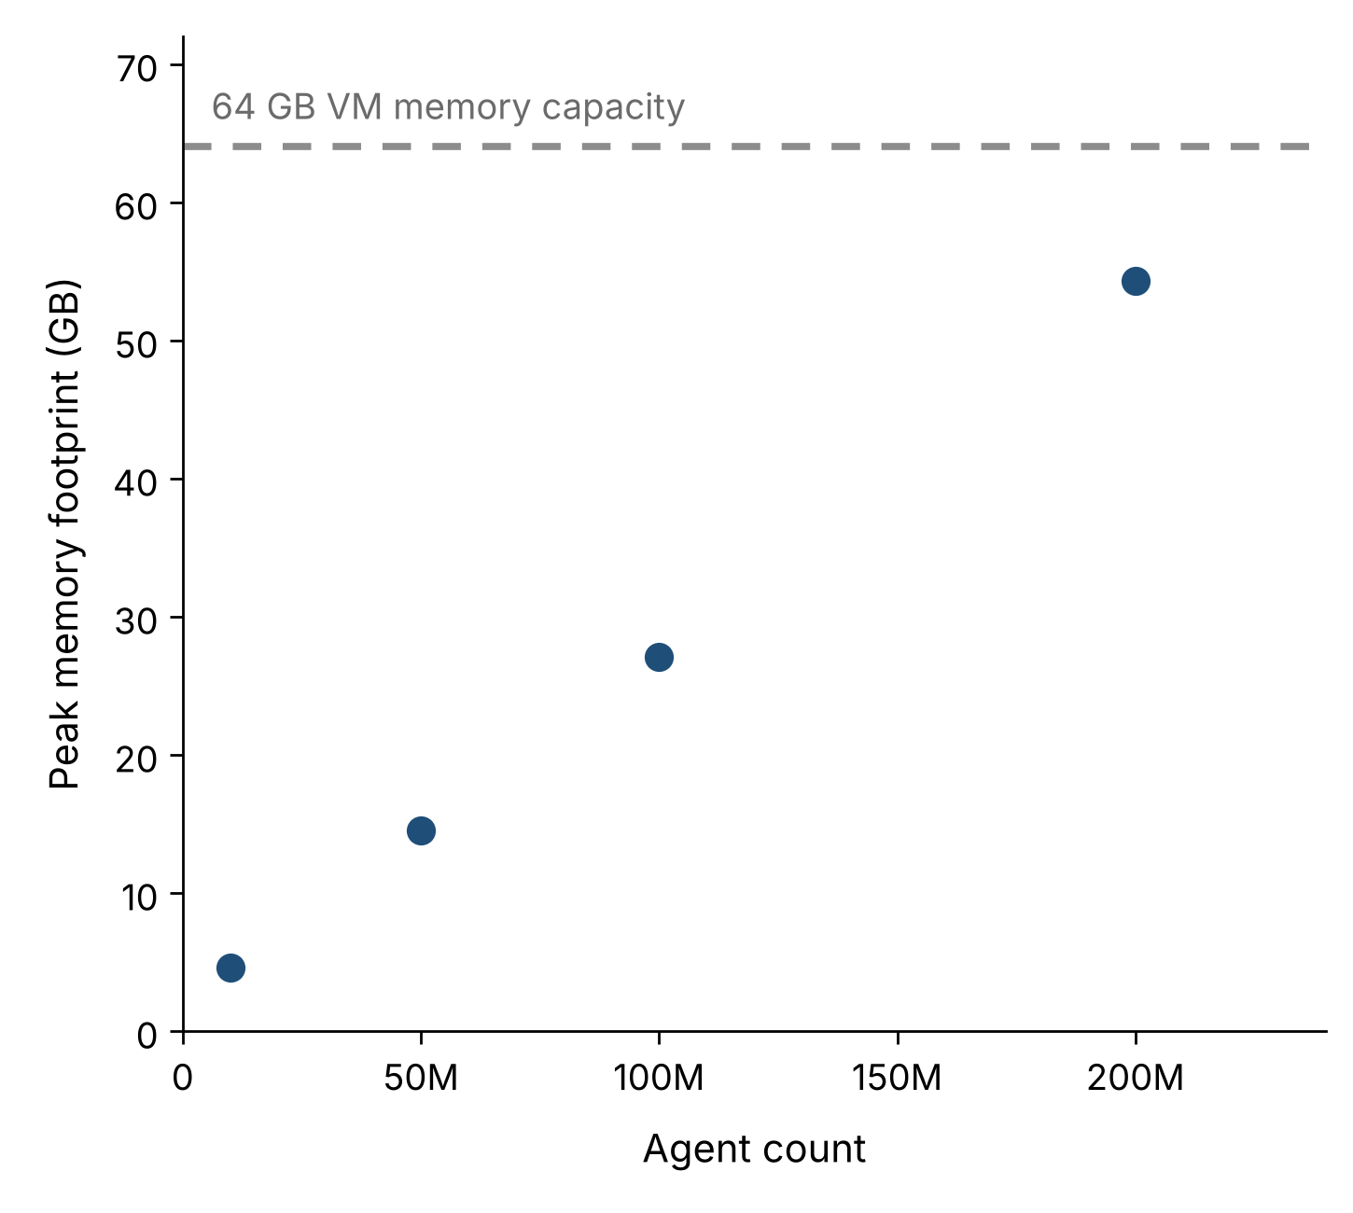
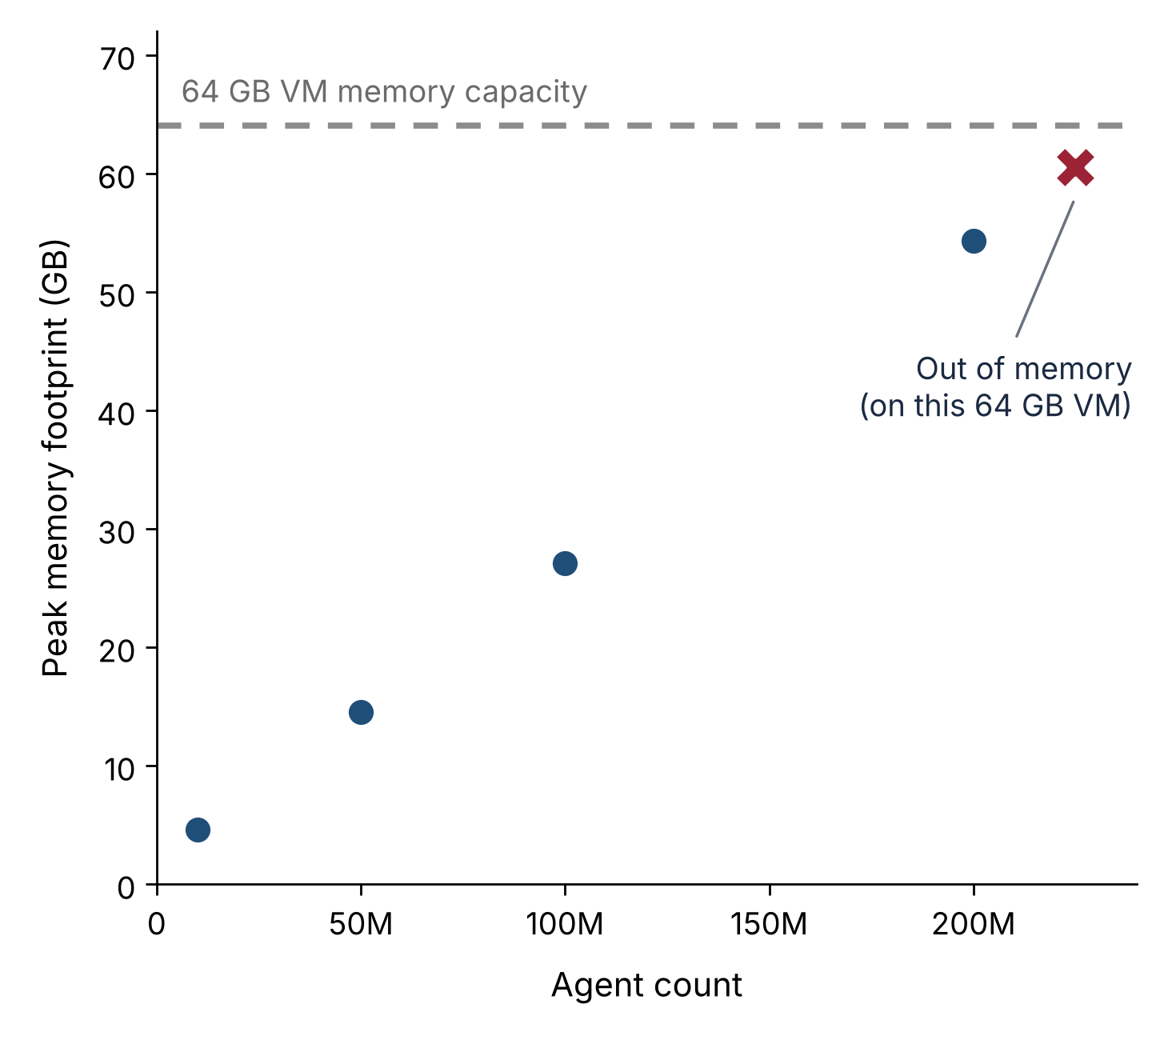
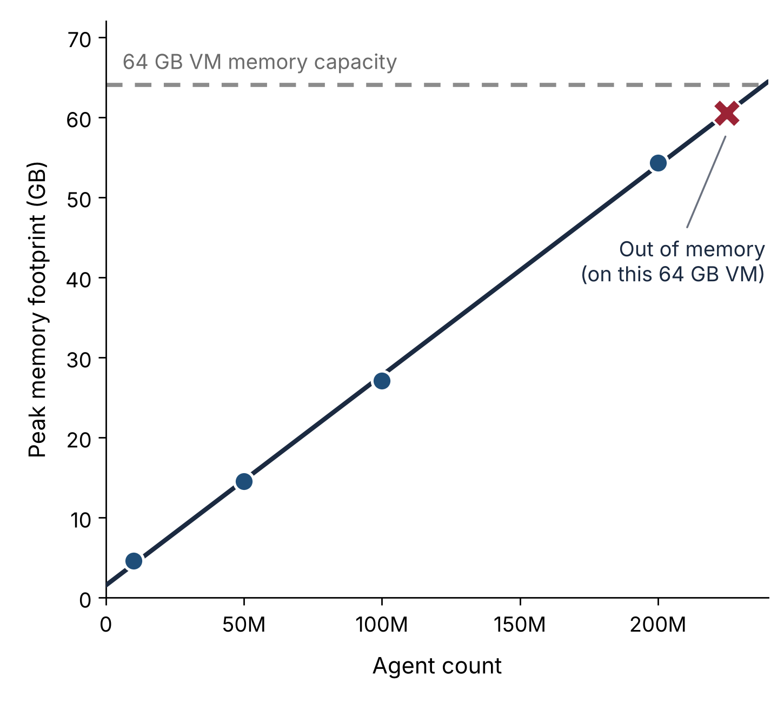
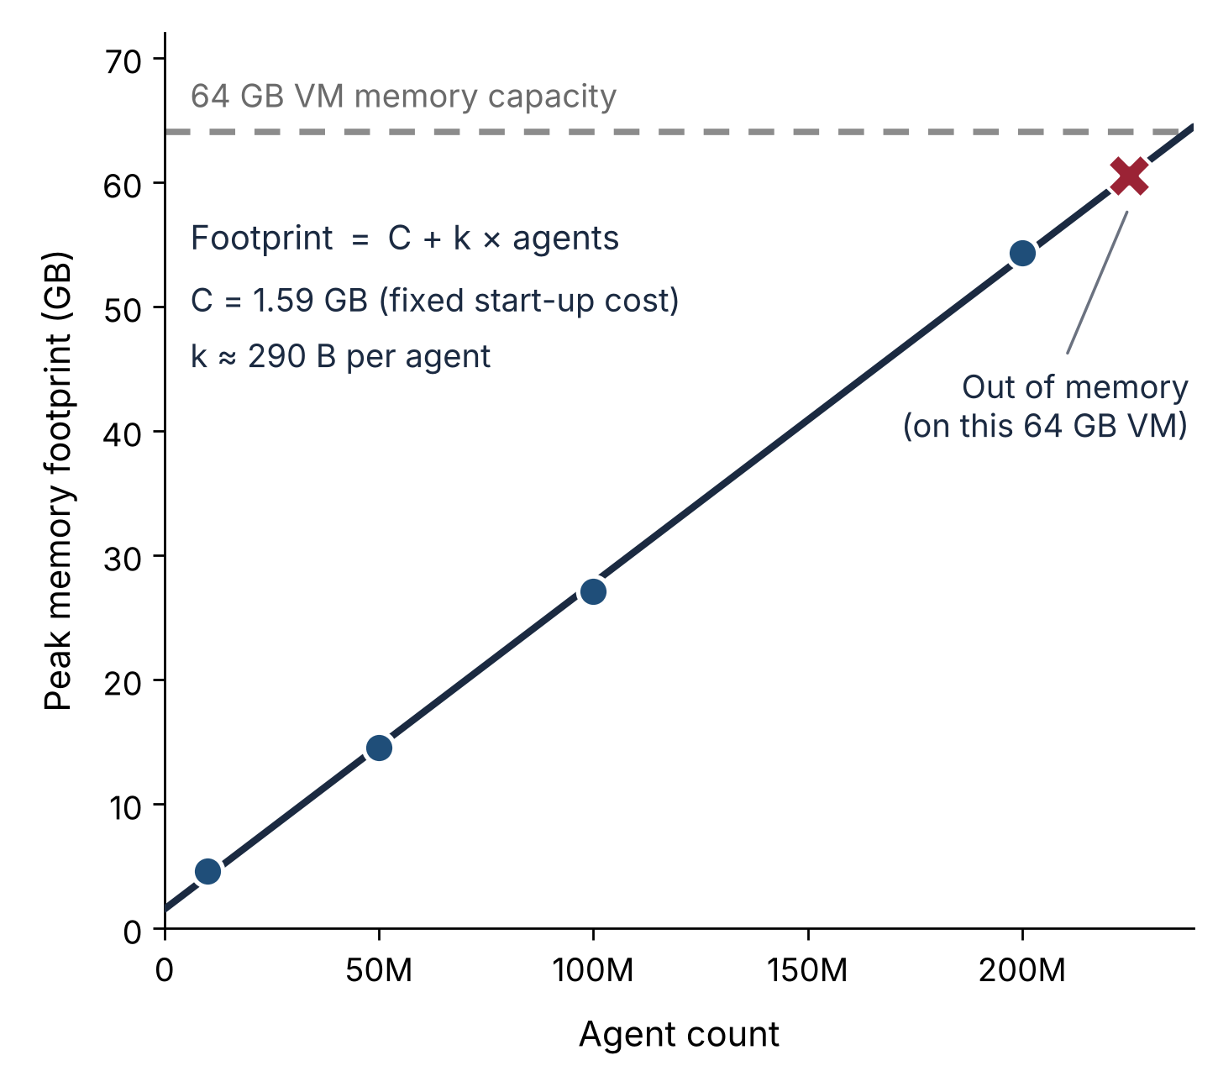
Memory Consumption
More complex simulation

Slide 19
Memory Consumption
Memory footprint scales linearly with agent count
and bounds simulation complexity
More complex simulation

Slide 20
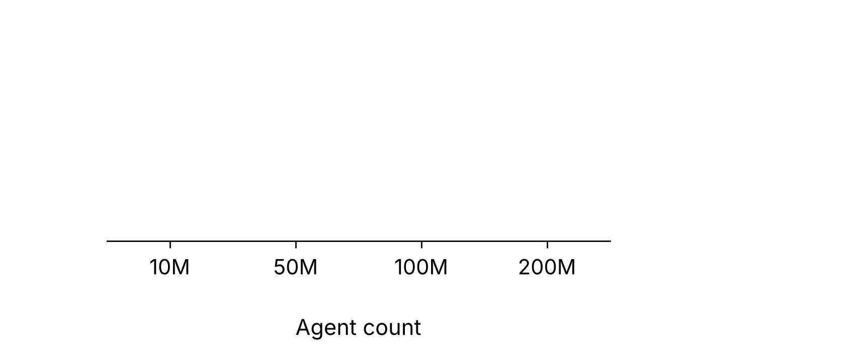
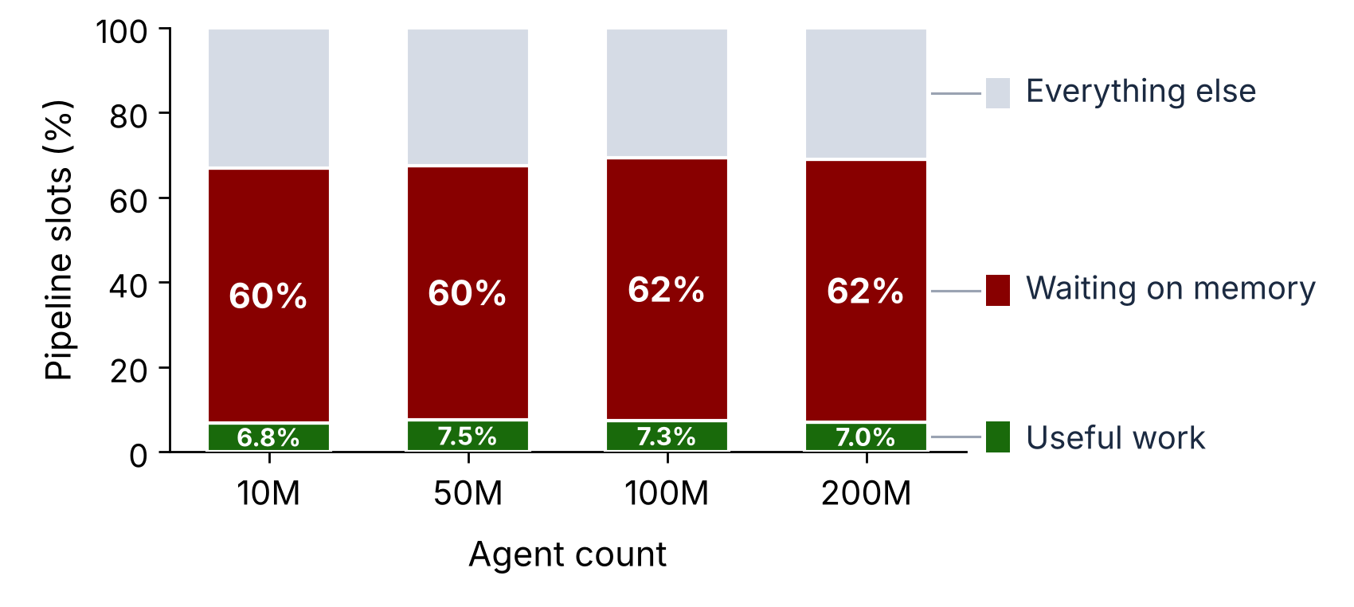
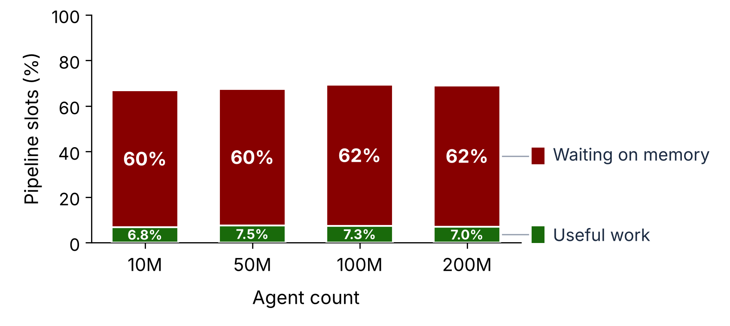
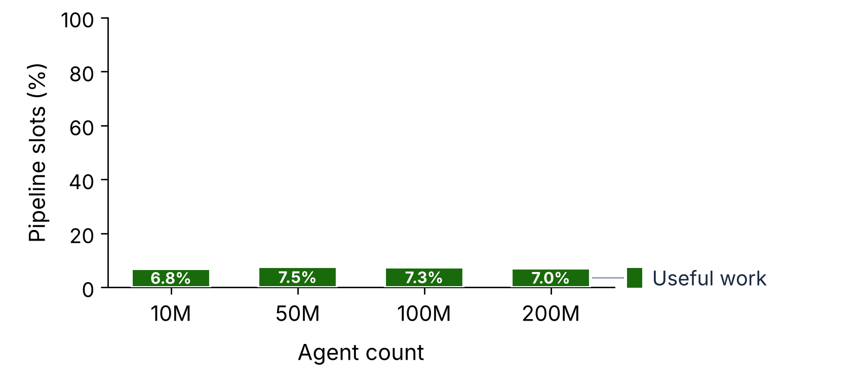
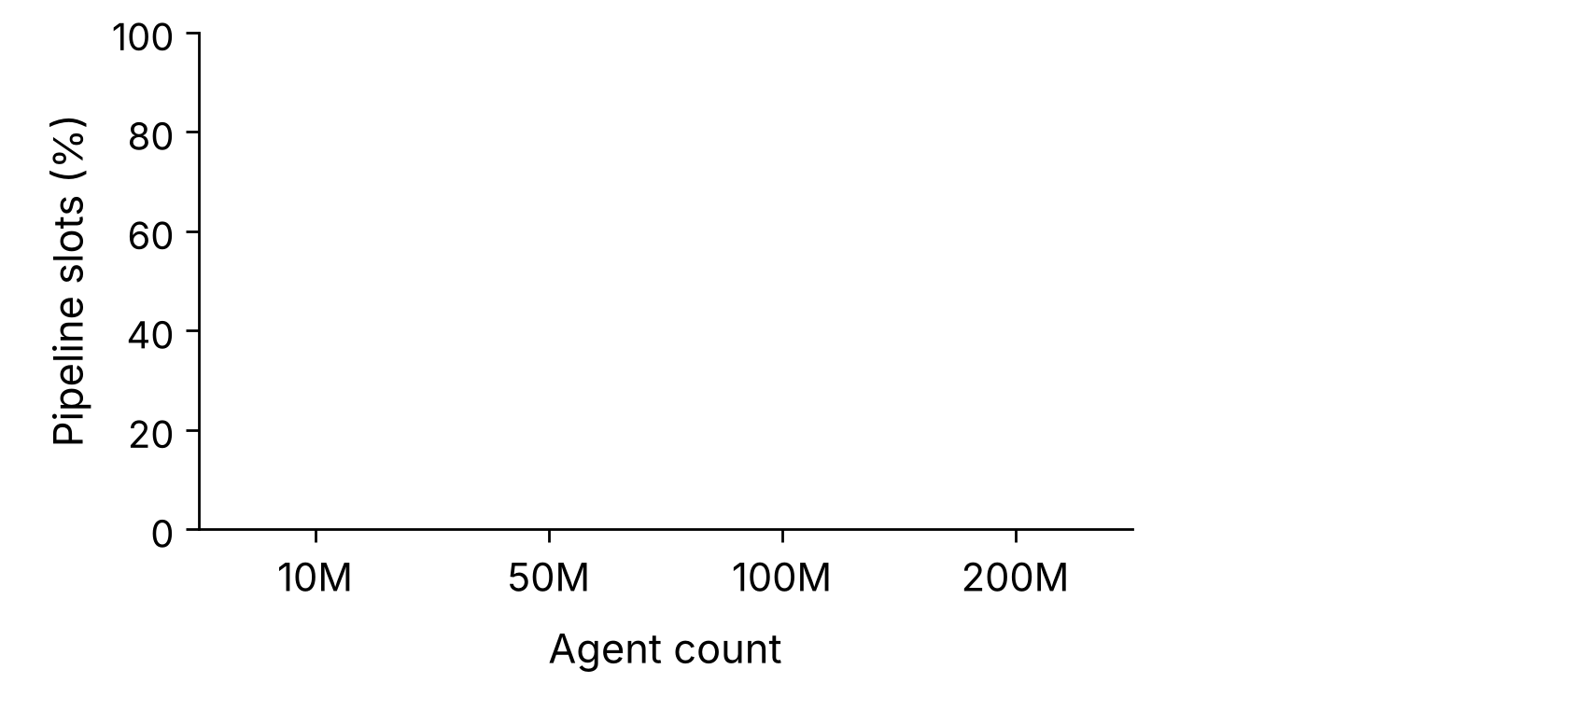
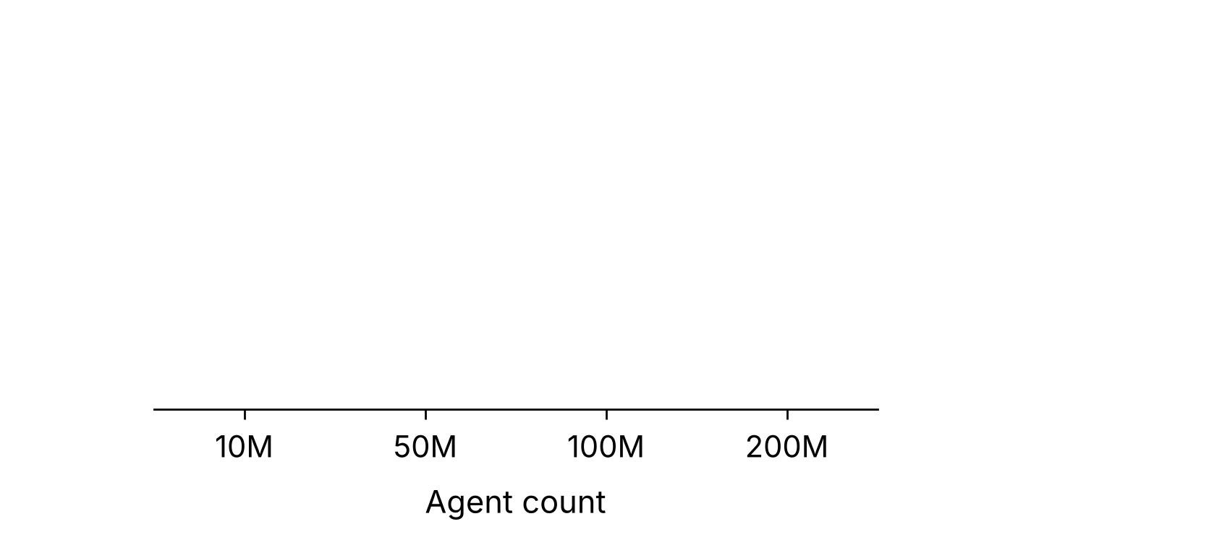
Microarchitectural View
Mem-bound stalls
Low compute utilization
More complex simulation

Slide 21
Microarchitectural View
Mem-bound stalls
It’s the Memory, Stupid!
Low compute utilization
More complex simulation

Slide 22
The Bottleneck
Low compute utilization + Mem-bound stalls
ABMs are memory bound
What type of memory-bound?
  Bandwidth?
  Latency?
  Capacity?
  Contention?
Where to optimize?
Software or Hardware improvements? Both?
We need to know more

Slide 23

Searching for the memory-bound cause
Roofline analysis
Full DAMOV methodology
Few, aggregated metrics on fixed hardware cannot reveal the cause
Let's use computer architecture simulators
Simulate the full ABM
  Far too slow
Use benchmarks then!
But no benchmarks for ABMs anywhere​

Slide 24
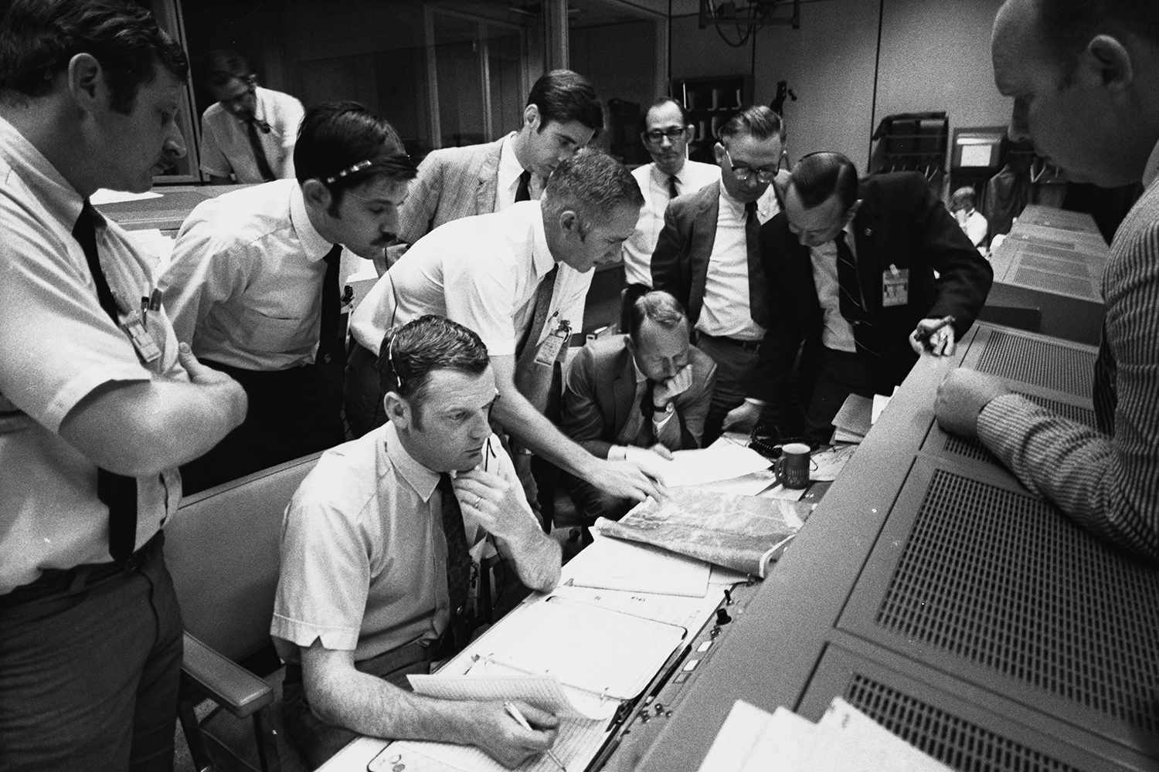
Houston, we have a problem

Slide 25
Outline
Agent-based Modeling Overview
Understanding Performance Bottlenecks
BeSA
Future Steps

Slide 26

Benchmarks, assemble!
BeSA: Benchmarks for Simulating Agent-based Models in
architecture research
Built on BioDynaMo
Two design goals
  Representative
  Reusable
Fixed agent count
  The same agents exist from the first iteration to the last
  Epidemiology
Dynamic agent count
  Agents are created or removed as the simulation runs
  Tumor growth, where agents are cells
  Biofilm growth, where agents are bacteria
Besa in Albanian means “word of honor”, an unbreakable promise that carries deep cultural and moral weight

Slide 27
BeSA
Problem: full ABM runs are too long to simulate cycle-accurately
  Epidemiology run: ~3.4×10¹⁴ dynamic instructions
SimPoint-based sampling
  Profile: basic-block vectors (BBVs) with Valgrind, over intervals of 100M instructions
  Cluster: grouped intervals that execute similar code and weighted each group by how much of the run it covers
90% coverage
A small subset of instructions is representative of the whole execution

Slide 28
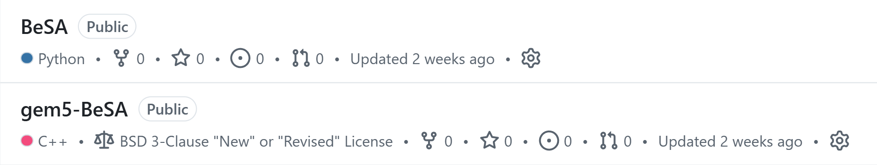
BeSA
https://github.com/SAL-Research/BeSA
https://github.com/SAL-Research/gem5-BeSA

Slide 29
Outline
Agent-based Modeling Overview
Understanding Performance Bottlenecks
BeSA
Future Steps

Slide 30
Future Steps
Extend BeSA with more use cases
  Add models from clinical and biomedical research
Multi-threaded sampling
  SimPoint assumes a single, reproducible instruction stream
  Parallel runs require thread alignment
Native support for trace-based memory simulation (Ramulator 2.1)
A complete benchmark pipeline

Slide 31

Conclusion
Agent-based modeling (ABM) is a powerful simulation tool used in health research
Key Observations:
  Short computation wrapped around irregular walks over a neighbor structure
  Most of the execution time goes to waiting for memory
  Limited by the memory capacity
What type of memory-boundness: bandwidth, latency, capacity or contention?
BeSA:
  The first ABM benchmark suite for architecture research (work in progress)
  Covers different health use cases
  Compatible with gem5 simulator
We have a lot more to do

Slide 32
BeSA:
Benchmarks for Simulating
Agent-based Models in Architecture Research
Amina Sokoli A. Giray Yağlıkçı
November 1, 2026
The Fourth Workshop on Architecture for Health, MICRO 2026
https://s4lresearch.org

Slide 33
Execution Time Coverage
Instr. Count | Epidemiology | Biofilm | Tumor
0 | 0 | 0 | 0
100 | 0.504 | 0.3 | 0.425
200 | 0.64 | 0.55 | 0.684
300 | 0.746 | 0.72 | 0.903
400 | 0.84 | 0.85 | 0.969
500 | 0.903 | 0.9 | 0.983
600 | 0.935 | 0.91 | 0.99
700 | 0.953 | 0.92 | 0.993
800 | 0.97 | 0.93 | 0.996
900 | 0.984 | 0.94 | 0.998
1000 | 0.996 | 0.94 | 1

Slide 34
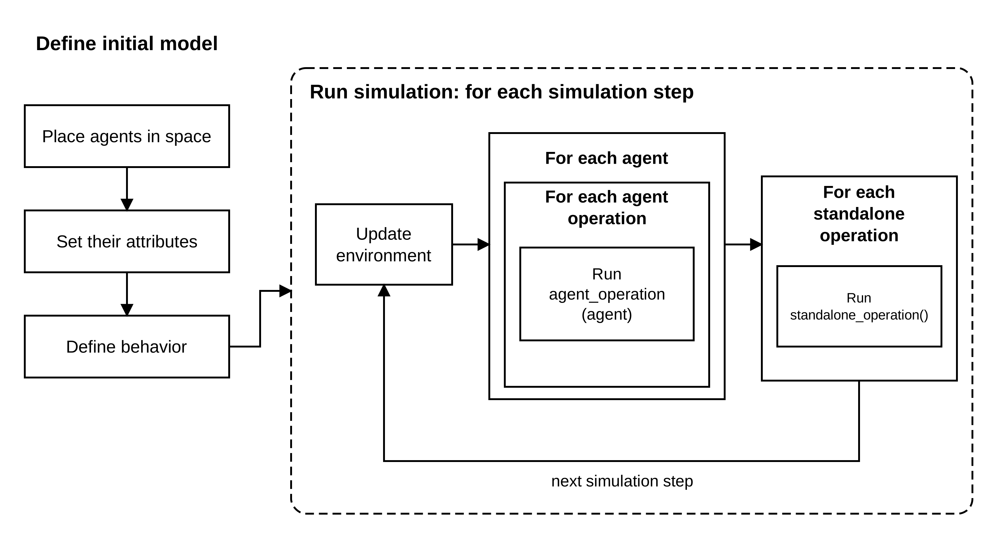
How a simulation runs

Slide 35

How a simulation runs (1)

Slide 36

How a simulation runs (2)
Notes:
Then the simulation runs in steps, and every step does the same thing. First, we update the environment. For each agent, we run each of its operations, for example grow, move, or divide. After that, there are standalone operations. These are not tied to a single event. An example is the diffusion of substances in environment.
And then we go back to the beginning and repeat. For as many steps as we want to simulate.

Slide 37
BarrierPoint
The multi-threaded counterpart of SimPoint
Uses global barriers in a multi-threaded program to find the most representative inter-barrier regions
Inter-barrier regions grow with input size
Estimates total execution time and metrics by simulating only those regions in detail
The pipeline
Region signatures. Per inter-barrier region, collect basic block vectors (code behavior) and LRU stack-distance vectors (data reuse)
Clustering. The signatures are normalized, and clustered with instruction-weighted k-means. One representative region per cluster becomes a barrierpoint
Detailed simulation. Each barrierpoint is simulated independently and in parallel, starting from a checkpoint or a fast-forward to its opening barrier
Reconstruction. Each barrierpoint gets a multiplier, and metrics are rebuilt as a multiplier-weighted sum

Slide 38
LoopPoint
BarrierPoint can give almost no speedup when a large application has few barriers
Uses loop iterations as the unit of work, and regions are bounded by a target size rather than by barrier placement
The pipeline
Region signatures. The application is recorded once as a PinPlay checkpoint, and a dynamic control-flow graph identifies loops
Spin-loop filtering. Instructions from the synchronization library (libiomp5 in the paper) are executed but not counted as work
Slicing. Each slice is roughly N × 100M global instructions for N threads. A region is specified by a (PC, count) pair
Signatures and clustering. Basic block vectors are collected per thread and concatenated. They are projected to 100 dimensions and clustered with k-means plus a BIC criterion. One representative per cluster becomes a looppoint
Simulation. Looppoints are simulated independently and in parallel, then runtime is rebuilt as a multiplier-weighted sum over filtered instruction counts

Slide 39
CXL as a solution to the memory consumption limit?
Why not use CXL?

Slide 40
CXL as a solution to the memory consumption limit?
A fix for out of memory runs, but not a scaling strategy for scaling to real-world simulations
We cannot buy our way past the wall
Latency
Wrong access pattern (the neighbor search is the hot spot)

Slide 41
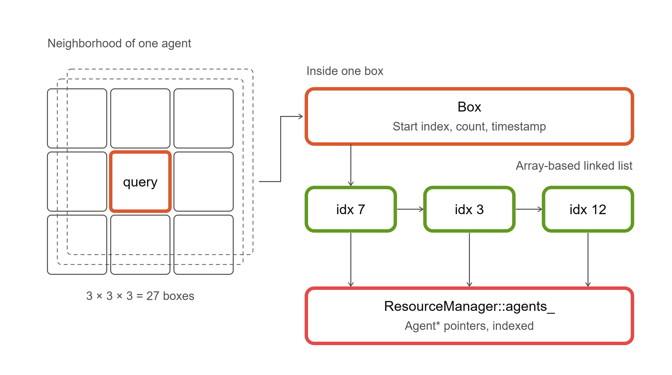
Neighbor search

