Slide 1
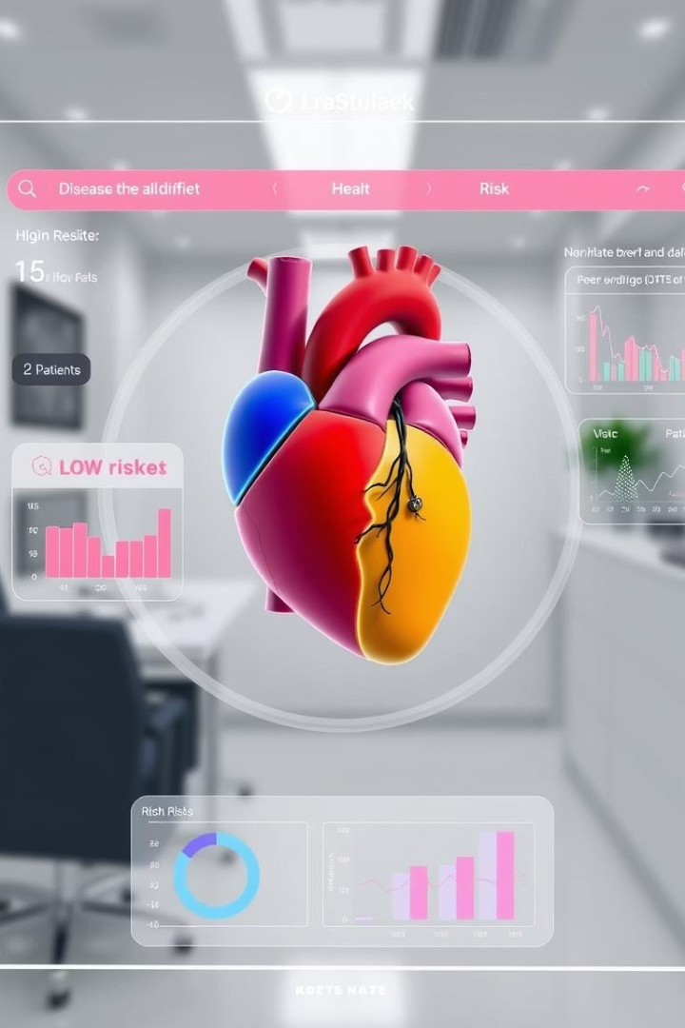

HealthCare Predictive Analysis
The HealthCare Predictive Analytics project focuses on developing a classification model to identify cardiovascular disease (CVD) risk in patients. Created by a team from CLS (Group CLS_CAI2_AIS4_G4), this project aims to provide data-driven insights to help healthcare professionals with patient risk detection and informed decision-making.
by Amina Zeyad

Slide 2




Data Collection and Exploration
Dataset Overview
Initial Analysis
Data Cleaning
The dataset consists of 70,000 records with 13 factors including age, gender, height, weight, blood pressure readings, cholesterol levels, glucose levels, lifestyle factors, and cardiovascular disease status.
Initial checks revealed no duplicates or null values in the dataset. Age was converted from days to years for better interpretation, and outliers were identified in height, weight, and blood pressure readings.
Outliers were handled by establishing medical thresholds: height (100-200cm), weight (45-190kg), systolic pressure (50-250mmHg), and diastolic pressure (40-150mmHg). Records with gender=3 were removed as they represented only 11 samples.

Slide 3
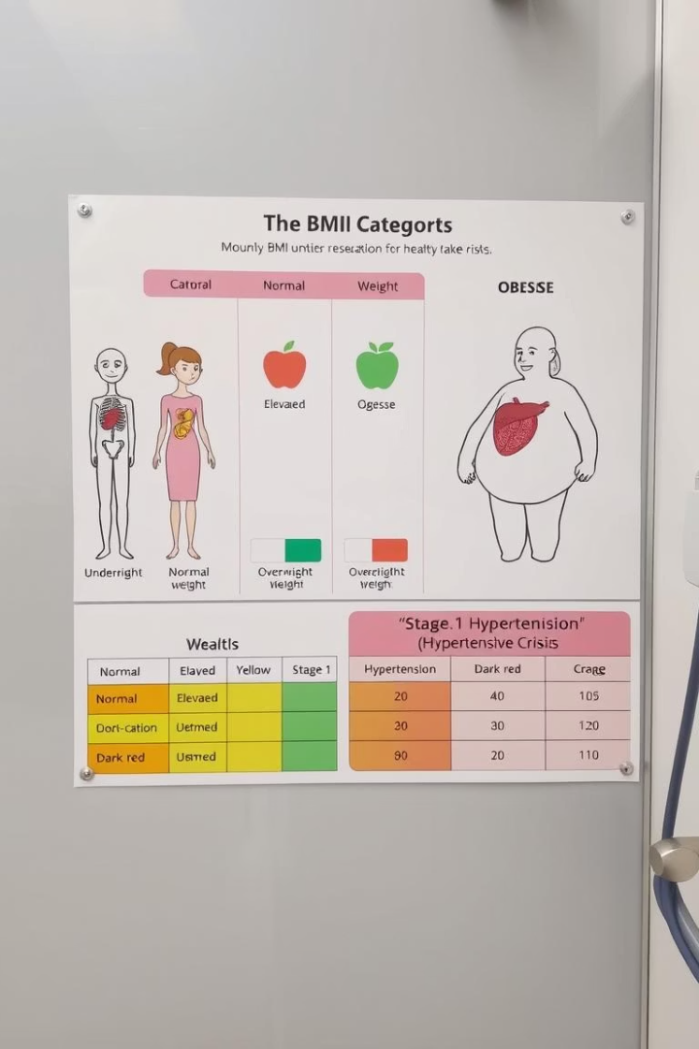




Feature Engineering
Body Mass Index (BMI)
BMI was calculated using weight and height, then categorized into: Underweight (<18.5), Normal weight (18.5-24.9), Overweight (25-29.9), and Obesity (≥30).
Hypertension Feature
A binary hypertension flag was created, set to 1 if systolic pressure >130mmHg or diastolic pressure >90mmHg, indicating stage 1 hypertension or higher.
Pulse Pressure & MAP
Pulse Pressure (PP = systolic - diastolic) and Mean Arterial Pressure (MAP = diastolic + 1/3(systolic - diastolic)) were calculated as key cardiovascular indicators.
Age Groups & PP Categories
Age was categorized into 6 groups (20-29, 30-39, etc.) and PP into 5 categories based on medical significance, from very low to very high pressure.

Slide 4
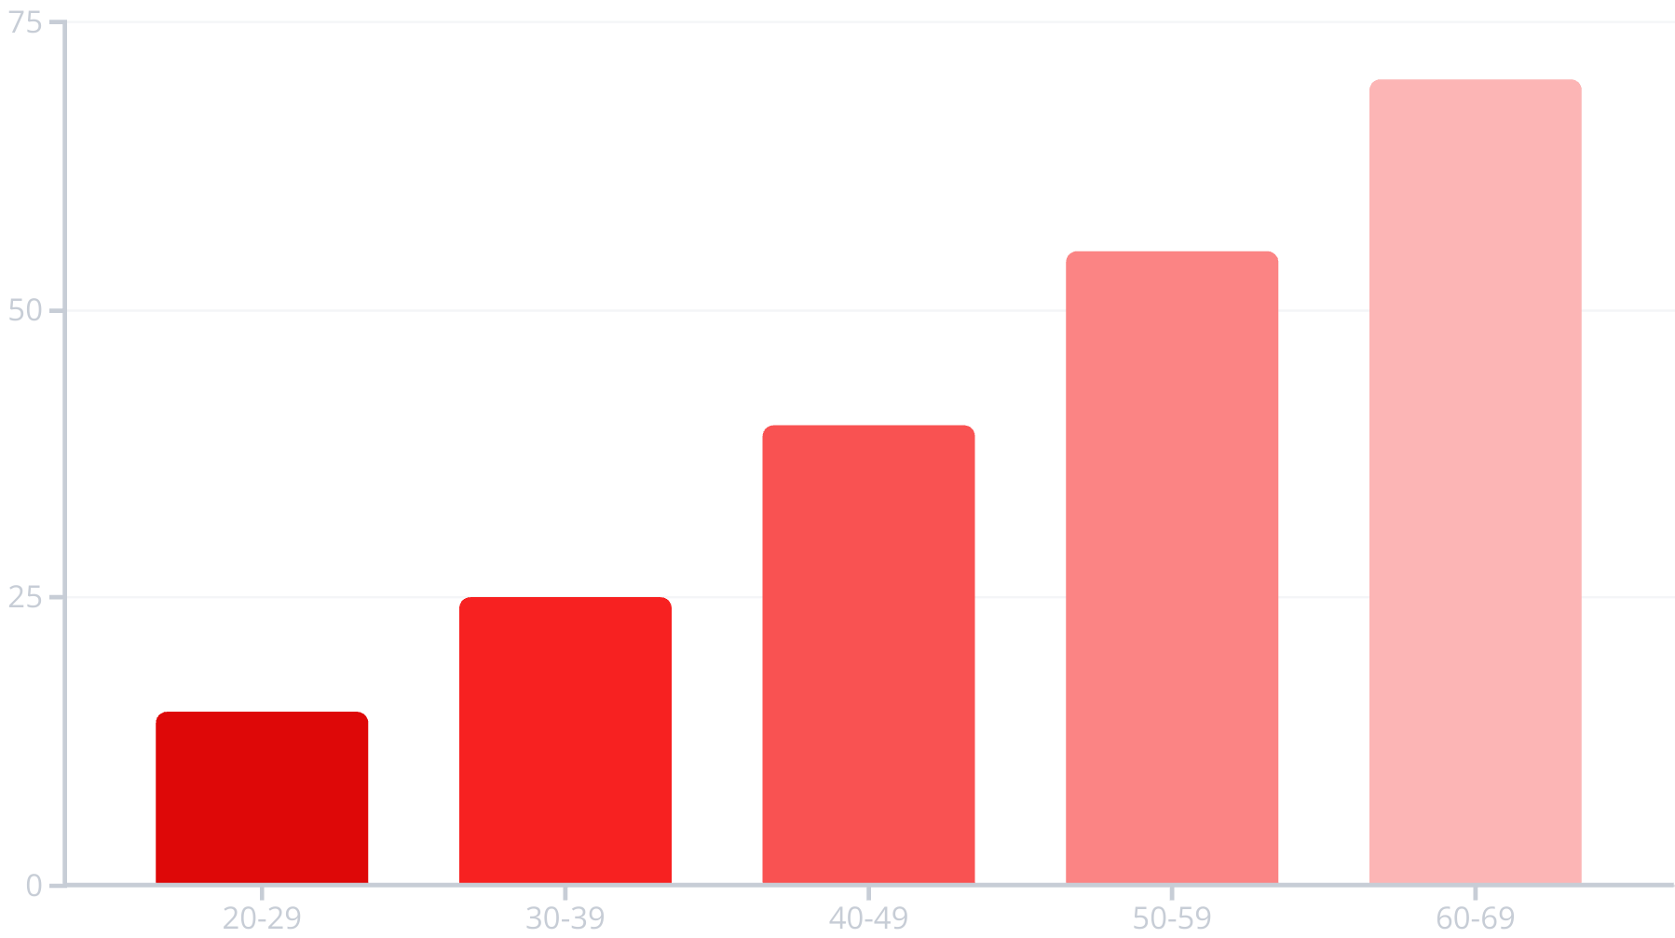
Exploratory Data Analysis
Data visualization revealed strong relationships between cardiovascular disease and several factors. BMI category and age group showed direct proportional relationships with CVD risk - people with higher BMI and in older age groups had significantly higher rates of cardiovascular disease.
Similarly, hypertension strongly correlated with CVD, especially in older age groups. Statistical tests confirmed dependencies between the target variable (cardio) and features like cholesterol, BMI category, hypertension, pulse pressure category, and age group (p-values ≈ 0).

Slide 5








Feature Dependency Analysis
Strongest Correlations
Systolic pressure (ap_hi), Mean Arterial Pressure (MAP), Pulse Pressure (PP), and diastolic pressure (ap_lo) showed the strongest correlations with cardiovascular disease.
Moderate Correlations
Age, BMI, and weight demonstrated moderate correlations with cardiovascular disease risk.
Weak Correlations
Target Balance
Height showed minimal correlation with cardiovascular disease, while gender had no statistically significant relationship (p-value > 0.05).
The target variable (cardio) was well-balanced in the dataset, allowing for effective model training without class imbalance issues.

Slide 6

Model Selection and Evaluation
74%
Best Model Accuracy
LightGBM model without the alcohol consumption feature
0.76
Precision for CVD
Ability to correctly identify positive cases
0.70
Recall for CVD
Proportion of actual positives correctly identified
0.73
F1 Score
Harmonic mean of precision and recall
Multiple classification models were evaluated including Logistic Regression, Random Forest, Gradient Boosting, XGBoost, LightGBM, Naive Bayes, SVM, and Decision Tree. After extensive testing and parameter tuning using RandomizedSearchCV, the LightGBM model without the alcohol consumption feature was selected as the best performer with an F1 score of 0.73.

Slide 7
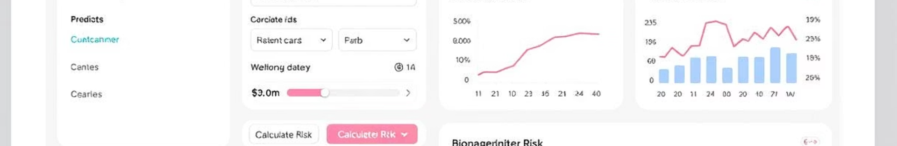



Model Tracking and Deployment
MLflow Integration
Streamlit Application
MLflow was implemented to track model performance, parameters, and metrics across all experiments, enabling better reproducibility and comparison.
A user-friendly web interface was created using Streamlit, allowing healthcare professionals to input patient data and receive cardiovascular risk predictions.
Model Serialization
The best performing LightGBM model and standardization parameters were serialized as PKL files for deployment.

Slide 8






Conclusion and Future Work
Accurate Prediction
74% accuracy in cardiovascular disease risk assessment
Key Risk Factors
Blood pressure, age, and BMI identified as strongest predictors
Practical Application
Deployed as an accessible tool for healthcare professionals
The HealthCare Predictive Analysis project successfully developed a model that can identify cardiovascular disease risk with 74% accuracy. Blood pressure measurements (systolic, diastolic, MAP, and pulse pressure) emerged as the strongest predictors, followed by age and BMI.
Future work could include incorporating additional biomarkers, expanding the dataset with more diverse populations, and developing more sophisticated ensemble models to further improve prediction accuracy. The current implementation provides a solid foundation for clinical decision support in cardiovascular risk assessment.

