Slide 1

Predictive Aircraft Valuation Using Statistical Learning

Slide 2

Analyzing the problem

Slide 3
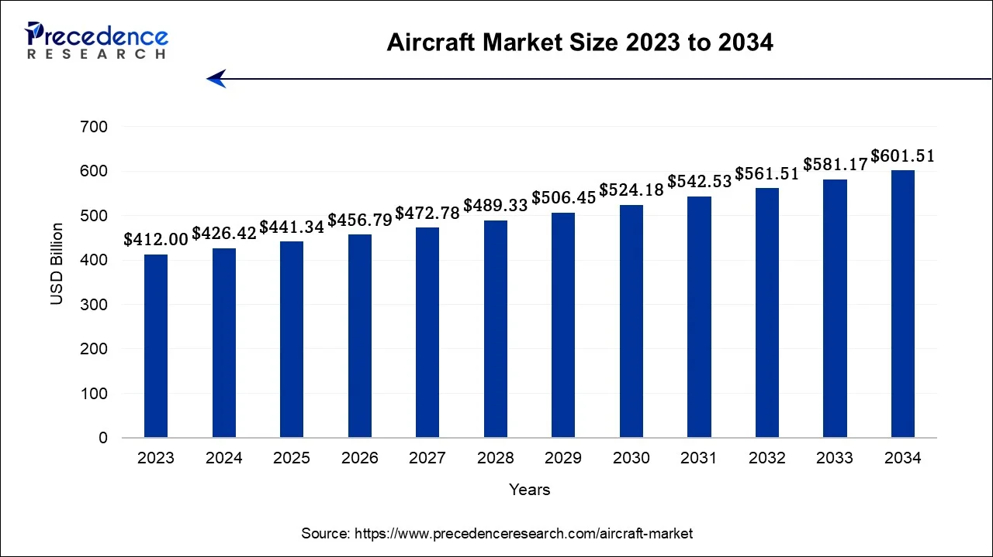
Aircraft as a growing market
The global aircraft market size was estimated at USD 426.42 billion in 2024 and is projected to hit around USD 601.51 billion by 2034

Slide 4
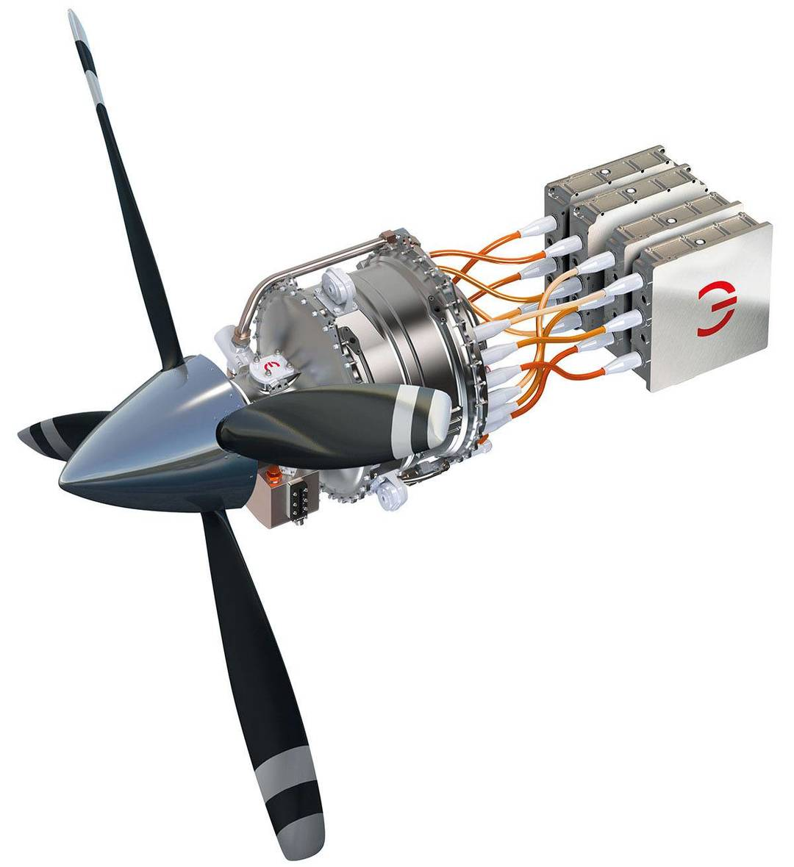

Aircraft as a Complex and Evolving Challenge
Technological innovation
(e.g. electric propulsion, lighter materials) makes traditional valuation methods less effective.
Market volatility
supply chain issues, and regulatory changes add further uncertainty.

Slide 5

Aircraft as a Complex and Evolving Challenge
Technological innovation
(e.g. electric propulsion, lighter materials) makes traditional valuation methods less effective.
Market volatility
supply chain issues, and regulatory changes add further uncertainty.
Traditional valuation
Aircraft appraisals are often slow, expensive, and subjective.

Slide 6

Aircraft as a Complex and Evolving Challenge
Technological innovation
(e.g. electric propulsion, lighter materials) makes traditional valuation methods less effective.
Market volatility
supply chain issues, and regulatory changes add further uncertainty.
Traditional valuation
Aircraft appraisals are often slow, expensive, and subjective.

Slide 7
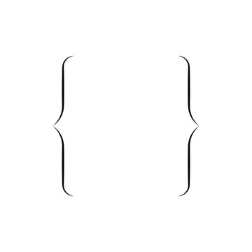

Aircraft as a Complex and Evolving Challenge
Technological innovation
(e.g. electric propulsion, lighter materials) makes traditional valuation methods less effective.
Making fast, data-driven valuation models
Market volatility
supply chain issues, and regulatory changes add further uncertainty.
Traditional valuation
Aircraft appraisals are often slow, expensive, and subjective.

Slide 8
Aircraft as a Complex and Evolving Challenge
“Traditional appraisals often require weeks and involve significant manual inspection, which is inefficient in fast-moving markets. Having a reliable data-based pricing model would be a game changer.”
Technological innovation
(e.g. electric propulsion, lighter materials) makes traditional valuation methods less effective.
Source: Interview published in Aviation Week
Market volatility
Making fast, data-driven valuation models
supply chain issues, and regulatory changes add further uncertainty.
Traditional valuation
Aircraft appraisals are often slow, expensive, and subjective.

Slide 9
Aircraft as a Complex and Evolving Challenge
“Traditional appraisals often require weeks and involve significant manual inspection, which is inefficient in fast-moving markets. Having a reliable data-based pricing model would be a game changer.”
Source: Interview published in Aviation Week
Making fast, data-driven valuation models

Slide 10

The dataset

Slide 11
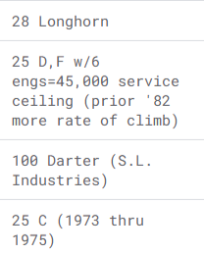
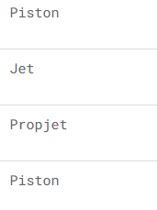
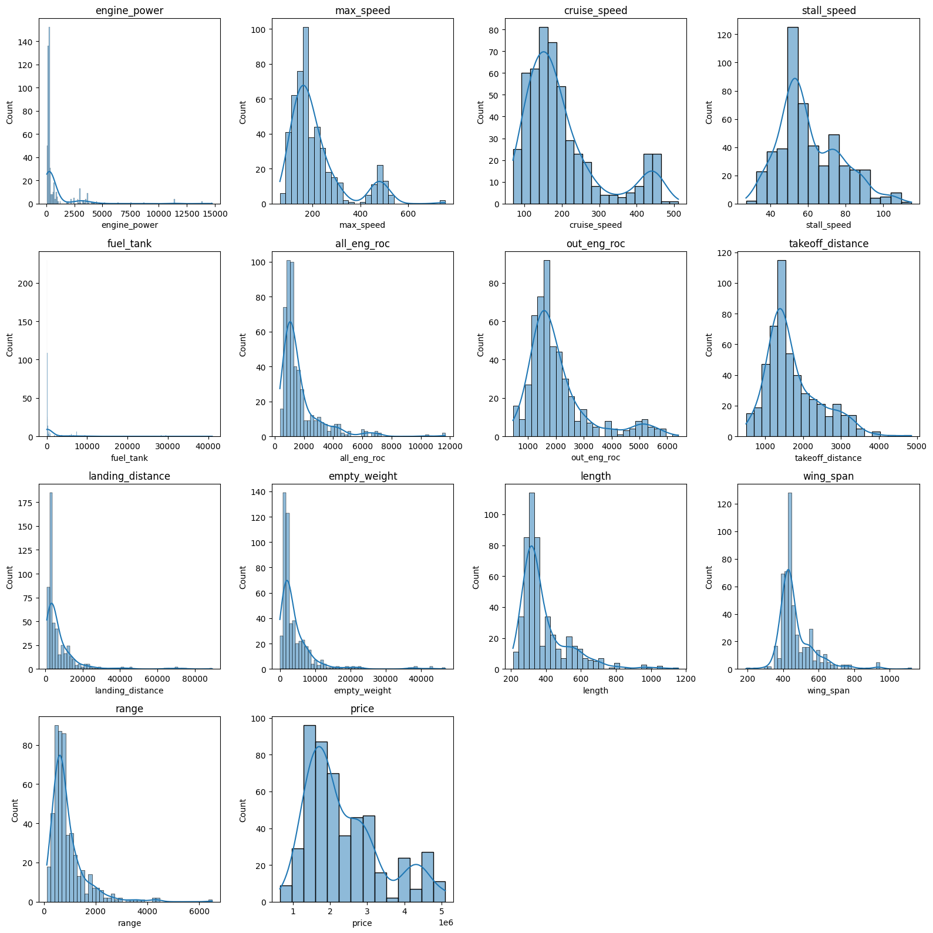
Categorical Variables
Exploring the Dataset:
model_name
engine_type:
Name of the aircraft model
Type of the engine.
Our dataset includes 14 numeric variables.

Slide 12
Numerical Variables
Exploring the Dataset:
engine_type:
model_name
Type of the engine.
Name of the aircraft model
Our dataset includes 14 numeric variables.

Slide 13
Numerical Variables
Exploring the Dataset:
engine_power
Power of the engine.
unit of measurement
HorsePower = 745.7 watts (W)

Slide 14
Numerical Variables
Exploring the Dataset:
max_speed
Maximum speed of the aircraft.
unit of measurement
Knots = 1.852 kilometers per hour (km/h)

Slide 15
Numerical Variables
Exploring the Dataset:
cruise_speed
Cruise speed of the aircraft.
unit of measurement
Knots = 1.852 kilometers per hour (km/h)

Slide 16
Numerical Variables
Exploring the Dataset:
stall_speed
Minimum speed of the aircraft to prevent stalling.
unit of measurement
Knots = 1.852 kilometers per hour (km/h)

Slide 17
Numerical Variables
Exploring the Dataset:
fuel_tank
Fuel tank capacity of the aircraft.
unit of measurement
Gallon = 3.785 liters (L)

Slide 18
Numerical Variables
Exploring the Dataset:
all_eng_roc
All Engine Rate of Climb. The maximum altitude of the aircraft at full power.
unit of measurement
Feet = 0.3048 meters (m)

Slide 19
Numerical Variables
Exploring the Dataset:
out_eng_roc
Out Engine Rate of Climb. The maximum altitude of the aircraft at out power.
unit of measurement
Feet = 0.3048 meters (m)

Slide 20
Numerical Variables
Exploring the Dataset:
takeoff_distance
The minimum distance required for an aircraft to take off.
unit of measurement
Feet = 0.3048 meters (m)

Slide 21
Numerical Variables
Exploring the Dataset:
landing_distance
The minimum distance required for an aircraft to landing.
unit of measurement
Feet = 0.3048 meters (m)

Slide 22
Numerical Variables
Exploring the Dataset:
empty_weight
Empty weight of the aircraft.
unit of measurement
Pound = 0.4536 kilograms (kg)

Slide 23
Numerical Variables
Exploring the Dataset:
length
Length of the aircraft.
unit of measurement
Inch = 2.54 centimeters (cm)

Slide 24
Numerical Variables
Exploring the Dataset:
wing_span
Wing span of the aircraft.
unit of measurement
Inch = 2.54 centimeters (cm)

Slide 25
Numerical Variables
Exploring the Dataset:
range
Range of the aircraft.
unit of measurement
Nautical mile = 1.852 kilometers (km)

Slide 26
Numerical Variables
Exploring the Dataset:
price
Price of the aircraft.
unit of measurement
USD dollars ≈ 0.92 EUR

Slide 27

Data preparation

Slide 28

Searching for missing data
A total of 10 missing values were found in the 'price' variable.
This represents a loss of approximately
1.93%
of the dataset's rows.
We decided to remove those rows.

Slide 29
Searching for missing data
A total of 10 missing values were found in the 'price' variable.
This represents a loss of approximately
1.93%
of the dataset's rows.
We decided to remove those rows.
This helps us identify highly correlated variables and ensure the reliability of our regression coefficients.

Slide 30
Calculating Variance Inflation Factor
Regressor | VIF
landing_distance | 172.36
empty_weight | 133.36
const | 94.26
fuel_tank | 27.04
engine_power | 24.51
length | 20.30
cruise_speed | 10.60
price | 8.62
Regressor | VIF
wing_span | 7.25
out_eng_roc | 6.51
max_speed | 5.30
takeoff_distance | 5.24
range | 4.65
stall_speed | 4.54
all_eng_roc | 2.71
This helps us identify highly correlated variables and ensure the reliability of our regression coefficients.

Slide 31
Calculating Variance Inflation Factor
Regressor | VIF
landing_distance | 172.36
empty_weight | 133.36
const | 94.26
fuel_tank | 27.04
engine_power | 24.51
length | 20.30
cruise_speed | 10.60
price | 8.62
Regressor | VIF
wing_span | 7.25
out_eng_roc | 6.51
max_speed | 5.30
takeoff_distance | 5.24
range | 4.65
stall_speed | 4.54
all_eng_roc | 2.71
This helps us identify highly correlated variables and ensure the reliability of our regression coefficients.

Slide 32
Calculating the Skewness
Regressor | Skewness
fuel_tank | 5.04
engine_power | 4.69
landing_distance | 4.29
empty_weight | 4.19
all_eng_roc | 3.00
range | 2.94
wing_span | 2.19
Regressor | Skewness
length | 2.10
out_eng_roc | 1.74
max_speed | 1.69
cruise_speed | 1.37
takeoff_distance | 1.05
price | 0.94
stall_speed | 0.70
We evaluate the symmetry of the numerical variable distributions. This helps us detect potential distortions that might affect model performance…
… And decided to apply a log transformation to all variables with skewness greater than 1.

Slide 33
Calculating the Skewness
Regressor | Skewness
fuel_tank | 5.04
engine_power | 4.69
landing_distance | 4.29
empty_weight | 4.19
all_eng_roc | 3.00
range | 2.94
wing_span | 2.19
Regressor | Skewness
length | 2.10
out_eng_roc | 1.74
max_speed | 1.69
cruise_speed | 1.37
takeoff_distance | 1.05
price | 0.94
stall_speed | 0.70
We evaluate the symmetry of the numerical variable distributions. This helps us detect potential distortions that might affect model performance…
… And decided to apply a log transformation to all variables with skewness greater than 1.

Slide 34
Overall results

Slide 35
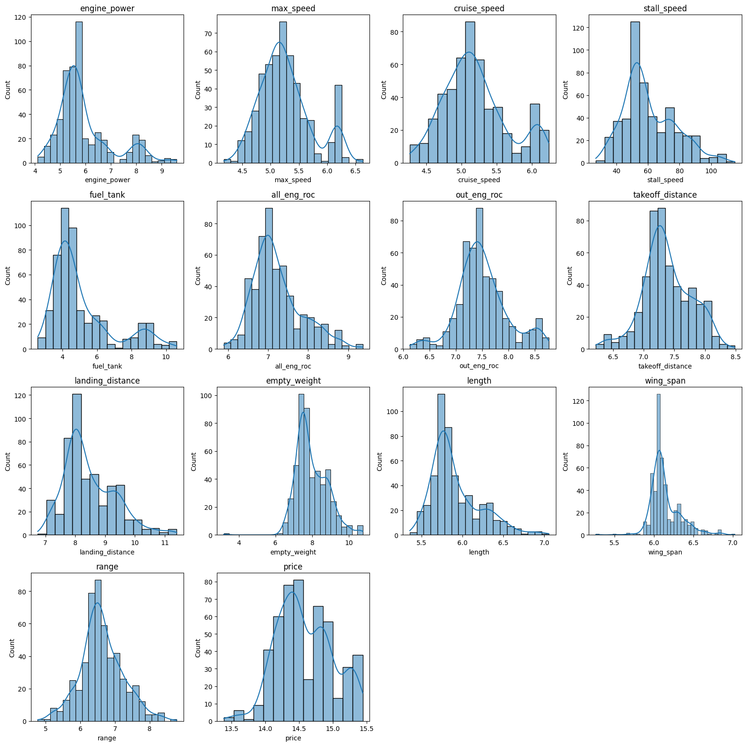
Overall results

Slide 36
Some results
Original
Log-Transformed

Slide 37
Some results
Original
Log-Transformed

Slide 38
Some results
Original
Log-Transformed

Slide 39
Some results
TARGET
Original
Log-Transformed

Slide 40
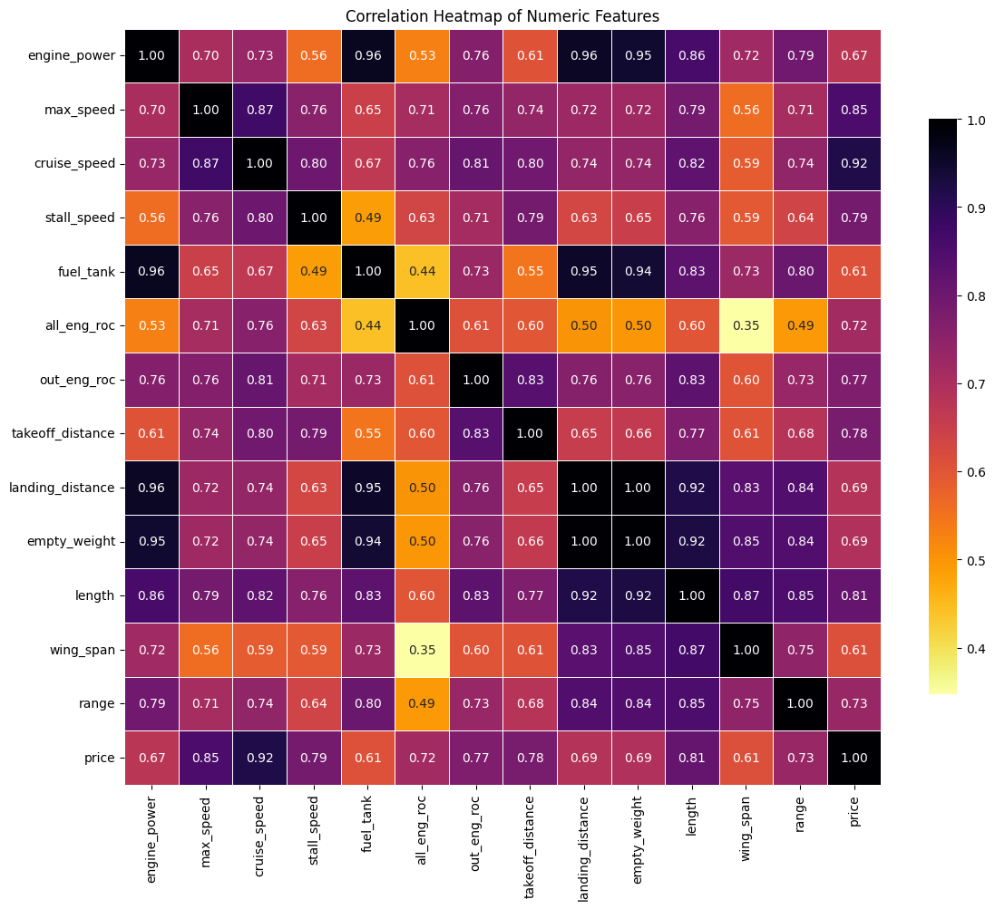
Correlation matrix

Slide 41
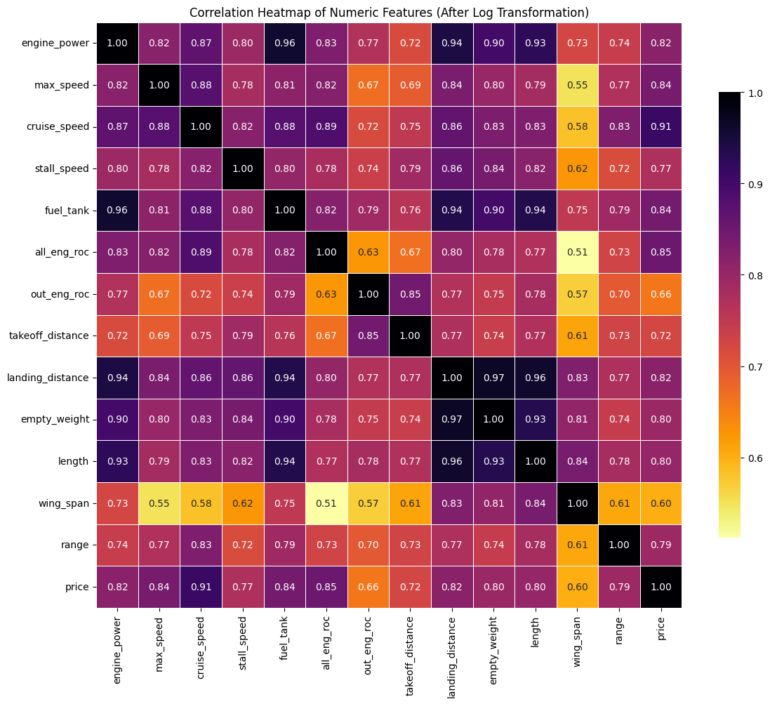
Correlation matrix

Slide 42
Old vs New Variance Inflation Factor
Regressor | VIF
landing_distance | 172.36
empty_weight | 133.36
const | 94.26
fuel_tank | 27.04
engine_power | 24.51
length | 20.30
cruise_speed | 10.60
price | 8.62
Regressor | VIF
wing_span | 7.25
out_eng_roc | 6.51
max_speed | 5.30
takeoff_distance | 5.24
range | 4.65
stall_speed | 4.54
all_eng_roc | 2.71
This helps us identify highly correlated variables and ensure the reliability of our regression coefficients.

Slide 43
Old vs New Variance Inflation Factor
Regressor | VIF
landing_distance | 172.36
empty_weight | 133.36
const | 94.26
fuel_tank | 27.04
engine_power | 24.51
length | 20.30
cruise_speed | 10.60
price | 8.62
Regressor | VIF
wing_span | 7.25
out_eng_roc | 6.51
max_speed | 5.30
takeoff_distance | 5.24
range | 4.65
stall_speed | 4.54
all_eng_roc | 2.71
This helps us identify highly correlated variables and ensure the reliability of our regression coefficients.

Slide 44
Old vs New Variance Inflation Factor
Regressor | VIF Variation
landing_distance | - 117.53
empty_weight | - 116.17
const | - 74.99
fuel_tank | - 8.21
engine_power | - 2.82
length | - 1.03
cruise_speed | + 2.22
price | - 1.22
Regressor | VIF Variation
wing_span | - 0.92
out_eng_roc | - 1.28
max_speed | + 0.45
takeoff_distance | + 0.11
range | - 0.51
stall_speed | + 1.01
all_eng_roc | + 3.33
This helps us identify highly correlated variables and ensure the reliability of our regression coefficients.

Slide 45
Old vs New Variance Inflation Factor
Regressor | VIF
landing_distance | 54.83
empty_weight | 17.19
const | 19.27
fuel_tank | 18.83
engine_power | 21.69
length | 19.27
cruise_speed | 12.82
price | 7.40
Regressor | VIF
wing_span | 6.33
out_eng_roc | 5.23
max_speed | 5.75
takeoff_distance | 5.35
range | 4.14
stall_speed | 5.53
all_eng_roc | 6.04
This helps us identify highly correlated variables and ensure the reliability of our regression coefficients.

Slide 46
Not enough

Slide 47
Feature engineering
To address high VIF values,
we implemented an iterative procedure that removes one variable at a time based on the highest VIF score. At each step, the VIF is recalculated until all remaining variables have a VIF below a defined threshold of 10. This approach helps reduce multicollinearity while preserving the most relevant features.

Slide 48
Feature engineering
Regressor | VIF
landing_distance | 54.83
empty_weight | 17.19
const | 19.27
fuel_tank | 18.83
engine_power | 21.69
length | 19.27
cruise_speed | 12.82
price | 7.40
Regressor | VIF
wing_span | 6.33
out_eng_roc | 5.23
max_speed | 5.75
takeoff_distance | 5.35
range | 4.14
stall_speed | 5.53
all_eng_roc | 6.04

Slide 49
Feature engineering
Regressor | VIF
landing_distance | 54.83
empty_weight | 17.19
const | 19.27
fuel_tank | 18.83
engine_power | 21.69
length | 19.27
cruise_speed | 12.82
price | 7.40
Regressor | VIF
wing_span | 6.33
out_eng_roc | 5.23
max_speed | 5.75
takeoff_distance | 5.35
range | 4.14
stall_speed | 5.53
all_eng_roc | 6.04

Slide 50
Feature engineering
Regressor | VIF
const | 6462.81
engine_power | 7.88
price | 5.74
all_eng_roc | 5.64
takeoff_distance | 5.19
Regressor | VIF
out_eng_roc | 4.90
max_speed | 4.89
stall_speed | 4.34
range | 3.52
wing_span | 2.65

Slide 51
Feature engineering
Regressor | VIF
const | 6462.81
engine_power | 7.88
price | 5.74
all_eng_roc | 5.64
takeoff_distance | 5.19
Regressor | VIF
out_eng_roc | 4.90
max_speed | 4.89
stall_speed | 4.34
range | 3.52
wing_span | 2.65

Slide 52
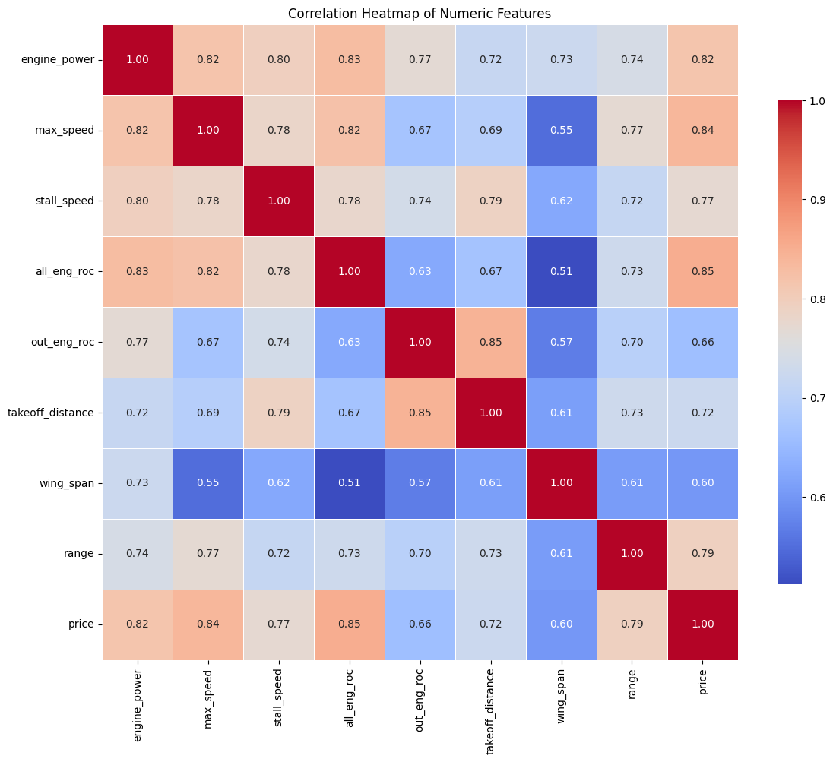
Correlation matrix

Slide 53
Feature engineering
Regressor | VIF
const | 6462.81
engine_power | 7.88
price | 5.74
all_eng_roc | 5.64
takeoff_distance | 5.19
Regressor | VIF
out_eng_roc | 4.90
max_speed | 4.89
stall_speed | 4.34
range | 3.52
wing_span | 2.65

Slide 54
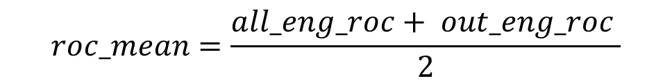
Feature engineering
Regressor | VIF
const | 6462.81
engine_power | 7.88
price | 5.74
all_eng_roc | 5.64
takeoff_distance | 5.19
Regressor | VIF
out_eng_roc | 4.90
max_speed | 4.89
stall_speed | 4.34
range | 3.52
wing_span | 2.65
$$roc_mean=\frac{all_eng_roc+ out_eng_roc }{2}$$

Slide 55
Feature engineering
Regressor | VIF
const | 6462.81
engine_power | 7.88
price | 5.74
all_eng_roc | 5.64
takeoff_distance | 5.19
Regressor | VIF
out_eng_roc | 4.90
max_speed | 4.89
stall_speed | 4.34
range | 3.52
wing_span | 2.65
$$speed_margin=max_speed− stall_speed$$

Slide 56
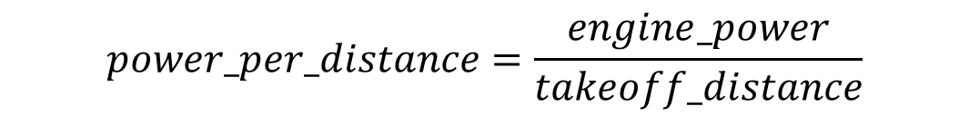
Feature engineering
Regressor | VIF
const | 6462.81
engine_power | 7.88
price | 5.74
all_eng_roc | 5.64
takeoff_distance | 5.19
Regressor | VIF
out_eng_roc | 4.90
max_speed | 4.89
stall_speed | 4.34
range | 3.52
wing_span | 2.65
$$power_per_distance=\frac{engine_power}{takeoff_distance}$$

Slide 57
Result
Regressor | VIF
const | 2327.79
roc_mean | 5.88
speed_margin | 3.63
power_per_distance | 3.14
wing_span | 2.12
range | 2.90

Slide 58
Result
Regressor | VIF
const | 2327.79
roc_mean | 5.88
speed_margin | 3.63
power_per_distance | 3.14
wing_span | 2.12
range | 2.90

Slide 59
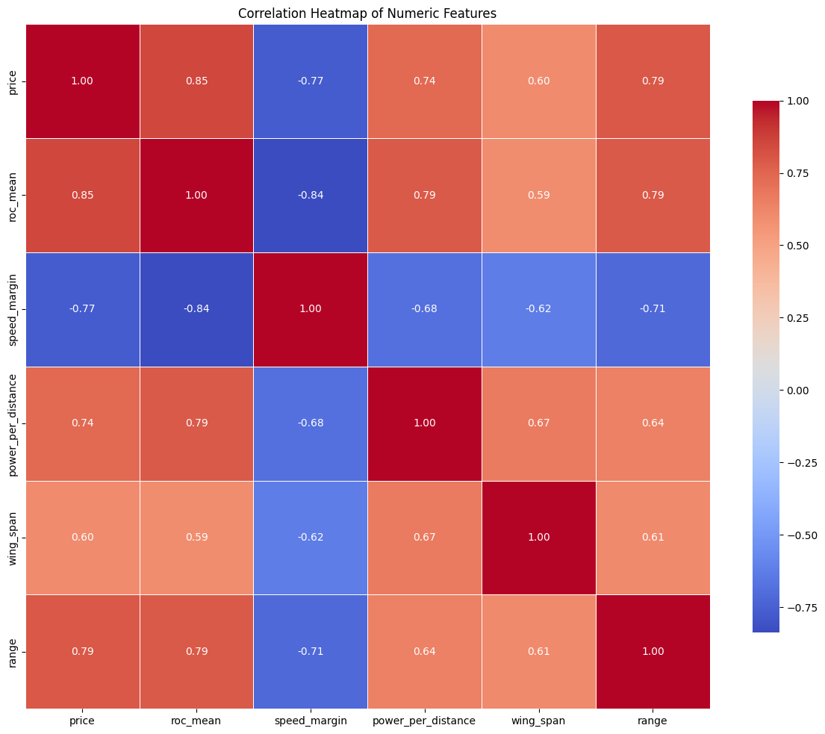
Correlation matrix

Slide 60
But what if we hadn’t log-transformed

Slide 61
Correlation matrix
OLD

Slide 62
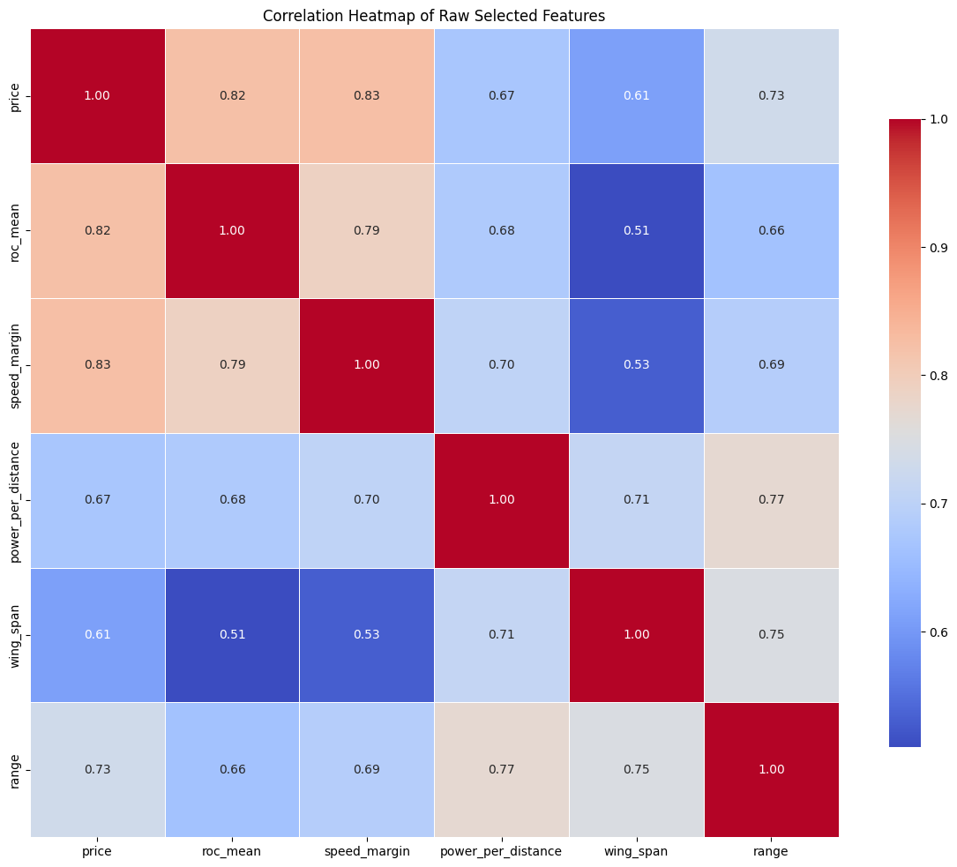
Correlation matrix
NEW

Slide 63
What about the VIF
Regressor | VIF
const | 2327.79
roc_mean | 5.88
speed_margin | 3.63
power_per_distance | 3.14
wing_span | 2.12
range | 2.90
Regressor | VIF
const | 42.8
roc_mean | 3.77
speed_margin | 3.95
power_per_distance | 3.41
wing_span | 2.68
range | 3.67
OLD
NEW

Slide 64
And what if we now log transform only the target?

Slide 65
Correlation matrix
OLD

Slide 66
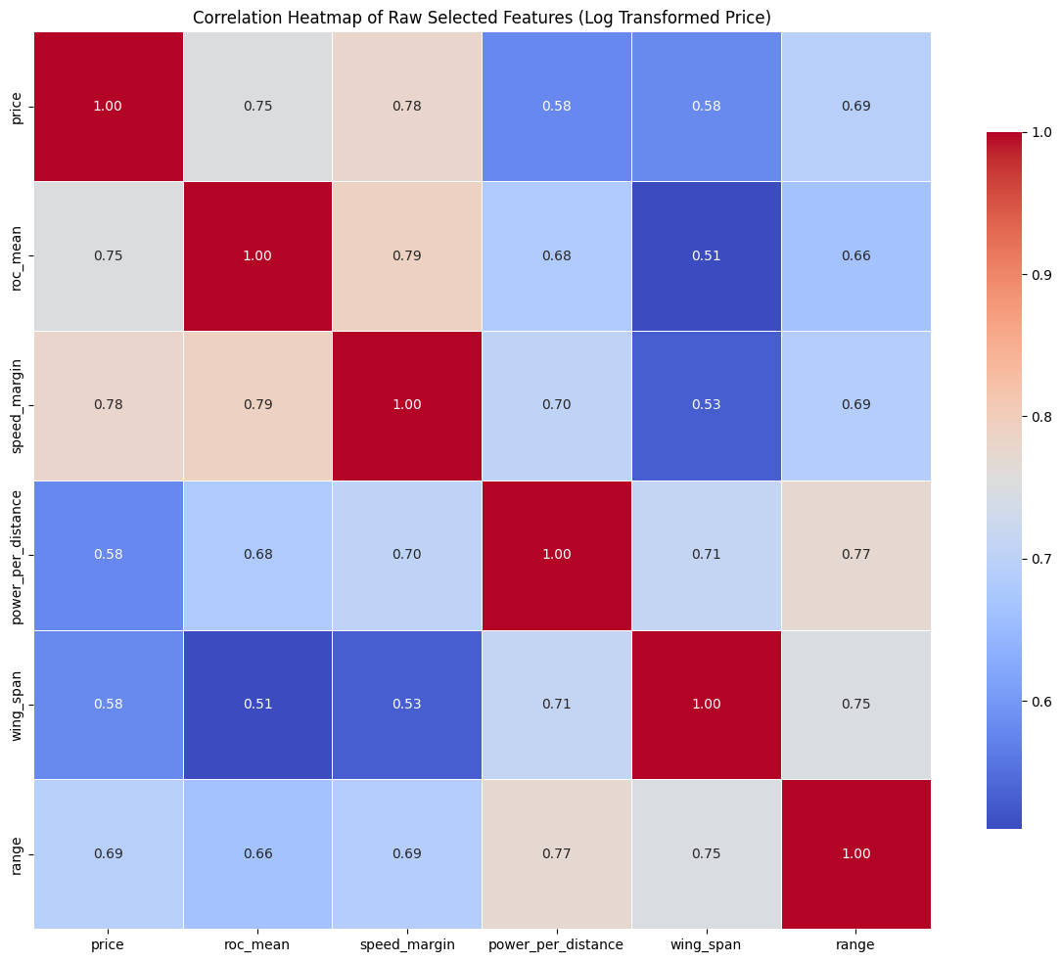
Correlation matrix
NEW

Slide 67
What about the VIF
Regressor | VIF
const | 42.8
roc_mean | 3.77
speed_margin | 3.95
power_per_distance | 3.41
wing_span | 2.68
range | 3.67
Regressor | VIF
const | 3885.36
roc_mean | 3.37
speed_margin | 3.90
power_per_distance | 3.63
wing_span | 2.71
range | 3.70
OLD
NEW

Slide 68
We decided that applying a log transformation only to the target variable results in the best model

Slide 69
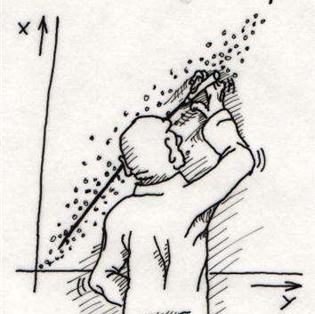
Linear Regression

Slide 70

$y=β_{0}+β_{1}× ????????????+e$
Choosing the regressor:
We developed a piece of code that allowed us to identify the most promising numerical variables for predicting the price, selecting those with the lowest p-values and a good coefficient of determination (R²).

Slide 71
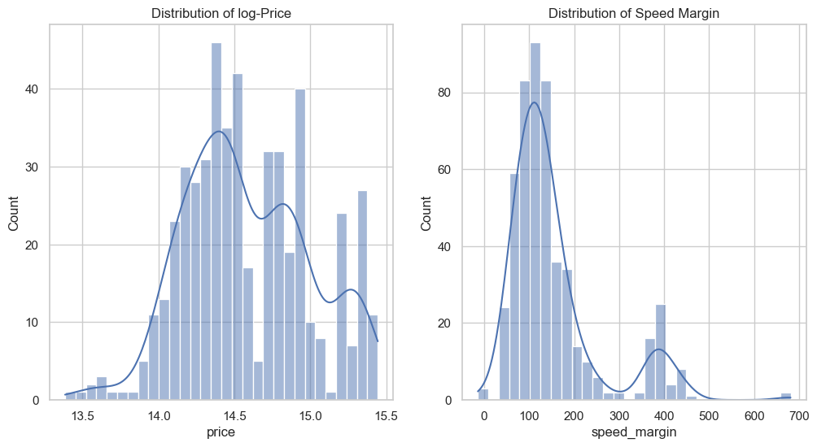

$y=β_{0}+β_{1}×speed_margin+e$
Choosing the regressor:
Log-Value
7
7,5
8
8,5

Slide 72
$y=β_{0}+β_{1}×speed_margin+e$
Prediction:
Log-Value
70
100
150
200

Slide 73
$y=β_{0}+β_{1}×speed_margin+e$
Prediction:
Log-Value | Log-Value Prediction
70 | 14.33 (± 0.029)
100 | 14.42 (± 0.025)
150 | 14.58 (± 0.022)
200 | 14.73 (± 0.025)

Slide 74
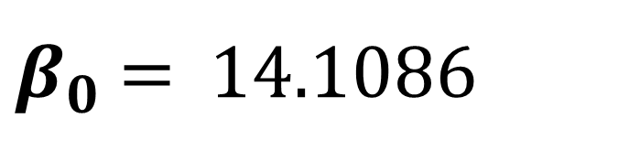
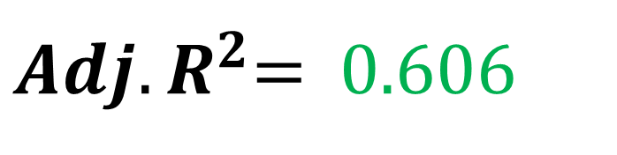
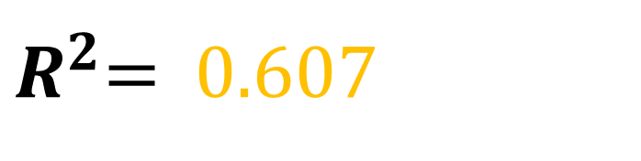
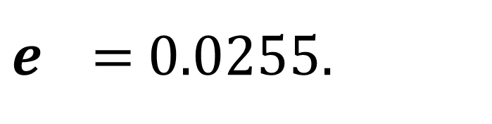
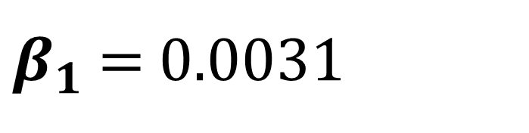
$y=β_{0}+β_{1}×speed_margin+e$
Prediction:
Log-Value | Log-Value Prediction | Prediction
70 | 14.33 (± 0.029) | 1 672 784.23
100 | 14.42 (± 0.025) | 1 830 317.48
150 | 14.58 (± 0.022) | 2 147 897.46
200 | 14.73 (± 0.025) | 2 495 500.82
$β_{0}$ = 14.1086
$R^{2}$= 0.607
$β_{1}$ = 0.0031
${Adj. R}^{2}$= 0.606
$e$ = 0.0255.

Slide 75

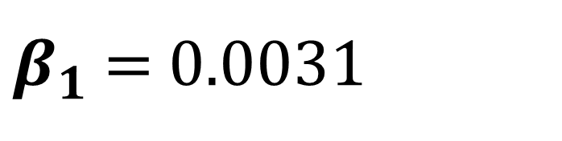
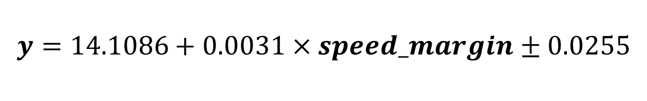
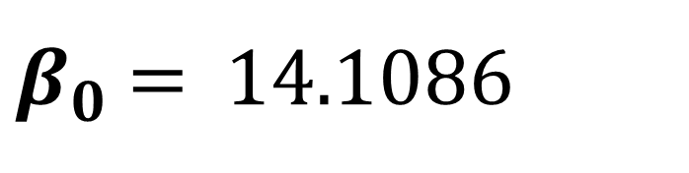
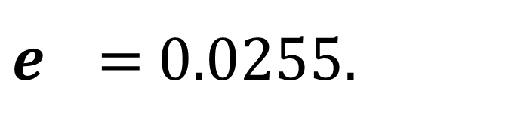
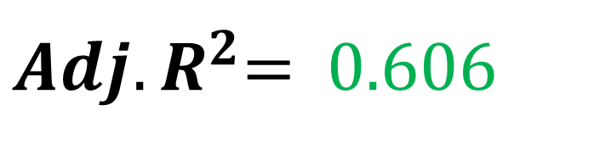
$y=β_{0}+β_{1}×speed_margin+e$
Formula:
Log-Value | Log-Value Prediction | Prediction
70 | 14.33 (± 0.029) | 1 672 784.23
100 | 14.42 (± 0.025) | 1 830 317.48
150 | 14.58 (± 0.022) | 2 147 897.46
200 | 14.73 (± 0.025) | 2 495 500.82
$β_{0}$ = 14.1086
$R^{2}$= 0.607
$$y=\text{14.1086}+\text{0.0031}×speed_margin±\text{0.0255}$$
$β_{1}$ = 0.0031
${Adj. R}^{2}$= 0.606
$e$ = 0.0255.

Slide 76
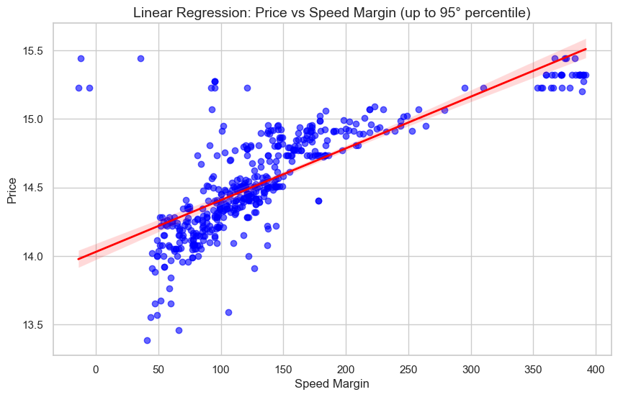
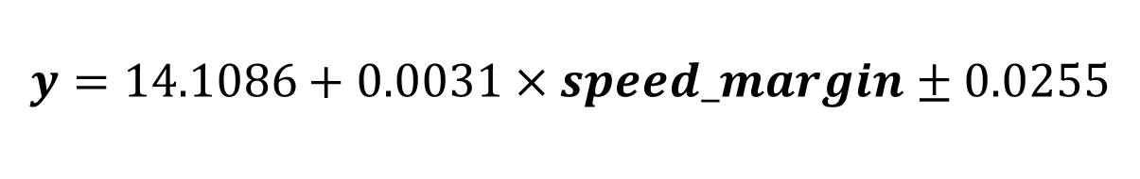
$y=β_{0}+β_{1}×speed_margin+e$
Formula:
$β_{0}$ = 14.1086
$$y=\text{14.1086}+\text{0.0031}×speed_margin±\text{0.0255}$$
$β_{1}$ = 0.0031
$e$ = 0.0255.

Slide 77
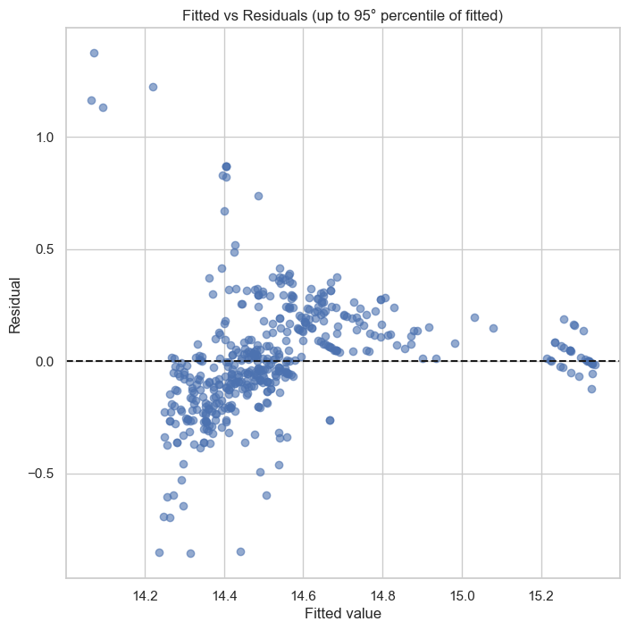
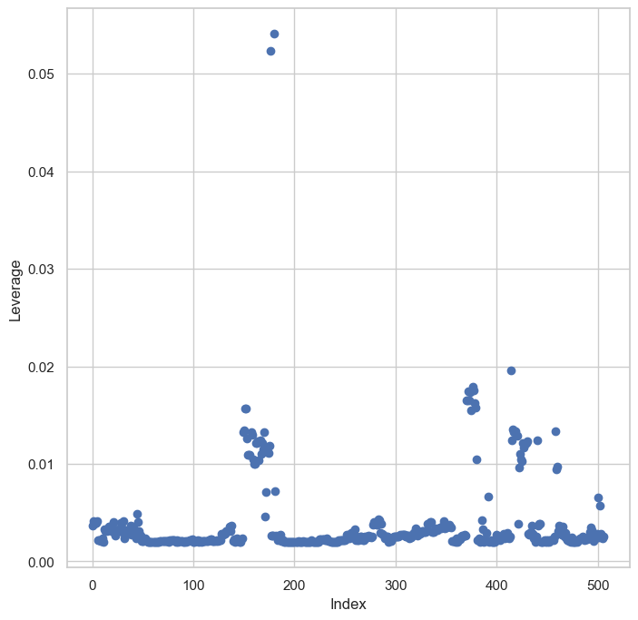
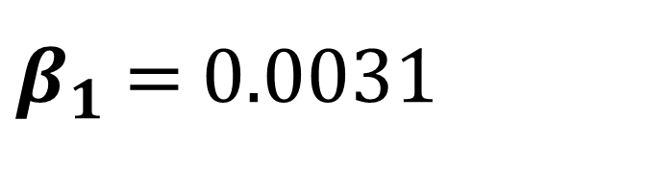

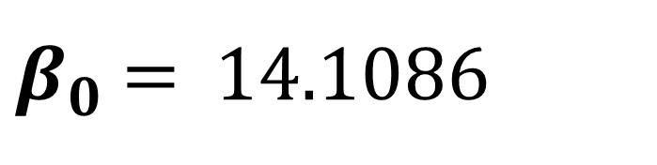
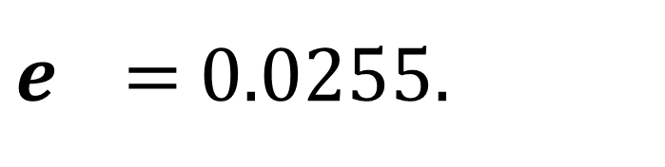
$$y=\text{14.1086}+\text{0.0031}×speed_margin±\text{0.0255}$$
Plots:
$β_{0}$ = 14.1086
$β_{1}$ = 0.0031
$e$ = 0.0255.

Slide 78

$$y=\text{9.3492}+\text{0.7114}×roc_mean±\text{0.0305}$$
Plots:

Slide 79
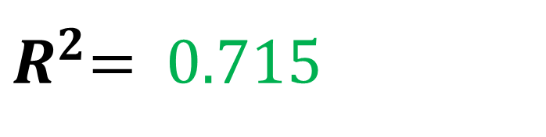

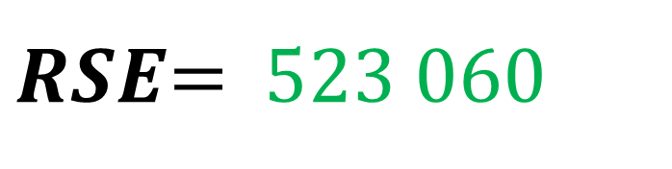
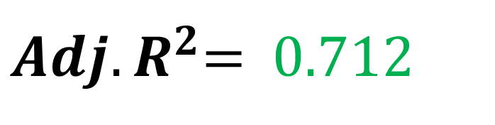
$Multiple Linear Regression$
Using all the regressors:
$R^{2}$= 0.715
${Adj. R}^{2}$= 0.712
$RSE$= 523 060

Slide 80
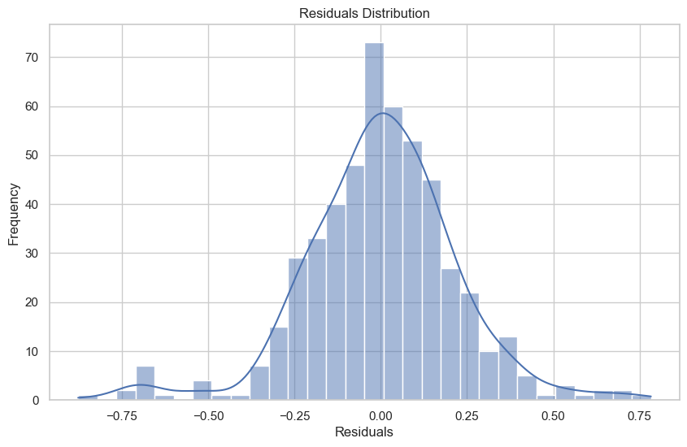
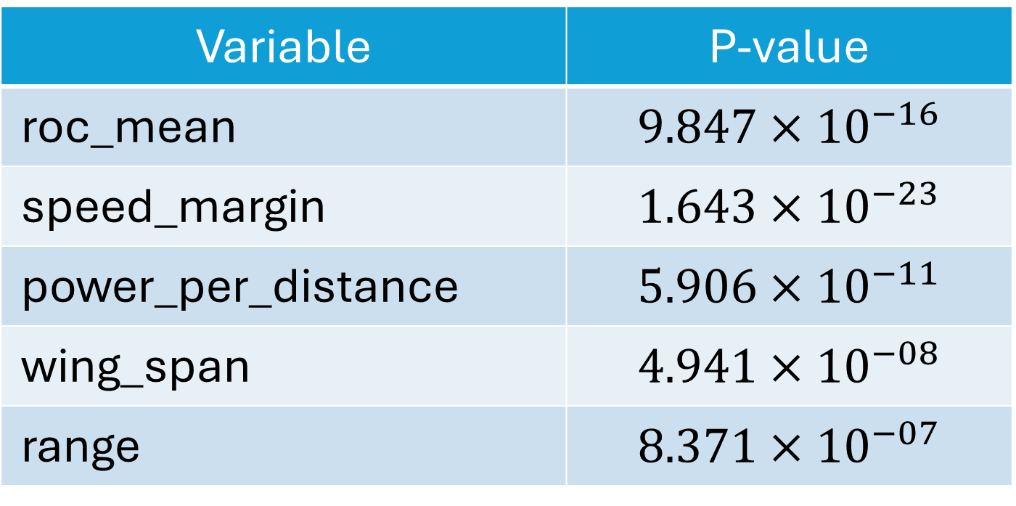
$Multiple Linear Regression$
Using all the regressors:
Variable | P-value
roc_mean | $$9.847×{10}^{−16}$$
speed_margin | $$1.643×{10}^{−23}$$
power_per_distance | $$5.906×{10}^{−11}$$
wing_span | $$4.941×{10}^{−08}$$
range | $$8.371×{10}^{−07}$$

Slide 81
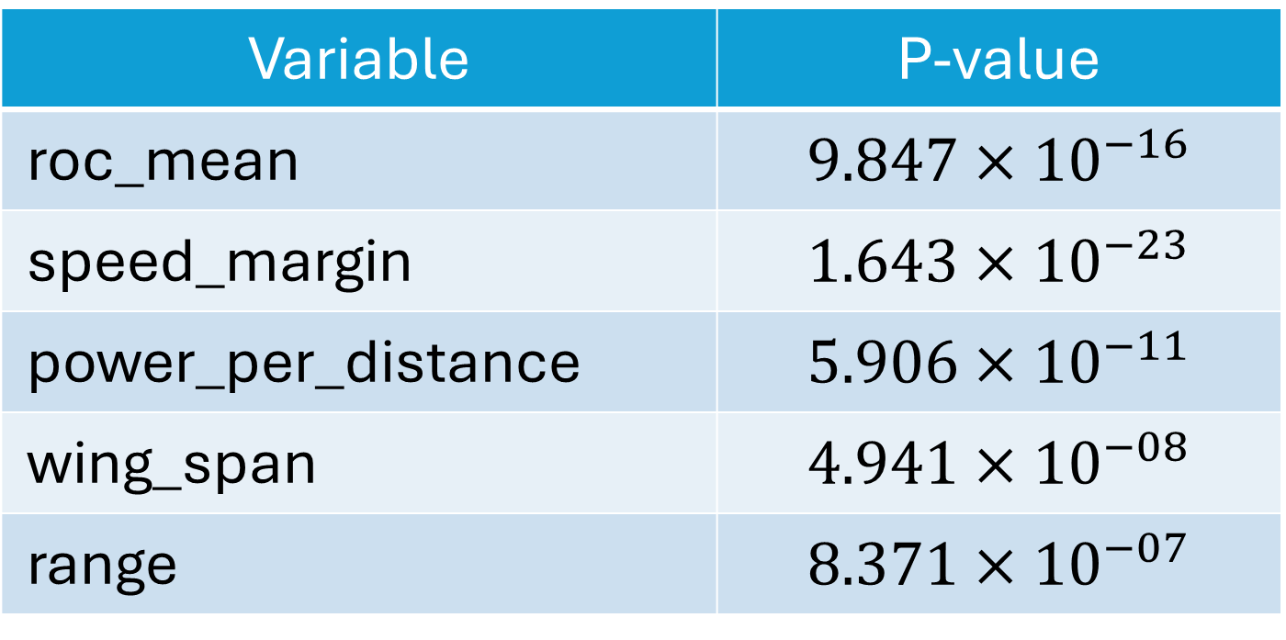
$Multiple Linear Regression$
Plots:
Variable | P-value
roc_mean | $$9.847×{10}^{−16}$$
speed_margin | $$1.643×{10}^{−23}$$
power_per_distance | $$5.906×{10}^{−11}$$
wing_span | $$4.941×{10}^{−08}$$
range | $$8.371×{10}^{−07}$$

Slide 82
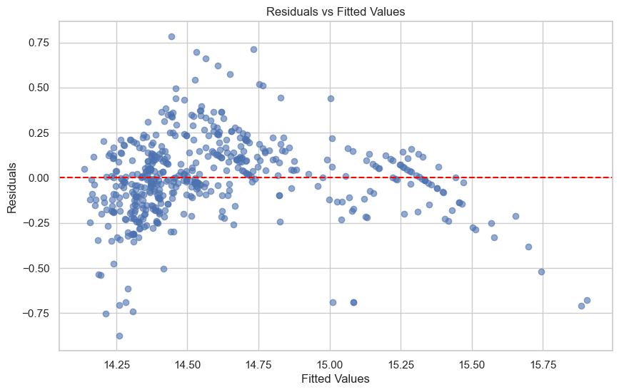
$Multiple Linear Regression$
Plots:

Slide 83
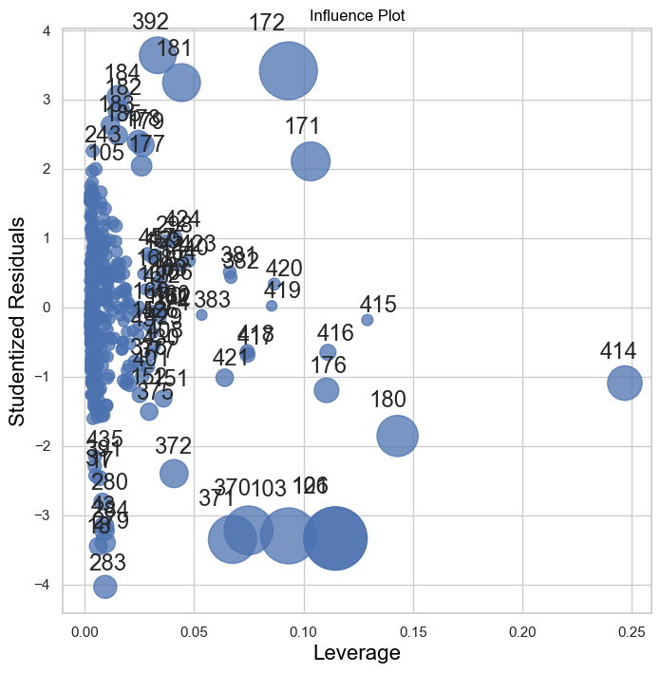
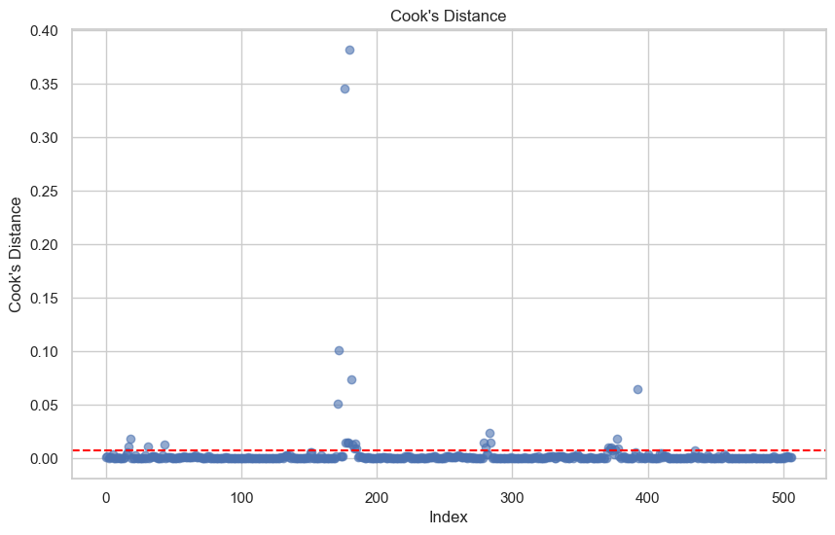
$Multiple Linear Regression$
Plots:

Slide 84
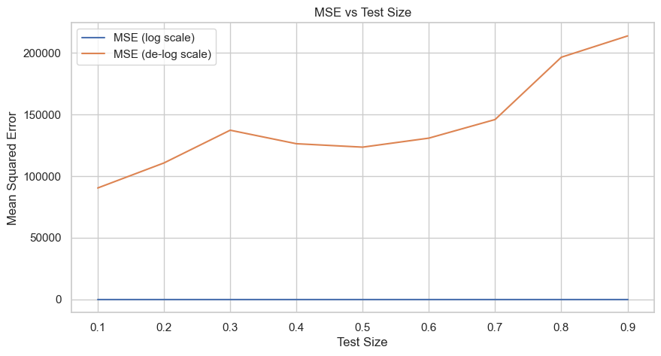
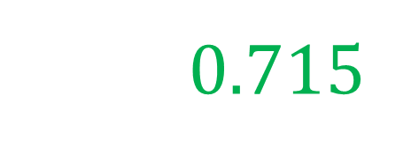

$80−20 Cross Validation$
$R^{2}$= 0.715

Slide 85
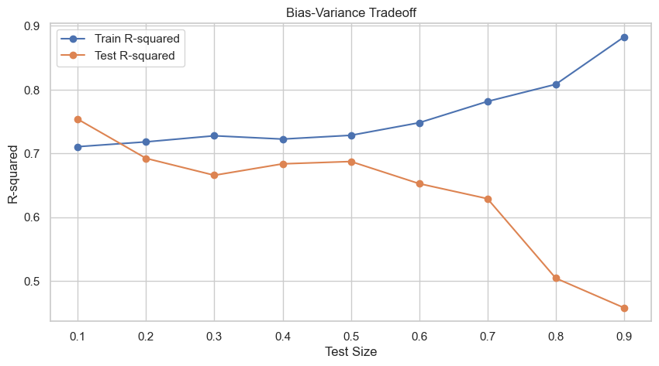

$80 −20 Cross Validation$
$R^{2}$= 0.715

Slide 86
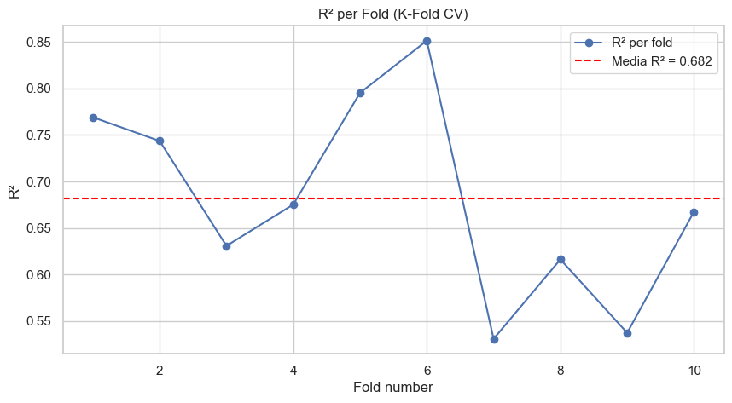

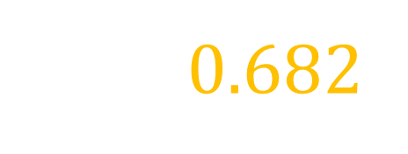
$K−Fold Cross Validation$
$R^{2}$= 0.682

Slide 87
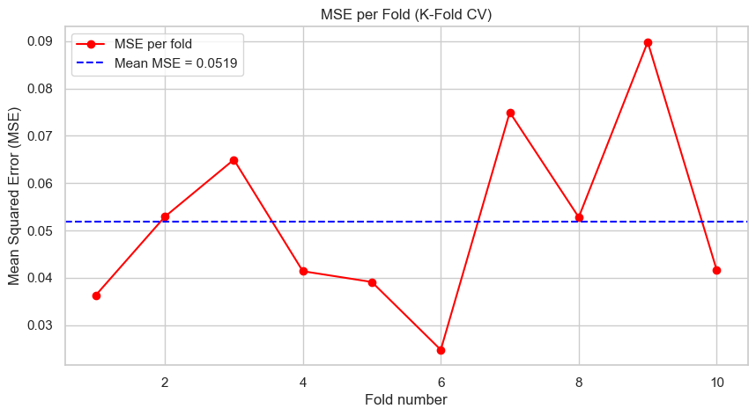
$K−Fold Cross Validation$
$R^{2}$= 0.682

Slide 88
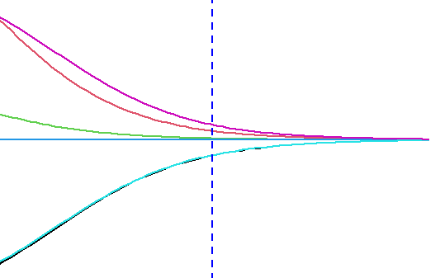
Ridge & Lasso

Slide 89


$$Ridge$$

Slide 90

$$Ridge$$

Slide 91


$$Lasso$$

Slide 92

$$Lasso$$

