Slide 1
Task 8
Generative
Models
TIES 4911 · 2026
CVAE · DCGAN vs MLP-GAN · Stable Diffusion
Dataset: tf_flowers (3,670 images)
Bahous Amine

Slide 2
Overview
What We Built
01
CVAE
Conditional Variational Autoencoder — class-conditioned flower generation
02
DCGAN vs MLP-GAN
Two architectures, one dataset, compared side-by-side
03
Stable Diffusion
Prompt engineering & generative AI services explored

Slide 3
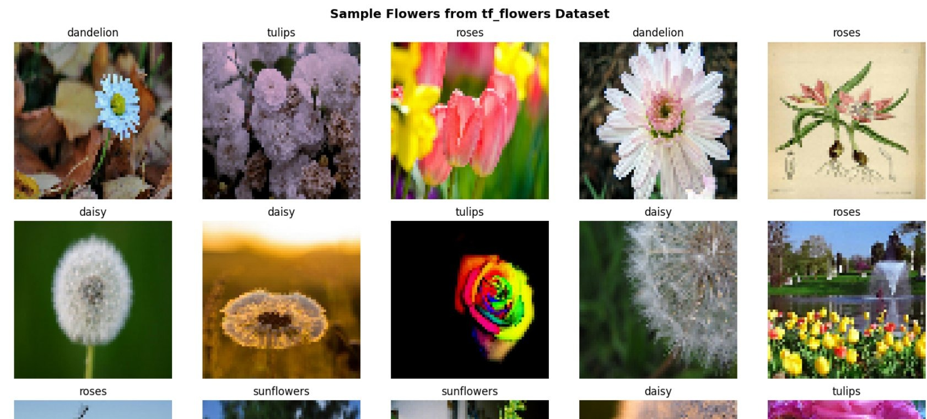
DATASET
tf_flowers
3,670
5
64×64
80/20
Total Images
Flower Classes
Pixel Resolution
Train / Test Split

Slide 4
TASK 8-1
Conditional VAE
Generating flowers conditioned on class labels
Input Image
+ Class Label
Encoder
Conv + Dense
Latent Space
z ~ N(μ, σ²)
Decoder
Dense + Conv
→
→
→
Generated Image
Architecture
Conv encoder, Dense latent projections, deconvolutional decoder (latent dim: 128)
Conditioning
Class label embedded and concatenated at both encoder and decoder stages
Loss
Reconstruction loss (MSE) + KL divergence regularisation (ELBO)
Training
60 epochs on tf_flowers — train/test loss converge cleanly after ~15 epochs

Slide 5
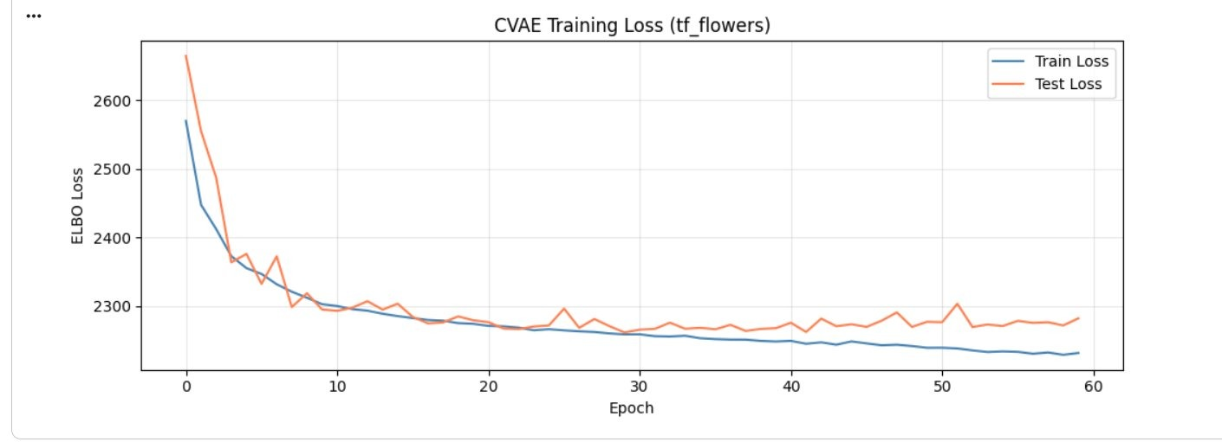
TASK 8-1 · TRAINING
CVAE Training Loss
ELBO loss (train + test) over 60 epochs — both curves converge, confirming stable learning
Sharp drop
Loss falls steeply in first 10 epochs as model learns basic structure
Convergence
Train and test loss stabilise together — no significant overfitting

Slide 6
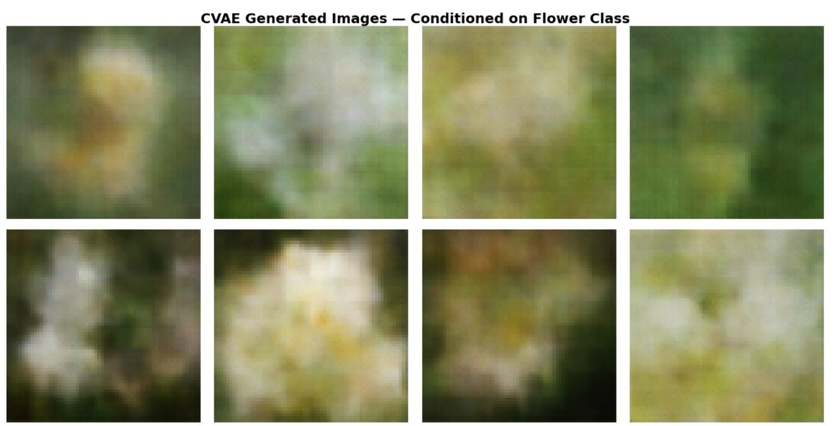
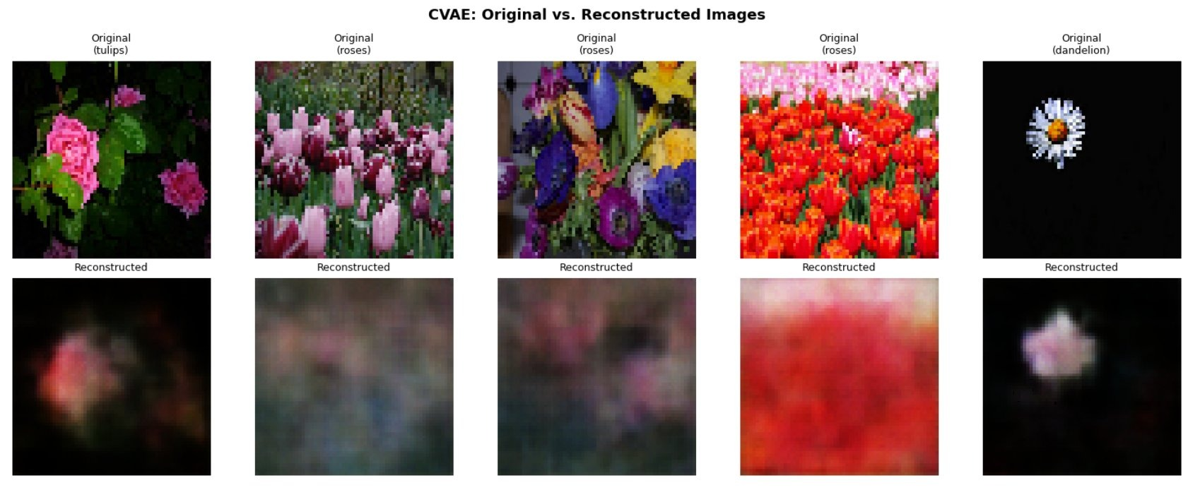
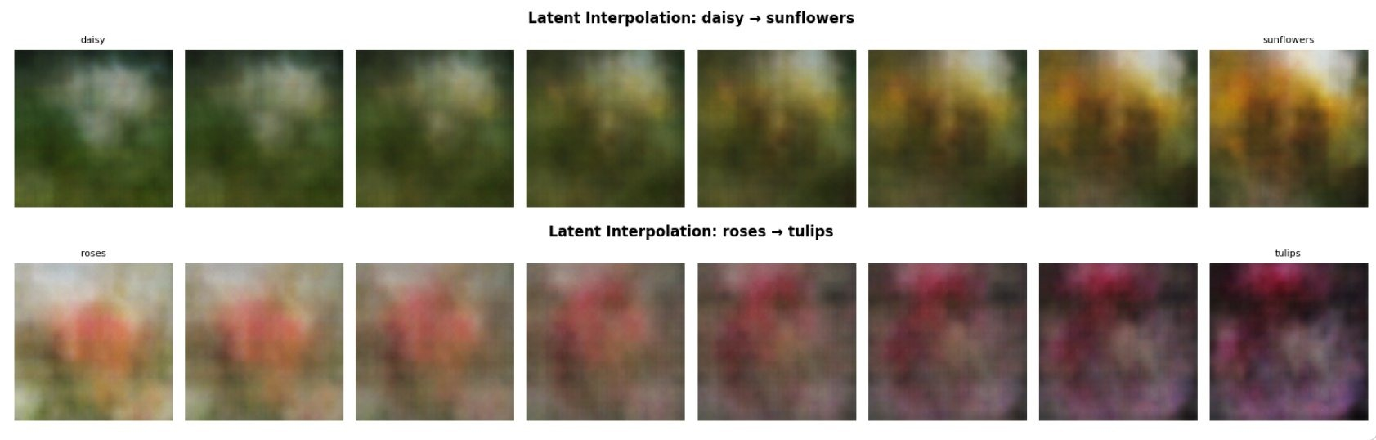
TASK 8-1 · RESULTS
CVAE Generated & Reconstructed
Conditioned Generation
Original vs. Reconstructed
Latent Space Interpolation (daisy → sunflowers · roses → tulips)

Slide 7
TASK 8-2
DCGAN vs MLP-GAN
Two generator architectures trained on the same flowers dataset
DCGAN
MLP-GAN
Generator
Generator
Dense → Reshape → 3× Conv2DTranspose → tanh
Dense → Dense → Dense → Reshape → tanh
Discriminator
Discriminator
3× Conv2D → Flatten → Dense(1)
Flatten → Dense → Dense → Dense(1)
Strength
Strength
Captures spatial structure via convolutions
Simpler; fewer parameters
Output size
Output size
32×32×3 color images
32×32×3 (same res, lower quality)
Key modification: Conv2D/Conv2DTranspose layers replaced with Dense layers in MLP variant — derived directly from DCGAN code.

Slide 8
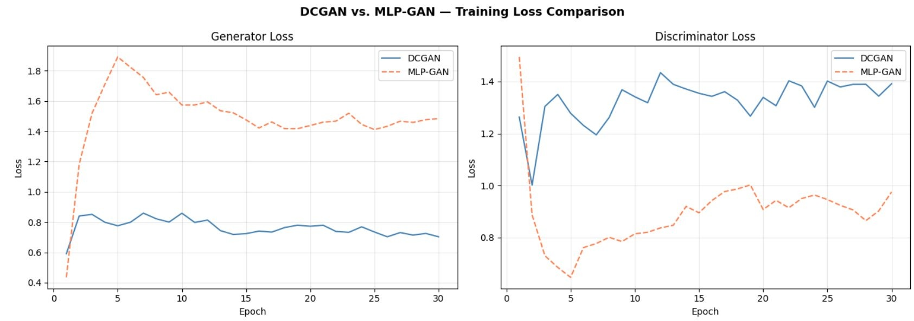
TASK 8-2 · TRAINING
Training Loss Comparison
Generator and discriminator loss over 30 epochs — DCGAN stabilises, MLP-GAN struggles
DCGAN
Generator loss stabilises ~0.75; discriminator holds steady — balanced adversarial training
MLP-GAN
Generator loss stays higher (~1.5); discriminator weaker — no spatial inductive bias

Slide 9
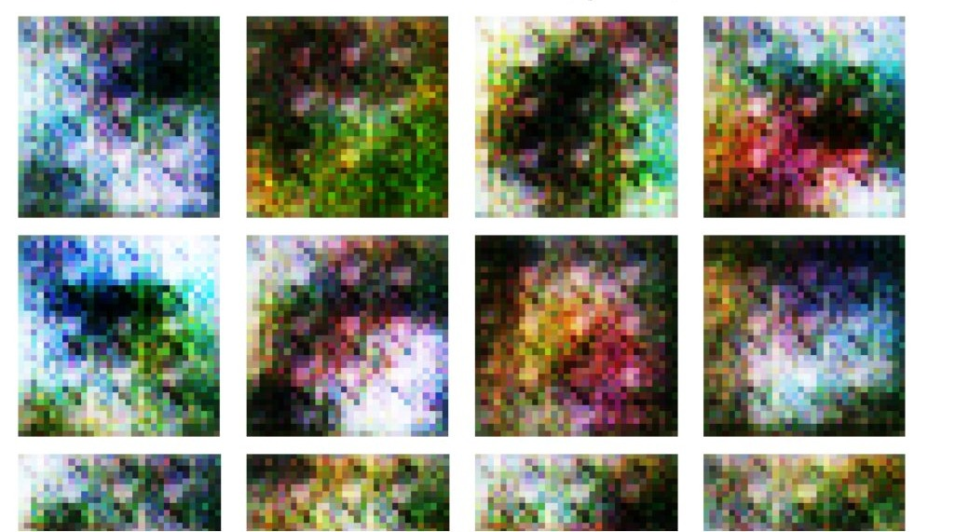
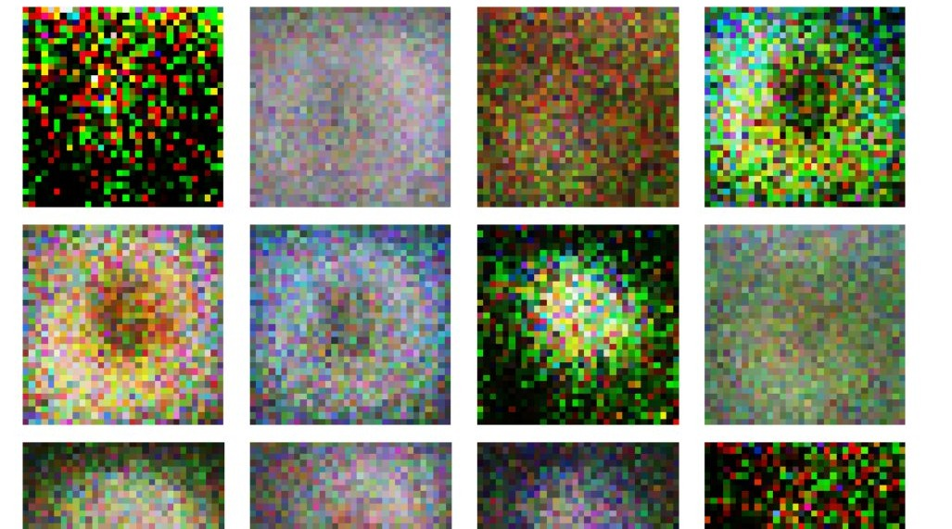
TASK 8-2 · RESULTS
Generated Images: DCGAN vs MLP-GAN
DCGAN — Epoch 30
MLP-GAN — Epoch 30
DCGAN produces more coherent colour blobs with flower-like structure. MLP-GAN generates noisier, more random patterns — convolutions matter for image data.

Slide 10
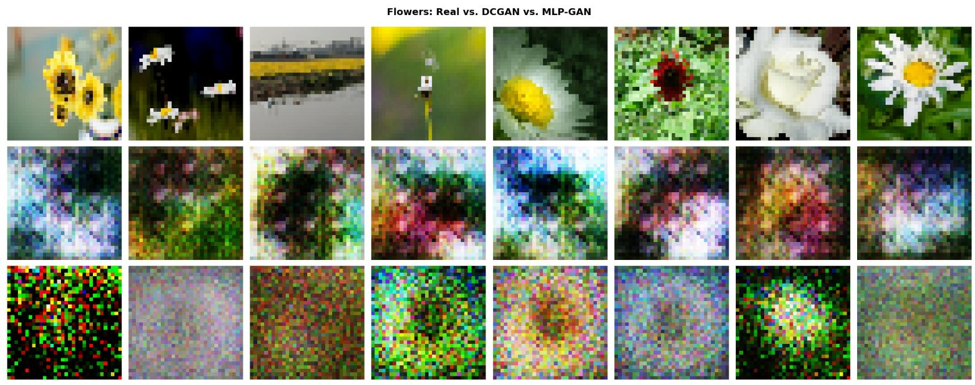
TASK 8-2 · COMPARISON
Real vs DCGAN vs MLP-GAN
Top row: real flowers · Middle row: DCGAN · Bottom row: MLP-GAN
DCGAN captures colour distributions and some spatial structure. MLP-GAN fails to learn meaningful patterns — purely pixel-level noise.

Slide 11
TASK 8-3
Stable Diffusion
Text-to-image generation via KerasCV · Prompt engineering exploration
1
2
3
CLIP Text Encoder
U-Net Diffusion
VAE Decoder
Converts text prompts into semantic embeddings
Iteratively denoises latent vectors guided by text
Decodes latent vectors back into pixel images
Prompts Explored
Nature & Botanical — sunflower field at golden hour, macro rose with morning dew
Art Style Exploration — same lion portrait: photorealistic vs oil painting vs anime
Guidance Scale Effect — CFG 3 vs 7.5 vs 15 on same prompt (zen garden theme)
Model: KerasCV StableDiffusion · Resolution: 256×256 · Steps: 20–25 · CFG scale: 3–15

Slide 12
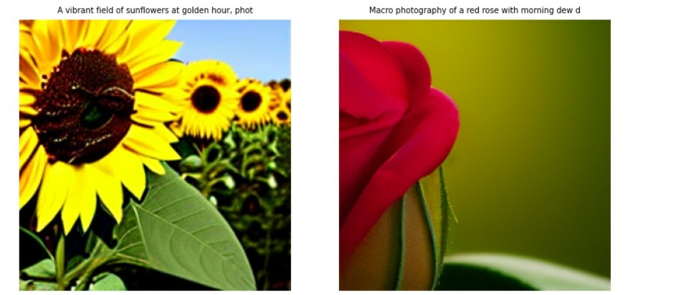
TASK 8-3 · RESULTS
Nature & Botanical Prompts
"A vibrant field of sunflowers at golden hour" · "Macro photography of a red rose with morning dew"
Stable Diffusion accurately renders photorealistic flower textures from natural-language descriptions alone.

Slide 13
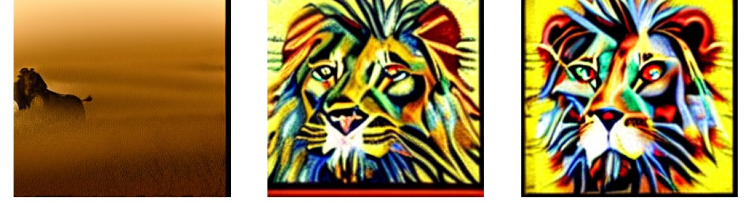
TASK 8-3 · RESULTS
Art Style Exploration
Same subject (majestic lion portrait) — three different style modifiers
Photorealistic
Oil painting · Impressionist
Anime art style

Slide 14
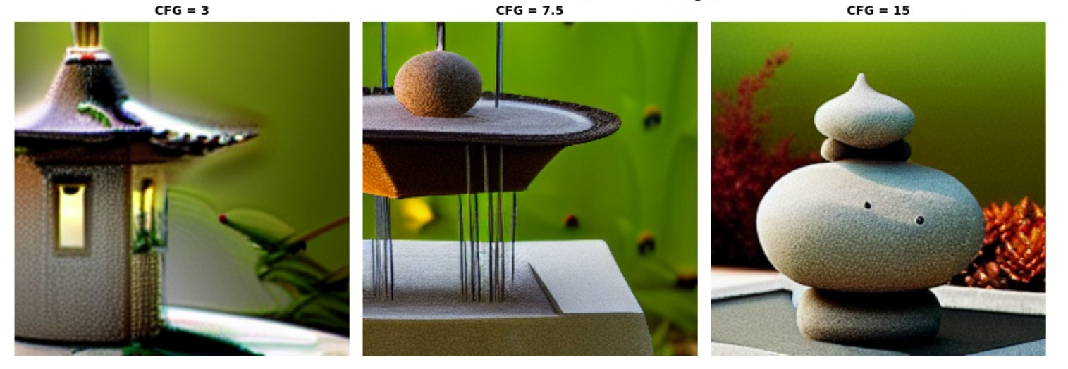
TASK 8-3 · RESULTS
Effect of Guidance Scale (CFG)
Lower CFG = more creative freedom · Higher CFG = stronger prompt adherence
CFG = 3
Loose — dreamlike, less structured
CFG = 7.5
Balanced — default recommended
CFG = 15
Strict — high prompt fidelity

Slide 15
TASK 8-3 · EXPLORATION
Generative AI Services
DALL·E 3
Image
ElevenLabs
Audio
High-fidelity text-to-image, strong prompt adherence
Voice synthesis and cloning; near-human quality TTS
Midjourney
Image
Runway Gen-3
Video
Artistic, highly stylized outputs via Discord bot
Image-to-video and text-to-video generation
Sora
Video
Adobe Firefly
Image
OpenAI text-to-video; cinematic motion and scene coherence
Commercial-safe image generation integrated with CC

Slide 16
SUMMARY
Model Comparison
Model
Architecture
Control
Quality
Speed
CVAE
Conv Encoder + Decoder
Class-conditioned
Moderate
Fast
DCGAN
Conv Generator + Disc.
None
Good
Medium
MLP-GAN
Dense Generator + Disc.
None
Low
Medium
Stable Diffusion
CLIP + U-Net + VAE
Text prompts
Excellent
Slow*
* Stable Diffusion run at 256×256; jit_compile disabled for CPU compatibility.

Slide 17
Conclusions
01
CVAE learns a class-conditioned latent space; class-specific generation and latent interpolation both work as expected.
02
Convolutional layers are critical for image quality — DCGAN clearly outperforms MLP-GAN in structure and coherence.
03
Stable Diffusion demonstrates the power of large-scale diffusion models; style modifiers and CFG scale dramatically affect output.
04
Commercial services (DALL·E 3, Midjourney, Runway) achieve production-level quality far beyond small-scale training runs.
Bahous Amine · TIES 4911 (2026) · Task 8

