Slide 1
TIES 4911 – Task 4 Deep Learning for Image Classification and Deployment
Student Name: Bahous Amine
Course: TIES 4911

Slide 2
INTRODUCTION :
This project explores convolutional neural networks (CNNs) using Keras
Applications for image classification. The work covers model comparison,
transfer learning, fine-tuning strategies, REST API deployment, and
multi-label classification.
The project demonstrates a complete deep learning workflow:
Data Preparation → Model Selection → Transfer Learning → Evaluation →
Deployment

Slide 3
2. DATASET
DESCRIPTION – VEHICLES DOMAIN
This project used two different datasets across the tasks. It is important to clearly distinguish between them, as Tasks 4-1 and 4-2 were performed on a scene classification dataset, while Tasks 4-3 and 4-4 were performed on a vehicle classification dataset.
2.1 Dataset for Task 4-1 and Task 4-2
(Scene Classification Dataset)
For Task 4-1 and Task 4-2, a scene classification dataset was used with three classes:
- Stadium
- Basketball
- Concert
Dataset characteristics:
Images captured in different lighting conditions
Indoor and outdoor scenes
Various camera angles and perspectives
Different crowd densities
Complex backgrounds

Slide 4
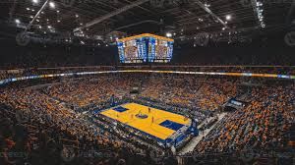
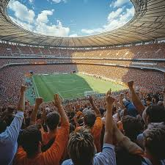
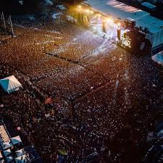
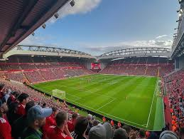
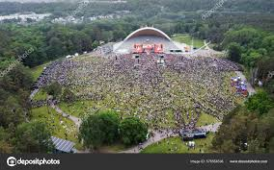
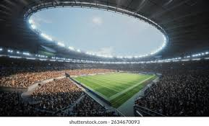
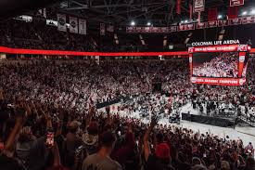
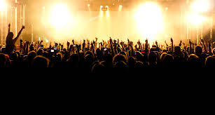
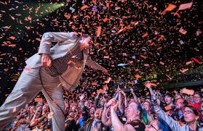

Slide 5
2.2 Dataset for Task 4-3 and Task 4-4
(Vehicle Classification Dataset)
For Task 4-3 and Task 4-4, a different dataset was prepared in the vehicle domain, consisting of three object classes:
• Car • Bicycle • Motorcycle
Dataset Structure:
Each folder contains real-world images collected to represent diverse
conditions such as:
- Different lighting environments
- Different angles and perspectives
- Background clutter
- Partial occlusion
- Various object scales

Slide 6
Dataset Structure:
Each folder contains real-world images collected to represent diverse
conditions such as:
- Different lighting environments
- Different angles and perspectives
- Background clutter
- Partial occlusion
- Various object scales
The dataset was intentionally not overly large. This made transfer
learning necessary, since training a deep CNN from scratch on a small
dataset would lead to overfitting.
Data Augmentation was applied during training to improve generalization:
• Rotation (±15°) • Width/height shifts (10%) • Zoom (15%) • Horizontal
flipping
Validation data was not augmented to preserve realistic evaluation.

Slide 7
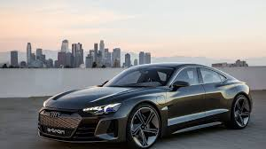
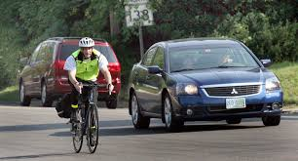
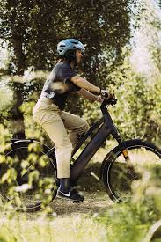
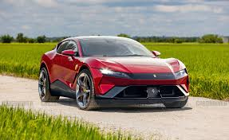
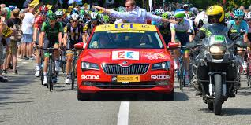
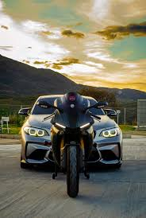
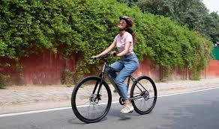
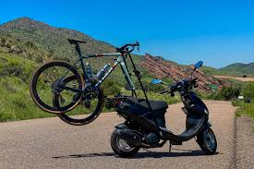

Slide 8
3. TASK 4-1
– PRETRAINED MODEL COMPARISON
Objective: Compare three pretrained CNN architectures under identical
conditions:
• MobileNetV2 (lightweight architecture) • ResNet50 (deep residual
network) • VGG16 (classical CNN)
All models used:
• Image size: 224 × 224 • Batch size: 16 • Adam optimizer • Categorical
crossentropy • EarlyStopping and ReduceLROnPlateau
Only the classification head was trainable (base model frozen).

Slide 9
Results:
ResNet50 achieved the best validation accuracy (≈ 96.97%) MobileNetV2
achieved ≈ 87.88% VGG16 achieved ≈ 81.82%
ResNet50 also produced the lowest validation loss (≈ 0.18).
Confusion Matrix Analysis (ResNet50):
• Basketball: 12/12 correct • Concert: 11/11 correct • Stadium: 9
correct, 1 misclassified
Only one misclassification occurred, indicating strong class separation.
Conclusion: ResNet50 provided the best trade-off between accuracy and
stability, and was selected as the strongest baseline model.

Slide 10
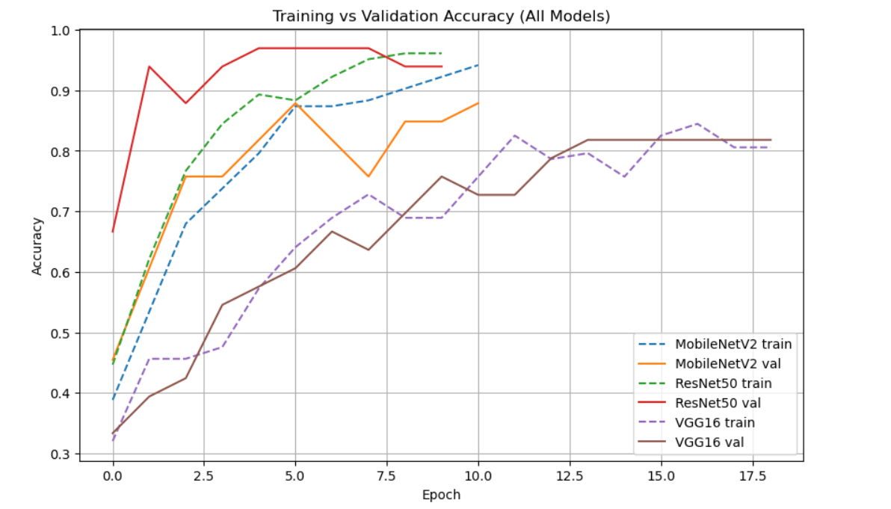
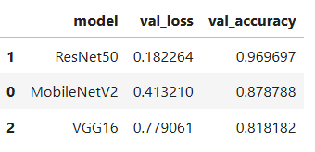
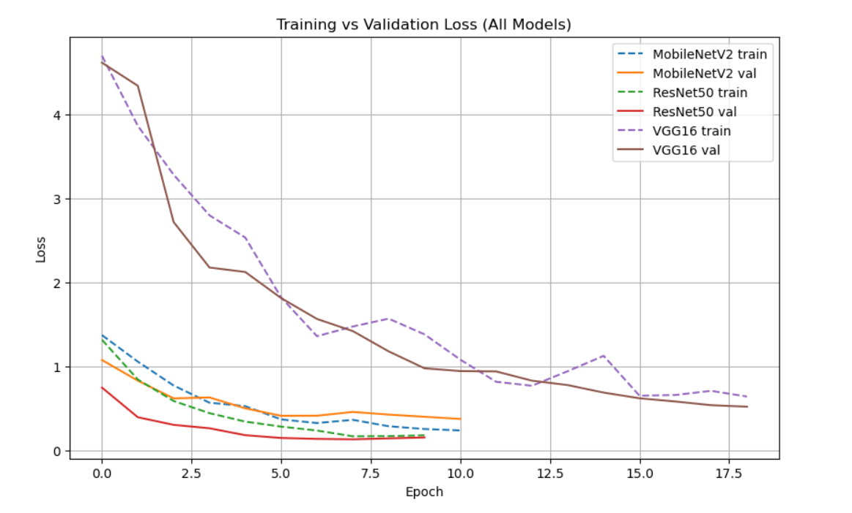
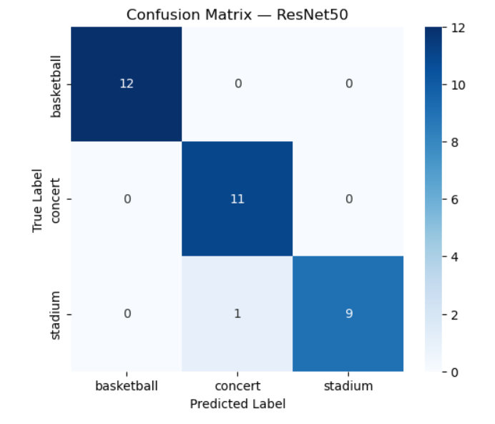

Slide 11
4. TASK 4-2
– TRANSFER LEARNING AND FINE-TUNING
Objective: Evaluate whether fine-tuning improves performance compared to
keeping the pretrained backbone frozen.
Two configurations were tested:
1) Frozen backbone
- All pretrained layers frozen
- Only classifier head trained
2) Fine-tuned (last 20 layers)
- Last 20 layers unfrozen
- Lower learning rate used

Slide 12
Results Summary:
MobileNetV2: performance decreased significantly when fine-tuned
ResNet50: performance decreased when fine-tuned
VGG16: slight improvement when fine-tuned
Interpretation:
For small datasets, pretrained features are already well optimized.
Unfreezing layers introduces too many trainable parameters, leading to:
• Overfitting • Instability • Performance degradation
Conclusion: For this dataset size, frozen backbones were more reliable
than fine-tuning.

Slide 13
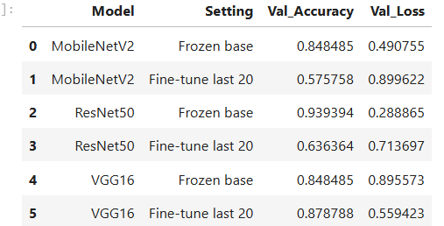
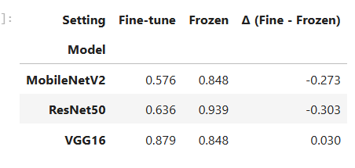
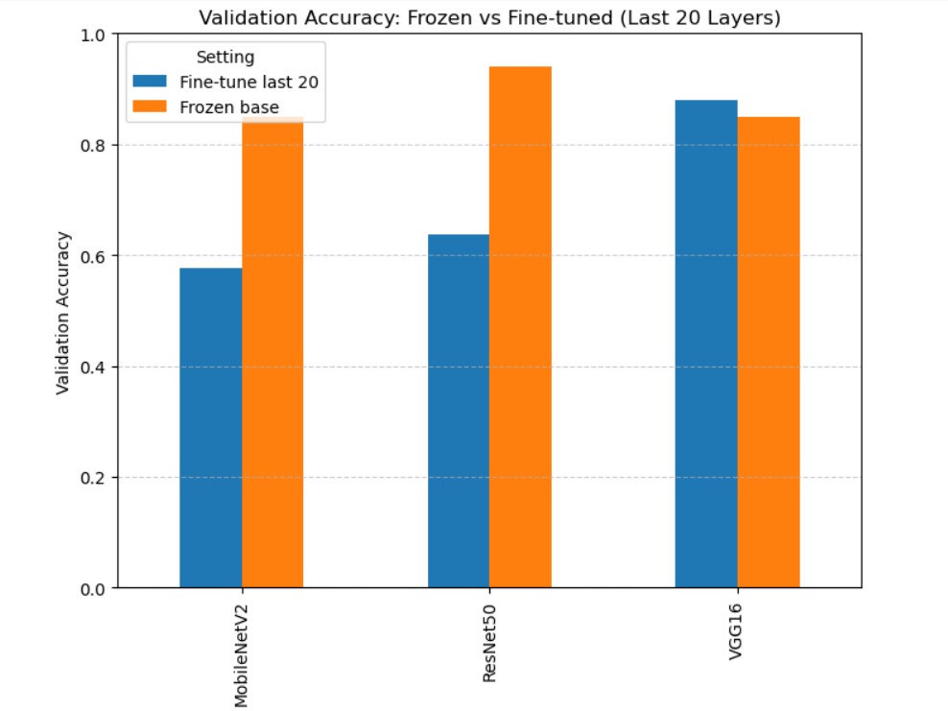

Slide 14
5. TASK 4-3
– VEHICLE CLASSIFICATION SERVICE
A new experiment was conducted specifically on the vehicle dataset (car,
bicycle, motorcycle).
Model comparison results:
EfficientNetB0: 100% (Frozen), 96% (Fine-tuned) MobileNetV2: 100%
(Frozen), 96% (Fine-tuned) ResNet50: 100% (Frozen and Fine-tuned)
ResNet50 (Frozen) was selected for deployment.
Model Architecture Summary:
Total parameters: 23,593,859 Trainable parameters: 6,147 Non-trainable
parameters: 23,587,712
Only the classifier head was trained, which prevented overfitting and
allowed fast convergence.

Slide 15
REST API Implementation:
The trained model was saved as: vehicle_resnet50_frozen.keras
Class labels saved as: vehicle_class_names.json
Endpoints:
GET /health Returns service status.
POST /classify Accepts an uploaded image and returns:
{ “prediction”: “car”, “confidence”: 0.92 }
This demonstrates successful end-to-end deployment from training to
real-time inference.

Slide 16
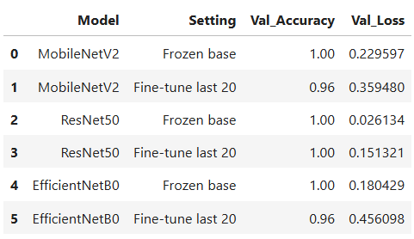
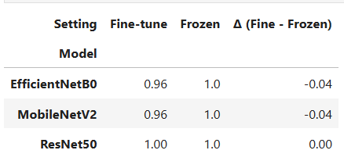
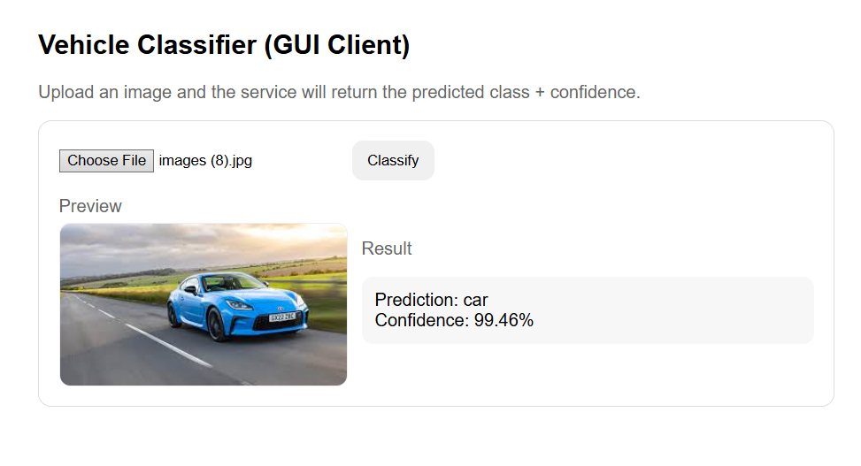

Slide 17
6. TASK 4-4
– MULTI-LABEL CLASSIFICATION
The system was extended to support multi-label classification, where an
image can contain multiple objects simultaneously.
Changes implemented:
• Output activation changed from Softmax to Sigmoid • Loss changed from
Categorical Crossentropy to Binary Crossentropy • Labels stored in CSV
format (multi-hot encoding)

Slide 18
Example output: [0.9, 0.1, 0.8]
Classification Report (Threshold = 0.5):
Car: Precision = 1.00 Recall = 1.00
Bicycle: Precision = 1.00 Recall = 0.95
Motorcycle: Precision = 0.91 Recall = 1.00
Macro F1-score ≈ 0.98
The multi-label extension achieved very strong performance.

Slide 19
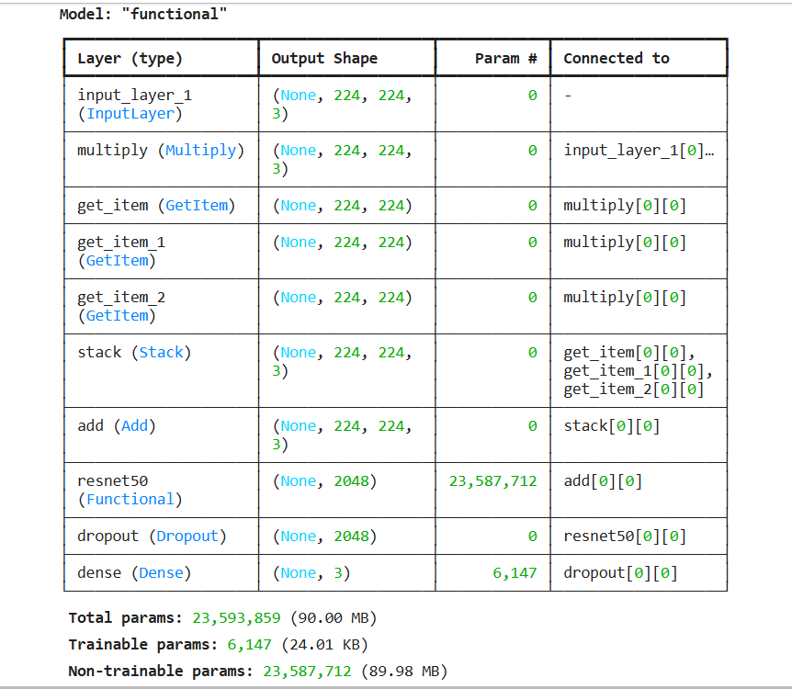
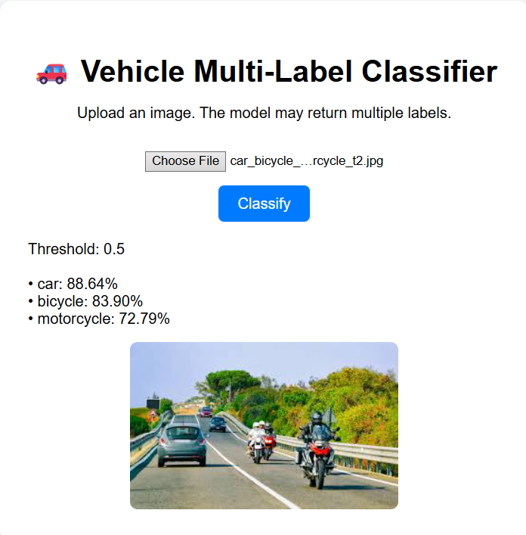
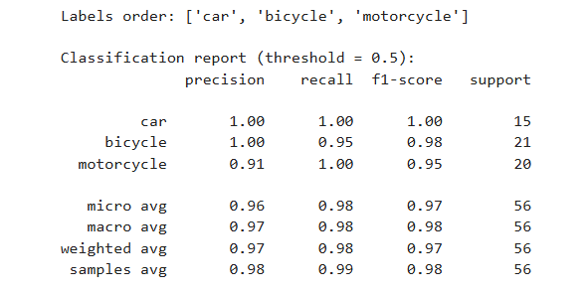

Slide 20
7. FINAL
CONCLUSIONS
1. ResNet50 consistently performed best across tasks.
2. Frozen backbones were more stable than fine-tuning for small
datasets.
3. Data augmentation improved generalization.
4. The REST API successfully deployed the trained model.
5. Multi-label classification was successfully implemented using
sigmoid outputs.
This project demonstrates a complete deep learning lifecycle:
Model Comparison → Transfer Learning → Fine-Tuning Analysis → Deployment
as REST API → Multi-Label Extension
The system is practical, reproducible, and ready for real-world use.

